Slide 1
Pregnancy Options Counseling with Adolescents
Notes:
Content from this slide set was adapted from Alissa Perrucci, PhD, MPH at UCSF.
Source: Perucci, A. Decision Assessment and Counseling in Abortion Care: Philosophy and Practice. 2012. Rowman & Littlefield Publishers, Inc.
ARSHEP would like to acknowledge faculty member Dr. Mandy Coles for her revision of this module.

Slide 2
Objectives
Discuss the approach used during options counseling and value clarification
Understand the importance of providing unbiased counseling
Describe the various pregnancy options within the counseling framework

Slide 3
Your Goals as a Health Care Provider
To create a space where patients feel that it is safe to ask questions
  You are listening without an agenda
To be the person whom patients trust
  You are known as someone who will give accurate information
To establish an environment free of stigma around pregnancy decisions
  You are modeling unbiased language
Notes:
As health care providers, we have a number of goals to accomplish during pregnancy options counseling.
The first is to create a space in which our patients feel comfortable speaking with us. We can demonstrate this by listening without an agenda for an outcome of her decision.
The second thing we want to do is become a person whom patients trust. We want to be known as someone who will give them accurate information. And patients facing a positive pregnancy test often run into a lot of medical misinformation, especially around the topic of abortion—so that is going to be something that is especially important.
The third goal is to establish an environment free of stigma around pregnancy decisions. And one of the ways we can do this is by modeling unbiased language.

Slide 4
Fundamental Principle
The patient has the answer
One pregnancy decision is not “more moral” than another; your patient is a good person making a moral decision. There is no knowledge that you possess about the answer to their dilemma that they do not.
Notes:
The fundamental principle that should ground all of the work that we do with young women facing a positive pregnancy test is that the patient has the answer to her dilemma. One pregnancy decision is not “more moral” than another; she is a good person making a moral decision for herself.
This concept can be really challenging, not because we do not trust patients, but because in a lot of the work that we do (medicine, nursing, social work, etc.), we are supposed to possess the answer, the right answer, for the patient. But in helping young women make pregnancy decisions, it is helpful to suspend that assumption that you have the answer, and let the patient find that for herself. We all possess a lot of knowledge, but in terms of what is the right decision for how a young woman should resolve her pregnancy, she alone has the information that will tell her what is the right way to go.

Slide 5
How Do We Do What We Do?
Approach to Options Counseling and Values Clarification
Notes:
In this next section, we are going to address one approach to options counseling, and also spend some time considering our own thoughts and beliefs, and how these frame to work of providing pregnancy options for young women.

Slide 6
Approach
Listen
Do not assume
Self-reflect
Notes:
When we teach counseling for positive pregnancy test results, we teach both an approach and a framework. The approach is a way that we prepare our minds psychologically, it’s the way that we want to think about things before we go into a conversation. And the approach has three steps: listen, do not assume, and self-reflect.
Let’s look at those three a little more closely.

Slide 7
Listening means…
Silence
Asking open-ended questions
Being open to, curious about, fascinated with, and interested in the patient’s process—while not having an agenda for the outcome
Notes:
So what does listening mean?
Well, it may seem obvious, but listening means being silent. In order for a patient to feel comfortable opening up, asking questions, sharing concerns, we need to be silent and give her the space to ask her questions.
Another way to listen is is to ask open-ended questions. This type of question helps to create an environment where listening is more of a priority than getting answers. There are obviously some times when using closed-ended questions are really important—in order to help get focused and pointed information. But in terms of what constitutes listening, using open-ended questions can give us this space.
The third thing to do when we are helping patients know that we are listening is being open to, curious about, fascinated with, and interested in the patient’s process—while not having an agenda for the outcome. And when you truly are living and practicing the fundamental principle that the patient has the answer to her pregnancy dilemma, you can relax and you can sink into the conversation and be really interested in what the other person is saying because you no longer have an agenda, you’re no longer pressing for something specific to happen.

Slide 8
Not assuming means…
Not taking for granted that you and the patient share the same understanding of medical terminology, feelings, or beliefs
You are free to inquire, investigate, and learn from the patient
Taking a step back from “professional mode.” You do not have The Answer, nor are you obligated to find it for the patient
Notes:
The second part of our approach is not assuming. So what does not assuming mean?
Well first, not assuming means that you don’t take for granted that you and the patient share the same understanding of medical terminology, feelings, or beliefs. We know a lot of that from giving test results where we don’t assume that the patient shares an understanding of complex words or terms. We also don’t assume that patients understand that a positive test result means one thing and a negative test result means something else. But it takes a little more practice to start realizing that when patients share their feelings or beliefs, that the personal meaning for them may be different than our own meaning—even if we are speaking the same language.
So when we are not assuming, we become more free to inquire, investigate, and actually learn from the patient.
And in not assuming, we take a step back from professional mode. And I know that this can be difficult, right? Because the way that we are taught is that—in medicine, in nursing, in social work, in psychology—we are supposed to have the answer. But, again, in this context, when guiding young women through pregnancy decision making, we actually don’t have the answer, nor are we obligated to find it out for the patient. Remember that she has the answer.

Slide 9
Self-reflecting means…
Asking yourself:
  What scenarios are hard for me?
  What particular decisions do I want patients to make?
  What decisions do I think are foolish?
Notes:
The last part of our approach is self-reflecting. Let’s look at what that means.
Here is an exercise that you can do at home. Sometimes it is particularly useful to get out a journal and write down your answers to these questions.
In the context of people making pregnancy decisions, I want you to think about:
What scenarios are hard for you?
What particular decisions do you find yourself actually wanting patients to make?
And what decisions do you think are foolish?
It is really important to be honest in your answers, and not think that you need to be someone who has no judgment, who has no bias. We all have judgment, we all have preferences, and we all have beliefs about what is right or wrong. What is important is for us to be aware of these so that we can bracket them and set them aside when we're having conversations with our patients. This exercise is something that can be important to return to on a regular basis to see how your values may have shifted based on different experiences that you have at work or in your personal life.

Slide 10
Values Clarification
Values clarification exercises can help providers to assess their own beliefs before starting to provide counseling or services in a potentially emotionally charged areas
These exercises help providers to create a nonjudgmental environment for patients
Values clarification exercises available at rhedi.org and adapted from workshop material by Vicki Breitbart and Jini Tanenhaus of Planned Parenthood NYC
Notes:
Values clarification is a more formal way to look at self reflection. These exercises can can help providers to assess their own beliefs before starting to provide counseling or services in a potentially emotionally charged areas. There are a number of these in medicine—for example when looking at end of life care and resuscitation. Given the material we are discussing today, we are going to use values clarification to consider our own beliefs and thoughts around options counseling and abortion. The goals of any values clarification exercise is to help providers to create a nonjudgmental environment for patients.
A more detailed version of these values clarification exercises is available at www.rhedi.org.

Slide 11
Agree—Neutral—Disagree
Adolescents deserve confidential care
Every woman has the right to terminate a pregnancy
Parental consent should be required for any teen requesting an abortion
Women who have more than one abortion are irresponsible
Male partners should have the right to be part of the decision about terminating a pregnancy
Abortions should be legal only up to 12 weeks
Values clarification exercises available at rhedi.org and adapted from workshop material by Vicki Breitbart and Jini Tanenhaus of Planned Parenthood NYC
Notes:
For this values clarification exercise, I am going to read through a number of statements. The statements start out more general, but then get into more details thoughts around abortion.
When you go through the exercises, ask people to raise their hands if they are comfortable, and to explain their positions. Often I will go through some of these statements and change the numbers—especially for “Women who have more than one abortion are irresponsible”—increasing the number to get people to a place of discomfort—and similarly for “Abortions should be legal only up to 12 weeks”

Slide 12
Options Counseling Framework
Notes:
Now let’s talk about a framework for providing options counseling.

Slide 13

Case: Kim
Kim, a 16-year-old female, comes to your office. She is a new a patient.
She tells you that she has been having sex with her boyfriend for six months.
Kim discloses that she and her partner use condoms “most of the time.”
Notes:
As we go through this presentation, we will follow a patient Kim who has just come to the office. As you talk further to Kim, she shares that she has been having sex with her boyfriend and not using condoms consistently. You discuss doing a pregnancy test, which she agrees to.

Slide 14
Steps in Pregnancy Options Counseling
Step 1
Preparing to disclose results
Step 2
Disclosing results
Step 3
Conversing with patients after a positive pregnancy test
Notes:
We when consider the situation of pregnancy test counseling, we tend to think of it as having three distinct parts. It's temporal. There's a before, during, and after. We are going to look at each step individually over the next few slides: step one is preparing to disclose results; step two is disclosing results; and step three are the conversations that we have with patients after we have given them a positive pregnancy test result.

Slide 15

Preparing to Disclose Results
What does Kim think the result will be?
  This can be part of your
  pre-test assessment
What is Kim hoping the result will be?
  No matter what the result, I can help you make a plan
Notes:
Let's look at Step 1—preparing to disclose results. These are a couple questions that you can ask patients before you have the results of the pregnancy test. You don’t yet know what the result is of her test, but her answers to these questions can give you information about how she might react when you deliver any particular results.
One could ask, what do you think the results will be? Many of us working in this field know that young women have often run multiple home urine pregnancy tests even before coming to the clinic, and may know that they're going to get a positive results. But it's helpful to know this information for yourself as well.
And then a correlative question that is also really important to ask is: what are you hoping the results will be? This will give you a lot of information about how a patient may respond when you give her the results.

Slide 16
Disclosing Results
Compare the following two statements:
Your test result came back positive. Do you want to keep the baby or not?
I have the results of your pregnancy test. The test came back positive; that means you are pregnant.
…
How are you doing with that information?
Notes:
Step 2: Disclosing results and patient reactions (continue case here)
We are going to consider a couple different ways that one could disclose positive pregnancy test results. Compare the following two statements, looking closely at word choice and phrasing to see: (1) What these different statements allow or open up in terms of conversation? (2) And what do they disallow or shut down? So take a moment to do that.
Looking at the statement on the left, people often notice a couple of things:
The counselor delivered the positive pregnancy test result as a statement, but then didn't define the medical terms—what does “positive” mean? So the counselor made an assumption that the patient understood what a positive result meant.
The counselor then went into a closed-ended question saying, do you want to keep the baby or not? This can make it sound like there are only two pregnancy alternatives. And it also can feel like the counselor here is rushing the patient to quickly make a decision.
Another thing to consider is the use of the word “keep” and the use of the word “baby.” In this scenario, the counselor has decided to use the word baby, maybe without knowing if that's how the patient refers to the pregnancy. The counselor also used the word keep which is a word that we hear in our everyday dialogue and discourse about pregnancy—you always hear people saying, “well, I'm going to keep the baby.” Is she going to keep the baby? And so it can be a natural way that we might talk about pregnancies. But I want you to think a little more deeply about what it means to use the word “keep.” And what that might imply in terms of the opposite.
Now let’s look at the statement on the right:
This counselor doesn't assume a shared knowledge of medical information. So when the counselor says the words, “the test came back positive,” there’s no assumption that he or she and the patient share a knowledge of what it means to have a positive result in this context.
The other thing that the counselor does is pause after the delivery of the results. And in that pause, we go back to the approach where we create a space where there's silence, where the patient has an opportunity to gather her thoughts and respond. And after a few seconds it’s only then that she says, “how are you doing with that information?”
If your patient responds with a particular feeling—say she starts crying—you can help to create a space and speak directly to that feeling. One way to do this is to validate her reaction by saying something like, “It's okay to cry here” and then go into silence. And then check in with them afterwards.

Slide 17

How is Kim Doing?
Kim knew that her pregnancy test would be positive. She took four at home.
She has never been pregnant before and was previously afraid to request birth control because she did not want her parents to find out.
She is unsure what she wants to do.

Slide 18
Framework for Conversing with Patients
After a Positive Pregnancy Test
Validate
the feelings that you see and hear
Seek understanding
of feelings and beliefs
Normalize experiences
You are unique, but not alone
Options counseling and/or referrals
Notes:
Here you can see a framework that is really helpful to use use when approaching these conversations around helping women make decisions as to how to resolve a positive pregnancy test result. Earlier we discussed an approach to options counseling—the approach is the state of mind or the way that we prepare ourselves psychologically to go into these conversations. In contrast, the framework is the actual steps, techniques, skills that we will use to engage in these conversations. And there are three levels to the framework.
The first part of this framework is validating and normalizing. And in validating, we witness the feelings that we see and hear and normalize her experiences in order to communicate to the young woman, “You are unique, but not alone.”
The next part of the framework is seeking understanding. And because we are not assuming a shared understanding of feelings and beliefs, we want to seek understanding of those from the patient and reach an understanding of what the personal meaning is of different feelings and beliefs for her. The last part of the framework is to conduct options counseling and or provide referrals.

Slide 19
Validate
It’s okay to not know the answer
I imagine that must have been very difficult
I can help you with that
I see your point; that makes sense
I can see why it might have been hard for you to come here
It’s okay to cry here
You’re doing a good job
Notes:
Let's look at validating more closely. Here are several examples of ways to validate different feelings, statements, or attitudes that a patient may be bringing to the conversation. You can practice saying these at home or at work—with a coworker or a friend—so that you can give each other feedback on tone of voice, on body posture, countenance or facial expression, and just the way that the other person feels when receiving these validating statements from you. If you don't have someone to practice them with, you can do it in a mirror or you can do it into a tape recorder where you can play it back and analyze the style of your speech.
Some different validating statements are things like, “It's okay to cry here.” Things like “I can help you with that” or “it's okay to not know the answer.” With all of these validating statements, you are communicating to the other person that you hear them, that you see them, and that what they're experiencing is important and that you're going to take it seriously.

Slide 20
Normalize
You know, lots of people have asked me that question
That’s not a strange question at all; I’m glad you’ve asked
This is a clinic where it’s okay to talk about that
Other people have expressed those same feelings
Notes:
Similarly, here are some normalizing statements that you can practice delivering in the context of giving positive pregnancy test results.
Some normalizing statements are things like, “other people have expressed those same feelings.” Or really normalizing the kinds of questions that people ask me, which brings tremendous relief to patients to know that they're not the only person who's asked this. So you can say things like, “you know, lots of people have asked me that question.” Or “that's not a strange question at all. I'm so glad you've asked.”

Slide 21
Seek Understanding
How are you doing with that information?
What’s coming up for you?
How are you feeling?
Say more about that.
What’s that like for you?
Notes:
The second part of our framework is seeking understanding, and this uses very simple, open-ended questions that to elicit an understanding of the feelings and beliefs that the patient is experiencing.
So these are things like we said before when we were delivering that positive pregnancy test result. When the counselor said, “how are doing with that information?” Also statements and questions like, “what's coming up for you?” or,” how are you feeling about that?” These are really important, and they're really easy to ask.
And sometimes providers hesitate in asking these questions because we are actually afraid to hear the answer. But with practice, you can learn different ways to do this. You don't have to have the answer for the patient, so your motivation is to create a context where it's safe to talk about things. And here you can listen without judgment and with compassion.

Slide 22
How to Approach Patients in Shock
Silence
Validate
  It’s okay to not know which way to go
Ask a closed-ended question
  Are you feeling [overwhelmed] by the news of being pregnant?
Change the subject
  Who came with you today?
  How far did you travel?
Break state
  I’m going to get us each a glass of water.
Notes:
People often struggle in options counseling when working with patients when they are silent or when we feel like the other person is not really participating in the conversation. This can be intimidating because a lot of us are afraid to sit in a space of silence. So I want to encourage you to practice sitting in a space of silence and being okay with that because what it communicates is the person is okay. And that you're comfortable with their feelings, you're comfortable with their presence.
There are a number of other things you can do when someone is in a state of silence or non-participation:
You can validate. And you can say, it's okay to not know which way to go.
You can also use closed-ended questions. This can be very helpful to try to narrow down or focus in on what might be going on for the patient. So you could say things like, “are you feeling overwhelmed by the news of being pregnant?” And then the person can just give you a simple nod or a shake of the head no.
You can change the subject and ask things like, who came with you today or how far did you travel. These are great ways to sort of shift the conversation.
And you can do something that's called breaking state—where you really just change up what's going on. You may ask the young woman to come to sit in a different room that's more comfortable. You may say, I'm going to go get each of us a glass of water. And this can be a nice distraction from an uncomfortable silence where the patient may be feeling a pressure to speak or know the answer or to not know it.

Slide 23
“What Do You Think I Should Do?”
“I actually don’t know what I would do if I were you—if I were making a pregnancy decision I’d have to look at my own life and my own situation to see what was the best way to go for me.”
Notes:
A lot of people ask what they should say when a patient asks, “What do you think I should do?” or “What would you do if you were in my situation?. This is a really common question that patients ask us. And there are actually some simple ways to respond. because the truth is, you actually don't know what you would do if you were in the patient's situation. So you could say something like, “If I were making a pregnancy decision I'd have to look at my own life and my own situation to see what was the best way for me to go.”
Another way to respond is to add in some normalizing. This can help young women feel a lot of relief, because they may be also self-conscious for even being so forward as to ask you what you think that they should do. So you might say something like, “Lots of people ask me what I would do. That's normal. And it's okay to ask me what I would do. While it might make you feel better right now if I told you what I would do the relief would probably be only temporary. That's because only you know the answer and only you know what’s the right decision for you.”

Slide 24
Reassuring Statements
I will support you no matter which way you decide to go
You are a good person no matter what you decide; one way does not make you a better person than the other
You have time to change your mind
You don’t have to decide today
Notes:
It can be helpful to add in some reassuring statements. This does not mean saying “Don’t worry. You’re going to be ok.” Rather you can reassure patients that you're not judging them, that you're compassionate, that this is an environment free of stigma, and that they have some time.
You might say something like “I will support you no matter which way you decide to go.” A little more deep is a statement such as, “you're a good person no matter which way you decide to go; one way does not make you a better person than the other.”
And really important is normalizing the uncertainty, normalizing changing your mind. So you might say something like, “You have time to change your mind. You have time to decide. You don't have to decide today.” Always follow up those statements with things like an actual amount of time that the person has to make the abortion decision before it might be either impossible for her to get an abortion or to get an abortion somewhere near her hometown. Be sure to discuss the legal parameters if considering abortion and present a realistic timeline moving forward. Cost is another factor after the first trimester to be transparent and honest about when telling a patient they “have time to change their mind” and “don’t have to decide today” since the price of an abortion goes up each week typically after 12 weeks.
And we're going to look at that a little bit later in more detail.

Slide 25
Reviewing Pregnancy Options
Notes:
So let's take a little bit closer look at the three pregnancy options: abortion, adoption, and parenting.

Slide 26
Semantics—Words Matter
Decision
  Instead of “choice”
Abortion
  Instead of “termination”
Making an adoption plan
  Instead of “putting the baby up for adoption” or “giving the baby away”
Continuing the pregnancy
  May use “pregnancy” or “baby” as appropriate
Notes:
The word “choice” carries a connotation of triviality, since one makes so many routine choices in the course of a day. “Decision” more accurately conveys the gravity of a person’s thinking in weighing their option to choose adoption, seek abortion or become a parent. (Source: Reproductive Health Technologies Project, Moving From Judgment to Empathy: Incorporating Values into Your Messaging)
We always want to attend to the language we use, or do not use, when discussing pregnancy options. Are we using the words “termination” or “procedure” instead of “abortion?” It’s interesting to consider whether you're avoiding saying certain words, what that communicates to patients, and how that choice of words might be contributing to stigma around any particular option.
Modern adoption language is make an adoption plan or place the baby for adoption, place the child for adoption. We no longer say “putting the child up for adoption” or “giving the baby away.”
Use words like “pregnancy” or “baby” when talking about abortion if they seem appropriate. Technologies like sonograms have made pregnancy more accessible to the general public, notably men and younger women who may not have experiences with pregnancy. Be careful how you categorize pregnancy (i.e. “wanted” or “planned”). (Source: Reproductive Health Technologies Project, Moving From Judgment to Empathy: Incorporating Values into Your Messaging)

Slide 27

Seek Understanding
How did you come to your beliefs about abortion?
What have you heard about adoption?
What are your thoughts about [single] parenthood?
Notes:
When you're talking with someone about different feelings or beliefs that they have about the different pregnancy options you might find yourself wanting to seek understanding of those beliefs. You can say things like, how did you come to your beliefs about abortion? What have you heard about adoption? What are your thoughts about single parenthood?
This can give you some information about what informs or shapes the patient's beliefs. If it seems that a young woman possesses some misinformation particularly, about abortion or adoption, providing correct information might help the patient make a more informed decision.

Slide 28
Common Abortion Myths
Myth | Reality
Abortion causes breast cancer | Women who have abortion do NOT have a increased risk of developing breast cancer
Mental health problems result from abortion | Pre-existing mental health problems predict mental health problems after abortion
Pregnancy will be difficult after one/more abortions | Well-conducted research has not found any link between abortion and infertility, ectopic pregnancies, miscarriage, or preterm birth
Abortion is dangerous | Abortion is at least 10 times SAFER than childbirth; it is safer than driving in a car
Melbye, M, 1997; Kalish RB. 2002; Jackson JE, 2007; Steinberg JR, 2009.
Notes:
Of the three pregnancy options, abortion is the one for which people tends to have the largest number of myths and misconceptions.
So let’s address a few of these that you might encounter when providing options counseling.
People often believe that abortion increases the risk of breast cancer. However a number of studies and consensus statements from the National Cancer Institute refute this claim. A summary of their findings can be found on the American Cancer Society website.
There have also been a number of studies that reports that women who have abortions struggle with emotional problems afterwards—there is even a phrase that has been coined around this issue “post-abortion syndrome.” However the truth is that well conducted studies have found no increased risk of mental health issues after abortion. In fact, the most reliable indicator of whether a woman will experience feelings of distress after an abortion is her emotional stability before the abortion. Women indicate that the most common feeling after the completion of an abortion is relief. While some women also experience a sense of loss, sadness, or grief, having an abortion is not associated with long-term psychological distress.
Women also report concerns about pregnancy after abortion. However the most well-conducted studies looking at this concern have not found any link between abortion and infertility, ectopic pregnancies, miscarriage, or preterm birth. Having an abortion will not prevent a woman from having a healthy pregnancy when she is ready.
The issue of abortion safety is also frequently mentioned, and we will look at this in a bit more detail in the following slide. However the short answer to this myth is that abortion is incredibly safe—it is more than 10 times safer than childbirth, and safer than driving in every city in the United States.
Sources
Melbye M, Wohlfahrt J, Olsen JH, Frisch M, Westergaard T, Helweg-Larsen K, et al. Induced abortion and the risk of breast cancer. N Engl J Med 1997;336(2):81–5.
Kalish RB, Chasen ST, Rosenzweig LB, Rashbaum WK, Chervenak FA. Impact of midtrimester dilation and evacuation on subsequent pregnancy outcome. Am J Obstet Gynecol 2002;187(4):882–5.
Jackson JE, Grobman WA, Haney E, Casele H. Mid-trimester dilation and evacuation with laminaria does not increase the risk for severe subsequent pregnancy complications. Int J Gynaecol Obstet 2007;96(1):12–5.
Steinberg JR, Russo NF. Evaluating research on abortion and mental health. Contraception 2009;80(6):500–3.

Slide 29
Majority of Abortion Patients are Young Adults
Jones, Guttmacher Institute 2010
Notes:
Young teens are actually a very small percentage of the overall number of women having abortions but young adults (20-24) are the largest percentage of women having abortions. If we take young adults and teens together, it makes up about half of abortion patients.
Source: Jones RK, Finer LB and Singh S, Characteristics of U.S. Abortion Patients, 2008, New York: Guttmacher Institute, 2010.
Jones RK and Jerman J, Abortion incidence and service availability in the United States, 2011, Perspectives on Sexual and Reproductive Health, 2014, doi: 10.1363/46e0414, accessed Jan. 22, 2014
Abortions by Age:
The majority (58%) of women having abortions are in their 20s.
Fewer than 1% are younger than 15, while 17% are aged 15–19.
More than four-fifths of pregnancies among teenagers are unintended, and teenagers account for more than one in five unintended pregnancies nationwide.
Abortion numbers and rates decline with age because fecundity declines, use of contraceptive sterilization increases and women’s likelihood of being married grows. Marriage makes it easier to use contraceptives effectively and to continue an unintended pregnancy if it occurs. For teens, abortion rates and numbers decline because of an increasing number of teens delaying first sex, improvements in teens’ contraceptive use and a relatively high likelihood of teens continuing unwanted pregnancies.

Slide 30

Most Abortions Occur in Early Pregnancy
% of abortions
Guttmacher 2010
CDC 2013
Weeks
Notes:
Looking more deeply at abortions that are occuring now, we see that most abortions ar occuring early in pregnancy, most within the 9 week getational age limit. A third occur within 7 weeks, almost another third between 7-8 weeks, and then a quarter between 9-12. That leaves just 10 pecent occuring between 13-20 weeks and around 1 percent after that.
Source: Guttmacher Institute, Special tabulations of data from the Centers for Disease Control and Prevention, Abortion surveillance—United States, 2010, Morbidity and Mortality Weekly Report, 2013, Vol. 66, No. SS-08.
Weeks of Gestation at Time of Abortion:
One-third of abortions occur at six weeks or earlier; 89% occur in first trimester of pregnancy (the first 12 weeks after the first day of the woman’s last menstrual period).
Sixty-three percent of abortions occur at or before eight weeks’ gestation—up from just 20% in 1970.
Just 1% of abortions are performed after 20 weeks.

Slide 31
Abortion Safety in Perspective
*Mortality risk per 100,000 people (including men)
Notes:
Let’s consider abortion safety in perspective. This graph shows the risk of death per 100,000 women for abortion and term delivery, as well as for one of the most commonly used antibiotics, and common daily activities such as driving a car.
Note that the mortality rate for abortions increase with increasing gestational age; though abortion is always safer than delivery. In the first trimester, the mortality rate for women having abortion in the first trimester is <0.3/100,000 women
≤8 weeks = 0.1
9–10 wks = 0.2
11–12 wks = 0.4
13–15 wks = 1.7
16–20 wks = 3.4
≥21 wks = 8.9
PRESENTER NOTE: NYC is actually one of the safer cities in the United States to drive in, despite popular opinion. (feel free to update the chart with data from http://www.cdc.gov/motorvehiclesafety/local/b/includes/mvcfatalitiesmap/mvcfatalitiesmap.html for whatever city you are presenting near)
Source:
Bartlett LA, Berg CJ, Shulman HB, Zane SB, Green CA, Whitehead S, et al. Risk factors for legal induced abortion-related mortality in the United States. Obstet Gynecol 2004;103(4):729–37

Slide 32
Describe Options: Aspiration Abortion
In an aspiration or surgical abortion, the provider empties the uterus using gentle suction. The provider uses something called a cannula, which is a thin plastic straw. The cannula is inserted through the natural opening of the uterus, which is called the cervix.
Option in first and second trimester of pregnancy
Notes:
So now that we have dispelled some common myths and concerns, how do we talks with patients around their pregnancy options. Well one thing that's really helpful is being able to describe the different options for them using language that makes sense to the patient.
Here are a couple of examples for you about the different options—you might even call them options elevator speeches. And in your descriptions, it's going to be really important that you define medical terms or any kind of terminology that the patient might not understand so that you're really ensuring comprehension by your patient.

Slide 33
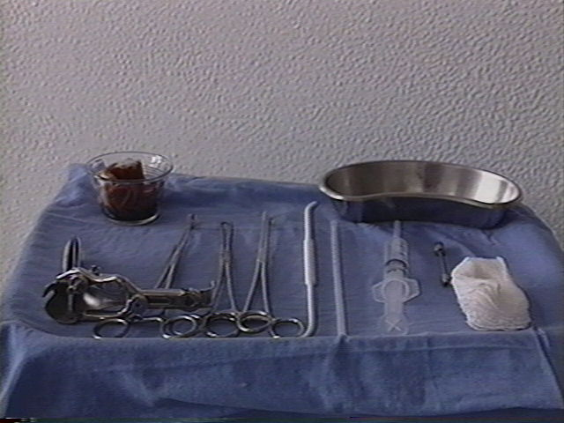
Aspiration Abortion

Slide 34



Dilation and Curettage
Cervical dilators
Curettes/Cannulas

Slide 35


Suction Devices
Manual Vacuum Aspiration
  MVA
Electric vacuum
  EVA

Slide 36
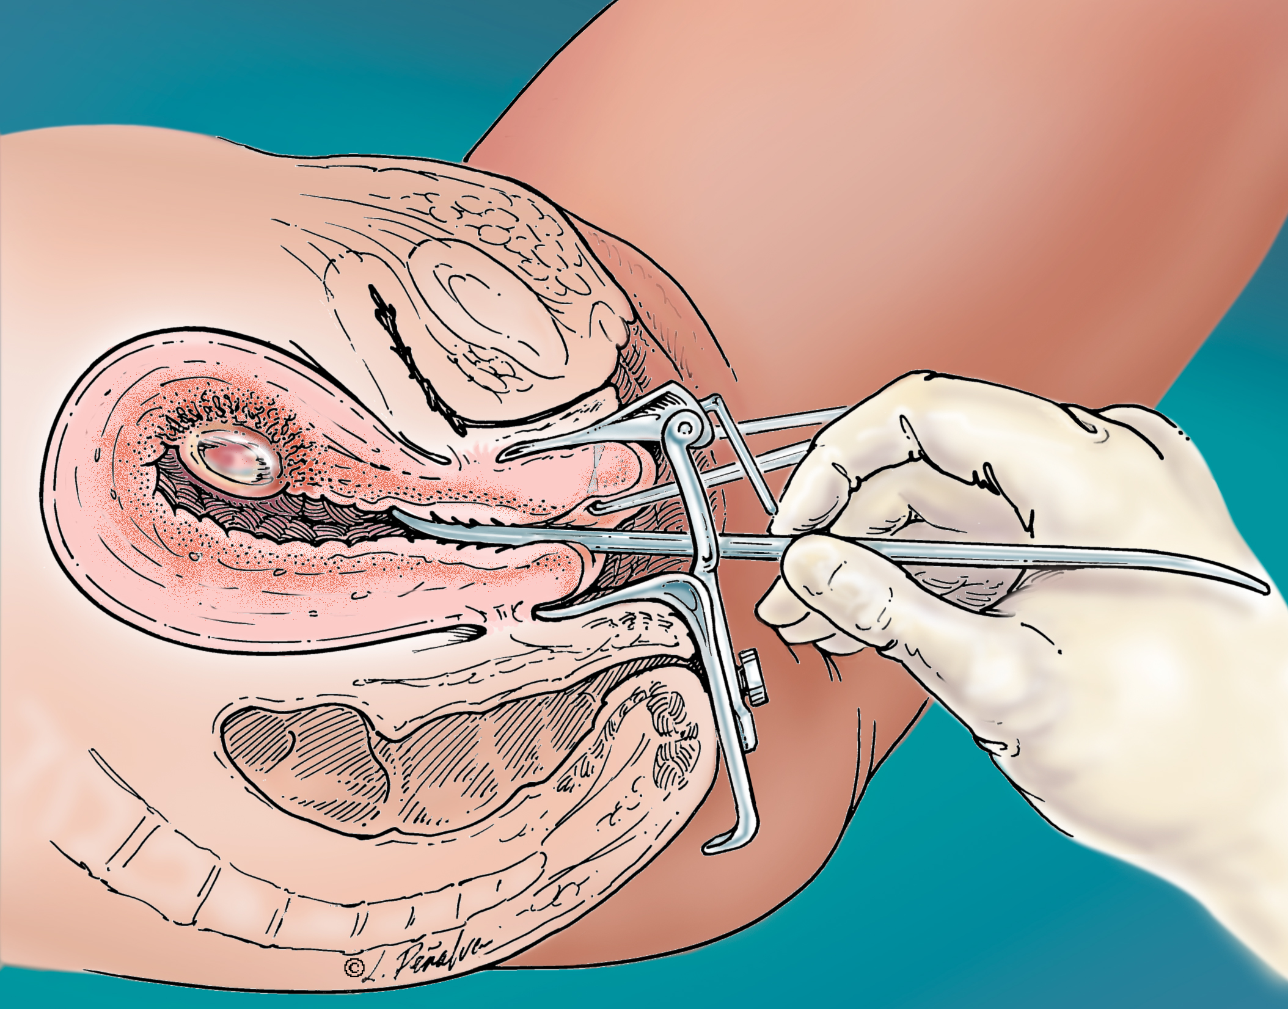
Dilation of Cervix
© Lisa Penalver
Notes:
After administration of anesthesia, the first step involves gentle dilation of the cervix. While holding the cervix with a tenaculum, a graduated, tapered dilator is gently inserted into the cervical os. This step may not always be necessary. For example, when early surgical abortion is performed following an unsuccessful medication abortion, the cervix may already be “ripened” by the effects of mifepristone and misoprostol.

Slide 37
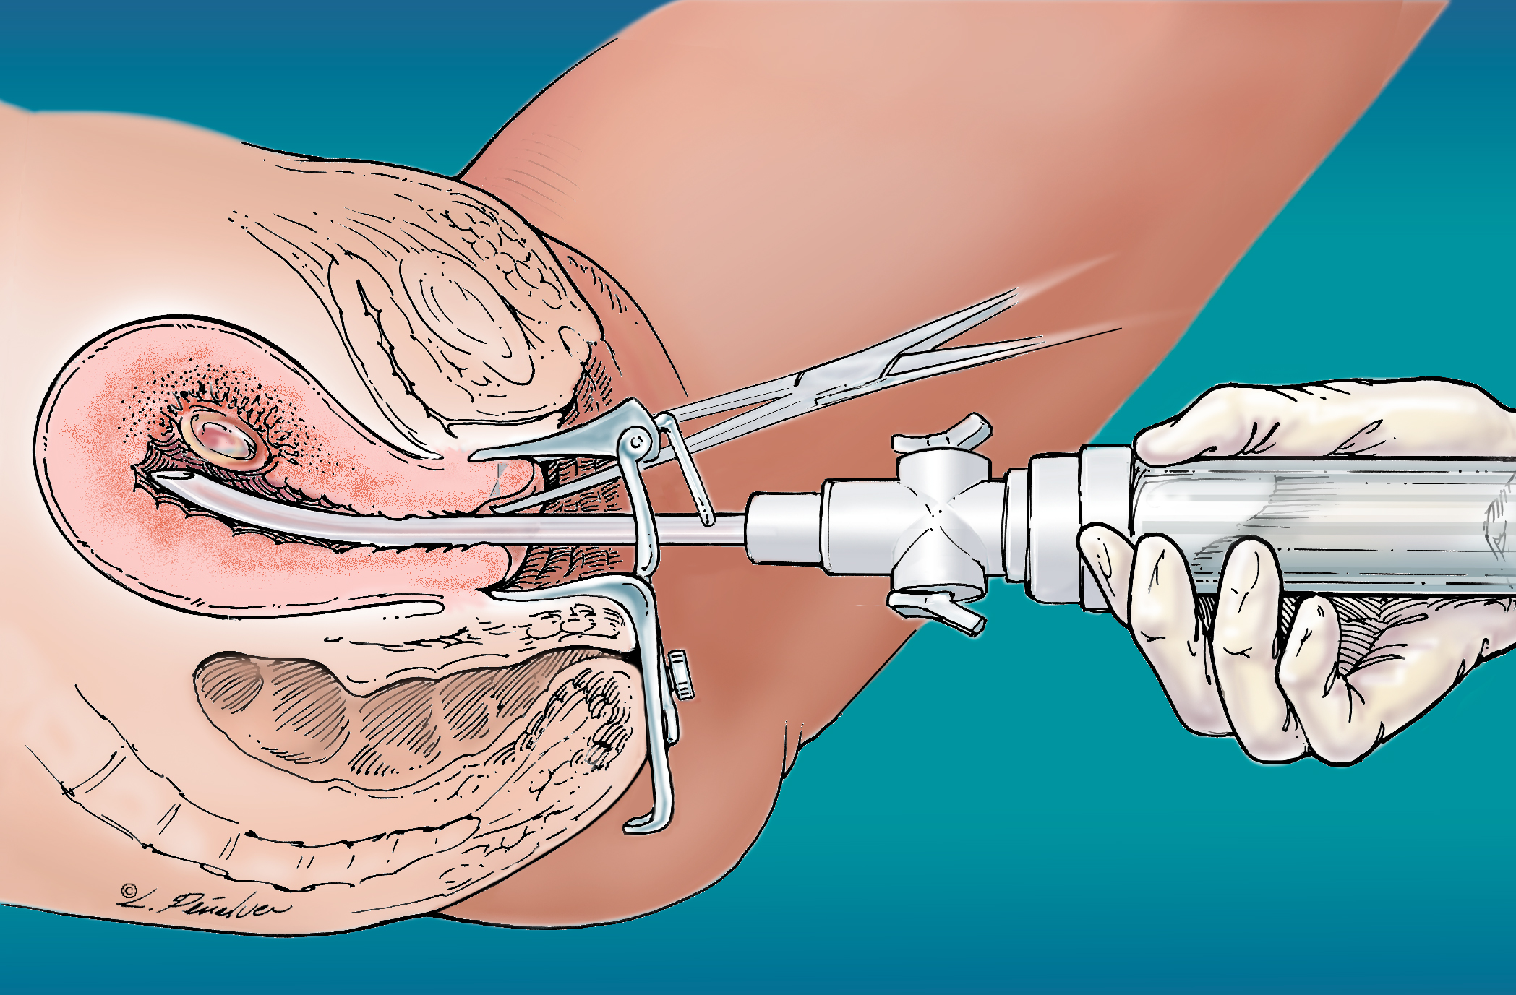
Cannula Attached to MVA
© Lisa Penalver
Notes:
The cannula should then be attached to the syringe. (The process of connecting the apparatus is not shown in the illustration.)
At this point, you are ready to insert the cannula through the cervical os, advancing the tip towards the uterine fundus.

Slide 38
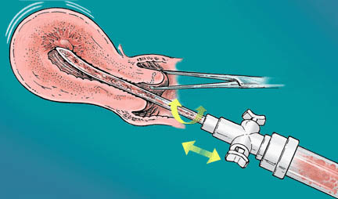
Evacuation of the Uterus
© Lisa Penalver
Notes:
Once the valves have been released to generate suction within the uterine cavity, gently move the cannula back and forth and rotate it. The combination of vacuum suction and cannula motion will evacuate the uterus.
Evacuation is usually complete when you feel a gritty sensation as the cannula moves along the uterine wall and when no more tissue appears in the syringe. For later gestations (i.e., after 8 weeks), you may need to reload the syringe one or more times if the amount of tissue will fill more than one syringe. Be careful not to contaminate the tip of the cannula if multiple reloadings and reinsertions are required. You can avoid contamination by using the “no touch” technique or by attaching a new cannula with each repeat suctioning.

Slide 39
Describe Options: Medication Abortion
A medical or medication abortion (MAB) uses two sets of pills. The first one (mifepristone) will be given to you in the clinic in order to stop the growth of the pregnancy. You will use the second medication (misoprostol) at home 1-2 days later in order to empty the uterus. This process will usually cause cramping and bleeding, lasting from days to weeks.
Option up to 7-10 weeks of pregnancy
  Depends on medication regimen and state regulations
Notes:
Privacy is also a major concern with the medical abortion method itself. Unlike a surgical abortion, medical abortions typically take place in the “privacy” of one’s home over several days that involve heavy cramping and bleeding (the equivalent of a medically induced miscarriage). This process is not so easy to “hide” or conceal from others. When counseling your adolescent on the best method for them it’s important to discuss the privacy issues inherent with medical abortion. in some cases, a surgical abortion may in fact be more private than a medication abortion.
Counsel patients appropriately.

Slide 40
Comparing Regimens
 | FDA regimen Approved in 2000 | Evidence-based Evolving since 2000
Mifepristone dose | 600 mg | 200 mg
Home use of misoprostol | NO | YES
Required office visits | 3 or more | 2 or more *
Gestational age limit | up to 49 days LMP | up to 70 days LMP
* Emerging evidence indicates in-person follow up may not be essential
Notes:
For context, lets look at the FDA regimen along side the most commonly used EB regimen. The EB regimen used lower doses of medication, and allows patients reduce office visits and extend the gestational age for which they can choose this method.
FDA regimen: Up to 49 days
600 mg Mifepristone PO
400 mcg Misoprostol PO at clinic 48 hours later
Follow-up 14 days
EB regimen: Up to 70 days
200 mg Mifepristone PO
800 mcg Misoprostol PV or bucally 24-72 hours later
Follow-up 4-8 days
Additionally, recent studies have examined whether women could assess completion of the MAB using a pregnancy test and phone counseling, and found this may be an alternative to an in person follow up. This could make MAB a one-visit process.
Source: Foster A. Medication Abortion: A Guide for Health Professionals. Cambridge, MA. Ibis Reproductive Health, 2005. Available at http://www.ibisreproductivehealth.org/downloads/Medication_abortion_A_guide_for_health_professionals_English.pdf. Accessed Feb 11, 2014.
Grossman D, Grindlay K. Alternatives to ultrasound for follow-up after medication abortion: a systematic review.
Contraception. 2011 Jun;83(6):504-10. doi: 10.1016/j.contraception.2010.08.023. Epub 2010 Oct 8.

Slide 41
State Laws Targeting MAB
17 states adopted restrictions on MAB provision since 2010
In 38 states, only physicians can provide MAB
In 3 states, providers must use FDA-approved MAB regimen
  TX, OH, and ND
In 16 states, clinicians must be physically present
  Prohibiting telemedicine-delivery of care at a distance using technology to increase access
Guttmacher Policies in Brief, January 2015
Notes:
There are 3 main areas where medication abortion is being restricted by state laws enacted in the last 3-4 years. First is what we call “physician only laws” meaning only a doctor can provide medication abortion to patients, blocking NPs, Pas CNMs from providing this care. Luckily we do see some progress in states like CA which recently enacted a law allowing advance practice clinicians to not only provide medication abortion but also first trimester surgical abortion.
The 2nd area, and one that seems to be ‘taking off” is requiring use of the FDA regimen for medication abortion. You all know that medical practice changes as research and evidence demonstrate that changing does, routes of administration or even uses of certain medications can benefit patients. Unfortunately several states are trying to freeze progress on medication abortion and forcing providers to use a regimen is 14 years old in the US and was actually developed in the late 1980s! When mifepristone was being tested in clinical trials in Europe. Much like TRAP laws, these laws look on their face like they are enforcing safety regulations when really they do nothing of the kind.
The last area of restrictions comes in prohibitions on telemedicine. In many rural areas across the US, telemedicine is being used for a wide range of services including medication abortion care. These laws single out MAB from the services clinicians can provide at a distance.
Source: Guttmacher Policies in Brief, January 2015

Slide 42
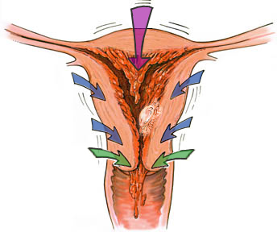
Mifepristone + Misoprostol:
Medication Abortion
Progesterone Blockade
Decidual
Necrosis
Rhythmic
Uterine
Contractions
Cervical
Ripening
Detachment
Expulsion
Abortion
© Lisa Penalver
Notes:
Up to 9 weeks
Mifepristone blocks the action of progesterone by binding to progesterone receptors without activating them. Withdrawal of progesterone during early pregnancy leads
to expulsion of the embryo via a prostaglandin-mediated mechanism.
Following administration of mifepristone during early pregnancy, the trophoblast separates from the decidua. Levels of hCG in the maternal circulation decline and prostaglandins are released locally. Uterine bleeding results.
Mifepristone induces cervical ripening and rhythmic uterine contractions. Misoprostol also induces uterine contractions.

Slide 43
Describe Options: Types of Adoption
Closed adoption
  No exchange of information
Open adoption
  Birth parents choose adoptive parents and maintain contact through letters, visits, etc.
  An openness agreement/plan outlines details
Semi-open adoption
  Identifying information is limited, though letters, pictures, etc., may be exchanged
  Interaction through a third party
Notes:
Source:
Content on this slide was provided by staff in the Spence-Chapin Services Community Outreach and Advocacy Department as well as from their workshop, Ensuring Access to the Adoption Option: Skills and Tools for Health Professionals.

Slide 44
Describe Options: Parenting
Seek patient’s understanding, perceptions, and views on what it would mean to be a young parent
Discuss potential health outcomes & parenting challenges
Unplanned pregnancy, young motherhood, and young fatherhood are not universally negative experiences
We must continue to create conditions where young families are successful in parenting, education, and providing economically for their families
  Teen parents are resilient and vulnerable
Notes:
Source: http://strongfamiliesmovement.org/young-parents
Respect adolescents’ decisions to parent.
Providers encounter myths about abortion and sometimes adoption not uncommonly. However it is also important to remember than young women may actually have myths and misconceptions about parenting and these are most often positive as opposed to negative
In talking about parenting, it is helpful to seek a patient’s understanding, including their perceptions (vs. reality) about how they would manage finances, housing, school, and relationships.

Slide 45

Scenario 1: Following up…
Kim comes back for
follow-up two days later
She has thought more about her options, and has decided to have an abortion
Kim has two questions for you:
  Will she have to tell her parents?
  Where can she go to get an abortion?
Notes:
Now that you have gone through options counseling with Kim and she is back for her follow-up. Kim has decided to have an abortion, and comes to you with a list of questions. Her biggest worries are if her parents need to know and where she can go to get an abortion.

Slide 46
Parental Involvement in Minors’ Abortions
Encourage, but do not mandate, involvement of parents or guardians after assessing for safety concerns
Majority of parents are supportive about abortion
  61% of minors inform at least one parent
  45% of minors inform both parents
Parental involvement laws differ by state, so you need to know the laws where you practice
  Guttmacher Institute: State Policies in Brief
Henshaw SK 1992
Notes:
When working with young women who choose abortion, it is important to discuss parental involvement – especially with minors. In many circumstances, one or both parents can be a great source of support for a young woman seeking an unintended pregnancy. We know that most parents are supportive about abortion and more than half of minors inform at least one parent and are more likely to do so the younger they are.
If a minor decides not to involve a parent or guardian, the situation can get a bit more challenging. While teen pregnancy is confidential in the vast majority of states under most circumstances, if a minor decides to have an abortion there are other state laws that may force parental involvement. These laws are generally called parental involvement laws and come in two types: parental notification and parental consent. As parental involvement laws differ by state, you need know the laws where you practice and there are some great resources online to find this information. For minors who feel that they cannot involve a parent, states are required to have a judicial bypass option whereby minors petition the court to waive the notification/consent requirement
Source:
Henshaw SK, Kost K. Parental involvement in minors’ abortion decisions. Family Planning Persepctives 1992;24:196–207, 213.
A survey of 1,519 unmarried pregnant minors in states where parental involvement is not mandatory found that 61% told one or both parents about their intent to have an abortion.
The younger the minor, the more likely she was to do so (90% of those 14 years old or younger, 74% of those 16 years old)
Among minors who did not involve a parent, virtually all involved at least one responsible adult other than clinic staff (such as another relative, teacher, counselor, professional, or clergy).

Slide 47
Making an Abortion Referral
What is the clinic’s gestational limit?
  Do they offer medication abortion?
  What is the gestational limit for a single-visit or
  aspiration abortion?
What is the cost for services?
  Is analgesia/anesthesia included? RhoGAM®?
What types of insurance does the clinic accept?
  As full payment for services?
Is the clinic teen friendly?
Notes:
When making an abortion referral it’s really important that you call around to clinics and gather this information, so that you can make competent, intelligent, accurate referrals.
So you want to know things like:
What are the clinics around?
What are their gestational limits?
Do they offer medication abortion?
And what is the gestational limit for a single visit abortion?
You also really want to know what the cost is for services, what kinds of insurance the clinics accepts, and whether different kinds of aspects of the visit are included within those costs such as, anesthesia or analgesia, RhoGAM®.
Are there other charges that the patients may expect even though they're paying for the abortion in a certain fee or with an insurance?
And when working with teens, you want to make sure that the clinic is teen-friendly

Slide 48
Making an Abortion Referral (cont.)
Ask about medical exclusions:
  Will the clinic see patients with acute or chronic medical conditions? current substance use?
Does the clinic offer post-abortion contraception?
How does the clinic offer emotional support/resources?
Does the clinic help minors pursue judicial bypass?
  Minor petitions court to waive the notification/consent requirement
Notes:
AB: Too much info on this slide, add a slide on websites-resources
There are a few other points that are really important about making an abortion referral. You want to ask clinics about whether they have any medical exclusions. Will they be able to see patients that have acute or chronic medical conditions? Will they be able to see patients who are currently using drugs or alcohol?
Especially when working with minors, you need to know if the clinic will help teens who do not want or cannot involve their parents in seeking judicial bypass—where the minor petitions court to waive the notification/consent requirement. The judge then decides if the minor is mature and sufficiently well-informed and if an abortion without informing parents is in her best interest.
If it's important to your patient, you want to know whether the clinic offers post abortion contraception. And likewise, does the clinic offer emotional support both before and during the abortion?

Slide 49


Judicial Bypass: Connect to Local Resources
Jane's Due Process (TX)
American Civil Liberties Union (ACLU) State Affiliate
Local Planned Parenthood Affiliate
National Abortion Federation (NAF) Referral Hotline
  1 (877) 257-0012
Notes:
These are a few examples of Local Resources to connect to in regards to parental involvement laws. As part of the ACLU, Illinois has a Judicial Bypass Coordination Project which offers FREE, confidential assistance, including a hotline number, text messaging service, and access to a free lawyer and clinic referral.
The local Planned Parenthood Affiliate in the Rocky Mountains of Colorado created a hotline to assist minors seeking information about the judicial bypass process and access to an attorney. The hotline will serve minors whether they are seeking an abortion at Planned Parenthood or at another abortion provider.
The NAF referral hotline is a national service BUT will connect you to a provider and resources in your area
http://ilbypasscoordinationproject.org/parental-notice-law/parental-notice-waiver-judicial-bypass
http://www.plannedparenthood.org/rocky-mountains/judicial-bypass-faq-10564.htm

Slide 50

Find a Local Abortion Provider
National Abortion Federation Hotline
1-877-257-0012
www.prochoice.org
Notes:
The National Abortion Federation is also a great resource, not just for financial assistance, but for referrals. This is an interactive map found on their website that allows you to click on the state you’re in and pulls up a list of NAF certified clinics (which means they are board certified, reputable, and have basically been approved by NAF-good, safe, clean clinic).
“Find a Provider” near me tab. Just visit www.prochoice.org; the phone #on the slide is JUST for referrals, not for funding. What are the hours? (adolescent friendly hours? Languages? They are bilingual and have people working who speak many other languages. I was a spanish speaking counselor there because I spoke “abortion spanish” (I could do financial counseling, how far along are you, etc) ☺
Referral Line ONLY, very hard to get through-have to be persistent and keep calling.

Slide 51
Prepare Your Teen or Young Adult Patient:
Financial Resource Counseling
State-based confidential insurance options for pregnant teens
  i.e., FPACT in CA, FPB in NY, Mass Health in MA
Other sources?
  Cash advance from work
  Pawn or sell; credit card
  Community, church, etc.
  Borrow $ from family/friends/partner
Connect to local/national funds if needed
  NNAF
  NAF Hotline (1-800-772-9100)
Notes:
In order to best help our patients we should feel equipped to do some financial resource counseling and explain why you are even asking these sensitive and sometimes invasive questions to begin with. You should now be able to talk about the current financial restrictions with Medicaid and insurance and explain how as a result of these reasons you are counseling them on ways to come up for the money-even when it may seem uncomfortable and shameful. These very laws that don’t include abortion as a part of MAINSTREAM HEALTH CARE for women serve only to separate it out and make women feel stigmatized and embarrassed for finding themselves in need of a medical procedure they can’t afford-even with health insurance)
In addition to financial resource counseling that you can do on your own, there are local and national abortion funds. The National Network of Abortion Funds can refer you to a local fund in your area, but keep in mind that they typically only give $50 or $200 and can’t cover the costs of the whole procedure.
The National Abortion Federation also has a screening process: While they don’t require proof of income, they will ask questions to determine federal poverty guideline levels, and their funding does not extend to women who live in what we call a “medicaid” state if you live in one of the 17 states where medicaid SHOULD cover the cost of the AB and if you have private insurance that pays for it

Slide 52
Scenario 2: Following up…
Kim comes back for
follow-up two days later
She has thought more about her options, and has decided to continue the pregnancy
  Kim is unsure if she wants to parent or make an adoption plan

Slide 53
Making an Adoption Referral
Make sure teens have accurate information about how adoption is (or should be) practiced today
Look for agencies that support all options for young women, including abortion and parenting
Young women should never be coerced or made to feel an obligation to place her baby for adoption
Agencies should accept diverse people as adoptive parents and as birth families
Notes:
In making an adoption referral, there are some really important things to look out for. You want to make sure that when you refer to a particular agency, that people there are being given accurate information about how adoption is or should be practiced today. That means that they're talking about open adoption and they're defining it correctly.
You also want to look for adoption agencies that support all options for the pregnant woman, including talking about abortion and parenting if that comes to be what the patient is interested in.
The pregnant woman should never be coerced or made to feel that she has an obligation to place her baby for adoption. And finally, agencies should accept diverse people as adoptive parents and as birth families.

Slide 54
Making a Prenatal Referral
Is the clinic teen-friendly?
Do providers respect young parents?
Does the clinic have options, such as:
  Group prenatal care, Teen-Tot Clinic, Fatherhood Outreach Programs
Does the clinic offer support for young women in addition to medical care?
  WIC, housing assistance, counseling
Notes:
When discussing prenatal referrals, you want to make sure that the clinic you send a pregnant teen to is adolescent friendly—that both the staff and providers respect a young woman’s decision to parent. It is also important to find out if the clinic uses any practice models that are particularly teen-friendly, such as group prenatal care or centering pregnancy, teen-tot programs, or fatherhood outreach programs.
And lastly, it is helpful to know what other supports the prenatal clinic may have available to young women. These can include things like referrals to WIC, helping with insurance, offering parent education classes and support groups. In addition, knowing that clinics that have the ability to assist patients with housing or counseling can be very important.
Does the clinic offer support for young women in addition to medical care?
Referrals to Women, Infants, and Children (WIC) programs
Access to enrollment in Medicaid/other insurance
Parenting education and support groups
Housing assistance

Slide 55
Transition/Close
Reframe
  You’re really brave
  You’re doing a great job
Express your own gratitude
  Thanks for sharing your thoughts about that
Normalize her plan or her next step
  You have a good plan
  Lots of people take this next step
Present information/referrals
Schedule follow-up visit
Notes:
When you need to transition through sections of options counseling or close a conversation where you've been talking about feelings, it is helpful to put it in a positive reframe. Say things like “you're really brave” or “I'm proud of you. You're doing a great job.” You can also express your own gratitude by thanking the patient for sharing what she did because she may have shared things that were very personal. You can also normalize her plan or the next steps that she's going to take. Say something like, “you have a good plan. Lots of people take this next step.” And at the end of a conversation, you can always present information or referrals, and then schedule a follow-up visit.

Slide 56
Take-Home Points
Effective pregnancy options counseling includes:
  An approach of listening, not assuming, and self-reflecting
  A framework of validating and normalizing patient experiences and working to seek understanding
  A discussion of all options, including abortion, adoption, and parenting

Slide 57
One pregnancy decision is not “more moral” than another; she is a good person making a moral decision for herself. There is no knowledge that you possess about the answer to her dilemma that she does not.
The patient has the answer
Notes:
Our last slide here really goes back to what I consider to be foundational for the work that we do in helping women make pregnancy decisions and the best decisions for themselves. And you really want to go back to the central principle that the patient has the answer to her dilemma. The patient knows what is the way that she needs to go. The more that you practice this and think deeply about it, think about, and self-reflect about what is hard for you, the more you're going to be able to achieve fluency in your conversations with patients and the more you're going to be the person that your patients trust. And your patients are going to come back to you because they appreciate what you've done for them.

Slide 58
Options Counseling Resources
www.yourbackline.org—Backline: Options Counseling
  Options Counseling Hotline: 1-888-493-0092
www.pregnancyoptions.info—Pregnancy Options Workbook
www.plannedparenthood.org/teens/going-to-the-doctor/im-pregnant-now-what—I’m pregnant. Now what? Info for teens
Notes:
58

Slide 59
Abortion Resources
www.prochoice.org—National Abortion Federation
  Information and Funding Assistance: 800-772-9100
  Clinic Referrals: 877-257-0012
www.abortioncarenetwork.org—Abortion Care Network
www.nnaf.org—National Network of Abortion Funds
www.4exhale.org—Exhale: Post Abortion Resources
  Post-abortion Support Hotline: 866-4 EXHALE
www.abortionconversation.com—Abortion Conversation Project
www.menandabortion.com
www.pregnancyoptions.info/emotional&spiritual.htm
www.faithaloud.org/faith/faith-counseling.php
www.theabortionproject.org
Notes:
59

Slide 60

Training to Provide MAB
TEACH
  Training for family medicine and primary care clinicians
  ANSIRH Early Abortion Training Workbook
  http://www.ansirh.org/training/workbook.php
Center for Reproductive Health Education in Family Medicine (RHEDI)
  Grants to residency programs to create opt-out training
  www.rhedi.org
Notes:
ANSIRH – Advancing New Standards in Reproductive Health
Main page on ANSIRH http://www.ansirh.org/
RHEDI provides grants only to family medicine residency programs who offer opt out training in MAB and early surgical AB

Slide 61
Adoption Resources
www.spence-chapin.org—Spence Chapin Adoption Services
www.adoptioninstitute.org—Evan B. Donaldson Institute
www.childwelfare.gov—Child Welfare Gateway
www.adoption.org—National Adoption Clearinghouse
www.openadoption.org/index.html—American Association of Open Adoption Agencies
www.openadoptioninsight.org—Insight Open Adoption Resources
Notes:
61

Slide 62
Teen Parenting Resources
Adolescent Pregnancy and Parenting Resources
  www.healthyteennetwork.org
  www.thepushback.org (pushing back against stigma and stereotypes about young parenthood)
  strongfamiliesmovement.org/young-parents
Notes:
Some local teen parent support programs include: (these are just a few examples)
Milwaukee Adolescent Health Program http://www1.mcw.edu/mahp.htm#.VLbXxivF98E
Children’s Hospital of Boston Young Parents Program (YPP) www.childrenshospital.org/clinicalservices/Site2277/mainpageS2277P10.html
National Children’s Medical Center Healthy Generations Program http://www.childrensnational.org/DepartmentsAndPrograms/Default.aspx?Type=Program&Id=280&Name=Teenage%20Pregnancy%20Program%20%28Generations%29&DeptId=&DeptName=

Slide 63

Please Complete Your Evaluations

