Slide 1


Male Adolescent Sexual and Reproductive Health

Slide 2
Objectives
Discuss misconceptions around male sexual health and how they affect health care delivery
Identify barriers to health care and opportunities to provide adolescent male-friendly health services
Understand how to take a male-focused sexual health history and recognize male genital concerns
Increase comfort and competency when performing a male genital exam
Update STI screening practices for young males

Slide 3
Myth
Busting

Slide 4

Age at First Intercourse
Young males start having sex much earlier than young females?
True or False?
Notes:
FALSE: The median age for BOTH males and females at first intercourse is 17.

Slide 5
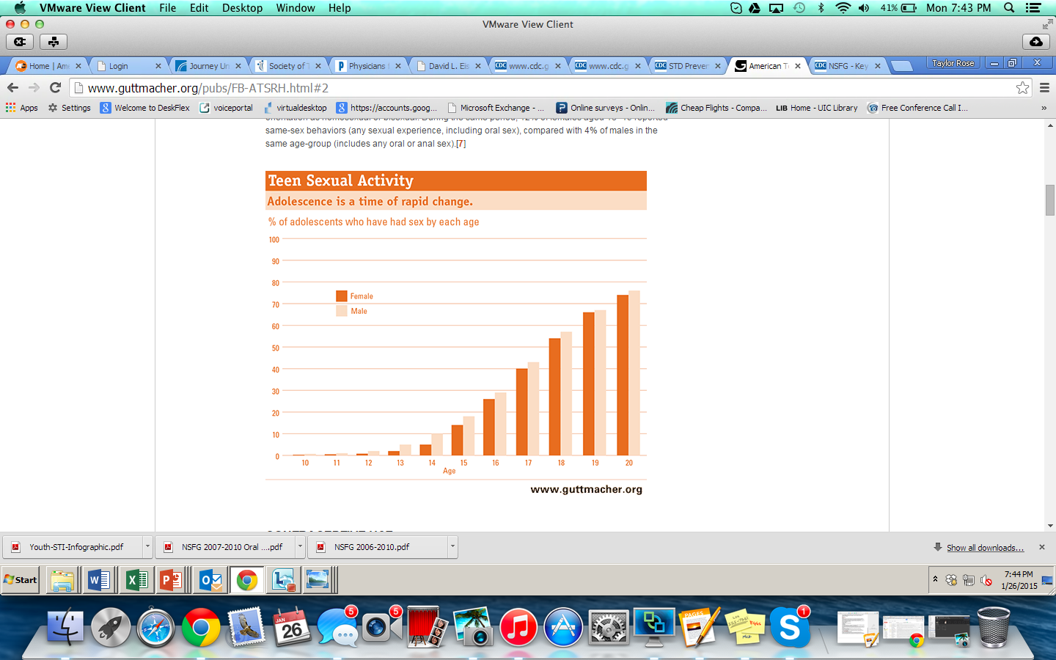
Most Males and Females Begin Sex at Age 17
Notes:
http://www.guttmacher.org/pubs/FB-ATSRH.html#2 (May 2014)
On average, young people have sex for the first time at about age 17.
Special tabulation by NCHS, 2013

Slide 6
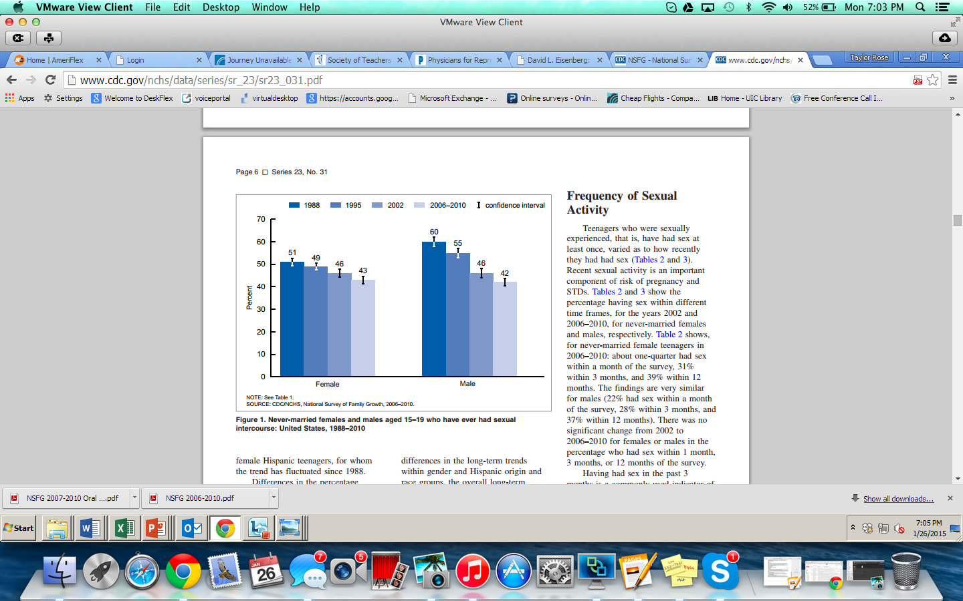
Nearly Half of Males and Females Aged 15-19 Have Had Sex
CDC/NCHS, National Survey of Family Growth, 2006–2010
Notes:
This graph shows never-married females and males aged 15–19 who have ever had sexual intercourse: United States, 1988–2010.
In 2006–2010, 43% of never-married teenaged females and 42% of never-married teenaged males had experienced sexual intercourse at least once.
YRBS Data from 2013 also shows very similar percentages, where 46.8% of high school students in grades 9-12 have EVER HAD SEX.

Slide 7

Sexual Behavior
Young males are more sexually active than females
True or False?
Notes:
FALSE. High school females are slightly more sexually active than males, according to the 2013 YRBS.

Slide 8
High School Females More Sexually Active
2013 Youth Risk Behavior Survey
Notes:
Source:
http://nccd.cdc.gov
2013 Youth Risk Behavior Survey. High School students grade 9-12.
32.7% males are currently sexually active (past 3 months) compared to 35.2% of females.

Slide 9
Males and Sexually Transmitted Infections
Young males acquire more STI infections than females.
True or False?
Notes:
False.

Slide 10
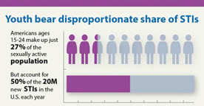
Males and Females BOTH at Increased Risk for STIs
  # of new STI infections is equal among young males (49%) and females (51%)
2013 CDC STD Surveillance Report
Notes:
While the consequences of untreated STIs are often worse for young women, the new analysis reveals that the annual
number of new infections is roughly equal among young women and young men (49 percent of incident STIs occurs among
young men, vs. 51 percent among young women).
http://www.cdc.gov/std/stats/STI-Estimates-Fact-Sheet-Feb-2013.pdf
CDC 2013 Report

Slide 11
Oral Sex
Young males engage in oral sex in place of vaginal sex to avoid the risk of pregnancy?
True or False?
Notes:
FALSE:.
Adolescent males, on average, are more likely to initiate oral sex and vaginal intercourse on the same occasion compared with adolescent females
Source: Haydon AA, Herring AH, Prinstein MJ, et al. Beyond age at first sex: Patterns of emerging sexual behavior in adolescence and young adulthood. J Adolesc Health 50(5):456–463. 2012.
Source: CDC/NCHS, National Survey of Family Growth, 2006–2010

Slide 12
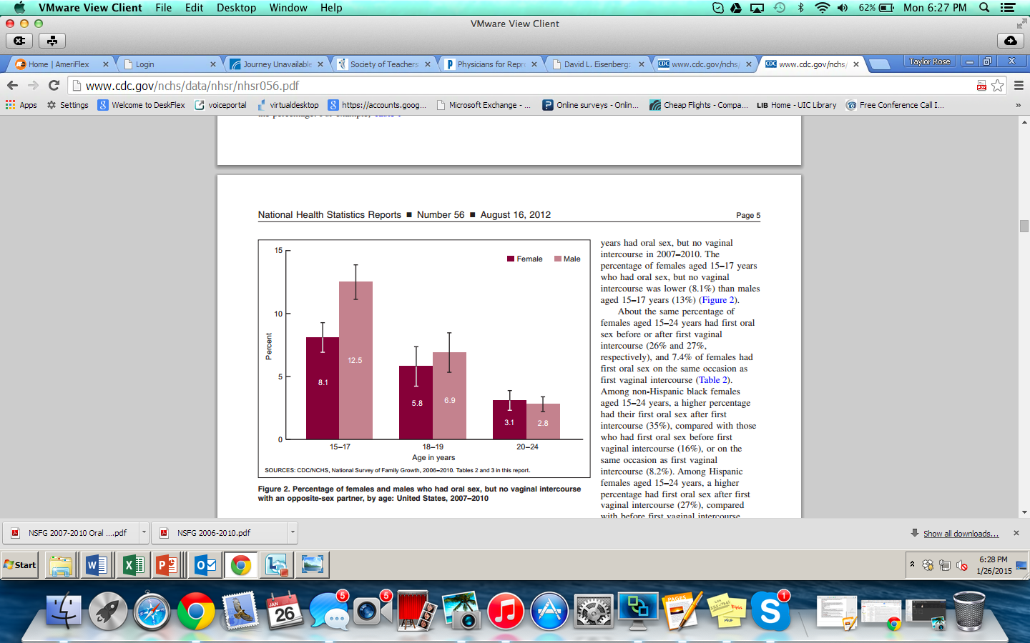
Oral Sex DOES NOT Replace Vaginal Sex
CDC/NCHS, National Survey of Family Growth, 2006–2010
Notes:
Source: http://www.cdc.gov/nchs/data/nhsr/nhsr056.pdf
This graph shows the percentage of females and males who had oral sex, but no vaginal intercourse with an opposite-sex partner, by age: United States, 2007–2010.
Younger males and females are more likely to have had oral sex but no vaginal intercourse than older adolescents and young adults.

Slide 13
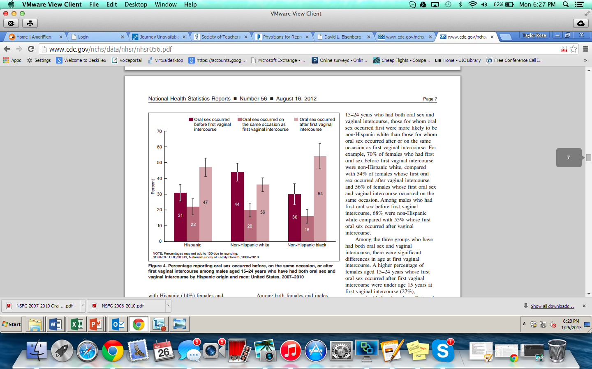
Timing of Oral Sex: Males Aged 15-24
CDC/NCHS, National Survey of Family Growth, 2006–2010
Notes:
Source: http://www.cdc.gov/nchs/data/nhsr/nhsr056.pdf
This graph shows the percentage reporting oral sex occurred before, on the same occasion, or after first vaginal intercourse among males aged 15–24 years who have had both oral sex and vaginal intercourse by Hispanic origin and race: United States, 2007–2010
For Hispanic males aged 15-24, oral sex was more likely to occur after vaginal intercourse. For white males, oral sex was more likely to occur before first avginal intercourse.

Slide 14
♂ Sexual Behavior with
Opposite-Sex Partners
Age (yrs) | Any sex | Vaginal sex | Oral sex | Anal sex
15–19 | 58% | 45% | 48% | 10%
20–24 | 86% | 82% | 80% | 32%
NSFG 2006-8
http://www.cdc.gov/nchs/data/nhsr/nhsr036.pdf
Notes:
These are data from the National Survey of Family Growth, which is a large, household–based survey of US males and females 15-44 years old conducted by the Centers for Disease Control and Prevention’s National Center for Health Statistics that obtains information on factors affecting birth and pregnancy rates.
These data illustrate the diversity in sexual behavior with opposite-sex partners among youth aged 15–24 years. You can see that many adolescent and young adults males and females are engaging in vaginal sex, oral sex, and/or anal sex. It is very important to know what type of sex your patients are practicing so you will know which orifices to test for STIs. We have to routinely ask the question, of kids who report sexual activity “are you having vaginal sex, oral sex, or anal sex” to guide our clinical practice.

Slide 15
♂ Sexual Behavior with Same-Sex Partners
Age (yrs) | Any sex with ♂ | Anal sex with ♂ | Oral sex with ♂
15–19 | 3% | 1% | 2%
20–24 | 6% | 3% | 6%
NSFG 2006-8
http://www.cdc.gov/nchs/data/nhsr/nhsr036.pdf
Notes:
These are also data from the NSFG that present the sexual behaviors with same-sex partners among males aged 15–24 years. You can see that the prevalence of same-sex behavior among young men is high enough where you should expect to see male patients in your practice who are engaging in sex with other men. But you are never going to know if you don’t ask. So, it is not only important to ask teens how they are having sex but also with whom they are having sex. STI risk is not just based on what you are doing, but also who you are doing it with.
Source:
http://www.cdc.gov/nchs/data/nhsr/nhsr036.pdf (NSFG 2006–2008 data)

Slide 16
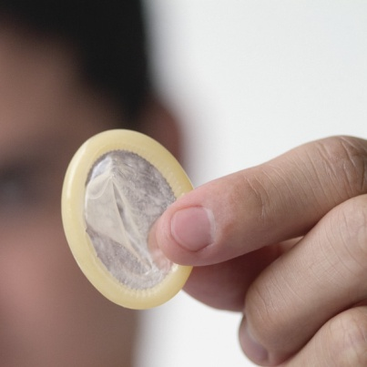
Condom Use
The majority of teenage males did not use a condom at last sex.
True or False?
Notes:
FALSE: According to the 2013 YRBS, 65.8% of HS males used condom at last sex in 2013.
Source:
2013 YRBS

Slide 17
YRBS 2013: Condom Use
% of HS Students Who Used a Condom at Last Intercourse
YRBS 2013
Notes:
53.1% of HS females used condom at last sex in 2013 from YRBS survey and 65.8% of HS males used condom at last sex in 2013.
(Slightly down from rates in 2011)

Slide 18
High School Male Contraceptive Use at Last Sex
2013 Youth Risk Behavior Survey
Notes:
For high school males in grades 9-12, 65.8% used a condom at last sex, 15.1% report birth control pill use, 1.3% IUD/Implant use, and 3.7% shot, patch, ring.

Slide 19
Barriers to Care for Young Males
Notes:
Now that we’ve provided some factual data on male sexual health and clarified some existing myths we will discuss the need for male reproductive health services and how to provide care in face of several barriers to accessing services for young males.

Slide 20
Few Young Males Receive
Sexual Health Services
Primary care providers 3 times more likely to take sexual histories from female than male patients
  2 times more likely to counsel females on condom use
Of 15- to 19-year-old sexually active males:
  1/4 have had an HIV test
  <50% used condoms 100% of time
Less than 20% of males received counseling from a health care provider on reproductive health
http://www.guttmacher.org/pubs/fb_YMSRH.html (JUNE 2008)
AAP. Clinical Report. Pediatrics. 128(6); December 2011.
Notes:
Sources:
1) Lafferty WE, Downey L, Holan CM, et al. Provision of sexual health services to adolescent enrollees in Medicaid managed care. Am J Public Health. 2002;92(11):1779–1783
2) Lafferty WE, Downey L, Shields AW, Holan CM, Lind A. Adolescent enrollees in Medicaid managed care: the provision of well
care and sexual health assessment. J Adolesc Health. 2001;28(6):497–508
http://www.guttmacher.org/pubs/fb_YMSRH.html (JUNE 2008)
15. National Campaign to Prevent Teen Pregnancy, HIV testing among sexually experienced teens, Science Says, 2005, No. 18.
Although two out of three males aged 15–19 had a physical exam in the past year, fewer than 20% received counseling or advice from a health care provider about birth control or STIs, including HIV.
Martinez GM et al., Fertility, contraception, and fatherhood: date on men and women from cycle 6 (2002) of the 2002 National Survey of Family Growth, Vital and Health Statistics, Series 23, No. 26.
Abma JC et al., Teenagers in the United States: sexual activity, contraceptive use, and childbearing, 2002, Vital and Health Statistics, 2004, Series 23, No. 24.
In general, the proportion of teenage men receiving reproductive health services is still very low.
To reduce rates of teen pregnancy and STIs, physicians and nurses need to incorporate reproductive health care into routine health services for teenage males, as well as females.

Slide 21
Structural Barriers to Care for Young Males
No consensus on standards
Lack of routine channel for obtaining care
Inadequate medical training
Gaps in financing
Provider/staff bias toward providing male reproductive health care
Notes:
Though there is growing interest in expanding the field of male reproductive health, there is still no consensus on the routine treatment this segment of the population needs.
Many federally- and state-funded reproductive health programs are designed to serve women but not men, and do not offer male services.
Source:
Alan Guttmacher Institute. In Their Own Right: Addressing The Sexual And Reproductive Health Needs Of American Men, March 2002: www.guttmacher.org/pubs/us_men.html.

Slide 22
Barriers to Health Care Use
Fear
Stigma
Shame
Denial
Lack of social support
Lack of confidential services
Lack of health insurance options (especially for older teens)
Not knowing where to go for care
AAP. Clinical Report. Pediatrics. 128(6); December 2011.
Notes:
Male adolescents’ use of sexual/reproductive health care services remains low for a variety of reasons
Source:
http://pediatrics.aappublications.org/content/early/2011/11/22/peds.2011-2384.full.pdf+html
References:
141. Kalmuss D, Austrian K. Real men do. . . Real men don’t: young Latino and African American men’s discourses regarding sexual health care utilization. Am J Mens Health. 2010;4(3):218–230
142. Ford C, Best D, Miller W. Confidentiality and adolescents’ willingness to consent to STD testing. Arch Pediatr Adolesc Med. 2001; 155(9):1072–1073
143. Fortenberry JD, McFarlane M, Bleakley A, et al. Relationships of stigma and shame to gonorrhea and HIV screening. Am J Public Health. 2002;92(3):378–381
144. Lowery LM, Chung S, Ellen JM. Social support and sexually transmitted disease related healthcare utilisation in sexually experienced African-American adolescents. Sex Transm Infect. 2005;81(1):63–66
145. Marcell AV, Howard TL, Plowden K, Watson C. Exploring women’s perceptions about their role in supporting partners’ and
sons’ reproductive health care. Am J Mens Health. 2010;4(4):297–304
146. Elster AB, Marcell AV. Health care of adolescent males: overview, rationale, and recommendations. Adolesc Med. 2003;
14(3):525–540, v

Slide 23
Opportunities to Provide
Reproductive Health Care
Sports physicals
Acute care visits
Chronic illness visits
School physicals and immunization visits
When young males accompany partners, friends, or other family members to medical visits
ANY VISIT

Slide 24
Establishing a
Male-Friendly Environment

Slide 25
Community Needs Assessment
Are there young males in the area who need services?
  Where are they?
  What are their health care needs?
  How can they be reached?
Are there other organizations offering young males care in the community?
What services will you offer that will differentiate yourself from others in the area?

Slide 26
Training Needs for Staff
Caring for Young Males
Exploration of preconceived opinions about young males
Male clinical issues
Insurance (private and government) eligibility and billing
Respectful communication
Cultural competence

Slide 27
The Values and Attitudes of Staff Around Males
Staff exercise
  How is serving young men different than serving adult males or young females?
  What does making your clinic “male adolescent-friendly” mean to you?
  What are some of your reservations about serving young males?

Slide 28
Male-Focused
Sexual Health History: Case Study

Slide 29

Case: Eric
Eric is a 17-year-old male who has made an appointment for a sports physical.
How do you begin the visit?

Slide 30
Sexual History Tips
Reassure confidentiality
Take history when the patient is still dressed
Assess development and structure questions accordingly
Watch for concrete vs. abstract answers
Use open-ended questions
Notes:
Sample opening to discuss confidentiality:
“During this visit, I’ll ask you some very personal questions to best help you. I promise that whatever you say will be kept private between us, and not be passed along to your parents or anybody else outside this office, unless you give permission”
Source:
Guttmacher Institute. State policies in brief. Minors Consent Laws
Source:
HEEADSSS 3.0

Slide 31
Components of a Sexual History
Engagement in vaginal, oral, or anal sex
Knowledge about correct condom use
Hormonal contraception
Comfort with changes in one’s body/physiology
Masturbation
Sexual pleasure and satisfaction
Sexual attraction/orientation
Sexual initiation and age of onset
Gender identity
Number of partners
Current/past STI history
Use of condoms
Experience of sexual abuse and safety
Healthy relationships
AAP. Clinical Report. Pediatrics. 128(6); December 2011.
Notes:
Source:
Marcell AV, Wibbelsman C, Seigel WM, Committee on Adolescence. Male Adolescent Sexual and Reproductive Health Care. Pediatrics. 128(6) 2011.
http://pediatrics.aappublications.org/content/early/2011/11/22/peds.2011-2384

Slide 32
Sexual Health Assessment
The 5 P’s Approach:
Practices
Partners
Pregnancy Prevention
Protection from STDs
Past STD History
Notes:
Use the 5 P’s approach to conduct a sexual health assessment [13, 22, 23]:
assessment 1. Practices: Assess for the types of sexual behavior that your patient engages in, such
as vaginal, anal, and/or oral sex.
2. Partners: Ask questions to determine the number, sex, and concurrency of your
patient’s sex partners. You may need to define the term “partner” to the patient or
use other, relevant terminology.
3. Pregnancy prevention: Discuss current and future contraceptive options with partner.
4. Protection from STDs: Ask about condom use, with whom they do or do not use
condoms, and situations that make it harder or easier to use condoms.
5. Past STD history: Ask about history of STDs, including whether their partners have
ever had an STD (The likelihood of an STD is higher with a past history of an STD).
Source: Marcell, A.V. and the Male Training Center for Family Planning and Reproductive Health. Preventive Male Sexual
and Reproductive Health Care: Recommendations for Clinical Practice. Philadelphia, PA: Male Training Center for Family Planning and
Reproductive Health and Rockville, MD: Office of Population Affairs; 2014.

Slide 33
Comprehensive
HEEADSSS
H: Home
E: Education/Employment
E: Eating
A: Activities
D: Drugs
S: Sexuality
S: Suicide/depression
S: Safety
*Additional questions:
  Strengths, Spirituality
Klein DA, Goldenring JM & Adelman WP. Contemporary Pediatrics. 2014.
Notes:
The HEEADDSSS model is a useful tool for taking a comprehensive psychosocial history for adolescent patients.
The HEEADDSSS Model was originally developed in 1972 by physicians. ARSHEP faculty, Melanie Gold, DO, DABMA, FAAP, FACOP developed the corresponding questions for this model.
The components of the model reflect the common causes of morbidity and mortality among adolescents, including unintended pregnancy and sexually transmitted diseases.
The health care provider who sees adolescents must be willing to take a developmentally appropriate psychosocial history, and may get more results by using non-traditional modes of physician-patient questioning.
The HEEADDSSS questions should be asked without a parent in the room unless the adolescent specifically gives permission or asks for a parent’s presence. If the questions are asked and answered with other people in the room, document this on chart and note that this was by patient request.
Some practitioners add yet another “S” to assess strengths, points of resiliency, or confidence in the patient.

Slide 34
Sexual Behavior Questions
Do
Assure confidentiality
Explain why you are asking sensitive questions
Ask patient to describe specific sexual behaviors
Add “second tier” questions to assess comfort with behaviors
Don’t
Ask “Are you sexually active?”
Use gender-biased pronouns when referring to sexual partners
Use judgmental language
Use slang unless patient offers it first

Slide 35
Sample Questions on Sexuality
Have you ever been in a romantic relationship?
Tell me about the people that you’ve dated.
Describe your sexual relationships (such as involving kissing or touching).
Tell me about your sexual life.
Let’s talk about sexual attraction. Are you interested in boys? Girl? Both? Not yet sure?
Klein DA, Goldenring JM & Adelman WP. Contemporary Pediatrics. 2014.
Notes:
Source:
HEEADSSS 3.0

Slide 36
Assessing the Health of the Relationship
What does a healthy relationship look like to you?
What is it like when you and your partner get into an argument?
How does you partner feel about you hanging out with other friends?
(If sexually active) Who makes the decisions about when to have sex?
Notes:
Among male adolescents, support having healthy relationships.
Source: World Health Organization. Defining sexual health:
report of a technical consultation on sexual health,
28-31 January 2002, Geneva. Geneva, Switzerland:
WHO Press: http://www.who.int/reproductivehealth/
publications/sexual_health/en/; 2006.
Workowski KA, Berman S. Sexually transmitted
diseases treatment guidelines, 2010. MMWR Recomm
Rep 2010 Dec 17;59(RR-12):1-110.

Slide 37
Case: Eric
During the sexual history, you discover that Eric has had two female partners and is currently in a monogamous relationship with his girlfriend.
He reports that his girlfriend is “on the pill”
and that he uses condoms “half the time.”
  What follow-up counseling do you give?

Slide 38
Case: Eric
Explore reasons for using condoms only “half the time”
  Comfort?
  Cost?
  Trust?
Develop an intervention plan to address issues raised as an obstacle
Discuss EC as rescue method for birth control

Slide 39
Case: Eric
Eric also tells you that he has no known history of STIs but has noticed swelling in his left testicle. He denies any pain.
What are possible causes of scrotal swelling?

Slide 40
Recognize Male Genital Concerns: Case Study

Slide 41
What Is Your Differential Diagnosis?
Testicular Swelling
Hydrocele
Spermatocele
Varicocele
Cancer
Hernia

Slide 42
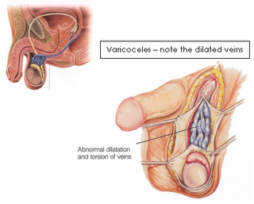
Varicocele
A dilation of the pampiniform venous plexus within the scrotum
Affects ~15%–20% of healthy fertile males
Much more common (approximately 80%–90%) in the left testicle than in the right
Usually asymptomatic but may present as scrotal pain or heaviness
Notes:
A varicocele is a dilatation of the pampiniform venous plexus within the scrotum. Approximately 15%–20% of the healthy fertile male population is estimated to have varicoceles; however, 40% of infertile men may have them. How a varicocele impairs sperm structure, function, and production is unknown, but researchers believe it interferes with testicular thermoregulation.

Slide 43
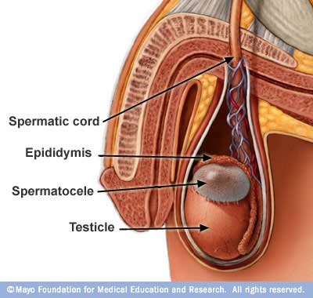
Spermatocele
Benign cystic accumulation of sperm from the head of the epididymis
Presents as small, freely movable, and (usually) painless
Typically from the head of the testicle on the superior aspect
Notes:
A spermatocele typically refers to a benign cystic accumulation of sperm that arises from the head of the epididymis. Within the current literature, such collections have been described in myriad locations, ranging from the testicle itself to locations along the course of the vas deferens. Nevertheless, in common usage, spermatoceles are intrascrotal, paratesticular cystic collections of sperm that arise from the epididymis.
Typically identified as smooth, soft, and well-circumscribed, spermatoceles are broadly described as scrotal masses.
Spermatoceles typically arise from the caput (head) of the epididymis, which is located on the superior aspect of the testicle. Conversely, hydroceles are fluid collections that cover the anterior and lateral surfaces of the testicle. A varicocele is a dilated plexus of veins along the spermatic cord. A hernia results from persistent patency of the processus vaginalis allowing intra-abdominal contents to pass into the abnormal intrascrotal peritoneal extension. In contrast to spermatoceles, both varicoceles and hernias may enlarge with the increased intra-abdominal pressure generated during Valsalva. Epididymal cysts are often grouped with spermatoceles, and the two may be impossible to differentiate based on gross anatomy. In contrast to the epididymal cyst, spermatocele fluid typically contains sperm.

Slide 44
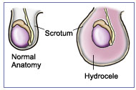
Hydrocele
Caused by a defect or irritation in the tunica vaginalis
Presents: soft, painless, fluid anterior mass
Incidence: 0.5%-1% of males

Slide 45
Testicular Cancer
Most common cancer in men between 15-34
Frequently presents as a circumscribed, non-tender mass within the testis
Patients can present with a feeling of heaviness in the scrotum
Majority of cases are asymptomatic
NOT RECOMMENDED TO:
  Routinely counsel about testicular self-exam for cancer
  Routinely examine testicles for cancer for asymptomatic patients, may cause harm
USPSTF, 2011
American Cancer Society, 2011
Notes:
Teaching Testicular Self Exam: Not recommended to routinely counsel about testicular self exam for cancer for male adolescents and adults and may cause harm. There is also no evidence that teaching young men how to examine themselves for testicular cancer would improve health outcomes, even among men at high risk, including men with a history of undescended testes or testicular atrophy.
Testicular Cancer Screen (Physical Exam): Not recommended to routinely examine testicles for testicular cancer for asymptomatic
male adolescents and adults and may cause harm. However, clinicians should be
aware that patients who present with symptoms of testicular cancer are frequently
misdiagnosed as having other genital complaints, such as epididymitis, testicular
trauma, hydrocele or other benign disorders. Refer to physical examination
for recommendations about male genital exam.
Sources:
1) U.S. Preventive Services Task Force. Screening for
testicular cancer: U.S. Preventive Services Task Force
reaffirmation recommendation statement. Ann Intern
Med 2011 Apr 5;154(7):483-486.
2) American Cancer Society. Detailed guide: Testicular
cancer: Can testicular cancer be found early?:
American Cancer Society; http://www.cancer.org/
Cancer/TesticularCancer/DetailedGuide/; 2011.

Slide 46
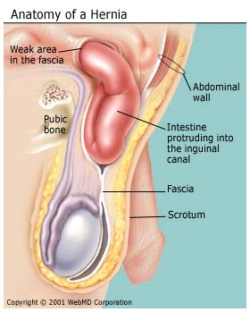
Hernia
Sac-like protrusion of intestine through the inguinal ring into the scrotum
Incidence ~1% in teenage boys
Reduces when patient is in the supine position and will not descend with traction
NO EVIDENCE to support
routine screening for hernia
unless clinically indicated
Marcell, A.V. and the Male Training Center for Family Planning and Reproductive Health. 2014.
Notes:
No evidence to support routine screening for hernia unless clinically indicated. Evidence
does not exist that reviews the harms and benefits to routinely screen for hernia.
Source: Marcell, A.V. and the Male Training Center for Family Planning and Reproductive Health. Preventive Male Sexual
and Reproductive Health Care: Recommendations for Clinical Practice. Philadelphia, PA: Male Training Center for Family Planning and
Reproductive Health and Rockville, MD: Office of Population Affairs; 2014.

Slide 47
Case: Eric
Case: Eric
You tell Eric that you will need to perform a physical exam to discern the cause of his swelling.

Slide 48
Performing a Male Genital Exam

Slide 49
Male Genital Exam
Warm hands first
Make sure there is enough light
Wear gloves
Examine patient while he is standing up to ensure detection of possible varicocele or hernia

Slide 50
Inspection: Pubic Hair
Tanner stage
Molluscum
Scabies
Lice and Crabs
Condyloma acuminata

Slide 51
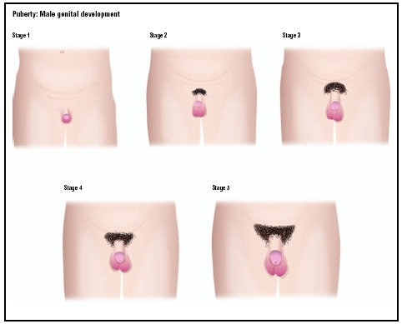
Inspection: Pubic Hair
Tanner Stage

Slide 52
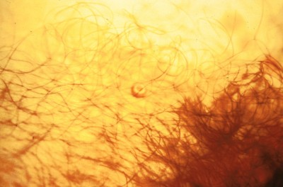
Inspection: Pubic Hair
Molluscum Contagiosum
Notes:
Molluscum contagiosum is a viral skin infection that causes raised, pearl-like papules or nodules on the skin.
Molluscum contagiosum is caused by a virus that is a member of the poxvirus family. It is contracted in a number of different ways.
It can occur after direct contact with a lesion. It is frequently seen on the face, neck, armpit, arms, and hands but may occur anywhere on the body except the palms and soles. The virus can spread through contact with contaminated objects, such as towels, clothing, or toys.
The virus also spreads by sexual contact. Early lesions on the genitalia may be mistaken for herpes or warts but, unlike herpes, these lesions are painless. Persons with a weakened immune system may have a rapidly worse case of molluscum contagiosum.
Typically, the lesion of molluscum begins as a small, painless papule that may become raised up to a pearly, flesh-colored nodule. The papule often has a dimple in the center. These papules may occur in lines, where the person has scratched. Scratching or other irritation causes the virus to spread in a line or in groups, called crops.
The papules are about 2–5 millimeters wide. There is usually no inflammation and subsequently no redness unless you have been digging or scratching at the lesions.
The skin lesion commonly has a central core or plug of white, cheesy, or waxy material.
In adults, the lesions are commonly seen on the genitals, abdomen, and inner thigh.
Diagnosis is based on the appearance of the lesion and can be confirmed by a skin biopsy. The health care provider should examine the lesion to rule out other disorders and to determine other underlying disorders.
TREATMENT: Self-limited so unless widespread we observe mostly for resolution.
http://www.uptodate.com/contents/molluscum-contagiosum/abstract/31-33

Slide 53
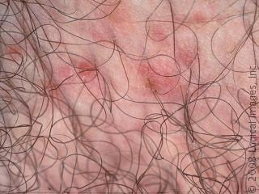
Inspection: Pubic Hair
Scabies
Notes:
Human scabies is caused by an infestation of the skin by the human itch mite (Sarcoptes scabiei var. hominis). The microscopic scabies mite burrows into the upper layer of the skin where it lives and lays its eggs. The most common symptoms of scabies are intense itching and a pimple-like skin rash. The scabies mite usually is spread by direct, prolonged, skin-to-skin contact with a person who has scabies.
Scabies occurs worldwide and affects people of all races and social classes. Scabies can spread rapidly under crowded conditions where close body contact is frequent. Institutions such as nursing homes, extended-care facilities, and prisons are often sites of scabies outbreaks.
Treatment: Permethrin 5% cream applied neck to the soles of the feet. Oral ivermectin can be used if there is a reason to not use topical therapy. All household contacts should be treated and underwear and bedclothes washed in hot water to prevent re-infection.

Slide 54
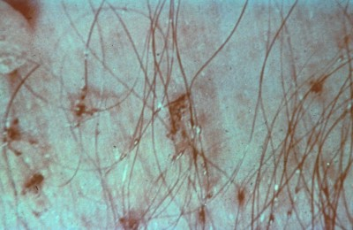
Inspection: Pubic Hair
Lice and Crabs
Notes:
Pubic Lice
Lice are parasitic insects that can be found on people's heads, and bodies, including the pubic area. Human lice survive by feeding on human blood. Lice found on each area of the body are different from each other. The three types of lice that live on humans are:
Pediculus humanus capitis (head louse),
Pediculus humanus corporis (body louse, clothes louse), and
Phthirus pubis ("crab" louse, pubic louse).
Only the body louse is known to spread disease.
Lice infestations are spread most commonly by close person-to-person contact. Dogs, cats, and other pets do not play a role in the transmission of human lice. Lice move by crawling; they cannot hop or fly. Both over-the-counter and prescription medications are available for treatment of lice infestations.
Pubic Crab Lice
Adult pubic lice are 1.1–1.8 mm in length. Pubic lice typically are found attached to hair in the pubic area but sometimes are found on coarse hair elsewhere on the body (for example, eyebrows, eyelashes, beard, mustache, chest, armpits, etc.).
Pubic lice infestations are usually spread through sexual contact. Dogs, cats, and other pets do not play a role in the transmission of human lice.
Both over-the-counter and prescription medications are available for treatment of pubic lice infestations.
Treatment: Pediculosis pubis is treated with topical pediculicides. Based upon safety and ease of use, we suggest treatment with topical permethrin 1% or a product containing pyrethrins with piperonyl butoxide Treatment should be repeated after 9 to 10 days if lice remain. Sexual partners should be treated simultaneously. Bedding and clothing should be laundered in hot water.

Slide 55
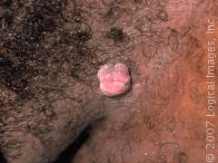
Inspection: Pubic Hair
Condyloma Acuminata
Notes:
Condyloma acuminatum refers to an epidermal manifestation attributed to the epidermotropic human papillomavirus (HPV). More than 100 types of double-stranded HPV papovavirus have been isolated to date. Many of these have been related directly to an increased neoplastic risk in men and women.
Approximately 90% of condyloma acuminata are related to HPV types 6 and 11. These two types are the least likely to have a neoplastic potential. Risk for neoplastic conversion has been determined to be moderate (types 33, 35, 39, 40, 43, 45, 51–56, 58) or high (types 16, 18), with many other isolated types. The picture is complicated by proven coexistence of many of these types in the same patient (10%–15% of patients), the lack of adequate information on the oncogenic potential of many other types, and ongoing identification of additional HPV-related clinical pathology
Treatment: The three major approaches to the treatment of condyloma acuminatum are chemical or physical destruction, immunologic therapy, and surgical therapy. The preferred approach depends upon the number and extent of the lesions. In general, all therapies for genital warts are somewhat unsatisfactory due to recurrence rates of 30 to 70 percent within six months of treatment. However, spontaneous regression is also possible, and has been reported to occur within three months in 20 to 30 percent of cases.
There is no evidence to suggest that one treatment is significantly superior to another or appropriate for all patients and all types of warts. If a clinician has trichloroacetic acid or podophyllin available in their office practice, then it would be most efficient for the clinician to provide an initial treatment of the warts at the diagnostic visit, and then to prescribe home treatments (imiquimod or podofilox) or examine the patient in follow-up to see how the initial treatment worked. For clinicians without trichloroacetic acid or podophyllin in their office, the patient could first try home treatments (imiquimod or podofilox). However, we suggest initially referring patients with very large condylomata (eg, 1 to 2 cm at the base) to a surgeon (gynecologist or anorectal surgeon) because surgical treatment is probably going to be needed.
http://www.uptodate.com/contents/condylomata-acuminata-anogenital-warts-in-adults/abstract/21
http://www.uptodate.com/contents/condylomata-acuminata-anogenital-warts-in-adults/abstract/19

Slide 56

Inspection: Groin
Hernia
Lymphadenopathy
Notes:
Source: Marcell, A.V. and the Male Training Center for Family Planning and Reproductive Health. Preventive Male Sexual
and Reproductive Health Care: Recommendations for Clinical Practice. Philadelphia, PA: Male Training Center for Family Planning and
Reproductive Health and Rockville, MD: Office of Population Affairs; 2014.

Slide 57


Inspection: Inner Thigh
Swelling
Fungal infection

Slide 58

Inspection: Prepuce
Phimosis
Notes:
Treatment is not always recommended any longer; info is at https://urology.ucsf.edu/patient-care/children/phimosis
Treatments for phimosis vary depending on the child and severity of phimosis. Treatments may include: gentle daily manual retraction, topical corticosteroid ointment application or circumcision
Congenital phimosis
Congenital phimosis is physiologic in young children.
It is entirely normal for young children, even into the teenage years, to have a congenital phimosis, which does not cause problems such as urinary obstruction, hematuria, or preputial pain.
Children with congenital phimosis may have a history of recent catheterization or of parents forcibly retracting the foreskin in an attempt to clean the glans.
Acquired phimosis
In acquired phimosis, there likely is a history of poor hygiene, chronic balanoposthitis, or forceful retraction of a congenital phimosis.
The physician must always obtain a historical description of the urinary stream. If it decreases, referral to an urologist is necessary for eventual circumcision.
In addition, the presence of hematuria or preputial pain is an important historical factor and may be an appropriate reason to refer the patient for circumcision.
Children with acquired phimosis have the usual history (as obtained in the adult) of poor hygiene and/or chronic balanoposthitis eventually leading to paraphimosis.
Paraphimosis
Pain and edema of the uncircumcised or improperly circumcised penis are characteristic.
Adults, especially the elderly population, may have a history of frequent catheterizations or of poor hygiene and/or chronic balanoposthitis leading to phimosis and eventual paraphimosis.
Vigorous sexual activity has been reported to predispose one to paraphimosis.
Pain with erection may occur.

Slide 59
Inspection: Glans
Redness
Ulcers
Discharge

Slide 60

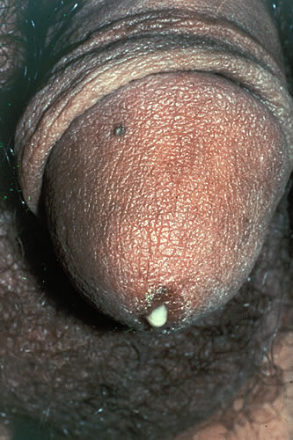

Inspection: Glans
Discharge
Balanitis
Contact dermatitis
Urethritis
Notes:
1) Balanitis is inflammation of the glans penis. Candida is one of many specific causes of balanitis. Balanitis involving the foreskin and prepuce is termed balanoposthitis. The most common complication of balanitis is phimosis, or inability to retract the foreskin from the glans penis.
**Uncircumcised men with poor personal hygiene are most affected by balanitis. Lack of aeration and irritation because of smegma and discharge surrounding the glans penis causes inflammation and edema. Adherence of the foreskin to the inflamed and edematous glans penis causes phimosis, which is the major presenting complication of balanitis seen in the ED.
2) Dermatitis is an inflammation of the skin. Contact dermatitis is a localized rash or irritation of the skin caused by contact with a foreign substance. Substances that cause contact dermatitis in many people include "poisonous" plants such as poison ivy, certain foods, some metals, cleaning solutions, detergents, cosmetics, perfumes, industrial chemicals, and latex rubber.
3) Urethritis:
Gonorrhea: Men with gonococcal urethritis may present with any combination of symptoms. In one study discharge was present in 82 percent of cases and dysuria in 53 percent. The discharge is often present spontaneously at the urethral meatus, purulent or mucopurulent in color, and copious in amount However, the discharge may also be indistinguishable on appearance from the more subtle manifestations that can be seen with nongonococcal urethritis.
Chlamydia: C. trachomatis is the most common cause of nongonococcal urethritis in men. The proportion of cases that are asymptomatic vary by population and range from 40 to 96 percent. When men do have symptoms, they typically present with a mucoid or watery urethral discharge, and dysuria is often a prominent complaint. The discharge is often clear and only seen upon milking the urethra. Sometimes the discharge is so scant that men only notice stained undergarments in the morning
Photo source: Seattle STD/HIV Prevention Training Center at the University of Washington: Connie Celum and Walter Stamm

Slide 61
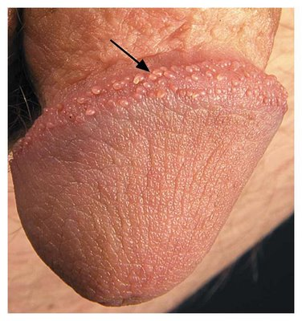
Inspection: Corona
Pearly Penile Papules
Notes:
Pearly penile papules are small dome-shaped to filiform skin-colored papules that typically are located on the sulcus or corona of the glans penis. Commonly, lesions are arranged circumferentially in one or several rows and often are assumed wrongly to be transmitted sexually.
These must be differentiated from condyloma to prevent treatment with irritating chemicals used to treat condylomata.

Slide 62
Inspection: Scrotum
Hydrocele
Infection
Hernia
Variocele
Scrotum
Atrophy
Tumor

Slide 63
The Genital Exam: Palpation
Testes
  Use thumb and first 1-2 fingers
  Note shape, size, tenderness, masses
  Adult: 4-5 cm long, 3 cm wide
  Left testis hangs lower

Slide 64
The Genital Exam: Palpation
Epidydimis
  Along posterior wall of testis
  Attaches at upper part and runs down back of testicle, becomes vas deferens
Vas Deferens
  Variocele, hydrocele
Inguinal Hernia Exam
  Place finger into the inguinal canal
  Have the patient valsalva to feel for intestine hitting finger

Slide 65
Case: Eric
During the genital exam, how do you determine the cause of Eric’s scrotal swelling?

Slide 66
Clinical Tool: Transillumination
Transillumination
  A light source is applied to one side of the scrotum
  If the mass transilluminates, it is filled with a clear serous-fluid

Slide 67
Clinical Tools
Ancillary tests
  Doppler stethoscope
  Technetium isotope
  Scrotal ultrasound
Notes:
Ancillary tests such as the Doppler stethoscope and technetium isotope study may aid in the diagnosis. Recently the scrotal ultrasound has been found to be an accurate way of confirming the presence of a varicocele. The size of the veins and abnormal blood flow can be seen and measured using the ultrasound.

Slide 68
Male Genital Exam: Scrotum
Varicocele | Hydrocele | Hernia | Tumor | Spermatocele
Does not transluminate | Can locate top in scrotum Covers the entire anterior surface of the testicle Transluminates | Cannot locate top in scrotum | Mass cannot be separated from the testicle Does not transluminate | Firm, palpable, separate from and superior to the testicle Transluminates

Slide 69
Case: Eric
You examined Eric and feel the spermatic cord
It feels like a bag of worms and, after coughing, the cord gets transiently engorged
You suspect varicocele. How would you definitively diagnose?
Notes:
The examination for varicocele initially should be performed with the patient standing. The scrotum is inspected for any visible distention around the spermatic cord. The scrotum, testes, and cord structures are then gently palpated; a palpable varicocele has the texture of a "bag of worms". Doppler ultrasonography would rule out other causes if suspected.

Slide 70
Case: Eric
What if Eric had reported swelling with accompanying pain?
What other conditions would you have to rule out?

Slide 71
Inspection: Testes
Epididymitis
Orchitis
Scrotal Swelling with Pain
Testicular Torsion
Injury

Slide 72
Symptoms and Other Findings | Torsion | Epididymitis
Cremasteric reflex | Usually absent | Usually present
Epididymal abnormality | Obscured and anterior | Palpable and tender
Pain Onset Prior Episodes | Sudden/abrupt 50% of cases | Hours to days Usually not
Position of affected testes | Long axis horizontal Elevated in scrotum | Normal
Prehn’s sign | Absent: No relief of or increase in pain with elevation of the scrotum | Present: Pain relief with elevation of the scrotum
Urethral Symptoms | Absent | May have dysuria or discharge
Urethral Gram Stain | Negative | May be positive
Urinalysis | Usually negative | First catch urine positive for white blood cells

Slide 73
Case: Eric
Case: Eric
Do you test Eric for sexually transmitted infections?

Slide 74
Considerations for STI Screening
Chlamydia | Screen at-risk males: Men who have sex with men (MSM); males in teen correctional facilities, high school & STD clinics; attending National Job Training Program; in military <30 years; entering jails <30 years; entering juvenile facilities; high-prevalence communities.
Gonorrhea | Screen at-risk males: MSM; persons reporting multiple or anonymous sex partners; engaging in sex and illicit drug use (e.g., methamphetamine).
Syphilis | Screen at-risk males: MSM; persons engaging in high-risk sexual behavior; commercial sex workers; persons who exchange sex for drugs; entering adult correctional facilities; high-prevalence communities.
Marcell, A.V. and the Male Training Center for Family Planning and Reproductive Health. 2014.
Notes:
Source: Marcell, A.V. and the Male Training Center for Family Planning and Reproductive Health. Preventive Male Sexual
and Reproductive Health Care: Recommendations for Clinical Practice. Philadelphia, PA: Male Training Center for Family Planning and
Reproductive Health and Rockville, MD: Office of Population Affairs; 2014.
Division of STD Prevention. Male Chlamydia Screening
Consultation. Atlanta, Georgia: National Center for
HIV/AIDS, Viral Hepatitis, STD and TB Prevention. U.S.
Centers for Disease Control and Prevention, 2006:
http://www.cdc.gov/std/chlamydia/.
Workowski KA, Berman S. Sexually transmitted
diseases treatment guidelines, 2010. MMWR Recomm
Rep 2010 Dec 17;59(RR-12):1-110.
U.S. Preventive Services Task Force. Screening for
Chlamydial infection: U.S. Preventive Services Task
Force recommendation statement. Ann Intern Med
2007;147(2):128-134.

Slide 75
Considerations for STI Screening
HIV/AIDS | Screen all clients aged 13-64 years & subsequently test high-risk individuals at least annually. High risk includes MSM; injection drug users & their sex partners; persons who exchange sex for money or drugs; sex partners of HIV-infected persons; persons who themselves or whose sex partners have had >1 sex partner since most recent HIV test.
Hepatitis C | Conduct one-time testing without prior ascertainment of HCV risk for persons born during 1945-1965, a population with a disproportionately high prevalence of HCV infection and related disease.
Marcell, A.V. and the Male Training Center for Family Planning and Reproductive Health. 2014.
Notes:
Source: Marcell, A.V. and the Male Training Center for Family Planning and Reproductive Health. Preventive Male Sexual
and Reproductive Health Care: Recommendations for Clinical Practice. Philadelphia, PA: Male Training Center for Family Planning and
Reproductive Health and Rockville, MD: Office of Population Affairs; 2014.
Screen for HIV infection all clients aged 13-64 years and all persons at high risk for
HIV should be re-screened at least annually. Persons likely to be at high
risk include MSM; injection drug users and their sex partners; persons who exchange
sex for money or drugs; sex partners of HIV-infected persons; and MSM or heterosexual
persons who themselves or whose sex partners have had more than one sex partner
since their most recent HIV test.
• CDC recommends that screening be provided after the patient is notified that testing
will be performed as part of general medical consent unless the patient declines
(opt-out screening).
Workowski KA, Berman S. Sexually transmitted
diseases treatment guidelines, 2010. MMWR Recomm
Rep 2010 Dec 17;59(RR-12):1-110.
Qaseem A, Snow V, Shekelle P, et al. Screening for HIV
in health care settings: A guidance statement from the
American College of Physicians and HIV Medicine
Association. Ann Intern Med 2009 Jan 20;150(2):
125-131.
Recommendations for the identification of chronic
hepatitis C virus infection among persons born during
1945-1965. MMWR Recomm Rep 2012 Aug
17;61(RR-4):1-32.
Moyer VA, U.S. Preventive Services Task Force.
Screening for Hepatitis C virus infection in adults:
U.S. Preventive Services Task Force recommendation
statement. Ann Intern Med. 2013 June 25

Slide 76
Case: Eric
Case: Eric
If Eric had reported oral or anal sex with another man, would you test for rectal or pharyngeal chlamydia and gonorrhea infection?

Slide 77
Chlamydia Testing for MSM under 25
Screen for urethral/rectal infection in males who in the past year have had:
  Insertive anal intercourse
  Receptive anal intercourse (NAAT of a rectal swab preferred)
Urine based NAAT is preferred
Re-screen for reinfection at 3 months
Screening for pharyngeal infection
NOT RECOMMENDED
Marcell, A.V. and the Male Training Center for Family Planning and Reproductive Health. 2014.
Notes:
Source: Marcell, A.V. and the Male Training Center for Family Planning and Reproductive Health. Preventive Male Sexual
and Reproductive Health Care: Recommendations for Clinical Practice. Philadelphia, PA: Male Training Center for Family Planning and
Reproductive Health and Rockville, MD: Office of Population Affairs; 2014.
U.S. Preventive Services Task Force. Screening for
Chlamydial infection: U.S. Preventive Services Task
Force recommendation statement. Ann Intern Med
2007;147(2):128-134.
Division of STD Prevention. Male Chlamydia Screening
Consultation. Atlanta, Georgia: National Center for
HIV/AIDS, Viral Hepatitis, STD and TB Prevention. U.S.
Centers for Disease Control and Prevention, 2006:
http://www.cdc.gov/std/chlamydia/.
74. Burstein GR, Eliscu A, Ford K, et al. Expedited partner
therapy for adolescents diagnosed with chlamydia or
gonorrhea: a position paper of the Society for
Adolescent Medicine. J Adolesc Health 2009
Sep;45(3):303-309.
U.S. Preventive Services Task Force. Scree

Slide 78
Gonorrhea Testing for MSM
Screen for urethral/rectal infection in sexually active MSM at least annually who have had:
  Insertive anal intercourse
  Receptive anal intercourse (NAAT rectal swab preferred)
Screen for pharyngeal infection in males who in past year have had:
  Receptive oral intercourse (NAAT preferred)
Urine based NAAT is preferred
Re-screen for reinfection at 3 months
More frequent screening for MSM w/multiple or anonymous partners/illicit drug use
Marcell, A.V. and the Male Training Center for Family Planning and Reproductive Health. 2014.
Notes:
More frequent screening refers to at 3-6 month intervals.

Slide 79
Treatment for Uncomplicated Gonococcal Infections of the Cervix, Urethra, and Rectum
Recommended
Ceftriaxone | 250 mg | IM | Once
PLUS
Azithromycin | 1 g | Orally | Once
OR
Doxycycline | 100 mg | Orally | Twice a day for 7 days
Quinolones are no longer recommended in the United States for the treatment of gonorrhea and associated conditions, such as PID
www.cdc.gov/mmwr/preview/mmwrhtml/mm6131a3.htm?s_cid=mm6131a3_w
Notes:
CDC now recommends treatment with TWO antibiotics rather than one. So the current recommendation for treatment of uncomplicated gonorrhea in the cervix, urethra, and rectum is ceftriaxone 250 mg (up from 125 mg) AND either azithromycin 1 gram or doxycycline 100 mg twice daily for 7 days. The azithro or doxy is not to treat an undiagnosed chlamydia infection, but CDC now recommends two antibiotics for enhanced synergy and decreased likelihood of a strain resistant to this antibiotic combination.

Slide 80
Treatment for Uncomplicated Gonococcal Infections of the Cervix, Urethra, and Rectum
Alternative 1: If Ceftriaxone is not available
Cefixime | 400 mg | Orally | Once
PLUS
Azithromycin | 1 g | Orally | Once
OR
Doxycycline | 100 mg | Orally | Twice a day for 7 days
PLUS
Test of cure in 1 week
www.cdc.gov/mmwr/preview/mmwrhtml/mm6131a3.htm?s_cid=mm6131a3_w
Notes:
Some offices do not provide IM infections or cannot bring patients back for treatment in a timely manor. In those cases, an alternative regimen can be used with just oral antibiotics that consists of cefixime orally PLUS either azithromycin or doxycycline, but to ensure a cure, providers should perform a test of cure 1 week after treatment is complete. The test of cure should preferably be a culture so that antibiotic susceptibility testing can be done. But if culture is not available, providers can use a NAAT. Although for chlamydia, it can take three weeks for the DNA or RNA to clear, for gonorrhea, studies show that the DNA or RNA clears by five days after treatment. So, a NAAT can be performed in a week.

Slide 81
Gonorrhea Treatment Options for Pharynx
Ceftriaxone 250 mg in a single intramuscular dose
Azithromycin 1 g orally in a single dose
OR
Doxycycline 100 mg daily
for 7 days
PLUS
As of 2007, quinolones are no longer recommended in the U.S. for treatment of gonorrhea and associated conditions.
Notes:
Treatment for the uncomplicated gonorrhea infection of the pharynx
Centers for Disease Control and Prevention. Sexually Transmitted Diseases Treatment Guidelines, 2010. MMWR 2010;59(12):1–116
http://www.cdc.gov/std/treatment/2010/gonococcal-infections.htm

Slide 82

Chlamydia Treatment
Recommended Regimens
  Azithromycin 1 g PO single dose
  Doxycycline 100 mg PO BID x 7 days
CDC STD Treatment Guidelines. 2010.
Notes:
Source:
Centers for Disease Control and Prevention. Sexually Transmitted Diseases Treatment Guidelines, 2010. MMWR 2010;59(12):1–116
Alternative Regimens:
Erythromycin base 500 mg PO QID x 7 days
Erythromycin ethylsuccinate 800 mg PO QID x 7 days
Levofloxacin 500 mg PO OD x 7 days
Ofloxacin 300 mg PO BID x 7days

Slide 83

Case: Eric
What other STI screening or immunizations would you consider?

Slide 84
Immunizations
Human papillomavirus (HPV4) vaccination
  Routine: ages 11-12; Catch up: ages 13-21; Special populations: ages 22-26; ages 9-10 can be vaccinated
Hepatitis B vaccination (HBV) among persons aged <19 years and for all adults who are at risk or who request vaccination.
  Young MSM may require more thorough evaluation
Hepatitis A (HAV) among persons at risk
Marcell, A.V. and the Male Training Center for Family Planning and Reproductive Health. 2014.
Notes:
Source: CDC. Recommendations on the Use of Quadrivalent Human Papillomavirus Vaccine in Males—Advisory Committee on Immunization Practices (ACIP), 2011. MMWR 60(50);1705–1708
Recommended for all MSM and immunocompromised ♂
Permissive recommendation for 22–26 y/o ♂ without risk factors
At risk defined as at risk for infection by sexual exposure including MSM;
injection-drug users; household contacts of persons with chronic HBV infection;
developmentally disabled persons in long-term care facilities; persons at risk for
occupational exposure to HBV; hemodialysis patients; persons with chronic liver
disease; travelers to HBV-endemic regions; and HIV-positive persons.
A risk for HAV defined by MSM; users of injection and
non-injection drugs; persons who have occupational risk for infection; persons with
clotting-factor disorders; vaccination of persons with chronic liver disease; Hepatitis A
vaccination during outbreaks; and persons traveling to or working in countries that
have high or intermediate endemicity of infection.

Slide 85
Recommendations AGAINST Routine Screening
Not recommended to routinely screen in males who are at low risk for infection/asymptomatic:
  Gonorrhea
  Syphilis
  Herpes Simplex
  Hepatitis B
  Hepatitis C
Notes:
Source: Marcell, A.V. and the Male Training Center for Family Planning and Reproductive Health. Preventive Male Sexual
and Reproductive Health Care: Recommendations for Clinical Practice. Philadelphia, PA: Male Training Center for Family Planning and
Reproductive Health and Rockville, MD: Office of Population Affairs; 2014.

Slide 86
Case: Eric
You tell Eric that his test results should be available in 2–3 days and provide him with a referral for treatment of the varicocele (if needed)
Give him a supply of condoms and discuss proper use.
Make a follow-up appointment to receive test results and for post-HIV test counseling.

Slide 87
Summary
Young males often do not receive the reproductive care they need.
To become more male-friendly, providers and staff must assess preconceived notions about adolescent males.
Comprehensive care includes
  Counseling
  Preventive health care
  Clinical diagnosis and treatment

Slide 88
Provider Resources and Organizational Partners
www.advocatesforyouth.org—Advocates for Youth
www.aap.org—American Academy of Pediatricians
www.aclu.org/reproductive-freedom American Civil Liberties Union Reproductive Freedom Project
www.acog.org—American College of Obstetricians and Gynecologists
www.arhp.org—Association of Reproductive Health Professionals
www.cahl.org—Center for Adolescent Health and the Law
www.glma.org Gay and Lesbian Medical Association

Slide 89
Provider Resources and Organizational Partners
www.guttmacher.org—Guttmacher Institute
janefondacenter.emory.edu Jane Fonda Center at Emory University
www.msm.edu Morehouse School of Medicine
www.prochoiceny.org/projects-campaigns/torch.shtml NARAL Pro-Choice New York Teen Outreach Reproductive Challenge (TORCH)
www.naspag.org North American Society of Pediatric and Adolescent Gynecology
www.prh.org—Physicians for Reproductive Health

Slide 90
Provider Resources and Organizational Partners
www.siecus.org—Sexuality Information and Education Council of the United States
www.adolescenthealth.org—Society for Adolescent Health and Medicine
www.plannedparenthood.org Planned Parenthood Federation of America
www.reproductiveaccess.org Reproductive Health Access Project
www.spence-chapin.org Spence-Chapin Adoption Services

