Slide 1

Human Papillomavirus and Adolescents
Notes:
ARSHEP would like to thank and acknowledge the following faculty members for assistance in developing this slide set:
Allison Eliscu, MD, FAAP
Assistant Professor of Pediatrics
Head of Adolescent Medicine Division
Stony Brook Children’s Hospital
Alexandra Sasha Carey, MD
Adolescent Medicine
Rockwood Pediatrics
Spokane, WA

Slide 2
Objectives
Describe the extent of HPV infection in adolescents
Discuss clinical presentations of HPV
Explain how to diagnose and manage HPV infection
Understand how to prevent HPV infections
Review proven efficacy and safety of HPV vaccines and general recommendations for adolescent vaccination

Slide 3

Case: Jenna
Jenna is 15-year-old female who presents with a bump on her vagina.
She has been sexually active for six months and has only had one partner.
What is your differential diagnosis?

Slide 4
Differential Diagnosis
Chancroid
(H. ducreyi)
Folliculitis
External Genital Warts
Genital Bump
Molluscum Contagiosum

Slide 5
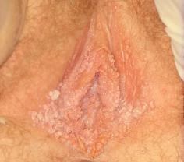
Physical Examination
You perform an exam of the external genitalia and find small, firm, painless bumps
No other abnormal findings found during pelvic and speculum exam and discharge is not present

Slide 6
Differential Diagnosis
Chancroid
(H. ducreyi)
Chancroid is painful with tender lymphadenopathy
Folliculitis
Skin tag
Vestibular papillae
Flat, papular, pedunculated growths
Dermatologic Conditions
External Genital Warts (HPV)
Flesh Colored Papular Painless Lesion
Moist, wart-like papules from syphilis infection
Discrete pearly firm papules with central umbulication
Condyloma Lata
Molluscum Contagiosum

Slide 7
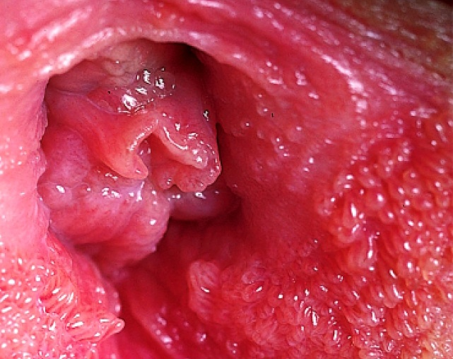
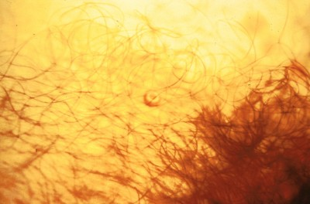

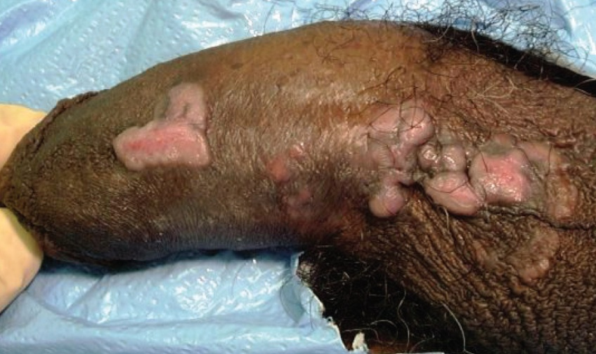
Differential Diagnosis
Vestibular Papillae
Molluscum Contagiosum
Condyloma Lata
Notes:
Vestibular papillae: http://hymen.pro/Sallie_Neill_Fiona_Lewis_Ridleys_The_Vulva_page_39_vestibular_papillomatosis.jpg
Molluscum contagiosum: http://www.cdc.gov/std/training/clinicalslides/
Condyloma lata: http://www.cdc.gov/std/training/picturecards.htm

Slide 8
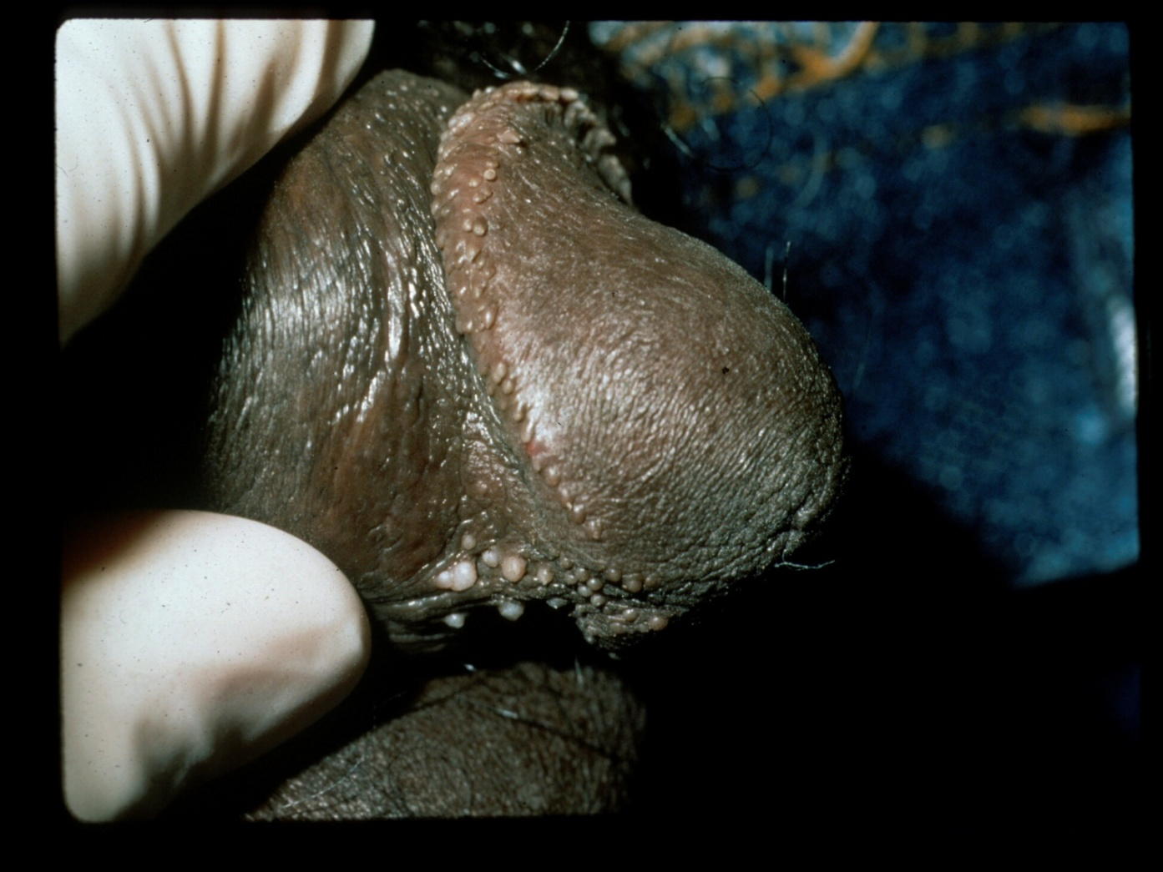
Differential Diagnosis: Pearly Penile Papules
Handsfield HH. Color atlas and synopsis of sexually transmitted diseases, 2nd ed. New York: McGraw-Hill, 2000:206.

Slide 9
Human Papillomavirus (HPV)
A member of a group of viruses in the genus Papillomavirus
Of the 100 strains, more than 40 are sexually transmitted and infect the genital area of males and females
Strains are classified as:
  High-risk (oncogenic)
  (16, 18, 31, 33, 35, 39, 45,
  51, 52, 56, 58, 59, 68)
  Low-risk (non-oncogenic)
  (6, 11, 40, 42, 43, 44, 53, 54,
  61, 72, 73 and 81)
Notes:
Sources:
Ho GYF, Bierman R, Beardsley L, Chang CJ, Burk RD. Natural history of cervicovaginal papilloma virus infection in young women. New England Journal of Medicine 1998;338:423–8.
Koutsky LA, Kiviat NB. Genital human papillomavirus. In: K. Holmes, P. Sparling, P. Mardh et al (eds). Sexually Transmitted Diseases, 3rd edition. New York: McGraw-Hill, 1999, p. 347–359.
Kiviat NB, Koutsky LA, Paavonen J. Cervical neoplasia and other STD-related genital tract neoplasias. In: K. Holmes, P. Sparling, P. Mardh et al (eds). Sexually Transmitted Diseases, 3rd edition. New York: McGraw-Hill, 1999, p. 811–831.
http://www.cdc.gov/std/HPV/STDFact-HPV.htm#common

Slide 10
HPV Incidence and Prevalence
Highest incident STI in the U.S.
Approximate prevalence in adolescents and young adults is 9.2 million
By age 50, at least 80% of females will have acquired genital HPV infection
Notes:
Assessing the extent of genital HPV infection in the U.S. is difficult because HPV does not grow in tissue culture; closely related types cause different diseases; and most infections are asymptomatic/subclinical.
No surveillance system exists, and no large population-based prevalence surveys have been feasible.
Current knowledge of HPV prevalence is based on measuring the viral DNA in genital epithelial cells.
However, HPV DNA detection is limited by sampling methodology and reflects only current status; HPV DNA becomes undetectable within two years in most women.
Limited data because HPV infection not reportable.
Sources:
Weinstock H, Berman S, Cates Willard. Sexually Transmitted Diseases Among American Youth: Incidence and Prevalence Estimates, 2000. Perspectives on Sexual and Reproductive Health 2004;36:6–10.
Koutsky LA, Kiviat NB. Genital human papillomavirus. In: K. Holmes, P. Sparling, P. Mardh et al (eds). Sexually Transmitted Diseases, 3rd edition. New York: McGraw-Hill, 1999, p. 347–359.

Slide 11
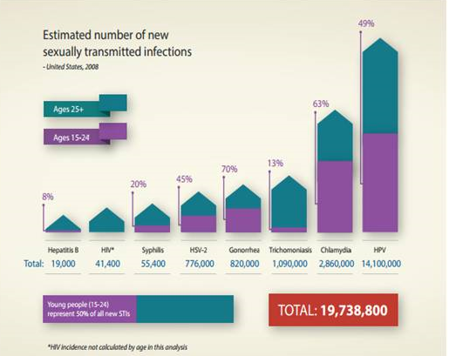
Half of New STIs: Ages 15-24
Notes:
http://www.cdc.gov/std/stats/STI-Estimates-Fact-Sheet-Feb-2013.pdf
While the consequences of untreated STIs are often worse for young women, the new analysis reveals that the annual
number of new infections is roughly equal among young women and young men (49 percent of incident STIs occurs among
young men, vs. 51 percent among young women).
**HIV incidence not calculated by age in the analysis
CDC estimates that HPV accounts for the majority of newly acquired STIs. While the vast majority (90 percent) of HPV
infections will go away on their own within two years and cause no harm, some of these infections will take hold and
potentially lead to serious disease, including cervical cancer

Slide 12
HPV Prevalence:
Females Aged 14–59 Years
Prevalence, %
60
Low-risk HPV*
50
High-risk HPV*
40
30
20
10
0
14–19
20–24
25–29
30–39
40–49
50–59
NOTE: Error bars indicate 95% confidence intervals. Both high-risk and low-risk HPV types were detected in some females.
Age
From the National Health and Nutrition Examination Survey (NHANES)
2003–2006
Notes:
This chart looks at HPV Prevalence among low-risk and high-risk strains for females aged 14–59.
From ages 14–24, high-risk HPV is more prevalent, and then from ages 25–59 it reverses where low-risk HPV is more prevalent.
Source:
Hariri S, Unger ER, Sternberg M, Dunne EF, Swan D, Patel S, et al. Prevalence of genital HPV among females in the United States, the National Health and Nutrition Examination Survey, 2003–2006.
J Infect Dis. 2011;204(4):566–73
Taken from the National Health and Nutrition Examination Survey, 2003–2006

Slide 13
Genital HPV Prevalence Rates in Males
(%)
years
Giuliano AR et al. J Infect Dis. 2008;198:827–835.
Notes:
18–20, low-risk HPV more prevalent in males, 21–40, high-risk HPV more prevalent, and from ages 41–44 low-risk HPV is more prevalent.
Males aged 18–44 years in Tucson, Arizona (N = 290).
High-risk/oncogenic HPV types included 16, 18, 31, 33, 35, 39, 45, 51, 52, 56, 58, 59, 66. Low-risk/non-oncogenic HPV types included 6, 11, 26, 40, 42, 53, 54, 55,62, 64, 67–73, 81–84, IS39, CP6108.

Slide 14
How Often Is Genital Warts
Diagnosed at the Doctor’s Office?
Visits (in thousands)
500
400
300
200
100
0
1966
1969
1972
1975
1978
1981
1984
1987
1990
1993
1996
1999
2002
2005
2008
Year
NOTE: The relative standard errors for genital warts estimates of more than 100,000 range from 18% to 30%.
Source: IMS Health, Integrated Promotional Services™. IMS Health Report, 1966–2010.
Notes:
Spike in 1987, dip in 1997 and increase again in 2005, appears to be on the rise again from 2010 on….
Genital Warts—Initial Visits to Physicians’ Offices, United States, 1966–2010

Slide 15

Age-Specific Anal Canal HPV Prevalence
Among Men Having Sex with Women
Perianal and possibly anal HPV may be caused by:
Autoinoculation
Sexual activity other than insertive anal sex
Spread from a nearby genital infection site
Nyitray AG, et al. J Infect Dis. 2010;201:1498–1508
Notes:
15
Figure. Age–specific prevalence of human papillomavirus in the anal canal of men having sex with women (n = 902):
Results
Overall prevalence of HPV on penis or scrotum is 51%
Overall prevalence of HPV in anal canal is 12%
902 Men
433 (48%) have had anal sex with males or females
94 (10%) have had anal or oral sex with a male
Nyitray AG, et al. J Infect Dis. 2010;201:1498–1508

Slide 16
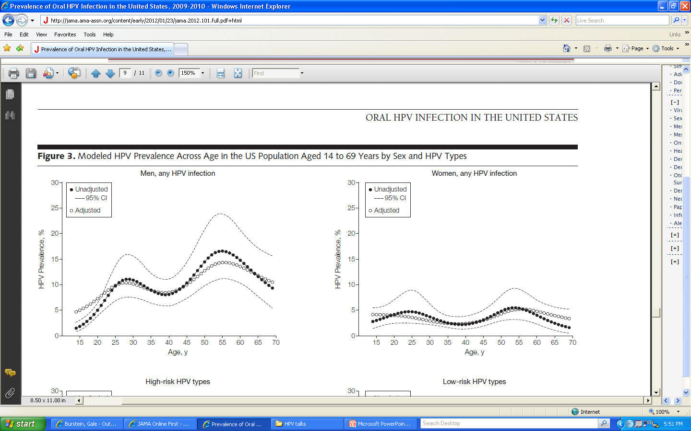
Prevalence of Oral HPV Infection:
NHANES Data
Prevalence 10.1%
Prevalence 3.6%
Gillison ML, et al. JAMA. 2012;307(7):doi:10.1001/jama.2012.101
Notes:
Males have higher rates than females
Bimodal pattern (30–34 yo and 60–64 yo peaks)
NHANES = National Health and Nutrition Examination Survey, conducted by the National Center for Health Statistics (NCHS) to assess the health and nutritional status of adults and children in the United States, and to track changes over time. The survey combines interviews and physical examinations.
Models adjusted for sex, race, smoking, marital status, and lifetime number of sex partners.

Slide 17
HPV Clinical Manifestations
Majority are subclinical
Low-Risk Types
High-Risk Types
Manifestations depend on oncogenic potential
Genital Warts
Low-grade squamous
and glandular intraepithelial
lesions
High-grade squamous
and glandular intraepithelial
lesions
Notes:
Today’s presentation will focus primarily on the low risk types and genital warts/HPV vaccine. We will not be talking about Oral HPV or the types of HPV strains (high risk) that may cause cervical cancer.

Slide 18
Genital Warts Appearance
Condyloma acuminata
Cauliflower-shaped, flesh-colored, pink, or hyperpigmented
Smooth papules
Usually dome-shaped and skin colored
Keratotic warts
Thick, horny layer that can resemble common warts
Flat papules
Macular to slightly raised, flesh-colored, with smooth surface
Notes:
Condyloma acuminata may be keratotic on skin but generally non-keratinized when present on mucosal surfaces

Slide 19
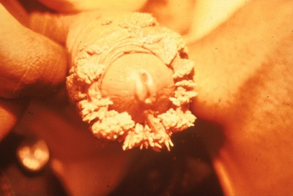
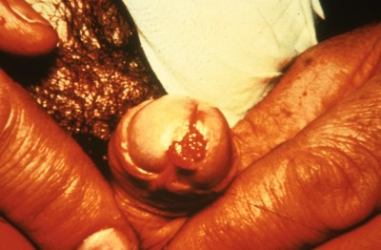
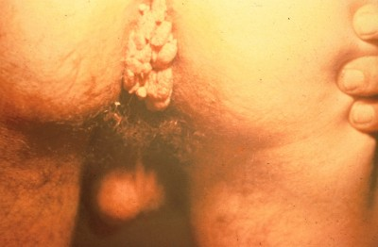
Genital Warts Sites of Infection
Penis
Scrotum
Urethral Meatus
Perianal
Glans
Meatus
Perianal
Notes:
Genital warts most commonly occur in areas of coital friction. In males they most commonly occur in the sites listed above.
Can also occur in other areas of genitals.
**Perianal warts do not necessarily imply anal intercourse, may be due to autoinoculation, anal touching, or spread from nearby genital wart site**
HPV types causing anogenital warts can occasionally cause lesions on oral, upper respiratory, upper GI, and ocular GI locations.

Slide 20
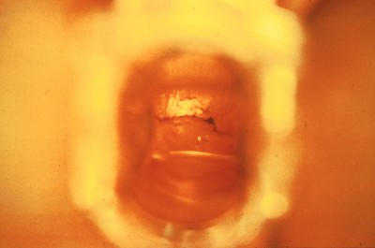
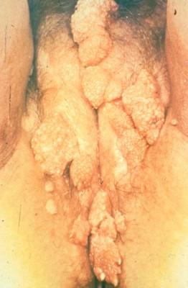
Genital Warts Sites of Infection
Introitus
Vulva
Perineum
Anus
Labia
Vaginal wall
(Vaginal and cervical lesions
are less common)
Notes:
Genital warts most commonly occur in areas of coital friction. Cervical and vaginal condylomata are less common than external warts. HPV types causing anogenital warts can occasionally cause lesions on oral, upper respiratory, upper GI, and ocular GI locations.

Slide 21
Genital Warts Symptoms
Vulvar
Dyspareunia, pruritus, burning
Penile
Occasional itching
Urethral meatal
Hematuria or difficulty urinating
Vaginal
Discharge, bleeding
Perianal
Pain, bleeding, itching
Cervical
• Irregular or postcoital bleeding
Notes:
Genital warts are usually asymptomatic. Symptoms may develop depending on size and location of warts
Sources:
Kiviat NB, Koutsky LA, Paavonen J. Cervical neoplasia and other STD-related genital tract neoplasias. In: K. Holmes, P. Sparling, P. Mardh et al (eds). Sexually Transmitted Diseases, 3rd edition. New York: McGraw-Hill, 1999, p. 811–831.
Ho GYF, Bierman R, Beardsley L, Chang CJ, Burk RD. Natural history of cervicovaginal papilloma virus infection in young women. New England Journal of Medicine 1998;338:423–8.

Slide 22
Case: Jenna
You think that Jenna has external genital warts. Is there a confirmatory test to make the diagnosis?

Slide 23
External Genital Warts: Diagnosis
Clinical diagnosis by visual inspection
Acetic acid application NOT recommended (low specificity)
Type-specific HPV DNA tests NOT recommended
Notes:
Acetic acid application NOT recommended (low specificity)—many false positives and false negatives. Other lesions that may turn white include vulvovaginitis, herpes, eczema.

Slide 24
External Genital Warts: Diagnosis
Consider biopsy for warts if:
  Atypical appearance
  Unresponsive or worsen with standard therapy
  Persistent ulceration or bleeding
  Irregular pigmentation
Notes:
atypical appearance, those that are unresponsive or worsen with standard therapy, or lesions that appear ulcerated or pigmented that raise suspicion for malignancy.

Slide 25
Should You Perform a Pap Smear?
 | <21 years old | 21–29 years old | 30–65 years old | >65 years old | Prior HPV Vaccine
USPSTF | Not Recommended | Pap every 3 years | Pap 3 yrs OR Pap + HPV 5 yrs | Not Recommended if low risk | Continue Regular Screening
ACS, ASCCP, ASCP | Not Recommended | Pap every 3 years | Pap + HPV 5 yrs OR Pap 3 yrs | Not Recommended | No Change
ACOG | Not Recommended | Pap every 2 years | Pap 3 yrs, cotest w/ HPV acceptable | Stop Paps at 65–70 yo | No Change
Notes:
No need for more frequent or earlier screening if external genital warts are present
ACOG: High-risk women should be screened more frequently
High-risk women include: HIV positive, immunosuppressed, exposed to diethylstilbestrol (DES) in utero, have been treated for cervical intraepithelial neoplasia (CIN) 2, CIN 3, or cervical cancer
ACOG now recommends (updated Nov 2009) that women begin screening at 21 years of age. Women ages 21–30 should be screened every two years instead of annually, using either the standard Pap or liquid-based cytology. Sexually active adolescents under 21 should be counseled and tested for sexually transmitted infections, with additional counseling regarding safer sex and contraception. These measures may be carried out without a Pap test.
Women age 30 and older who have had three consecutive negative cervical cytology test results may be screened once every three years with either the Pap or liquid-based cytology.
Moving the baseline cervical screening to age 21 is a conservative approach to avoid unnecessary treatment of adolescents which can have economic, emotional, and future childbearing implications. ACOG previously recommended that cervical screening begin three years after first sexual intercourse or by age 21, whichever occurred first. Although the rate of HPV infection is high among sexually active adolescents, invasive cervical cancer is very rare in women under age 21. The immune system clears the HPV infection within one to two years among most adolescent women. Because the adolescent cervix is immature, there is a higher incidence of HPV-related precancerous lesions (called dysplasia). However, the large majority of cervical dysplasias in adolescents resolve on their own without treatment.
Source:
ACOG Practice Bulletin No. 109: Cervical cytology screening. ACOG Committee on Practice Bulletins--Gynecology. Obstet Gynecol. 2009;114:1409–1420.

Slide 26
Natural History of HPV Infection
Most infections subclinical with no clinical consequences
Incubation period is variable
  Weeks-to-months for genital warts
  Months-to-years for cellular changes
Most infections are transient and self-resolve
Notes:
Most cases of cervical cancer detected in females who had never been screened before or had not been screened within 5 years

Slide 27
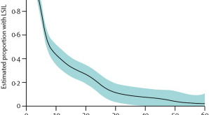
Time to Regression in Adolescent
Females with LGSIL
Median time to regression 8 months
61% regressed in 12 months
91% regressed in 36 months
Moscicki, et al. Lancet. 2004; 364: 1678–1683.
Notes:
187 with LGSIL 13–22 y/o, tested every 4 months with cytology, colpo and DNA status
Regression defined as 3 consecutive normal Pap smears
-61% regressed in 12 mos; 91% regressed in 36 mos
-median time to regression was 8 months
-3% progressed to HGSIL

Slide 28
Why the Change in
Screening for Adolescents?
Invasive cervical cancer is very rare in ♀ under age 21
Immune system clears HPV infection within 1-2 years in most adolescent ♀
Large majority of cervical dysplasia (HPV-related precancerous lesions) resolve on their own with no treatment
Notes:
Moving the baseline cervical screening to age 21 is a conservative approach to avoid unnecessary treatment of adolescents which can have economic, emotional, and future childbearing implications.
Although the rate of HPV infection is high among sexually active adolescents, invasive cervical cancer is very rare in women under age 21. The immune system clears the HPV infection within one to two years among most adolescent women. Because the adolescent cervix is immature, there is a higher incidence of HPV-related precancerous lesions (called dysplasia). However, the large majority of cervical dysplasias in adolescents resolve on their own without treatment.
**Most cases of cervical cancer detected in females who had never been screened before or had not been screened within 5 years **

Slide 29
Case: Jenna
How would you treat Jenna’s external genital warts?

Slide 30
Genital Warts: Treatment
Goal: Removal of symptomatic or cosmetically concerning warts
Does not eradicate underlying infection
Recurrence is common

Slide 31
Genital Warts:
Patient Applied Treatments
Podofilox 0.5% solution/gel
Apply to visible genital warts twice a day for three days, followed by four days of no therapy
Repeat if necessary
Imiquimod (Aldara) 5% cream
Apply once daily at bedtime, wash off in A.M., use three times a week for up
to 16 weeks
Redness, irritation, induration, ulcerations, and vesicles common;
*May weaken condoms!
Mild to moderate pain or local irritation possible
Sinecatechins (Veregen®) 15% ointment
Apply 3 times daily (0.5 cm strand of ointment to each wart) using finger to ensure coverage. Use no longer than 16 wks. Do not wash after use.
Erythema, itching, burning, ulceration, edema, and rash;
*May weaken condoms!
Notes:
-Aldara is a topical immune enhancer, stimulates production of interferon and other cytokines.
-Podofilox is antimitotic drug that destroys warts. Apply with finger or cotton swab
-Sinecatechins (15%) (sin-a-CAT-ah-kins) ointment, known as Veregen®, is a new treatment for external genital warts. It is patient applied
-Green tea extract with an active product (catechins)
-Antioxidant and immune modulation properties
-Apply three times daily (0.5cm strand of ointment to each wart) using a finger to ensure coverage with a thin layer of ointment until complete clearance of warts up to 16 weeks.; Do not wash off after use.
-Sexual (i.e., genital, anal or oral) contact should be avoided while the ointment is on the skin.
-Most common side effects are erythema, pruritis/burning, pain, ulceration, edema, induration and vesicular rash.
-Not recommended for HIV-infected persons, immunocompromised persons or persons with clinical genital herpes because of safety and efficacy not established.
-Unknown safety during pregnancy; Expensive.
Source:
Centers for Disease Control and Prevention. Sexually Transmitted Diseases Treatment Guidelines, 2010. MMWR 2010;59(12):1–116.
excision, tangential shave excision, curettage, or electrosurgery

Slide 32
Genital Warts: Costs of
Patient-Applied Treatments
Drug and Strength | Estimated Cost/Month Supply ($)*
Sinecatechins ointment 15% Veregen® | Estimated 1 month supply (1-2 15 mg tubes): $150-$300
Podofilox 0.5% topical solution | Estimated 1 month supply: $24
Imiquimod 5% topical cream (Aldara) | 1 month supply: $95
Usage dependant on total wart area
Data from April 2008 www.pbm.va.gov

Slide 33
Genital Warts:
Provider-Applied Treatments
Cryotherapy
with liquid nitrogen or cryoprobe
Must be trained in use
Repeat every 1-2 weeks
Podophyllin resin 10%-25% in compound tincture of benzoin
Apply small amount, allow to dry, wash off in 1-4 hours
May repeat weekly
Trichloroacetic acid (TCA) or Bichloroacetic acid (BCA) 80%-90%
Apply small amount, allow to dry
May repeat weekly
Local irritation, burning pain
Low viscosity, can easily spread to adjacent tissue
Pain, necrosis, ulceration, blistering
Surgical removal
scissor excision, shave excision, curettage, or electrosurgery
*Single Visit Elimination of Warts*
Local irritation
-Limit to <0.5 mL or <10 cm² of warts
-No open wounds in treated area
Best option for large number of warts or large affected area
Notes:
Provider-Administered:
Cryotherapy with liquid nitrogen or cryoprobe. Repeat applications every 1–2 weeks.
OR
Podophyllin resin 10%–25% in a compound tincture of benzoin. A small amount should be applied to each wart and allowed to air dry. The treatment can be repeated weekly, if necessary. To avoid the possibility of complications associated with systemic absorption and toxicity, two important guidelines should be followed: (1) application should be limited to <0.5 mL of podophyllin or an area of <10 cm² of warts per session, and (2) no open lesions or wounds should exist in the area to which treatment is administered. Some specialists suggest that the preparation should be thoroughly washed off one to four hours after application to reduce local irritation. The safety of podophyllin during pregnancy has not been established.
OR
Trichloroacetic acid (TCA) or Bichloroacetic acid (BCA) 80%–90%. A small amount should be applied only to the warts and allowed to dry, at which time a white “frosting” develops. If an excess amount of acid is applied, the treated area should be powdered with talc, sodium bicarbonate (i.e., baking soda), or liquid soap preparations to remove unreacted acid. This treatment can be repeated weekly, if necessary.
OR
Surgical removal either by tangential scissor excision, tangential shave excision, curettage, or electrosurgery
CDC. STD Treatment Guidelines, 2010. MMWR 2010;59(12):1–116.

Slide 34
Genital Warts:
Treatment of Internal Warts
Cervical Warts
-Biopsy to rule out high-grade squamous intraepithelial lesion
Vaginal Warts
-Cryotherapy with liquid nitrogen (no cryoprobe use)
-TCA/BCA 80%–90%
Perianal Warts
-Cryotherapy with liquid nitrogen
-TCA/BCA 80%–90%
-Surgical excision
Involve specialist for cervical lesions
Urethral Meatal Warts
-Cryotherapy with liquid nitrogen
-Podophyllin 10%–25%
Involve specialist for Intra-anal lesions
Notes:
The use of a cryoprobe in the vagina is not recommended because of the risk for vaginal perforation and fistula formation.
Centers for Disease Control and Prevention. Sexually Transmitted Diseases Treatment Guidelines, 2010. MMWR 2010;59(12):1–116.

Slide 35

Case: Jenna
Should Jenna’s partner receive any treatment?

Slide 36
Genital Warts:
Partner Implications
Counsel patients and partners about risk of transmission
Recommend routine STI testing
Recommend condom use
No HPV DNA test recommended
Treatment for subclinical warts or to prevent formation of warts NOT recommended

Slide 37
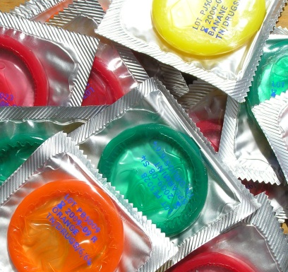
A Little Note on Condoms…
Regular and consistent condom use achieves about 60% protection against HPV

Slide 38
Case: Jenna
Should you give Jenna the HPV vaccine?

Slide 39
HPV Vaccine
Enormous potential for disease prevention
Cost-effective
Protects against multiple strains
Can be given prior to sexual initiation

Slide 40
HPV Vaccines:
FDA Approved
Gardasil
  Quadrivalent HPV vaccine
    Prevents HPV types 16/18 & 6/11
  FDA approved for females (2006)
  and males (2009)
Cervarix
  Bivalent HPV vaccine
    Prevents HPV types 16/18
  FDA approved for females (2009)
HPV 6,11 cause 90% of genital warts
HPV 16,18 cause 70% of cervical cancer
Notes:
Source:
http://www.fda.gov/NewsEvents/Newsroom/PressAnnouncements/2009/ucm187048.htm
Merck (Gardasil): Protects against the…
70% of cervical cancers are caused by HPV strains 16/18
90% of genital warts are caused by HPV strains 6/11
Aluminum Adjuvant, made in yeast
FDA approved in 2006
GlaxoSmithKine (Cervarix): Protects against the…
70% of cervical cancers caused by HPV strains 16/18
ASO4-Adjuvant (Aluminum + MPL)
Made in insect cells
FDA approved in 2009

Slide 41
ACIP Recommendations:
3 Doses of HPV Vaccine
Males: HPV4 vaccination
  Routine: 11-12 yos
  Catch up: 13-21 yos
  Special populations: 22-26 yos
  9-10 yos can be vaccinated
Females: HPV vaccination
  Routine: 11-12 yos
  Catch up: 13-26 yos
  9-10 yos can be vaccinated
Endorsed by: ACOG, AAFP, ACP, AAP, SAHM
Notes:
Since 2006 the Advisory Committee on Immunization Practices has recommended routine vaccination of adolescent girls at ages 11=12 years w/ 3 doses of HPV vacine. 2 vaccines currently available.
American college of obstetricians and gynecologists; American academy of family physicians, American college of physicians
ACIP: ADVISORY COMM ON IMMUNIZATION PRACTICES (PART OF CDC)
Source: CDC. Recommendations on the Use of Quadrivalent Human Papillomavirus Vaccine in Males—Advisory Committee on Immunization Practices (ACIP), 2011. MMWR 60(50);1705–1708
Recommended for all MSM and immunocompromised ♂
Permissive recommendation for 22–26 y/o ♂ without risk factors

Slide 42
Reasons for Routine Vaccination in 11-12 yos
Most effective time to vaccinate is prior to exposure, which is true for ALL vaccines
  More robust immune response in 11-12 yos
Patients coming to pediatric offices
  Vaccinating at as young an age as possible offers longer catch-up time
  Catch-up vaccination ≥ 13 based on very real statistics
Cost has not been an obstacle
Risk-based vaccination strategy impractical
Notes:
Cost is typically covered either via private insurance or VFC programs

Slide 43
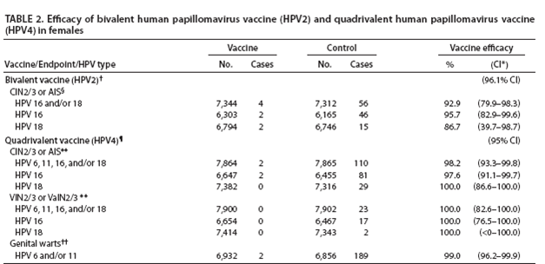
Efficacy of HPV2 and HPV4
Vaccine in Females
CDC. MMWR 2010; Vol. 59, No. 20
Notes:
http://www.cdc.gov/mmwr/preview/mmwrhtml/mm5920a4.htm
HPV4 Vaccine (Gardasil) has higher efficacy rates than HPV2 Vaccine.
Abbreviations: CIN2/3 = cervical intraepithelial neoplasia grade 2 or 3, AIS = adenocarcinoma in situ, VIN2/3 = vulvar intraepithelial neoplasia grade 2 or 3, VaIN2/3 = vaginal intraepithelial neoplasia grade 2 or 3, HPV = human papillomavirus.
* Confidence interval.
† Phase III trial. According to protocol efficacy analysis included females aged 15 through 25 years who received all three vaccine doses, were seronegative at day 1 and HPV DNA negative at day 1 through month 6 for the respective HPV type, and had normal- or low-grade cytology at day 1, with case counting beginning 1 day after third vaccine dose; mean duration of follow-up post first vaccine dose: 34.9 months.
§ Source: Paavonen J, Naud P, Salmeron J, et al. Efficacy of human papillomavirus (HPV)-16/18 AS04-adjuvanted vaccine against cervical infection and precancer caused by oncogenic HPV types (PATRICIA): final analysis of a double-blind, randomised study in young women. Lancet 2009;374:301—14.
¶ Combined analysis of one phase II and two phase III trials. Per protocol efficacy analysis included females aged 16 through 26 years who received all 3 vaccine doses, were seronegative at day 1 and HPV DNA negative at day 1 through month 7 for the respective HPV type, with case counting beginning 1 month after third vaccine dose; mean duration of follow-up post first vaccine dose: 42 months.
** Source: Kjaer SK, Sigurdsson K, Iversen OE, et al. A pooled analysis of continued prophylactic efficacy of quadrivalent human papillomavirus (Types 6/11/16/18) vaccine against high-grade cervical and external genital lesions. Cancer Prev Res 2009;2:868–78.
†† Source: Food and Drug Administration. Product approval-prescribing information [package insert]. Gardasil [human papillomavirus quadrivalent (types 6, 11, 16, and 18) vaccine, recombinant], Merck & Co, Inc: Food and Drug Administration 2009. Available at http://www.fda.gov/biologicsbloodvaccines/vaccines/approvedproducts/ucm094042.htm. Accessed May 25, 2010.

Slide 44
Efficacy in Males
TABLE. Efficacy of quadrivalent HPV vaccine for prevention of HPV 6-, 11-, 16-, and 18-related genital warts, AIN1/2/3, or AIN 2/3, per protocol,* in males aged 16 through 26 years†
Condition | Control |  | Vaccine |  | Vaccine efficacy
 | No. | Cases | No. | Cases | % | (95% CI)
Genital warts | 1,404 | 28 | 1,394 | 3 | 89.3 | (65.3–97.9)
AIN1/2/3§ | 208 | 24 | 194 | 5 | 77.5 | (39.6–93.3)
AIN2/3§ | 208 | 13 | 194 | 3 | 74.9 | (8.8–95.4)
Notes:
Abbreviations: HPV = human papillomavirus; AIN = anal intraepithelial neoplasia; CI = confidence interval.
Source: Food and Drug Administration. Highlights of prescribing information. Gardasil (human papillomavirus quadrivalent [types 6, 11, 16 and 18]). Available at http://www.fda.gov/downloads/biologicsbloodvaccines/vaccines/approvedproducts/ucm111263.pdf .
* Per protocol population included males who received all 3 vaccine doses, were seronegative at day 1 and DNA negative at day 1 through month 7 to the respective HPV type, with case counting beginning after month 7.
† Participants were enrolled from North America, South America, Europe, Australia, and Asia; median duration of follow-up was 2.3 years for the study in all males and 2.6 years for the study in men who have sex with men (MSM).
§ Efficacy for AIN studied in MSM.
In a phase III efficacy trial, HPV4 had high efficacy for prevention of genital warts among 4,055 males aged 16 through 26 years. Exclusion criteria included history of genital warts, history of genital lesions possibly HPV-related, and less than one or more than five lifetime sex partners. Among those who received all 3 vaccine doses and were seronegative at day 1 and DNA-negative day 1 through month 7 to the respective HPV type (per protocol population), efficacy for prevention of HPV 6-, 11-, 16-, and 18-related genital warts was 89.3% (95% confidence interval [CI] = 65.3%–97.9%); efficacy for HPV 6- and 11-related genital warts was similar. Efficacy for prevention of HPV 6-, 11-, 16- and 18-related genital warts among males who received at least 1 vaccine dose, regardless of baseline infection or serology (intent to treat population), was 68.1% (CI = 48.8%–80.7%) (4). No efficacy was observed among males who were infected with the respective HPV type at baseline. Although grade 1, 2, and 3 penile/perineal/perianal intraepithelial neoplasias were evaluated, too few were observed, and efficacy was not demonstrated (4).
A substudy of the phase III efficacy trial included 598 men who have sex with men (MSM), aged 16 through 26 years; outcomes were genital warts; AIN grades 1, 2, or 3 (AIN1/2/3); and AIN2/3. Per protocol efficacy for prevention of HPV 6-, 11-, 16-, and 18-related genital warts was 88.1% (CI = 13.9%–99.7%) (Carlos Sattler, MD, Merck, personal communication, August 2011). Per protocol efficacy for prevention of HPV 6-, 11-, 16-, 18- related AIN1/2/3 was 77.5% (CI = 39.6%–93.3%), and against AIN2/3 was 74.9% (CI = 8.8%–95.4%) (Table) (4). In the intent to treat population, efficacy for prevention of HPV 6-, 11-, 16-, and 18-related AIN1/2/3 was 50.3% (CI = 25.7%–67.2%), and prevention of HPV 6-, 11-, 16-, and 18-related AIN2/3 was 54.2% (CI = 18.0%–75.3%) (4). In the intent to treat population, efficacy for prevention of any HPV type-related AIN2/3 was 24.3% (CI = -13.8%–50.0%) (4). No studies have evaluated the efficacy of HPV4 for prevention of recurrent respiratory papillomatosis or oropharyngeal cancer.
The efficacy of HPV4 for prevention of HPV-related precancerous lesions and disease is supported further by studies among females. In three trials, HPV4 had high efficacy (>98%) for prevention of HPV 6-, 11-, 16-, and 18-related grade 2 or 3 cervical intraepithelial neoplasia (CIN2/3) or adenocarcinoma in situ (AIS), grade 2 or 3 vulvar intraepithelial neoplasia (VIN2/3), and grade 2 or 3 vaginal intraepithelial neoplasia (VaIN2/3) (12).
Immunogenicity

Slide 45
Side Effects and Safety
~56 million doses HPV4 distributed in US (3/2013)
21,194 AEs* reports to VAERs
8% considered serious
Reporting peaked in 2008
Serious AEs reported in past
GBS: no evidence of association
Blood clots: prior risk factors
*Adverse event
Notes:
Estimated 56 million doses of HPV4 distributed in US from June 2006-March 2013 and surveillance systems have found no new safety issues. In the United States, postlicensure vaccine safety monitoring and evaluation are conducted independently by federal agencies and vaccine manufacturers.
From June 06 through March 2013, approximately 56 million doses of HPV4 were distributed. B/c HPV4 accounts for 99% of the doses distributed in the US, analysis of vaccine safety data was limited to HPV4. During that period VAERs received 21,194 report, most not serious. After peaking in 2008 reports of steadily declined each year thereafter. Serious reports peaked in 2009 at 12.8% then decreased thereafter to 7.4% in 2013.
The most common reports classified as serious are: headache, nausea, vomiting, fatigue,, dizziness, syncope and generalized weakness.
Overall reporting of AEs to VAERS is consistent with prelicensure clinical trial data and during the last 7 years reporting patterns have remained consistent.
56 deaths: no common pattern

Slide 46
HPV4 Vaccination Schedule
Administered IM as a 0.5 mL dose at the following schedule: 0, 2, and 6 months
Recent data suggests flexibility of dosing:
  ±1 month for dose 2 (i.e., month 1 to month 3)
  ±2 months for dose 3 (i.e., month 4 to month 8)
Notes:
Data suggests that this flexibility of dosing does not impact the immune response to GARDASIL.
Females in the trials received all 3 vaccination s w/i one year of enrollment and efficacy based on that.

Slide 47
NIS-Teens Vaccination Coverage Data
ACIP recommends preteens (11-12) get Tdap, MCV4, HPV series, catch up on varicella
Healthy People 2020 vaccination goal for 13-15 yos are 80% for:
  ≥ 1 Tdap dose
  ≥ 1 MenACYW dose
  ≥ 3 HPV doses (among females)
Goal is 90% for ≥ 2 varicella doses
Wide gap between rates of HPV vaccination compared to other recommended teen vaccines
Notes:
National Immunization Survey-Teens

Slide 48
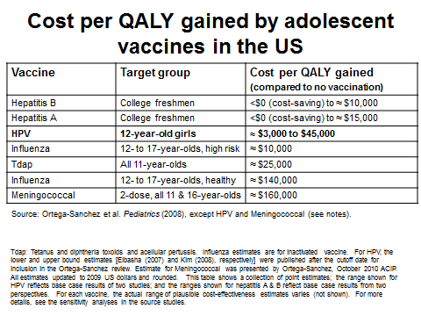
For Comparison…
HPV 12 y/o boys
$41,400–$134,800

Slide 49
How Are We Doing with HPV Immunization Rates?

Slide 50
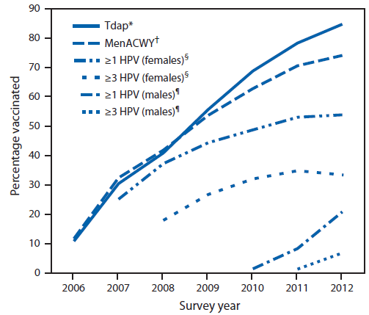
HPV Vaccination Rates Lagging Behind Those of other Recommended Teen Vaccines
Notes:
HPV COVERAGE INCREASED FROM 25.1% IN 07 TO 53% IN 2011 (FOR ONE SHOT OF SERIES). FAILED TO INCREASE BETWEEN 2012 – 53.8%.
FOR ALL 3 SHOTS COVERAGE HAD INCREASED FROM 5.9% TO 34.8%. ESSENTIALLY THE SAME IN 2012 ` 33.4%, JUST 1/3
TDAP COVERAGE HAS DRAMATICALLY INCREASED SINCE 2006 (JUST AROUND 10%) TO 84.6% IN 2012 (INCREASE FROM 78.2% IN 2011)
MENACWY INCREASED FROM ABOUT 10% IN 2006 TO 70.5% IN 2011 AND CONT’D TO CLIMB TO 74% IN 2012.
HPV IN MALES IS ALSO INCREASING: 2011 WAS 8.3% TO 2012 20.8%; FIRST YEAR MEASURED – FOR AT LEAST ONE DOSE.
ALL 3 HPV DOES IN MALES IS STILL DISMAL: 1.3% IN 2011 TO 6.8% IN 2012
NIS –teen identifies persons aged 13-17 in the 50 states and DC and US virgin islans using random digit dialed smaple of landline and since 2011 cell telephone numbers. Survey respondents are parents or guardians of tenns 13-17 who provide information about the childs SE char’cs and vaccination providers. After receiving consent from respondents, questionnaires are mailed to all identified providers to obtain data fro medical records to get provider reported immunization histories. Details re: NIS-teen methodology have been described and are considered valid.
ANALYSIS OF THIS REPORT (NIS-TEEN) WAS LIMITED TO GIRLS WITH PROVIDER-REPORTED VACCINATION HISTORIES. DID NOT DIFFERENTIATE BETWEEN HPV2 OR 4. t-TESTS USED AND CONSIDERED STAT’Y SIGNIFICANT IF p<0.05

Slide 51
HPV Vaccination: Troubling Trends
Coverage varies widely between states/regions
Substantial missed opportunities remain for vaccinating teens against HPV infection
Varying state laws regarding vaccine requirement:
  40 states require TdAP
  13 states require MCV4
  2 states require HPV
Notes:
Every healthcare visit should be an opportunity to review adolescents’ immunization histories and ensure that every teen is fully vaccinated – not happening. Whether for health problems or well visits providers need to recommend HPV and MCV vaccination to boys and girls during same visit Tdap is administered. No preference of order despite school requirements/state laws.
WA state requires TDAp and varicella only (of teen vaccines); DC and VA (girls only) require HPV

Slide 52
HPV Vaccination: Troubling Trends
Overall, HPV vaccination series completion among females was lower in 2012 than 2011
HPV vaccination lower for the recommended 11-12 yos compared to older teens
  Vaccine completion 44.5% in 17 yo females
Notes:
Among females, HPV vaccination coverage increased by an average of about a4-6 percentage points per year of age for 1,2,3 doses and series completion.
17 yo females the most highly vaccinated group for HPV

Slide 53
Missed Opportunities Are Increasing
Unvaccinated girls with missed opportunities for HPV vaccination increased from 20.8% in 2007 to 84% in 2012.
If HPV vaccine had been administered during health care visits when another vaccine was given coverage for ≥ 1 dose could have reached 92.6%
Notes:
A missed opportunity was defined as a health-care encounter occurring on or after a girl’s 11th –day and on or after March 23, 2007 (publication date of ACIP’s HPV4 recommendation) during which a girl received at least one vaccine but did not receive HPV vaccine. So, among unvaccinated girls, 84% had a health care encounter in which they received a vaccine but not HPV vaccine.
If adolescents received HPV vaccine at same rate as other adol vaccines, coverage for at least one dose would reach over 90% and there would be tens of thousands fewer cases of HPV cancers and disease in the coming years. It is really critical that we treat HPV vaccines the same ways as other vaccines. Since introduction in 06 most parents have become less concerned re; sexuality issues surrounding the vaccine. We should describe it as a vaccine to prevent cancer and minimize sexuality issues.

Slide 54
Why Are HPV Vaccination
Rates So Low?
Fewer and weaker health care provider recommendations
Physicians uncomfortable with discussing sex in 11 year olds
Presented as optional instead of recommended or required

Slide 55
Reasons Parents Cite for Not Vaccinating Their Daughters
Vaccine not needed (19.1%)
Vaccine not recommended (14.2%)
Vaccine safety concerns (13.1%)
Lack of knowledge about the vaccine or the disease (12.6%)
Daughter is not sexually active (10.1%)
CDC MMWR 2014 63(29); 620–4.
Notes:
NIS-Teen asked parents who did not intend to vaccinate their daughters in next 12 months (23% of respondents) the main reason why their daughters would remain unvaccinated. 25% of surveyed parents did not intend to vaccinate their daughters in the next 12 months. The top 5 reasons are:

Slide 56
Communicating with Parents
Jenna’s mom is hesitant about the HPV vaccine
How would you address her concerns that the vaccine would increase Jenna’s sexual activity?

Slide 57
Strategies for Increasing HPV Vaccination Rates
Primary care providers need to give a strong recommendation
  Reassure that HPV vaccination is safe and effective
Every health care visit is an opportunity to vaccinate
All needed vaccines of equal importance
Emphasize importance of vaccinating before exposure
Notes:
Reasons cited for not vaccinating their daughters demonstrate major gaps in our communication w/ parents; including why vaccination is recommended BY age 13.
Studies have documented that, especially when counseling younger adolescents or their parents, providers give weaker recommendations for HV vaccination compared w/ other vaccinations recommended for teens. Studies have shown that some parents reported that the HPV vaccine was not recommended in the same way as other teen vaccines. Providers need to give clear recommendation; let parents know you personally recommend it. CDC has developed a great tip sheet to help provider make clear, important recommendation.
Missed vaccine opportunities need to be reduced. Although providers have cited infrequent preventive health care visits amount the adolescent population as a vaccination barrier these data demonstrated that healthcare access is not the main impediment. Teens are receiving other vaccinations at many visits *84% in 2012 when not getting HPV. It should be introduced in the same way as Tdap and meningitis, no tiered system for vaccinating.
State laws re: vaccination requirements seem arbitrary and should play role in provider recommendation

Slide 58
Counseling Tips
Focus on cancer prevention
Do not focus on sexual activity
Vaccine more effective in younger age group
Vaccine does not play role in adolescents’ decisions about sex
More deaths from HPV-related diseases than tetanus, diphtheria, pertussis, and N. meningitidis combined in the U.S.
HPV Resources for Health Care Providers:
www.cdc.gov/vaccines/who/teens/for-hcp/hpv-resources.html

Slide 59
Effect of HPV Vaccine on Sexual Behavior
Studies show strong evidence that HPV vaccination DOES NOT have any significant effect on sexual behavior among adolescents
Concerns over increased promiscuity following HPV vaccination are unwarranted
Yet, in the US, only 38% of girls and 14% of boys received all doses of HPV vaccine
Bednarczyk, D et al. Pediatrics 2012; 130:798–805.
Leah M. Smith, et al. CMAJ. 2014.
Notes:
A new study finds that, despite concerns, vaccinating young girls against HPV doesn't affect sexual behavior. Using administrative health databases, researches identified 260,493 girls who were in grade 8 in the two years before and after implementation of Ontario's grade 8 HPV vaccination program. Teen girls in the study who received the HPV vaccine were no more likely to become pregnant or contract another sexually transmitted infection (STI) than girls who were not vaccinated. These results suggest HPV vaccination does not have any significant effect on sexual behavior and that concerns over increased promiscuity following HPV vaccination are unwarranted and should not deter from vaccinating at a young age. In the US, only 38% of girls and 14% of boys received all three doses of the HPV vaccine.
Source: Effect of human papillomavirus (HPV) vaccination on clinical indicators of sexual behaviour among adolescent girls: the Ontario Grade 8 HPV Vaccine Cohort Study
Leah M. Smith MSc, Jay S. Kaufman PhD, Erin C. Strumpf PhD, Linda E. Lévesque PhD. CMAJ 2014. DOI:10.1503/cmaj.140900
2nd source: http://pediatrics.aappublications.org/content/early/2012/10/10/peds.2012-1516.abstract
Sexual Activity–Related Outcomes After Human Papillomavirus Vaccination of 11- to 12-Year-Olds
Bednarczyk, Davis, Ault, Orenstein, Omer
Center for Health Research-Southeast, Kaiser Permanente, Atlanta, Georgia; and Rollins School of Public Health, School of Medicine, and
Emory Vaccine Center, Emory University, Atlanta, Georgia
RESULTS: Retrospective cohort study. The cohort included 1,398 girls (493 HPV vaccine–exposed; 905 HPV vaccine–unexposed). Risk of the composite outcome (any pregnancy/sexually transmitted infection testing or diagnosis or contraceptive counseling) was not significantly elevated in HPV vaccine–exposed girls relative to HPV vaccine–unexposed girls (adjusted incidence rate ratio: 1.29, 95% confidence interval [CI]: 0.92 to 1.80; incidence rate difference: 1.6/100 person-years; 95% CI: −0.03 to 3.24). Incidence rate difference for chlamydia infection (0.06/100 person-years [95% CI: −0.30 to 0.18]) and pregnancy diagnoses (0.07/100 person-years [95% CI: −0.20 to 0.35]), indicating little clinically meaningful absolute risk differences.

Slide 60
Cancers Attributable to HPV Occur Years After Infection
It might be decades before reduction in cancers due to vaccination shown
In meantime greater than 50% decrease in HPV infections caused by types targeted in HPV4 vaccine in 14-19 yo females shown
Notes:
Recent data from the NHANEs show greater than 50% decrease(almost 60%) in vaccine types of hpv in 14-19 yos vaccinated w/I 4 years.
Administrative claims data from privately insured patients show declining genital warts incidence amon patients aged 15-19 from 2.9 per 1000 to 1.8 in 2010. Substantial reductions in genital warts have occurred in other countries where vaccination programs achieved high coverage in target and catch up groups. Genital warts decreased substantially in australia, including males who were targeted earlier for vaccination.

Slide 61
HPV Vaccination Is Necessary to Attain Reductions in HPV-Related Cancers
By increasing HPV vaccination coverage to 80% ~53,000 additional cases of cervical cancer could be prevented (for those <13)
Another 4,400 women will develop cervical cancer for every year increases in coverage are delayed
Notes:
Over their lifetime

Slide 62
Jenna: Case Synopsis
Differential diagnosis for genital bumps:
  HPV
  Condyloma lata
  Molluscum contagiosum
  Dermatological conditions
Majority of HPV infections will self-resolve
The HPV vaccine provides tremendous prevention opportunity

Slide 63
HPV Vaccination in the Future
Reiterate recent data showing efficacy of the vaccine in this country
Reiterate safety data – absolutely no doubt the vaccine is safe
50,000 girls today will develop cervical cancer over their lifetime if we don’t reach 80% vaccination rates
FDA approves Gardasil 9 for prevention of certain cancers caused by five additional types of HPV (12/2014)
Notes:
This is preventable and this is what we need to focus on our sell to parent’s. This is a real issue. Anyone who knows someone who has been affected by cervical cancer could be a spokesperson. Personal stories do help.
http://www.fda.gov/NewsEvents/Newsroom/PressAnnouncements/ucm426485.htm?utm_source=NCC+Newsletter+Issue+65+December+2014++&utm_campaign=December+NCC+News&utm_medium=email
Covering nine HPV types, five more HPV types than Gardasil (previously approved by the FDA), Gardasil 9 has the potential to prevent approximately 90 percent of cervical, vulvar, vaginal and anal cancers.
Gardasil 9 is a vaccine approved for use in females ages 9 through 26 and males ages 9 through 15. It is approved for the prevention of cervical, vulvar, vaginal and anal cancers caused by HPV types 16, 18, 31, 33, 45, 52 and 58, and for the prevention of genital warts caused by HPV types 6 or 11. Gardasil 9 adds protection against five additional HPV types—31, 33, 45, 52 and 58— which cause approximately 20 percent of cervical cancers and are not covered by previously FDA-approved HPV vaccines.
A randomized, controlled clinical study was conducted in the U.S. and internationally in approximately 14,000 females ages 16 through 26 who tested negative for vaccine HPV types at the start of the study. Study participants received either Gardasil or Gardasil 9. Gardasil 9 was determined to be 97 percent effective in preventing cervical, vulvar and vaginal cancers caused by the five additional HPV types (31, 33, 45, 52, and 58). In addition, Gardasil 9 is as effective as Gardasil for the prevention of diseases caused by the four shared HPV types (6, 11, 16, and 18) based on similar antibody responses in participants in clinical studies.
The effectiveness of Gardasil 9 in females and males ages 9 through 15 was determined in studies that measured antibody responses to the vaccine in approximately 1,200 males and 2,800 females in this age group. Their antibody responses were similar to those in females 16 through 26 years of age. Based on these results, the vaccine is expected to have similar effectiveness when used in this younger age group.
Gardasil 9 is administered as three separate shots, with the initial dose followed by additional shots given two and six months later. For all of the indications for use approved by the FDA, Gardasil 9’s full potential for benefit is obtained by those who are vaccinated prior to becoming infected with the HPV strains covered by the vaccine.
The safety of Gardasil 9 was evaluated in approximately 13,000 males and females. The most commonly reported adverse reactions were injection site pain, swelling, redness, and headaches.

Slide 64
HPV-specific Resources
U.S. Centers for Disease Control and Prevention
  http://www.cdc.gov/std/hpv/default.htm
  Statistics and Surveillance Reports: www.cdc.gov/std/stats/default.htm
  Treatment Guidelines: www.cdc.gov/STD/treatment/default.htm
American Sexual Health Association:
  www.ashastd.org/std-sti/hpv.html
U.S. Department of Health and Human Services
  http://www.hhs.gov/opa/reproductive-health/stis/hpv/

Slide 65
HPV-Specific Resources
CDC tip sheet to aid providers in talking to parents: www.chop.edu/service/vaccine-education-center
Pediatric office material: HealthyChildren.org
www.merckvaccines.com/VaccinationReminderCards/Pages/home
QI module for pediatric practice: eqipp.aap.org/
QI strategy to raise immunization coverage: www.cdc.gov/vaccines/programs/afix/index.html

Slide 66
Provider Resources and Organizational Partners
www.advocatesforyouth.org—Advocates for Youth
www.aap.org—American Academy of Pediatricians
www.aclu.org/reproductive-freedom American Civil Liberties Union Reproductive Freedom Project
www.acog.org—American College of Obstetricians and Gynecologists
www.arhp.org—Association of Reproductive Health Professionals
www.cahl.org—Center for Adolescent Health and the Law
www.glma.org Gay and Lesbian Medical Association

Slide 67
Provider Resources and Organizational Partners
www.guttmacher.org—Guttmacher Institute
janefondacenter.emory.edu Jane Fonda Center at Emory University
www.msm.edu Morehouse School of Medicine
www.prochoiceny.org/projects-campaigns/torch.shtml NARAL Pro-Choice New York Teen Outreach Reproductive Challenge (TORCH)
www.naspag.org North American Society of Pediatric and Adolescent Gynecology
www.prh.org Physicians for Reproductive Health

Slide 68
Provider Resources and Organizational Partners
www.siecus.org—Sexuality Information and Education Council of the United States
www.adolescenthealth.org—Society for Adolescent Health and Medicine
www.plannedparenthood.org Planned Parenthood Federation of America
www.reproductiveaccess.org Reproductive Health Access Project
www.spence-chapin.org Spence-Chapin Adoption Services

Slide 69

Please Complete Your Evaluations Now

