Slide 1
Physicians As Advocates For Adolescent Reproductive Health
SPEAKER
DATE
Notes:
(Slides also applicable to all health professionals – can change “physician” to “provider”)
This talk is about why physicians should be advocates for adolescent RH, and steps to become an advocate.
Our examples are specific to adolescent RH advocacy, but definitions and tools apply to physician advocacy for any issue.

Slide 2
Disclosures

Slide 3
Physicians for Reproductive Health

Slide 4
Objectives
List reasons for physician adolescent reproductive health advocacy
List ways physicians can influence public policy
Provide strategies to bring the physician's voice to the public arena
Describe how to effectively use storytelling as a tool for adolescent reproductive health advocacy
Notes:
At the end of this session, participants will be able to… [list objectives]

Slide 5
What Is Physician Advocacy?
Action by a physician to promote social, economic, educational, and political changes that ameliorate the suffering and threats to human health and well-being that he or she identifies through his or her professional work and expertise
Notes:
There are many definitions of advocacy – here is one we think is useful. We will be talking about advocacy as defined by Dr. Earnest, who based his definition on the AMA definition of advocacy. His article called for curriculum change in medical schools and residencies to include teaching specific advocacy skills – we’ll cover medical education advocacy again later in this talk.
This is advocacy for policy change and working to address the root causes of the problems our patients face.
Source: Earnest MA et al. Physician Advocacy: What is it and how do we do it? Journal of Academic Medicine, 85:1; 63-67.

Slide 6
Reflection
External factors affecting patients' health and/or your ability to provide the best care for your patients
Existing advocacy skills and skills to develop
Advocate in practice setting or community
Advocate as individual or as part of an organization
Notes:
You may think you don’t have opportunities for advocacy, but consider a time where you saw something was not right or got so frustrated with the challenges a patient was enduring? When were you motivated enough to do something and change the situation? When did you care so much or were bothered enough to do something about it? That is advocacy.
You may also realize that you already participate in advocacy, but never thought about it in that way, or you may realize that you have particular strengths that would make you an effective advocate [list examples]…
You may decide that your issue is best addressed by advocating within your practice setting or you might want to advocate in the community. Physicians are members of a variety of communities – professional, social, local, regional, national, and international.
While some of you might want to advocate as an individual, some of you might want to join an organization that already advocates on the issue you're focused on. They can be professional (state medical society, specialty organization) or advocacy organization (Physicians for Reproductive Health)

Slide 7
Why Advocacy?
Notes:
Next, I'm going to make the case for why advocacy is needed on health care.

Slide 8
Influences On Health
Direct Socio-Economic Influences
Broad Socio-Economic Influences
Global Health Influences
Individual Patient Care
Access to Care
Adapted from: Gruen RL, et al. JAMA 2004.
Notes:
One way or another, you have realized that there are a range of personal, social, economic, and environmental factors that influence your patients’ health status.
In the center of this graph is your patient who is sitting in the exam room. Their health is influenced by their ability to access care, their socioeconomic status and environmental influences.
[Then either give examples – see below – or ask for examples from the audience]
Due to these external influences, physicians and medical organizations are increasingly becoming more involved in policy change in order to have a larger impact on health.
Examples:
Access to care – insurance status, availability of clinics/providers
Direct socioeconomic influences – interpersonal violence, unsafe housing
Broad socioeconomic influences – race, income, employment status – voting rights, access to healthy food
Global health – climate change, armed conflict

Slide 9
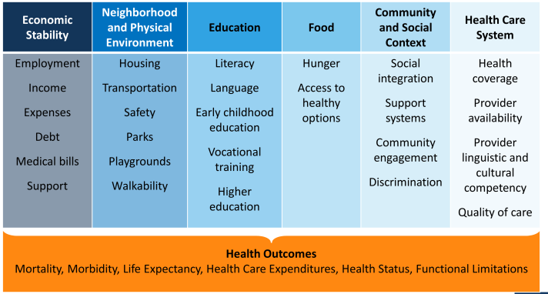
Social Determinants Of Health
Image credit: the Kaiser Family Foundation
Notes:
Social determinants of health are “the conditions in which people are born, grow, work, live, and age, and the wider set of forces and systems shaping the conditions of daily life”. (WHO definition)
Sometimes we can feel overwhelmed with the magnitude of these problems, since they reach into nearly every facet of life.
There are large cultural and bias issues we are grappling with in medicine – these sometimes manifest as racial and ethnic disparities. How can we as doctors address these biases? – give examples
One practical issue to address health care system and economic stability issues is via INSURANCE → segue to ACA
American Public Health Association president Camara Jones MD MPH PhD has made addressing racism, poverty, and social determinants of health and equity a focus of her term in office.
ACOG’s has also issued recommendations for addressing racial and ethnic disparities in healthcare.
Image credit: http://kff.org/disparities-policy/issue-brief/beyond-health-care-the-role-of-social-determinants-in-promoting-health-and-health-equity/ Accessed 9/18/2016

Slide 10
Economic Disparities In Unintended Pregnancy
$22,000 - 44,000
> $44,000
Adapted from the Guttmacher Institute
Notes:
There continues to be disparities in reproductive health based on race and income.
Graph shows unintended pregnancy rate per 1,000 women ages 15-44 from 1981 to 2011 by income level – here we show Federal Poverty Level for a family of four in 2011, which is about $22,000:
While the rate increased substantially before declining among poor and low-income women, it has steadily declined (and has historically been lower) among higher-income women.
If you only look at the unintended pregnancy rate among all women, you will conclude that there has been little change in national unintended pregnancy rate from 1981-2008.
But when you break it down by income, it's clear that lower-income women are experiencing higher rates of unintended pregnancy, particularly among women < 100% of the federal poverty level.
In 2008, the national unintended pregnancy rate was 54 per 1,000 women aged 15–44. In 2011, it dropped to 45 per 1000.
The rate of unintended pregnancy among the poorest group of women was more than five times that of women with an income of at least 200% of the federal poverty level (137 vs. 26 per 1,000 women aged 15–44).
Finer, L and Zolna, M. N Engl J Med 2016;374:843-52.
http://www.guttmacher.org/media/nr/2013/12/19/index.html

Slide 11
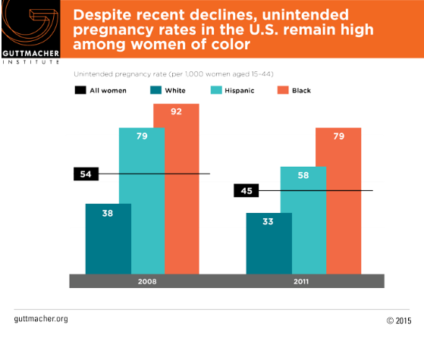
Racial And Ethnic Disparities
Image credit: the Guttmacher Institute
Notes:
This graph shows unintended pregnancy rate in 2011 per 1,000 women ages 15-44 by race/ethnicity. The horizontal black lines are the overall rate of unintended pregnancy in all women of reproductive age.
There continue to be disparities in unintended pregnancy rates based on race and ethnicity, even when controlling for income
This finding is reflective of the broader health disparities that people of color experience due to barriers in accessing health care services.
Previous research suggests that minority communities face barriers in accessing high quality contraceptive services and accessing their chosen method of birth control, leading to higher unintended pregnancy rates.
Some groups—including higher-income women, white women, college graduates and married women—are comparatively successful at timing and spacing their pregnancies. For example, higher-income white women experience unintended pregnancy at less than half the national rate (20 vs. 54 per 1,000).
www.guttmacher.org/news-release/2016/us-unintended-pregnancy-rate-falls-30-year-low-declines-seen-almost-all-groups

Slide 12
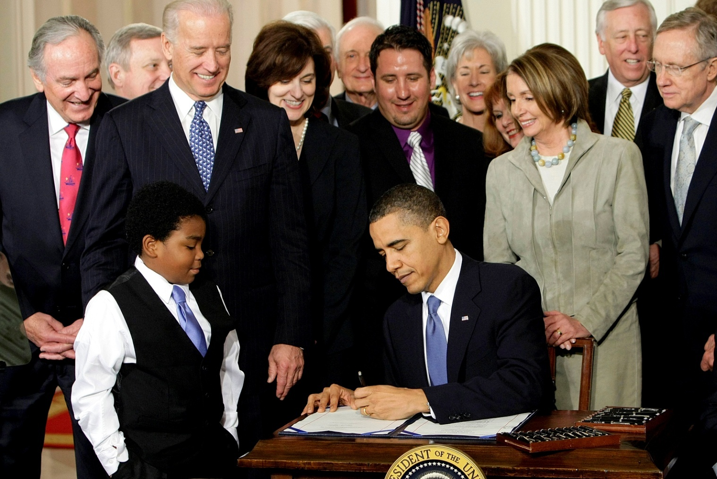
Insurance Coverage
President Obama signing the Patient Protection and Affordable Care Act into law
Notes:
One example of medical organizations becoming involved in policy advocacy:
Affordable Care Act (ACA, Obamacare)/health insurance coverage
Major national medical organizations came out in support of the ACA, including the American Medical Association (AMA), the American Academy of Family Physicians (AAFP), American Academy of Pediatrics (AAP), the American College of Obstetricians and Gynecologists (ACOG), and American College of Physicians (ACP) because expanding insurance coverage would lead to improvements in health care access, and thus, the health status of patients.

Slide 13
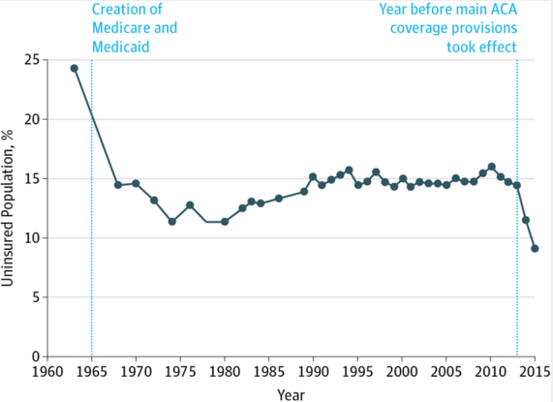
United States Health Care Reform:
Progress To Date And Next Steps
Obama, B. JAMA. 2016.
Notes:
The Department of Health and Human Services reports that 20 million previously uninsured people gained insurance coverage under the ACA as of March 2016.
This graph is from a JAMA article authored by President Obama in August 2016, discussing the impact of the Affordable Care Act. The rate of uninsured dropped in the mid-1960s with the creation of Medicare and Medicaid, then remained stagnant until after 2010, when the ACA’s coverage provisions began to take effect.
Obama, B. JAMA. 2016;316(5):525-532.

Slide 14
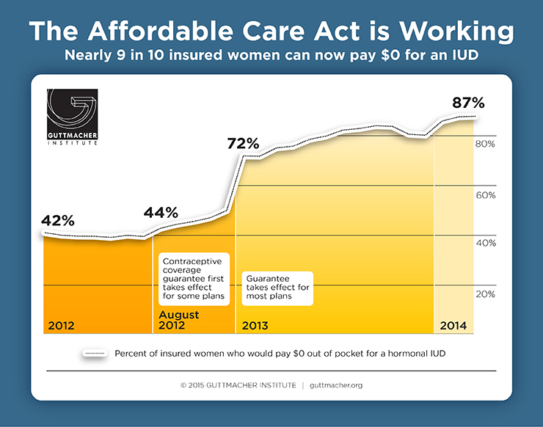
Image credit: the Guttmacher Institute
Notes:
This is the IMPACT of advocacy – we are now able to measure the changes as a result of the ACA
Here’s an example of advocacy at work: Contraception coverage was reviewed and included as a covered service in the ACA with no cost sharing due to the advocacy work of our colleagues.
Source: Bearak JM et al., Contraception, Feb 2016 Volume 93, Issue 2, Pages 139–144
http://www.guttmacher.org/media/infographics/aca-working-2015.html Accessed 1/26/16

Slide 15
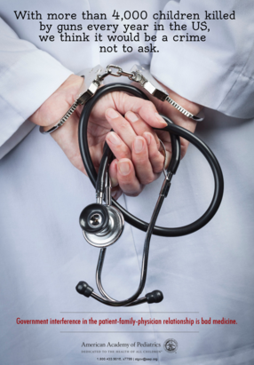
“Docs Vs. Glocks”: Gun Safety,
Privacy, & Free Speech
Image credit: American
Academy of Pediatrics
Notes:
Another example of a medical organization becoming involved in policy advocacy:
AAP guidelines include assessments for safety and violence. Firearm-related deaths are one of the top three causes of death in American youth ages 15-19.
In 2011 Florida passed a law that prohibited physicians from even asking patients about firearms in the home. The law was challenged by a group that included the American Academy of Pediatrics, the American College of Physicians, and several private physicians, but it was upheld by a 3-judge appellate panel 2014. The same group of physicians then petitioned for the case to be re-heard, and the full 11TH Circuit Court of Appeals agreed to hear the case. A decision is pending.
(ref: Council on Injury, Violence and Poison Prevention Executive Committee. Firearm-related injuries affecting the pediatric population. Pediatrics 2012;130:e1416 –e1424)

Slide 16
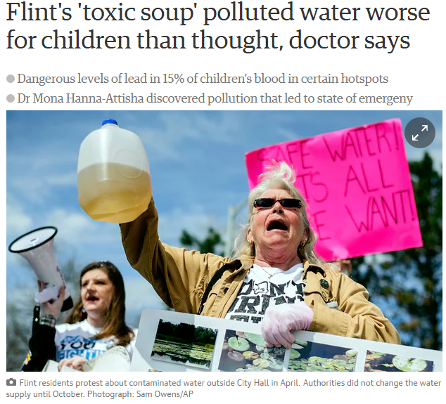
Flint Water Crisis
"Research is not supposed to be shared at press conferences . . . We had an ethical, professional, moral responsibility to alert our community (to) what was going on.”
Dr. Mona Hanna-Attisha
CNN.com
'Our mouths were ajar': Doctor's fight to expose Flint's water crisis
Image credits: The Guardian
Notes:
The city of Flint, Michigan changed its water supply from Lake Huron to the polluted Flint River in April 2014. Shortly after, Dr. Mona Hanna-Attisha, a pediatrician, noted an increase in illness, then starting testing lead levels in her patient population. She compiled her findings and brought them to the attention of lawmakers, who initially dismissed her claims. She persisted and what followed was the uncovering of what was called a “manmade disaster” that prompted the declaration of a state of emergency in the city.
https://www.theguardian.com/us-news/2015/dec/17/flint-polluted-water-toxic-lead-children-at-risk

Slide 17
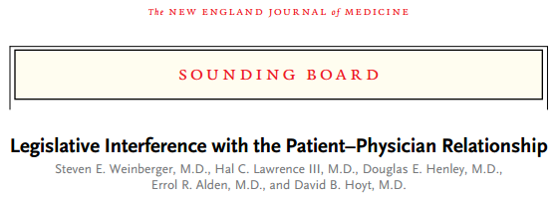
NEJM 2012
Notes:
Medical organizations have recognized that there is a need for physician involvement in policy.
In 2012, the NEJM published an article by the executive leadership of five professional organizations, the AAFP, AAP, ACOG, ACP, ACS (surgeons) addressing legislative interference with the patient-physician relationship.
They were concerned about increasing inappropriate legislation negative affecting clinical practice and doctor-patient relationships.
The fact that these five very different professional organizations united to make this statement signals how serious and widespread this problem is – it affects physicians across specialties. We see the real-life impact of legislation on our patients, so we are best suited to educate legislators and the public.
Interference includes legislation:
prohibiting doctors from asking questions, such as asking about firearms at home to assess for safety
Mandating medically unnecessary tests or procedures, like transvaginal ultrasound prior to abortion
Requiring physicians to provide scripted information about end-of-life care options, without regard for a patient’s unique circumstances
Prohibiting doctors from disclosing possible exposure to chemicals involved in fracking, or requiring doctors to sign a non-disclosure agreement in order to obtain a list of the chemicals used

Slide 18
Why Adolescent Reproductive Health Advocacy?
Notes:
Reproductive health (and adolescent reproductive health) is singled out in a way that very few other areas of medicine are.

Slide 19
Adolescents Need Physicians to Advocate on Their Behalf
Source: Getty Images

Slide 20
Policy Issues Affecting Adolescent SRH
Restrictions on contraception and abortion
Sexuality education policies and funding
Confidentiality and Explanation of Benefits (EOBs)
Emergency Contraception Over-the-Counter (EC OTC), Rx only, age restrictions
HPV vaccination policies
Condom distribution in schools
Notes:
So many policy issues that affect adolescent sexual reproductive health.
Here are just some examples.

Slide 21
Access To Contraception
Winner B, et al. N Engl J Med 2012.
Notes:
LARC- long acting reversible contraception
PPR- pill, patch, ring
The Contraceptive Choice Project showed that people will predominantly choose LARC when cost is not a barrier.
Here’s another example that demonstrates the benefit and the need to advocate for contraceptive coverage: it is worthwhile to get birth control coverage since it works to prevent unintended pregnancy.
How can we reduce the unintended pregnancy rate?
Access to family planning helps our patients decide if or when they want to have children – leading to improved health of women, their children, and their families and helps our patients achieve their educational and financial goals.
There is consistent and strong research that removing cost as a barrier to contraceptive use results in women being able to use the contraceptive method of their choice and helps prevent unintended pregnancy – and all of those benefits results in savings in healthcare costs.
(Source: Sonfield A. The case for insurance coverage of contraceptive services and supplies without cost-sharing. Guttmacher Policy Review 2011;14. www.guttmacher.org/pubs/gpr/14/1/gpr140107.html)
The Contraceptive Choice Project in St. Louis is one of many studies that have shown the benefits of offering contraceptive methods to women with no additional out-of-pocket costs. When cost was removed as a barrier, women of diverse backgrounds preferentially chose a LARC method (75% of women chose a LARC method vs. 8.5% of women nationally). Women who chose LARC had lower rates of unintended pregnancy and abortion when compared to women who chose other methods, like the pill or ring.
Figure: Cumulative Percentage of Participants Who Had a Contraceptive Failure at 1, 2, or 3 Years, According to Contraceptive Method. Bars depict the cumulative percentage of participants who had a contraceptive failure with long-acting reversible contraception (LARC), depot medroxyprogesterone acetate (DMPA), or pill, patch, or ring (PPR) at 1, 2, or 3 years. Participants using PPR had significantly more unintended pregnancies than those using LARC (P<0.001) or DMPA (P<0.001).

Slide 22
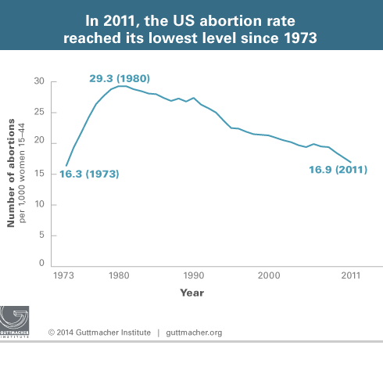
Unintended Pregnancy & Abortion Decline With Contraceptive Use
Image credit: the Guttmacher Institute
Notes:
This is another graph showing how access to contraception leads to reductions in unintended pregnancy and abortion.
Graph shows the number of abortions per 1,000 women ages 15-44 from 1973-2011:
Decline in abortion since 1980 and in 2011 coincides with the national drop in overall pregnancy and birth rates
Researchers attribute an important part of the decline to improved contraceptive use, particularly use of highly effective LARC methods, such as the IUD. Researchers also attribute the drop in overall pregnancy rates with the recent recession, leading to women and couples wanting to avoid or delay pregnancy.
They did not find evidence that the overall drop in abortion incidence was related to the decrease in providers or to restrictions implemented between 2008 and 2011.
Their findings support the importance of women having access to highly effective contraceptive methods.
http://www.guttmacher.org/media/presskits/abortion-US/graphics.html

Slide 23
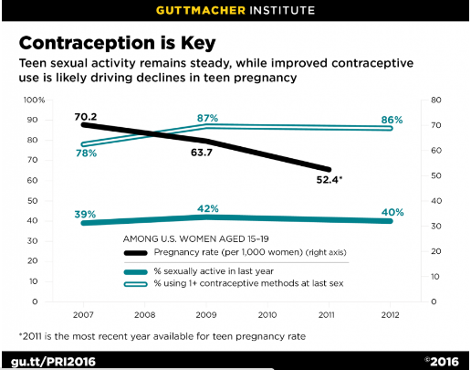
Adolescent Pregnancy Rates Decline Due To Improved Contraceptive Use
Among U.S. women aged 15 – 19:
% using 1+ contraceptive
methods at last sex
Pregnancy rate
(per 1000 women)
% sexually active in last year
Adapted from https://www.guttmacher.org
Notes:
It’s great that adolescent pregnancy rates declined – but why did it happen? A 2016 study that examined data from the National Survey of Family Growth estimated that the decline in adolescent pregnancy rates was almost entirely attributable to improved contraceptive use.
This graph shows a decline in adolescent pregnancy rates from 2007 – 2012, despite the fact that the level of sexual activity did not decrease (and actually increased a small amount). There was a small increase in the percent of teens reporting using at least 1 contraceptive method at the time of last sex.
The study also found significant increases in teens using highly-effective methods like LARC, and in the use of more than one method (like condoms + pills, for example). This doesn’t predict an absolute number of people who will choose LARC methods, but we do know when cost is not a factor, people will choose the best method for themselves. This is why it’s so important to protect insurance coverage for LARC because people will choose it more often when cost is not a barrier.
Source: Linberg, Laura et al. Understanding the decline in adolescent fertility in the United States, 2007 – 2012. Journal of Adolescent Health, 2016, 1-7.
https://www.guttmacher.org/news-release/2016/declines-teen-pregnancy-risk-entirely-driven-improved-contraceptive-use

Slide 24
Adolescent Pregnancy In U.S. Compared To Similar Countries
Notes:
Although it is good news that the adolescent pregnancy rate has decreased, it’s important to note that we in the U.S. still have one the highest unplanned pregnancy rate, the highest birth rate, and among the highest abortion rates in economically-similar countries.
Here we are at the top of this chart that uses 2011 data, with 15 abortions (dark orange), 34 births (lightest orange), and 8 miscarriages per 1000 women age 15 – 19.

Slide 25
Sex Education
Notes:
From 2011- went to Senate and House or provided written testimony every year- passed Senate in November 2015.
S. 2048: Curriculum must be medically accurate and age-appropriate. Teach both abstinence and contraception, about ways to discuss safe sexual activity and about the skills needed to form relationships fee of violence or coercion.

Slide 26
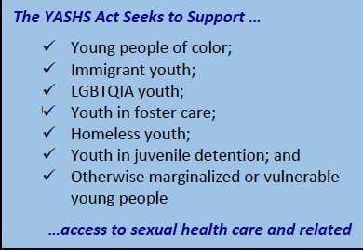
Youth Access to Sexual Health Services Act of 2017
Senator Mazie K. Hirono (D-HI)
Congresswoman Alma Adams (D-NC-12)
First introduced in 2016
Notes:
Provides grants to increase and improve the linkage and access of marginalized people to sexual and reproductive health care and related services.

Slide 27
Physicians As Advocates
Notes:
We gave a snapshot of how reproductive health care is under attack.
So what do we do? Either fight or give up.
And I'm here to say that we should fight.
Now we're going to talk about why physicians are ideal advocates.

Slide 28
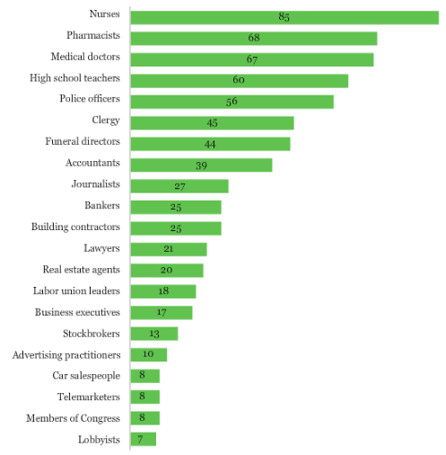
Physicians And The Public Trust
56% in 1976, 67% in 2015!
Adapted from www.gallup.com
Notes:
(Slide appears with only “medical doctor” circled, on first click, journalist is circled, on second click, Members of Congress are circled)
First, the public trusts us! We rank #3 in credibility by the public, and public trust in doctors has increased since 1976.
Every year, the Gallup organization conducts a poll about public trust in various professions. These is the 2015 poll – what’s shown is the percent of people who rated trust as high or very high.
We rank higher than journalists, and much higher than Members of Congress.
We also rank higher than lawyers.
http://www.gallup.com/poll/1654/honesty-ethics-professions.aspx

Slide 29
Voting
Grande D, Asch DA, Armstrong KA. J Gen Intern Med 2007.
Notes:
However, physicians may be less civically engaged than lawyers. This study found that physicians have been found to have consistently lower odds of voting when compared to lawyers and the general population. Perhaps we feel as though we already “gave at the office”, or that advocacy would take time and energy away from our care of patients.
Though we might not think of voting as advocacy, we want our elected officials to prioritize and pass bills and policies that result in improved patient health.
A cross-sectional survey of a subgroup of physicians from a representative household survey of civilian, non-institutionalized adult citizens
P-values comparing physicians to lawyers and general population all statistically significant except for 2002 when comparing to general population
Grande D, Asch DA, Armstrong KA. Do doctors vote? J Gen Intern Med 2007; 22(5): 585-589.
A total of 350,870 participants in the Current Population Survey (CPS) November Voter Supplement from 1996–2002, including 1,274 physicians and 1,886 lawyers; 414,989 participants in the CPS survey from 1976–1982, including 2,033 health professionals.

Slide 30
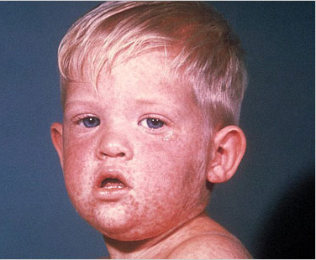
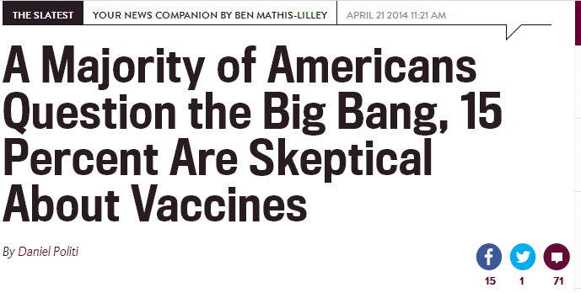
Need For Public Education
Image credit: www.slate.com & CDC
Notes:
[Slate headline shows up first] There is a lot of misinformation among the public. In the case of vaccine deniers, public skepticism has resulted in outbreaks of diseases that were essentially nonexistent.
[Second click shows child with measles] Anyone know what this is? Measles! For which we have a safe and effective vaccine. Hospitals dealing with these outbreaks have had to send photos to their staff because most younger people had never seen a case in real life.
An Associated Press-GfK poll (methodology here http://ap-gfkpoll.com/poll-methodology) found that 15% of the participants were not too confident or not at all confident that vaccines are safe and effective.
Try to think about a time when you read about a bill that would negatively impact your practice or your patients or when you read an article that contained inaccurate medical information; can you remember if a doctor was quoted in the article? Or did you wish that they had accurate medical information or wrote about how the topic would affect your patients or your practice?
The majority of bills that impact your patients or your ability to provide care for your patients do not have a doctor's input.
The media tends to perpetuate misinformation or choose to only represent a non-fact/science-based viewpoint since controversy sells. By putting yourself out there, you can provide important education about health policies and legislation.
http://www.slate.com/blogs/the_slatest/2014/04/21/scientific_poll_most_americans_question_big_bang.html

Slide 31
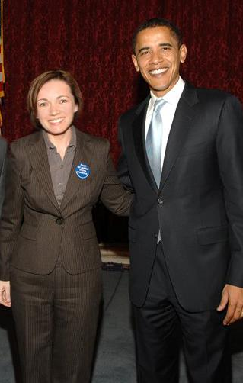
Political Influence
Dr. Kelly Culwell, alumna of the Physicians for Reproductive Health Leadership Training Academy, meeting with her then-Senator from Illinois
Capitol Hill 2006
Notes:
Not only does the public trust doctors, lawmakers trust doctors as well.
Legislators need doctors – they WANT advice on health policy and they want patient stories that they can share with their colleagues
Lawmakers respect physicians, they value meeting their constituents and appreciate when physicians lobby on behalf of their patients.
Legislators need advice on policy and patient stories.
Legislators have told us that they don't necessarily have all the background information needed to make an informed vote – most of the time, they don't know how a bill will affect our patients' health or their medical care. They want physicians as a resource!
Example: February 2014, the Missouri House of Representatives had a hearing on a preventive health services bill that would require evidence-based sex education in public schools, improve medical services for survivors of rape, improve access to EC, and improve access to contraceptive services. A doctor in Missouri, Elizabeth Schmidt, volunteered to testify at the hearing, but last minute, they changed the hearing to a different date that conflicted with her work schedule. After she notified them of the schedule conflict, they moved her testimony time to the start of the hearing so that they would be able to hear her statements.
And you never know where your local legislator will end up…

Slide 32
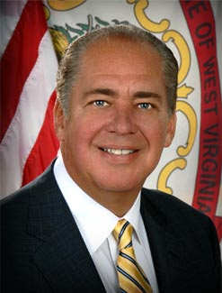
Political Influence
“This bill is also problematic because it unduly restricts the physician-patient relationship. All patients, particularly expectant mothers, require the best, most unfettered medical judgment and advice from their physicians regarding treatment options.
The medical community has made it clear to me that the criminal penalties this bill imposes will impede that advice, and those options, to the detriment of the health and safety of expectant mothers.”
Notes:
An example of how physicians can change the mind of a lawmaker:
This is West Virginia governor Earl Ray Tomblin, who in 2014 was considering whether to sign or veto a ban on abortions after 20 weeks (with only a narrow exception for “medical emergencies”)
This anti-choice Democratic Governor vetoed the ban and pointed out that he was influenced by the medical community.

Slide 33
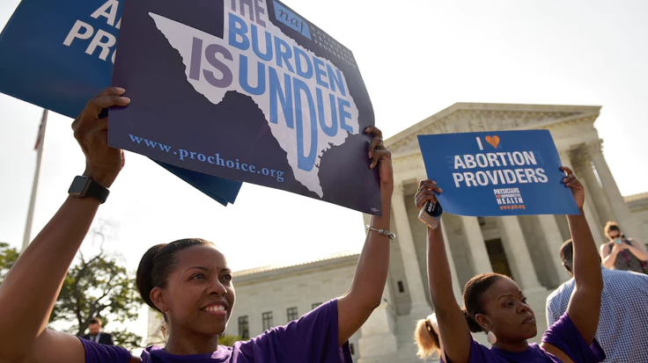
Political Influence
Physicians must “advocate for the social, economic, educational, and political changes that ameliorate suffering and contribute to human well-being.”
American Medical Association Declaration of Professional Responsibility
Image credit: Mandel Ngan/AFP/Getty Images
Notes:
This image features two of our doctors, Serina Floyd and Jamila Perritt, awaiting the decision for Whole Woman’s Health v. Hellerstedt on the steps of the Supreme Court.
The SCOTUS decision in this case was the result of a massive collaboration between providers, clinics, attorneys, and advocates. At each step of the way, physician advocacy was an essential part of the process. Things like sharing stories with the media, contributing to amicus briefs, researching and publishing on the negative effects of TRAP laws.
The AMA created the Declaration of Professional Responsibility, an oath by which 21st century physicians can publicly uphold and celebrate the ideals that, have inspired individuals to enter medicine and the conduct that has earned society's trust in the healing profession. The duties the Declaration imposes transcend physician roles and specialties, professional associations, geographic boundaries, and political divides.
Advocacy is one way to fulfill that obligation to our patients and to society.

Slide 34
Professionalism
Adapted from: Gruen RL, et al. JAMA 2006.
Notes:
Survey of a nationally representative sample of physicians in three primary care specialties (general internal medicine, family practice, pediatrics) and three non-primary care specialties (general surgery, anesthesiology, cardiology)
This graph shows that physicians believe that advocacy is important. But our beliefs don't match up with our actions. This may reflect that physicians experience many barriers to advocacy, one of which might be lack of training and mentorship or lack of guidance on how to advocate with competing professional and personal responsibilities.
[Specifics about the study – if asked or if time allows] Physicians rated all three advocacy roles as important and the importance remained high when broken down by specialty (>87%). While physicians overall believe they have professional responsibilities to promote health outside of their clinical practice, there is discrepancy between the values of physicians and participation, particularly for political involvement and collective advocacy.
They were asked to rate three types of advocacy roles that physicians may engage in: community participation, political involvement, and collective advocacy.
For each role, they were asked to rate the importance on a four-point scale and assess whether each physician had acted in each of the three roles in the past three years.
Community participation was defined as a physician providing health-related expertise to local community organizations, such as school boards and local media.
Political involvement was defined as a political activity other than voting in health-related matters at the local, state, or national level.
Collective advocacy was defined as encouraging medical organizations to advocate for public health or policy issue not primarily concerned with physician welfare.

Slide 35
Questions To Consider
?
?
What’s my institution’s policy?
Effects on personal life?
How does advocacy fit into my career path?
Criticism or alienation?
Unexpected support from colleagues?
Improved job satisfaction?
?
?
?
Notes:
So maybe by now you’ve decided to engage in advocacy work – what does this mean for your career and personal life? What if you’re working on stigmatized issues like firearm control or abortion?
An important first question is “What’s my institution’s policy?” It can be helpful to identify and contact your organization’s public affairs or PR office proactively. They may have media guidelines on whether you can speak publicly and if you can use your work credentials.
Another important question is: How does advocacy fit into my career path? What can I take on and still fulfill my other obligations?
Related to this is: Will advocacy help improve my satisfaction with my job? There is a high rate of burnout among physicians – advocacy can be a way to remind yourself why you chose to become a doctor, help you address some of the social and political determinants of health, and connect you to the community.
It’s also important to consider the possible effects on your personal life. How will advocacy affect your family and friend relationships, especially if you’re advocating about a stigmatized topic?
Might you risk criticism or alienation from colleagues? What are your support networks if this happens?
Conversely, might you receive unexpected support from colleagues, or gain allies to advocate with you?
The bottom line is that any shift in your career trajectory can change your personal and professional lives – it’s important to consider the potential for both positive and negative effects.

Slide 36
Advocacy Skills
Notes:
We talked about why advocacy is needed and why physicians are ideal advocates.
Let’s talk about the skills you’ll need to be an effective advocate.
Advocacy is doable - you need skills and a strategic approach.

Slide 37
Innate Physician Skills
Patient stories
Credibility
Technical and scientific knowledge
Access to and understanding of research
Experience with advocating for individual patients
Notes:
As doctors, you are poised to be excellent advocates. You have a breadth of firsthand experiences and patient stories to draw on.
Physicians have high public trust. You can ground your advocacy in evidence.
The skills you already use to advocate for individual patients can be used for policy advocacy.

Slide 38
Skills To Develop
Defining your goal and your audience
Crafting personal stories to frame your issue
Developing and sticking to your message
Recognizing opportunities for advocacy
Developing relationships with partners, media, legislators
Notes:
Advocacy consists of developing the skills and advantages that you already have.
You want to first identify the issue you want to address then decide what kind of impact you want to make – who is your target audience? What are their priorities? What is your “ask” or request or call to action? What do you want your audience to do?
Draw on patient stories – consider what details you should include and what details you should leave out – what parts of the story are compelling or will move the audience? What details will drive home your message?
[Note to speaker – consider adding a personal story that you have used in an advocacy setting]
How do you want to get your message out? Through the media? With Legislators? Through a clinic or hospital committee?
Seek & identify critical strategic relationships that leveraged his or her own expertise & experience to achieve broader effect.

Slide 39
Using Stories
https://www.youtube.com/watch?v=7ovsrgXU93s&feature=youtu.be
Notes:
Example (allow PowerPoint to play the embedded video)
The bedrock of writing and speaking about the human impact of law and policy
Stories make people connect emotionally with the need for patient health care. They can be persuaded by stories while research findings leave them cold.
Dr. Lin-Fan Wang, ARSHEP faculty & alumna of the Physicians for Reproductive Health Leadership Training Academy, spoke at the “Not My Boss's Business” Rally during the Supreme Court hearing on insurance coverage for contraception through the Affordable Care Act. This happened while she was the Reproductive Health Advocacy Fellow at Physicians for Reproductive Health.
As you watch, write down some notes of what she did that was effective.

Slide 40
What Was Effective?
Summarized patients’ stories and how existing laws affected them
Used lay terms, not medical jargon
Provided a few details about the patient to make her come alive
Let passion show
Used pseudonyms or did not use names
Brought things back to the ask or the main message
Notes:
[slide appears empty at first, bullet points appear after mouse click]
Summarized patients’ stories and how particular proposed or existing law or policy might hurt or helped her
Used lay terms, not medical jargon
Provided a few details about the patient to make her come alive – age, children, partner, career, emotions, her concerns
Let her passion show – emotional reaction to her patient's situation, compassion
Used pseudonym – leave out, change minor details (type of employment, number of children) or combine stories so that the patient cannot be identified but you keep the core truth of the story, you can also ask patients if you can use their story – they can be active participant in advocacy
Ended with an ask – what do you want the audience to do?
If you don't have a story of your own that applies, use one from a colleague and attribute it to her or him. Don’t make something up!

Slide 41
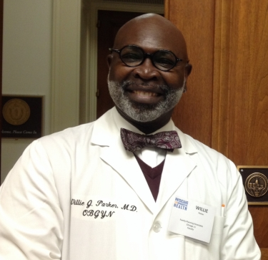
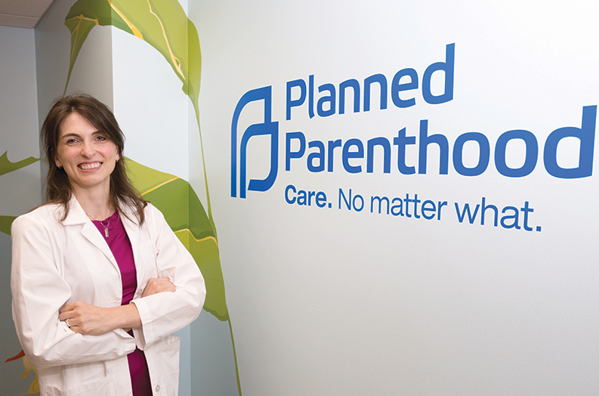
Our Stories Matter: Amicus Briefs
Photo credits: Memphis Daily News/Andrew J. Breig; www.christiantoday.com
Notes:
Physicians for Reproductive Health filed amicus brief before the United States Supreme Court in Whole Woman’s Health v. Hellerstedt to tell the stories of abortion providers in our own voices.
“My goal as an abortion provider is to create a non-judgmental space for women to make their decision and to provide the best quality medical care. I feel really good providing this care because I know I’m helping these women when they need it. That’s my calling as a doctor.” Sarah Wallett, MD, MPH, Kentucky
“My belief in God tells me that the most important thing you can do for another human being is to help them in their time of need. That’s why I have provided abortions full-time since 2009. I do not miss my easier path. I know that providing abortion care is just and noble and right.” Willie Parker, MD, MPH, MSc, Birmingham, AL
While these stories weren’t specifically mentioned in the oral arguments or the court’s decision, the brief was submitted because so often abortion providers have someone else telling their story for them.
https://www.memphisdailynews.com/Editorial_Images/26169.jpg

Slide 42
Models of Advocacy
Notes:
Overview of various ways to advocate
Will not cover all different types of advocacy, also will not go into depth
But will provide resources at the end if you want more resources or training

Slide 43
Models Of Advocacy
Policy
Media &
Communications
Medical Education
Professional Associations & Societies
Legislative
Regulatory
Traditional
New
Notes:
[If you have time or are speaking with a more experienced audience, you could elicit personal experiences from audience – what experiences have they had with advocacy and why? What were their experiences like? How much time did they spend?]
Here is a list of different ways that you can advocate, depends on your target audience and your goal. You may decide that there are other places you want to advocate in, such as schools, volunteer organizations, places of worship
Where and how you advocate may also depend on what you're comfortable doing or interested in as an advocate. You may be someone who enjoys being on TV or being interviewed in a hostile environment. Or you may be involved in research and wants to use it to build solid evidence for advocacy. Or you may be someone who likes one-on-one interactions and prefers meeting with legislators or working with your peers or students.
You might also surprise yourself with what you end up doing. Start small, start local and see where the work takes you.

Slide 44
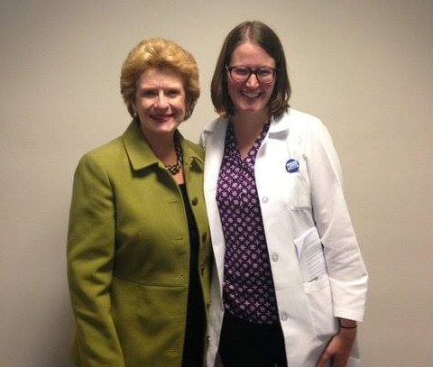
Legislative Advocacy
Work with your legislators
Join an Advocacy or Lobby Day
Join an organization
Dr. Lauren MacAfee with Representative Debbie Stabenow at the Leadership Training Academy Advocacy Day in Washington, DC, 2015
Notes:
An easy way to become involved is to join a medical or advocacy organization – they will notify you when there's an opportunity to reach out to your legislator about a bill or sign on a provider letter. They may also work with you on drafting testimony or statement
Work with your legislators: legislative visits/email or phone call/petitions, join your legislator's Citizen's Advisory Board, sign petitions

Slide 45
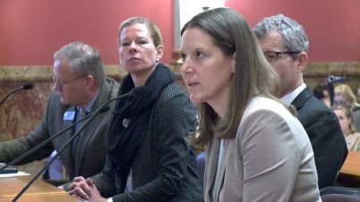
Testimonies
Dr. Kristina Tocce
Personhood bill hearing
Denver, CO
Notes:
Anyone can offer testimony at local or state level
On bills that affect medical practice, often there are no doctors or other health care providers who testify – it is important that your voice as a doctor is present. Legislators aren't necessarily fully informed about the bill, aware of the medical evidence, or aware how the bill impacts practice
On March 11, 2014, Dr. Kristina Tocce (LTA class 2014) testified and spoke at a press conference against a proposed personhood bill in Denver. The bill would have banned abortion in all circumstances, including in cases of rape and incest. A clip of her testimony was included in a news segment, which referred to her as an OB/GYN, not a lawmaker, who was on hand to make the case that the anti-choice Republicans are anti-women's health. The bill was voted down by the House Judiciary Committee. http://kdvr.com/2014/03/11/with-an-eye-on-november-democrats-reject-gop-abortion-ban-proposal/

Slide 46
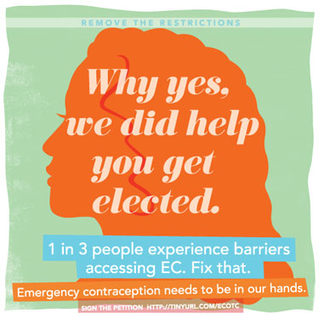
Regulatory Advocacy
Administrative and governmental agencies
Institution, hospital, clinic committees
Image credit: http://the-orbit.net
Notes:
You can become involved in creating new policies, revising guidelines, and resolving program problems via activities directed at administrative & governmental agencies
Work with Medicaid directors – they need RH advisors
Join your hospital or clinic committees – this can be more manageable, show up & raise your voice
Community health center association – statewide lobby for community health centers
Examples: Coalition advocated for EC OTC – Change in HHS regulations
Image: http://the-orbit.net/almostdiamonds/2012/11/26/emergency-contraception-otc-its-time/

Slide 47
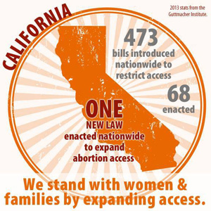
Medical & Professional Society Advocacy
Notes:
You can participate as a delegate or committee at the local, state, regional, or national level. Becoming active in the state or regional chapter of a medical organization is a way to gain medical organization support on local or state legislation or advocate for changes on the national level
Medical organizations can only advocate on legislation if they have official position statements or resolutions. Local and state-level chapters of medical associations adopt policies and resolutions that can be introduced to the national level
Example of the importance of joining state medical association - Abortion bill in CA & CMA
AB 154 improves access by authorizing trained and qualified nurse practitioners, certified nurse-midwives, and physicians assistants to perform early abortions. The bill is based on a five-year study conducted by the University of California San Francisco that showed that specially trained health professionals can provide high quality early abortion care. Physicians for Reproductive Health reached out to their physician network in California – some were members and were able to get CMA to move their position from opposed to neutral to support!

Slide 48
Medical Education Advocacy
ACGME requires residents to be taught to “advocate for quality patient care and optimal patient care systems.”
Multiple specialty programs also recognize advocacy as a competency
Independent opportunities for training
ARSHEP program
Notes:
There is growing recognition of advocacy as a competency, and it is a common program requirement under the ACGME. All residency programs must meet the common program requirements, regardless of specialty. Some specialties have additional requirements beyond those of the ACGME.
Even though there is recognition that advocacy is a component of professionalism, faculty and residency programs need further guidance on the specifics of meeting the above requirements. You may decide that your role as an advocate is to develop advocacy training at your residency program.
Other advocacy opportunities include things like the Adolescent Reproductive and Sexual Health Education Program by Physicians for Reproductive Health.
Goal is to train youth-serving professionals in best practices around adolescent reproductive and sexual health care. It includes a curriculum with over 20 modules that can be used to provide extra education to physicians and students in topics like contraception, caring for LGBT youth, options counseling and STDs, and a speakers bureau of 50 adolescent specialists who travel the country giving free trainings based on that curriculum.
Other opportunities for medical education advocacy:
- Collect, analyze, and publish data that assess gaps in reproductive health content in undergraduate and graduate medical education
- Present at medical schools, residency programs, grand rounds, and national conferences to increase the amount of evidence-based reproductive health information disseminated to the medical community
- Mentor or sponsor an MS4C or AMSA elective program
- Join a curriculum committee or Residency journal club
https://www.acgme.org/acgmeweb/Portals/0/PFAssets/ProgramRequirements/CPRs2013.pdf

Slide 49
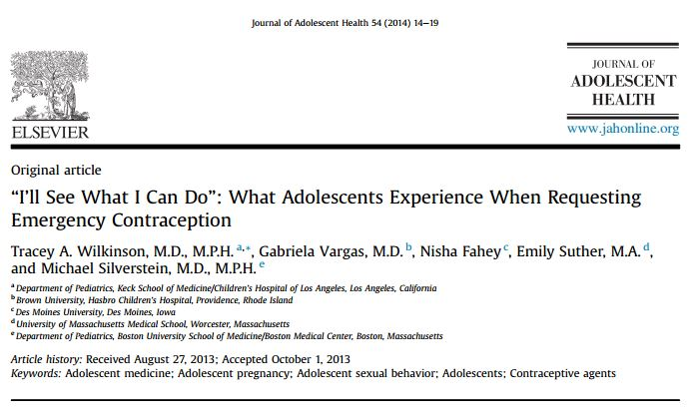
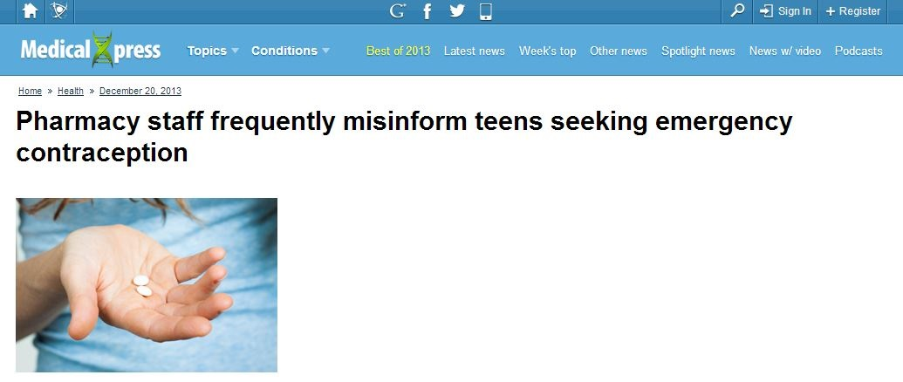
Research As An Advocacy Tool
"I try to emphasize that teens should have emergency contraception at home, just like they have Tylenol for a headache—don't wait until you need it to try and go get it."
Image credit: http://medicalxpress.com
Notes:
[JAMA picture appears first, with mouse click -> JAMA picture disappears, Medical xpress & quote appears]
Research is an obvious advocacy tool for physicians – this is an example of how research can answer questions, and how findings are interpreted and communicated to the public. This is where our unique voice as physicians and researchers adds value to the conversation.
Leadership Training Academy alumna & pediatrician Dr. Tracey Wilkinson was inspired by the stories her adolescent patients shared about not being able to obtain emergency contraception. So she decided to study the experiences of adolescents requesting EC – she wrote it up as a paper and it was published in the January 2014 edition of Journal of Adolescent Health, and this story was picked up by Medical Xpress.
http://medicalxpress.com/news/2013-12-pharmacy-staff-frequently-misinform-teens.html

Slide 50
Media Advocacy
Traditional print media
Letters to the editor (LTEs)
Opinion editorials (Op-Eds)
New media
Social media
Online/digital media
Health websites
Online chats
Notes:
Use media to your advantage to increase public awareness and influence broader public debate about your issue.
Advantages of Traditional media: Legislators READ the LTEs and op-eds. Keeping your issue in the news creates public recognition and support, thereby increasing its practical and political importance. Stay local
Differences b/t LTE & op-ed: LTE can respond to recent article or editorial, op-ed must comment on issue of the moment (current legislation, debate, trend, research finding)
Advantages of New media: connect directly with the public/patient, educate & dispel myths, hear what patients have to say/what their concerns are, influence public debate, connect with mainstream media – may lead to opportunities with them
Online/digital media Examples – Huffington Post, RH Reality Check, Medscape
Online chats – AMA (ask me anything) on Reddit, Google hangouts, etc

Slide 51
Letter to the Editor
As a pediatrician and adolescent-medicine specialist, I welcome additional evidence that the HPV vaccine has no impact on young people’s sexual behavior (“An HPV Vaccine Myth Debunked,” editorial, Oct. 19). This new study should reassure parents who are reluctant to let their children be vaccinated because they fear that it will be a catalyst for sexual activity.
I’ve found that such worries distract parents from a far more significant factor in teenagers’ decision-making: the parents themselves. I often remind parents that their behavior, messages and expectations play a key role in their children’s decisions regarding sex and relationships; the HPV vaccine has nothing to do with it.
Communicating with your son or daughter, starting in childhood, about these expectations is critical for all families. Accurate information, realistic approaches and parental support help raise a teenager who is better prepared to make healthy decisions when the time comes.
Michelle Forcier, MD, MPH
ARSHEP faculty
Providence, RI
http://www.nytimes.com/2012/10/31/opinion/influencing-teenagers-advice-from-a-pediatrician.html?_r=0
Notes:
LTEs can respond to recent articles or editorials.
Dr. Michelle Forcier is a current member of the ARSHEP faculty, a pediatrician, and an adolescent-medicine specialist.

Slide 52
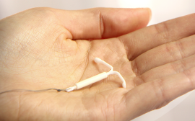
Contributor
AAP Issues Birth Control Guidelines for Teen Girls
Dr. Kate Greenberg, adolescent medicine specialist at Golisano Children's Hospital, said the AAP guidelines echo the recommendations of other expert groups in the past several years.
"Including the American College of Obstetricians and Gynecologists since about 2012, which is that these longer-acting and reversible methods of birth control are the safest and most effective and most appropriate for teenagers."
http://wxxinews.org/post/aap-issues-birth-control-guidelines-teen-girls
Notes:
Here is an example of being contributor for a radio station (local Rochester affiliate of NPR-WXXI News).
September 29, 2014
AAP Issues Birth Control Guidelines for Teen Girls
By BETH ADAMS
Dr. Kate Greenberg is current ARSHEP faculty, Physicians for Reproductive Health, Leadership Training Academy alumni, and pediatrician practicing in Rochester, NY.

Slide 53
OP-ED
“Today, I am a family physician who believes in providing comprehensive health care. We deserve to be in healthy, positive relationships and to decide when and with whom we want to have sex. We should have affordable contraception and quality health care. We should be able to choose to continue a pregnancy without judgment or shame, regardless of our backgrounds.
I believe that my adolescent patients have the resiliency to build strong positive relationships. And yes, these relationships involve sex. So my job involves providing solid and accurate information about sex.
Too many of us don’t support teen parents. But when a pregnant teenager enters my office and declares she is ready to be a mother, I believe her. I support her.”
-Rebecca Trotzky-Sirr, MD, MSc
Los Angeles
http://feministing.com/2013/05/08/for-the-mamas-who-dont-get-love-on-mothers-day/
Notes:
An op-ed must comment on issue of the moment, such as current legislation, debate, trend, or a research finding. (Teen parents)
Rebecca Trotzky-Sirr, MD, MSc, is a single mom to an amazing teenager who barely tolerates her sense of humor. She’s been a part of the reproductive justice movement since before becoming a family doctor. During medical school, Rebecca received a Fulbright grant to study human rights based medicine in Venezuela. Currently she practices family medicine in Los Angeles. She is a Physicians for Reproductive Health Leadership Training Academy Fellow.

Slide 54
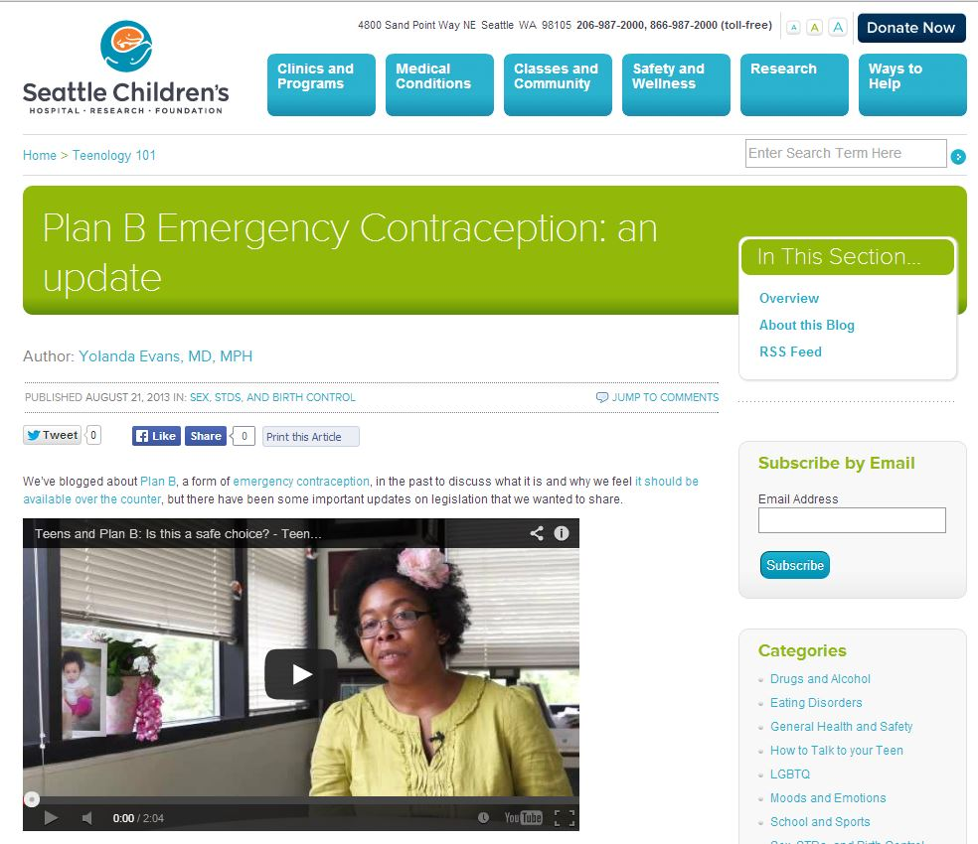
New Media Advocacy
http://teenology101.seattlechildrens.org/plan-b-emergency-contraception-an-update/
Notes:
Advantages of New media: connect directly with the public/patient, educate & dispel myths, hear what patients have to say/what their concerns are, influence public debate, connect with mainstream media.
LTA alumna & pediatrician Dr. Yolanda Evans writes a blog for Seattle Children's Hospital – this is her YouTube video on Plan B and teens
Other forms of new media advocacy: Twitter (especially the use of Twitter storms and chats), Reddit, Facebook, etc.

Slide 55
Finding Media Opportunities
Put yourself in the press – stay LOCAL for best results
Talk to your institution’s public affairs department
Write letters or editorials for medical journals
Become a source or a contributor
Notes:
The key is to pick a media outlet or two or three and follow them so that you know when an opportunity arises – an anti-abortion newspaper column that demands a letter to the editor, a local politics blog that would be interested in the legislature's latest move on birth control and your perspective on it, a newspaper's op-ed page that hasn't published a pro-choice piece in a long time.
In general, advocacy within your local area or within your state can be very powerful – local voices are the most authentic, you can speak to how patients in your state or local doctors are affected.
One way is to talk to public affairs at your institution – tell them that you are available to talk to the media on behalf of your institution about specific topics. Also be sure to discuss your institution’s policy on media and using your institution’s credentials when you speak or write.
If you are interested in working with the media, consider media training, offered by advocacy/professional organizations like Physicians for Reproductive Health.

Slide 56
Make Advocacy A Part Of Your Job
Join an advocacy organization
Write down patient stories once a week
Find a faculty champion
Involve residents and students
Encourage their participation in medical societies
Notes:
Join an advocacy organization – They will make it very easy for you to get involved. Click on everything that they send you, whether it's about issues, signing onto letters, sending emails. Donate money if you can and participate in organized campaigns.
Patient stories – find time once a week to write down patient stories. This makes it easier to think of a story when you need one. You can send stories to advocacy organizations or to your legislators so that they can use your stories. Again, change or leave out details to de-identify the patient and consider asking if you can use their story with details changed
Ended with an ask – what do you want the audience to do?
Faculty champion – having a faculty to act as champion or support you as faculty, can help troubleshoot and lend support.
Involve residents and students – a few residency programs have annual advocacy days for their residents, which provides an educational experience for advocacy. One way to make this easier is to join the advocacy day of another organization, such as Physicians for Reproductive Health, ACOG, AAFP, AAP, etc. Those organizations may also be able to provide funding support.
Many medical organizations also need residents to act as delegates at state, regional, or national meetings. Many also provide leadership training at these meetings or have advocacy days. They sometime also provide funding. For example, ACOG has a Congressional Leadership Conference every February, and there is funding to send delegates from EVERY state. AAFP provides funding support for students and residents to represent as delegates or to participate in committees.

Slide 57
Finding Time
Activity | Estimated Time
Voting | 10 min - one day
Signing a petition | One minute
Writing email to legislator | 1 - 15 minutes
Calling your legislator | 5 - 10 minutes
Writing a letter to the editor | 15 - 60 minutes
Testifying | Half - whole day
Notes:
These times are estimates
#1 – vote if you can! If you've ever been outraged by a politician or by a piece of legislation – then vote to express your voice. This is particularly important for local elections. Voting can be really quick if you're close to your polling location and if there's no line, or it can take an entire day if the polling location is further away, if intimidation tactics are used, and if there is a long line.
- Signing a petition can take less than a minute if you just provide your personal information. If you add a few sentences to personalize the petition, then that might take a little longer.
- Writing an email can take about a minute if you use a form email provided by an organization or you can write a personal email
- Calling your legislator only takes a few minutes, particularly if you are using a script provided by an organization
- A letter to the editor can be quick or can take longer, depending on how quickly you write
- Testifying can take a half day to a whole day depending on how much time you spend on writing your statement, how far you need to travel, and if you stay for the entire hearing. But if you're able to fit it into your schedule, your testimony can have a substantial impact.

Slide 58
Impact Of Physician Advocacy
“The chairman physically sat back in his seat [after hearing that Ohioan doctors are leaving Ohio due to bills limiting abortion access]. He was really shocked by that. Every doctor who testified … said the same thing. The doctors were leaving the state in droves. It's a bad environment already and the heartbeat bill would make it impossible. Ohio already has an ob-gyn shortage, that's pretty commonly known. So to have doctor after doctor testify that 'if you pass this, we're leaving,' I think it really shook them up.”
Kellie Copeland, executive director of NARAL Pro-Choice Ohio in “Crow After Roe” by Jessica Mason Pieklo and Robin Marty
Notes:
2011 was the first year a “heartbeat” bill was introduced in Ohio. This bill would ban abortions after the first detectable heartbeat, which means that the bill would effectively ban nearly all abortions in Ohio.
The Ohio Senate conducted a 3-day hearing to hear from opponents and supporters of the bill – they were deeply impacted by the testimonies of physicians against the bill.
Kellie Copeland, who was in attendance, recalls her memory of the hearings in the book.

Slide 59
Reflection Questions
External factors affecting patients' health and/or your ability to provide the best care for your patients
Existing advocacy skills and skills to develop
Advocate in practice setting and/or community
Advocate as individual and/or part of an organization
Notes:
We went through why physician advocacy is needed and different models of physician advocacy
You may be feeling inspired - Share if there's time

Slide 60
Take Away Messages
Physicians are effective and sought-after advocates
Advocacy is strategic, learnable, and builds on existing skills
Variety of opportunities available – work with others
Stick with it – long-term process of speaking truth as doctors

Slide 61
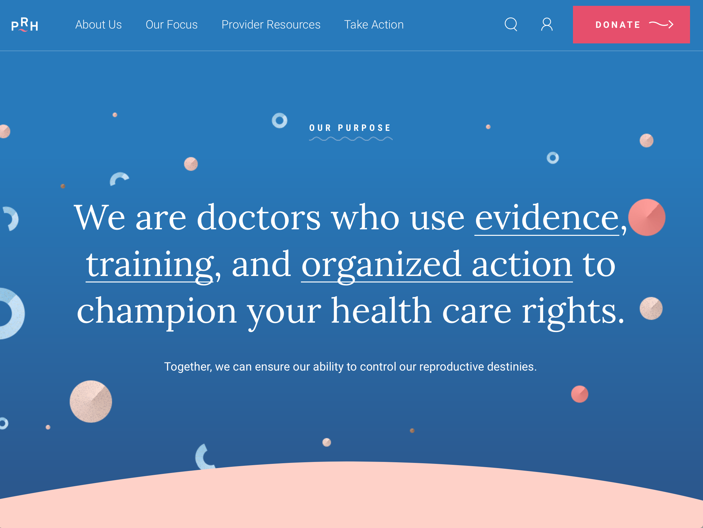
Get Involved
www.prh.org
Notes:
Join an established advocacy organization!

Slide 62
RH Advocacy Resources
Physicians for Reproductive Health
www.prh.org
American College of Obstetricians and Gynecologists
www.acog.org/Advocacy
Association of Reproductive Health Professionals
www.arhp.org/Policy-and-Advocacy
National Abortion Federation
www.prochoice.org/get_involved/activistkit.html
Reproductive Health Access Project
www.reproductiveaccess.org/advocacy/
Notes:
Repro health advocacy resources – provide guides for LTEs/Op-Eds, resolutions, etc

Slide 63
Advocacy Resources
National Medical Organizations
(AAFP, AAP, ACP, AMA, SAHM, etc.)
National Physicians Alliance
www.npalliance.org
Doctors for America
www.drsforamerica.org
Physicians for Social Responsibility
www.psr.org
Notes:
(can edit first bullet depending on specialty of audience)
A small list of the many medical and advocacy organization that you can join, many of which also offer training and fellowships
National Physicians Alliance: Issues include integrity and trust in medicine, and equitable, affordable health care for all
Doctors for America is a national movement of physicians and medical students working together to improve the health of the nation and to ensure that everyone has access to affordable, high-quality health care.
Physicians for Social Responsibility has been working for over 50 years to create a healthy, just, and peaceful world for present and future generations. PSR advocates to prevent nuclear war and proliferation; slow, stop, and reverse global warming; protection from toxic chemicals; eliminate the use of nuclear power.

Slide 64
RH Training Opportunities
Physicians for Reproductive Health
Leadership Training Academy
American College of Obstetricians and Gynecologists (ACOG)
Gellhaus Advocacy Fellowship
ACOG District II Residency Advocacy Program
John McCain Memorial Fellowship
Reproductive Health Access Project (RHAP)
Reproductive Health Care and Advocacy Fellowship
Training in Early Abortion for Comprehensive Care (TEACH) Advocacy Fellow
Notes:
Focused on repro health-related training, but other advocacy fellowships available
Physicians for Reproductive Health: The goal of the Academy is to prepare physicians to become lifelong leaders in reproductive health advocacy by helping them develop and internalize the skills and attributes they need to be powerful, effective advocates for comprehensive reproductive and sexual health care. Almost 300 physicians have completed the program since 2003.
ACOG: Gellhaus Resident Advocacy Fellowship affords ob-gyn residents the rare opportunity to learn about federal health policy and the political factors that shape ACOG's advancement of women's health. Established in 2009 through the ingenuity and support of Dr. Thomas Gellhaus, former McCain Fellow and District VI Chair, the Gellhaus Fellowship consists of a two to four week program typically occurring over a third-year resident's elective. Gellhaus Fellows join ACOG's Department of Government Affairs in the political advocacy process, including attending legislative hearings, issue briefings, and meetings with Members of Congress. During the fellowship, participants complete a project designed in conjunction with Government Affairs staff.
Also, ACOG NY (District 2) Residency ADVO PROGRAM
Post Residency: ACOG's John McCain Memorial Fellowship program gives two Fellows each year a unique opportunity to experience first-hand how ACOG represents our specialty with the U.S. Congress.
3. Reproductive Health Access Project: Falenki fellowship: a one-year fellowship that develops family medicine leaders who will promote and teach full-spectrum women's reproductive health care within family medicine
4. TEACH: Training in Early Abortion for Comprehensive Health Care is an academic-community partnership whose goal is to expand abortion access by helping Family Medicine residencies and primary care clinicians integrate abortion training into their curricula and to model comprehensive reproductive health care.

Slide 65
References
Gruen RL, et al. JAMA 2004;291:94-98
Weinberger, et al. N Enl J Med 2012;367:1557-1559
Winner B, et al. N Engl J Med 2012;366:1998-2007.
Jones RK, Jerman J. Perspect Sex Reprod Health 2014;46:3-14 doi: 10.1363/46e0414
Jones RK, Jerman J. J Women's Health 2013;22:706-713
Gruen RL, et al. JAMA 2006;296:2467-2475.
Grande D, Asch DA, Armstrong KA. J Gen Intern Med 2007;22:585-589.
Marty R, Pieklo JM. Crow After Roe.
Bearak JM et al., Contraception, Feb 2016 Volume 93, Issue 2, Pages 139–144
Obama, B. JAMA. 2016;316(5):525-532.
Finer, L and Zolna, M. N Engl J Med 2016;374:843-52.
Firearm-related injuries affecting the pediatric population. Pediatrics 2012;130:e1416 –e1424
Linberg, L et al.. Journal of Adolescent Health, 2016, 1-7.
Sheldon, W, Winikoff, B. Contraception 92 (2015) 182–185
Cleland, K, Smith N. Contraception 92 (2015) 179–181
Upadhyay UD. PLoS Med 13(8):
http://kff.org/disparities-policy/issue-brief/beyond-health-care-the-role-of-social-determinants-in-promoting-health-and-health-equity/
http://www.guttmacher.org/media/nr/2013/12/19/index.html
www.guttmacher.org/pubs/gpr/14/1/gpr140107.html
http://www.guttmacher.org/media/inthenews/2013/07/08/
http://www.guttmacher.org/media/inthenews/2014/01/02/index.html
http://www.guttmacher.org/media/infographics/barriers-to-access2.html
http://www.businessweek.com/articles/2013-11-27/abortion-clinics-face-shutdown-spiral-as-republicans-push-restrictions
http://www.gallup.com/poll/1654/honesty-ethics-professions.aspx
http://www.slate.com/blogs/the_slatest/2014/04/21/scientific_poll_most_americans_question_big_bang.html
http://ap-gfkpoll.com/poll-methodology
http://www.ama-assn.org/resources/doc/ethics/decofprofessional.pdf
https://www.acgme.org/acgmeweb/Portals/0/PFAssets/ProgramRequirements/CPRs2013.pdf
http://www.acgme.org/acgmeweb/Portals/0/PDFs/commonguide/CompleteGuide_v2%20.pdf
http://www.usnews.com/opinion/articles/2016-09-30/its-long-past-time-to-remove-abortion-pill-restrictions
http://www.guttmacher.org/media/nr/2013/12/19/index.html

Slide 66
Questions?

Slide 68
Thank You!

