Slide 1


Long-Acting Reversible Contraception:
First Line Care for Adolescents

Slide 2
Objectives
Describe the long-acting reversible contraception (LARC) methods available to adolescents
Provide counseling addressing the advantages and disadvantages of each method
Identify barriers that impact LARC use among adolescents
Discuss resources for provider training on LARC insertion and refer patients to LARC education and referral sources

Slide 3
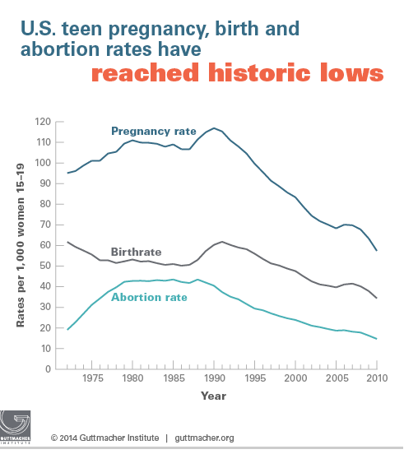
Teen Pregnancy, Birth, and Abortion Rates Are Declining (15-19 year olds)
Kost K and Henshaw S, U.S. Teenage Pregnancies, Births and Abortions, 2010: National and State Trends by Age, Race and Ethnicity. Guttmacher Institute 2014.
Notes:
Overall pregnancy, birth, and abortion rates for 15–19 year olds are declining
In 2010, some 614,000 pregnancies occurred among teenage women aged 15–19, for a rate of 57.4 pregnancies per 1,000 women that age. This marks a 51% decline from the 1990 peak, and a 15% decline in just two years, from 67.8 in 2008.
While there was a substantial drop in the pregnancy rate for 15–17-year-olds and 18–19-year-olds between 2008 and 2010, pregnancies among 18–19-year-olds constituted the majority (69%) of teen pregnancies. During this same time period, increasing proportions of 18–19-year-olds reported having ever had sex, yet fewer of them became pregnant. The likely reason is improved contraceptive use and use of more effective methods.
The study also found dramatic declines in teen pregnancy rates among all racial and ethnic groups.
However, wide disparities persist, and rates among both black and Hispanic teens remain twice as high as the rate for non-Hispanic white teens.
Teen pregnancy rates declined in all 50 states between 2008 and 2010. Yet even with ongoing declines, substantial disparities remain between states. In 2010, New Mexico had the highest teenage pregnancy rate (80 per 1,000), followed by Mississippi (76), Texas (73), Arkansas (73), Louisiana (69) and Oklahoma (69). The lowest rates were in New Hampshire (28 per 1,000), Vermont (32), Minnesota (36), Massachusetts (37) and Maine (37). The authors suggest that the demographic characteristics of states’ populations, the availability of comprehensive sex education, knowledge about and availability of contraceptive services and cultural attitudes toward sexual behavior and early childbearing likely play a role in these variations
Sources:
https://guttmacher.org/media/nr/2014/05/05/index.html
www.guttmacher.org/pubs/USTPtrends10.pdf

Slide 4
Teen Pregnancy Rates Remain High
Teen Pregnancy Rates per 1,000 Teens, Ages 15-19
NYS
U.S.
National Campaign and Advocates for Youth 2006–2008 data
Notes:
The US has the highest teen pregnancy, birth, and abortion rates in the developed world (2006 data). The teen pregnancy rates in NYS are 4-8 times higher than western European countries.
Almost 1/3 of girls (30%) become pregnant before age 20 in the US (2008 data-national campaign).
Many areas of the Rochester city school district have teen pregnancy rates that are 10–14 times higher than European countries with 1 in 6 teens becoming pregnant every year.
Teen pregnancy has significant negative consequences for teens as well as their children. So what does it mean for a 17-year-old to have a baby?
-she is twice as likely to drop out of high school
-She is twice as likely to die in childbirth
-Her baby is twice as likely to be born premature or low birth weight and 3 times as likely to die in the first month of life
-Her child is almost 4 times more likely to grow up poor. If she does not marry and finish high school, she and her child are 9 times more likely to grow up poor.

Slide 5
Current Contraceptive Options
Extremely Effective | Very Effective | Moderately Effective | Effective
Prevents pregnancy >99% of the time | Prevents pregnancy ~91%–99% | Prevents pregnancy ~78%–98% | Prevents pregnancy ~72%–99%
Long-Acting Reversible Contraception: Intrauterine Devices (IUDs) Implants Sterilization | Pills Ring Patch Injectable | Male Condom Withdrawal Diaphragm Female Condom | Fertility awareness methods Spermicide
Contraceptive Technology. Twentieth Edition. 2011.
Notes:
Patch, Pill, Ring: 91%–99%
Depo (Implant): 94%–99%
Moderately Effective (Typical to perfect rates):
Withdrawal: 78%–96%
Diaphragm: 88%–94%
Male Condom: 82%–98%
Female Condom: 79%–95%
Effective Methods:
Fertility Awareness: 76%–99%
Spermicide: 72%–82%
NOT ALL BC CREATED EQUAL, so we shouldn’t present options as such.
In this presentation, effectiveness rates for most of the contraceptive methods are expressed as failure rates, or the percentage of women who can be expected to become pregnant within the first year they use that method.
Effectiveness rates are given with both perfect use (correct and consistent use of the method with every act of intercourse) and typical use (actual use, including occasional inconsistent or incorrect use).
Except where otherwise noted, these rates are based on those reported in the 20th edition of Contraceptive Technology.
Sources:
Rollnick S, Butler CC, Kinnersley P, GregoryJ, Mash B. Motivational interviewing. BMJ. 2010;340:c1900
pediatrics.aappublications.org/content/early/2014/09/24/peds.2014-2300.full.pdf+html
Original content for this slide submitted by Association of Reproductive Health Professionals in June 2008. Original funding received from the Association of Reproductive Health Professionals general operating funds. This slide is available at www.arhp.org/core
Source: T r u s s e l l J . C o n t r a c e p t i v e E f f i c a c y . I n H a t c h e r R A , T r u s s e l l J ,
N e l s o n A L , C a t e s W , K o w a l D , P o l i c a r M . C o n t r a c e p t i v e T e c h o l o g y :
T w e n t i e t h R e v i s e d E d i t i o n . N e w Y o r k N Y : A r d e n t M e d i a , 2 0 1 1 .

Slide 6
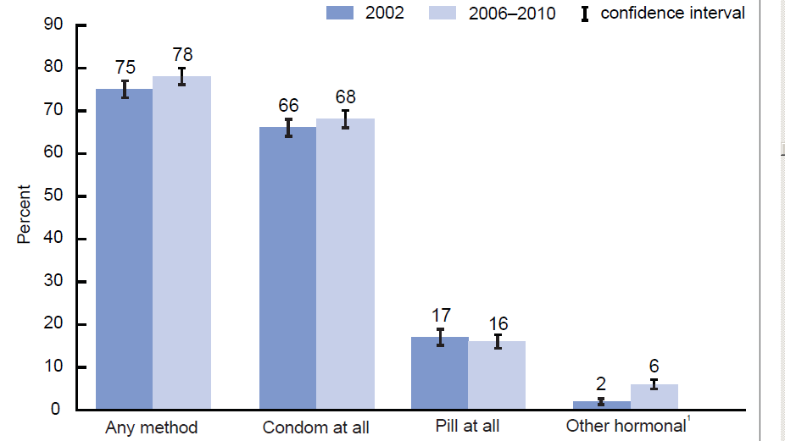
What Birth Control Methods
Are Teens Using?
CDC/NCHS. National Survey of Family Growth. 2006-2010.
Notes:
www.cdc.gov/nchs/data/series/sr_23/sr23_031.pdf
Use of contraception AT FIRST SEX among females aged 15-19, by method used, US 2006-2010.
Other Hormonal includes: Injectable, EC, Patch, Ring & Implant
This is what teens are using- What if you removed all the barriers- myths, access, cost, information- what would teens choose?

Slide 7
What Birth Control Would Teens Choose?
Contraceptive CHOICE Project findings
N Engl J Med 2014;371:1316–23
Notes:
www.nejm.org/doi/full/10.1056/NEJMoa1400506#t=article
“Provision of No-Cost, Long-Acting Contraception and Teenage Pregnancy”
The Contraceptive CHOICE Project was a prospective cohort study involving 9,256 St. Louis area girls and women 14 to 45 years of age, in which the use of LARC methods was promoted to reduce unintended pregnancy.
CHOICE provided standardized contraceptive counseling to study participants regarding commonly used reversible contraceptive methods. Methods were presented in order from most to least effective, and the potential side effects, risks, and benefits of each method were reviewed. Participants were provided with their chosen method at their enrollment session in accordance with evidence-based clinical guidelines.
This analysis involves the 1,404 adolescents who enrolled in CHOICE between 14 and 19 years of age, from 2007 through 2011; 716 teens were followed for 3 years, and 688 teens were followed for 2 years.

Slide 8
What Do Teens Choose?
Contraceptive Choice Project: Mestad, R et al. Contraception 84:2011.
Notes:
When you break it down further by age, young teens aged 14–17 were even more likely to choose a long acting method—almost 70%
1,054 (21% of total sample) 14–20 y/o (214 14–17yr/ 840 18–20yrs)

Slide 9
Of Teens Choosing LARC…
What Do Teens Choose?
Contraceptive Choice Project: Mestad, R et al. Contraception 84:2011.
Notes:
Of teens who chose LARC, young teens (14–17) were more likely to choose Implanon® and older teens (18–20) were more likely to choose IUDs
1,054 (21% of total sample) 14–20 y/o (214 14–17yrs/ 840 18–20yrs)

Slide 10
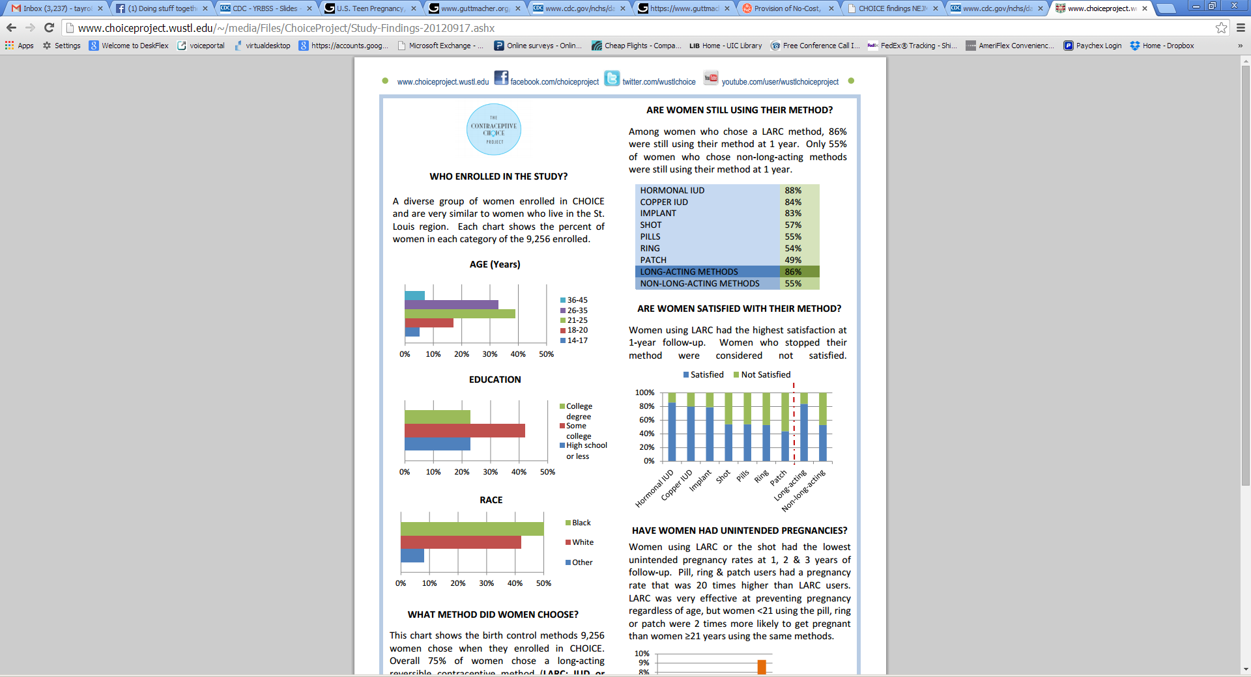
Continuation Rates at 1 Year
www.choiceproject.wustl.edu
Notes:
Among women who chose a LARC method, 86% were still using their method at 1 year. Only 55% of women who chose non-long-acting methods were still using their method at 1 year.

Slide 11

Are Women Satisfied with Their Method?
www.choiceproject.wustl.edu
Notes:
Women using LARC had the highest satisfaction at 1-year follow-up. Women who stopped their method were considered not satisfied.

Slide 12
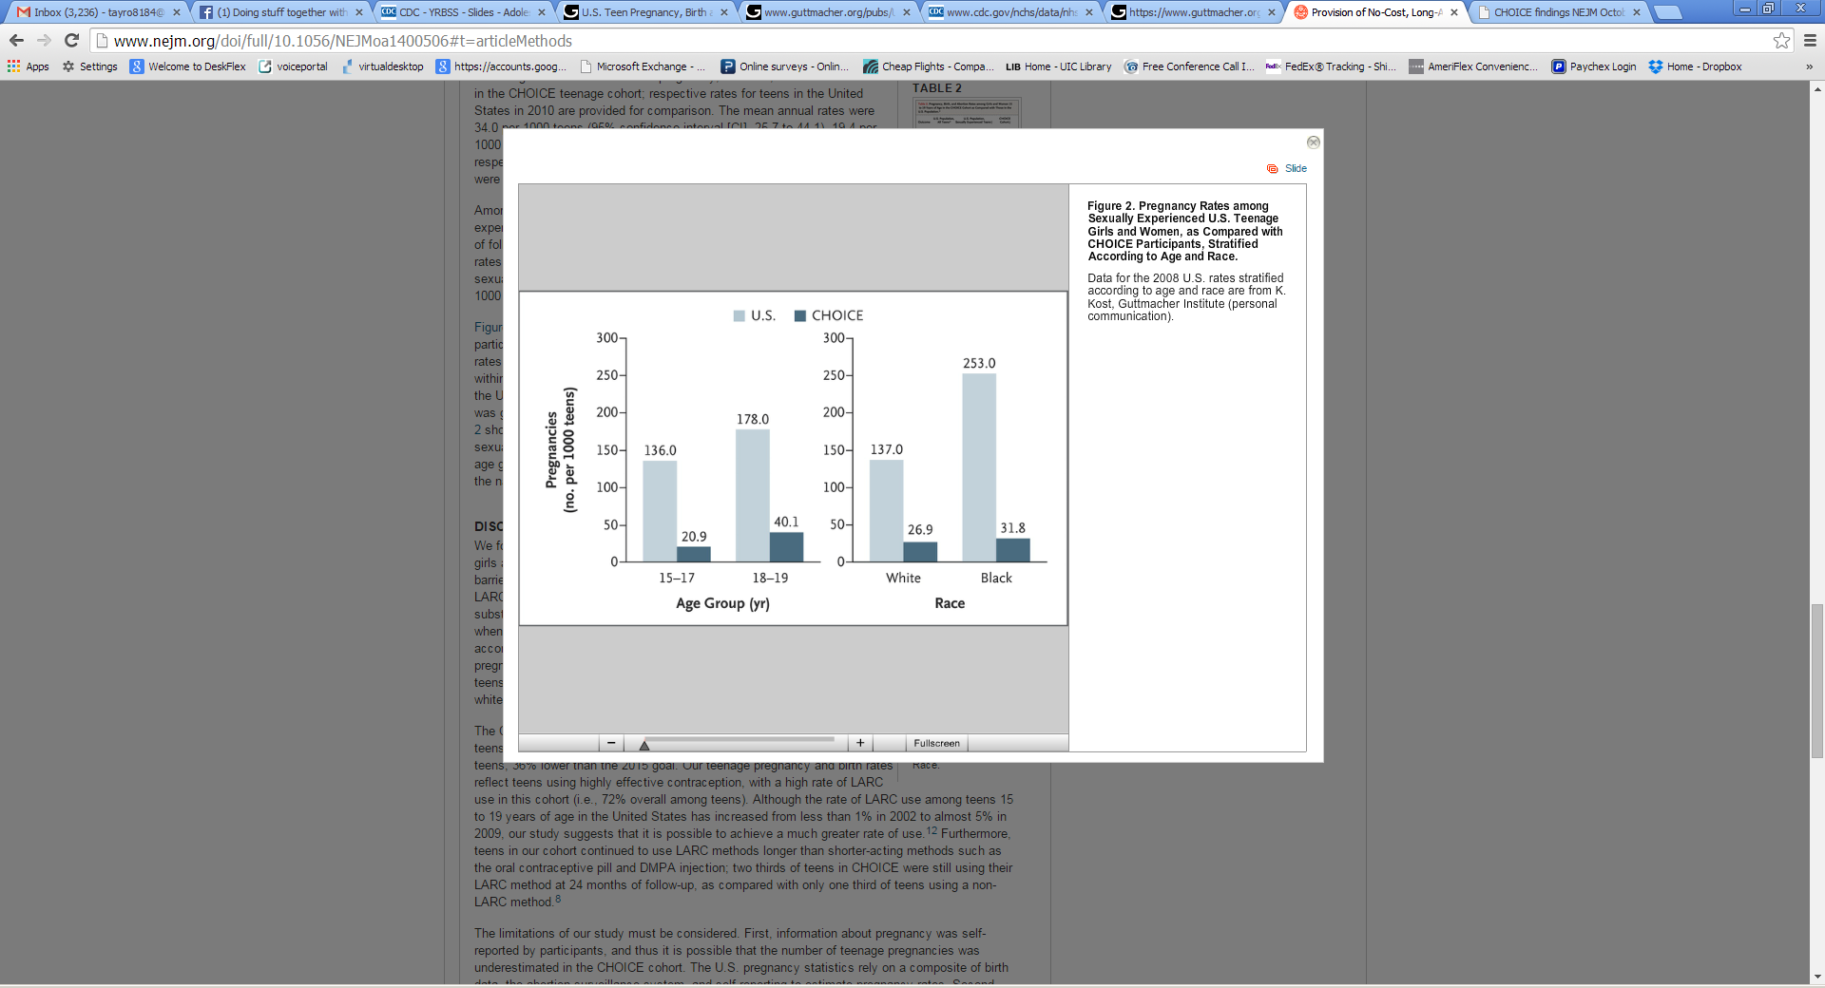
Pregnancy Rates: U.S. vs. CHOICE
N Engl J Med 2014;371:1316-23
Notes:
www.nejm.org/doi/full/10.1056/NEJMoa1400506#t=article
Pregnancy rates among CHOICE teens, as compared with sexually experienced U.S. teens, according to age group and race. For both age groups and both races, the CHOICE rates were substantially lower than the national rates.
Take Home Point: Teenage girls and women who were provided contraception at no cost and educated about reversible contraception and the benefits of LARC methods had rates of pregnancy, birth, and abortion that were much lower than the national rates for sexually experienced teens. (access and education barriers)

Slide 13
LARC Use Increasing for Teens
(15-19 years old)
Finer et al. Fertility and Sterility. 2012.
Notes:
Source:
Finer LB, Jerman J and Kavanaugh ML, Changes in use of long-acting contraceptive methods in the United States, 2007–2009, Fertility and Sterility, 2012, 98(4):893–897.
The proportion of U.S. contraceptors (teens aged 15–19) using the IUD and implant increased from 0.3% in 2002 to 1.5% in 2007 and 4.5% in 2009, more than offsetting decreases in sterilization.
Good news!

Slide 14

What is Larc?
Long-
Acting
Reversible
Contraception
Notes:
Source: Mary Alice Carter

Slide 15
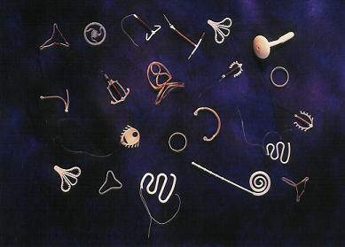
Long-Acting Reversible Contraception
(LARC) = IUDs and Implants
Most effective methods: >99%
Safest
  No estrogen
  Contraindications rare
Highest patient satisfaction
  (80% LARC vs 50% short acting)
Highest continuation rates
  (86% LARC vs. 55% short acting)
Long-term protection—lasts 3-12 years
Rapid return of fertility
Most cost effective
Least likely to be used by teens
Secura GM. The Contraceptive Choice Project. Am J Obstet Gyn. 2011.
Notes:
[Insert Lecture Name Here]
Slide 15
9,256 women from St Louis—over 4 years
Short acting methods (pill, patch, ring, DMPA)
Continuation rates were at 1 year (88% Mirena®/84% Paragard®/83% Implanon®)
The Contraceptive Choice Project

Slide 16
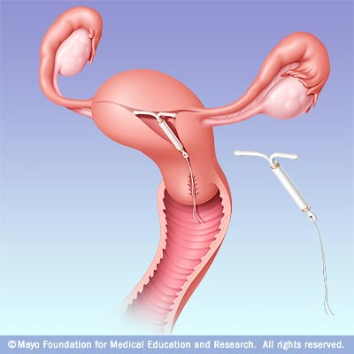
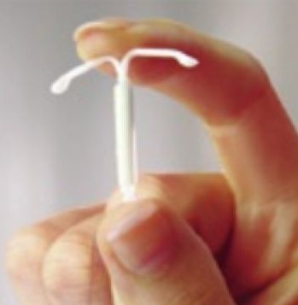
Levonorgestrel IUD (Mirena®)
    20 mcg levonorgestrel/day
    Progestin-only method
5 years use
Cost : ~$300–$700
Bleeding pattern:
  Light spotting initially:
      25% at 6 months
      ~10% at 1 year
  Amenorrhea in:
      44% by 6 months
      50% by 12 months
Extremely Effective
Trussel J. Contraceptive Technology. 2007;
Hidalgo M. Contraception. 2002.
Notes:
The LNG IUS (Mirena) became available in U.S. in 2001. It is a long-acting, progestin-only intrauterine contraceptive method.
Provides highly effective contraceptive protection for five years.
The T-shaped reservoir placed within the uterine cavity releases 20 μg of levonorgestrel per day initially; rate decreases progressively to 10 μg/day after 5 years.
LNG IUS requires an office visit for insertion and an office visit for removal.
Mechanism of Action:
LNG IUS thickens the cervical mucus and inhibits sperm motility and function.
The endometrial atrophy that is a consequence of the high endometrial levels of LNG leads to a substantial decrease in menstrual flow and absence of bleeding in some women who use this form of intrauterine contraception.
It is important to some patients that the LNG IUD mechanisms of action are all before conception. It prevents fertilization rather than disrupts implantation (a common misconception).
The low ectopic pregnancy rate relative to pregnancy rate suggests that an anti-implantation effect is not the primary contraceptive mechanism of action of the device.
Candidates:
All women of reproductive age who are seeking a long-term, highly effective contraceptive.
IUD is especially appropriate for:
Women who are looking for a convenient method.
Women with menstrual symptoms that may improve with LNG IUS. Similar to long-acting, progestin-only DMPA, use of the LNG IUS generally improves menorrhagia, dysmenorrhea, and anemia.
Lactating women.
Advantages:
Use of the LNG IUS may reduce menstrual symptoms in women with uterine fibroids or adenomyosis, thereby reducing the need for hysterectomy.
Data from the United Kingdom also suggest that use of the LNG IUS may reduce the occurrence of benign endometrial polyps in patients who have breast cancer and are taking tamoxifen.
Can be used by lactating women.
Contraindications (WHO MEC):
Puerperal sepsis
Immediate post-septic abortion
Unexplained vaginal bleeding before evaluation
Malignant gestational trophoblastic disease
Cervical cancer awaiting treatment
Current breast cancer
Endometrial cancer
Uterine fibroids with distortion of the uterine cavity
Distorted uterine cavity
Current PID (initiation of IUD)
Current purulent cervicitis or chlaymdial infection or gonorrhea at initiation
Acute PID or recent history of PID
Risk factors for STIs and PID
Post-pregnancy infection (if within the past 3 months)
Distorted uterine cavity
Uterine or cervical cancer or unresolved abnormal Pap smear
Genital bleeding of unknown source
Acute cervicitis, vaginitis, or genital actinomycosis
Increased susceptibility to infection
Disadvantages:
Uterine perforation is a possible, but rare complication of LNG IUS use (1/1000), occurring only at the time of insertion.
Rates of expulsion from 2% to 12% have been reported. Most expulsions occur in the first months following insertion, with decreasing frequency thereafter.
Enlarged ovarian follicles have been diagnosed in about of 12% of subjects using the LNG IUS. Most of these follicles are asymptomatic, although some may be accompanied by pelvic pain or dyspareunia. Usually, the enlarged follicles disappear spontaneously during 2–3 months of observation, and surgical intervention is usually not required.
Obese women have an elevated risk of dysfunctional uterine bleeding and endometrial neoplasia, so the LNG IUS may be an appropriate choice in these women.
Counseling:
Users of the LNG IUS may experience progestin-related side effects such as mood changes, acne, headache, breast tenderness, and follicular ovarian cysts. These side effects are more common during the initial months of use and occur less often over time.
During the first 3–6 months of use, women may experience an increased number of bleeding and spotting days and irregular bleeding patterns. Thereafter, the number of bleeding and spotting days usually decreases, but bleeding may remain irregular. Amenorrhea develops in approximately 20% of LNG IUD users by 1 year.
Breast tenderness and nausea are quite uncommon.
Inform women that LNG IUS do not cause an increased risk of STIs, tubal infertility, and ectopic pregnancies.
Explain non contraceptive benefits and possible menstrual changes.
Describe how to check for the string, follow-up visits, and warning signs.
References
ACOG Committee on Practice Bulletins. No. 73. Use of Hormonal Contraception in Women with Coexisting Medical conditions. Obstet Gynecol. 2006;107:1453–72.
Gardner FJ, Konje JC, Abrams KR, et al. Endometrial protection from tamoxifen-stimulated changes by a levonorgestrel-releasing intrauterine system: a randomised controlled trial. Lancet. 2000;356:1711–7.
Hatcher RA, et al. A Pocket Guide to Managing Contraception. 4th ed. Tiger, GA: The Bridging the Gap Foundation, 2001.
Hidalgo M, Bahamondes L, Perrotti M, Diaz J, Dantas-Monteiro C, Petta C. Bleeding patterns and clinical performance of the levonorgestrel-releasing intrauterine system (Mirena) up to two years. Contraception. 2002;65(2):129–32.
Hubacher D, Grimes DA. Noncontraceptive health benefits of intrauterine devices: a systematic review. Obstet Gynecol Surv. 2002;57:120–8.
Inki P, Hurskainen R, Palo P, Ekholm E, Grenman S, Kivel A, Kujansuu E, Teperi J, Yliskoski M, Paavonen J. Comparison of ovarian cyst formation in women using the levonorgestrel-releasing intrauterine system vs. hysterectomy. Ultrasound Obstet Gynecol. 2002 Oct;20(4):381–5.
Jonsson B, Landgren B-M, Eneroth P. Effects of various IUDs on the composition of cervical mucus. Contraception. 1991;43:447.
Luukkainen T. The levonorgestrel intrauterine system: therapeutic aspects. Steroids. 2000;65:699–7.
Mirena [package labeling]. Montville, NJ: Berlex Laboratories, Inc.; 2000.
Mirena Prescribing Information. Berlex Laboratories, Inc., Montville, NJ; 2000.
Mohllajee AP, Curtis KM, Peterson HB. Does insertion and use of an intrauterine device increase the risk of pelvic inflammatory disease among women with sexually transmitted infection? A systematic review. Contraception. 2006 Feb;73(2):145–53.
Nelson AL. The intrauterine contraceptive device. Obstet Gynecol Clin North Am. 2000;27(4):723–40.
Silverberg SG, Haukkamaa M, Arko H, et al. Endometrial morphology during long-term use of levonorgestrel-releasing intrauterine devices. Int J Gynecol Pathol. 1986;5(3):235–41.
Trussel J. Contraceptive efficacy. In Hatcher RA, Trussel J, Nelson AL, Cates W, Stewart FH, Kowal D. Contraceptive Technology: Nineteen Revised Edition. New York, NY: Ardent Media, 2007.
16

Slide 17
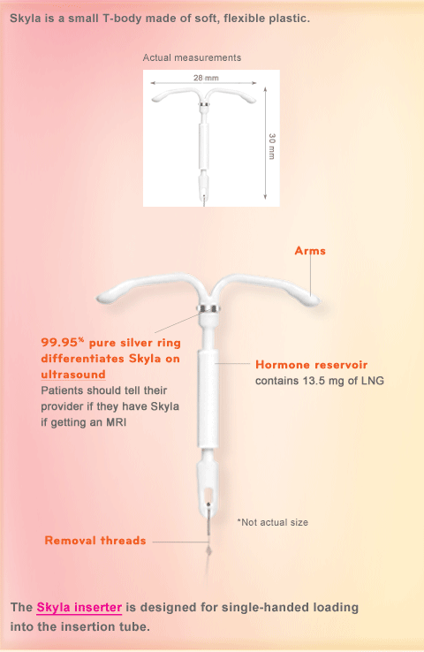
Levonorgestrel IUD (Skyla®)
    14 mcg levonorgestrel/day
    Progestin-only method
3 years use
Cost : ~$300–$650
Smaller in size than Mirena
  1.1 x 1.2 in. (vs. 1.3 x 1.3 in)
  Inserter tube 0.15 in. (vs. 0.19 in)
More irregular bleeding than Mirena
  Only 6% have amenorrhea at 1 yr
Extremely Effective
Notes:
17

Slide 18
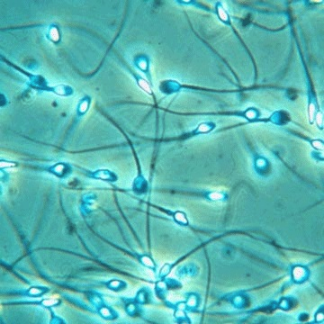
Mirena/Skyla: Mechanism of Action
Fertilization inhibition:
  Cervical mucus thickened
  Sperm motility and function inhibited
  Weak foreign body reaction induced
  Ovulation inhibited
  (in 5%–15% of cycles)
Jonsson et al. Contraception 1991;43:447
Videla-Rivero et al. Contraception 1987;36:217
Notes:
Talking Points:
The mechanism of action of the levonorgestrel intrauterine contraceptive is similar to that of LNG implants or LNG-containing mini-pills. Thickening of the cervical mucus and inhibition of sperm motility and function are the primary mechanism of action.
The endometrial atrophy that is a consequence of the high endometrial levels of LNG leads to a substantial decrease in menstrual flow and absence of bleeding in some women who use this form of intrauterine contraception.
It is important to some patients that the LNG IUD mechanisms of action are all before conception. It prevents fertilization rather than disrupts implantation (a common misconception).
The low ectopic pregnancy rate relative to pregnancy rate suggests that an anti-implantation effect is not the primary contraceptive mechanism of action of the device.
Source
Jonsson B, Landgren B-M, Eneroth P. Effects of various IUDs on the composition of cervical mucus. Contraception 1991;43:447.
Nilsson CG, Lahteenmaki PLA, Luukkainen T, et al. Ovarian function in amenorrheic and menstruating users of a levonorgestrel-releasing intrauterine device. Fertil Steril 1984;41:52.
Videla-Rivero L, Etchepareborda J, Desseru E. Early chorionic activity in women bearing intert IUD, copper IUD and levonorgestrel-releasing IUD. Contraception 1987;36:217.

Slide 19
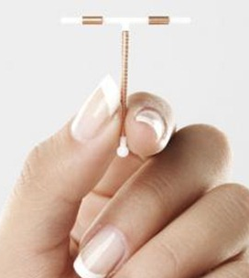
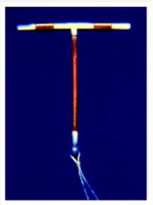
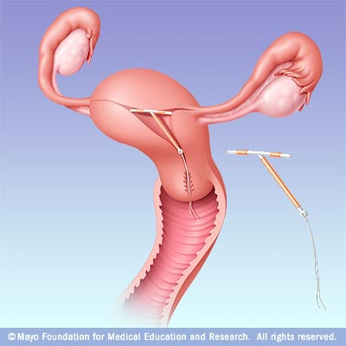
Extremely Effective
Copper ions
No hormones
12 years of use
Cost: ~$150-$475
99% effective as EC
Bleeding Pattern:
  Menses regular
  May be heavier, longer, crampier for first 6 months
Copper-T IUD: Paragard®
Thonneau, PF. Am J Obstet Gynecol. 2008. Trussel J.
Contraceptive Technology. 2007.
Notes:
[Insert Lecture Name Here]
Slide 19
The Cooper T 380A IUD is a small T-shaped device made of polyethylene. The device has two flexible arms that fold down for insertion and expand to form a T shape when released inside the uterus. The vertical stem of the device is wound with fine copper wire, and the two horizontal arms also have a sleeve of cooper. At the bottom of the vertical stem, a 3-mm bulb houses a monofilament poyethylene string that enables the device’s easy removal.
The arms of the Copper-T IUD are wrapped with copper wire, which acts as a functional spermicide. There is clear evidence that IUDs are not abortifacients. They prevent pregnancy by preventing fertilization.
The Copper-T IUD is approved for 10 years of use; however, efficacy lasts 12 years or more.
Mechanism of Action:
Cooper-containing IUDs reduce the motility and viability of the sperm and the development of ova.
Research shows that sperm counts found in the cervical mucus and uterine tube are much lower in women using IUDs than those in non-users.
A clinical study found that women using copper-containing IUDs had uncoordinated contractions, which suggests that the device may act by hindering sperm transport.
Candidates:
Women who desire long-term contraception.
Women who do not want the systematic effects of hormones.
Women who desire a quickly reversible method
Advantages
Fertility returns rapidly after removal of the copper IUD.
There is no ongoing cost after insertion.
The Cooper-T IUD may be associated with a decreased risk for endometrial cancer, but the exact mechanism for this association is unclear.
Contraindications (WHO Criteria): same as Mirena
Disadvantages
Menstrual changes
The Copper T IUD can increase the duration and amount of menstrual flow and menstrual cramping.
Expulsion is rare, occurring in only 5% of users, but is the most likely cause of IUC failure. Expulsion is most common within the first three months after insertion.
Uterine perforation is a rare complication of IUC, occurring approximately once every 770 to 1600 insertions. Perforation generally occurs at insertion, when a portion of the device becomes embedded in the uterine wall.
There’s a possible increased risk of PID during early post-insertion period in women with cervical infections.
Studies suggest that women with chlamydial infection or gonorrhea at the time of IUD insertion were at an increased risk of PID relative to women without infection. The absolute risk of PID was low for both groups (0%–5% for those with STIs and 0%–2% for those without).
Counseling:
Inform women that IUDs do not cause an increased risk of STIs, tubal infertility, and ectopic pregnancies.
Describe how to check for the string, follow-up visits, and warning signs.
References
Beining RM, Dennis LK, Smith LK, Smith EM, Dokras A. Meta-Analysis of Intrauterine Device Use and Risk of endometrial cancer. Ann Epidemiol. 2008.
Fortney JA, Feldblum PJ, Raymond EG. Intrauterine Devices. J Reprod Med. 1999. March;44(3):269–274.
Larsson G, Milsom I, Jonasson K, Lindstedt G, Rybo G. The long-term effects of copper surface area on menstrual blood loss and iron status in women fitted with an IUD. Contraception. 1993;48(5):471–80.
Maslow KD, Lyons EA. Effect of oral contraceptives and intrauterine devices on midcycle myometrial contractions. Fertil Steril. 2003;80(5):1224–7.
Milsom I, Rybo G, Lindstedt G. The influence of copper surface area on menstrual blood loss and iron status in women fitted with an IUD. Contraception. 1990;41(3):271–81.20.
Mohllajee AP, Curtis KM, Peterson HB. Does insertion and use of an intrauterine device increase the risk of pelvic inflammatory disease among women with sexually transmitted infection? A systematic review. Contraception. 2006 Feb;73(2):145–53
Nelson AL. The intrauterine contraceptive device. Obstet Gynecol Clin North Am. 2000;27(4):723–40.12.
Thonneau PF, Almont TE. Contraceptive efficacy of intrauterine devices. Am J Obstet Gynecol. 2008. March;198(3): 248–253.
Trussel J. Contraceptive efficacy. In: Hatcher RA, Trussel J, Nelson AL, et al. Contraceptive Technology: 19th revised ed. New York, NY: Ardent Media, 2007.
WHO Medical Eligibility Criteria for Contraceptive Use, 3rd edition 2004.

Slide 20
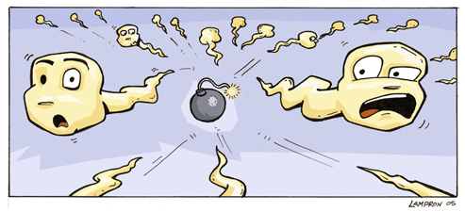
Paragard: Mechanism of Action
Spermicidal
  Copper ions block sperm motility and enzymes needed to fertilize the egg
  Sterile inflammatory reaction in endometrium kill sperm
  Alvarez F. Fertil Steril. 1988.
Notes:
References:
Alvarez F, Brache V, Fernandez E, et al. New insights on the mode of action of intrauterine contraceptive devices in women. Fertil Steril. 1988;49:768.
Segal SJ, Alvarez-Sanchez F, Adejuwon CA, et al. Absence of chorionic gonadotropin in sera of women who use intrauterine devices. Fertil Steril. 1985;44:214.
American College of Obstetricians and Gynecologists. Statement on Contraceptive Methods. Washington, DC: ACOG; 1998.

Slide 21
Which IUD Is the Best Choice?
Copper T IUD (Paragard)
LNG IUD (Mirena)
OK w/irregular bleeding
OK w/amenorrhea
H/O dysmenorrhea
H/O menorrhagia
Want regular periods
Want no hormones
No h/o dysmenorrhea
No h/o menorrhagia
Notes:
[Insert Lecture Name Here]
Slide 21

Slide 22
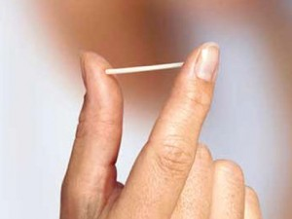
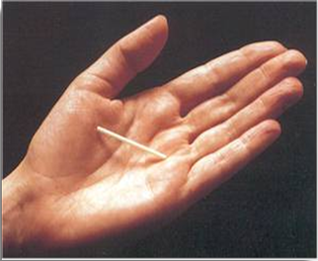

Implant: Nexplanon®
Extremely
Effective
Progesterone
only (etonogestrel)
Effective for 3 years
Cost: ~$300–$600
Mechanism: Inhibits ovulation
Bleeding pattern:
  Amenorrhea (22%)
  Infrequent (34%)
  11% stop due
  to frequent bleeding
Implanon insert: Diaz S., Contraception, 2002: Trussel J, Contraceptive Technology, 2007 Croxatto HB, Contraception, 1998; Diaz S, Contraception, 2002; Funk S, Contraception, 2005.
Notes:
Note: The original version of the implant was called Implanon. The current version is referred to as Nexplanon.
Implanon, an etonogestrel implant, is used by more than 2 million women in European and Asian countries and is now available in the United States.
One rod is 40 mm x 2 mm and its core is 40% ethylene vinyl acetate (EVA) and 60% etonogestrel. It has a rate-controlling membrane of 100% EVA
Because contraceptive implants do not contain estrogen, they can be used during lactation as soon as six weeks postpartum. This feature may be especially attractive to women with young infants who want highly effective contraception that does not require daily action.
The effectiveness of Implanon in overweight women has not been determined; women who weighed more than 130% of their ideal body weight were not studied.
Mechanism of Action:
The multiple-rod implant relies on ovulation inhibition for contraceptive action for the first 3 months of use, then on thicker cervical mucus after three months of use. In contrast, the single-rod implant continues to rely on ovulation inhibition over the entire duration of use.
Candidates:
In addition to its high efficacy rate and long-term effectiveness (3 years), it has rapid reversibility. After the etonogestrel implant is removed, most women (94%) ovulate by 3 months, the majority within 3 weeks.
Advantages:
This method is a particularly good choice for women who do not want a daily or weekly action, desire a discreet method (it is nearly invisible), or want to use contraception during lactation. According to studies with lactating women, there are no negative effects on nursing or infant growth or development with etonogestrel implant.
This method also can confer noncontraceptive benefits, such as improved dysmenorrhea and acne.
Contraindications:
Known or suspected pregnancy
Current or past history of thrombosis
Hepatic tumor or active liver disease
Undiagnosed abnormal genital bleeding
Known or suspected carcinoma of the breast or history of breast cancer
Hypersensitivity to the components of the implant
Disadvantages:
The most common side effect of implant is bleeding irregularities, including infrequent bleeding (26.9%), amenorrhea (18.6%), prolonged bleeding (15.1%), and frequent bleeding (7.4%).
But as with other progestin-only methods, it is the variability and unpredictably of the bleeding that is most characteristic of this method; for example, a bleeding pattern may change from one 2 to 3 month period to the next.
More unpredictable bleeding than Depo, less amenorrhea.
Unfortunately, studies on progestin-only methods have not identified a simple approach for managing bleeding.
However, one study found that ethinyl estradiol may help control bleeding during the first few months of implant use.
Other side effects include weight gain (2.3%), emotional lability (2.3%), headache (1.6%), acne (1.3%), and depression (1.0%).
There is no evidence of long-term effects such as decreased bone mineral density (BMD) and deep vein thrombosis, or anemia with the etonogestrel implant. On the contrary, lumbar spine BMD improved in studies.
Both procedures are rapid: insertion takes 1 minute and removal takes 3 minutes.
Counseling:
During patient counseling, address misperceptions about implants, such as visibility of the implant, low libido, excessive hair growth, and they break off in the arm.
To decrease chances of unintended pregnancy, a quick start method can be used. With this method, the implant can be inserted any time after a negative urine pregnancy test. Another test will need to be done in 3 weeks to make sure the woman was not pregnant when the implant was inserted.
Counseling women about bleeding patterns and other side effects helps prevents early discontinuation.
References
Beerthuizen R, van Beek A, Massai R, Mäkäräinen L, Hout J, Bennink HC. Bone mineral density during long-term use of the progestogen contraceptive implant Implanon compared to a non-hormonal method of contraception. Hum Reprod. 2000;15(1):118–122.
Croxatto HB, Mäkäräinen L. The pharmacodynamics and efficacy of Implanon. An overview of the data. Contraception. 1998;58(6):91S–97S.
Croxatto HB, Urbancsek J, Massai R, Coelingh Bennink H, van Beek A. A multicentre efficacy and safety study of the single contraceptive implant Implanon. Implanon Study Group. Hum Reprod. 1999;14(4):976–981.
Diaz S. Contraceptive implants and lactation. Contraception. 2002;65(1):39–46.
Funk S, Miller MM, Mishell DR Jr, et al; The Implanon US Study Group. Safety and efficacy of Implanon, a single-rod implantable contraceptive containing etonogestrel. Contraception. 2005;71(5):319–326.
Implanon [package insert]. Roseland, NJ: Organon USA, Inc; 2005.
Implanon prescribing information.sa.com/authfiles/images/543_174733.pdf
Meirik O, Fraser IS, d’Arcangues C, et al. WHO Consultation on Implantable contraceptives for women. Hum Reproduct Update. 2003;9(1):49–59.
Trussel J. Contraceptive efficacy. In Hatcher RA, Trussel J, Nelson AL, Cates W, Stewart FH, Kowal D. Contraceptive Technology: Nineteen Revised Edition. New York, NY: Ardent Media, 2007.
Urbancsek J. An integrated analysis of nonmenstrual adverse events with Implanon. Contraception. 1998;58(6):109S–115S.
Weisberg E, Hickey M, Palmer D, et al. A pilot study to assess the effect of three short-term treatments on frequent and/or prolonged bleeding compared to placebo in women using Implanon. Hum Reprod. 2006;21(1):295–302.
Zheng SR, Zheng HM, Qian SZ, Sang GW, Kaper RF. A randomized multicenter study comparing the efficacy and bleeding pattern of a single-rod (Implanon) and a six-capsule (Norplant) hormonal contraceptive implant. Contraception. 1999;60(1):1–8.
---
Original content for this slide submitted by Association of Reproductive Health Professionals in June 2008. Original funding received from the Association of Reproductive Health Professionals general operating funds. This slide is available at www.arhp.org/core

Slide 23
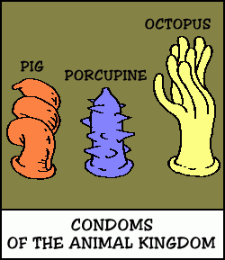
Dispelling Myths
When providers or patients hold misperceptions about the risks associated with contraception…
Teens’ choices are unnecessarily limited
Notes:
Myth about birth control are common and pose significant barriers to use. Myths are held by both patients and providers.

Slide 24
Myths
IUDs cause PID and infertility
IUDs are only for women who have had a baby
Notes:
Audience check in
Who here feels uncomfortable w/ the idea of using IUDs and teens—seems like a bad idea

Slide 25
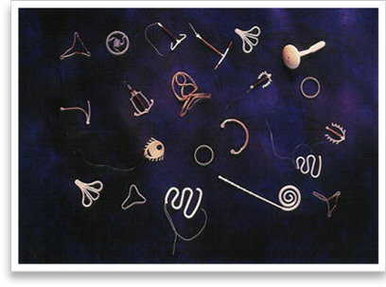
IUDs Do NOT Cause PID
PID incidence for IUD users similar to that of general population
Risk increased only during first month after insertion, still extremely low (1/1000)
Preexisting STI at time of insertion (not the IUD itself) increases risk
=>R/O GC/CT in at risk women
  In Asx teens may insert and screen
Svensson L, et al. JAMA. 1984; Sivin I, et al. Contraception. 1991; Farley T, et al. Lancet. 1992.
Notes:
[Insert Lecture Name Here]
Slide 25
Talking Point:
The presence of a preexisting sexually transmitted infection (STI) at time of insertion, not the IUD itself, increases the risk of PID.
References:
Svensson L, Westrom L, Mardh PA. Contraceptives and acute salpingitis. JAMA. 1984;251(19):2553–5.
Sivin I, Stern J, Coutinho E, et al. Prolonged intrauterine contraception: a seven-year randomized study of the levonorgestrel 20 mcg/day (LNg 20) and the Copper T380 Ag IUDS. Contraception. 1991;44(5):473–80.
Farley T, Rowe P, Meirik O, et al. Intrauterine devices and pelvic inflammatory disease: an international perspective. Lancet. 1992;339:1904.

Slide 26
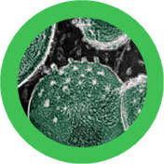
IUDs Do Not Cause Infertility…
Chlamydia Does!
2000 women case-control
IUD users NOT more likely to have infertility than gravid controls (OR = 0.9)
Women with CT antibodies more likely to be infertile (OR = 2.4)
IUD use is not related to infertility
Chlamydia is related to infertility
Similar results in multiple studies
Hubacher D, et al. NEJM. 2001.
Notes:
[Insert Lecture Name Here]
Slide 26
Talking Points:
Background: Previous studies of IUDs, many no longer in use, suggested that copper IUDs might cause tubal infertility, decreasing the use of this method in nulligravid women.
Hubacher et al. enrolled 1,895 women in a case-control study: 358 women with primary infertility with tubal occlusion documented by hysterosalpingogram, 953 women who were infertile without tubal occlusion (infertile controls), and 584 primigravid women (pregnant controls).
Information was obtained about the women’s past use of contraceptives including copper IUDs, previous sexual relationships, and history of STIs. Each subject had antibody testing for Chlamydia trachomatis. Stratified analysis and logistic regression analyses were employed.
Results: Odds ratio for tubal occlusion associated with previous use of a copper IUD was 1.0 (95% CI, 0.6–1.7) using infertile controls. When the primigravid women served as controls, the odds ratio was 0.9 (95% CI, 0.5–1.6). Odds ratio for tubal occlusion associated with chlamydia was 2.4 (95% CI, 1.7–3.2).
Conclusions: Previous use of a copper IUD is not associated with increased risk of tubal occlusion among nulligravid women; rather, chlamydial infection is.
These results have been confirmed by others:
Hov GG, Skjeldestad FE, Hilstad T. Use of IUD and subsequent fertility: Follow-up after participation in a randomized clinical trial. Contraception. 2007;75:88–92.
Skjeldestad F, Bratt H. Fertility after complicated and non-complicated use of IUDs. A controlled prospective study. Adv Contracept. 1988;4:179–84.
Wilson JC. A prospective New Zealand study of fertility after removal of copper intrauterine contraceptive devices for conception and because of complications: A four-year study. Am J Obstet Gynecol. 1989;160:391–6.
Reference:
Hubacher D, Lara-Ricalde R, Taylor D, et al. Use of copper intrauterine devices and the risk of tubal infertility among nulligravid women. NEJM. 2001;345:561–7.

Slide 27
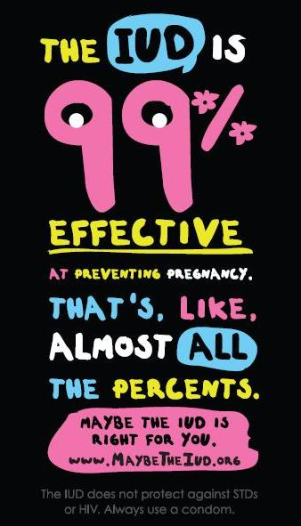
Almost ALL TEENS Can Use IUDs
YES!
YES!
YES!
YES!
YES!
YES!
Who Can Use IUDs:
  Teens?
  Never been pregnant?
  Multiple partners?
  History of STD?
  History of PID?
  History of ectopic?
MacIsaac L. Obstet Gynecol Clin N Am. 2007;
Toma A. J Pediatr Adolesc Gynecol. 2006.
Notes:
[Insert Lecture Name Here]
Slide 27
Talking Points:
A 4-year study found that IUD failure and expulsion rates were lower for nulliparous than parous women. Another study that evaluated three types of IUDs in nulliparous women found low failure and expulsion rates.
According to the World Health Organization’s Medical Eligibility Criteria for Contraceptive Use, nulliparity is considered a condition for which the advantages of using an IUD generally outweigh the theoretical or proven risks.
IUD use in women with a previous ectopic pregnancy is appropriate but reflects off-label use.
IUD users who develop an STI or PID should be tested for relevant organisms and treated with appropriate antibiotic therapy. Clinical guidelines state that removal of the IUD is not necessary unless symptoms fail to improve within 72 hours of the start of treatment.
Actinomyces-like organisms (ALO) normally exist in the female genital tract and are sometimes identified on Pap tests.
Current recommendations state that symptomatic women with a finding of ALO from a Pap or other test should be treated with appropriate antibiotics and the IUD should be removed (after the patient has begun antibiotics). Asymptomatic women require neither IUD removal nor antibiotic therapy.
References:
Duenas JL, Albert A, Carrasco F. Intrauterine contraception in nulligravid vs. parous women. Contraception 1996;53:23–4.
Stanwood NL, Garrett JM, Konrad TR. Obstetrician-gynecologists and the intrauterine device: a survey of attitudes and practice. Obstet Gynecol. 2002;99:275–80.
Forrest JD. U.S. women’s perceptions of and attitudes about the IUD. Obstet Gynecol Surv. 1996;51(12 Suppl):S30–4.
Lippes J. Pelvic actinomycosis: a review and preliminary look at prevalence. Am J Obstet Gynecol. 1999;180(2 Pt 1):265–9.
Otero-Flores JB, Guerrero-Carreno FJ, Vazquez-Estrada LA. A comparative randomized study of three different IUDs in nulliparous Mexican women. Contraception. 2003;67(4):273–6.
World Health Organization. Medical Eligibility Criteria for Contraceptive Use. 3rd ed. Geneva: WHO; 2004.
Penney G, Brechin S, de Souza A, et al. The copper intrauterine device as long-term contraception. J Fam Plann Reprod Health Care. 2004;30(1):29–41.

Slide 28

AAP: LARC and Teens
“Given the efficacy, safety, and ease of use, LARC methods should be considered first-line contraceptive choices for adolescents.”
“Pediatricians should be able to educate patients about LARC methods…”
American Academy of Pediatrics. Policy Statement.
Contraception for Adolescents. 9/29/2014
Notes:
AAP Statement released September 2014
This policy statement updates the 2007 statement on contraception and adolescents.
pediatrics.aappublications.org/content/early/2014/09/24/peds.2014-2300.full.pdf+html

Slide 29

ACOG: IUDs and Teens
“Intrauterine devices are safe to use among adolescents.”
“Intrauterine devices do not increase an adolescent’s risk of infertility.”
“Intrauterine devices may be inserted without technical difficulty in most adolescents and nulliparous women.”
Notes:
Using authority

Slide 30

ACOG: LARC and Teens
“With top-tier effectiveness, high rates of satisfaction and continuation, and no need for daily adherence, LARC methods should be first-line recommendations for adolescents.”
“Health care providers’ concerns
about LARC use by adolescents
are a barrier to access.”

Slide 31
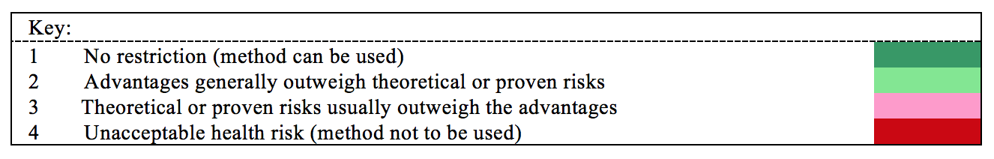
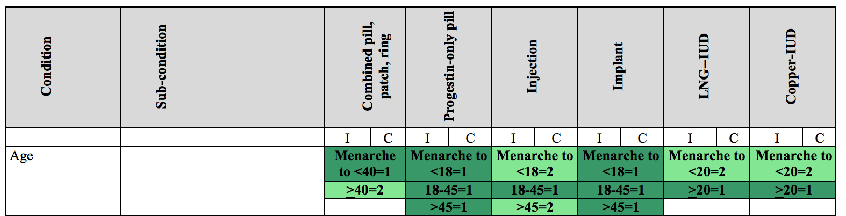
CDC: LARC and Teens
CDC USMEC:
U.S. Medical Eligibility Criteria
Notes:
Objective

Slide 32
IUDs Have VERY FEW Contraindications
Current PID
Current untreated mucopurulent cervicitis, gonorrhea, or chlamydia
Post abortion/partum infection in past 3 mo.
Current or suspected pregnancy
Anatomically distorted uterine cavity
Wilson’s disease (Paragard)
  Other: Uncommon issues for teens
    Known cervical or uterine cancer
    Known breast cancer (Mirena only)
    Genital bleeding of unknown etiology
CDC US Medical Eligibility Criteria 2010

Slide 33
Implant:
Only ONE Contraindication
Current breast cancer
Important to know about class labeling of implant with CHC by FDA.

Slide 34
Young Pregnant Women
Lack Knowledge About IUDs
How safe/effective are IUDs compared to
pills, injections, or tubal sterilization?
Unsure of
safety
Unsure of
efficacy
71%
58%
Stanwood NL, et al. Obstet Gynecol. 2006.
Notes:
[Insert Lecture Name Here]
Slide 34
Talking Points:
190 women, 14–25 year olds (avg ~20), have had a baby.
BUT… 91% had an unplanned current pregnancy!
A study of 190 women ages 14–25 presenting for prenatal or abortion care inquired about contraceptive history, plans, and knowledge.
The majority of subjects wanted to postpone another pregnancy for 4 or more years and wanted a safe and effective method of contraception to reach this goal.
The women were 20 years old on average, 27% had education past high school, and 47% had delivered a child. Ninety-one percent had not planned their current pregnancy.
Fifty percent had heard of intrauterine contraception, 71% did not know about its safety, and 58% did not know about its efficacy.
Respondents who knew of IUDs were older (21 vs. 19 years, p <0.001) and more likely to be parous (55% vs. 39%, p = 0.04).
The study suggests that “young women choosing contraception after a pregnancy would benefit from counseling about the relative safety and efficacy of IUDs, allowing them to make fully informed contraceptive choices.”
Reference:
Stanwood NL, Bradley KA. Young pregnant women’s knowledge of modern intrauterine devices. Obstet Gynecol. 2006;108:1417–22.

Slide 35
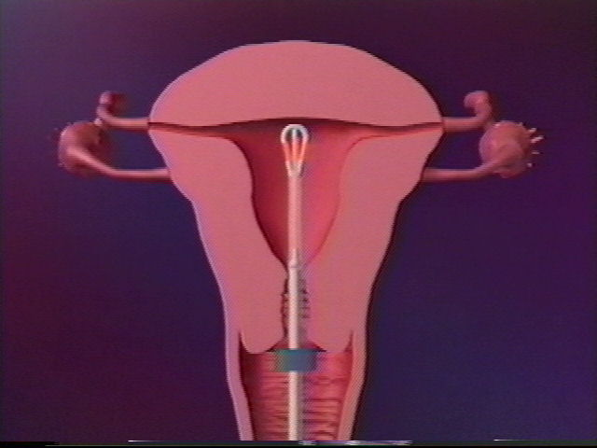
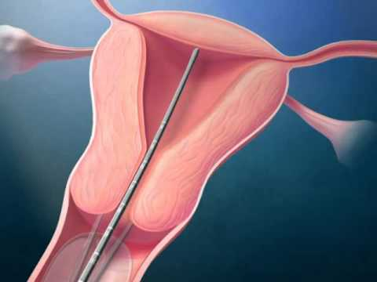
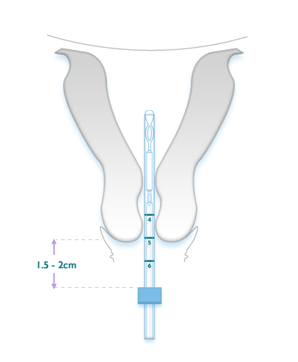
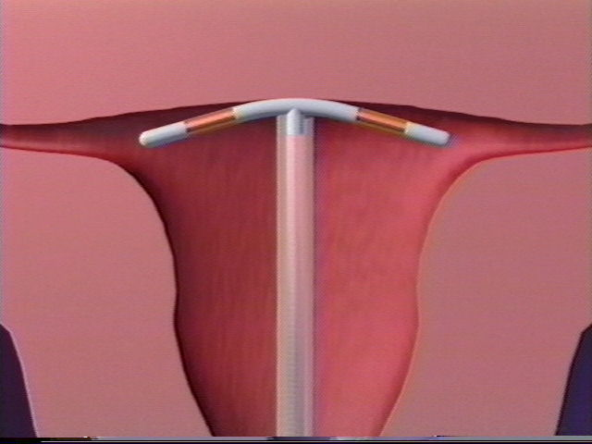
IUD Insertion: What to Expect?
Notes:
IUD insertion—overall, young women tolerate placement really well, particularly if they've had good counseling about what to expect before-hand. I ask them to take 600–800 mg of ibuprofen with some food about 30 minutes before hand, and have a hot pack on hand for afterwards. For young women who've never had a pelvic exam before, I talk through the speculum placement, etc. I tell them they're going to feel 3 cramps—the first when I use an instrument to hold onto their cervix (and I use an anatomical model if I can), a second cramp when I measure how deep their uterus is, and a third when I place the IUD. I also let them have a support person with them if desired, we listen to music on their phones, etc.—lots of calming stimuli and "verbicane" where I can!

Slide 36
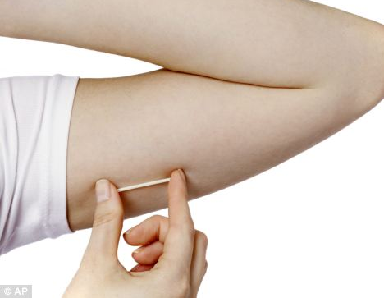
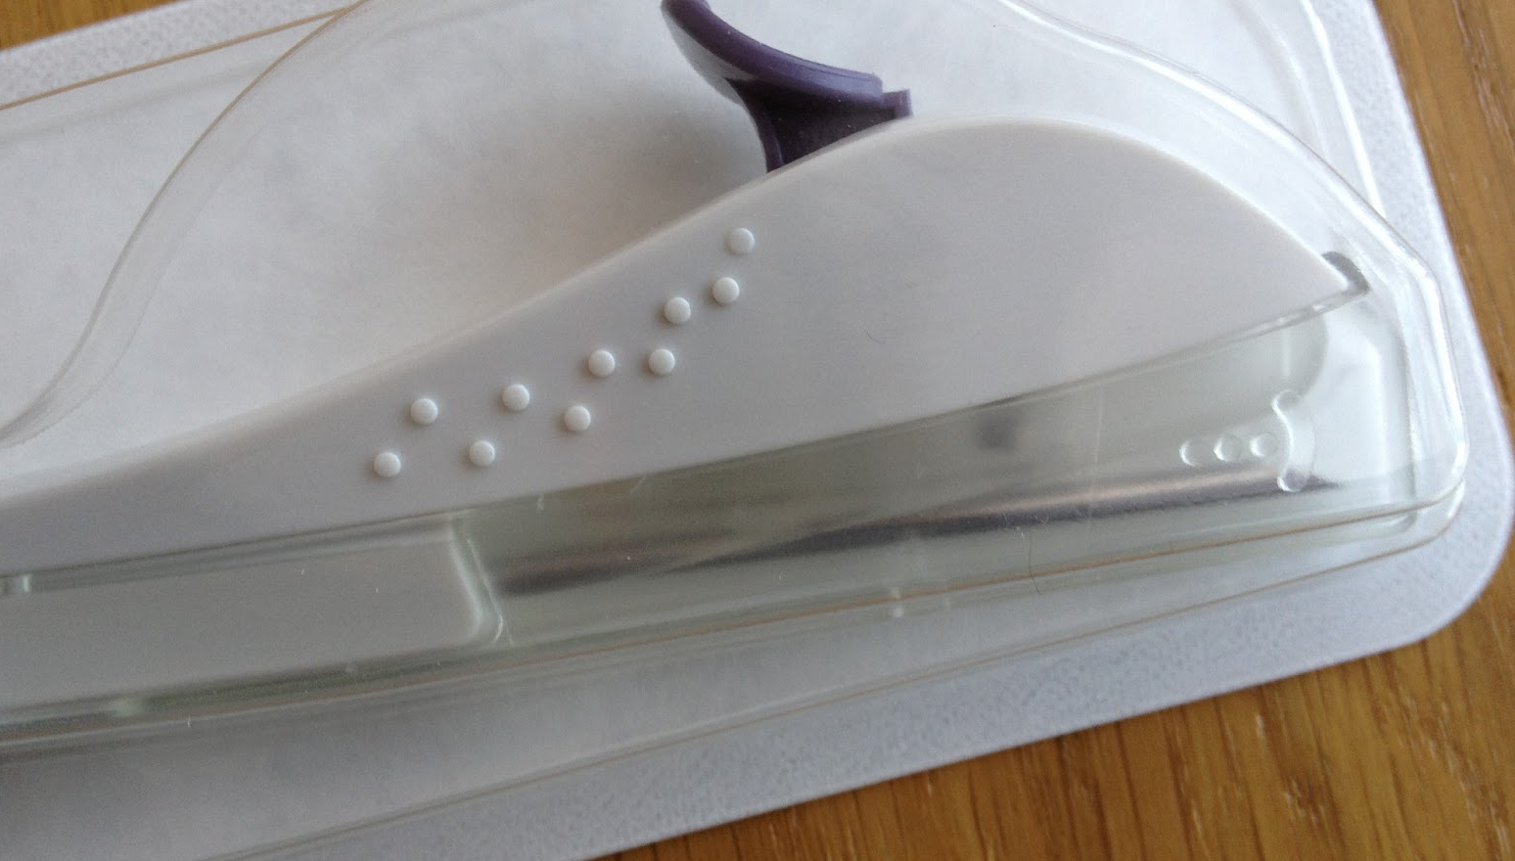
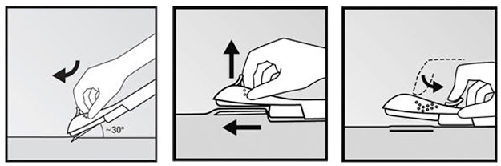
Implant Insertion: What to Expect?
Notes:
Implant insertion—easy peasy! I tell young women the only thing they're going to feel is the numbing medicine (like a bee sting, or a pinch and a burn) and that the longest part of the procedure will be waiting for the numbing medicine to work. The overall reaction is "wait, you're done?” For those young women switching off of Depo, their reaction is that the implant placement was less painful than a Depo shot.

Slide 37
Training to Insert Implants
Training available exclusively through Merck
Those trained in Implanon® can be trained online to insert and remove Nexplanon®
www.nexplanon-usa.com/en/hcp/services-and-support/request-training/index.asp

Slide 38
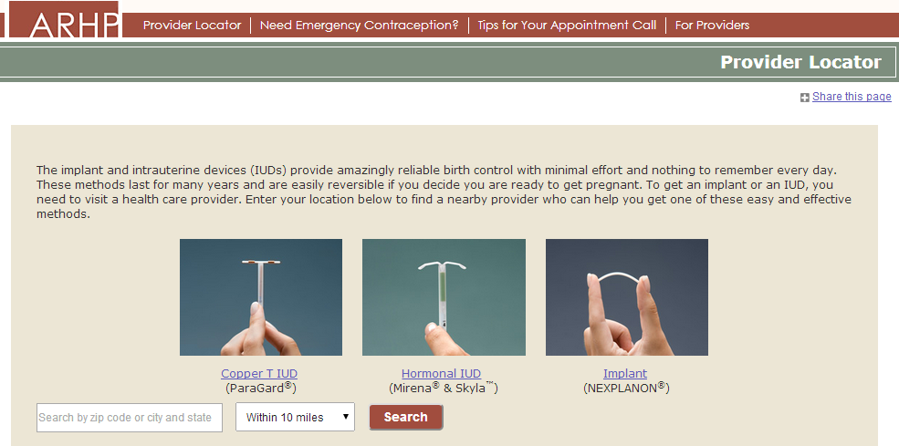
Referring Teens for LARC
Planned Parenthood
Family Planning Clinics
Ob/gyn
LARC Locator
  larc.arhp.org

Slide 39
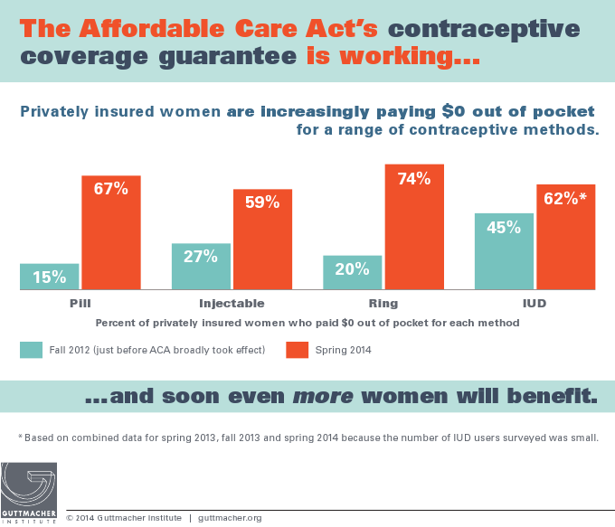
Making Contraception Affordable
www.contraceptionjournal.org/article/S0010-7824(14)00687-8/pdf
Notes:
Between fall 2012 and spring 2014, the proportion of privately insured women paying zero dollars out of pocket for oral contraceptives increased substantially, from 15% to 67%. Similar changes occurred among privately insured women using injectable contraception, the vaginal ring and the intrauterine device.
Data for this study come from a subset of the 1,842 women aged 18–39 years who responded to all four waves of a national longitudinal survey. This analysis focuses on the 892 women who had private health insurance and who used a prescription contraceptive method during any of the four study periods. Women were asked about the amount they paid out-of-pocket in an average month for their method of choice.
Source:
Sonfield A et al., "The Impact of the Federal Contraceptive Coverage Guarantee on Out-of-Pocket Payments for Contraceptives: 2014 Update," Contraception, 2014, <www.contraceptionjournal.org/article/S0010-7824(14)00687-8>

Slide 40
LARC-Specific Resources
In-service UCSF Bixby Center LARC training: bixbycenter.ucsf.edu/research/cd_and_fp/larc.html
www.acog.org/About-ACOG/ACOG-Departments/Long-Acting-Reversible-Contraception
www.love-my-larc.org/live/larc-awareness-week
www.teensource.org/birth-control/long-acting-reversible-methods
www.safeandeffective.org/pages
bedsider.org/methods/iud#details_tab

Slide 41
Provider Resources and Organizational Partners
www.advocatesforyouth.org—Advocates for Youth
www.aap.org—American Academy of Pediatricians
www.aclu.org/reproductive-freedom American Civil Liberties Union Reproductive Freedom Project
www.acog.org—American College of Obstetricians and Gynecologists
www.arhp.org—Association of Reproductive Health Professionals
www.cahl.org—Center for Adolescent Health and the Law
www.glma.org Gay and Lesbian Medical Association

Slide 42
Provider Resources and Organizational Partners
www.guttmacher.org—Guttmacher Institute
janefondacenter.emory.edu Jane Fonda Center at Emory University
www.msm.edu Morehouse School of Medicine
www.prochoiceny.org/projects-campaigns/torch.shtml NARAL Pro-Choice New York Teen Outreach Reproductive Challenge (TORCH)
www.naspag.org North American Society of Pediatric and Adolescent Gynecology
www.prh.org—Physicians for Reproductive Health

Slide 43
Provider Resources and Organizational Partners
www.siecus.org—Sexuality Information and Education Council of the United States
www.adolescenthealth.org—Society for Adolescent Health and Medicine
www.plannedparenthood.org Planned Parenthood Federation of America
www.reproductiveaccess.org Reproductive Health Access Project
www.spence-chapin.org Spence-Chapin Adoption Services

Slide 44

Please Complete Your Evaluations Now

