Slide 1


Emergency Contraception and Adolescents

Slide 2
Objectives
Discuss the need for emergency contraception (EC) among adolescents
Describe the clinical components of EC
Understand the challenges and opportunities for increasing EC use at the patient, provider, and health systems level

Slide 3

Case: Sophie
Case: Sophie
Sophie is a 16-year-old girl who comes to you requesting EC
She tells you the condom broke during sex with her boyfriend

Slide 4
What Is Emergency Contraception (EC)?
A safe and effective way of preventing pregnancy in cases of:
  Contraceptive failure
  No contraceptive use
  Unplanned or forced intercourse
  Contraceptive sabotage
Some methods very effective up to 120 hours after unprotected intercourse (UPI)
Notes:
Sources:
vonHertzen H, Piaggio G, Ding J et al. Low dose mifepristone and two regimens of levonorgestrel for emergency contraception: a WHO multicentre randomized trial. Lancet 2002;360:1803–1810.
Ellertson C, Evans M, Ferden S, et al. Extending the time limit for starting the Yuzpe regimen of emergency contraception to 120 hours. Obstet Gynecol 2003;101:11168–71.

Slide 5
Adolescents Need EC
The U.S. has one of the highest teen pregnancy rates in the industrialized world.
5% of teen pregnancies due to contraceptive failure
  Effectiveness of method
  Consistent and correct use
Santelli et al., 2006
Notes:
In comparison with other western nations, U.S. teens are less likely to use contraception, and have less access to reproductive health services and sex education. These factors likely explain why the U.S. has the highest teen pregnancy rate of the industrialized world.
A study published in 2006 in the American Journal of Public Health indicates that the major factor in the decrease in teen pregnancy rates in the U.S. was due to an increase in contraceptive use.
Sources:
Santelli JS, et al. Explaining recent declines in adolescent pregnancy in the United States: The contribution of abstinence and improved contraceptive use. Am J Public Health 2007;97:150–156.

Slide 6
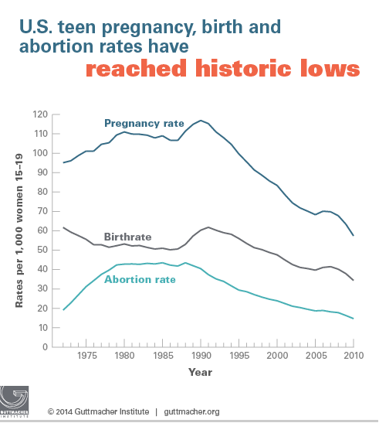
Teen Pregnancy, Birth, and Abortion Rates Are Declining (15-19 year olds)
Kost K and Henshaw S, U.S. Teenage Pregnancies, Births and Abortions, 2010: National and State Trends by Age, Race and Ethnicity. Guttmacher Institute 2014.
Notes:
https://guttmacher.org/media/nr/2014/05/05/index.html
http://www.guttmacher.org/pubs/USTPtrends10.pdf
More recent data are available for teen birthrates than for teen pregnancy rates, and those data show that the decline in teen births has continued: It dropped 10% from 2012 to 2013, to 27 per 1,000—the lowest rate ever reported for the United States. Although data for the same time period are not yet available for abortions (and therefore pregnancies), these numbers suggest that teen pregnancy rates may very well have continued their long-term declines as well.
Source: Hamilton BE et al., Births: preliminary data for 2013, National Vital Statistics Reports, 2014, Vol. 63, No. 2, http://www.cdc.gov/nchs/data/nvsr/nvsr63/nvsr63_02.pdf, accessed Aug. 20, 2014.
Overall pregnancy, birth and abortion rates for 15-19 year olds are declining
In 2010, some 614,000 pregnancies occurred among teenage women aged 15–19, for a rate of 57.4 pregnancies per 1,000 women that age. This marks a 51% decline from the 1990 peak, and a 15% decline in just two years, from 67.8 in 2008
While there was a substantial drop in the pregnancy rate for 15–17-year-olds and 18–19-year-olds between 2008 and 2010, pregnancies among 18–19-year-olds constituted the majority (69%) of teen pregnancies. During this same time period, increasing proportions of 18–19-year-olds reported having ever had sex, yet fewer of them became pregnant. The likely reason is improved contraceptive use and use of more effective methods.
The study also found dramatic declines in teen pregnancy rates among all racial and ethnic groups.
However, wide disparities persist, and rates among both black and Hispanic teens remain twice as high as the rate for non-Hispanic white teens.
Teen pregnancy rates declined in all 50 states between 2008 and 2010. Yet even with ongoing declines, substantial disparities remain between states. In 2010, New Mexico had the highest teenage pregnancy rate (80 per 1,000), followed by Mississippi (76), Texas (73), Arkansas (73), Louisiana (69) and Oklahoma (69). The lowest rates were in New Hampshire (28 per 1,000), Vermont (32), Minnesota (36), Massachusetts (37) and Maine (37). The authors suggest that the demographic characteristics of states’ populations, the availability of comprehensive sex education, knowledge about and availability of contraceptive services and cultural attitudes toward sexual behavior and early childbearing likely play a role in these variations

Slide 7
Youth Risk Behavior Survey, 2013
YRBS Question | U.S.
% students ever had sex | 47%
% students who used a condom at last sex | 59%
% students who used birth control pills at last sex | 19%
% students who used Depo-Provera, NuvaRing®, Implanon®, or any IUD before last sex | 5%
Notes:
The YRBS, or Youth Risk Behavior Survey, is an anonymous survey administered by the CDC every two years in selected high schools throughout the United States. Thus, it is a survey of adolescents in grades 9-12 who are in school. The survey focuses on many different health concerns and behaviors including: mental health, exercise, nutrition, use of seatbelts, substance use behavior and sexual behavior. We will be briefly review some of the data pertaining to sexual health.
The data is available nationally, by state, and also at local levels. It is helpful to become familiar with the results in your area, especially when trying to sensitize stakeholders about the need to develop services to support adolescents to reduce risk.
Discuss each cell.

Slide 8
Indications for EC

Slide 9
Human Error
Inconsistent contraceptive use
Incorrect contraceptive use

Slide 10

Method Failure: Patch
Patch off for 24 hours or more during patch-on weeks
More than two days late changing a patch
Late putting patch back on after patch-free week
Notes:
Source:
Nanda K. Contraceptive Patch and Vaginal Contraceptive Ring. In: Hatcher RA, Trussell J, Nelson A, Cates W, Stewart F, Kowal D. (editors) Contraceptive Technology, 19th revised edition. New York: Ardent Media, 2007.

Slide 11

Method Failure: Ring
Taken out for more than three hours during ring-in weeks
Same ring left in more than five weeks in a row
Late putting ring back in after ring-out week
Notes:
Source:
Nanda K. Contraceptive Patch and Vaginal Contraceptive Ring. In: Hatcher RA, Trussell J, Nelson A, Cates W, Stewart F, Kowal D. (editors) Contraceptive Technology, 19th revised edition. New York: Ardent Media, 2007.

Slide 12
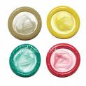

Method Failure: Others
Condom breaks or slips
Two or more missed active OCPs
DMPA shot 14 or more weeks ago
Expelled IUD
Three or more hours late taking a POP
Diaphragm or cervical cap dislodges

Slide 13
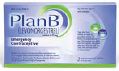
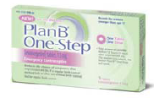
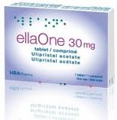


Methods of EC
Notes:
Emergency contraception is recommended for all women at risk for unintended pregnancy.
There are several options for EC in the U.S. which include levonorgestrel or “levo” pills, ulipristal acetate or ella®, and the Copper IUD.
Levo EC is the most well known and available form of EC here in the U.S. Current Levo products include Plan B®, Plan B One-Step® and Next Choice™.
Levo EC has been available over the counter to young men and women that are age 17 or older over the last few years, in 2013 Plan B One-Step became available OTC regardless of age or point of sale.
Other generic versions of EC were not approved OTC, however this may happen very soon.
The generic pill still requires that individuals present age identification, which effectively discriminates against populations less like to have identification. While significant gains have been made, much remains to be done to achieve universal access to EC.
As medical providers, it is important to be aware of which pharmacies carry Plan B One-Step and whether or not it is easily accessible to teens.
It is important to note that the WHO states that “there are no situations in which the risks of using EC outweigh the benefits and there are documented studies that show that Levo EC will not disrupt or harm an existing pregnancy, it has also been tested and proven to be safe in adolescents specifically.
OTC cost is $35 (Next Choice) to $50 (Plan B One-Step) at CVS
The most effective method of EC is the Copper IUD. Wherever possible this would be the first line method.
It’s used to prevent pregnancy after sex
Regimen:
Plan B One-Step: high-dose progestin-only pill (approved specifically for EC) approved by FDA in July 2009
The original Plan B manufacturer, Teva, discontinued 2 pill product. Now—Take 1 tablet within 72 hours (3 days) after unprotected sex or contraceptive failure
Generic two pill formulation (approved by FDA 2009): Take 2 tablets within 120 hours (5 days) after unprotected sex or contraceptive failure
Oral contraceptives used for EC: Regimen varies by product (The Yuzpe Regimen is becoming a historical detail. Hopefully not easily tolerated)
Copper-T IUD: Insertion within 5 days after unprotected intercourse (Mirena® should NOT be used as EC)
ella: ulipristal acetate, Progesterone agonist/antagonist, FDA approved 2010, efficacy does not wane up to 5 days (120 hours), only prescription, not indicated of known/suspected pregnancy. May also work by preventing implantation. 2.2% pregnancy rate compared to 5.5 percent (48–120 hours)
Today most formulations of emergency contraception come in a single dose product. Advise patients that if they take a 2-dose product, such as the original Plan B, it is preferable to take both doses at once.

Slide 14
Branded EC Products in the U.S.
Plan B OneStep®
ella®
Single dose
Single dose
1.5 mg levonorgestrel
30 mg Ulipristal acetate (UPA)
Prescription Only
OTC for men and women of all ages
Can order online at www.ella-kwikmed.com
Label: Up to 72 hrs after unprotected sex
Label: Up to 120 hrs after unprotected sex
Recommend: Up to 120 hrs
Notes:
Plan B OneStep:
1 tablet, 1.5 mg levonorgestrel
Manufactured by Teva Pharmeceuticals
Currently available in pharmacies and health centers
0–120 hours (Less effective between 72 and 120 hours and may be less effective for women with BMI >30kg/m²)
Mechanism of action: (1) prevents ovulation and fertilization, (2) may inhibit implantation, not effective once implantation has begun.
Costs about $35–$60
Source: Glasier, A., Cameron, S.T., Blithe, D., Scherrer, B., Mathe, H., Levy, D., et al. (2011). Can we identify women at risk of pregnancy despite using emergency contraception? Data from randomized trials of ulipristal acetate and levonorgestrel. Contraception, 84(4), 363-367.
Source: Reproductive Health Technologies Project. (2013). Frequently Asked Questions: The Impact of Weight on Efficacy of Emergency Contraception.
ella:
1 tablet 30 mg ulipristal acetate
Manufactured by Watson Pharmaceuticals
Available in health clinics
Single product labeled for prescription usage only
One tablet taken orally as soon as possible within 120 hours (5 days) after unprotected intercourse or a known or suspected contraceptive failure.
Mechanism of action: (1) inhibits or delays ovulation, (2) may inhibit implantation
Pharmacy prices tend to be $5–$10 dollars more than Plan B One-Step. Since it is prescription only, it is covered by some private and public insurance.
Through KwikMed, the product plus shipping is $42.
Rx required for all ages
May be ordered from online prescription service - https://www.ella-kwikmed.com/
Pill mailed the next day
One 30 mg ulipristal acetate pill
Label: Take within 120 hrs after intercourse
Unlike levonorgestrel, ulipristal effectiveness does not decline with delay in treatment
http://www.rhtp.org/contraception/emergency/documents/FDAApprovedEmergencyContraceptiveChartDecember2011-PRINTABLE_000.pdf
Additionally, the new EC product ella entered the market in November 2010. ella is effective for five days after unprotected intercourse, and the efficacy does not diminish over this time period. ella primarily works by delaying ovulation.

Slide 15
Generic EC Products in the U.S.
Next Choice™ One Dose
and My Way®
Levonorgestrel Tablets
Generic
Generic
Label: 1 dose of 1.5 mg levonorgestrel up to 72 hrs after unprotected sex
OTC for ages 17 & older; Rx required for minors**
OTC for ages 17 & older
Label: 2 doses of 0.75 mg levonorgestrel up to 72 hrs after unprotected sex
Recommend: Up to 120 hrs
Recommend: 2 tablets at once up to 120 hrs
Notes:
Next Choice™ One Dose:
1 dose of 1.5 mg levonorgestrel
Manufacturer: Watson Pharmaceuticals, INC
Currently available in pharmacies and health centers
Mechanism of action: (1) prevents ovulation and fertilization, (2) may inhibit implantation, not effective once implantation has begun.
This generic EC is currently priced around 10%–20% lower than Plan B One-Step ($35–$60)
**DISCAIMER: The FDA now allows Next Choice One Dose and My Way to be sold OTC to all women (identification will not be required) with the exception that the label must clearly state that it’s intended use is for women 17 years of age and older
Source: Food and Drug Administration. Letter Reference ID 346025. Accessed April 10, 2014: http://www.hpm.com/pdf/blog/PLAN%20B%20-%20FDA%20Exclusivity%20&%20Carve-Out%20Determination.pdf
Levonorgestrel Tablets:
2 tablets each, 0.75 mg levonorgestrel
Manufactured by Perrigo Pharmaceuticals, Inc.
Currently available in Rite Aid Pharmacies and other locations nationwide
Single product that is “dual labeled” for both prescription and OTC usage with the following restrictions: Rx—16 years and younger, OTC—ages 17 years and older.
First tablet taken orally as soon as possible within 72 hours after unprotected intercourse. Second tablet should be taken 12 hours after the first dose.
Mechanism of action: (1) prevents ovulation and fertilization, (2) may inhibit implantation, not effective once implantation has begun.
This generic EC is currently priced around 10%–20% lower than Plan B One-Step ($35–$60)
Talking Points
Both Plan B One-Step and the generic Next Choice products are FDA-approved to be sold without a prescription to women and men 17 and older in the United States.
A government-issued ID is required for proof of age to purchase Plan B OTC.
Women age 16 and younger still need a prescription from a health care professional. In pharmacy access states, that prescription can be written by a pharmacist.
“Pharmacy access” means specially trained pharmacists can decide if EC is medically appropriate for the woman requesting it and can prescribe or dispense ECPs under protocol.
States that currently have pharmacy access in place: AK, CA, HI, NH, NM, MA, ME, VT, and WA.
OTC availability of EC pills has dramatically increased women’s access.
Pharmacy access reduces barriers by
Not requiring appointments
Being open evening, weekends and holidays
Offering OTC EC to men who meet the age requirement
Prescribing EC to undocumented women immigrants, women Medicaid clients who otherwise can’t afford OTC ECPs, and women needing a prescription for their private insurance to cover the cost of ECPs.
References
Food and Drug Administration. Plan B One-Step Approval Letter. 2009. Available at http://www.accessdata.fda.gov/drugsatfda_docs/appletter/2009/021998s000ltr.pdf. Accessed November 14, 2011.
Next Choice Consumer Information. Available at http://pi.watson.com/data_stream.asp?product_group=1648&p=ppi&language=E. Accessed November 14, 2011.
http://www.rhtp.org/contraception/emergency/documents/FDAApprovedEmergencyContraceptiveChartDecember2011-PRINTABLE_000.pdf

Slide 16
Case: Sophie
Case: Sophie
Sophie tells you that it has been four days since the condom broke
Her medical history also indicates that her BMI is 30
Which EC options would you discuss with Sophie?

Slide 17
Emergency Contraception
Decision Tree
Unprotected Sex
When?
Up to 72 hours
72 to 120 hours
Most effective
BMI?
Cu-T380A IUD
≤ 30 kg/m²
> 30 kg/m²
Unable to have a Cu-IUD inserted?
Preferred
ella
Plan B
ella
ella not available?
ella
Plan B
Created by Physicians For Reproductive Health:
Anne R. Davis, MD, MPH
Notes:
Source: http://prh.org/wp-content/uploads/ECPractGuideApril2014.pdf
Physicians for Reproductive Health. Emergency Contraception a practitioner’s guide. Updated April 2014.

Slide 18
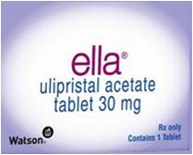
ella ®
FDA approved August 2010 and entered market November 2010
Rx-only for all ages
Effective 5 days after unprotected intercourse (UPI)
Efficacy does not diminish over time
Average failure rate of 2.1%
More effective for obese women
than levonorgestrel
Notes:
Talking Points
ella was approved by the FDA in August 2010 and entered the market November 2010
It is labeled for use up to 120 hours after unprotected intercourse.
ella is the only EC product labeled for use in the 73–120 hours after sex window.
While the effectiveness of progestin-only pills declines with delay in treatment, the effectiveness of ella does not (up to 120 hours).
Has been shown to be more effective for obese women.
ella is available online through Kwikmed for $42 including a waived shipping fee.
ECPs can be obtained for a reduced rate (or free) at Planned Parenthood or other family planning clinics that use a sliding scale to determine charges for those who are low income or don’t have insurance coverage.
References
Glasier A, Cameron ST, Blithe D, et al. Can we identify women at risk of pregnancy despite using emergency contraception? Data from randomized trials of ulipristal acetate and levonorgestrel. Contraception 2011;84(4):363–7.
Moreau C, Trussell J. Results from pooled phase III studies of ulipristal acetate for emergency contraception. Contraception 2011;84:308.
How to get emergency contraception? How much do emergency contraceptive pills cost? Available at http://ec.princeton.edu/questions/eccost.html. Accessed November 10, 2011.
Reproductive Health Technologies Project. FDA approved emergency contraceptive products currently on the US market. August 2011. Available at http://www.rhtp.org/contraception/emergency/documents/FDAApprovedEmergencyContraceptiveChartAugust2011-PRINTABLE.pdf. Accessed November 4, 2011.

Slide 19
ella Is Available Online: Kwikmed
No face-to-face is required to diagnose
Allows patient to receive pills in a timely, discreet manner
Resolves pharmacy access barriers
Online physician consultation
Highly cost efficient
KwikMed is the only firm licensed to prescribe online
www.kwikmed.com/ella.asp
Notes:
Online orders are typically reviewed within 4 hours
Pharmacy transfers: 7% of orders
Average sale price: $59
Average days from UPI to delivery: 1 day

Slide 20
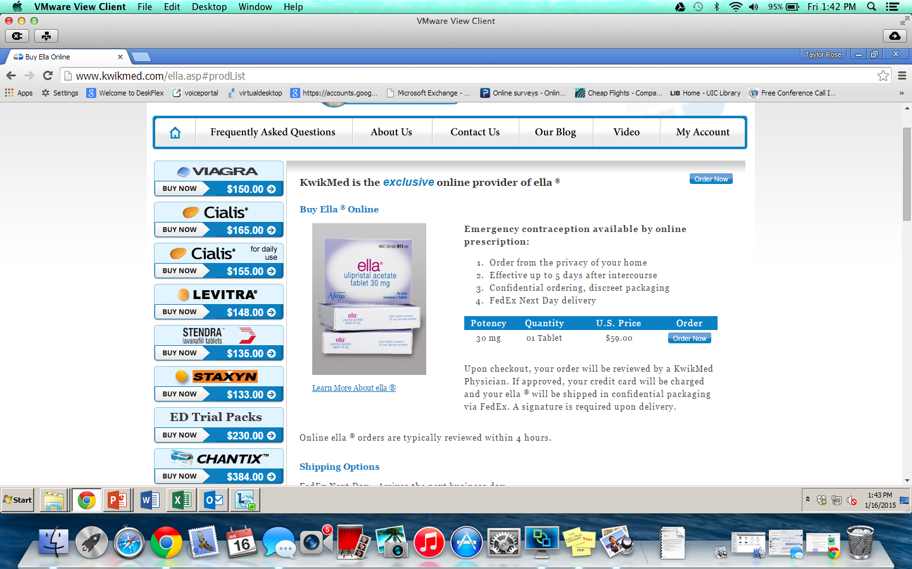
ella-kwikmed.com

Slide 21
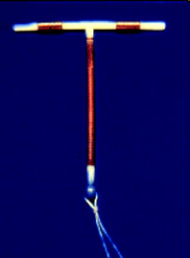
Paragard® (Copper IUD): Off-Label Use
Insert within five days after UPI
Highly effective: Reduces risk of pregnancy by more than 99%
  Efficacy doesn’t decline over time
Historically, rarely used for EC alone
but this may change
Cannot use levonorgestrel IUS
(Mirena® or Skyla®) for EC
Notes:
Insertion of a copper-T IUD is much more effective than use of ECPs or minipills, reducing the risk of pregnancy following unprotected intercourse by more than 99%. A copper-T IUD can be left in place to provide continuous effective contraception for up to ten years.
Off label use
Placed within 5 days after intercourse
Effectiveness does not decline with delay
Placed by a trained clinician
Cost: may be $500
Source:
Stewart F, Trussel J, Van Look PF. Emergency Contraception. In: Hatcher RA, Trussell J, Nelson A, Cates W, Stewart F, Kowal D. (editors) Contraceptive Technology, 19th revised edition. New York: Ardent Media, 2007.
Image source: http://www.gynob.emory.edu/familyplanning/images/copperpto.jpg

Slide 22
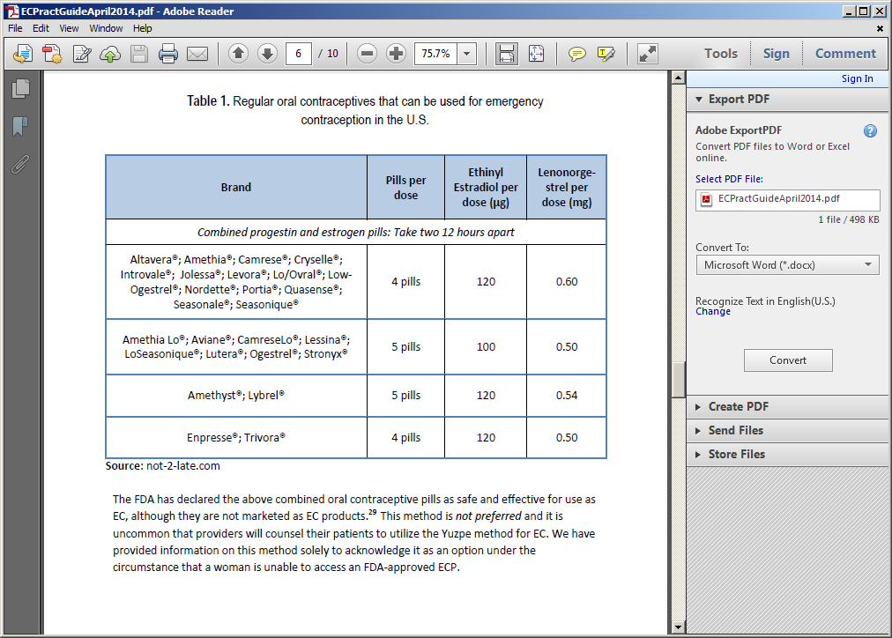
Yuzpe method:
Not preferred
Notes:
Source: Physicians for Reproductive Health, Emergency Contraception a practitioners guide. Updated April 2014.
http://prh.org/wp-content/uploads/ECPractGuideApril2014.pdf
Yuzpe method
Combined oral contraceptive pills (OCPs) containing combined ethinyl estradiol and either norgestrel or levonorgestrel

Slide 23
Mechanism of
Action

Slide 24
Dispelling Myths
  EC is not the abortion pill and does not cause an abortion
  EC does not harm an existing pregnancy
  UPA: No adequate well-controlled studies in pregnant women
  EC does not affect future fertility
Notes:
EC should not be confused with mifepristone: ECP are not abortifacients and will not disrupt an existing pregnancy, nor will they have adverse effects on the fetus.
Sources:
1.Brache, V., Cochon, L., Jesam, C., Maldonado, R., Salvatierra A.M., Levy, D. P., et al. (2009). Immediate pre-ovulatory administraion of 30 mg ulipristal acetate significantly delays follicular rupture. Human Reproduction, 25(9), 2256–2263.
2.Trussell, J., & Jordan, B. (2006). Mechanism of action of emergency contraceptive pills. Contraception, 74(2), 87–89.
Contraindications/Indications:
There are no medical conditions that preclude the use of emergency contraception
CAN USE EMERGENCY CONTRACEPTION AS FREQ AS NEEDED!

Slide 25
Mechanism of Action: Oral Methods
Disrupt normal follicular development by delaying or inhibiting ovulation
DO NOT prevent fertilization or implantation
ECP are not effective once fertilization occurs
Notes:
Sources:
1.Gemzell-Danielsson, K., Berger, C., & P.G.L., L. (2013). Emergency contraception—mechanisms of action. Contraception, 87(3), 300–308.
2.Marions, L., Hultenby, K., Lindell, I., Sun, X., Ståbi, B., & Gemzell Danielsson, K. (2002). Emergency contraception with mifepristone and levonorgestrel: Mechanism of action. Obstetrics & Gynecology, 100(1), 65–71.
3.Trussell, J., & Jordan, B. (2006). Mechanism of action of emergency contraceptive pills. Contraception, 74(2), 87–89.

Slide 26
Mechanism of Action: Copper IUD
Releases copper that induces an inflammatory response
Can inhibit fertilization or implantation of a fertilized egg
Notes:
Sources:
1. Koyama, A., Hagopian, L., & Linden, J. (2013). Emerging options for emergency contraception. Clinical Medicine Insights: Reproductive Health, 7(3547-), 23–35.
2. International Consortium for Emergency Contraception. (2012). The Intrauterine Device (IUD) for Emergency Contraception.

Slide 27
Efficacy

Slide 28
How Do We Measure EC Efficacy?
The reduction in pregnancy risk after a single coital act

Slide 29
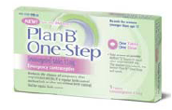
Current Estimatesof EC Pill (LNg) Efficacy
Plan B® package (LNg regimen): 88%
Published literature on regimen: 52%-100%
Trussell J, Raymond EG. 2011 at
http://ec.princeton.edu/questions/ec-review.pdf.
Notes:
Talking Points
ECP efficacy conveys the reduction in pregnancy risk after a single coital act
Plan B package (LNg regimen): 88%
Published literature:
LNg regimen: 52%–100%
References
Trussell J, Raymond EG. Emergency Contraception: A Last Chance to Prevent Unintended Pregnancy. November 2011. Available at http://ec.princeton.edu/questions/ec-review.pdf.

Slide 30
Relative Effectiveness of EC by Method
Pregnancies expected per 1000 women who had unprotected sex in the last week
12
10
8
6
4
2
0
Levonorgestrel (Plan B)
UPA (ella)
Copper IUD (Paragard)
Raymond E, et al. 2004; Task Force on Postovulatory Methods of Fertility Regulation. 1998; Trussell J, Raymond EG 2011; Fine P, et al. 2010; Glasier AF, et al. 2010.
Notes:
Talking points
Here is another representation of the relative effectiveness of the different EC methods. The Copper IUD is the most effective method, followed by the ulipristal acetate pill, and then progestin-only pills.
Most published efficacy figures for ECPs are probably overestimates.
The exact effectiveness of ECPs is difficult to measure, and some researchers believe the effectiveness may be lower than that reported on package labels. The effectiveness rates listed on this slide have known discrepancies.
The published literature on progestin-only ECPs (Plan B® One-Step and Next Choice™) estimates a range of effectiveness between 52% and 100% in reducing pregnancy risk based on twelve studies of more than 13,500 women. The effectiveness listed on the Plan B/Next Choice package is 89%.
There is no mention of the effectiveness of ella® in the patient package insert. In the provider label, there is also no mention of effectiveness, but the observed and expected pregnancies are shown for the two Phase III clinical trials and from these effectiveness rates of 60% and 66% can be computed.
Data clearly show that the progestin-only ECP regimen is more effective than the Yuzpe method and therefore more effective than nothing.
The published literature on combined progestin-estrogen ECPs estimates a range of effectiveness between 56%–89% in reducing pregnancy risk. A meta-analysis of eight studies estimated the effectiveness of the Yuzpe Regimen at 74%.
Copper-T IUD EC is 99% effective in reducing pregnancy risk.
References
Raymond E, Taylor D, Trussell J, et al. Minimum effectiveness of the levonorgestrel regimen of emergency contraception. Contraception 2004;69:79–81.
Task Force on Postovulatory Methods of Fertility Regulation. Randomised controlled trial of levonorgestrel versus the Yuzpe regimen of combined oral contraceptives for emergency contraception. Lancet 1998;352:428–33.
Trussell J, Raymond EG. Emergency Contraception: A Last Chance to Prevent Unintended Pregnancy. November 2011. Available at http://ec.princeton.edu/questions/ec-review.pdf.
Fine P, Mathé H, Ginde S, et al. Ulipristal acetate taken 48-120 hours after intercourse for emergency contraception. Obstet Gynecol. 2010;115:257–63.
Glasier AF, Cameron ST, Fine PM, et al. Ulipristal acetate versus levonorgestrel for emergency contraception: a randomised non-inferiority trial and meta-analysis. Lancet. 2010;375:555–62.

Slide 31
UPA vs. LNg Effectiveness:
Time Since Intercourse
In RCT, all 3 pregnancies with EC use at 73-120 hours after sex were in the LNg group
Significantly more pregnancies were prevented in the UPA group (p = 0.037)
Glasier AF et al. Lancet 2010;
Trussell and Schwarz. Contraceptive Technology 2011.
Notes:
Talking Points
The reason seems to be that ulipristal acetate is more effective than levonorgestrel in postponing imminent ovulation.
Randomized trial of UPA vs. LNg
References
Glasier AF, Cameron ST, Fine PM, et al. Ulipristal acetate versus levonorgestrel for emergency contraception: a randomised non-inferiority trial and meta-analysis. Lancet. 2010;375:555–62.
Trussell J and Schwarz EB. Emergency Contraception. In Hatcher RA, Trussell, J Nelson AL, Cates W, Kowal D, Policar M (eds). Contraceptive Technology: Twentieth Revised Edition. Ardent Media: New York NY, 2011. Pp.113—145.

Slide 32
ella Is More Effective than Plan B
Effectiveness Ella vs. Plan B: when taken within 72 hrs
(ella)
(Plan B/NextChoice)
(Placebo)
Glasier et al (2010)
Notes:
The second Phase III trial compared the efficacy of Plan B® with that of ella® when taken within 72 hours of unprotected intercourse or contraceptive failure. The participants were masked to their treatment regimen, while the investigators were not. Among the 1,696 women evaluated, there were 37 pregnancies: 15 (1.8% failure rate) among ella® users and 22 (2.6% failure rate) among Plan B® users, all of whom received treatment within 72 hours. This is a substantial reduction from the expected pregnancy rate of 5.5%
Although the study was not powered to detect superiority, it demonstrated that ella® is at least as effective as Plan B® when taken up to 72 hours after intercourse.

Slide 33
ella: Efficacy Decreases Over Time
Fine et al 2010
Notes:
Overall, the pregnancy rate was 2.1%. The majority of the women in this study sought emergency contraception for unprotected intercourse (72.3%), the remainder for condom breakage/slippage.

Slide 34
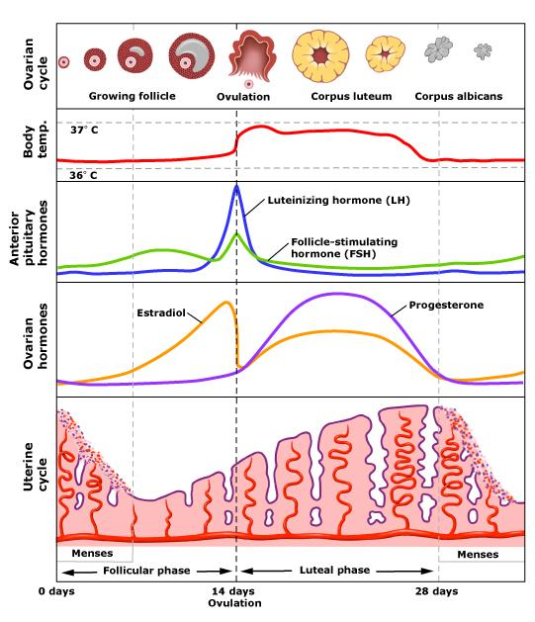
Ella
PlanB
Notes:
Efficacy of EC depends on timing of administration
Both Plan B and Ella: Delay or Block ovulation by inhibiting LH surge that triggers ovulation,
Plan B/LNg only works if taken prior to LH surge
LNg taken on the day of ovulation or after doesn’t work
Unlike levonorgestrel EC, ella® can delay ovulation even after LH surge has begun
Once LH surge begins – Plan B LNg EC cannot prevent ovulation, but ella still can
Once the ovulatory process has been initiated by LH peak, Ella cannot prevent follicular rupture

Slide 35
EC Effectiveness Decreases with Repeated UPI
Pregnancy Rates
Repeated UPI in same cycle | Ulipristal | LNg
No | 1.0% | 1.9%
Yes | 5.6% | 7.3%
Copper IUD provides BEST protection because ALL future episodes of sex will be protected
Glasier A et al. Contraception 2011.
Notes:
When women have multiple episodes of UPI, EC effectiveness decreases even when EC is administered after every incident of unprotected intercourse.
Talking Points
When women had repeated acts of unprotected intercourse their risk of pregnancy increases, even if they use ECPs
An IUD provides women the best protection because all future episodes of intercourse will be protected
Some have worried that because UPA delays rather than inhibits ovulation, women who have taken UPA might be at greater risk of pregnancy after subsequent unprotected intercourse than women who took LNg. However, this is not supported by the evidence.
Reference
Glasier A, Cameron ST, Blithe D, et al. Can we identify women at risk of pregnancy despite using emergency contraception? Data from randomized trials of ulipristal acetate and levonorgestrel. Contraception. 2011;84:363–7.
Update on Emergency Contraception
Slide 35

Slide 36
BMI and Its Efficacy on EC

Slide 37
Special Population: Obese and
Overweight Women
Risk of pregnancy when sex around ovulation regardless of EC type (UPA, LNG) taken:
  >3× for obese women (BMI of 30kg/m2 or greater, OR = 3.60, CI 1.96–6.53; P<.0001)
  >1.5× for overweight women (BMI 25–30kg/m2)
  Obese and overweight women, higher oral EC failure rate
Recommend obese and overweight women use UPA or a Copper IUD rather than LNG
Glasier A , Cameron ST, Blithe D, et al., Contraception, 2011
Notes:
Women who have intercourse around ovulation should ideally be offered a copper intrauterine device. Women with body mass index >25 kg/m² should be offered an intrauterine device or UPA.
Risk of pregnancy was more than threefold greater for obese women when compared with women with normal BMI, whichever EC was taken. For obese women, the risk was greater for those taking levonorgestrel than for UPA users. For both ECs, pregnancy risk was related to the cycle day of intercourse.
Glasier A , Cameron ST, Blithe D, et al. Can we identify women at risk of pregnancy despite using emergency contraception? Data from randomized trials of ulipristal acetate and levonorgestrel. Contraception. 2011;84:363–7.

Slide 38
Effectiveness by Method in Obesity
EC Failure Among Obese (BMI 35) versus Non-obese (BMI 26) Women
  LNg: OR = 4.41, 95% CI 2.05–9.44
  Ulipristal: OR = 2.62, 95% CI 0.89–7.00
Glasier A et al. Contraception 2011.
Notes:
Talking Points
LNG showed a rapid decrease inefficacy with increasing BMI, reaching the point where it appeared no different from pregnancy rates expected among women not using ECPs at a BMI of 26 kg/m² compared with 35 kg/m² for UPA.
No decrease in effectiveness of IUD
Sources
1.Glasier A, Cameron ST, Blithe D, et al. Can we identify women at risk of pregnancy despite using emergency contraception? Data from randomized trials of ulipristal acetate and levonorgestrel. Contraception. 2011;84:363–7.
2. Gemzell-Danielsson, K., Berger, C., & P.G.L., L. (2013). Emergency contraception—mechanisms of action. Contraception, 87(3), 300–308.
3.Reproductive Health Technologies Project. (2013). Frequently Asked Questions: The Impact of Weight on Efficacy of Emergency Contraception.
4.American College of Obstetricians and Gynecologists. Emergency Contraception. ACOG Practice Bulletin, Number 69. Washington, DC: The American College of Obstetrics and Gynecologists, December 2005. Obstet Gynecol. 2005;106:1443–1451.
38

Slide 39
Use ella in Obese Teens
LNG EC Efficacy
(Plan B/Next Choice)
UPA Efficacy (ella)
Less effective in overweight women (BMI 25–30)
NOT effective in obese women (BMI >30)
Equally effective in overweight women (BMI 25–30)
Less effective in obese women (BMI >30)
NOT effective in women with BMI >35
Notes:
References
Glasier A, Cameron ST, Blithe D, et al. Can we identify women at risk of pregnancy despite using emergency contraception? Data from randomized trials of ulipristal acetate and levonorgestrel. Contraception. 2011;84:363–7.

Slide 40
Case: Sophie
This is Sophie’s fourth request for EC over the past three months.
She’s used birth control pills in the past but her mom found them and threw them away.
What method would you recommend to Sophie?

Slide 41
When to Consider Copper IUD for EC
Interest in a long-acting method without dysmenorrhea, menorrhagia, anemia, or copper allergy
When EC medications may be less effective
Obese or overweight women
When UPI occurs around ovulation
All adolescent and adult women
The Copper IUD is a great method for patients who have privacy concerns or who have partners who try to sabotage their contraception.

Slide 42
What Is Contraceptive Sabotage?
A form of sexual coercion and control over a partner’s fertility
Hiding, withholding, or destroying a partner’s birth control pills
Breaking or poking holes in a condom on purpose (or removing condom during sex)
Not withdrawing when that was the agreed-upon method of contraception
Pulling out vaginal rings/tearing off contraceptive patches
Notes:
Adapted from, “Hanging out or Hooking Up: Clinical Guidelines on responding to Adolescent Relationship Abuse” by Elizabeth Miller, MD, PhD and Rebecca Levenson, MA. (pg 7)

Slide 43
Take-Away Points on EC Effectiveness
EC works!
Effectiveness can only be estimated
EC is more effective than nothing
Copper IUD is most effective option
International Consortium for Emergency Contraception. (2012).
Notes:
Talking Points
ECPs do work!
Even though effectiveness cannot be precisely estimated, ECPs offer a proven and safe method to prevent pregnancy after unprotected intercourse.
More effective than nothing.
IUD is the most effective option, especially for women who are obese or who have repeated acts of unprotected intercourse.
Reference
International Consortium for Emergency Contraception. (2012). The Intrauterine Device (IUD) for Emergency Contraception.
Trussell J, Ellertson C, von Hertzen H, et al. Estimating the effectiveness of emergency contraceptive pills. Contraception. 2003;67:259–65.
Raymond E, Taylor D, Trussell J, et al. Minimum effectiveness of the levonorgestrel regimen of emergency contraception. Contraception 2004;69:79–81.
American College of Obstetricians and Gynecologists. Emergency Contraception. ACOG Practice Bulletin, Number 69. Washington, DC: The American College of Obstetrics and Gynecologists, December 2005. Obstet Gynecol. 2005;106:1443–1451.
Gemzell-Danielsson, K., Berger, C., & P.G.L., L. (2013). Emergency contraception—mechanisms of action. Contraception, 87(3), 300–308.
Reproductive Health Technologies Project. (2013). Frequently Asked Questions: The Impact of Weight on Efficacy of Emergency Contraception.
[Hormones and Healthy Bones]

Slide 44
Side Effects and
Contraindications of EC

Slide 45
Research
Documented studies:
  World Health Organization states that there are no situations in which “the risks of using EC outweigh the benefits”
  Will not disrupt or harm an existing pregnancy
  Is equally safe and effective for teen and adult women
12. World Health Organization (2004).
13. ACOG (2010).
14. Cremer et al. (2009).
Notes:
Levo EC is the most well known and available form of EC here in the U.S. The current levo products include Plan B®, Plan B® One-Step and Next Choice™. While levo EC has been available over the counter to young men and women that are age 17 or older over the last few years, a federal judge mandated on April 5, 2013 that it be made available to young people of all ages due to its well established safety profile. In response the federal government filed legal paperwork to appeal this decision but then withdrew the appeal in June 2013. The only product approved OTC was Plan B One-Step. Other generic versions of EC are still not approved for women under the age of 17. The generic pill still requires that individuals present age identification, which effectively discriminates against populations less like to have identification. While significant gains have been made, much remains to be done to achieve universal access to EC. As medical providers, it is important to be aware of which pharmacies carry Plan B One-Step and whether or not it is easily accessible to teens.
It is important to note especially in the wake of this ongoing controversy that the WHO states that “there are no situations in which the risks of using EC outweigh the benefits and there are documented studies that show that levo EC will not disrupt or harm an existing pregnancy, it has also been tested and proven to be safe in adolescents specifically.

Slide 46
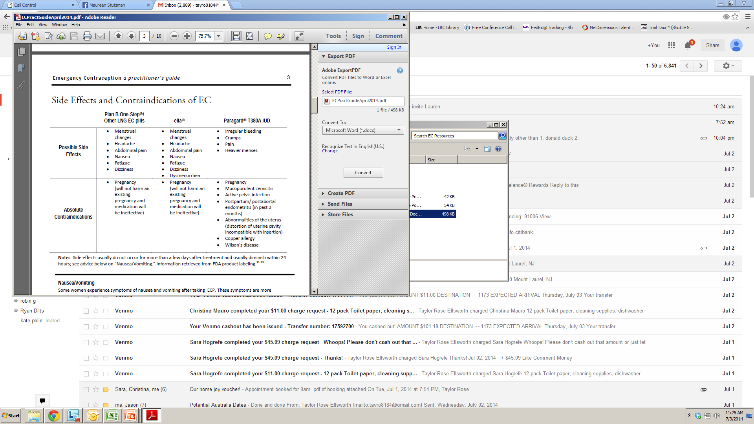
Side Effects and Contraindications
Physicians for Reproductive Health Emergency Contraception a practitioners guide
Notes:
Graph of side effects from PRH Guide
Note: Side effects usually do not occur for more than a few days after treatment and usually diminish within 24 hours

Slide 47
Side Effects: Nausea/Vomiting
More common with Yuzpe method; not common with LNG or UPA ECP
If vomiting occurs within 3 hours of taking ECP, another dose of ECP should be taken as soon as possible. (Use of an antiemetic should be considered)
Notes:
In cases when vomiting makes oral administration impossible, a repeat antiemetic dose may be administered vaginally (inserted high in the vagina). http://prh.org/wp-content/uploads/ECPractGuideApril2014.pdf
Routine use of antiemetics before taking ECPs is not recommended.
Source:
1. Raymond, E. G., Creinin, M. D., Barnhart, K. T., Lovvorn, A. E., Rountree, R. W., & Trussell, J. (2000). Meclizine for prevention of nausea associated with use of emergency contraceptive pills: A randomized trial. Obstetrics & Gynecology, 95(2), 271–277.
Source: http://www.cdc.gov/mmwr/preview/mmwrhtml/rr6205a1.htm (CDC 2013 Update)

Slide 48
Contraindication: Breastfeeding
LNG ECP are NOT contraindicated during lactation
Recommendation: Women who take UPA ECP express and discard breast milk for 36 hours post-UPA intake or use LNG ECP instead
Notes:
Sources:
1.International Consortium for Emergency Contraception. (2012). Emergency Contraceptive Pills: Medical and Service Delivery Guidelines, third edition.
http://prh.org/wp-content/uploads/ECPractGuideApril2014.pdf

Slide 49
Contraindication: Pregnancy
ECP do NOT affect an existing pregnancy
ECP are not recommended for women with known or suspected pregnancy because it will be ineffective.
Notes:
EC medications are safe and can be considered even for women who have medical conditions that make them poor candidates for combined oral contraceptives, as ECP do not contain estrogen. This is especially important when pregnancy is unsafe for some women.

Slide 50
Adolescent Access to EC:
Challenges and Opportunities

Slide 51
Challenges and Opportunities
To utilize EC, young women must:
  Be aware of their options
  Locate a provider or pharmacy
  Obtain a prescription if needed
  Find the money to pay for EC (out of pocket/health insurance)
  Find a pharmacy with EC in stock
  Use EC in a timely manner after UPI

Slide 52
Challenges and Opportunities
Patient Level
Provider Level
Health Insurance and Pharmacy Access

Slide 53

Patient Level

Slide 54
Few Young Women Are Aware of EC
28% of teen girls have heard of EC
40% of teens who know about EC understand that the pills should be taken after, not before, sex
Since ella® has recently been approved, awareness of this drug is expected to be much lower
Notes:
Source: Delbanco SF, Parker M, McIntosh M, Kannel S, Hoff T, Stewart F. Missed opportunities: teenagers and emergency contraception. Arch Pediatr Adolesc Med 1998;152(8):727–33.

Slide 55
Patient Misconceptions Create
Barriers to EC Use
Beliefs that EC functions as an abortifacient
Fear that the drug would harm fetus
Confusion over fertility cycle and timing
Notes:
Source: Minnis AM. Padia NS. Reproductive health differences among Latin American and US born young women. J Urban Health 2001;78:627–37.

Slide 56
Other Barriers
Perceived lack of confidentiality
Lack of money and/or insurance
Lack of transportation
Inability to locate a health care provider within the limited and effective timeframe
Belief that pelvic examination is mandatory
OTC exclusion of minors
Notes:
A 2005 study was published to determine the extent to which parents are currently aware that their teenage daughters are accessing reproductive health services and how minors would react in the face of mandated parental involvement laws for prescription birth control.
1,526 female adolescents younger than 18 years seeking reproductive health services at a national sample of 79 family planning clinics were surveyed between May 2003 and February 2004. Sixty percent of minors reported that a parent or guardian knew they were accessing sexual health services at the clinic. Fifty-nine percent of all adolescents would use the clinic for prescription contraception even if parental notification were mandated. This response was less common (29.5%) among adolescents whose parents were unaware of their clinic visits and more common (79%) among those whose parents were aware. Many adolescents gave more than one response to mandated parental involvement. Forty-six percent would use an over-the-counter method, and 18% would go to a private physician. Seven percent said that they would stop having sex as one response, but only 1% indicated this would be their only reaction. One in five adolescents would use no contraception or rely on withdrawal as one response to mandated notification. Conclusions: Most minor adolescent females seeking family planning services report that their parents are aware of their use of services. Most would continue to use clinic services if parental notification were mandated. However, mandated parental notification laws would likely increase risky or unsafe sexual behavior and, in turn, the incidence of adolescent pregnancy and sexually transmitted diseases.
Source: Jones R, et al. Adolescents’ reports of parental knowledge of adolescents’ use of sexual health services and their reactions to mandated parental notification for prescription contraception JAMA 2005;293:340–348.

Slide 57

Provider Level

Slide 58
AAP Policy Statement on EC
Officially endorses advance provision of EC
Reinforces safety/efficacy of EC among adolescents
Educates pediatricians/physicians on EC
Encourages routine counseling of EC
Provides current data on EC methods
Emphasizes goal to reduce teen pregnancy
Issued by the AAP on November 26, 2012
Notes:
http://pediatrics.aappublications.org/content/130/6/1174
**Promotes contraceptive use with dual methods and discusses adverse consequences for adolescents when physicians and pharmacists refuse to provide EC to teenagers

Slide 59
Providers Can
Facilitate Use

Slide 60
Many Providers Do Not Discuss EC with Young Patients
Of pediatricians with adolescent patients:
  20% report prescribing EC
  24% report counseling adolescents about EC
Notes:
Although first described more than 20 years ago, physician awareness of EC has been limited and many feel uncomfortable prescribing it.
Source:
Skills et al. Associations among pediatricians’ knowledge, attitudes and practices regarding emergency contraception. Pediatrics 2000;105:954–6.

Slide 61
Providers Need More Training on EC
As ella® becomes more widely available, physicians will need to learn about this option
A 2001 survey of pediatricians found:
  72.9% were unable to identify any of the FDA-approved methods of EC
  Only 27.9% correctly identified the timing for initiation
  31.6% felt comfortable prescribing EC
Notes:
A 2001 study was conducted to assess the knowledge, attitudes, and opinions of practicing pediatricians regarding the use of EC in adolescents.
An anonymous questionnaire was mailed to all 954 active members of New York Chapter 2, District II of the American Academy of Pediatrics. The questionnaire assessed basic knowledge, attitudes, and opinions regarding EC in adolescents. Data were analyzed by physician age, gender, year completed residency, and practice type.
Most respondents of the survey (72.9%) were unable to identify any of the Food and Drug Administration–approved methods of EC. Only 27.9% correctly identified the timing for its initiation and only 31.6% of respondents felt comfortable prescribing EC. Inexperience with use was cited as the primary reason for not prescribing EC by 70% of respondents. A minority of respondents (17%) believed that adolescents should have EC available at home to use if necessary and only 19.6% believed that EC should be available without a prescription. The vast majority (87.5%) were interested in learning more about EC.
Source:
Golden NH, Seigel WM, Fisher M, Schneider M, Quijano E, Suss A, Bergeson R, Seitz M, Saunders D. Emergency contraception: pediatricians' knowledge, attitudes, and opinions. Pediatrics 2001;107(2):287–92.

Slide 62
Provider Misconceptions
Can Discourage Use
2001 survey of pediatricians found:
  22% believed that providing EC encourages adolescent risk-taking behavior
  52.4% would restrict the number of times they would dispense EC to a patient
  12% cited moral or religious reasons for not prescribing
  17% were concerned about teratogenic effects
Notes:
Inexperience with use was cited as the primary reason for not prescribing EC by 70% of respondents. Twelve percent cited moral or religious reasons and 17% were concerned about teratogenic effects. There were no differences in comfort level based on age, gender, or practice type. Twenty-two percent of respondents believed that providing EC encourages adolescent risk-taking behavior and 52.4% would restrict the number of times they would dispense EC to an individual patient. A minority of respondents (17%) believed that adolescents should have EC available at home to use if necessary and only 19.6% believed that EC should be available without a prescription. The vast majority (87.5%) were interested in learning more about EC. CONCLUSIONS: Despite the safety and efficacy of EC, the low rate of use is of concern. Pediatricians are being confronted with the decision to prescribe EC but do not feel comfortable prescribing it because of inadequate training in its use. Practicing pediatricians are aware of their lack of experience and are interested in improving their knowledge base.
Source:
Golden NH, Seigel WM, Fisher M, Schneider M, Quijano E, Suss A, Bergeson R, Seitz M, Saunders D. Emergency contraception: pediatricians’ knowledge, attitudes, and opinions. Pediatrics 2001;107(2):287–92.

Slide 63
Providers Can Remove
Clinical Barriers to EC
No pelvic examination or pregnancy test required by ACOG or FDA
Pregnancy test prior to EC treatment is recommended
only if:
  Other episodes of unprotected sex occurred that cycle
  LMP (last menstrual period) was not normal in duration, timing, or flow

Slide 64
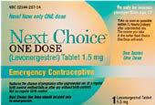
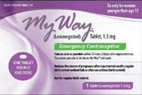
Prescribing EC
Plan B® One-Step is OTC for men and women of any age
ella® is available for patients of all ages with a prescription
Some states allow people 16 years and younger to obtain Next Choice™ One Dose and My Way® without an Rx
Notes:
Source:
Some states allow people 16 years and younger to obtain Next Choice™ One Dose and My Way® without a prescription. These states include: Alaska, California, Hawaii, Maine, Massachusetts, New Hampshire, New Mexico, Vermont, and Washington state. (See ec.princeton.edu/questions/state-pharmacy-access-list.html to find up-to-date information on pharmacy access.)

Slide 65
Training Office Staff
Train office staff on EC
  Importance of timely appointments
  Lack of required exam for prescriptions
  If provider is uncomfortable counseling/providing EC, must make appropriate referral
Notes:
Ethical Obligations

Slide 66
Counseling and Education

Slide 67

Provide Supportive Counseling
EC is responsible behavior
If using a two-dose product, taking both doses at once may improve compliance without additional side effects or decreasing efficacy
Counsel on other methods of birth control
Provide STI/HIV counseling/testing if possible
Provide condoms and review use
Provide return appointment
Notes:
When providing EC it is important to provide supportive counseling and encouragement even if the patient does not choose a more effective routine method. The patient needs to hear that using EC is responsible behavior even while making it clear that other more effective methods are available. A contraception visit should also incorporate STI/HIV counseling and testing whenever possible. Condoms should be provided at every opportunity and a return appointment should be arranged whether it is for more comprehensive care or just for follow-up of the current visit.

Slide 68
Addressing Concerns About STI Risk
While EC does NOT protect against STIs or HIV:
  2005 study: Young women obtaining EC from pharmacist were no more likely to get an STI
  Product’s label clearly states that regimen does not protect against STIs or HIV
Notes:
Sources:
Raine TR et al. Direct access to emergency contraception through pharmacies and effect on unintended pregnancy and STIs JAMA 2005;293: 54–62.
FDA, Nonprescription Drugs Advisory Committee and the Advisory Committee for Reproductive Health Drugs, December 16, 2003, Briefing Information. Accessed December 16, 2008. Available at http://www.fda.gov/ohrms/dockets/ac/03/briefing/4015b1.htm.

Slide 69
Individual Patient Needs
Providers must take into account a patient’s:
  Knowledge of reproductive physiology
  Ability to understand the regimen
  Moral perceptions of contraception
  Misconceptions about the drug’s mechanism of action
  Barriers that may restrict access

Slide 70
Instruct Patient on Use
More effective the sooner it is taken (LNg EC)
To be effective, EC must be used each and every time a woman has UPI
Having unprotected sex after EC use can increase pregnancy risk
Call provider if no menstrual period within 3 weeks after taking EC

Slide 71
Opportunities for Bridging Contraceptive Services
Cost of EC may prohibit multiple use within a cycle
(~$25-$50)
  Cost of ella® expected to be higher
During visit, discuss alternative and ongoing methods of contraception that are more effective and less expensive

Slide 72
Counseling Teens About
Contraception Method
Have you tried anything to prevent pregnancy in past?
Any problems with a previous method?
  Trouble remembering to take the pill?
  Concerns over privacy with the pill/patch?
  Difficulty using condoms consistently?
  Cost barriers?

Slide 73
Be Adolescent-Friendly
Display posters and materials about EC
Work with teen patients to establish a “plan” in the event of contraceptive failure, including identifying:
  A pharmacy that will fill prescription
  A method of transportation to pharmacy
  A means of locating or borrowing funds for pills

Slide 74

Providing Resources
List yourself as an EC provider on/refer patients to www.not-2-late.com
Compile list of pharmacists in area that dispense EC

Slide 75
Crisis
Management

Slide 76
Intimate Partner Violence and
Emergency Contraception
Repeated requests for EC may indicate pregnancy coercion or birth control sabotage
  Adolescent girls in physically abusive relationships were 3.5 times more likely to become pregnant than non-abused girls
  Among teen mothers on public assistance who experienced recent abuse, 66% experienced birth control sabotage by a dating partner.
Notes:
Adapted from, “Hanging out or Hooking Up: Clinical Guidelines on responding to Adolescent Relationship Abuse” by Elizabeth Miller, MD, PhD and Rebecca Levenson, MA. (pg. 14)

Slide 77
Screening for IPV
Make sure to explain confidentiality and mandatory reporting
Know what your resources are for ensuring patient safety while in your care
Be prepared to offer referral information for follow-up
Notes:
St. Mars, T., RN,BSN, CEN, Valdez, A.M., RN, MSN, CEN. (2007). Adolescent dating violence: understanding what is “at risk?” Journal of Emergency Nursing, 33(5): 492–494.

Slide 78
Sexual Assault and EC
>50% of all rapes occur in young women under 18 years old
For teens, 5.3% of rapes lead to a pregnancy
Emergency contraception should be offered to all survivors of sexual assault
Notes:
More than half of all rapes (54%) of women occur before age 18; 22% of these rapes occur before age 12.
Source:
Tjaden P, Thoennes N. Full report of the prevalence, incidence, and consequences of violence against women: findings from the national violence against women survey. Washington (DC): National Institute of Justice; 2000. Report NCJ 183781.
Source: American Academy of Pediatrics. Adolescent assault victim needs: A review of the issues and a model protocol. Pediatrics 1996; 98: 991–1001.
Rape-related pregnancy occurs with significant frequency. It is a cause of many unwanted pregnancies and is closely linked with family and domestic violence. As we address the epidemic of unintended pregnancies in the United States, greater attention and effort should be aimed at preventing and identifying unwanted pregnancies that result from sexual victimization.
Source:
Holmes MM, Resnick HS, Kilpatrick DG, Best CL. Rape-related pregnancy: estimates and descriptive characteristics from a national sample of women. Am J Obstet Gynecol 1996;175:320–24.
Wilson, K, Klein, J. Opportunities for appropriate care: health care and contraceptive use among adolescents reporting unwanted sexual intercourse. Arch Pediatr Adolesc Med 2002;156: 341–345.

Slide 79
EC and Sexual Assault Survivors
Most states have no requirements to provide EC to survivors of sexual assault
Only 16 states require hospitals to offer information and counseling about EC, and only 12 of those states also mandate that hospitals provide EC on-site to victims
EC State Laws, National Conference of State Legislature (NCSL) August 2012
Notes:
http://www.ncsl.org/issues-research/health/emergency-contraception-state-laws.aspx

Slide 80
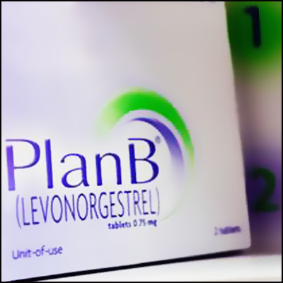

EC in the ER
Each year, approximately 25,000 American women become pregnant as a result of sexual violence
As many as 22,000 of those pregnancies could be prevented by using EC
Source: http://www.mergerwatch.org/ec-in-the-er/
Notes:
Source:
http://www.mergerwatch.org/ec-in-the-er/

Slide 81
Sample Questions
Was the sex you had something you wanted to do?
Are you at all concerned that a partner may be trying to get you pregnant when you don’t want to be?
Sometimes women have to worry about someone else finding their emergency contraception and throwing it away. If that is an issue for you, you might want to think about some other forms of birth control.
Notes:
Adapted from, “Hanging out or Hooking Up: Clinical Guidelines on responding to Adolescent Relationship Abuse” by Elizabeth Miller, MD, PhD and Rebecca Levenson, MA. (pg. 34)

Slide 82
Quick Start

Slide 83
Starting Contraception After LNG EC
COCs/Progestin-only Pills
Start immediately after taking EC
Vaginal Ring/Patch
Start immediately after taking EC
DMPA/Implants/
IUCs
Start immediately after taking EC
*With ALL methods: abstain/use back-up protection for first 7 days
**After taking ella: Can start contraception immediately;
Abstain/Use Back-Up protection for first 2 weeks
Notes:
Source: The CDC’s 2013 update for Selected Practice Recommendations for Contraceptive Use, http://www.cdc.gov/mmwr/preview/mmwrhtml/rr6205a1.htm
Note: COCs, patch, and ring are not effective until seven days after initiation (abstain from intercourse or use back-up protection for the first 7 days for ALL methods).
**Note: ella is an antiprogestin. When starting hormonal contraception immediately after using ella, it is not known whether the instructions above for abstaining or using back-up contraception are conservative enough. It is recommended to abstain or use condoms for 2 weeks.
**If starting hormonal methods immediately after EC treatment, a pregnancy test should be administered 3 weeks later to rule out pregnancy that may have resulted from failed EC.
Source:
Hatcher RA, Trussell J, Nelson AL, Cates Jr. W, Kowal D, Policar MS. Contraceptive Technology: Twentieth Revised Edition. “Emergency Contaception.” Trussell J, Schwarz, EB. Chapter 6, p.134.

Slide 84
Case: Sophie
Sophie has private health insurance and wants to know if it covers the IUD.
How would you respond to her questions?

Slide 85
Health Insurance Coverage and EC

Slide 86
Affordable Care Act (ACA):
August 2012
New health plans must provide contraceptives and contraceptive counseling without a co-pay
For many plans, this new benefit starts January 1, 2013; for others it may not be until “new” changes are made
Guidelines are unclear about coverage of generic versus brand name products and how to implement over time
Notes:
http://www.hrsa.gov/womensguidelines/

Slide 87
Things to Know About the ACA and EC
All FDA-approved birth control methods should be covered without a co-pay
  Unclear if every brand of EC will be covered
  No FDA guidelines about limitation regarding how many times EC is covered in one year/month?
  More guidance needed
Notes:
Velocity/Frequency issue with EC coverage? Like with Medicaid coverage of abortion (how many times is “too many” times)?
http://ec.princeton.edu/questions/ec-ACA.html
http://www.hrsa.gov/womensguidelines/#footnote2

Slide 88
ACA: Contraceptive Coverage
Has potential to eliminate cost barriers for highly effective/more expensive EC methods
  e.g., ella® and the copper IUD

Slide 89
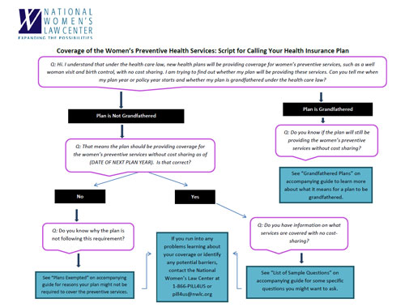
What Questions Should You Ask Your
Health Insurance?
State that you’re aware of the new contraceptive coverage with ACA
Ask when your plan year or policy year starts
Ask whether your plan is “grandfathered” under the health care law
Notes:
This Flowchart can be found and downloaded from the National Women’s Law Center website and is a useful tool to give to patients and providers. (Contacting Insurance Guide Flowchart)
http://www.nwlc.org/resource/how-find-out-if-and-when-your-health-plan-will-begin-covering-women%E2%80%99s-preventive-services-n
If you need additional help in figuring out whether EC is covered by your insurance plan, or if you have trouble getting coverage without a co-pay, or if you have been refused EC by a pharmacist, you can get help from the National Women's Law Center contraception hotline at 1-866-PILL4US (1-866-745-5487) or pill4us@nwlc.org.
List of Sample Questions
Assuming your plan is going to start covering the women’s preventive health services without cost sharing, you might want to ask about a particular service you plan to use. For example:
o Is it possible to find out if a specific birth control pill will be covered without a co-pay?
o What services associated with an IUD are covered? Can I go to any provider?

Slide 90
National Women’s Law Center:
Tools for EC Access
The “Contacting your Insurance Guide” Flowchart can be found and downloaded from the National Women’s Law Center website at:
  www.nwlc.org/resource/how-find-out-if-and-when-your-health-plan-will-begin-covering-women%E2%80%99s-preventive-services-n

Slide 91
Clinicians with Prescribing Privileges
Clinicians are recommended to provide patients with written prescriptions for insurance purposes
Rx is helpful when seeking reimbursement
It’s easier for patients without government issued ID, embarrassed to request from pharmacist/be asked additional questions
Notes:
In many states, Medicaid only covers EC for enrolled women with an Rx
Source:
http://prh.org/resources/emergency-contraception-a-practitioners-guide/

Slide 92
Case: Sophie
Sophie says she will call her health plan about IUD coverage but requests EC pills today and for the future “just in case”
She asks you if her 18-year-old boyfriend can pick them up for her from the pharmacy

Slide 93
Can Sophie’s Boyfriend
Get EC Without an Rx?
Plan B One-Step
UPA (ella®)
Yes
No; only the patient may request ella
Access Issues: Not all pharmacies comply/stock EC
Based on Sophie’s BMI, you would still prefer to prescribe ella
Notes:
The FDA did not list specific forms of ID that must be presented to verify a consumer’s age, and that decision is left to individual pharmacies. A driver’s license or passport is certainly sufficient, and other forms of ID, including ID issued by foreign governments, should be accepted as well. There is debate regarding whether school identification, especially from private schools, is a valid form of identification. Since public school IDs are government IDs, they are valid.
Source: http://www.nwlc.org/resource/accessing-non-prescription-emergency-contraception-basics

Slide 94
Advanced Provision

Slide 95
Advanced Provision
Does NOT increase risk-taking behavior
  Does not condom use
  Does not contraceptive use
  Does not increase number of sexual partners or increase risk for STIs
DOES increase use of EC and increases earlier use when EC more effective
  Risks are reduced from episodes of unprotected sex and/or contraceptive failure that occur
Notes:
Several studies have concluded that, while increased access to EC increases use of the medication, it does not increase the number of sexual partners or episodes of unprotected sex in adolescents or adult women.
Sources:
Harper CC, Cheong M, Rocca CH, Darney PD, Raine TR. The effect of increased access to emergency contraception among young adolescents. Obstet Gynecol 2005 Sep;106(3):483–91.
Raine TR, Harper CC, Rocca CH, et al., Direct access to emergency contraception through pharmacies and effect on unintended pregnancy and STIs: a randomized controlled trial. JAMA 2005 Jan 5;293(1):54–62.
Gold MA, Wolford JE, Smith KA, Parker AM. The effects of advance provision of emergency contraception on adolescent women's sexual and contraceptive behaviors. J Pediatr Adolesc Gynecol 2004 Apr;17(2):87–96.
Polis CB, Grimes DA, Schaffer K, Blanchard K, Glasier A, Harper C. Advance provision of emergency contraception for pregnancy prevention. Cochrane Database of Systematic Reviews 2007, Issue 2. Art. No.: CD005497. DOI: 10.1002/14651858.CD005497.pub2.

Slide 96
Advanced Provision: No Increase
in Risk Behavior
Advance Rx: ~twice as much EC use as control (15% vs. 8%)
Receive EC in advance
No decrease in condom or contraceptive use
2004 study of young women randomized to:
No increase in unprotected sex
Receive instructions on how to get EC
Advance Rx: used EC sooner than control group (10 vs. 21 hrs)
Notes:
Source:
Gold MA, Wolford JE, Smith KA, Parker AM. The effects of advance provision of emergency contraception on adolescent women's sexual and contraceptive behaviors. J Pediatr Adolesc Gynecol 2004 Apr;17(2):87–96.

Slide 97
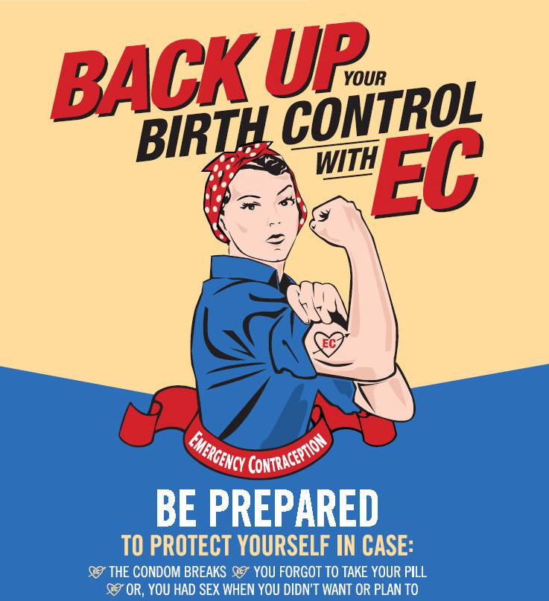
Advanced Provision Does Increase Use!
Women who receive LNG EC in advance:
Twice as likely to use EC when they needed it
  44% vs. 29%—Harper
  15% vs. 8%—Gold
Twice as likely to use it more than once
Used EC sooner when more effective (Gold)
Gold MA, et al. Journal of Pediatric and Adolescent Gynecology 2004;17:87–96 Harper CC, et al. Obstetrics and Gynecology 2005
Notes:
Who should get advanced provision? (really anyone, since teens DC methods all the time)
Initiating contraception
If condoms are not used during first week of Quick Start
In case of contraceptive use error at any time
Not ready to initiate routine contraception but sexually active or considering sex
Using condoms and/or EC as their primary method of contraception
ADVANCE PROVISON OF EC IS IMPORTANT: does not increase risk taking behavior

Slide 98
Who Supports Advance EC?
American Academy of Pediatrics
Society for Adolescent Health and Medicine
The American Medical Association
American Academy of Family Physicians
American Congress of Obstetricians and Gynecologists
Notes:
Sources:
1. American Medical Association. Access to emergency contraception. Policy of the House of Delegates, H-75.985; 2002 https://ssl3.ama-assn.org/apps/ecomm/PolicyFinderForm.pl?site=www.ama-assn.org&uri=%2fresources%2fhtml%2fPolicyFinder%2fpolicyfiles%2fHnE%2fH-75.985.HTM. Accessed March 19, 2014
2. American College of Obstetricians and Gynecologists. Emergency Contraception. ACOG Practice Bulletin, Number 69. Washington, DC:
3. American Academy of Pediatrics, Committee on Adolescence. Emergency contraception. Pediatrics 2005;116:1026–1035.
4. Gold MA, Sucato GS, Conard LA, Hillard PJ, Society for Adolescent Medicine. Provision of emergency contraception to adolescents: position paper of the Society for Adolescent Medicine. J Adolesc Health. 2004;35:67–70.
5. Weismiller DG. Emergency contraception. Am Fam Physician. 2004;70:707–714.

Slide 99
EC: Pharmacy Access

Slide 100
Accessing EC in Pharmacies
NO age restrictions for one-pill LNG EC products
  Any person can buy this EC; no ID required!
  No limit to number of packages a person can buy
  Should be on store shelves; not behind counter
Age restrictions remain for two-pill LNG EC products
  Must be kept behind counter
  Pharmacist must check ID to ensure person is 17 or older
ella is by Rx only
  Must be kept behind counter
  Some states allow pharmacist to provide Rx to patients
Notes:
Source: RHTP, ASEC, American College of Clinical Pharmacy Women’s Health Practice & Research Network

Slide 101
Pharmacy Access Does Not
Increase Risk Behavior
2005 study of 2,117 young women
Improved access group no more likely to:
  Miss a pill
  Switch birth control methods
  Forgo using a condom
Frequency of intercourse, amount of unprotected sex, and number of sexual partners similar among the study groups
Notes:
Source:
Raine TR, Harper CC, Rocca CH, et al., Direct access to emergency contraception through pharmacies and effect on unintended pregnancy and STIs: a randomized controlled trial. JAMA 2005 Jan 5;293(1):54–62.

Slide 102
Males and EC

Slide 103
What Has Been Said About Male Involvement?
“Special efforts should be made to emphasize men’s shared responsibility and promote their active involvement in responsible parenthood; sexual and reproductive behavior, including family planning; prenatal, maternal and child health; prevention of STDs, including HIV; prevention of unwanted and high-risk pregnancies…”
1994 International Conference On Development and Population
Notes:
Most importantly, it was a call from primarily women saying that advances in female’s sexual and reproductive health had reached a plateau.

Slide 104
Comparing Men and Women on EC
Men less likely to know about EC
Rates of purchase not different statistically
  (10.8% vs. 18.3%)
Nguyen, B., & Zaller, N. (2009). Male access to over-the-counter emergency contraception. Women's Health Issues, 19, 365-372.
Notes:
Only concerns about female user side effects predicted a decreased willingness to buy EC among men

Slide 105
Attitudes on Buying and Using EC
Many men felt that:
  they should offer to buy EC if needed (56.1%)
  their purchases would prevent unplanned pregnancies (67.6%)
  the decision to use EC was a woman’s (75.4%)
73.8% of women agreed that men should always have EC access.
Nguyen, B., & Zaller, N. (2009). Male access to over-the-counter emergency contraception. Women's Health Issues, 19, 365-372.

Slide 106
2012 Review on Young Men and EC
Young men’s knowledge of EC
  Equated with awareness or familiarity
  38% of teenagers knew about EC
  65%–100% of adults knew about EC
Previous use or discussion
  13%–30% had used or discussed EC
Previous purchase
  11% previously purchased EC
Attitudes
  Supportive of use
Marcell AV, Waks AB, Rutkow L, McKenna R, Rompalo A, Hogan MT. What Do We Know About Males and Emergency Contraception? A Synthesis of the Literature. (2012) Perspectives on Sexual and Reproductive Health 2012;9999:n/a-n/a.

Slide 107
Male Access to EC: Mystery Shopper Survey
Study:
  Male mystery shoppers, 158 pharmacies visited, 3 neighborhoods, NYC
Results:
  73% of pharmacies created barriers to EC
  Cost of EC higher in higher SES neighborhoods
Conclusions:
  Males had a 20% likelihood of NOT being able to access EC
D.L. Bell et al. Contraception 90 (2014) 413–415
Notes:
Source: Bell, David L., Camacho, Elvis J., Velasquez, Andrew B. Male access to emergency contraception in pharmacies: a mystery shopper survey. Contraception 90 (2014) 413–215.

Slide 108

Males and Emergency Contraception
Plan B One-Step OTC for males
ella: Rx for patient only
Pharmacies have not been 100% compliant in dispensing EC to males
  ACLU has documented several cases over the years
Can still counsel males
Notes:
Not Again: Two More Pharmacies Refuse to Sell Emergency Contraception to Men—ACLU BLOG OF RIGHTS. March 12, 2012.

Slide 109
Implications
Availability ≠ Access
Notes:
Putting all of that together—you have to remember that pharmacies are not required to stock emergency contraception, and simply stocking emergency contraception does not guarantee timely ACCESS, especially for adolescents.

Slide 110
Wrap-Up
Discuss all dedicated products, including UPA and copper IUD for EC
Write advance prescription for EC or provide instructions on OTC access with all teens
Check local pharmacies for available products and EC access policies for youth 16 and under
Offer women with a BMI >30 kg/m² UPA or copper IUD and offer those having UPI around time of ovulation a copper IUD

Slide 111
Conclusions
EC: safe and effective method of preventing pregnancy
Can prevent pregnancies when taken within indicated window
Should be readily available to all women, especially adolescents
Advanced provision and pharmacy access will not increase health risks for young women

Slide 112
EC-Specific Resources
prh.org/resources/emergency-contraception-a-practitioners-guide: Physicians for Reproductive Health, Emergency Contraception: A Practitioner’s Guide
www.not-2-late.com: Provides a list of local providers and answers to the most common questions about EC
www.cecinfo.org: International Consortium on EC
ec.princeton.edu: EC at Princeton University: a site aimed at patients with credible research sources
www.rhtp.org: The Reproductive Health Technologies Project
www.backupyourbirthcontrol.org: Offers basic facts about EC; mainly intended for general public/section for providers
www.arhp.org/topics/emergency-contraception/clinical-publications-and-resources
National Sexual Assault Hotline 1-800-656-HOPE Provides victims of sexual assault with free, confidential, around-the-clock services

Slide 113
Additional EC Information
ecotc.tumblr.com
americansocietyforec.org/uploads/3/2/7/0/3270267/asec_ec_access_report.pdf
  EC on the Shelf: Real-World Access in the OTC Era
ec.princeton.edu/ASECPricingReport.pdf
  The Cost of EC: Results from Nationwide Survey 2013

Slide 114
Provider Resources and Organizational Partners
www.advocatesforyouth.org—Advocates for Youth
www.aap.org—American Academy of Pediatricians
www.aclu.org/reproductive-freedom American Civil Liberties Union Reproductive Freedom Project
www.acog.org—American College of Obstetricians and Gynecologists
www.arhp.org—Association of Reproductive Health Professionals
www.cahl.org—Center for Adolescent Health and the Law
www.glma.org Gay and Lesbian Medical Association

Slide 115
Provider Resources and Organizational Partners
www.guttmacher.org—Guttmacher Institute
janefondacenter.emory.edu Jane Fonda Center at Emory University
www.msm.edu Morehouse School of Medicine
www.prochoiceny.org/projects-campaigns/torch.shtml NARAL Pro-Choice New York Teen Outreach Reproductive Challenge (TORCH)
www.naspag.org North American Society of Pediatric and Adolescent Gynecology
www.prh.org—Physicians for Reproductive Health

Slide 116
Provider Resources and Organizational Partners
www.siecus.org—Sexuality Information and Education Council of the United States
www.adolescenthealth.org—Society for Adolescent Health and Medicine
www.plannedparenthood.org Planned Parenthood Federation of America
www.reproductiveaccess.org Reproductive Health Access Project
www.spence-chapin.org Spence-Chapin Adoption Services

