Slide 1


Beyond Abstinence and Risk:
A New Paradigm for Adolescent Sexuality

Slide 2
Objectives
Identify limitations of the “Abstinence-Only” and “Sex-as-Risk-Taking” paradigms
Discuss ways that dramatization may affect approaches to adolescent sexuality and teen health outcomes
Describe the alternative ABCD paradigm of adolescent sexuality
Explore practical applications of ABCD paradigm in working with adolescents, parents, and health professionals

Slide 3
Sexual
Orientation
Sexual
Attraction
Relationships
Paradigm of
Sexuality
Biological
Sex
Sexual
Behavior
Gender
Identity/
Expression
Notes:
Adolescence is a time of remarkable transition: Not only is it a period of physical change that culminates in the achievement of reproductive capacity, it is also a time during which youth define for themselves their vocational, ego, moral, and sexual identities.
In terms of sexual development, we know that this is a central theme of adolescence. During the adolescent years, youth consolidate the influences of biologic sex, gender identity, sexual attraction, sexual orientation into behaviors and relationships expressed in the context of relationships through a rich, complex, fluid and highly nuanced developmental process.

Slide 4
Two Narrow Approaches to
Adolescent Sexual Development
Over past three decades, two approaches have predominated in U.S. sexual health policy and practice:
  Abstinence-only
  Sex as risk taking
Notes:
As rich, complex, and highly nuanced the developmental process may be, the two dominant approaches to adolescent sexual health policy and practice in US health policy and practice—sex as risk taking and abstinence only—focus almost solely on certain sexual behaviors of youth while paying little attention to the developmental context and relationships within which these behaviors occur.

Slide 5
What Is Healthy Sexuality?
Sexual development and growth is a natural part of human development
Healthy sexual expression is different than sexual risk
Same-sex sexual behavior is included in the realm of healthy sexuality

Slide 6
The Abstinence-Only
(No-Sex) Paradigm
  Provides a code, not empowerment
  Gives limited tools for navigating relationships other than marriage
  Makes sex between teens hard to discuss when it does happen
  Despite investment of federal funds, not shown to be effective
Notes:
The abstinence only (until marriage paradigm) stigmatizes adolescent sexuality and all sexual expression outside the context of a heterosexual marriage. The approach makes sex an either–or thing rather than viewing sexual activity as part of a continuum of a repertoire of sexual behaviors through which adolescents act on desires, express feelings, and explore intimacy—and it is a continuum—the first crush, the first kiss, the first date, the first time.
The paradigm gives very limited tools for youth to navigate romantic relationships not oriented toward finding a marriage partner.
It provides an external code of behavior, not an empowerment to make self-directed sexual choices.
The stigma that it attaches to sexual exploration outside the context of heterosexual marriage makes teenage sex very difficult to discuss with adults (parents, health care providers, etc.) when it does happen.
For over two decades the US federal government has spent millions of dollars on programs that advocate abstinence until marriage and that withhold information on contraception. These programs often exclude information on even the most basic topics in human sexuality such as puberty, reproductive anatomy, and sexual health, and they have not been shown to be effective.
Source last bullet:
Trenholm C et al. Impacts of Four Title V, Section 510, Abstinence Education Programs: Final Report, submitted to the U.S. Dept. of Health & Human Services, Office of the Assistant Secretary for Planning & Evaluation. Princeton, NJ: Mathematica Policy Research, 2007.

Slide 7
Sex-as-Risk-Taking Paradigm
  Makes sex a disease rather than part of development
  Does not distinguish healthy sexual expression from sexual risk
  Instills fear, not sense of mastery/control
  Leaves out the pleasurable and relational contexts of sexuality
Notes:
This “sex-as-risk-taking” paradigm tends to focus solely on the negative consequences of youthful sexual expression—STIs, unintended pregnancy, and relationship violence being among them. Not only does this approach fail to distinguish healthy sexual expression from disease and sexual risk, it also instills in youth a sense of fear rather than mastery and control. Moreover, it leaves out the positive and pleasurable aspects sexuality and the skills that youth can gain through their intimate relationships.
Even some more comprehensive sexuality education programs have focused only “sex as risk-taking” behavior that can only result in unwanted pregnancies and horrible sexually transmitted infections. Even the way we collect data about adolescents, through the “Youth Risk Behavior Surveillance Survey” is set up to highlight identifying risk as a primary goal. This survey is the leading source on adolescent health from the CDS and is a clear example of this paradigm’s prevalence among public health professionals, clinicians and researchers on adolescent behavior in the U.S.

Slide 8
“Sex as Risk” in Current Practice
Medically-derived risk-assessment/prevention, screening, and treatment approach
Results in discussions that are based on:
  Narrow definitions of sexual health
  Focus on specific sexual behaviors as part of risk-assessment strategy instead of personal development and interpersonal relationships
Notes:
Although there are examples in the literature of sexual-history-taking guides that include discussions on the positive and relational aspects of adolescent sexuality, the dominant themes in the dialogues betweens physicians and adolescents highlight a medically-derived prevention, screening, detection, and treatment approach to adolescent sexuality. Such a schema results in discussions that are based on narrow definitions of sexual health and behavior focused on risk-assessment strategy instead of interpersonal relationships and personal development.
It leaves providers without a template for an affirming, empowering, and educational discussion with adolescents about the normalcy of feelings and arousals, choice, sexual decision-making, responsibility, and relationships.
Another way to put it is that this “Sex as Risk” paradigm does not open up conversations about sexuality “above the waist,” i.e., the way youth view and experience their sexuality and relationships, which are an important aspect of their sexual health.

Slide 9
Shared Experiences in Adolescence
Across developed nations adolescents go through similar developmental processes
  Schooling extends into the twenties
  Marriage in mid to late twenties/early thirties
  First sex typically happens during teen years
    What do you think the average age of first sex is in the U.S. and the Netherlands?
www.guttmacher.org/pubs/FB-ATSRH.html
www.rutgerswpf.nll
Notes:
ANSWER: Age 17 for both
Sources:
Finer LB and Philbin JM, Sexual initiation, contraceptive use, and pregnancy among young adolescents,Pediatrics, 2013, <http://pediatrics.aappublications.org/content/early/2013/03/27/peds.2012-3495>, accessed May 31, 2013
2. Special tabulation by NCHS, 2013 <http://www.cdc.gov/nchs/nsfg/abc_list_s.htm#vaginalsexual> accessed May 31, 2013.
3. U.S. Bureau of the Census, America’s Families and Living Arrangements, Washington, DC: U.S. Government Printing Office, 2009.
4) http://www.rutgerswpf.nl/sites/rutgersnl/files/PDF-Onderzoek/Factsheet_Seksonderje25ste_ENG.pdf (2012)
Especially useful is the comparison with other developed nations, where adolescents go through similar bio-social developmental processes: schooling extends into the twenties for a large proportion of youth; (hetero) sexual marriage does not take place until the mid or late twenties, or even early thirties. By contrast, first sexual activities—broadly defined—tend to start in the mid or late teens, leaving as much as a decade or more of “pre” marital sex, assuming that youth can even legally marry, which not all can.
In the US, on average, young people have sex for the first time at about age 17, [2] but they do not marry until their mid-20s.[3] This means that young adults may be at increased risk for unintended pregnancy and STIs for nearly a decade or longer
Sources:
Chandra A, Mosher WD, Copen C, Sionean C. Sexual behavior, sexual attraction, and sexual identity in the United States: Data from the 2006–2008 National Survey of Family Growth. National health statistics reports; no 36. Hyattsville, MD: National Center for Health Statistics. 2011.
deGraaf H, Meijer S, Poelman J, Vanwesenbeeck I. Seks onder je 25ste; Seksuele Gezondheid van Jongeren in Nederland Anno 2005. Utrecht and Amsterdam: Rutgers Nisso Groep/Soa Aids Nederland.
Darroch J, Singh S, Frost J. Differences in teenage pregnancy rates among five developed countries: The roles of sexual activity and contraceptive use. Fam Plann Perspect 2001;33(6):244-50 and 281.
U.S. Census Bureau. Estimated Median Age at First Marriage, by Sex: 1890 to the Present. Current Population Survey, March and Annual Social and Economic Supplements, 2011 and earlier.

Slide 10

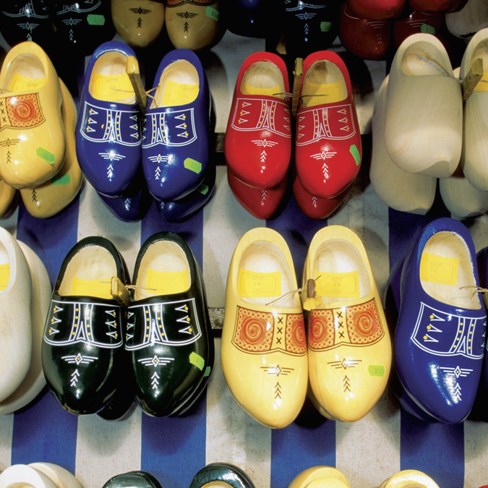
The U.S. vs. the Netherlands
Notes:
But despite these cross-national similarities in the experiences of adolescence as a life phase, there is a great range across developed nations in the adolescent sexual health outcomes. This module focuses on two cases in particular—the US and the Netherlands

Slide 11
Why Compare the U.S. and the Netherlands?
Similarities
  Developed countries
  Went through a sexual revolution
  Reproductive health technologies
Differences
  Approaches to adolescent sexuality
  Adolescent sexual health outcomes
  Socioeconomic, racial, and ethnic diversity in populations
Notes:
Why compare these two countries?
They are useful to compare because first they are similar in several important ways:
Both are developed countries which are similar in terms of wealth, education, and reproductive technologies
Both underwent a sexual revolution during the 1960s and 1970s, which led to a liberalization of sexual attitudes and behavior
At the same time the two countries differ greatly in terms of the way adults today approach teen sexuality, as reflected in policy and practice both at home and in health care and education.
The two countries also differ greatly in terms of adolescent sexual health outcomes, in fact they occupy opposite positions among the spectrum of developed nations: with the US having one of the highest and the Netherlands one of the lowest teen pregnancy rates.

Slide 12
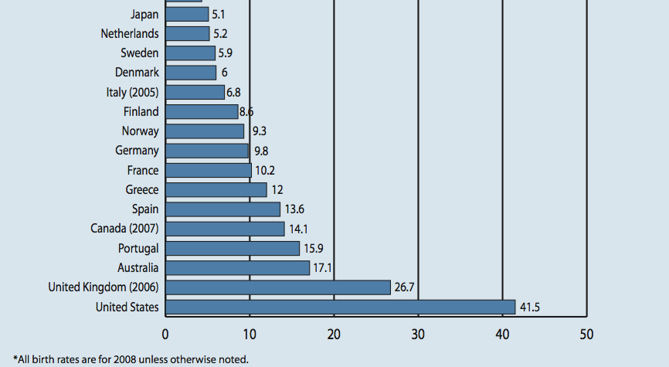
Teen Birth Rate by Country,
Age 15-19, 2008
2016 US Teen Birth Rate = 20.3 vs
Netherlands Birth Rate = 4.5
www.TheNationalCampaign.org
Notes:
https://powertodecide.org/what-we-do/information/national-state-data/national
https://www.rutgers.international/sites/rutgersorg/files/PDF/RHRN-HLPF_A4leaflet_NL.pdf
United States 2016:
National Overall Teen Birth Rate: 20.3
Whites: 14
Black: 29
Hispanic: 32
AI/AN: 35
Netherlands Teen Birth Rate:
4.5 per 1,000 Births (2016)
CBS-Centraal Bureau voor de Statistiek. (2016) Geboorte; leeftijd moeder (exact) 1950-2014. CBS StatLine. Retrieved 6 July 2017 from: http://statline.cbs.nl/Statweb/publication/?DM=SLNL&PA=37520&D1=0-14&D2=0&D3=(l-2)-l&VW=T.

Slide 13
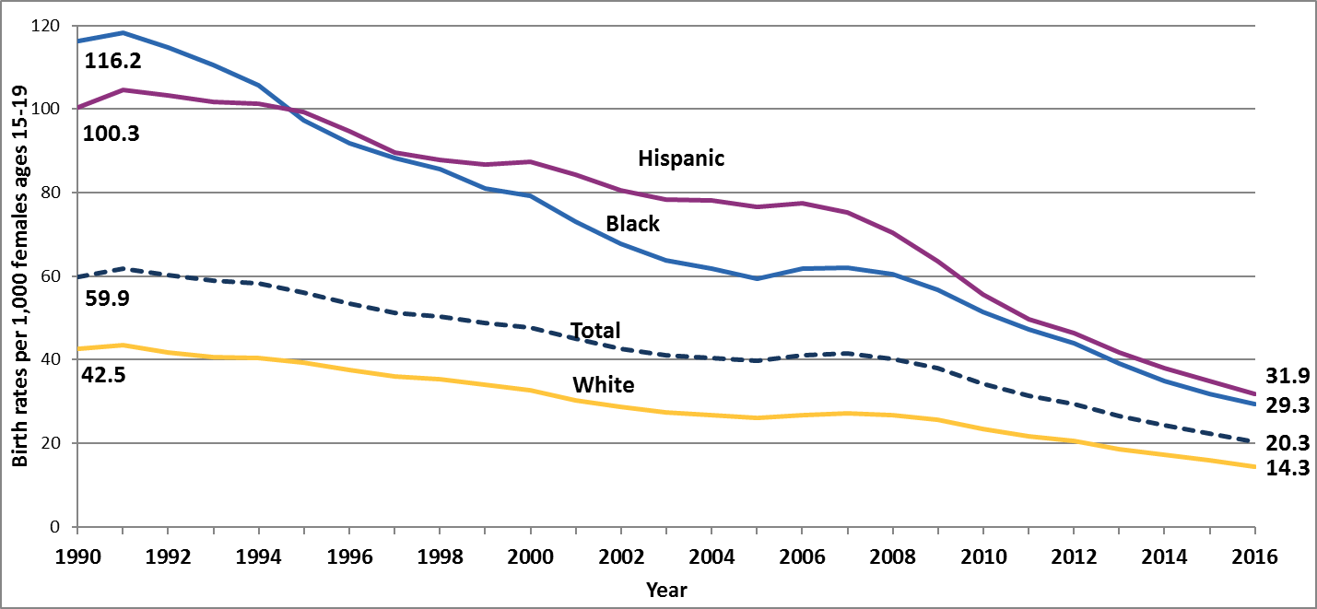
US Birth rates per 1,000 females ages 15-19, by race/ethnicity, 1990-2016
Source: Martin, J.A., Hamilton, B.E., Osterman, M.J., Driscoll, A.K., & Drake, P. (2018). Births: Final data for 2016. Hyattsville, MD: National Center for Health Statistics.

Slide 14
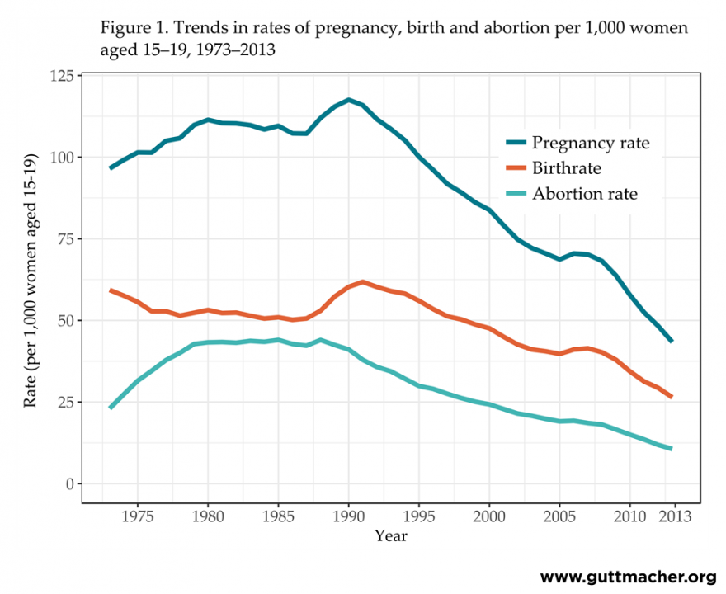
Teen Pregnancy, Birth, and Abortion Rates Are Declining (15- to 19-year-olds), 1973-2013
Kost K, Maddow-Zimet I and Arpaia A, Pregnancies, Births and Abortions among Adolescents and Young Women in the United States, 2013: National and State Trends by Age, Race and Ethnicity, New York: Guttmacher Institute, 2017.
Notes:
https://www.guttmacher.org/report/us-adolescent-pregnancy-trends-2013
KoKost K, Maddow-Zimet I and Arpaia A, Pregnancies, Births and Abortions Among Adolescents and Young Women in the United States, 2013: National and State Trends by Age, Race and Ethnicity, New York: Guttmacher Institute, 2017, https://www.guttmacher.org/report/us-adolescent-pregnancy-trends-2013.
National-level trends in pregnancy, 1973–2013
The 2013 abortion rate among 15–19-year-olds was 11 per 1,000 women, the lowest since abortion was legalized and just 24% of the peak rate in 1988 (44).
The pregnancy rate among 15–19-year-olds was 43 per 1,000 women; this means that fewer than 5% of 15–19-year-olds became pregnant in 2013.

Slide 15
What Methods of Contraception are
US High School Youth Using?
YRBS Question | US
% of students who used a condom before last sex | 53.8%
% of students who used birth control pills before last sex | 20.7%
% of students who used IUD/Implant, pills, shot, patch, ring | 29.4%
% of students who used an IUD or Implant before last sex | 4.1%
National Youth Risk Behavior Survey, 2017
Notes:
Source: MMWR 2017;67(SS-8) June 15, 2018
The YRBS, or Youth Risk Behavior Survey, is an anonymous survey administered by the CDC every two years in selected high schools throughout the United States. Thus, it is a survey of adolescents in grades 9–12 who are in school. The survey focuses on many different health concerns and behaviors including: mental health, exercise, nutrition, use of seatbelts, substance use behavior and sexual behavior. We will briefly review some of the data pertaining to sexual health.
The data is available nationally, by state, and also at local levels. It is helpful to become familiar with the results in your area, especially when trying to sensitize stakeholders about the need to develop services to support adolescents to reduce risk.
Discuss each cell.
1) The percentage of high school students who used a condom during last sexual intercourse (among students who were currently sexually active):
The percentage for all students is 53.8. The percentage for Male students is 61.3. The percentage for Female students is 46.9. The percentage for 9th grade students is 54.5. The percentage for 10th grade students is 57.8. The percentage for 11th grade students is 56.3. The percentage for 12th grade students is 49.9. The percentage for Black students is 52.1. The percentage for Hispanic students is 54.9. The percentage for White students is 54.1. All Hispanic students are included in the Hispanic category.
The percentage for 1991 is 46.2. The percentage for 1993 is 52.8. The percentage for 1995 is 54.4. The percentage for 1997 is 56.8. The percentage for 1999 is 58.0. The percentage for 2001 is 57.9. The percentage for 2003 is 63.0. The percentage for 2005 is 62.8. The percentage for 2007 is 61.5. The percentage for 2009 is 61.1. The percentage for 2011 is 60.2. The percentage for 2013 is 59.1. The percentage for 2015 is 56.9. The percentage for 2017 is 53.8
2) The percentage of high school students who used birth control pills before last sexual intercourse (to prevent pregnancy, among students who were currently sexually active): The percentage for all students is 20.7. The percentage for Male students is 19.0. The percentage for Female students is 22.4. The percentage for 9th grade students is 8.6. The percentage for 10th grade students is 17.0. The percentage for 11th grade students is 20.6. The percentage for 12th grade students is 27.2. The percentage for Black students is 13.2. The percentage for Hispanic students is 12.1. The percentage for White students is 27.1. All Hispanic students are included in the Hispanic category. All other races are non-Hispanic..
The percentage for 1991 is 20.8. The percentage for 1993 is 18.4. The percentage for 1995 is 17.4. The percentage for 1997 is 16.6. The percentage for 1999 is 16.2. The percentage for 2001 is 18.2. The percentage for 2003 is 17.0. The percentage for 2005 is 17.6. The percentage for 2007 is 16.0. The percentage for 2009 is 19.8. The percentage for 2011 is 18.0. The percentage for 2013 is 19.0. The percentage for 2015 is 18.2. The percentage for 2017 is 20.7.
3) The percentage of high school students who used birth control pills; an IUD or implant; or a shot, patch, or birth control ring (before last sexual intercourse to prevent pregnancy among students who were currently sexually active).
The percentage for all students is 29.4. The percentage for Male students is 23.9. The percentage for Female students is 34.6. The percentage for 9th grade students is 14.3. The percentage for 10th grade students is 24.1. The percentage for 11th grade students is 30.4. The percentage for 12th grade students is 36.9. The percentage for Black students is 22.5. The percentage for Hispanic students is 16.8. The percentage for White students is 37.4. All Hispanic students are included in the Hispanic category. All other races are non-Hispanic. Note: This graph contains weighted results.
The percentage for 2013 is 25.3. The percentage for 2015 is 26.8. The percentage for 2017 is 29.4.
4) Percentages from 2013 through 2017 for high school students who used an IUD (e.g., Mirena or ParaGard) or implant (e.g., Implanon or Nexplanon) (before last sexual intercourse to prevent pregnancy among students who were currently sexually active).: The percentage for all students is 4.1. The percentage for Male students is 2.7. The percentage for Female students is 5.3. The percentage for 9th grade students is 2.2. The percentage for 10th grade students is 3.6. The percentage for 11th grade students is 4.4. The percentage for 12th grade students is 4.6. The percentage for Black students is 3.3. The percentage for Hispanic students is 2.2. The percentage for White students is 4.9. All Hispanic students are included in the Hispanic category. All other races are non-Hispanic. Note: This graph contains weighted results.
The percentage for 2013 is 1.6. The percentage for 2015 is 3.3. The percentage for 2017 is 4.1.

Slide 16
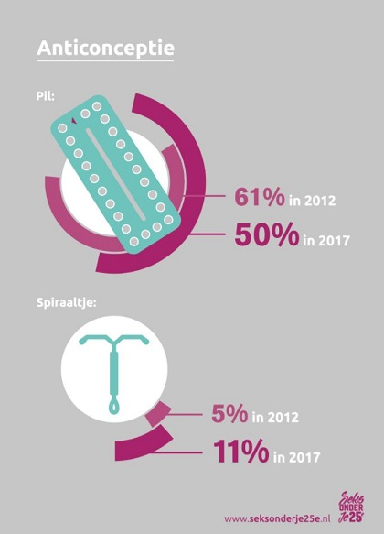
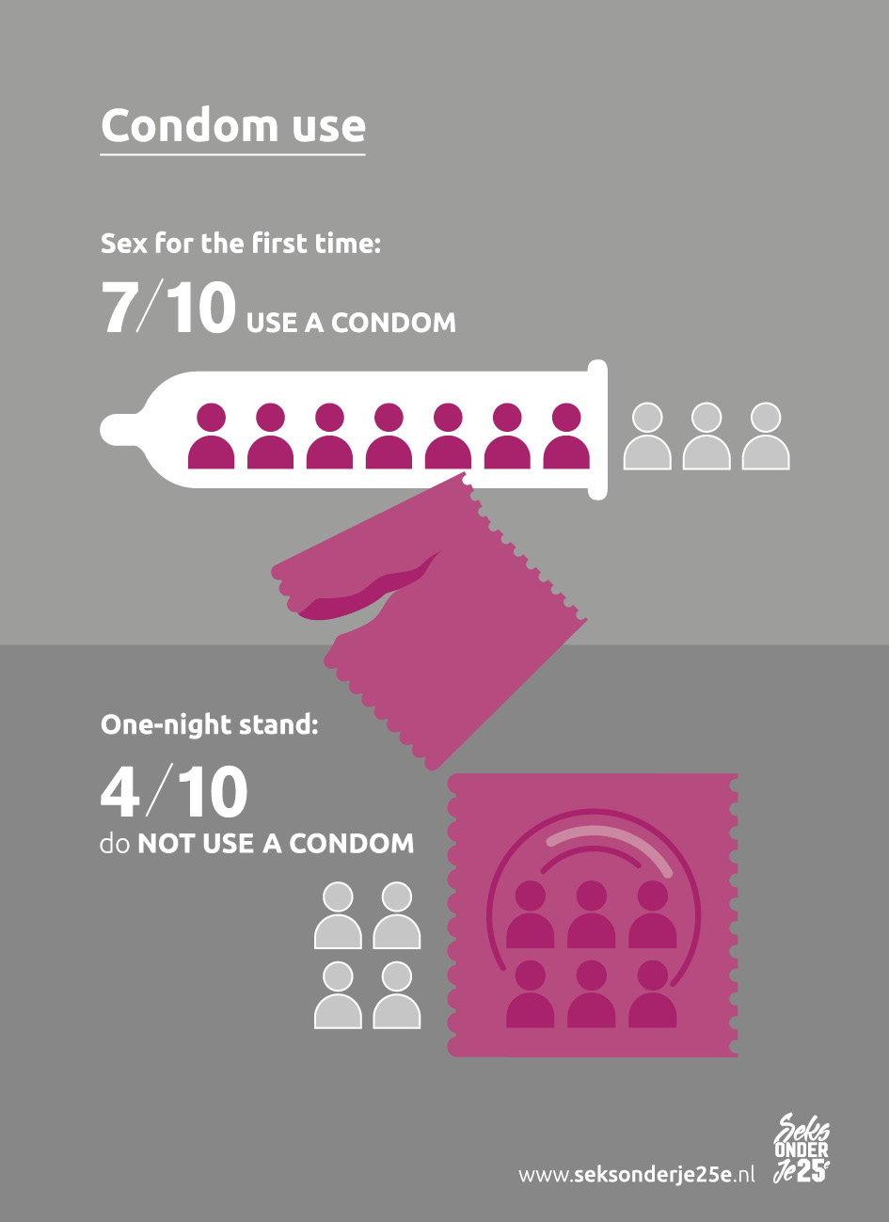
Contraceptive Use Among Dutch Youth is High
Sex Under the Age of 25 Survey: Rutgers and Soa Aids Netherlands
Notes:
https://www.rutgers.nl/feiten-en-cijfers/kennisdossiers/anticonceptie/de-feiten-beeld-over-anticonceptie
http://seksonderje25e.nl/page/Infographics373
http://seksonderje25e.nl/files/uploads/Sex%20under%20the%20age%2025%20Summary.pdf
Sex under your 25th is a large nationally and regionally representative study of the relational and sexual health of young people aged 12 to 25, carried out by Rutgers and Soa Aids Netherlands in collaboration with GGDs and the RIVM. With the outcomes of Sex under your 25th, the information and assistance to young people will be improved.
Well protected against pregnancy Contraceptive use is high among young people. During their first sexual intercourse, 92% of young men and 94% of young women used contraception. This is a slight improvement compared to 2012. Four in five young people always use contraception with their most recent partner. This is also a slight improvement (among young women). The use of contraceptive methods other than the pill is increasing. The pill is still the most-used method, but its use has declined strongly, from 74% to 64% among young women with experience of sexual intercourse. After the pill, particularly IUDs are used a lot: 11% of sexually experienced young women use this method, meaning the percentage has doubled compared to 2012. The shift from the pill to other contraceptive methods can be considered positive, because it seems young women are more careful in choosing a method that suits them. Two thirds of young women received information about at least one other contraceptive method when they received contraceptive counselling. In addition, a shift from the pill towards long-lasting contraceptive methods entails less risk of user mistakes (such as forgetting to take the pill).
Over seven in ten young people use a condom during their first sexual intercourse, but this is often not the case during later sexual contacts. Among young men, condom use with the most recent partner has also declined. In 2017, 29% of young men and 19% of young women always used condoms with their most recent sex partner. In 2012 this was 37% and 21% respectively
Condom use The main reasons for not using a condom are the use of another form of contraception, the fact that they and their sex partner trusted each other or that it is less enjoyable. The last reason is mentioned more often by young men (58%) than young women (45%). Even with casual sex partners, condom use is low. Over four in ten young people whose most recent sex partner was a one-nightstand report they did not use a condom on that occasion. Among young people who had sex more than once with the same sex partner without being in a relationship, three quarters did not always use condoms. Carrying condoms is an important predictor of their use. However, many young people have a negative view of carrying condoms. Forty per cent of young men and thirty per cent of young women think you are looking for sex if you have condoms with you. Moreover, carrying condoms seems to be a “male thing”. Among the sexually experienced young men, 52% usually or always carries condoms; among young women this is 25%.
Contraception use among young people is high. The Sex Survey under the age of 25 (2017) shows that 92% of boys and 94% of girls use contraception at first sexual intercourse. This has improved slightly compared to 2012

Slide 17
The Question
Why are there such large differences in sexual health outcomes between countries with so many similarities?
Notes:
The question is why does adolescent sexual maturation and exploration—in two countries that are similar in terms of wealth, education, reproductive technology and recent cultural shifts in norms around sexual behavior—produce such different outcomes?
And why do youth seem to have very different experiences of sexual initiation, with youth in one country, by and large, feeling empowered to make their own choices and enjoy first sexual experiences, while youth in the other express regret?
This is a big question. And it has a multi-facetted answer.
Supplementary: it may be that one reason US youth express regret is that teenage sex is more stigmatized in the US (so answers do not necessarily indicate true regret but what respondents believe they should feel) but this point is more easily explored later on.

Slide 18
Explaining Differences in Health Outcomes
Policies, economics, and culture play a role:
  U.S. teens are more likely to be poor and lack access to socioeconomic resources
  Dutch teens have better access to sexual health education and services
  Adults approach adolescent sexuality differently because of difference in culture
Notes:
First, the US simply has much higher rates of poverty and socioeconomic disadvantage than the Netherlands, where government programs provide assistance for an array of human needs, including housing, health care, education, and income. (For some audience, it may be important to note that the Netherlands is a capitalist country but it is a more robust welfare state than the U.S..)
As noted before, socioeconomic disadvantage is highly correlated with poor sexual health outcomes, so if poverty rates are higher, it really is not that surprising that unintended pregnancies and STI rates are also higher.
Second, Dutch teens have, on the whole, much better access to sexuality education and sexual health services than US teens—sex education, including about contraception, is universal in the Netherlands. Dutch teens have easy access to contraceptive counseling—it is integrated into routine care through the family physician who tends to provide most of the first-line health care or clinics available in larger cities. Oral contraception for youth must be covered in insurance plans. Finally, Dutch teens, sixteen and older may consent to abortions free of charge without parental consent.
Resources and services are an important part of the story, but they are not the whole story. To understand why young people feel more in control of their sexual choices and empowered to use the services available to them, we need to look at adult approaches. Adult approaches to adolescent sexual development differ greatly in the two countries because of different cultural understandings.

Slide 19
Turning to the Research
Study: Examining
Cultural Meanings of
Adolescent Sexuality
For information on this study, see
Not Under My Roof: Parents, Teens and the Culture of Sex
(University of Chicago Press) or visit
works.bepress.com/amy_schalet
Notes:
This draws on the research of sociologist Amy Schalet, PhD (University of Massachusetts Amherst) and a longstanding collaboration between Dr. Schalet and education specialists and faculty of the Adolescent Sexual and Reproductive Health Program (ARSHEP) at Physicians. The collaboration started when Dr. Schalet first presented her research on a new paradigm at a yearly faculty training, and many participants were inspired to use her findings and analyses in their own educational efforts and counseling practices. In subsequent years, she has worked together with many ARSHEP faculty members to co-present her research and its practical and policy applications (including at the American Academy of Pediatrics, the American Medical Students Association, and many venues). This module reflects the synergy of those collaborations.
The following slides draw heavily on the following publications:
For research findings and analyses
Amy T. Schalet. 2011. Not Under My Roof: Parents, Teens, and the Culture of Sex. Chicago: University of Chicago Press.
Amy T. Schalet. 2004. “Must We Fear Adolescent Sexuality.” Medscape General Medicine. 6 (4).
For the ABCD model:
Amy T. Schalet. 2011. “Beyond Abstinence and Risk: A New Paradigm for Adolescent Sexual Health.” Women’s Health Issues 21 (3S); S5–S7.
For more on these topics through the lens of gender:
Schalet, A. Sexual subjectivity revisited: The significance of relationships in Dutch and American girls’ experiences of Sexuality. Gender & Society 2010; 24 (3): 304–329.

Slide 20
Interviews with Dutch and U.S. Parents and Teens: 1991-2000
Subject demographics: white, secular, moderately religious, and middle class
Interviews: 1-2 hours, taped, transcribed, and analyzed
Interview type: Semi-structured, in-depth interviews
  72 interviews with boys and girls, ages 15-18
  58 parent interviews (mothers and fathers)
Elliot S. Symbolic Interaction. 2010.
Notes:
The results that will be presented in the following slides are based on a qualitative study.
The advantages of qualitative studies is that they are able to get at cultural meanings that are often taken for granted, difficult to discern, and therefore not studied and accounted for in explanation of sexual behavior/outcomes. This study is ground-breaking in being able to demonstrate cultural processes that contribute to international differences in adolescent sexual health outcomes. But because it is an in-depth qualitative study, it could only involve a limited sample size, and to keep the two groups as comparable as possible, those two groups must be as consistent as possible between the two countries. The study focused on groups that one might expect to be most similar: the white middle class, elected from 5 different comparable localities across the 2 countries.
It is important to note several limitations.
The study’s sample does not reflect the economic and cultural variation within each country, and caution must be exercised in generalizing toward other groups.
The data is from the 1990s and early 2000s. Some shifts may have taken place since then.
That said, studies conducted more recently among diverse populations suggest that many of the findings of this study continue to hold true and pertain beyond the specific group studied.
Source:
Elliott S. Parents’ constructions of teen sexuality: Sex panics, contradictory discourses, and social inequality. Symbolic Interaction 2010;33(2): 191–212.

Slide 21
U.S. Culture and Adolescent Sexuality: Dramatization
Notes:
The overarching concept Schalet uses to describe the US approach to adolescent sexuality is “dramatization” and the assumption of conflict: within a teenagers, between cognition and hormonal impulses, between boys and girls, and between teens and parents

Slide 22
United States: Dramatization
Raging hormones
Sex as risk taking
Battle of the sexes
Falling in love is extraordinary
Secrecy between parents and teens
Notes:
Interviews with parents and teens in the US brought out several cultural themes around adolescent sexuality. Together, these themes demonstrate an approach that dramatizes adolescent sexuality: emphasizes conflict within a teenager (between impulse and cognition), between teenagers, especially boys and girls, and between teens and their parents.
This cultural processes of dramatization can be broken down into five (related) themes.

Slide 23
Dramatization—Raging Hormones
“Adolescents are completely hormonally driven”
—American mother
The concept of “raging hormones” assumes:
  Teenagers are unable to control urges
  Disjunction between the onset of hormones and the development of the cognitive and emotional capacity to handle them
  Parents’ role is to contain
Schalet, A. Medscape General Medicine. 2004
Notes:
In the US, the approach to adolescent sexuality is one of dramatization. When asked about teenagers, parents describe raging hormones and refer to teenage sexuality as an individual, overpowering force that is difficult for teenagers to control. Closely associated with the power of hormones are their dangerous consequences and accounts of lives seriously disrupted because of sex.
US parents also see a disjunction between the onset of hormones, on the one hand, and the development of the cognitive and emotional capacity to handle them, on the other. As a result teenage sexual behavior is seen as destined to be reckless and dangerous by nature. Thus, many American parents worry that their children lack self-regulatory capacities and they see their own role as containing and directing, rather than giving full range, to their children's raging hormones.
Source:
Schalet, A. Medscape General Medicine. 2004

Slide 24
Dramatization—Sex as Risk Taking
“Sex is a risk. If you’re not looking to have a baby, sex is definitely a risk…. I have had a situation where condoms have broken and I was like, flippin’ out of my mind ready to puke. I was like ‘Jesus Christ, we’re dead. I’m screwed for the rest of my life.’”
—16-year-old American boy
Notes:
Many teens articulate a notion of sex as by definition dangerous in a second theme, namely, that of sex as risk-taking. In this, they distinguish themselves from the Dutch teens who assume that they have the power (and responsibility) to prevent the unwanted consequences of sex. These different beliefs on the part of teens reflect the different messages they receive from adults.

Slide 25
Dramatization—Battle of the Sexes
Males want sex, females want love
Consequences fall on females
Parents must “protect” females, “rein in” males
Schalet, A. Medscape General Medicine. 2004
Notes:
A third theme that stood out was that of the “battle between the sexes.” Many US parents stress the ways in which girls and boys have opposing, even antagonistic, desires and interests. Boys want sex and girls want love. With teen sex conceptualized as a battle where there are costs and benefits, winners and losers, American parents view it as their job to protect females and reign in males.
(Boys) Males want sex, (girls) males want love
Source:
Schalet, A. Medscape General Medicine. 2004

Slide 26
Dramatization—Love Is Extraordinary
Parents: “Teens just ‘think they are in love’; it is not real”
Teens: “I want to be in love but other teens just want to have sex”
Schalet, A. Medscape General Medicine. 2004
Notes:
In interviews, the American parents express extreme skepticism about love during the teenage years. Parents frequently say that while teenagers, particularly girls, may think they are in love, they are not truly in love. Thus, they feel it their role to contain sexual behaviors until such time that their teens are capable of being in love.
American teens add their own twist to this cultural conception: they may describe themselves as in love, but often think that other teens who have sex are not
or they describe being in love as something that is so difficult to attain that only a few lucky ones can have it.

Slide 27
Dramatization—Sex Is a Secret
[My mother] hasn’t asked me [whether I am having sex] and I haven’t told her…I’d rather her not ask me straight out.”
—16-year-old American girl
Teens keep sex a secret
Some parents prefer “not to know”
Secrecy weighs especially on girls
Notes:
The final theme in the dramatization of adolescent sexuality is that of sex as a secret. Parents tend to be ambivalent in their communication about sex, conveying that it would be a disappointment to them if their teenage children became sexually active. (Exception to this rule are some fathers about their sons). Some do not address the topic at all, other than to warn against danger. Others may talk about contraception but make clear they do not want their children to have sex. Only half of the girls in this study say their parents have talked with them about contraceptive methods (matches data from the National Survey for Family Growth.)
As a consequence of silence, prohibitions, and ambivalence, many young people say that they do—or would not—confide in their parents about sexual activity. This secrecy leads to a disconnection between parents and teens, and especially for girls a kind of psychic “bifurcation.” They experience their roles as “good” daughters and their sexual development in conflict. This is problematic because they carry a “psychic burden” and they are unable to draw on their parents for support to navigate sex and relationships. The theme of secrecy and disconnect is most pronounced for girls, who face greater stigmatization for sex, but also there for boys.

Slide 28
Dutch Culture and
Adolescent Sexuality
Normalization
Notes:
In the Netherlands, parents look at teen sexuality through a very different cultural lens. They engage in what Schalet calls “normalization.” It is important to note up front that normalization is different from “permissiveness” and involves a form of control.

Slide 29
Netherlands: Normalization
Readiness and self-regulation
Sex is preparation
Falling in love is common
Relationships between the sexes
“Normal” sexuality, not secretive
Notes:
Like dramatization, normalization can be broken down into 5 themes.

Slide 30
Normalization—Readiness and Self-Regulation
“[My daughter] is 16, almost 17. I think she knows very well what matters, what can happen. If she is ready, I would let her be ready.”
    —Dutch father
Teens are able to self-regulate
Concept of “er aan toe zijn” or being ready
  Parents stress that sexual development should occur gradually
  Concept of “vrijen”
  A range of behavior, not limited to intercourse
Notes:
Source:
Schalet, A. Medscape General Medicine. 2004
The first theme is readiness and self-regulation.
In contrast to their American counterparts, Dutch parents assume that teenagers can be self-regulating sexual agents. They illustrate this confidence in their children's capacity for self-regulation with their use of a term which translates as "being ready." Dutch parents indicate that the state of being ready is best recognized by the teen and they view taking preventive measures as part of being ready.
It is easier to know when one is ready, when sexual development happens gradually, and several Dutch parents emphasize that a gradual, slowly paced sexual development is ideal.
They feel more comfortable about teenage children engaging in sexual intercourse if they have witnessed the establishment and progression of their romantic relationships.
The concept of “vrijen” indicates the notion that sex consists of more than intercourse; it includes all sexual expression, including kissing, touching, etc.
Supplementary: Dutch parents do not usually feel comfortable if sexual intercourse occurs before age 16; and for some 16, is even too young. But as this father indicates, seventeen is a generally viewed acceptable age for first intercourse (be it in relationship).

Slide 31
Normalization—Sex as Preparation
“It goes without saying that you use them [contraceptives].”
    —16-year-old Dutch boy
Preparation is part of readiness for sex
Contraception and condom use are expected preparations for sex
Notes:
Part of self-regulating is preparation. Parents emphasize that being ready means taking responsibility to prevent unintended consequences. This emphasis on the importance of using contraception is emphasized in the home, but also at school. Thus, even youth who do not receive much sex education at home, including the 16-year-old quoted here, take contraceptive use for granted.
In the Netherlands, sex is viewed instead in the context of responsibility and preparation. With readiness for safe responsible sex, comes protection from pregnancy and infection. The Dutch spend less time and effort trying to prevent young people from becoming sexually active, and more time and effort in educating and empowering young people to behave responsibly when they do.
Sources:
Lewis and Knijn 2002; 2003; Ketting and Visser 1994.
Four-fifths of Dutch youth say they feel a sense of control over their first sexual experiences (broadly defined, not just intercourse).
Sources
Schalet, A
De Graaf et al. 2005. Medscape General Medicine. 2004

Slide 32
Normalization—Falling in Love Is Common
Being in love is a common experience
  Including for teens
In national survey, 63% of Dutch youth say they are “very much” in love with their current sexual partner
deGraaf H, Meijer S, Poelman J, Vanwesenbeeck I. Seks onder je 25ste; Seksuele Gezondheid van Jongeren in Nederland Anno 2005
Notes:
In contrast to the US interviewees, the Dutch described being in love as a normal experience, one that anyone could experience, including teens. In fact, in a national survey, 90 percent of Dutch 14-year-old boys say they have been in love (de Graaf, et al., 2005)
There is also the expectation that sex only occurs within a loving committed relationship. This does not mean that it always does, of course. It does mean that youth have access to a culturally acceptable form of sexual expression, on which parents and teens agree.
This means that it is clear when sex is not stigmatized: when ready, protected, and in a steady relationship. This need not be a life-long relationship. Dutch parents do not expect, or even want relationships to last forever. They do take teen relationships seriously.
These expectations about love and relationships are largely reflected in practice: A national survey found that 63% of sexually active Dutch youth (12–24 years old) say they are very much in love with their current (or last) sexual partner. That survey found that three-quarters of sexually active Dutch youth had their last (same- or opposite-sex) intercourse with someone with whom they had a steady relationship.
Source:
deGraaf H, Meijer S, Poelman J, Vanwesenbeeck I. Seks onder je 25ste; Seksuele Gezondheid van Jongeren in Nederland Anno 2005. Utrecht and Amsterdam: Rutgers Nisso Groep/Soa Aids Nederland.

Slide 33
Normalization—Relationship
Between the Sexes
“If they really have something special with someone and then [sex] happens, well then who am I [to object]?”
    —Dutch mother
Sex is part of a relationship
  Reflects mutual desires and interests
Parents support relationships
  Not casual sex
Schalet, A. Medscape General Medicine. 2004
De Graaf et al. 2005
CBS 2003
Notes:
Unlike the US parents, the Dutch parents don’t talk about teenage sex in terms of a battle of the sexes. Instead they talk about teenage sex as growing out of relationships in which partners have mutual interests.
One mother said she would object if her sons had a “brief [sexual] contact with a girl or boy. Because I hope that for them it means more than a brief fling. But if they really have something special with someone and then it happens, well then who am I [to object]?”
One thing to note about this quote is that the mother is talking about two boys, suggesting, almost in passing, that sexual contact might occur with a same-sex partner. She applies the same concept of relationship-based sexuality, and does not suggest that she would treat it differently than opposite-sex relationships. This is indicative of a broader cultural trend: The Dutch population, as a whole, tends to accept same-sex sexuality as legitimate, although forms of homophobia, including in parenting, continue to exist.
The Dutch parents tend to draw strong distinctions between steady romantic relationships (not necessarily for life) and casual relationships, which most disapprove of. But if parents know and approve of a steady boy- or girlfriend, they often permit couples to spend the night together. Both parents and teens indicate that this does not necessarily mean sex takes place during a sleepover.
Source:
Schalet, A. Medscape General Medicine. 2004
De Graaf et al. 2005
CBS 2003
Supplementary: with regard to gender differences, the national survey found none with regard to the sleepover question. In Schalet’ study she found slight gender differences in that boys were sometimes allowed sleepovers without being in a steady relationship.

Slide 34
Normalization—“Normal” Sexuality
“It should be normal to talk about during dinner”
    —Dutch mother
Concept of “gewoon” or normal sexuality
  Sex should be normal, acceptable part of life
  Sex should not lead to secrets but be discussed openly between family members
  Sex should not cause conflict and alienation between parents and teenagers
Notes:
The first themes we discussed pertained to how teens are to relate to themselves (being ready) and to each other around sexuality. The last theme pertains to how parents and young people are supposed to relate with regard to sex. The concept of “normal” (or “gewoon”) sexuality refers to the belief that parents and teens should be able to discuss sexuality without embarrassment, for instance during dinner time. Parents emphasize that the topic of sex and relationship should be integrated into everyday conversation and not lead to secrets. This is not always easy. Nor do they always succeed: teens sometimes don’t welcome their parents attempts at sex education. Still, parents seek to keep sex from becoming a source of conflict and alienation in the family.
Normal sexuality is not emotionally disruptive; it does not cause conflicts or needless separation between parents and children.
Source:
Schalet, A. Medscape General Medicine. 2004

Slide 35
Normalization—Sex Is Negotiation
“I wanted to tell my mother. I don’t know. It was on my mind. So I told her regardless of the consequences.”
    —16-year-old Dutch girl
An open subject is rendered negotiable
Parents may not always be completely comfortable with teen sex, but they do not want it to lead to deception
Notes:
“It is something that is yours, but I think you do want to share it with your parents...I wanted to tell that to my mother…It was just on my mind. So I told her, regardless of the consequences.”
”We talked about it, kind of very carefully feeling our way: my parents were like, “What exactly do you want?” And I was like, “What would they really allow?”
In the Netherlands, sex is negotiation. Throughout the interviews, Dutch parents repeatedly mention that sexuality is, and should be, normal. The wish to have sexuality be normal and not a cause for deception or separation between parents and children renders it discussable and negotiable. Do Dutch parents experience angst and discomfort? Yes they do, and yet the discussions take place because of a belief that sex ought not be a dividing issue.
One Dutch mother discussed how she did not feel her daughter was ready for sex, but their family doctor advised her not to forbid it, that such a rule would cause the situation to “go wrong.” Instead, when her daughter asked to go on contraception, the mother discussed it with her and took her to the doctor. She understood that while it was beyond her comfort level, her daughter was being sensible.
The negotiation as told by a seventeen-year-old Dutch boy:
“We talked about it, kind of very carefully feeling our way: my parents were like, ‘What exactly do you want?’ And I was like, ‘What would they really allow?’ After a while I just asked plainly, would it be allowed? And then they said ‘yes’...They’d rather that I am at home when I am going to do something like that, than elsewhere. Because they know: if something is going to happen, it is going to happen. And if it happens at home, at least they know where I am.”
Schalet, A. Medscape General Medicine. 2004

Slide 36
Can Cultural Approaches to Adolescent Sexuality Change?
Notes:
At this point in the presentation, you may be asking yourself, this is all fine and well, but that is a different culture and how does that apply here. There are several lessons that can be learned from the Dutch case. The first is that attitudes and approaches toward teenage sexuality can change.

Slide 37
Conceptualizing a New Paradigm: ABCD2
Notes:
The second thing that we can take away from the Dutch case is that under the right conditions, teens can feel empowered to make healthy choices around sexuality and relationships, confide in trusted adults—including their parents—and receive guidance around their sexual development.
To provide youth with these conditions, we need to shift the overarching paradigm we use to approach them (and their parents) in our educational and healthcare policy and practices—away from an exclusive focus on the negative aspects of sexuality toward positive sexual development.

Slide 38
A New Paradigm
ABCD²
ABCD² = HEALTHY SEXUALITY
  AUTONOMY
  BUILD
  CONNECTEDNESS
  DIVERSITY/DISPARITIES
Notes:
Read what each word stands for:
AUTONOMY: Develop sexual autonomy
BUILD: Build good relationships
CONNECTEDNESS: Foster connectedness.
DIVERSITY/DISPARITIES: Recognize diversity; remove disparities

Slide 39
A New Paradigm
Adolescent sexuality is a normal process of psychosocial and biological development
Sexuality is a continuum along which youth move as maturity and relationships permit
Adults play vital roles in providing resources and supporting the development of skills
Notes:
The paradigm that will be outlined today differs from the risk and abstinence paradigms that have prevailed. It was developed out of Schalet’s comparative research, but also integrates concepts and research from feminist psychology, public health, and positive youth development.
Before going into the different components of the conceptual model, let’s take a look at three underlying precepts, namely
that it is normal for adolescents to develop sexually and to start to explore their sexuality in feelings, relationships, and if they so choose, behavior;
that sexuality comprises a continuum of feelings and behaviors, and that teens ideally move along that continuum as their maturity and relationships permit;
that adults play a vital role in providing the resources (health care, information, etc.) as well supporting the development of the skills youth need to explore sexuality and relationships.
The article that will be most useful for this part of the presentation is:
Amy T. Schalet. 2011. “Beyond Abstinence and Risk: A New Paradigm for Adolescent Sexual Health.” Women’s Health Issues 21 (3S); S5–S7.

Slide 40
FIRST: Provider Values Clarification
  Be aware of your own feelings about adolescent sexual behavior.
  How comfortable are you talking to adolescents?
  What are your feelings/beliefs about adolescent sexuality?
  Are you able to separate your own values to effectively counsel your patient?
Notes:
The first step is to address this often loaded topic of sexuality, and the even more loaded topic of adolescent sexuality, within ourselves and amongst the colleagues that we work with.

Slide 41

Case: Janice
16-year-old female
She has decided to have sex for the first time
Wants to know where her boyfriend can get tested for STIs
Notes:
Throughout the next few slides start to think about Janice and applying some pearls of practice from this new ABCD paradigm.
This case brings forward points about supporting adolescents’ autonomy of sexual self and talking to teens about their role in assessing their readiness and decision-making around sex.

Slide 42
A New Paradigm
A
  Develop Autonomy
  of Sexual Self
Notes:
To navigate their sexual development in a healthy fashion, young people need to develop “autonomy” of sexual self. At the most basic level, such autonomy requires knowing about anatomy, reproduction, and contraception (perhaps repeat that only 50% of US girls, and a third of US boys get the latter at home). But beyond this basic knowledge, young people also need to develop self-knowledge in relation to their bodies, feelings and sexuality that allows them to make self-directed choices and navigate sexuality in relationship to others. They need to know about their capacity for sexual desire and pleasure, and that their own desires are important in their decision-making [especially girls who are rarely affirmed in their sexual desires, and do not know how to use them as a barometer for sexual decision-making (see also Tolman, 2002)]. Other critical components of autonomy of sexual self are being able to recognize and articulate sexual wishes and boundaries, and learning to anticipate and prepare for sexual acts. When youth have sexual autonomy, they can recognize their sexual feelings as separate from the desires and pressures of others, own their feelings, and exercise control over their sexual decision-making.
Knowing about anatomy, reproduction, and contraception
Knowing about pleasure and enjoyment of sexual contact
Recognizing and articulating own wishes and boundaries
Owning and controlling sexual decision-making process
Anticipating and adequately preparing for sexual activity

Slide 43
Autonomy of Sexual Self
Research has found that:
  Personal control and self-efficacy in sex negotiation are significantly associated with safer sex behavior
  Adolescents with a sense of control over their lives (in general and in sexual situations) more likely to abstain from sex or to use condoms when they engage in sexual intercourse
Notes:
Sexual autonomy helps youth to navigate their sexual interactions with others: Teens who have a greater sense of control in sexual situations are more likely to refrain from intercourse and use condoms when they have sex. Obtaining a strong sense of autonomy with regard to sexuality is especially important for girls.
Source:
Pearson J/ Personal Control, Self-Efficacy in Sexual Negotiation, and Contraceptive Risk among Adolescents: The Role of Gender. Sex Roles. 2006; 54 :615–625.

Slide 44
Autonomy of Sexual Self
Research has found that:
  “Sexual subjectivity”—sexual body esteem, sense of entitlement to pleasure, sexual self-reflection—is associated with higher levels of self-efficacy in condom use in girls
  Girls who report more “sexual self-efficacy”—ability to act upon their own needs in a relationship—are more likely to have used condoms at first intercourse.
Notes:
Developmental psychologists have found that when girls have a stronger sense of autonomy with regard to their sexuality, they tend to feel more empowered in negotiating condom use.
Boys also need to be bolstered in their autonomy so they are better equipped to resist rigid masculinity norms, which, like rigid femininity norms can undermine contraceptive use and sexual health.
Sources:
Horne, S. and M. J. Zimmer-Gembeck. The Female Sexual Subjectivity Inventory: Development and Validation of a Multidimensional Inventory for Late Adolescents and Emerging Adults. Psychology of Women Quarterly. 2006; 30 (2006):125–138.
Impett, E., D. Schooler and D. Tolman. To Be Seen and Not Heard: Femininity Ideology and Adolescent Girls' Sexual Health. Archives of Sexual Behavior. 2006; 35 (2):131–144.
Pleck JH, Sonenstein FL, Leighton KC. Masculinity ideology: Its impact on adolescent males’ heterosexual relationships. J Social Issues 1993;49(3):11–29.

Slide 45
Case: Janice
How would you respond to Janice and her service request?
How could you assess her autonomy?
How can you create positive communication about sexual decision-making?
Notes:
Creating fear of consequences associated with sexual behavior does not contribute to self efficacy or autonomy is sexual decision-making.
This conversation should be an opportunity to assess Janice’s autonomy in terms of sexual decision-making and help her gain the skills she needs to make the right choice for herself. As a 16 year old, we assume she is capable of desire and sexual autonomy but providers should still be aware of and identify instances of sexual or reproductive coercion or abuse.

Slide 46
Autonomy: Pearls for Practice
Assess understanding of anatomy, reproduction, and contraception
  Identify sources of information
  Bridge gaps through education
Assess self-efficacy in other domains and problem-solving abilities
Notes:
One of the ways to assess understanding of anatomy and reproductive health is by starting early and bringing up these topics at pediatric visits prior to the adolescent years. Even at a younger age you can explore with parents, families, and patients what they are learning about their bodies and relationships at home, in school, and from friends. As they get older the specific issues you discuss are adapted as appropriate and in a logical sequence.
Assess knowledge and understanding:
For example pregnancy test requests can open a discussion of the patient’s knowledge of anatomy, pregnancy, and prevention methods.
Assess self-efficacy:
A patient’s ability to manage chronic conditions such as asthma or even his/her academic achievements can provide indicators of self-efficacy. You can also evaluate self esteem and problem solving capacity at younger ages by exploring what activities they are participating in or what roles they are taking on at school, home, in extracurricular activities. You can actually ask them directly how they approach challenging situations or problems with friends, teachers, in their families. This sets the stage for discussing communication and problem solving in more intimate relationships in the future.
If you’ve discussed much of the above already as part of routine visits then when it comes time to “examine if they are ready for sex” you’ve already paved the way….

Slide 47
Autonomy: Pearls for Practice
Acknowledge the pleasurable and enjoyable aspects of sexual contact
Normalize desire and arousal
Emphasize owning and controlling one’s sexual
decision-making
  Help youth examine readiness
Promote preparation for sexual activity
Notes:
Acknowledging pleasure and enjoyment provides balanced context and a good lead-in to discussing partners, personal readiness, contraception, and STI testing.
Emphasizing agency and personal control can help patients with decision-making and contraceptive/condom negotiation.
Help youth examine their readiness for sex. Have patients identify the right conditions for themselves and prepare, as needed, starting contraception, using condoms, and involving partners in contraceptive/condom use.

Slide 48
A New Paradigm
B
  Build Good
  Romantic
  Relationships
Notes:
The B in the new paradigm refers to building healthy romantic relationships. Our current paradigms often place teenage sexuality outside the context of the relationships in which it is expressed. Or they reference two relationship archetypes: The heterosexual marriage ideal and the risk of the unhealthy relationships. But rather than uphold marriage as the only valid relationship, we must validate adolescents’ need for intimacy and assist them in building egalitarian and nourishing romantic relationships suited to their life stage. And rather than teach about healthy relationships primarily through the lens of unhealthy relationships, we must also attend to the characteristics of positive romantic relationships and the skills to build them.
Validate adolescents’ need for intimacy
Assist them in building egalitarian relationships suited to their life stage
Teach about healthy relationships, not just the avoidance of unhealthy relationships

Slide 49
Building Healthy Relationships
Research has found that:
  Communication with partners about contraception prior to first sex significantly increases contraception use in both genders
  Open communication in adolescent dating couples increases communication about contraception
Notes:
Good romantic relationships, in which young people feel comfortable communicating with one another, build positive sexual health outcomes.
Sources:
Stone N, Ingham N. Factors Affecting British Teenagers' Contraceptive Use at First Intercourse: The Importance of Partner Communication. Perspectives on Sexual and Reproductive Health, 2002; 34 (4):191–197.
Widman, L., D.P. Welsh, J.K. McNulty and K.C. Little. Sexual Communication and Contraceptive Use in Adolescent Dating Couples. Journal of Adolescent Health. 2006; 39:893–899.

Slide 50
Building Healthy Relationships
Research has found that:
  Adolescent sexual activities are more likely to be safe, wanted, and pleasurable when:
    Partners are more equal (in age)
    Teens feel satisfied by their relationship
    Teens experience intimacy in their relationship
Notes:
Parents and health and education professionals tend to be wary of romantic relationships between teens because such relationships can lead to sexual intimacy.
But it may be more important to identify the critical characteristics of teenagers’ romantic relationships: Adolescent sexual activities are more likely to be safe, wanted, and gratifying when relationships are equal—that is, not characterized by large age differences between girls and older boyfriends—and when teenagers feel satisfied, experience intimacy, and are able to discuss contraception openly within their relationships.
Sources:
Houts L. But was it wanted? Women’s first voluntary sexual intercourse. J Fam Issues 2005;26(8):1092–1102.
Manlove J, Ryan S, Franzetta K. Contraceptive use patterns within teenagers’ first sexual relationships. Perspect Sex Repro Health 2003;35(6):246–55.
Stone N, Ingham R. Factors affecting British teenagers; contraceptive use at first intercourse: The importance of partner communication. Perspect Sex Repro Health 2002;24(4):191–7.
Sprecher S, Barbee A, Schwarz P. Was it good for you, too? Gender differences in first sexual intercourse experiences. J Sex Research 1995;32(1):3–15.
Wildman L, Welsh DP, McNulty JK, Little KC. Sexual communication and contraceptive use in adolescent dating couples. J Adolesc Health 2006;39:893–9.
Guggino, J.M., and J.J. Ponzetti, Jr. Gender Differences in Affective Reactions to First Coitus. Journal of Adolescence. 1997; 20:189–200.

Slide 51
Building Relationship: Pearls for Practice
Discuss peer relationships as lead-in to romantic relationships
Acknowledge the value of relationship-building and the “virtues” of intimate relationships
Encourage youth to discuss
  Defining a healthy relationship
  Communication with partners
  Sex-related communication
  Conflict resolution
Notes:
Once again start early, examine peer relationships at visits prior to when a patient has entered a more intimate physical relationship with a boyfriend or girlfriend. Explore with them what they think a healthy relationship looks like and what “trust and respect” mean. Ask them if they have role models for a healthy relationship and how they communicate when there is conflict.
When it comes to sex ask them what role they see it playing in their relationship.

Slide 52
Building Relationships: Pearls for Practice
What does a healthy relationship look like to you?
Disagreements and arguments are a normal part of any intimate relationship. What is it like when you and your partner get into an argument? How do you usually resolve it?
How often are you and your partner together? How does your partner feel about you hanging out with other friends?
(If sexually active) Who makes the decisions about when to have sex and what kind of contraceptives you should use?
Notes:
Ask these questions to patients to assess the health of the relationship

Slide 53
A New Paradigm
C
  Connectedness
  Between Adolescents
Notes:
The “C” in the new paradigm refers to connectedness with parent(s) and other trusted adults. Because of the shame and stigma that is often attached teenage sexual exploration, honest communication and integrity in teens’ relationships with adults is often undermined in the US.
And here is where youth-serving professionals can play an important role in helping youth and parents overcome the communication breakdown around sexuality, by helping spur conversations at home and by supplementing those conversations in their respective fields.
Honesty and integrity in relationships with care providers
Parents/guardians
Educators
Medical professionals
Members of the clergy

Slide 54

Case: Eric
15-year-old male
His mother comes in concerned her son may be having sex
She requests information on pregnancy and STIs she can give him to encourage abstinence
Notes:
Case: Eric
This case brings forward points about encouraging connectedness between parents and children in regard to sexuality and sexual health.

Slide 55
Connectedness
Research has found that:
  Maintaining connectedness with parents/guardians and other trusted adults is important for many aspects of adolescent health, including sexual health
Notes:
Yet, ongoing connectedness with parents/guardians and adults is important for young people, not only with regard to their sexual health but with regard to all aspects of their thriving.
Sources:
Resnick, M.D., et al. Protecting Adolescents from Harm: Findings from the National Longitudinal Study of Adolescent Health. JAMA 1997; 278 (10):823–832.
Bernat, D.H. and M.D. Resnick. Connectedness in the lives of adolescents. In Adolescent Health: Understanding and Preventing Risk Behaviors, edited by R. J. DiClemente, J.S. Santelli, and R.A. Crosby San Francisco: Josey-Bass; 2009.

Slide 56
Connectedness
Research has found that:
  Parent-teenager communication about sex has positive impacts on teen sexual health when:
    Parents and teenagers have a close relationship
    Communication about sex is frequent rather than one-time
    Teenagers feel their parents are open and comfortable in discussing the topic
Notes:
And positive parent-teen communication can have important impacts on adolescent sexual health, especially when parents/guardians maintain a close relationship, communicate frequently and address many sexuality-related topics, rather than have one “big” talk. Finally, talks are more likely to impact teens’ sexual behavior when they feel parents are open and comfortable.
Sources:
Martino, S., Elliott, M., Corona, R., Kanouse, D., and M. Schuster. “Beyond the ‘Big Talk’: The Roles of Breadth and Repetition in Parent-Adolescent Communication about Sexual Topics.” Pediatrics 2008; 121(3):612–618.
Whitaker, D., Miller, K., May, D., and Levin, M. “Teenage Partners’ Communication about Sexual Risk and Condom Use: Importance of Parent-Teenager Communication.” Family Planning Perspectives 1999; 31(3): 117–121.

Slide 57
Connectedness: Including Parents in the Discussion
Adolescents aged 12 to 19 years report that parents are the greatest influence regarding sexual decision-making and values
Nearly 87% of adolescents agree that “it would be easier to postpone sexual activity and avoid adolescent pregnancy if they were able to have more open, honest conversations about these topics.”
Notes:
Adapted from, “Promoting Healthy Sexual Development and Sexuality” from the Bright Futures Guidelines for Health Supervision of Infants, Children and Adolescents.

Slide 58
Case: Eric
How do you respond to Eric’s mother and her service request?
How can clinicians foster communication between adolescents and adults in regard to sex and sexual health?
What other adults might be in Eric’s life to give Eric support around sexual decision-making?

Slide 59
Case: Eric
How might this parent encounter have differed if this mother was concerned about her daughter rather than her son?
How might you promote the concept of relationship between the sexes in this parent encounter?
Notes:
The questions posed here focus on addressing the ways the “battle of the sexes” play out in the US, views of adolescent sexuality, and how we can start conversations to change that framework when working with parents.

Slide 60
Connectedness: The Caregiver
Role in Education
Parents usually not primary source of information
Many parents feel unsure about how best to approach the topic
Discussions about sexuality limited to one “Big Talk”
Communication about sex not very extensive
Parent-teen conversations about sex often one-way
  Based on the experiences and perception of the parent
Notes:
Well, what about parents and caregivers?
Parents themselves believe that they have an important role in providing sex education for their children. Studies have found that adolescents whose parents communicate with them about sexuality are more likely to delay intercourse and, if they have intercourse, to use contraception and have fewer partners.
Despite the widespread belief that parents should be the primary source of information about sexuality, in practice they usually are not.
Because most parents do not feel comfortable or competent talking with their adolescents about sexual issues, they tend to limit conversations to “safe” topics, such as developmental changes (e.g., menstruation and other pubertal changes), and negative consequences, such as AIDS and sexually transmitted diseases.
Other than being narrow in scope, parent-adolescent conversation about sexuality is often of poor quality. Parents are often defensive, avoidant, impersonal, and rule-oriented. In observational studies, parental communication about sex, compared with other topics, is indirect and involves more dominance, less turn-taking, and lower levels of comfort. Meanwhile adolescent communication about sex versus other topics involves more contempt, dishonesty, and avoidance.
It is important to have a discussion about this with parents earlier than later because they may not realize it themselves. Often parents are so entrenched in their own life experience and teen culture that they don’t stop and acknowledge how things might be different now.

Slide 61
Guiding Patients Towards Connectedness
Parental Involvement vs. “Parentectomy”:
  Encourage honest and open communication if possible between caregiver and teen
  Encourage parents to communicate their values and beliefs but recognize that their children may have different perspectives and experiences
Notes:
We focus so much on the “parentectomy” in adolescent practice that we sometimes forget that parents can be great allies in our work even if it takes a bit more effort.
In addition to parents, adolescents need connection to educators, medical professionals, members of the clergy, and leaders in their communities.
Encourage parents to communicate their values and beliefs (while recognizing that the development of autonomy, sexual ego, and moral identities are key developmental tasks of adolescence).

Slide 62
Connectedness: Pearls in Practice
Talking to adolescents:
  Examine patient’s perspective of relationship with caregiver
  Examine barriers for conversation with caregiver about romantic/sexual relationships
  Offer to be a resource to both parents and teens
Notes:
Has the young person actually tried to speak with their parent about these topics or are they too afraid to even try? If so why? If they have approached the topic what has the reaction been? If the reaction was negative did they get any sense of why? Were they uncomfortable, afraid, angry? Helping a young person understand their parents struggle with the topic can often help them move towards better communication
Ask youth:
Who do you turn to for advice and talk to about things you are going through?
How would you describe your relationship with your parent?
Have you and your mom/dad talked about dating and relationships?
Encourage parental involvement past age 18.

Slide 63
Connectedness: Pearls in Practice
Talking to caregivers:
  Acknowledge to caregiver talking about relationships is difficult, but healthy
  Help caregiver understand the importance of modeling healthy relationships
Notes:
Discuss in advance how a teen will go through not only bodily changes during puberty but will also develop attractions and feelings which are normal. Put it forward that this can be a divisive issue for teens and parents and offer yourself as a resource.
If one-to-one conversations with parents aren’t so feasible then educational sessions for groups of parents might be an option, like workshops or PTA talks.

Slide 64
A New Paradigm
D²
  Recognize Diversity
  and Disparities
Notes:
The two D’s in the new paradigm refer to diversity and disparities, respectively. Young people are different in the pace of their sexual development—some are “ready” at 16, others not until 21. They differ in their sexual orientations and gender identities. And finally, there are profound cultural differences between communities in how sexuality is viewed and approached. Part of teaching and counseling about sexual development is recognizing and respecting this diversity.
Finally, it is important to recognize the disparities that shape sexual health. As mentioned before, one of the reasons US youth fare so much more poorly than their Dutch peers is that they are more likely to lack access to vital socioeconomic resources, like quality health care and education.
Diversity in Sexual Development, Orientations, and Values
Disparities in Access to Socioeconomic Resources

Slide 65
Diversity and Disparities
Research has found that:
  Poverty and lack of access to socioeconomic and health resources negatively affect many aspects of adolescent sexual health, including
      STD/HIV rates
      Pregnancy rates
      Contraceptive use
      Teens’ feelings of self-efficacy
Notes:
Just one example of the links between poverty and poor sexual and reproductive health outcomes is the recent report by the CDC that points toward poverty as a key determinant of HIV. This report highlights the effect of economic disparities on sexual health, which in turn affect patients autonomy, relationships, and connectedness. Reports like these also remind us that systemic factors play a large role in the individual health outcomes of patients and our abilities to provide quality care.
Source:
Denning P, DiNenno E. Communities in crisis: Is there a generalized HIV epidemic in impoverished areas of the Urban United States? Centers for Disease Control and Prevention. Accessed January 27, 2012. Available at http://www.cdc.gov/hiv/topics/surveillance/resources/other/pdf/poverty_poster.pdf
65

Slide 66
Cultural Humility
Practicing “cultural humility” and patient-centered interviewing
  Recognizes interactions between A-B-C & D²
  Avoid generalizing based on knowledge of some cultures/communities
  Patients communicate the role of culture in the encounter
Notes:
A patient’s autonomy, his/her views and experiences with relationships as well as his/her ability and experience of connectedness are all intertwined with an individual’s diversity in and disparities to resources. Additionally, recognizing how factors such as poverty affect one’s access to health care and sexual education bring forward further connections between poverty and outcomes like unintended pregnancy or sexually transmitted infections. When applying the “Ds” of this paradigm, it is essential to recognize the range of diversity and disparities that exist among communities while still treating each patient as an individual.
Some providers and educators have found a framework of “cultural humility” helpful in guiding efforts to recognize patients experiences in communities and as individuals.
“Cultural humility is a commitment and active engagement in a lifelong process that individuals enter into on an ongoing basis with patients, communities, colleagues, and themselves…It requires individuals to engage in self-reflection and self-critique as lifelong learners…It is a process that requires humility in how physicians bring into check the power imbalances that exist in the dynamics of physician-patient communication by using patient-focused interviewing and care.”
Patient-focused interviewing uses less controlling, authoritative styles. With these approaches, along with other specifically cross-cultural interaction techniques, physicians potentially create an atmosphere that enables and does not obstruct the patient’s telling of his or her own illness or wellness story. This eliminates the need for a complete mastery of every group’s health beliefs and other concerns because the patient, in the ideal scenario, is encouraged to communicate how little or how much culture has to do with that particular clinical encounter.
Source:
Tervalon M, Murray-Garcia J. Cultural humility versus cultural competence: A critical distinction in defining physician training outcomes in multicultural education. J Health Care for Poor Undrsvd 1998;9(2):117–25.

Slide 67
Recognizing Diversity and
Disparities in Practice
How do we create best practices for diverse populations?
How do we utilize knowledge about health disparities in communities without making assumptions about individual patients?

Slide 68
Diversity and Disparities: Pearls for Practice
Where is the patient in his/her sexual development?
How do cultural, religious beliefs play into patient values around sexuality?
What barriers exist for patients to access health services and health information?
How do socioeconomic forces shape patients experiences with clinicians?
Notes:
Recognizing economic and other patient barriers may affect how you plan or are able to care for your patient. Their understanding of how available you are to them also depends on this. Some patients aren’t even aware they can call a doctor “on call” if they are concerned about something or for example need EC called in to a pharmacy on a weekend….

Slide 69
ABCD²: Overall Practice Implications
NORMALIZE adolescent sexual development
Provide access to comprehensive and accurate reproductive and sexual health information and care
Promote affirming discussions about sexual feelings and arousal, decision-making, responsibility, and relationships
Change from “parentectomy” to parental involvement when appropriate/possible
Reframe research focus—go beyond risk to help inform and support a paradigm shift
Notes:
What does this mean for us as adolescent health care providers:
One, there needs to be greater support for adolescents’ self-determination of normal sexuality—treating adolescents as the owners of their own bodies and the agents of their own sexual behavior. This means a commitment to providing them access to the information and resources they need
We need a language and a template for affirming, empowering, and educating adolescents about the normalcy of sexual feelings and arousals, decision-making, responsibility, and relationships. Sexuality spans a lifetime and they need to be prepared for now and the future.

Slide 70
Conclusions
Sexual development is a natural part of adolescence
Cultural approaches to sexuality can affect clinical practice and patient outcomes
Traditional clinical approach in the U.S. is primarily one of risk-assessment
New paradigm needed to recognize healthy sexuality beyond abstinence and risk

Slide 71
Beyond Individual Practice
Providers can advocate to normalize adolescent sexual development, and provide youth with necessary resources
  In schools
  In group practice
  In professional organizations
  In communities
  With policymakers
Notes:
In truth, one of the most important things that health care providers can do to normalize adolescent sexuality in the United States will come not only from their practice as individuals but from advocating for the comprehensive sexual and reproductive health education and support that young people need and deserve in order to live fulfilling and healthy lives.

Slide 72
Exercise:
Case Studies
Notes:
The following cases explore how the ABCD paradigm can be utilized with adolescent patients of varying needs and circumstances, as well as when working with parents. The goal of the cases is to generate questions providers can ask that allow them to discuss sexuality and intimacy within a short-time frame of a single visit or conversation.

Slide 73

Case: Shana
17-year-old female
Comes to the clinic for emergency contraception
  Has received at the ED before
Reports inconsistent condom use with her current boyfriend
Notes:
Case: Shana
This case brings forward points about discussing adolescent relationships as they relate to sexual and reproductive health needs.

Slide 74
Case: Shana
How would you respond to Shana’s
service request?
How could you use a conversation about condom use to discuss healthy relationships?

Slide 75

Case: Maria
17-year-old female
Scheduled visit for Depo-Provera shot and instead indicates desire for pregnancy
Living with the same foster family since age 7
Foster family is part of a conservative Dominican-American community
Notes:
Case: Maria
This case brings forward points about recognizing diversity and disparities in communities where we practice.

Slide 76
Case: Maria
How do you respond to Maria?
What are some questions you would ask about family, community, and partner support to help her make decisions about childbearing?
How can you recognize diversity of patients and cultural backgrounds in family planning discussions?

Slide 77
Case: Maria
How can you recognize disparities in health education and access in a conversation about family planning?
How can you help this patient access health and community resources?
Notes:
When discussing family planning decisions, consider whether the patient has access to:
Quality sexuality education and health information
Contraception and STI prevention services
Prenatal care
Support for young mothers and children, such as WIC food programs
How can you help Maria connect with appropriate services now?

Slide 78
Provider Resources and Organizational Partners
www.advocatesforyouth.org—Advocates for Youth
www.aap.org—American Academy of Pediatricians
www.aclu.org/reproductive-freedom American Civil Liberties Union Reproductive Freedom Project
www.acog.org—American College of Obstetricians and Gynecologists
www.arhp.org—Association of Reproductive Health Professionals
www.cahl.org—Center for Adolescent Health and the Law
www.glma.org Gay and Lesbian Medical Association

Slide 79
Provider Resources and Organizational Partners
www.guttmacher.org—Guttmacher Institute
janefondacenter.emory.edu Jane Fonda Center at Emory University
www.msm.edu Morehouse School of Medicine
www.prochoiceny.org/projects-campaigns/torch.shtml NARAL Pro-Choice New York Teen Outreach Reproductive Challenge (TORCH)
www.naspag.org North American Society of Pediatric and Adolescent Gynecology
www.prh.org—Physicians for Reproductive Health

Slide 80
Provider Resources and Organizational Partners
www.siecus.org—Sexuality Information and Education Council of the United States
www.adolescenthealth.org—Society for Adolescent Health and Medicine
www.plannedparenthood.org Planned Parenthood Federation of America
www.reproductiveaccess.org Reproductive Health Access Project
www.spence-chapin.org Spence-Chapin Adoption Services

Slide 81
Additional Resources
Resources for Parents
  Advocates for Youth: Parents Sex Ed Center
  www.advocatesforyouth.org/parents-sex-ed-center-home
  Adolescent Health Working Group: Resources for Parents/Caregivers
  http://www.ahwg.net/resources-for-parents.html
  American Academy of Pediatrics Healthy Children
  www.healthychildren.org/English/Pages/default.aspx
  Planned Parenthood Tools for Parents
  www.plannedparenthood.org/parents/index.htm

Slide 82
Additional Resources
Resources for Educators and Teens
  Healthy Children Radio: Adolescent Dating Violence, featuring Elizabeth Alderman, MD, FAAP
  www.futureswithoutviolence.org
  SexEdLibrary (a project of SIECUS with resources for providers of sexuality education) www.SexEdLibrary.org
  www.datingabusestopshere.com (DASH)
  Adolescent Health Working Group: Resources for Youth www.ahwg.net/resources-for-youth.html

Slide 83
Please Complete Your Evaluations Now

