Slide 1
Abortion and the Adolescent Patient

Slide 2
Objectives
Offer support and appropriate referrals to your adolescent patient who has decided to have an abortion
Describe both medication and aspiration methods and review current literature on adolescents and abortion
Answer common questions adolescents may have about safety, efficacy, privacy and post-abortion care
Provide local resources to your patient and educational and teaching resources for abortion training

Slide 3
Be Prepared to Manage Pregnancy Test Results
If the pregnancy test is negative, this means the teen is at risk for future pregnancy:
Review pregnancy intentions
Provide contraception counselling and initiate method as indicated
Evaluate need for immediate EC use
Consider STI screening
If the pregnancy test is positive:
Counsel on all pregnancy options, including Abortion
Provide referrals based on patient’s desires
Notes:
If you are ordering pregnancy tests, you should be prepared to manage the results

Slide 4
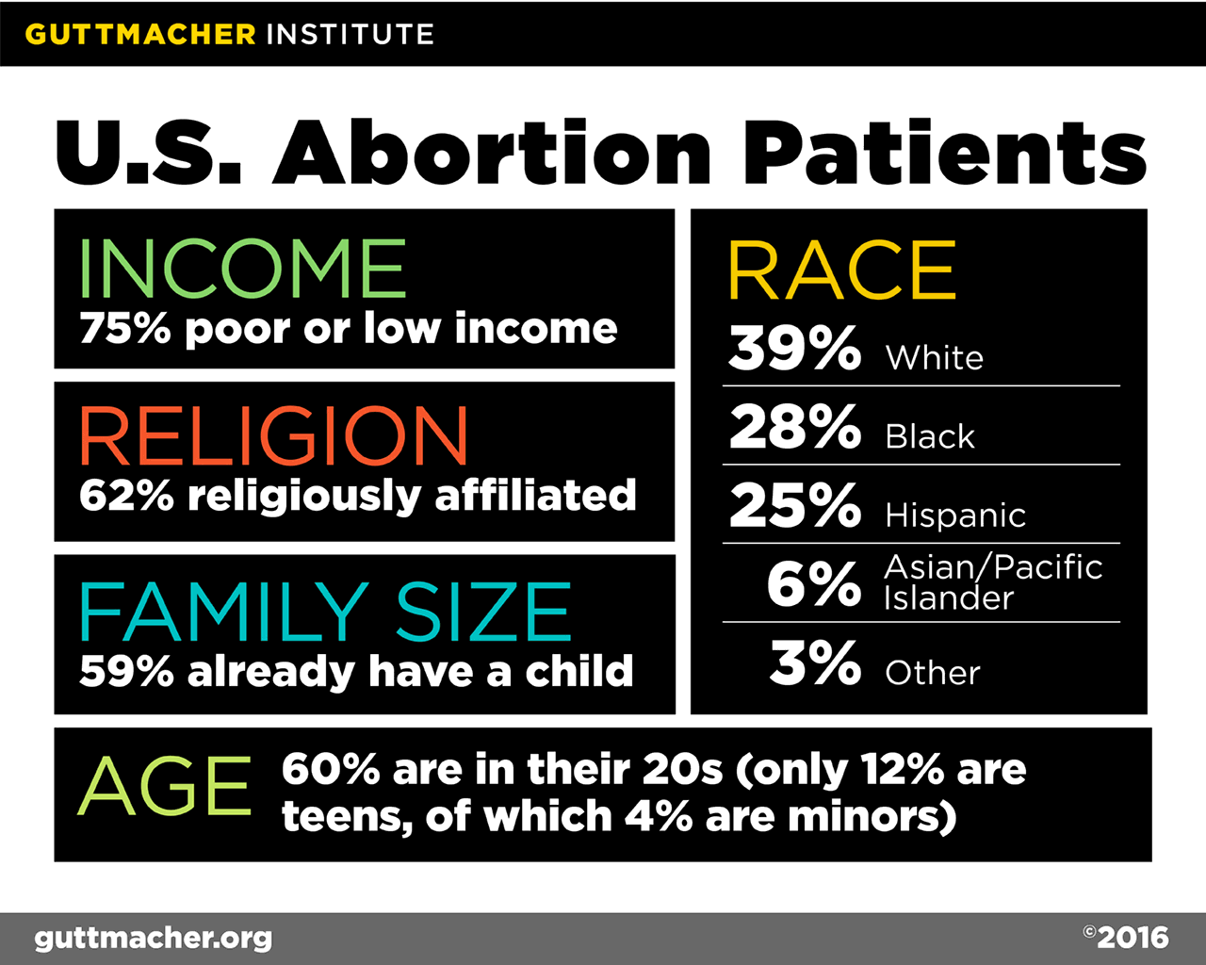
U.S. Abortion Patients
Notes:
For the first time, the survey on which this report is based asked patients about their sexual orientation, and results showed that 94% of abortion patients identified as heterosexual or straight; 4% identified as bisexual, less than 1% as lesbian and 1% as “something else.” 12 of the 81 who answered affirmatively indicated “pansexual,” which was the only response provided by more than one respondent. Researchers and health care providers should be aware that unintended pregnancy and abortion are not limited to heterosexual women.
Source: Jerman J, Jones RK and Onda T, Characteristics of U.S. Abortion Patients in 2014 and Changes Since 2008, New York: Guttmacher Institute, 2016.

Slide 5
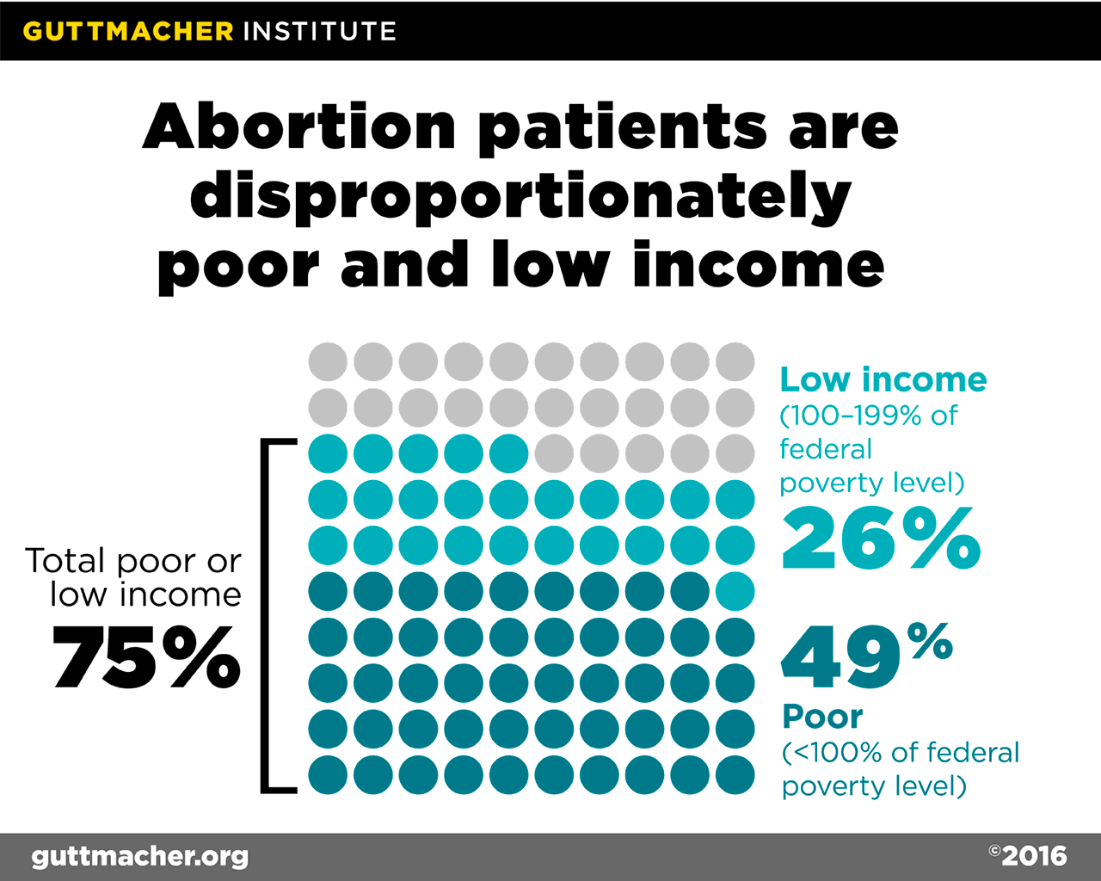
Abortion Patients are Disproportionately Poor and Low Income
Notes:
Nearly half of abortion patients in the United States are poor and another 26% are low income. These data come from a nationally representative survey of nonhospital abortion patients in the United States. Poor women continue to account for a disproportionate share of abortion patients, and this representation increased from 42% to 49% over the six-year period, mostly driven by an increase in the population of women of reproductive age who are poor.
Source. Jerman J, Jones RK and Onda T, Characteristics of U.S. Abortion Patients in 2014 and Changes Since 2008, New York: Guttmacher Institute, 2016.

Slide 6
Majority of Abortion Patients are Young Adults
Notes:
So, just as a reminder, Young teens are actually a very small percentage of the overall number of women having abortions but young adults (20-24) are the largest percentage of women having abortions. If we take young adults and teens together, it makes up about half of abortion patients.
Source: Jenna Jerman, Rachel Jones, Tsuyoshi Onda. Characteristics of U.S Abortion Patients in 2014 and Changes Since 2008. Guttmacher Institute. May 2016.
Available at https://www.guttmacher.org/sites/default/files/report_pdf/characteristics-us-abortion-patients-2014.pdf
Abortions by Age:
The majority (60%) of women having abortions are in their 20s.
Fewer than 1% are younger than 15, while 11% are aged 15–19.
More than four-fifths of pregnancies among teenagers are unintended, and teenagers account for more than one in five unintended pregnancies nationwide.
Abortion numbers and rates decline with age because fecundity declines, use of contraceptive sterilization increases and women’s likelihood of being married grows. Marriage makes it easier to use contraceptives effectively and to continue an unintended pregnancy if it occurs. For teens, abortion rates and numbers decline because of an increasing number of teens delaying first sex, improvements in teens’ contraceptive use and a relatively high likelihood of teens continuing unwanted pregnancies.

Slide 7
More Abortions Are Occurring in Very Early Pregnancy
Notes:
It is also important to remember, as mentioned in the video, that most abortions are occurring early in pregnancy, the vast majority within the 10 weeks gestational age limit.
Weeks of Gestation at Time of Abortion:
One-third of abortions occur at six weeks or earlier; 89% occur in first trimester of pregnancy (the first 12 weeks after the first day of the woman’s last menstrual period).
65 % of abortions occur at or before eight weeks’ gestation—up from just 20% in 1970, and up from 59% just a decade ago
Just 1% of abortions are performed after 20 weeks.
Sources:
Special tabulations of data from Centers for Disease Control and Prevention, Abortion surveillance—United States, 2001, Morbidity and Mortality Weekly Report, 2004, Vol. 53, No. SS-09. Centers for Disease Control and Prevention, Abortion surveillance—United States, 2011, Morbidity and Mortality Weekly Report, 2014, Vol. 63, No. SS-11.

Slide 8
Case: Zoe
16 year old high school sophomore, doing well in school, plans to go to college
One male partner for last few months
Uses condoms “100%” of the time
Missed her period and has some breast tenderness
She already took a home pregnancy test…which was positive
Notes:
An adolescent well known to you comes in for a clinic visit. She is generally doing well in school, and things at home are goo. She reports using condoms “100%” of the time (so misses a few times). She misses her period and is having breast tenderness so decides to take a home pregnancy test.

Slide 9
Case: Zoe
The urine pregnancy test in clinic is positive
You provide Zoe her pregnancy options, including
Continuing the pregnancy and parenting
Continuing the pregnancy and making an adoption plan
Having an abortion
Zoe is certain about her decision to have an abortion
Boyfriend and mother are supportive
Zoe wants more information about her abortion options
Notes:
Zoe does want to have a family one day but wants to be prepared to be a good parent and thinks she’s too young
Zoe’s mom and boyfriend are going to help pay for the abortion if not covered by her insurance and her mother will go with her to the appointment.

Slide 10
Your Role as a Referring Provider
Support the patient’s pregnancy decision
Be knowledgeable about resources in your area
Consider giving patients the option of calling a clinic or hotline while you see another patient, so that you can answer any questions and provide immediate assistance
Help patients problem solve, as able
Supports, privacy issues, time-off
Follow-up with patients after abortion
Use experience to help next patient
Adapted from Zurek M, et al. Contraception 2015.
Notes:
Source:
Contraception. 2015 Jan;91(1):1-5. doi: 10.1016/j.contraception.2014.10.007. Epub 2014 Oct 22.
Referral-making in the current landscape of abortion access.
Zurek M1, O'Donnell J2, Hart R2, Rogow D3.

Slide 11
Making a Warm Referral
Notes:
FLOW:
Most important piece is getting your patient where they need to be.
Are you sure and do you have support?
Talk about access issues first
You deal with this context FIRST
What are the financial barriers?
Which type of abortion you want to do is the last piece/the last detail

Slide 12
Barriers for Adolescents and Young Adults
Parental involvement laws
Navigating increasing restrictions to abortion access
Confidentiality/privacy concerns
Funding
Crisis Pregnancy Centers
Source: Planned Parenthood v. Farmer, 762 A.2d 620, 633 (N.J. 2000)
Notes:
Transportation and ID requirements can also be added to this list.
As most of us already know, Younger women, especially teenagers are already more likely than older women to delay seeking reproductive health care for a multitude of reasons. When teens know that they are forced by law to tell their parents or get their permission before obtaining care, they are less likely to access reproductive health care services in a timely manner. Additional state restrictions don’t make it any easier.
As we know, getting an abortion is not so simple. You don’t just “get an abortion,” even after making the decision, finding a provider, and scheduling the appointment there are still numerous obstacles to get through before the actual procedure. This includes finding a ride to the clinic, if you don’t drive or can’t take public transportation that may require telling another person in order to ask for a lift. If you do drive, you face car troubles, traffic, especially if you have to TRAVEL long distances to get to your appointment.
ID requirements are another barrier, especially for teenagers who may only have a student ID but with no date of birth, who don’t yet have a drivers license, OR who are even required to show a birth certificate. Not to mention the additional hurdles for undocumented women.
When you add these issues with the existing state level policies, adolescents and young women, particularly those with lower incomes, are facing restricted access to care.
Reference for 1st sentence: Planned Parenthood v. Farmer, 762 A.2d 620, 633 (N.J. 2000) (discussing the physiological, cognitive, and financial factors that help explain why teenage women, as a group, generally take longer to decide whether to have an abortion).

Slide 13
Mandatory Parental Involvement Laws
Connecticut, Maine and D.C. are the only places where ALL minors can consent to abortion services
21 states require at least one parent consent
3 states require BOTH parents to consent
11 states require parental notification
1 state requires BOTH parents be notified
5 states require BOTH notification and consent
Guttmacher State Policies. September 2016.
Notes:
A majority of states require parental involvement in a minor’s decision to have an abortion. Most of these states require the consent or notification of only one parent, usually 24 or 48 hours before the procedure, but a handful of states require the involvement of both parents. Some states require the parental consent documentation to be notarized.
38 states require parental involvement in a minor’s decision to have an abortion.
21 states require parental consent only, 3 of which require both parents to consent.
11 states require parental notification only, 1 of which requires that both parents be notified.
5 states require both parental consent and notification.
8 states require the parental consent documentation to be notarized.
Source: https://www.guttmacher.org/state-policy/explore/parental-involvement-minors-abortions

Slide 14
Young People Already Involve Parents in Abortion Decisions
61% of minors who have abortions do so with at least one parent’s knowledge
45% inform parents of intentions to have an abortion
Younger teens are more likely to involve a parent
Majority of parents support their child’s decisions
Henshaw SK. Fam Plan Perspect 1992;24:196–207, 213.
Notes:
A survey of 1,519 unmarried, pregnant minors in states where parental involvement is not mandatory found that 61% told one or both parents about their intent to have an abortion.
The younger the minor, the more likely she was to do so (90% of those 14 years old or younger; 74% of those 16 years old or younger)
Among minors who did not involve a parent, virtually all involved at least one responsible adult other than clinic staff (such as another relative, teacher, counselor, professional, or clergy).
Sources:
Henshaw SK, Kost K. Parental involvement in minors’ abortion decisions. Family Planning Perspectives 1992;24:196–207, 213.
Teen Sex and Pregnancy: Facts in Brief. Guttmacher Institute: New York, 1999. Available at: http://www.agi-usa.org/pubs/fb_teen_sex.pdf

Slide 15
Judicial Bypass
36 states that require parental involvement have an alternative process for minors
Judicial Bypass allows a minor to obtain approval from a court
7 states require judges to decide based on specific criteria
Intelligence, emotional stability
15 states require judges to use “clear and convincing evidence”
Is minor mature enough?
Is the abortion in their best interest?
Guttmacher State Policies. September 2016.
Notes:
36 states that require parental involvement have an alternative process for minors seeking an abortion.
36 states include a judicial bypass procedure, which allows a minor to obtain approval from a court.
7 states require judges to use specific criteria, such as a minor’s intelligence or emotional stability, when deciding whether to waive a parental involvement requirement.
15 states require judges to use the “clear and convincing evidence” standard that the minor is mature and the abortion is in her best interest when deciding whether to waive parental involvement requirement.
Source: https://www.guttmacher.org/state-policy/explore/parental-involvement-minors-abortions

Slide 16
Exceptions
7 states permit a minor to obtain an abortion if their grandparent/adult relative is involved
34 states make exception to parental involvement in case of medical emergency
15 states make exceptions in cases of:
Abuse, assault, incest or neglect
Guttmacher State Policies. September 2016.
Notes:
7 states also permit a minor to obtain an abortion if a grandparent or other adult relative is involved in the decision.
Most states that require parental involvement make exceptions under certain circumstances.
34 states permit a minor to obtain an abortion in a medical emergency.
15 states permit a minor to obtain an abortion in cases of abuse, assault, incest or neglect.
Source: https://www.guttmacher.org/state-policy/explore/parental-involvement-minors-abortions

Slide 17
Notes:
The number of restrictions on abortion has skyrocketed over the past decade, and laws are continuing to change. It is important that you know the laws in the state were you work. One of the best resources for this is the Guttmacher Institute: State Policies in Brief
[presenter can provide state specific laws here, if they choose]
Laws on
-confidential reproductive health care for minors
-parental involvement laws
-mandatory waiting periods
-medicaid funding restrictions

Slide 18
Confidentiality is Key
Confidentiality concerns
Explanation of benefits
Young adults (age ≥ 18 yrs) may still be on parents’ insurance
Inadvertent release of information from electronic medical records and disclosures
Privacy effects on quality of care
Willingness to seek care/use services
Choice of provider
Disclosure of sensitive information
English A et al. Confidentiality for Individuals Insured as Dependents: A Review of State Laws and Policies. New York: Guttmacher Institute and Public Health Solutions, 2012
Notes:
With the ACA expansion, young adults can be covered by their parents’ insurance up to the age of 26, which creates additional confidentiality concerns where billing/paperwork is involved if the young person cannot tell their parents. (what is their level of protection-depends on the state and insurance carrier)
1) Confidentiality Concerns: Out of pocket vs. parents’ insurance and Electronic Medical Issues, Disclosures via billing/insurance claims
2) Some states protect confidentiality explicitly
NY: FPBP (Family Planning Benefit Program: expands family planning benefits for those who don’t qualify for medicaid; also good for those with confidentiality concerns; (can be covered even if you have private/parents insurance can enroll in this state funded medicaid program)
Explanation of benefits (EOB) sent directly to
patient (NY, WI)
Minor may refuse parents' request for EOB (ME)
Some states are being pro-active and protect confidentiality of RH care with insurance.
In some cases, however, states allow only certain groups of minors—such as those who are married, pregnant or already parents—to consent. Several states have no relevant policy or case law; in these states, physicians commonly provide medical care without parental consent to minors they deem mature, particularly if the state allows minors to consent to related services. Providing care refers to Birth Control, STI, Adoption, Prenatal care and medical care for minors’ child. “Mature” minor is based on the Clinicians’ judgment call (similar to judges deciding whether or not the minor is mature and competent to make the decision about having an abortion versus carrying to term)
This is one example of how physicians are providing care to adolescents and young people in a restrictive environment; they are learning how to navigate the system.
Resource to go to about confidentiality and insurance: 1) Abigail English and the Center for Adolescent Health and the Law and the 2) flowchart from National Women’s Law Center (http://www.nwlc.org/resource/how-find-out-if-and-when-your-health-plan-will-begin-covering-women%E2%80%99s-preventive-services-n) on questions to ask when contacting your insurance company. 3) English A et al. Confidentiality for Individuals Insured as Dependents: A Review of State Laws and
Policies. New York: Guttmacher Institute and Public Health Solutions, 2012,
www.guttmacher.org/pubs/confidentiality-review.pdf.
Source : Center for Reproductive Rights, http://reproductiverights.org/en/project/parental-involvement-laws
Both adolescents and young adults have privacy concerns: Legal confidentiality protections not identical for
adolescent minors (< 18) and young adults (> 18)
Source for second section: Abigail English, “The Supreme Court ACA Decision: What Happens Now for Adolescents and Young Adults?” , Center for Adolescent Health & the Law, National Adolescent and Young Adult Information Center, November 2012
Source for third section: Guttmacher; https://www.guttmacher.org/statecenter/spibs/spib_OMCL.pdf
In most cases, state consent laws apply to all minors age 12 and older.
Changing health environment
More young adults will have health insurance
Coverage to age 26 on family policy
Coverage of preventive services without cost
sharing in private health plans
Contraceptive services
STD screening
Confidentiality challenges for young people
covered on a family health insurance policy
English,
Along with confidentiality, not feeling like your decision and/or information is private can have very serious consequences, especially for young adults and adolescents. They may in turn choose a clinic or provider that is not reputable, especially in small town communities where “everyone knows your name” and “people talk.” In order to ensure your patient feels protected and therefore create an open and supportive environment for trust, it is necessary to educate them on state and clinic laws about sharing information (when it’s prohibited and when it’s mandated-like in cases of sexual abuse), especially with parents and partners.
Resources:
English A, Park MJ. The Supreme Court ACA Decision: What Happens Now for Adolescents and
Young Adults? Chapel Hill, NC: Center for Adolescent Health & the Law; and San Francisco,
CA: National Adolescent and Young Adult Health Information Center, 2012,
www.nahic.ucsf.edu.
‥◻ English A et al. State Minor Consent Laws: A Summary, 3rd. Ed. Chapel Hill, NC: Center for
Adolescent Health & the Law, 2010, www.cahl.org.
‥◻ Guttmacher Institute. State Policies in Brief, 2013,
http://www.guttmacher.org/statecenter/spibs/index.html.
‥◻ Morreale M, et al., eds. Policy Compendium on Confidential Health Services for Adolescents,
2nd Ed. Chapel Hill, NC: Center for Adolescent Health & the Law, 2005. www.cahl.org.
‥◻ English A et al. Confidentiality for Individuals Insured as Dependents: A Review of State Laws and
Policies. New York: Guttmacher Institute and Public Health Solutions, 2012,
www.guttmacher.org/pubs/confidentiality-review.pdf.
‥◻ Anoshiravani A et al. Special Requirements for Electronic Medical Records in Adolescent
Medicine. J Adol Health 51;2012:409-414.
Spitz IM, Bardin CW, Benton L, Robbins A. Early pregnancy with mifepristone and misoprostol in the United States. N Engl J Med 1998;338:1241-1247.

Slide 19
Counseling Patients on Financial Resources
Some public and private health insurances cover abortion
Need to be aware of the policies in your state
Guttmacher Institute: Restricting Insurance Coverage of Abortion
If there is no coverage, an adolescent has options:
National Abortion Federation (NAF) Referral Hotline
(877) 257-0012
State Abortion Funds
https://fundabortionnow.org/explore/by_state
Notes:
Is the partner involved – Can they help?
Have you asked their friends/family for $$?
In order to best help our patients we should feel equipped to do some financial resource counseling and explain why you are even asking these sensitive and sometimes invasive questions to begin with. You should now be able to talk about the current financial restrictions with medicaid and insurance and explain how as a result of these reasons you are counseling them on ways to come up for the money-even when it may seem uncomfortable and shameful. These very laws that don’t include abortion as a part of MAINSTREAM HEALTH CARE for women serve only to separate it out and make women feel stigmatized and embarrassed for finding themselves in need of a medical procedure they can’t afford-even with health insurance)
In addition to financial resource counseling that you can do on your own, there are local and national abortion funds. The National Network of Abortion Funds can refer you to a local fund in your area, but keep in mind that they typically only give $50 or $200 max and can’t cover the costs of the whole procedure.
The National Abortion Federation also has a screening process: While they don’t require proof of income, they will ask questions to determine federal poverty guideline levels, and their funding does not extend to women who live in what we call a “medicaid” state if you live in one of the 17 states where medicaid SHOULD cover the cost of the AB and if you have private insurance that pays for it (They do have a small fund called the Rachel Falls Patient Fund specifically for these women with insurance who can’t use it or in cases of Medicaid can’t get it in time).
The Costs of Denying Abortion Funding
When women are denied abortions that they seek because their insurance or Medicaid plans do not cover them, there are both real and hidden costs that they, their families, and other taxpayers must bear. There is also the social cost associated with forcing some women to bear children when they are not prepared to be mothers or when parents are unable to support their children.
For example, many of the women who are denied funding for abortion have one anyway, usually at great sacrifice to themselves and their families. They may take on extra work or borrow from their rent or grocery budgets. Sometimes, because it takes time to find the money, the woman has to obtain the abortion at a later stage of pregnancy, when the procedure is more expensive and more complicated.⁴
Some women without money to pay for an abortion attempt to induce one themselves. This usually fails, resulting in delays before seeking surgical abortion. Self-induced abortion attempts are often medically very dangerous, leading to serious complications or death.
Those who oppose public funding for abortion call it an unfair burden on taxpayers. In fact, funding restrictions on abortions cost taxpayers millions of dollars every year, due to the much higher cost of prenatal care and childbirth, and the secondary costs of unplanned births.⁴Families also pay a high price whenever a woman must carry an unwanted pregnancy to term because she is unable to pay for abortion services.

Slide 20
A Word on Crisis Pregnancy Centers
Crisis Pregnancy Centers (CPCs)exist to keep women from having abortions
CPCs are not medical facilities
Most volunteers are not medical professionals
CPCs do NOT provide women with full reproductive health option information – even if they claim to provide pregnancy options counseling
Women who went to CPCs have described
Harassment
Bullying
Being given blatantly false information
Notes:
What to expect
What they are
Know your referral list before sending your patient there
Know that there are a lot of APPS on CPCs and only 1 on abortion provider
Here are reputable sites
Near the referral slides

Slide 21
Medication and Aspiration Abortion
Describing the methods

Slide 22
Case: Zoe
Zoe wants more information about her abortion options so you describe the different methods

Slide 23
Describing Medication Abortion
A medication abortion uses two sets of pills. The first one (mifepristone) will be given to you in the clinic in order to stop the growth of the pregnancy.
You will use the second medication (misoprostol) at home 24-48 hours later in order to empty the uterus.
You can expect heavy bleeding and cramping, similar to a miscarriage, for 6-8 hours following the second medication. Additional bleeding and cramping, more similar to a period, can continue for up to several weeks.
Notes:
Start with this is the medical procedure AND this is how I explain to patients
Privacy is also a major concern with the medical abortion method itself. Unlike a surgical abortion, medical abortions typically take place in the “privacy” of one’s home over several days that involve heavy cramping and bleeding (the equivalent of a medically induced miscarriage). This process is not so easy to “hide” or conceal from others. When counseling your adolescent on the best method for them it’s important to discuss the privacy issues inherent with medical abortion. in some cases, a surgical abortion may in fact be more private than a medication abortion.
Counsel patients appropriately..

Slide 24
Medication Abortion Regimen
 | FDA regimen Updated in 2016
Mifepristone dose | 200 mg (1 tablet) orally
Misoprostol dose | 800 μg bucally
Location of misoprostol dose | Home or office
Required office visits | 1 or more
Gestational age limit | up to 70 days LMP
Evidence indicates in-person follow up may not be essential
Notes:
Mifepristone was first approved for use by the FDA in 2000, with very specific guidelines for dosing, gestational age, and follow-up. Research done over the following 15 years provided evidence that medication abortion using mifepristone and misoprostol could be done quite effectively using lower doses of medication and fewer office visits, and up to 10 weeks gestational age. On March 29, 2016, the U.S. Food and Drug Administration (FDA) approved updated labeling for mifepristone to be consistent with evidence-based guidelines.
Jones RK, Boonstra HD. The Public Health Implications of the FDA Update to the Medication Abortion Label . Guttmacher Institute. Available at: http://us8.campaign-archive1.com/?u=ca1e42e28a45edcdc4e51bc32&id=18ca19f93a&e=4db6c109d7

Slide 25
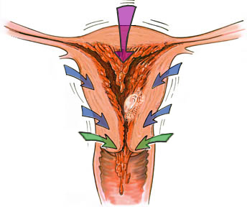
Medication Abortion up to 10 weeks with Mifepristone + Misoprostol
Progesterone Blockade
Decidual
Necrosis
Rhythmic
Uterine
Contractions
Cervical
Ripening
Detachment
Expulsion
Abortion
© Lisa Penalver
Notes:
Up to 10 weeks
Mifepristone blocks the action of progesterone by binding to progesterone receptors without activating them. Withdrawal of progesterone during early pregnancy leads to expulsion of the embryo via a prostaglandin-mediated mechanism.
75% abort in 4-6 hrs; 90% by 24 hrs
Following administration of mifepristone, the trophoblast separates from the decidua. Levels of hCG in the maternal circulation decline and prostaglandins are released locally. Uterine bleeding results.
Mifepristone also induces cervical ripening and rhythmic uterine contractions.
Misoprostol aids in the process of pregnancy termination by adding to the progresterone blockade and inducing uterine contractions, as well as contributing to cervical ripening.

Slide 26
State Laws Targeting Medication Abortion
37 states require clinicians to be licensed physicians
3 states require mifepristone to be provided with the outdated FDA protocol
19 state require that the clinician providing a medication abortion be physically present during the procedure
Prohibiting use of telemedicine to prescribe medication for abortion remotely
Guttmacher. October 2016.
Notes:
37 states require clinicians who perform medication abortion procedures to be licensed physicians.
3 states require mifepristone to be provided in accordance with the out-dated FDA protocol rather than the simpler evidence-based protocol that has been proven to be safe and effective.
19 states require that the clinician providing a medication abortion be physically present during the procedure, thereby prohibiting the use of telemedicine to prescribe medication for abortion remotely.
Source: https://www.guttmacher.org/state-policy/explore/medication-abortion

Slide 27
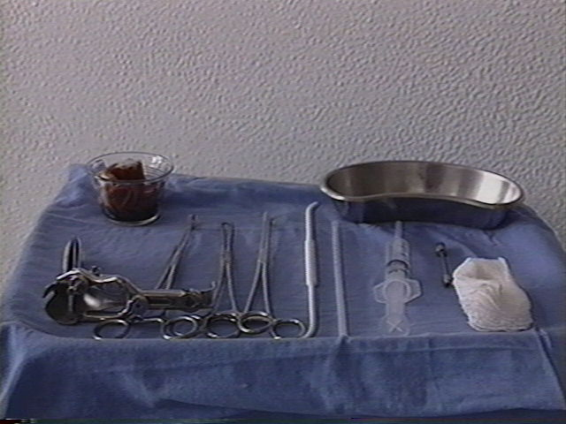
Describing Aspiration Abortion
A first trimester aspiration abortion is a simple, safe, 5-10 minute procedure.
The cervix, which is the opening into the uterus from the vagina, is gently stretched with something called a dilator
Next, a small plastic tube called a cannula, like a straw, can be inserted into the uterus and the uterus is emptied using gentle suction.
Notes:
In an aspiration or surgical abortion, the provider empties the uterus using gentle suction. The provider uses something called a cannula, which is a thin plastic straw. The cannula is inserted through the natural opening of the uterus, which is called the cervix.
So now that we have dispelled some common myths and concerns, how do we talks with patients around their pregnancy options. Well one thing that's really helpful is being able to describe the different options for them using language that makes sense to the patient.
Here are a couple of examples for you about the different options—you might even call them options elevator speeches. And in your descriptions, it's going to be really important that you define medical terms or any kind of terminology that the patient might not understand so that you're really ensuring comprehension by your patient.

Slide 28
Dilation and Suction Devices
Cervical dilators
Cannulas

Slide 29
Suction Devices
Manual Vacuum Aspiration
MVA
Electric Vacuum Device
EVA

Slide 30
Dilation of Cervix
© Lisa Penalver
Notes:
After administration of anesthesia and provision of patient-preferenced pain control, the first step involves gentle dilation of the cervix. While holding the cervix with a tenaculum, a graduated, tapered dilator is gently inserted into the cervical os. This step may not always be necessary. For example, when early surgical abortion is performed following an unsuccessful medication abortion, the cervix may already be “ripened” by the effects of mifepristone and misoprostol.

Slide 31
Insertion of Cannula
© Lisa Penalver
Notes:
The cannula Is placed through the cervix into the uterus and advanced to the fundus. It is then attached to suction – either a syringe as shown which provides manual vacuum aspiration, or an electric vacuum aspirator. (The process of connecting the apparatus is not shown in the illustration.)
At this point, you are ready to insert the cannula through the cervical os, advancing the tip towards the uterine fundus.

Slide 32
Evacuation of the Uterus
© Lisa Penalver
Notes:
Once the valves have been released to generate suction within the uterine cavity, gently move the cannula back and forth and rotate it. The combination of vacuum suction and cannula motion will evacuate the uterus.
Evacuation is usually complete when you feel a gritty sensation as the cannula moves along the uterine wall and when no more tissue appears in the syringe. For later gestations (i.e., after 8 weeks), you may need to reload the syringe one or more times if the amount of tissue will fill more than one syringe. Be careful not to contaminate the tip of the cannula if multiple reloadings and reinsertions are required. You can avoid contamination by using the “no touch” technique or by attaching a new cannula with each repeat suctioning.

Slide 33
Abortion Options Side-by-side
Medication Abortion
Usually avoids invasive procedure
Occurs in privacy of home
Aspiration Abortion
Involves invasive procedure
Occurs in medical setting
Days to weeks to complete
Usually requires 2 visits
Available thru 10 weeks gestation
Follow-up required
Safe and effective
Active patient participation in multi-step process
Avoids anesthesia
May seem more natural
Usually requires 1 visit
Complete on same day
Available in 2nd trimester
Follow-up usually unnecessary
Safe and effective
Passive patient participation in one-step process
Anesthesia is an option
Notes:
Many of the women that we counsel will present early enough in pregnancy to be eligible for either the medication or the surgical approach, so you’ll need to explain the pros and cons of both methods clearly in order to enable them to make an informed choice. Medication abortion is generally perceived as less invasive, an aspect that will appeal to some women. The duration of the procedure also differs. Early surgical abortion can usually take place in one visit. In contrast, medication abortion usually involves medications taken on two separate occasions, and completion of the abortion can take weeks, although the majority of women will abort within 24 hours of taking the second medication (misoprostol).¹
Medication abortion and surgical abortion can both be performed safely during early pregnancy. However, surgical abortion may not be offered before 6 (or, in some cases, 7 or 8) weeks’ gestation in some medical facilities.² Some women may feel that because medication abortion involves using medications rather than undergoing a surgical procedure, it affords greater privacy. For other women, the fact that medication abortion can be associated with gastrointestinal (GI) symptoms and pain may be a deterrent. Additionally, in some situations it may be difficult for women to conceal the fact that they are experiencing the equivalent of a (medically induced) miscarriage at home. In these instances, a surgical abortion, because it is performed during a relatively brief office visit, may in fact be more private than a medication abortion.
Women who opt for medication abortion may see blood clots and perhaps a gestational sac—and need to be apprised of this possibility. An embryo is not typically visible until more than 8 weeks’ gestation. Since women undergoing surgical abortion are not performing the abortion themselves, they are less likely to see a lot of blood and clots. Lastly, both procedures are associated with high rates of patient satisfaction, safety, and efficacy.³⁻⁵ In roughly 5% of cases, women who choose medication abortion will still require surgical evacuation to complete the abortion.⁶ In contrast, the percentage of women requiring a reaspiration following an unsuccessful surgical abortion before 7 weeks’ gestation is about 1%.⁷
Refs:
¹ Spitz IM, Bardin CW, Benton L, Robbins A. Early pregnancy with mifepristone and misoprostol in the United States. N Engl J Med 1998;338:1241-1247.
² Wiebe ER. Choosing between surgical abortions and medication abortions induced with methotrexate and misoprostol. Contraception 1997;55:65-71.
³ Winikoff B, Sivin I, Coyaji KJ, et al. Safety, efficacy, and acceptability of medication abortion in China, Cuba, and India: a comparative trial of mifepristone-misoprostol versus surgical abortion. Am J Obstet Gynecol 1997;176:431-437.
⁴ Henshaw RC, Naji SA, Russell IT, Templeton AA. Comparison of medication abortion with surgical vacuum aspiration: women’s preferences and acceptability of treatment. Br Med J 1993;307:714-717.
⁵ Lichtenberg ES, Grimes DA, Paul M. Abortion complications: prevention and management. In: Paul M, Lichtenberg ES, Borgatta L, Grimes DA, Stubblefield PG, eds. A Clinician’s Guide to Medical and Surgical Abortion. New York, NY: Churchill Livingstone; 1999:197-216.
⁶ Kahn JG, Becker BS, MacIsaac L, et al. The efficacy of medication abortion: a meta-analysis. Contraception 2000; 61:29-40.
⁷ MacIsaac L, Darney P. Early surgical abortion: an alternative to and backup for medication abortion. Am J Obstet Gynecol 2000;183(suppl):S76-S83.

Slide 34
Answering Common Questions

Slide 35
Medication vs. Aspiration Abortion
Which method is better?
Both are good methods, just different
Both methods are more than 95% effective
Would you be more comfortable having your abortion at home or in the clinic?
Notes:
Add comments here

Slide 36
Medication vs. Aspiration Abortion
Which one hurts less?
Everyone is different
Aspiration abortion is more intense cramping but quicker
Medication abortion is less intense cramping but lasts longer
Notes:
Add comments here

Slide 37
Medication vs. Aspiration Abortion
Is one more private?
Medication abortion takes place at home over a period of hours, so can feel more private
Aspiration abortion takes place in a clinic, and may be easier to conceal from others
Notes:
Privacy is also a major concern with the medical abortion method itself. Unlike a surgical abortion, medical abortions typically take place in the “privacy” of one’s home over several days that involve heavy cramping and bleeding (the equivalent of a medically induced miscarriage). This process is not so easy to “hide” or conceal from others. When counseling your adolescent on the best method for them it’s important to discuss the privacy issues inherent with medical abortion. in some cases, a surgical abortion, because it is performed during a relatively brief office visit, may in fact be more private than a medication abortion.

Slide 38
Medication vs. Aspiration Abortion
Which is safer?
Both are extremely safe
Notes:
Add comments here

Slide 39
Abortion Safety in Perspective
*Mortality risk per 100,000 people (including men)
Notes:
Let’s consider abortion safety in perspective. This graph shows the risk of death per 100,000 women for abortion and term delivery, as well as for one of the most commonly used antibiotics, and common daily activities such as driving a car. IN fact you are more likely to be struck by lightening than to die from having an abortion.
Note that the mortality rate for abortions increase with increasing gestational age; though abortion is always safer than delivery. In the first trimester, the mortality rate for women having abortion in the first trimester is <0.3/100,000 women
≤8 weeks = 0.1
9–10 wks = 0.2
11–12 wks = 0.4
13–15 wks = 1.7
16–20 wks = 3.4
≥21 wks = 8.9
PRESENTER NOTE: NYC is actually one of the safer cities in the United States to drive in, despite popular opinion. (feel free to update the chart with data from http://www.cdc.gov/motorvehiclesafety/local/b/includes/mvcfatalitiesmap/mvcfatalitiesmap.html for whatever city you are presenting near)
Source:
Bartlett LA, Berg CJ, Shulman HB, Zane SB, Green CA, Whitehead S, et al. Risk factors for legal induced abortion-related mortality in the United States. Obstet Gynecol 2004;103(4):729–37

Slide 40
Abortion Safety
< 1% of patients experience major complication
< 0.3% require hospitalization
Rare potential complications
Bleeding
Infection
Injury to cervix or uterus
Incomplete abortion
Continuing pregnancy
Paul M, Lichtenberg S, Borgatta L, Grimes DA, Stubblefield PG, Creinin MD, editors. Management of Unintended and Abnormal Pregnancy: Comprehensive Abortion Care: Wiley-Blackwell; 2009.

Slide 41
Common Abortion Myths
Myth | Reality
Abortion causes breast cancer | Women who have abortion do NOT have a increased risk of developing breast cancer
Mental health problems result from abortion | Pre-existing mental health problems predict mental health problems after abortion
Pregnancy will be difficult after one/more abortions | Well-conducted research has not found any link between abortion and infertility, ectopic pregnancies, miscarriage, or preterm birth
Abortion is dangerous | Abortion is 14 times SAFER than childbirth; it is safer than driving in a car
Melbye, M, 1997; Kalish RB. 2002; Jackson JE, 2007; Steinberg JR, 2009.
Notes:
Of the three pregnancy options, abortion is the one for which people tends to have the largest number of myths and misconceptions.
So let’s address a few of these that you might encounter when providing options counseling.
People often believe that abortion increases the risk of breast cancer. However a number of studies and consensus statements from the National Cancer Institute refute this claim. A summary of their findings can be found on the American Cancer Society website.
There have also been a number of studies that reports that women who have abortions struggle with emotional problems afterwards—there is even a phrase that has been coined around this issue “post-abortion syndrome.” However the truth is that well conducted studies have found no increased risk of mental health issues after abortion. In fact, the most reliable indicator of whether a woman will experience feelings of distress after an abortion is her emotional stability before the abortion. Women indicate that the most common feeling after the completion of an abortion is relief. While some women also experience a sense of loss, sadness, or grief, having an abortion is not associated with long-term psychological distress.
Women also report concerns about pregnancy after abortion. However the most well-conducted studies looking at this concern have not found any link between abortion and infertility, ectopic pregnancies, miscarriage, or preterm birth. Having an abortion will not prevent a woman from having a healthy pregnancy when she is ready.
The issue of abortion safety is also frequently mentioned, and we will look at this in a bit more detail in the following slide. However the short answer to this myth is that abortion is incredibly safe—it is more than 10 times safer than childbirth, and safer than driving in every city in the United States.
Sources
Melbye M, Wohlfahrt J, Olsen JH, Frisch M, Westergaard T, Helweg-Larsen K, et al. Induced abortion and the risk of breast cancer. N Engl J Med 1997;336(2):81–5.
Kalish RB, Chasen ST, Rosenzweig LB, Rashbaum WK, Chervenak FA. Impact of midtrimester dilation and evacuation on subsequent pregnancy outcome. Am J Obstet Gynecol 2002;187(4):882–5.
Jackson JE, Grobman WA, Haney E, Casele H. Mid-trimester dilation and evacuation with laminaria does not increase the risk for severe subsequent pregnancy complications. Int J Gynaecol Obstet 2007;96(1):12–5.
Steinberg JR, Russo NF. Evaluating research on abortion and mental health. Contraception 2009;80(6):500–3.

Slide 42
Research on Adolescents and Abortion
Systematic data review of 24 studies
> 300,000 women
Efficacy similar between age groups
Overall complications similar between age groups
Younger women at increased risk for cervical laceration
Younger women at decreased risk of uterine perforation and mortality
Satisfaction similar between age groups
Renner RM. Abortion care for adolescent and young women. 2013.
Notes:
Int J Gynaecol Obstet. 2014 Jul;126(1):1-7. doi: 10.1016/j.ijgo.2013.07.034. Epub 2013 Oct 31.
Abortion care for adolescent and young women.
Renner RM1, de Guzman A2, Brahmi D3.
BACKGROUND:
Unintended pregnancy among adolescents (10-19years) and young women (20-24years) is a global public health problem. Adolescents face challenges in accessing safe abortion care.
OBJECTIVE:
To determine, via a systematic data review, whether abortion care for adolescent and young women differs clinically from that for older women.
METHODS:
In a comprehensive data review, the Cochrane Central Register of Controlled Trials, MEDLINE, and POPLINE databases were searched from the earliest data entered until November 2012. Randomized controlled trials and observational studies comparing effectiveness, safety, acceptability, and long-term sequelae of abortion care between adolescent/young women and older women were identified. Two reviewers independently extracted data, and the Cochrane guidelines and Newcastle-Ottawa Scale were used for quality assessment.
RESULTS:
In total, there were 25 studies including 346 000 women undergoing first- and second-trimester medical abortion, vacuum aspiration, or dilation and evacuation. Effectiveness and overall complications were similar among age groups. However, younger women had an increased risk for cervical laceration and a decreased risk of uterine perforation and mortality. Satisfaction and long-term depression were similar between age groups. Except for less uptake of intrauterine devices among adolescents, age did not affect post-abortion contraception.
CONCLUSIONS:
Evidence from various healthcare systems indicates that abortion is safe and efficacious among adolescent and young women. Clinical services should promote access to safe abortion for adolescents.
Mifepristone abortion in minors. R Phelps.
Adolescents 14- to 17-years-old, with pregnancies < or =56 days gestation, and seeking abortion services with parental consent from at least one parent were enrolled. Mifepristone (200 mg) was administered, followed 2 days later by 800 microg of misoprostol administered vaginally. Follow-up visit occurred on Day 4-8 to confirm abortion completion. Questionnaires regarding acceptability of the procedure as well as emotional coping were administered at the initial visit, at the follow-up visit, and by phone at 4 weeks postabortion. All 28 adolescents had complete medical abortions without complications or surgical intervention, and five minors did not require misoprostol. At the Day 4-8 follow-up visit, 75% of teens found the procedure acceptable, and that increased to 96% by the 4-week visit. Although 57% reported stress and 43% reported fear initially, by 4 weeks postabortion only 21% of the teens reported stress, and 8% were still experiencing fear. In addition, the minors' satisfaction with their abortion decision increased from 43% to 79% by 4 weeks postabortion. Medical abortion with mifepristone and misoprostol was highly effective and well tolerated, physically and emotionally, by adolescents in our sample. A larger clinical trial is needed to generalize these findings to other adolescent populations seeking medical abortion services.
During 2000-6, 3024 adolescents and 24,006 adults underwent at least one medical abortion. The rate of chlamydia infections was higher in the adolescent cohort (5.7% v 3.7%, P < 0.001). The incidence of adverse events among adolescents was similar or lower than that among the adults. The risks of haemorrhage (adjusted odds ratio 0.87, 95% confidence interval 0.77 to 0.99), incomplete abortion (0.69, 0.59 to 0.82), and surgical evacuation (0.78, 0.67 to 0.90) were lower in the adolescent cohort. In subgroup analysis of primigravid women, the risks of incomplete abortion (0.68, 0.56 to 0.81) and surgical evacuation (0.75, 0.64 to 0.88) were lower in the adolescent cohort. In logistic regression, duration of gestation was the most important risk factor for infection, incomplete abortion, and surgical evacuation. The incidence of adverse events among adolescents was similar or lower than that among the adults. Comparison of rates of adverse events in adolescent and adult women undergoing medical abortion: population register based study.
Comparison of rates of adverse events in adolescent and adult women undergoing medical abortion: population register based study.
Niinimäki M1, Suhonen S, Mentula M, Hemminki E, Heikinheimo O, Gissler M.
Author information

Slide 43
Post-Abortion Care

Slide 44
Case: Zoe
Zoe comes back one week after her abortion because she wants to start birth control
She’s experiencing some spotting but no pain
She has not been sexually active since the abortion
She says that it went better than she thought it would

Slide 45
Post-Abortion Questions
Should I still be bleeding?
Medication abortion: Heavy bleeding should stop within 24-48 hours of taking misoprostol. Spotting to period like bleeding may continue for up to 4-6 weeks. Patients should not soak more than two heavy pads an hour for two consecutive hours
Aspiration abortion: Bleeding should go from period like bleeding to light spotting or no bleeding by the end of the first week after the abortion
Notes:
Common question-do you have counseling for people afterwards? Residents often ask.

Slide 46
Post-Abortion Questions
How long should I be cramping for?
Medication abortion: Cramping usually peaks after taking misoprostol, and should be getting better within 24 hours. Persistent or worsening pain would be concerning.
Aspiration abortion: Cramping is usually better within 24 hours. Persistent or worsening pain would be concerning.
Notes:
Common question-do you have counseling for people afterwards? Residents often ask.

Slide 47
Post-Abortion Questions
I took a pregnancy test at home and it is still positive. Am I still pregnant?
Pregnancy tests may be positive up to 4-6 weeks after an abortion.
Other reasons for a positive urine pregnancy test
Ongoing pregnancy (ectopic or intrauterine)
Rapid repeat pregnancy
Notes:
Common question-do you have counseling for people afterwards? Residents often ask.
Your PT will be positive 4-6 weeks after.
If you’re concerned about new pregnancy…..
I took a pregnancy test at home and it is still positive. Am I still pregnant?
Pregnancy tests may be positive up to 4 weeks after an abortion.
You can ask if a woman still feels pregnancy, and if her bleeding and cramping pattern is normal.
You also need to know about unprotected sex…
Other reasons for a positive urine pregnancy test
Ongoing pregnancy (ectopic or intrauterine)
Rapid repeat pregnancy

Slide 48
Starting Contraception after Abortion
Ovulation may occur 7–10 days post-abortion
Contraception is essential to prevent another pregnancy
If patient is not on birth control, recommend:
Insert LARC method
Quickstart any patient-dependent method
Offer emergency contraception for prn use
Encourage condom use for STI risk reduction
www.arhp.org/core
Notes:
Talking Points
Ovulation may occur w/in 7–10 days after the procedure.
Emergency contraception should be dispensed with instructions for use.
Hormonal contraceptives can be started immediately.
An IUD may be inserted immediately after the procedure.
A barrier contraceptive should be used with first intercourse and continued, unless another contraceptive method is selected, and/or the patient is at risk for STIs.
- - -
Original content for this slide submitted by the ARHP Clinical Advisory Committee for the Manual Vacuum Aspiration Education Partnership Project in December 2004. Original funding received from Ipas and the John Merck Fund through an unrestricted educational grant. Last reviewed/updated by the ARHP Clinical Advisory Committee for the Manual Vacuum Aspiration Education Partnership Project in October 2007. This slide is available at www.arhp.org/core.

Slide 49
Emotional Responses to Abortion
Pre-pregnancy mental health correlates with post-abortion mental health, abortion-related emotions and evaluations
Turnaway Study: ~1000 women presenting within or after clinic gestational age limit, followed x 5 years
Community stigma & lower social support a/w negative emotion
Women overall do not regret their decision
~95% reported the abortion was the right decision for them
http://www.ansirh.org/research/turnaway-study
Notes:
Study of > 400 women presenting for 1st trimester abortion, followed x 2 years
Most common emotion immediately after the abortion was relief
Most women felt they had benefited from their abortion
Major B, et al. Arch Gen Psychiatry. 2000.
Women reported feeling more relief than positive emotions and more relief than negative emotion, more positive than negative emotions
Benefit from abortion at 1 month and 2 years, did not change with time, benefit more than harm
Women with who had better mental health (less depression and higher self esteem) reported more positive abortion emotions and evaluations
Pre-pregnancy history of depression consistently predicted poorer postabortion mental health and more negative abortion-related emotions and evaluations
Women arriving at 1 of 3 sites for an abortion of a first-trimester unintended pregnancy were randomly approached to participate in a longitudinal study with 4 assessments-1 hour before the abortion, and 1 hour, 1 month, and 2 years after the abortion. Eight hundred eighty-two (85%) of 1043 eligible women approached agreed; 442 (50%) of 882 were followed for 2 years. Preabortion and postabortion depression and self-esteem, postabortion emotions, decision satisfaction, perceived harm and benefit, and posttraumatic stress disorder were assessed. Demographic variables and prior mental health were examined as predictors of postabortion psychological responses.
Turnaway study description:
From 2008 to 2010, collaborated with 30 abortion facilities around the country—from Maine to Washington, Texas to Minnesota—to recruit about 1,000 women who sought abortions, some who received abortions because they presented for care under the gestational limit of the clinic and some who were “turned away” and carried to term because they were past the gestational limit.
Findings
1) Community stigma and lower social support associated with negative emotion
2) Women overall do not regret their decision. 6 months post-abortion, on average thought about it “sometimes”, by three years, thought about it “rarely”
3) Approximately 95% of women reported that having the abortion was the right decision for them. The predicted probability of the average participant reporting that the abortion was the right decision was > 99% across all times with an increase over three years (ref Rocca CH, Kimport K, Roberts SCM, Gould H, Neuhaus J, et al. (2015) Decision Rightness and Emotional Responses to Abortion in the United States: A Longitudinal Study. PLoS ONE 10(7): e0128832. doi:10.1371/journal.pone.0128832)
All emotions and thoughts about abortion subsided over time
No differences in emotional trajectories or decision rightness between women having earlier vs. later procedures
Difficulty deciding to terminate the pregnancy and higher pregnancy planning levels were strongly associated with negative emotions and lower decision rightness
Being in school and working at the time of pregnancy associated with far higher feelings of decision rightness
Community stigma and lower social supported were associated with negative emotions

Slide 50
Longer-term Supports
Even if abortion was the right decision, it doesn’t mean it was an easy one…
Stigma can make it difficult for women to talk about their experience
It is OK to ask about feelings around abortion
Online supports and talklines
Backline at www.yourbackline.org
Exhale at www.exhaleprovoice.org
Notes:
Secrecy and silence around abortion are ubiquitous; many women do not freely or openly talk about their abortion experiences. This silence around abortion
has given rise to a “prevalence paradox,” asKumar and colleagues described. 1 That is, abortion is quite prevalent—roughly one in three U.S. women will have an abortion by the end of their reproductive years—but at the same time, abortion is widely believed to be unusual or deviant. 7 Given that so
many women (and the men with whom they conceive) share an experience with abortion, why is there such pervasive secrecy and silence around it?
Social scientists tell us that secrecy and silence are predictable responses to stigma.8
1. Kumar A, Hessini L, Mitchell EMH. Conceptualizing abortion
stigma. Cult Health Sex 2009;11:625–39.
2. Norris A, Bessett D, Steinberg JR, Kavanaugh ML, De Zordo S,
Becker D. Abortion stigma: a reconceptualization of constituents,
causes, and consequences. Women Health Iss 2011;21
(suppl):S49–54.
3. Martin LA, Debbink MP, Hassinger J, Harris LH. Abortion—
possible and impossible: stigma and the narratives of Ghanaian
doctors who provide abortions. Reflections 2011;17:79–87.
4. Goffman E. Stigma: notes on the management of spoiled identity.
New York (NY): Simon and Schuster; 1963.
5. World Health Organization. Unsafe abortion: global and
regional estimates of unsafe abortion and associated mortality,
2008. 6th ed. Geneva (Switzerland): World Health Organization;
2011.
6. Guttmacher Institute. Making abortion services accessible in
the wake of legal reforms: a framework and six case studies.
2012. Available at: http://www.guttmacher.org/pubs/ abortionservices-
laws.pdf. Retrieved July 17, 2012.
7. Jones RK, Kavanaugh ML. Changes in abortion rates between
2000 and 2008 and lifetime incidence of abortion. Obstet Gynecol
2011;117:1358–66.
8. Major B, O’Brien LT. The social psychology of stigma. Annu
Rev Psychol 2005;56:393–421.

Slide 51
Educational and Training Resources

Slide 52
Teaching Resources for Resident and Student Education
www.prh.org Physicians' E-Learning Courses & ARSHEP
www.reproductiveaccess.org Reproductive Health Access Project
www.arhp.org Association for Reproductive Health Professionals
www.prochoice.org National Abortion Federation
Notes:
www.prh.org Physicians' E-Learning Courses
ARSH: Adolescent Reproductive and Sexual Health course
LEARN: Lessons to Enhance Awareness of Reproductive Needs (family planning curriculum)
www.reproductiveaccess.org Reproductive Health Access Project
Handouts, exercises, workshops, mentorship network
www.arhp.org Association for Reproductive Health Professionals
Webinars, conference, LARC locator
www.prochoice.org National Abortion Federation
Fact sheets, training, conference

Slide 53
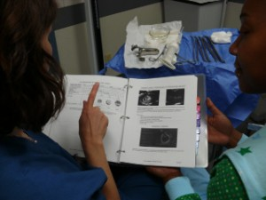
Clinical Training to Provide Abortion
TEACH
Training in early abortion for primary care providers
http://www.teachtraining.org/training-tools/early-abortion-training-workbook/
http://www.teachtraining.org/advocacy/what-you-can-do/
Center for Reproductive Health Education in Family Medicine (RHEDI)
Grants to residency programs to create opt-out training
www.rhedi.org
Notes:
-office practice tools
-complication and emergency simulation exercises
-advocacy tools
ANSIRH – Advancing New Standards in Reproductive Health
Main page on ANSIRH http://www.ansirh.org/
RHEDI provides grants to family medicine residency programs who offer opt out training in MAB and early surgical AB

Slide 54
Abortion Funding, Referrals, & Stigma Resources
National Network of Abortion Funds: www.nnaf.org
National Abortion Federation: www.prochoice.org
Information and Funding Assistance: 800-772-9100
Clinic Referrals: 877-257-0012
Provide: http://provideaccess.org/
Abortion Care Network: www.abortioncarenetwork.org
Sea Change: http://seachangeprogram.org/
Transforming the culture of stigma around abortion
1 in 3 Campaign: http://www.1in3campaign.org/
Sharing abortion stories
Exhale: Post Abortion Resources: www.4exhale.org
Post-abortion Support Hotline: 866-4 EXHALE
Notes:
54

Slide 55
Religious and Reproductive Justice Resources
Religious Coalition for Reproductive Choice: http://rcrc.org/
Catholics for Choice: http://www.catholicsforchoice.org/
All Above All Coalition: http://allaboveall.org/
United for Abortion Coverage
Sister Song: http://sistersong.net/
Women of Color Reproductive Justice Collective
Social Workers for Reproductive Justice: http://swrj.org/
If When How: http://www.ifwhenhow.org/
Lawyering for Reproductive Justice
National Latina Institute for Reproductive Health: http://www.latinainstitute.org/en
National Asian Pacific American Women’s Forum: https://napawf.org/

