Slide 1

Adolescent Reproductive and Sexual Health Education Project (ARSHEP)
Taking a Sexual History:
Essential Questions
Notes:
Updated 2020

Slide 2
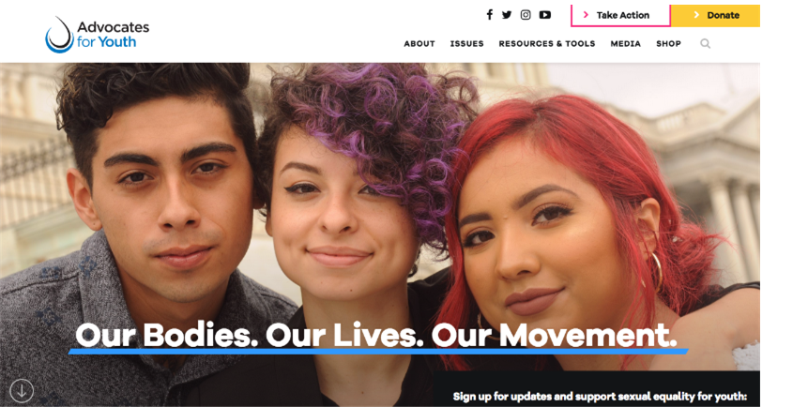
Notes:
Advocates for Youth partners with youth leaders, adult allies, and youth-serving organizations to advocate for policies and champion programs that recognize young people’s rights to: honest sexual health information; accessible, confidential and affordable sexual health services; and the resources and opportunities necessary to create sexual health equity for all youth.
Our values are reflected in the 3Rs:
•Youth have the inalienable right to honest sexual health information.
•Youth deserve respect.
•Society has the responsibility to provide young people with tools need to safeguard their sexual health and lead the lives they desire.

Slide 3

This presentation was originally created by Physicians for Reproductive Health as part of the ARSHEP curriculum.
Updates and modifications to this presentation were supported, in part, by Cooperative Agreement PS18-1807 from the Centers for Disease Control and Prevention, Division of Adolescent and School Health (CDC-DASH). The contents do not necessarily represent the official views of the Centers for Disease Control and Prevention.

Slide 4
Adolescent Reproductive and Sexual Health Education Project (ARSHEP)
[Faculty member information goes here]
Notes:
Updated 2020

Slide 5
Objectives
Understand why it is important to take a sexual history for adolescents and young people
Understand state laws surrounding consent and confidentiality
Provide a framework and example questions for taking a sexual history from an adolescent patient
Increase personal comfort level and confidence when taking sexual histories from adolescent patients

Slide 6
Rights. Respect. Responsibility.
RIGHTS. Young people have the right to accurate, unbiased information about their health and access to the full range of sexual and reproductive healthcare without discrimination or coercion.
ARSHEP and Advocates for Youth’s approach to adolescent health:
RESPECT. Young people deserve respect for their bodily autonomy, their ability to affirm their own goals and identities, and their agency to make informed decisions about their own lives and well-being.
RESPONSIBILITY. Medical providers and healthcare systems have the responsibility to provide confidential, accessible, respectful care to youth that is equitable and free from bias.
Notes:
Rights: Youth have the right to receive complete, accurate, and unbiased information about their sexual and reproductive health, and to access the full range of sexual and reproductive healthcare services in a way that is confidential and free of discrimination or coercion.
Respect: Young people deserve respect for their bodily autonomy, their ability to affirm their own goals and identities, and their agency to make informed decisions about their futures and their health and well-being.
Responsibility: Medical providers and healthcare systems have the responsibility to provide confidential, accessible, and respectful care to youth that centers young people’s agency and autonomy and is equitable and free from bias.

Slide 7
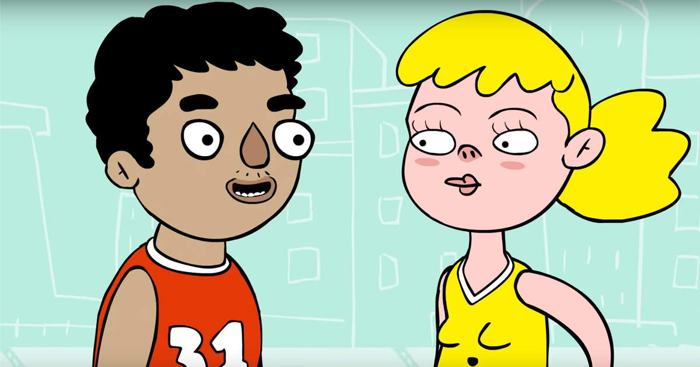
Why is a Sexual History Important?
Affirm and provide education about healthy behaviors
Address patient questions or concerns
Provide counseling to reduce current and future risk behaviors
Assess sexual functioning

Slide 8

All Youth Need Sexual and Reproductive Health Care
Adolescents can:
  Engage in healthy relationships that may include sexual activity
  Participate in decision-making around pregnancy and sexually transmitted infection (STI) prevention
Notes:
Why is reproductive health care important for adolescents?
An estimated 45% of 15- to 19-year-old male and female youth in the United States report having had vaginal intercourse with an opposite-sex partner, 2.5% of 15- to 19-year-old male youth report having had oral or anal sex with another male, and 11% of 15- to 19-year-old female youth report having had a sexual experience (including oral sex) with another female.
Sixty-five percent of reported Chlamydia and 50% of reported gonorrhea cases occur among 15- to 24-year-olds.
Teen-aged birth rates in the United States have declined to the lowest rates seen in 7 decades yet still rank highest among industrialized countries. Pregnancy and birth are significant contributors to high school dropout rates among female youth; only approximately 50% of teen-aged mothers earn a high school diploma by 22 years of age versus approximately 90% of females who did not give birth during adolescence.
Child sex trafficking and commercial sexual exploitation of children (CSEC) is increasingly being identified as a public health problem in the United States, and victims of sex trafficking and CSEC may present for medical care for a variety of reasons related to infections, reproductive issues, and trauma and mental health.
Source:
Marcell AV, Burstein GR. Sexual and Reproductive Health Care Services in the Pediatric Setting. Committee on Adolescence. Pediatrics Nov 2017, 140 (5) e20172858; DOI: 10.1542/peds.2017-2858

Slide 9
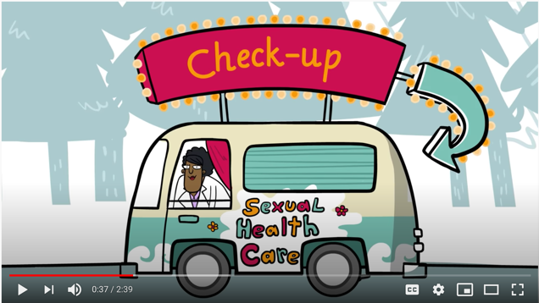
When to Take a Sexual History
Adolescents should have a sexual history taken at all preventative care visits
In addition, taking the time to screen for sexual health concerns at other visits provides opportunities for patients to express their needs
A sexual history is important and frequently relevant to other issues the adolescent may present with
Take sexual history at least annually

Slide 10

Adolescents
For the most part, adolescents are:
  Healthy
  Resilient
  Learning to be independent
Adolescents are not:
  Big children
  Little adults
Each adolescent is an individual

Slide 11
Adolescent-Friendly Health Services
Adolescent-specific
Racially equitable and inclusive
Welcoming to LGBT+ youth
Accessible time and location
Free or low-cost
Confidential and respectful of young people’s autonomy
Multi- and interdisciplinary
Provides comprehensive care, including sexual and reproductive health care
Supports teen-parent communication
Supports youth transitioning into the adult medical care system
Notes:
Communication and flexibility are a vital part of adolescent care. Examination requirements and guidelines can be flexible, and providers should undertake the most appropriate steps to maximize the adolescent's health.
Is the clinic accessible? Financially affordable?
Are there adolescent focused materials on display such as magazines, posters, etc.?
Does the clinic offer flexible scheduling?
Has the staff been trained to be sensitive to adolescents’ needs?
Does the clinic offer comprehensive services?
Is a minor’s right to confidential health care respected, and has the staff been trained to ensure confidentiality?
Does the clinic have a method of helping youth transition into the adult medical care system?
Elements of adolescent-friendly health services derived from multiple sources, including the CDC, American Academy of Pediatrics, and the World Health Association

Slide 12

Why are adolescent-friendly services important?
Services that are not youth-friendly can lead young people to:
Not share important details about their health or behavior
Leave the clinic or nurse’s office without getting the care they need
Choose not to follow through with treatments
Refuse or forget follow-up care
Notes:
https://advocatesforyouth.org/resources/health-information/bp-youth-friendly-services/

Slide 13

Barriers to Care
Lack of knowledge about where, how and when to access care
Legal or cultural restrictions
Physical or logistical restrictions
  Inaccessible location
  Inconvenient hours
Poor quality of clinical services
  Lack of provider knowledge and skills
  Limited services or supplies
Unwelcoming services
  Perceived lack of confidentiality and restrictions (parental consent/notification)
  Insensitive attitudes of care providers
Notes:
Source: Adolescent Friendly Health Services: An Agenda for Change. The World Health Organization, 2004. Available at: http://www.who.int/reproductivehealth/publications/cah_docs/cah_02_14.pdf

Slide 14

What is Healthy Sexuality?
Understanding that sexuality is a natural part of life and involves more than sexual behavior
Recognizing and respecting the sexual rights we all share
Having access to sexual health information, education, and care
Making an effort to prevent unintended pregnancies and STIs and seek care and treatment when needed
Being able to experience sexual pleasure, satisfaction, and intimacy when desired
Being able to communicate about sexual health with others including sexual partners and healthcare providers
According to the American Sexual Health Association (ASHA), being sexually healthy means:
Notes:
Source: https://www.ashasexualhealth.org/sexual-health/
Healthy sexuality is expressing the sexual aspect of yourself while minimizing risk to physical and mental health and emphasizes appropriate adult sexual health and well being.
Remember that sexuality is multifaceted and not limited to sexual behaviors or risks. It involves many aspects of an individual:
Sexual Orientation
Gender Identity
Biological Sex
Sexual Attraction
Sexual Behavior

Slide 15
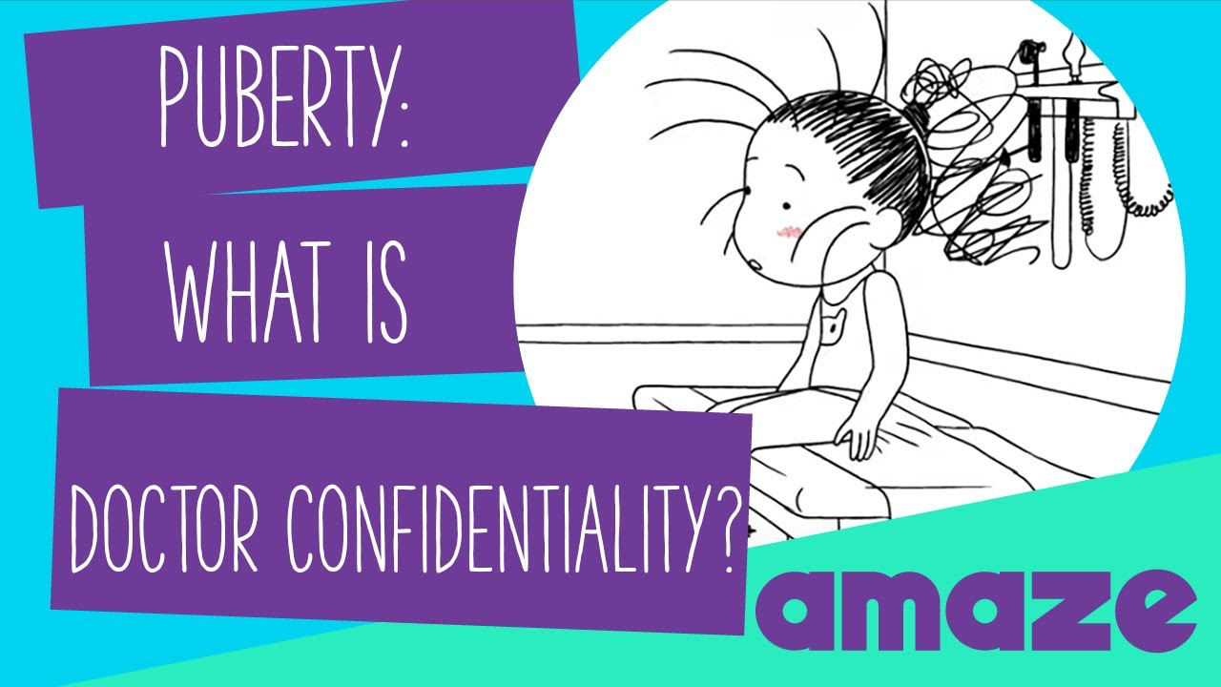
AMAZE: Puberty: What is Doctor Confidentiality?
Play video
Notes:
https://www.youtube.com/watch?v=11mcSEQW6EI&feature=emb_title

Slide 16
Confidentiality
Confidentiality in Adolescent Health Care
Clinically Essential | Developmentally Expected | Supported by Expert Consensus
Notes:
Clinically Essential-Several studies support the rationale for confidentiality in adolescent medicine and demonstrate that confidentiality is clinically essential in adolescents’ decisions to seek care, disclosure of behaviors, and if they will seek follow-up for care.
Developmentally Expected- Adolescents demonstrate an increasing need for autonomy. The stage of adolescent development is characterized as a transition from the dependence of childhood to the independence of adulthood. This process does not occur overnight. Additionally, adolescents have been shown to have increasing intellectual capacity to give informed consent. Many studies have demonstrated that by age 14 most adolescents possess adult decision-making capacity. Thus they want to have the opportunity to take responsibility for their own health.
Supported by Experts-Organizations such as The American College of Obstetricians and Gynecologists, the Society for Adolescent Health and Medicine, the American Medical Association, the American Public Health Association, and the American Academy of Pediatrics have reached consensus that adolescent health care should be confidential but encourage young people to discuss and include their parent’s when addressing their health.
Society for Adolescent Health and Medicine policy: https://www.jahonline.org/article/S1054-139X%2804%2900086-2/fulltext
Policy statement from American Academy of Pediatrics: https://pediatrics.aappublications.org/content/138/2/e20161347
Policy statement from American College of Obstetricians and Gynecologists: https://www.acog.org/-/media/project/acog/acogorg/clinical/files/committee-opinion/articles/2020/04/confidentiality-in-adolescent-health-care.pdf
Society for Adolescent Health and Medicine policy: https://www.jahonline.org/article/S1054-139X%2804%2900086-2/fulltext
Policy statement from American Academy of Pediatrics: https://pediatrics.aappublications.org/content/138/2/e20161347
Policy statement from American College of Obstetricians and Gynecologists: https://www.acog.org/-/media/project/acog/acogorg/clinical/files/committee-opinion/articles/2020/04/confidentiality-in-adolescent-health-care.pdf

Slide 17
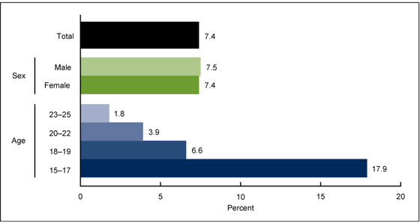
Importance of Confidentiality
What percent of youth 15–25 years old would not seek sexual or reproductive health care because of concerns that their parents might find out about it?
Notes:
ANSWER: 7.4% of all persons ages 15-25, but 17.9% of adolescents 15-17
From the National Survey of Family Growth 2013-2015
A 2002 study of girls younger than 18 years old attending family planning clinics found that 47% would no longer attend if their parents had to be notified that they were seeking prescription birth control pills or devices, and another 10% would delay or discontinue STI testing or treatment. Only 1% said they would stop having intercourse. (2)
Source:
Copen CE, Dittus PJ, Leichliter JS. Confidentiality concerns and sexual and reproductive health care among adolescents and young adults aged 15–25. NCHS data brief, no 266. Hyattsville, MD: National Center for Health Statistics. 2016.
Reddy DM, Fleming R, Swain C. Effect of mandatory parental notification on adolescent girls’ use of sexual health care services. JAMA 2002;288:710–4.

Slide 18
Confidentiality: Sample Policy
Our Policy on Confidentiality
Our discussions with you are private. We hope that you feel free to talk openly with us about yourself and your health. Information is not shared with other people unless we are concerned that someone is in danger.
Notes:
Policy developed by the University of Rochester Medical Center Department of Pediatrics, Rochester, NY.

Slide 19

Discuss Confidentiality in Advance
Inform parents about the confidentiality policy up front before a visit
  Send a letter home:
    Detail when parent will or will not be included in the clinical visit.
    Discuss billing issues (e.g., routine STI testing, etc.).
  Display materials discussing importance of doctor/patient confidentiality
Notes:
Important to consider parent’s perspective, parents are experiencing their own adjustment to their child’s adolescence. Providers have an opportunity to educate parents about the need for confidentiality in the provider-patient encounter.

Slide 20

Minor Consent for Health Services
All states allow minors to consent for sexually transmitted infection testing and treatment services
State laws vary widely regarding consent for contraceptive services, abortion, mental health services substance abuse services and other health care
Providers should be aware of laws regarding minor consent in their state
Notes:
Consent:
Teens receive clear information about informed consent—their right to complete and understandable information about their care and medical procedures, and to give permission to receive medical care related to contraceptive and reproductive health.
Teens receive clear information that confidential contraceptive and reproductive health services are available without the need for parent or caregiver consent, consistent with state laws and regulations.
Sources:
Teen-Friendly Reproductive Health Visit. Centers for Disease Control and Prevention. Page last reviewed: December 6, 2018. https://www.cdc.gov/teenpregnancy/health-care-providers/teen-friendly-health-visit.htm
Fact Sheet: Adolescent Sexual and Reproductive Health in the United States. Guttmacher Institute, September 2019. https://www.guttmacher.org/fact-sheet/american-teens-sexual-and-reproductive-health

Slide 21
The CDC’s Framework for a Sexual Health History:
The 5 P’s
Partners
Practices
Protection from STIs
Past history of STIs
Prevention of pregnancy
Notes:
Source:
A Guide to Taking A Sexual History. Centers for Disease Control and Prevention. Available at https://www.cdc.gov/std/treatment/sexualhistory.pdf.

Slide 22
Expanded Sexual Health History Template
Gender identity
Sexual orientation
Sexual activity
  Number and genders of partners
  Frequency of sexual activity
  Type of sex practices
STI history and risk assessment
Pregnancy history and risk assessment
Contraceptive behaviors
Use of substances during sexual activity
Screening for sexual violence
Notes:
Elements uniformly present in templates for sexual and reproductive history taking include questions and discussions on: sexual orientation, sexual activity; number of partners; frequency of intercourse; type of sex practices; sexual abuse experience; STI history and risk assessment; contraceptive behaviors, and pregnancy history and risk assessment. Added elements in some history taking and counseling templates include discussions on substance use as a sexual and reproductive health risk.

Slide 23
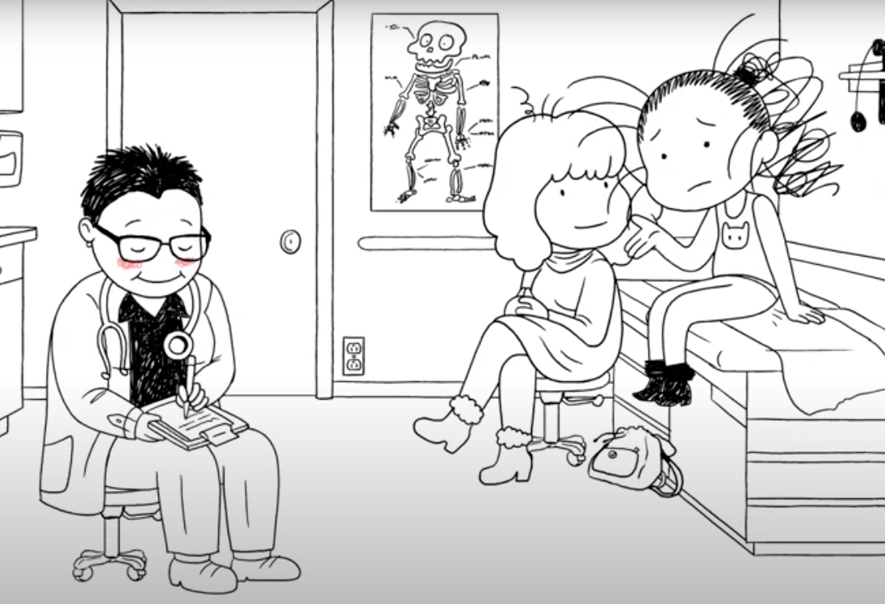
Sexual Health History Tips
Establish rapport and introduce the conversation
Include sexual history as part of a broader risk assessment
Take history while the patient is still dressed
Normalize the discussion
Minimize note-taking during sensitive questions
Provide confidentiality assurance and establish limits of confidentiality
Notes:
Source:
Clinical Tools Section 1.7: Taking A Sexual History, PrEP Education for Youth-Serving Primary Care Providers Toolkit. March 2016. Sexuality Information and Education Council of the United States. https://siecus.org/wp-content/uploads/2018/07/1.7-Taking-A-Sexual-History.pdf

Slide 24
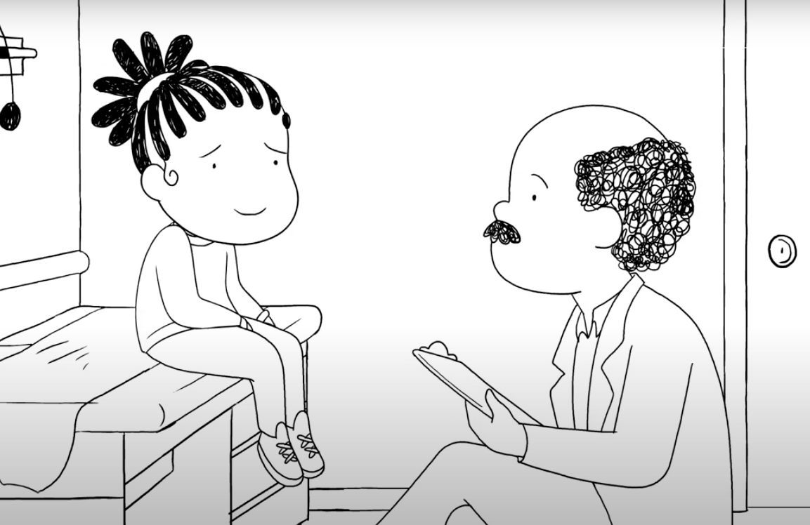
Sexual Health History Tips
Avoid assumptions of sexual orientation or behavior
Understand the difference between gender and sexual orientation and how it may apply to your patients
Use gender-inclusive language
Be familiar with colloquial terminology your patients might use, and if you don’t know a term, ask for clarification
Notes:
Gender identity is a person’s internal sense of gender: man/male, woman/female, both, neither, or another gender.
Gender expression is the ways in which a person acts, presents themselves, and communicates. Gender expression may or may not correspond to assigned gender at birth or gender identity.
Sexuality encompasses sexual orientation (how a person characterizes their emotional and sexual attraction to others, e.g., heterosexual, lesbian, gay, bisexual), sexual attraction (who one loves and/or is attracted to) and sexual behaviors.
Note that youth who may be questioning their sexual orientation and/or gender identity may have changing responses to questions in this area over time.
See Glossary of LGBT Terms for Health Care Teams (National LGBT Health Education Center) for more information: https://www.lgbtqiahealtheducation.org/wp-content/uploads/LGBT-Glossary_March2016.pdf
Ask your patients which pronouns they prefer. Some may prefer the pronouns you and they, rather than he and she. Some sexual minority youth prefer non-traditional pronouns to describe themselves such as yo, ze, zhe, hir, they.
Instead of asking “What do you and your girlfriend do together?” ask “Tell me about your partner.” Or, “What do the two of you do together?”
Source:
Clinical Tools Section 1.7: Taking A Sexual History, PrEP Education for Youth-Serving Primary Care Providers Toolkit. March 2016. Sexuality Information and Education Council of the United States. https://siecus.org/wp-content/uploads/2018/07/1.7-Taking-A-Sexual-History.pdf

Slide 25
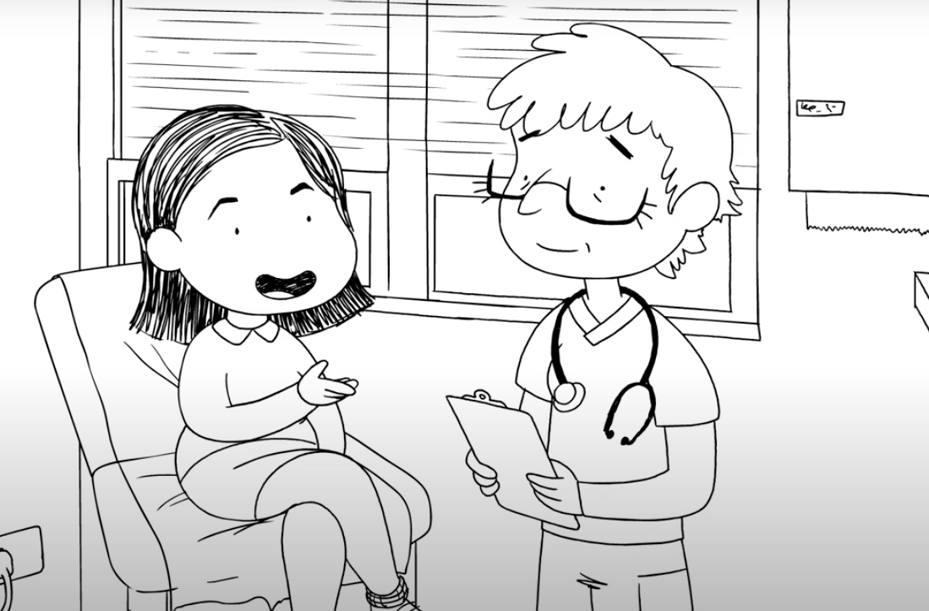
Sexual Health History Tips
Be non-judgmental and supportive
Ask developmentally appropriate questions
Provide reassurance that you are not judging the patient
Avoid lecturing
Practice listening skills
Remember, it’s a conversation… not an interrogation!
Notes:
Source:
Clinical Tools Section 1.7: Taking A Sexual History, PrEP Education for Youth-Serving Primary Care Providers Toolkit. March 2016. Sexuality Information and Education Council of the United States. https://siecus.org/wp-content/uploads/2018/07/1.7-Taking-A-Sexual-History.pdf

Slide 26

Case Discussion: Ayesha
Ayesha is a 16-year-old who has been your patient since she was a toddler, but you haven’t seen her in 2 years
She comes in today for a sports physical
How do you begin the visit?
What questions do you need to ask?
Notes:
Every visit is an opportunity to collect or update sexual history information.
At every visit, each teen patient should have time alone with a provider to discuss or ask questions about contraceptive and reproductive health concerns, regardless of whether the visit is urgent or preventive.
Source: Teen-Friendly Reproductive Health Visit. Centers for Disease Control and Prevention. Page last reviewed: December 6, 2018. https://www.cdc.gov/teenpregnancy/health-care-providers/teen-friendly-health-visit.htm

Slide 27

Case Discussion: Zoe
The next patient on your schedule is Zoe, a 16-year-old new patient. The triage note states that the reason for the visit is a missed period
How do you begin the visit?
What questions do you need to ask?
Notes:
Every visit is an opportunity to collect or update sexual history information.
At every visit, each teen patient should have time alone with a provider to discuss or ask questions about contraceptive and reproductive health concerns, regardless of whether the visit is urgent or preventive.
Source: Teen-Friendly Reproductive Health Visit. Centers for Disease Control and Prevention. Page last reviewed: December 6, 2018. https://www.cdc.gov/teenpregnancy/health-care-providers/teen-friendly-health-visit.htm

Slide 28
Starting the Conversation and Asking Sensitive Questions
First, introduce the topic:
I’m going to ask you some questions about your gender and sexual health now. I know these are private, but they are also a really important part of everyone’s health. I ask these questions of all my patients.
Notes:
Elements uniformly present in templates for sexual and reproductive history taking include questions and discussions on: sexual orientation, sexual activity; number of partners; frequency of intercourse; type of sex practices; sexual abuse experience; STI history and risk assessment; contraceptive behaviors, and pregnancy history and risk assessment. Added elements in some history taking and counseling templates include discussions on substance use as a sexual and reproductive health risk.

Slide 29
Gender Identity and Sexual Orientation
Do you think of yourself as a boy, a girl or another gender?
What pronouns do you use?
Are you attracted to boys, girls, or people of other genders?
Are you attracted to anyone now? Tell me more about that.
Notes:
Alternate ways to ask some of these questions include:
Do you think of yourself as male, female, neither, or both?
How do you feel about your gender? Does it cause you any stress?
Are you romantically interested in men, women, or both?
For younger teens: when you imagine yourself in a relationship in the future is it with a man, a woman, or both?

Slide 30
Partners: Romantic and Sexual Relationships
Have you ever had a crush on someone? What was that like?
Have you ever had a romantic relationship with someone? How did that go for you?
Are you in a relationship now? How is that relationship going for you?
Notes:
Alternate ways to ask some of these questions include:
Do you think of yourself as male, female, neither, or both?
How do you feel about your gender? Does it cause you any stress?
Are you romantically interested in men, women, or both?
For younger teens: when you imagine yourself in a relationship in the future is it with a man, a woman, or both?

Slide 31
Assessing the Health of the Relationship
Does your partner treat you well? Do you feel good about yourself when you spend time with your them?
What do you think are the strengths of your relationship?
How do you handle conflict in your relationship?
Does your partner support you in spending time with your other friends?
Does your partner ever make you feel bad about yourself? Do they ever hurt you, emotionally or physically, or threaten you?

Slide 32

Characteristics of Healthy Relationships
Nonviolent conflict resolution
Open and honest communication
Right to autonomy for both people
Shared decision-making
Trust
Mutual respect
Individuality
Empathy
Notes:
Healthy relationships have open and honest communication. No relationship is conflict free, but the key to a healthy relationship is knowing how to resolve those conflicts.
Belief in non-violent conflict resolution/anger control—how we express anger is what makes the difference between healthy and unhealthy relationships
Ability to negotiate and adjust to stress
Open and honest communication—each partner needs to say exactly what they mean without interruption
Partners work together to make decisions—about the relationship or their own interests
Belief in partner’s right to autonomy—individuals in a relationship need to be free to pursue their own interests, make their own decisions and take their own actions
Individuality—not choosing who you are or what you do to please your partner
Shared decision making
Trust—partners are able to rely on one another
Mutual Respect—each person values the other and understands personal boundaries
Honesty—when someone says something, it’s actually what they mean
Compromise
Fighting fair—when disagreeing, partners stick to the subject of the argument without insulting
Empathy—taking time to figure out a partner’s feelings
Sources:
Catallozzi et al. (2011). Understanding control in adolescent and young adult relationships. Arch Pediatr Adolesc Med, 165 (4), 313–319.
Glass et al. (2011) Adolescent dating violence: prevalence, risk factors, health outcomes, and implications for clinical practice. Curr Opin Pediatr, 23(4): 379–83.
Adapted from, “Hanging out or Hooking Up: Clinical Guidelines on responding to Adolescent Relationship Abuse” by Elizabeth Miller, MD, PhD and Rebecca Levenson, MA.

Slide 33
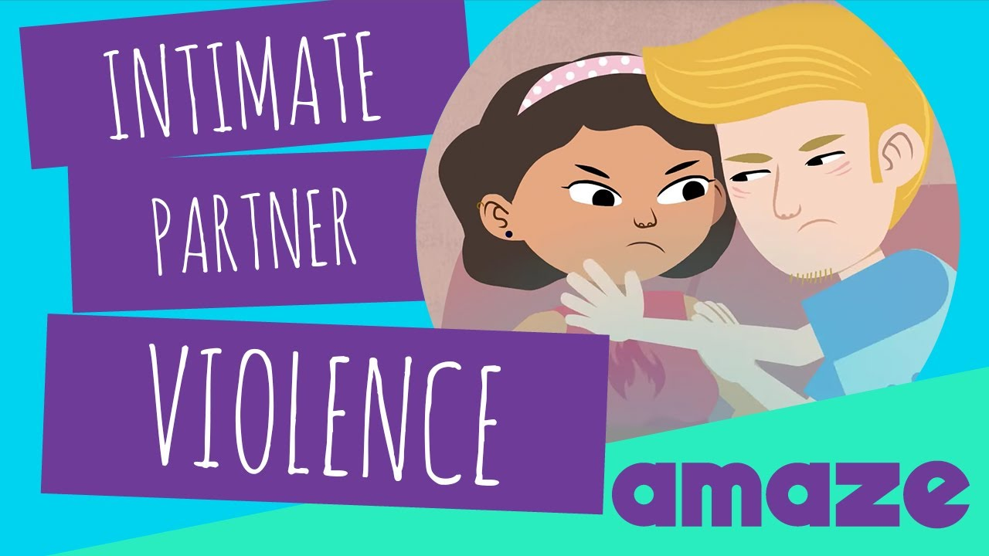
Risk Factors for Intimate Partner Violence
Partner is 3-5 years older
Exposure to violence in the household or community
Early sexual activity
Low education level
Sexual risk-taking
Substance use
Notes:
Sources:
Catallozzi et al. (2011). Understanding control in adolescent and young adult relationships. Arch Pediatr Adolesc Med, 165 (4), 313–319.
Glass et al. (2011) Adolescent dating violence: prevalence, risk factors, health outcomes, and implications for clinical practice. Curr Opin Pediatr, 23(4): 379–83.

Slide 34
Clinical Signs Associated with Intimate Partner Violence
Depression/anxiety
Changes in eating patterns
Changes in social relationships
Substance use
Abdominal pain/pelvic pain
Physical findings inconsistent with stated mechanism of injury, or findings associated with intentional injury (patterned marks, bruises in varied stages of healing, burns)
Notes:
Sources:
Catallozzi et al. (2011). Understanding control in adolescent and young adult relationships. Arch Pediatr Adolesc Med, 165 (4), 313–319.
Glass et al. (2011) Adolescent dating violence: prevalence, risk factors, health outcomes, and implications for clinical practice. Curr Opin Pediatr, 23(4): 379–83.

Slide 35
Adolescents and Intimate Partner Violence
Adolescents report intimate partner violence that is bi-directional, meaning girls and boys report being both the victims and the perpetrators
9.3% of females and 9.5% of males report being hit, slapped, or physically hurt on purpose by their boyfriend or girlfriend
11.8% of females and 4.5% of males have ever been physically forced to have sex
Notes:
Sources:
Glass et al. (2011) Adolescent dating violence: prevalence, risk factors, health outcomes, and implications for clinical practice. Curr Opin Pediatr, 23(4): 379–83.
Centers for Disease Control and Prevention. Youth Risk Behavior Surveillance – United States, 2011. Surveillance Summaries, August 2, 2012. MMWR 2012;61(No. 4).

Slide 36
Sexual Behavior History Questions
There are many ways of being sexual or intimate with another person: kissing, hugging, touching, having oral sex, vaginal sex, or anal sex.
  Have you ever had any of these experiences? Which ones? With boys, girls, both or other genders?
How many sexual partners have you had in the past 3 months? In the past 12 months?
When was the last time you had sex?
Notes:
Adapted from the presentation "Interviewing the Adolescent: Tricks of the Trade" by Dr. Melanie A. Gold.
Don’t
Ask “Are you sexually active?”
Use gendered-biased pronouns when referring to sexual partners
Use judgmental language
Use slang unless patient offers it first
Do
Assure confidentiality
Explain why you are asking sensitive questions
Ask patient to describe specific sexual behaviors
Add “second tier” questions to assess comfort with behavior
Knowing the date of last sexual intercourse is necessary to assess the possibility of pregnancy and the need for emergency contraception.
Assessing number of partners in the past 3, 6 or 12 months helps determine risk of exposure to STIs

Slide 37
Orientation vs. Behavior
Remember, orientation does not always match behavior
Many people who identify as gay, lesbian, or bisexual have had sex with people of other genders
While respecting a patient’s identification, you should inquire about sexual behaviors with partners of all genders.
Notes:
Source: Diamant AL, Schuster MA, McGuigan K, Lever J. Lesbians’ sexual history with men: implications for taking a sexual history. Arch Intern Med 1999;159:2730–6.

Slide 38
Discussing Abstinence
Abstinence from sexual activity is optimal for pregnancy and STI prevention. However, research indicates nearly half of teenagers in the United States have had sexual intercourse
Youth who are abstinent should be supported in that choice and encouraged to continue
Youth who have already engaged in sexual intercourse may consider becoming abstinent if they are uncomfortable with their decision
  Discuss other options for intimacy between partners
  Discuss ways patient can communicate decision to partner
Notes:
https://www.cdc.gov/nchs/pressroom/nchs_press_releases/2017/201706_NSFG.htm

Slide 39

Discussing Readiness for Sexual Activity
Some questions providers can ask to begin to explore a teen’s readiness for sexual activity are:
  How would they know if they were ready to start having sex?
  Does the patient feel that sexual activity will be a positive experience for them?
  Does the patient feel like they can decide for themself and that their partner will respect their decision?
  Can they openly talk to partners about their feelings?

Slide 40
Case Discussion: Ayesha
Ayesha’s pronouns are she/her
Ayesha tells you she has a boyfriend she has been dating for about 4 months
She has not had sex but thinks she might be ready in a few months
She agrees to come back to talk about options for contraception

Slide 41
Case Discussion: Zoe
Zoe’s preferred pronouns are she/her
She tells you that she is attracted to girls but isn’t sure if she is lesbian or bisexual and has had vaginal sex with 2 male partners in the last year
She recently had vaginal sex (about 48 hours ago) with a male and they did not use a condom
She isn’t currently in a relationship with anyone which is why she didn’t think she needed to be on another form of contraception

Slide 42
Protection from STIs
How often do you use protection against sexually transmitted infections?
  What kind of protection? (External condom, internal condom, dental dam)
  In what situations or with whom are you most likely to use protection? To not use protection?
Did you use protection the last time you had sex?
Notes:
Other questions you may want to ask include:
Do you and your partner(s) use any protection against STDs?
If so, what kind of protection do you use? How often do you use this protection?
If not, could you tell me the reason?
Do you use condoms consistently? If not, in which situations are you most likely to use or not use a condom?
How often do you use condoms? Never, sometimes, or most of the time? (not including ”always” as an option may help normalize choosing a different answer)
What kind of protection did you use the last time you had sex? Condoms? Hormonal contraception?
Sources:
1) A Guide to Taking A Sexual History. Centers for Disease Control and Prevention. Available at https://www.cdc.gov/std/treatment/sexualhistory.pdf.
2) A Clinician’s Guide to Sexual History Taking. California Department of Public Health, Sexually Transmitted Diseases Control Branch in collaboration with California STD/HIV Prevention Training Center. May 2011. Available at https://www.cdph.ca.gov/Programs/CID/DCDC/CDPH%20Document%20Library/CA-STD-Clinician-Guide-Sexual-History-Taking.pdf
3) Clinical Tools Section 1.7: Taking A Sexual History, PrEP Education for Youth-Serving Primary Care Providers Toolkit. March 2016. Sexuality Information and Education Council of the United States. https://siecus.org/wp-content/uploads/2018/07/1.7-Taking-A-Sexual-History.pdf

Slide 43
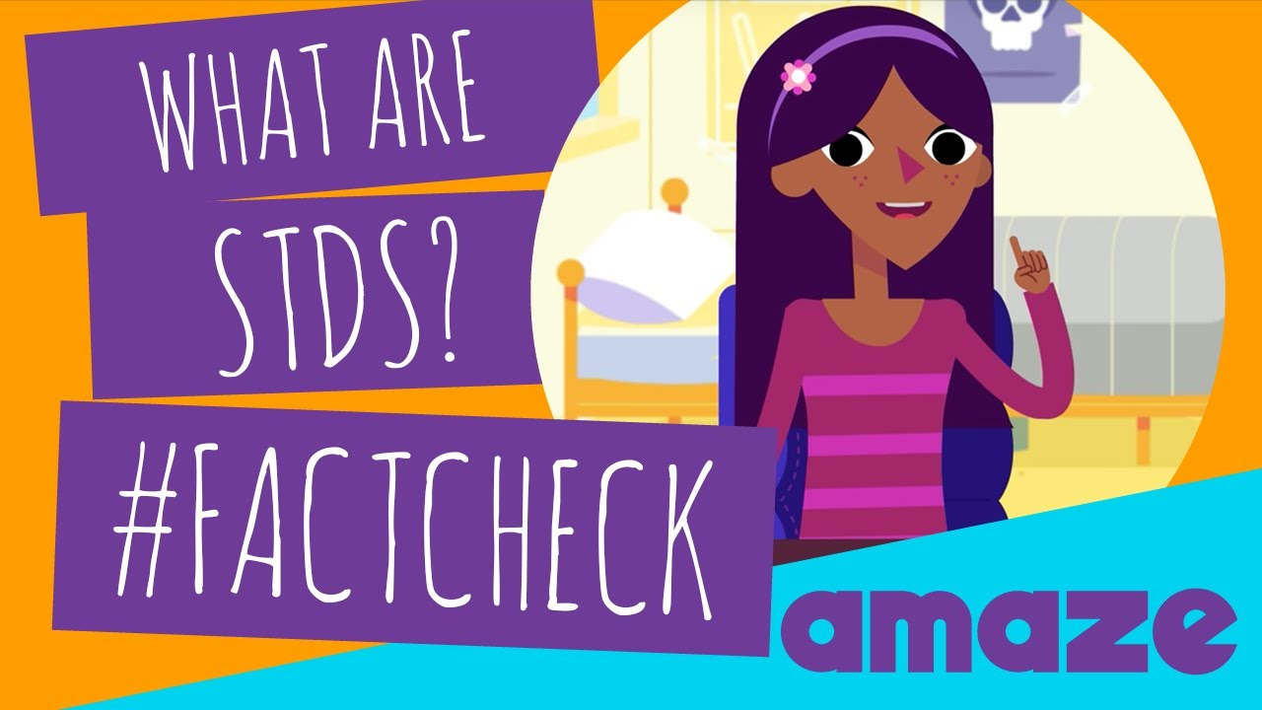
Past History of STIs
Have you ever had a sexually transmitted infection? How long ago was it? Did you complete treatment?
How about your partner?
Would you like to be tested today?
Notes:
Adapted from the presentation "Interviewing the Adolescent: Tricks of the Trade" by Dr. Melanie A. Gold.
Other ways to ask some of these questions include:
Have you ever been diagnosed with an STI such as HIV, herpes, gonorrhea, chlamydia, genital warts, syphilis, HPV or trichomonas? When? How were you treated?
Have you had any recurring symptoms or diagnoses?
Have you ever been tested for HIV or other STIs? When?
Would you like to be tested today?
Has your current partner or any former partners ever been diagnosed or treated for an STI that you know of?
Were you tested and treated for the same STIs?
Additional questions to identify HIV and hepatitis risk include:
Have you or any of your partners been diagnosed with HIV or hepatitis B or C?
Have you or any of your partners ever injected drugs?
Do you have sex when you have been using drugs or after drinking alcohol?
Have you ever taken pre-exposure prophylaxis (a medication to prevent against HIV)?
Have you ever taken post-exposure prophylaxis (a medication taken within 72 hours after sex to prevent against HIV)?
Have you had all the doses of the hepatitis B vaccine? (three doses)
Have you had the hepatitis A vaccine (two doses)? (Recommended for men who have sex with men and injection drug users)
Sources:
1) A Guide to Taking A Sexual History. Centers for Disease Control and Prevention. Available at https://www.cdc.gov/std/treatment/sexualhistory.pdf.
2) A Clinician’s Guide to Sexual History Taking. California Department of Public Health, Sexually Transmitted Diseases Control Branch in collaboration with California STD/HIV Prevention Training Center. May 2011. Available at https://www.cdph.ca.gov/Programs/CID/DCDC/CDPH%20Document%20Library/CA-STD-Clinician-Guide-Sexual-History-Taking.pdf
3) Clinical Tools Section 1.7: Taking A Sexual History, PrEP Education for Youth-Serving Primary Care Providers Toolkit. March 2016. Sexuality Information and Education Council of the United States. https://siecus.org/wp-content/uploads/2018/07/1.7-Taking-A-Sexual-History.pdf

Slide 44
Pregnancy History and Prevention
Do you want to get pregnant within the next year?
What are you doing to prevent an unintended pregnancy?
Have you taken emergency contraception in the past year? How many times?
Have you ever been pregnant or gotten anyone pregnant? What were the outcomes?
Notes:
There are many ways to ask about pregnancy history, fertility, reproductive planning and contraception.
Don’t assume adolescents have never been pregnant or are not trying to become pregnant
Other ways to ask these questions include:
Do you want to become pregnant/father a child in the next year?
Are you concerned about getting pregnant or getting your partner pregnant?
Are you using contraception or practicing any form of birth control?
Do you need any information on birth control?
Have you used emergency contraception in the past year? If so, how many times?*
* Note: Repeated use of emergency contraception (EC) is a flag for unprotected sex. Use of EC twice or more in six months may warrant screening for intimate partner violence (IPV) as partners may be sabotaging or prohibiting their partner’s use of contraception.
Sources:
1) A Guide to Taking A Sexual History. Centers for Disease Control and Prevention. Available at https://www.cdc.gov/std/treatment/sexualhistory.pdf.
2) A Clinician’s Guide to Sexual History Taking. California Department of Public Health, Sexually Transmitted Diseases Control Branch in collaboration with California STD/HIV Prevention Training Center. May 2011. Available at https://www.cdph.ca.gov/Programs/CID/DCDC/CDPH%20Document%20Library/CA-STD-Clinician-Guide-Sexual-History-Taking.pdf
3) Clinical Tools Section 1.7: Taking A Sexual History, PrEP Education for Youth-Serving Primary Care Providers Toolkit. March 2016. Sexuality Information and Education Council of the United States. https://siecus.org/wp-content/uploads/2018/07/1.7-Taking-A-Sexual-History.pdf

Slide 45
Discussing Birth Control
What methods of birth control have you used for pregnancy prevention? What was your experience with that?
What is most important to you in a birth control method?
Would you like me to tell you about the options available?
Notes:
Contraceptive counseling is a large topic.
Key elements of contraceptive counseling for adolescents include:
Respect adolescent confidentiality, agency and autonomy
Take a full medical and sexual history
Explore patient’s knowledge, experience and preferences regarding contraceptive method choice
Discuss side effects candidly and validate concerns
Encourage dual condom/contraception use
Offer to write an advanced prescription for emergency contraception or instruct on over the counter access
For more information, you can refer to the Essentials of Contraception and Adolescents module in this series.
The following are provider resources regarding contraception and contraceptive counseling:
www.cdc.gov/reproductivehealth/unintendedpregnancy/usmec.htm United States Medical Eligibility Criteria (US MEC) for Contraceptive Use, 2016
www.managingcontraception.com –Managing Contraception
store.managingcontraception.com/contraceptive-technology-20th-edition -Contraceptive Technology 20th Edition
www.choiceproject.wustl.edu -Contraceptive Choice Project
bedsider.org -Bedsider
https://powertodecide.org/ - Power to Decide, the campaign to prevent unplanned pregnancy
www.reproductiveaccess.org/key-areas/contraception -Reproductive Health Access Project

Slide 46
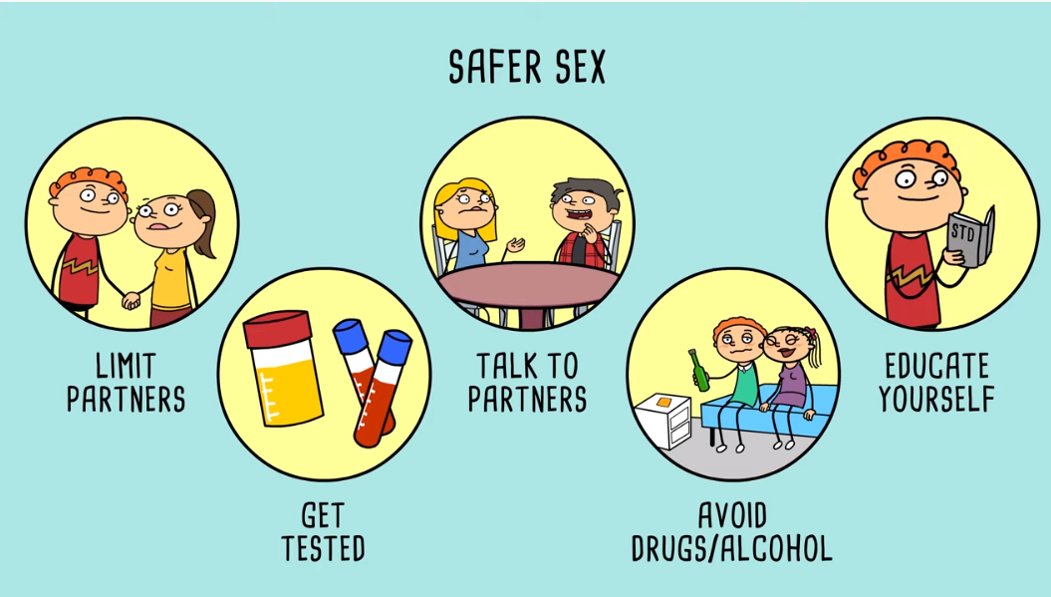
Screening for Substance Use during Sexual Activity
Do you ever drink alcohol or get high before having sex?
Has anyone ever encouraged you to drink or get high so that they could have sex with you?
Notes:
Of adolescents who are sexually active, 19% drank alcohol or used drugs before their last sexual intercourse.
Substance use is associated with behaviors that put youth at risk for HIV, STDs, and pregnancy, including, possibly decreased use of condoms.
https://www.cdc.gov/healthyyouth/substance-use/pdf/dash-substance-use-fact-sheet.pdf

Slide 47
Screening for Sexual Violence
Has anyone ever forced you to do something sexual that you didn’t want to do?
Has anyone every touched you in a sexual way that you didn’t want?
Is anyone currently touching you or forcing you to do sexual acts that you don’t want to do?
Did you tell anyone?
Have you ever talked with a therapist or counselor about these experiences?
Notes:
Sexual violence is common. 1 in 3 women and 1 in 4 men experienced sexual violence involving physical contact during their lifetimes. Nearly 1 in 5 women and 1 in 38 men have experienced completed or attempted rape and 1 in 14 men was made to penetrate someone (completed or attempted) during his lifetime.
Sexual violence starts early. 1 in 3 female rape victims experienced it for the first time between 11-17 years old and 1 in 8 reported that it occurred before age 10. Nearly 1 in 4 male rape victims experienced it for the first time between 11-17 years old and about 1 in 4 reported that it occurred before age 10.
The consequences of sexual violence are physical, like bruising and genital injuries, and psychological, such as depression, anxiety and suicidal thoughts.
The consequences may also be chronic. Victims may suffer from post-traumatic stress disorder, experience re-occurring gynecological, gastrointestinal, cardiovascular and
sexual health problems.
Sexual violence is also linked to negative health behaviors. For example, victims are more likely to smoke, abuse alcohol, use drugs, and engage in risky sexual activity.
Source: https://www.cdc.gov/violenceprevention/sexualviolence/fastfact.html

Slide 48

Responding to Disclosure of Sexual Violence
Stay calm and maintain a warm, caring emotional tone
Reassure the young person that you’re glad they told you and that you believe them
Affirm that the abuse or rape wasn’t their fault
Assess for ongoing safety
Assess for mental health support – do they have a therapist or counselor? Who else have they told?
Offer ongoing support and resources
Notes:
In most states, clinicians and nurses are mandated reporters of children and youth who have been or are victims of abuse or neglect
Source for mandated reporting law summaries: https://www.childwelfare.gov/topics/systemwide/laws-policies/statutes/manda/

Slide 49
Mandated Reporting
States have specific requirements for reporting known or suspected child abuse or neglect
Healthcare providers and teachers are generally mandated to report
When possible, have an open conversation with the young person about the need to report
Revisit the confidentiality policy, which describes the need to break confidentiality in cases of danger to the patient
Notes:
In most states, clinicians and nurses are mandated reporters of children and youth who have been or are victims of abuse or neglect
note: some school districts also have processes for mandated reporters teachers and other school staff;
the presenter should be prepared to acknowledge any local processes/practices required.
Source for mandated reporting law summaries: https://www.childwelfare.gov/topics/systemwide/laws-policies/statutes/manda/

Slide 50
Case Discussion: Ayesha
Before she leaves, what preventive measures do you discuss with Ayesha for the future?
Notes:
Complete HPV vaccine series
Emergency contraception
Over-the-counter
Advance prescription still possible
Does not protect against STIs
Condom use
Give patient condoms to take home
Encourage dual use of both condoms and another contraceptive method

Slide 51
Case Discussion: Zoe
You refer Zoe to a local clinic that provides confidential sexual health services to teens, and discuss with her what to expect at that visit, including a pregnancy test and testing for STIs
How else do you counsel and treat Zoe today?
Notes:
Zoe should be counseled about emergency contraception, including what it is and how to get it, since she had unprotected sex 48 hours ago.
She should be encouraged to use both a condom and another contraceptive method with all sexual encounters.

Slide 52
Wrapping Up
Is there anything else about your sexual health that you would like to talk about today?
Are you or your partner having any sexual difficulties at this time?
Do you have any other sexual concerns or questions you would like to discuss?
Notes:
Specific questions you can ask about sexual satisfaction or disfunction include:
How often do you have pain during sexual intercourse or other sexual activities?
Are you satisfied with how often you have sexual relations and with what you do with your sexual partner?
Any problems becoming aroused, getting an erection, getting lubricated (wet), or having an orgasm?
Sources:
1) A Guide to Taking A Sexual History. Centers for Disease Control and Prevention. Available at https://www.cdc.gov/std/treatment/sexualhistory.pdf.
2) A Clinician’s Guide to Sexual History Taking. California Department of Public Health, Sexually Transmitted Diseases Control Branch in collaboration with California STD/HIV Prevention Training Center. May 2011. Available at https://www.cdph.ca.gov/Programs/CID/DCDC/CDPH%20Document%20Library/CA-STD-Clinician-Guide-Sexual-History-Taking.pdf
3) Clinical Tools Section 1.7: Taking A Sexual History, PrEP Education for Youth-Serving Primary Care Providers Toolkit. March 2016. Sexuality Information and Education Council of the United States. https://siecus.org/wp-content/uploads/2018/07/1.7-Taking-A-Sexual-History.pdf

Slide 53

Take-Home Messages
All adolescents need sexual and reproductive health care
Positive sexuality is part of healthy development
Confidentiality is essential
Taking about sexual health with patients helps them avoid unintended pregnancies and STIs

Slide 54
Other Clinical Interview Tools
GAPS: AMA Guidelines for Adolescent Preventive Services
American Academy of Pediatrics guidance on adolescent health care
Bright Futures: Collaboration between AAP and Bureau of Maternal Child Health Care
Society for Adolescent Health and Medicine clinical guidance in sexual and reproductive health
ACOG Toolkit: Designed by the ACOG Committee on Adolescent Health Care

Slide 55
Adolescent Reproductive and Sexual Health Education Project (ARSHEP)
Taking a Sexual History: Essential Questions
•Open your cell phone camera
•Aim the camera at the QR code
•The survey link will pop up – please click
•Fill out the survey
Notes:
Updated 2020

