Slide 1

Adolescent Reproductive and Sexual Health Education Project (ARSHEP)
Essentials of Contraception and Adolescents
Notes:
Updated 2020

Slide 2

Notes:
Advocates for Youth partners with youth leaders, adult allies, and youth-serving organizations to advocate for policies and champion programs that recognize young people’s rights to: honest sexual health information; accessible, confidential and affordable sexual health services; and the resources and opportunities necessary to create sexual health equity for all youth.
Our values are reflected in the 3Rs:
•Youth have the inalienable right to honest sexual health information.
•Youth deserve respect.
•Society has the responsibility to provide young people with tools need to safeguard their sexual health and lead the lives they desire.

Slide 3

This presentation was originally created by Physicians for Reproductive Health as part of the ARSHEP curriculum.
Updates and modifications to this presentation were supported, in part, by Cooperative Agreement PS18-1807 from the Centers for Disease Control and Prevention, Division of Adolescent and School Health (CDC-DASH). The contents do not necessarily represent the official views of the Centers for Disease Control and Prevention.

Slide 4
Adolescent Reproductive and Sexual Health Education Project (ARSHEP)
[Faculty Member information goes here}
Notes:
Updated 2020

Slide 5
Acknowledgment
This presentation was made possible by Cooperative Agreement PS18-1807 from the Centers for Disease Control and Prevention, Division of Adolescent and School Health (CDC-DASH). The contents do not necessarily represent the official views of the Centers for Disease Control and Prevention.

Slide 6
Objectives
Review pregnancy trends, rates of sexual activity and contraceptive use among adolescents and young adults
Describe available contraceptive methods and advantages/disadvantages of each
Discuss tips for initiation and use
Dispel common myths

Slide 7
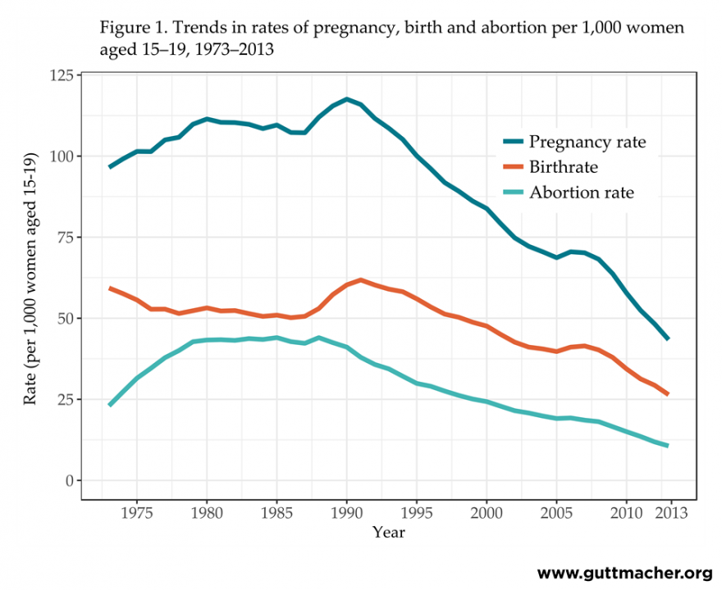
Teen pregnancy, birth, and abortion rates are declining
Source: Kost, et.al. Guttmacher Institute. 2014.
Notes:
Kost K and Henshaw S, U.S. Teenage Pregnancies, Births and Abortions, 2010: National and State Trends by Age, Race and Ethnicity. Guttmacher Institute 2014.
https://guttmacher.org/media/nr/2014/05/05/index.html
More recent data are available for teen birthrates than for teen pregnancy rates, and those data show that the decline in teen births has continued: it declined 7% in 2018, to 17.4 births per 1,000 females aged 15–19, the lowest rate ever reported for the United States. Although data for the same time period are not yet available for abortions (and therefore pregnancies), these numbers suggest that teen pregnancy rates may very well have continued their long-term declines as well.
Source: Hamilton BE et al., State Teen Birth Rates by Race and Hispanic Origin: United States, 2017–2018. National Vital Statistics Reports, 2020, Vol. 69, No. 6,
<https://www.cdc.gov/nchs/data/nvsr/nvsr69/NVSR69-6-508.pdf> Accessed October 6, 2020.
From Guttmacher report:
Overall pregnancy, birth and abortion rates for 15–19 year olds are declining
In 2013, the U.S. pregnancy rate among 15–19-year-olds was at its lowest point in at least 80 years and had dropped to just above one-third of a recent peak rate in 1990 (118 per 1,000 women). Between 2008 and 2013, the rate dropped 36% (from 68 to 43).
The pregnancy rate among 15–19-year-olds was 43 per 1,000 women; this means that fewer than 5% of 15–19-year-olds became pregnant in 2013.
18–19-year-olds made up 41% of all women ages 15-19 in 2013 but constituted the majority (72%) of teen pregnancies in that group. During this same time period, increasing proportions of 18–19-year-olds reported having ever had sex, yet fewer of them became pregnant. The likely reason is improved contraceptive use and use of more effective methods.
The study also found dramatic declines in teen pregnancy rates among all racial and ethnic groups.
However, wide disparities exist, for example in 2013, the pregnancy rate among non-Hispanic black 15–19-year-olds was 75 per 1,000 women and the rate was 28 among non-Hispanic 15–19-year-olds of other races.
Authors suggest that differences in overall levels of pregnancy by race and ethnicity might reflect systemic inequities—including access to comprehensive sex education and health care more generally—as well as family planning and contraceptive services specifically, distinctly different social and cultural attitudes toward young parenthood, or other factors not yet fully understood.
Teen pregnancy rates declined in all 50 states between 2008 and 2013. Yet even with ongoing declines, substantial disparities remain between states. In 2013, New Mexico had the highest teenage pregnancy rate (62 per 1,000), followed by Arkansas (59), Mississippi (58), Oklahoma (58), Texas (58) and Louisiana (54). The lowest rates were in New Hampshire (22), Massachusetts (24), Minnesota (26), Utah (28), Vermont (28) and Wisconsin (28).

Slide 8
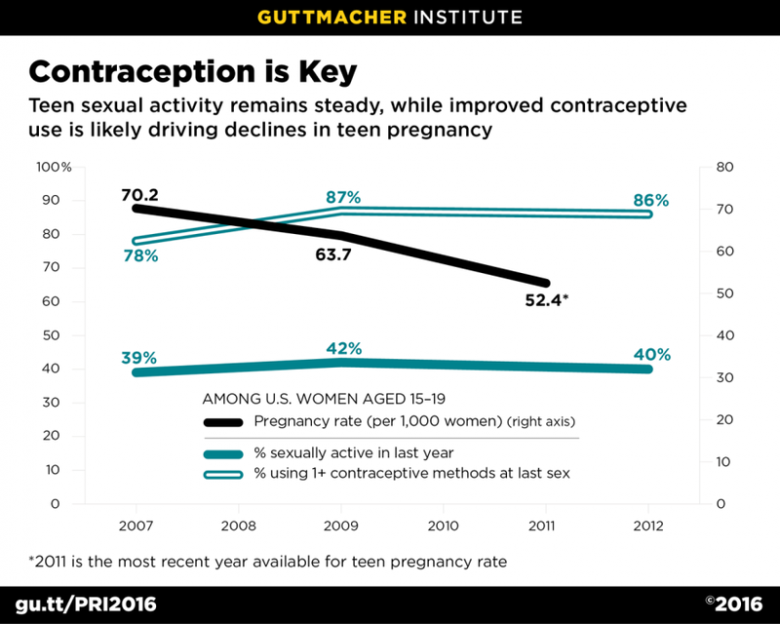
Declines in adolescent pregnancy are primarily due to increased contraceptive use
Source: Lindberg, et.al. Journal of Adolescent Health, 2016.
Notes:
A 2016 study that examined data from the National Survey of Family Growth estimated that the decline in adolescent pregnancy rates was almost entirely attributable to improved contraceptive use.
This graph shows a decline in adolescent pregnancy rates from 2007 – 2012, despite the fact that the level of sexual activity did not decrease (and actually increased a small amount). There was a small increase in the percent of teens reporting using at least 1 contraceptive method at the time of last sex.
The study also found significant increases in teens using highly-effective methods like LARC, and in the use of more than one method (like condoms + pills, for example).
This is yet another example of how improved access to effective contraceptive options can make a measurable positive impact on the health outcomes of many people.
Source: Lindberg, Laura et al. Understanding the decline in adolescent fertility in the United States, 2007 – 2012. Journal of Adolescent Health, 2016, 1-7.

Slide 9
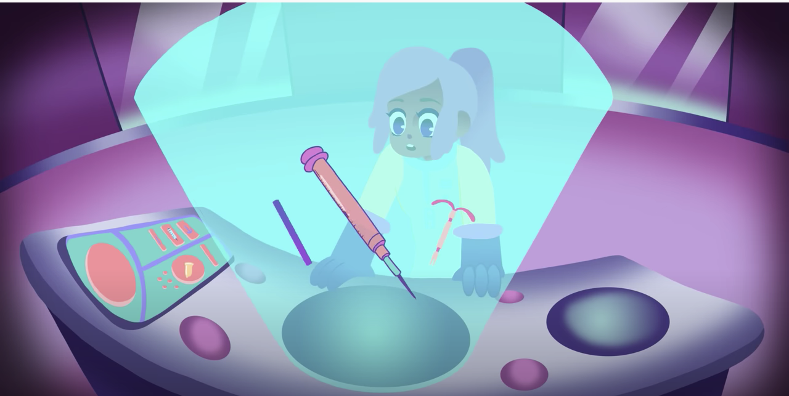
Contraceptive Use:
What contraceptives do you think are most used by adolescents?
Notes:
Source: https://www.guttmacher.org/sites/default/files/factsheet/fb-atsrh.pdf (September 2019)
The proportion of U.S. females aged 15–19 who used contraceptives the first time they had sex increased from 48% in 1982 to 79% in 2011-2013, but in 2015-2017 it declined slightly to 77%.
Source: Martinez GM and Abma JC, Sexual activity, contraceptive use, and childbearing of teenagers aged 15–19 in the United States, NCHS Data Brief, 2015, No. 209.
■ Most adolescents use contraceptives at both first sex and most recent penile-vaginal sex. In 2015–2017, 89% of females and 94% of males aged 15–19 reported that they or their partner had used contraceptives the last time they had sexual intercourse, and 77% of females and 91% of males reported contraceptive use the first time they had sexual intercourse.

Slide 10
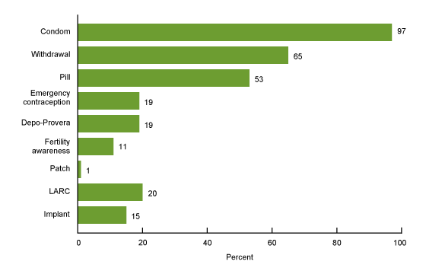
Contraceptive Use:
What contraceptives do you think are most used by adolescents?
Source: NCHS Data Brief #366, May 2020 (CDC NSFG 2017-2019)
Notes:
% of teens who’ve had sex 1+ times using these methods
LARC = Long Acting Reversible Contraception, includes IUD or Implant
Contraceptive ring and intrauterine device (IUD) are not shown because they did not meet NCHS reliability criteria.
Between 2015-2017:
42% of never-married female teenagers aged 15–19 and 38% of never-married male teenagers had had sexual intercourse. This is a decline of 17% for male teenagers between 2002 and 2015–2017.

Slide 11
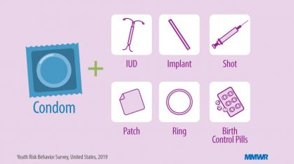
Contraceptive Use:
According to the 2019 Youth Risk Behavior Survey, 54% of sexually active high school students used a condom at last sex
But only 9% used a condom AND a more effective birth control method the last time they had sex
Source: Szucs, et.al. MWMR Suppl. CDC. 2020.
Notes:
Source: Szucs LE, Lowry R, Fasula AM, et al. Condom and Contraceptive Use Among Sexually Active High School Students — Youth Risk Behavior Survey, United States, 2019. MMWR Suppl 2020;69(Suppl-1):11–18. DOI: http://dx.doi.org/10.15585/mmwr.su6901a2external icon
Data for this slide are from the 2019 National Youth Risk Behavior Survey. This slide shows the percentage of high school students who used a condom and a more effective form of birth control (during last sexual intercourse among students who were currently sexually active).
In this survey, 27.4% of students reported being sexually active, defined as having had sexual intercourse with one or more persons within the past 3 months.
The percentage for all students who used a condom at last sex is 54.3.

Slide 12

Case example: Angela
Angela is a 16-year-old young woman who makes an appointment to discuss birth control.
Her intake form indicates that she uses external condoms “most of the time.”
What additional information do you need from this patient?

Slide 13
Medical History:
Menstrual history
Health history (looking specifically for conditions that would be a contraindication to contraceptive use, such as migraines with aura or deep venous thrombosis)
Family history of blood clots
Prior experiences with contraception

Slide 14
Sexual Health History:
Sexual orientation and gender identity
Age at first sex
History of vaginal, anal and oral sex
Number and gender of sexual partners
History of pregnancy and sexually transmitted infections (STIs)
Use of condoms or other protection against pregnancy and STIs
History of transactional, unwanted, or coerced sex
Notes:
To learn more about taking a sexual health history from adolescent and young adult patients, see the module on Taking a Sexual History: Essential Questions
Consent & Confidentiality: Most states have specific laws regarding minor consent to contraception
For an updated summary by state, see: https://www.guttmacher.org/state-policy/explore/minors-access-contraceptive-services
Careful attention to minor consent and confidentiality are important, because confidentiality is a major concern of adolescents and a reason for foregoing contraceptive care
Source: Ford CA, Millstein SG, Halpern-Felsher BL, Irwin CE Jr. Influence of physician confidentiality assurances on adolescents’ willingness to disclose information and seek future health care. A randomized controlled trial. JAMA. 1997;278(12):1029–1034pmid:9307357

Slide 15
Contraceptive knowledge, experience and preference:
Knowledge of contraceptive methods available
Previous use of condoms and contraception
Positive or negative experiences with previous methods
Preference – What is most important to her?
  Ex.; Hormone-free, private, most effective, etc.
Childbearing plans
Notes:
Contraceptive experiences and preferences, pregnancy intention and reproductive life plan, sexual health assessment, and medical history are key elements of the patient history.
Important to keep the conversation patient-centered and to respect the rights and preferences of adolescents
ACOG clinical guidelines: “Adolescents’ right of refusal for initiating or discontinuing a method should be addressed by obstetrician–gynecologists. At no time should an adolescent patient be forced to use a method chosen by someone other than herself, including a parent, guardian, partner, or health care provider.”
Source: ACOG Clinical Guidelines: Counseling Adolescents about contraception. August 2017. https://www.acog.org/clinical/clinical-guidance/committee-opinion/articles/2017/08/counseling-adolescents-about-contraception

Slide 16
Case example: Angela
Angela is a little unsure of her medical history
She doesn’t have a history of migraines and doesn’t think anyone in her family has a history of clots
She has never been on birth control before and wants something that is certain to work

Slide 17
Case example: Angela
Angela has had sex with her current boyfriend 3 times, and used an external condom during 2 of those encounters
How would you respond to this information?

Slide 18
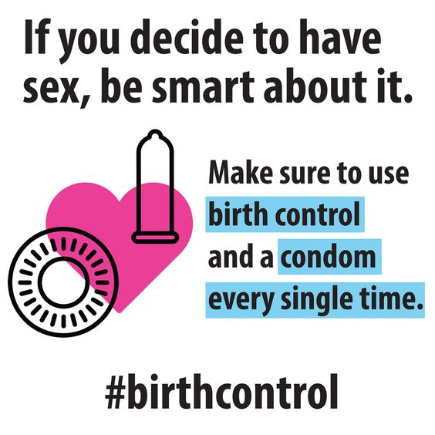
Affirmation and Education
Give positive reinforcement whenever possible!
  She used condoms 2 of the times!
  She came in to discuss birth control methods!
Avoid judgment
Encourage dual use, or use of both a contraceptive and a barrier method
Notes:
“Although the perfect use failure rate of condoms is 2%, the typical use failure rate is 18% for all users and can be higher among adolescents. The high typical use failure rate, coupled with the condom’s high STI protection, has led to the recommendation for dual contraception: condoms plus a highly effective hormonal or other long-acting method.”
AAP Policy Statement: Contraception for Adolescents, 2014. https://pediatrics.aappublications.org/content/pediatrics/early/2014/09/24/peds.2014-2299.full.pdf

Slide 19
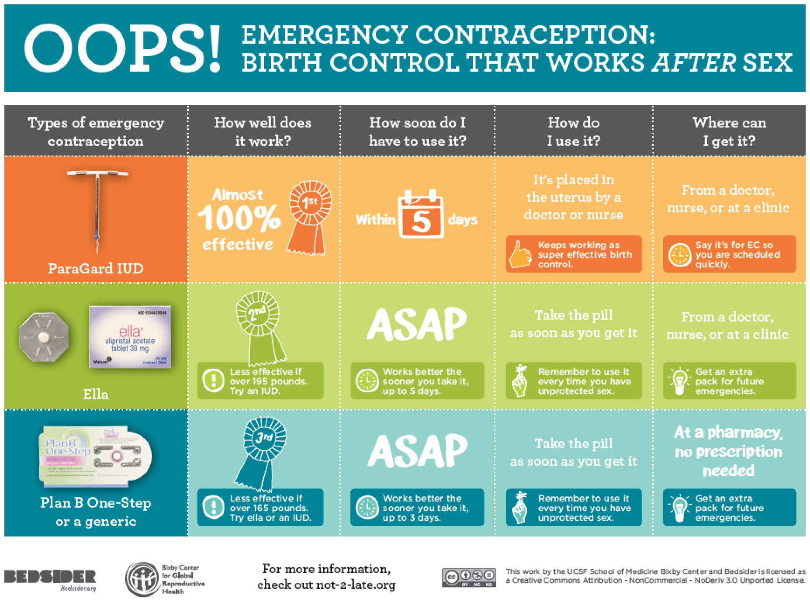
Does she need emergency contraception?
If she has had sex without a condom in the past 5 days, she should be offered emergency contraception
Notes:
“Although the perfect use failure rate of condoms is 2%, the typical use failure rate is 18% for all users and can be higher among adolescents. The high typical use failure rate, coupled with the condom’s high STI protection, has led to the recommendation for dual contraception: condoms plus a highly effective hormonal or other long-acting method.”
AAP Policy Statement: Contraception for Adolescents, 2014. https://pediatrics.aappublications.org/content/pediatrics/early/2014/09/24/peds.2014-2299.full.pdf

Slide 20
Emergency Contraception Available in the US:
Paragard IntraUterine Device (IUD) | ella: ulipristal acetate | Levonorgestrel Emergency Contraception: Plan B One-Step and others
Inserted by a healthcare provider | Prescription required | No prescription required, available at most pharmacies
Most effective method – prevents 99% of pregnancies | 2nd most effective method | 3rd most effective method
May be used up to 5 days after intercourse, effectiveness doesn’t decrease over time | May be used up to 5 days after intercourse, effectiveness doesn’t decrease over time | Most effective in the first 3 days, may be used up to 5 days after intercourse
Effectiveness not affected by body weight | May be less effective in patients weighing over 195 pounds | May be less effective in patients weighing over 165 pounds
Notes:
ACOG guidelines (updated 2019) https://www.acog.org/clinical/clinical-guidance/practice-bulletin/articles/2015/09/emergency-contraception
The following conclusions are based on good and consistent scientific evidence (Level A):
Ulipristal acetate is more effective than the levonorgestrel-only regimen and maintains its efficacy for up to 5 days.
The levonorgestrel-only regimen for emergency contraception is more effective than the combined hormonal regimen and is associated with less nausea and vomiting.
Insertion of a copper IUD is the most effective method of emergency contraception.
The following recommendations are based on limited or inconsistent scientific evidence (Level B):
No clinical examination or pregnancy testing is necessary before provision or prescription of emergency contraception.
Treatment with emergency contraception should be initiated as soon as possible after unprotected or inadequately protected sexual intercourse to maximize efficacy.
Emergency contraceptive pills or the copper IUD should be made available to patients who request it up to 5 days after unprotected or inadequately protected sexual intercourse.
Body weight influences the effectiveness of oral emergency contraception. The efficacy of the copper IUD is not affected by body weight. Therefore, consideration should be given to use of a copper IUD as an alternative to oral emergency contraception in obese women. However, oral emergency contraception should not be withheld from women who are overweight or obese.
The following recommendations are based primarily on consensus and expert opinion (Level C):
Any emergency contraceptive regimen may be made available to women with contraindications to the use of conventional oral contraceptive preparations.
To maximize effectiveness, women should be educated about the availability of emergency contraception in advance of need.
Information regarding effective long-term contraceptive methods should be made available whenever a woman requests emergency contraception.
Oral emergency contraception may be used more than once, even within the same menstrual cycle.
Clinical evaluation is indicated for women who have used emergency contraception if menses are delayed by a week or more after the expected time or if lower abdominal pain or persistent irregular bleeding develops.
The copper IUD is appropriate for use as emergency contraception in women who meet standard criteria for an IUD and who desire long-acting contraception.

Slide 21
Case example: Angela
Angela informs you that she last had unprotected sex two weeks ago.
You do a urine pregnancy test. The result is negative.
Does she need a pelvic exam before starting a contraceptive method?
Notes:
Pap screen and pelvic exam are NOT required before starting contraception.
https://www.cdc.gov/reproductivehealth/contraception/mmwr/spr/appendixc.html

Slide 22
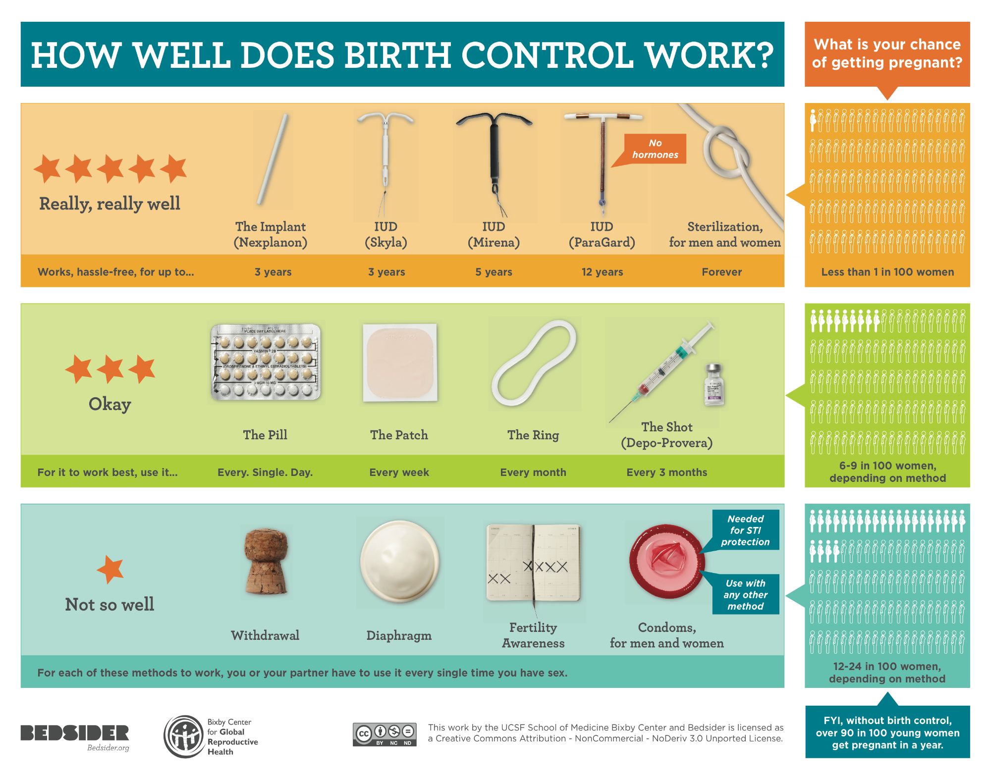
Birth Control Overview
Notes:
Chart available from www.bedsider.org.

Slide 23
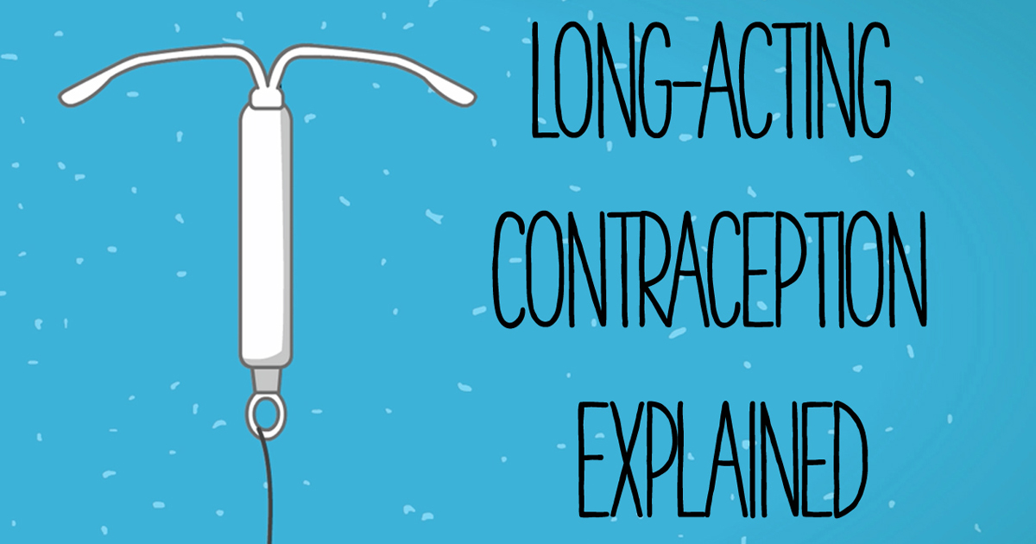
Long-Acting Reversible Contraception (LARC)

Slide 24
Long-Acting Reversible Contraception (LARC)
Includes IUDs and implants
Most effective methods: >99%
Safest
  No estrogen
  Contraindications rare
Highest patient satisfaction
  (80% LARC vs 50% short acting)
Highest continuation rates
  (86% LARC vs. 55% short acting)
Long-term protection—lasts 3-12 years
Rapid return of fertility
Most cost effective
Least likely to be used by teens
Notes:
Source: Secura GM. The Contraceptive Choice Project. Am J Obstet Gyn. 2011.
9,256 women from St Louis—over 4 years
Short acting methods (pill, patch, ring, depo shot)
Continuation rates were at 1 year (88% Mirena®/84% Paragard®/83% Implanon®)

Slide 25
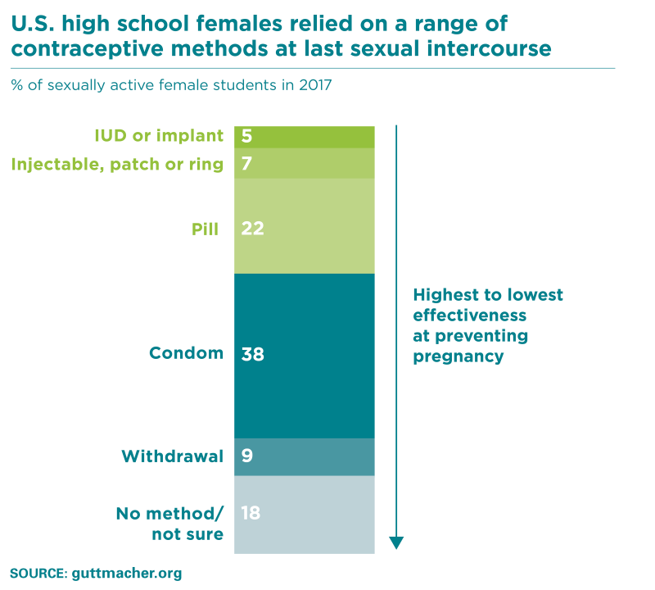
LARC Use Among Adolescents
Notes:
Source: Witwer E, Jones RK & Lindberg LD. Sexual Behavior and Contraceptive and Condom Use Among U.S. High School Students, 2013‒2017. Guttmacher Institute, September 2018. https://www.guttmacher.org/report/sexual-behavior-contraceptive-condom-use-us-high-school-students-2013-2017
While there was no shift in female students’ overall contraceptive use between 2013 and 2017, there was a significant increase in the use of IUDs and implants (from 2% to 5%).

Slide 26
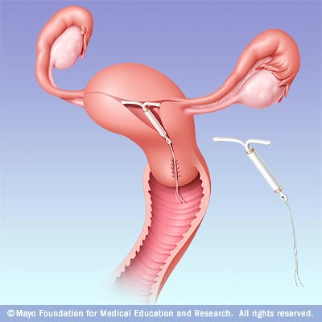
Levonorgestrel IUDs
    Multiple versions on the market
    Provide a steady dose of progestin
May be used from 3-7 years
Requires a doctor visit for removal
Cost : up to $858, some are much less expensive (Liletta) – most insurances cover the costs
Most will cause irregular bleeding initially
Many will make periods lighter and some cause periods to stop altogether
Notes:
The first LNG IUS (Mirena) became available in U.S. in 2001. It is a long-acting, progestin-only intrauterine contraceptive method.
Provides highly effective contraceptive protection for five years.
The T-shaped reservoir placed within the uterine cavity releases a steady dose of levonorgestrel (a progestin hormone).
LNG IUS requires an office visit for insertion and an office visit for removal.
Mechanism of Action:
LNG IUS thickens the cervical mucus and inhibits sperm motility and function.
Candidates:
All women of reproductive age who are seeking a long-term, highly effective contraceptive.
IUD is especially appropriate for:
Women who are looking for a convenient method.
Women with menstrual symptoms that may improve with LNG IUS. Similar to long-acting, progestin-only DMPA, use of the LNG IUS generally improves menorrhagia, dysmenorrhea, and anemia.
Lactating women.

Slide 27
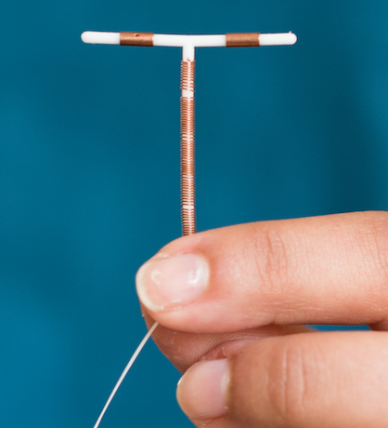
Copper T IUD: Paragard®
Works by copper ions – does not contain hormones
Approved for 10 years use
  Acceptable duration up to 12 years
Cost: ~$150-$475 – most insurances cover the costs
99% effective as EC
Bleeding Pattern:
  Menses regular
  May be heavier, longer, crampier for first 6 months
Notes:
The Copper T 380A IUD is a small T-shaped device made of polyethylene. The device has two flexible arms that fold down for insertion and expand to form a T shape when released inside the uterus. The vertical stem of the device is wound with fine copper wire, and the two horizontal arms also have a sleeve of cooper. At the bottom of the vertical stem, a 3-mm bulb houses a monofilament poyethylene string that enables the device’s easy removal.
The arms of the Copper-T IUD are wrapped with copper wire, which acts as a functional spermicide. There is clear evidence that IUDs are not abortifacients. They prevent pregnancy by preventing fertilization.
The Copper-T IUD is approved for 10 years of use; however, efficacy lasts 12 years or more.
Mechanism of Action:
Cooper-containing IUDs reduce the motility and viability of the sperm and the development of ova.
Research shows that sperm counts found in the cervical mucus and uterine tube are much lower in women using IUDs than those in non-users.
A clinical study found that women using copper-containing IUDs had uncoordinated contractions, which suggests that the device may act by hindering sperm transport.
Candidates:
Women who desire long-term contraception.
Women who do not want the systematic effects of hormones.
Women who desire a quickly reversible method

Slide 28
Which kind of IUD is the best choice?
Copper T IUD |  | Levonorgestrel IUD
Patient wants regular periods Patient doesn’t want hormones Patient has no history of heavy or painful periods |  | Patient is ok with irregular bleeding Patient is ok with amenorrhea Patient has a history of heavy or painful periods
Notes:
The Copper T 380A IUD is a small T-shaped device made of polyethylene. The device has two flexible arms that fold down for insertion and expand to form a T shape when released inside the uterus. The vertical stem of the device is wound with fine copper wire, and the two horizontal arms also have a sleeve of cooper. At the bottom of the vertical stem, a 3-mm bulb houses a monofilament poyethylene string that enables the device’s easy removal.
The arms of the Copper-T IUD are wrapped with copper wire, which acts as a functional spermicide. There is clear evidence that IUDs are not abortifacients. They prevent pregnancy by preventing fertilization.
The Copper-T IUD is approved for 10 years of use; however, efficacy lasts 12 years or more.
Mechanism of Action:
Cooper-containing IUDs reduce the motility and viability of the sperm and the development of ova.
Research shows that sperm counts found in the cervical mucus and uterine tube are much lower in women using IUDs than those in non-users.
A clinical study found that women using copper-containing IUDs had uncoordinated contractions, which suggests that the device may act by hindering sperm transport.
Candidates:
Women who desire long-term contraception.
Women who do not want the systematic effects of hormones.
Women who desire a quickly reversible method
Advantages
Fertility returns rapidly after removal of the copper IUD.
There is no ongoing cost after insertion.
The Cooper-T IUD may be associated with a decreased risk for endometrial cancer, but the exact mechanism for this association is unclear.
Contraindications (WHO Criteria): same as Mirena
Disadvantages
Menstrual changes
The Copper T IUD can increase the duration and amount of menstrual flow and menstrual cramping.
Expulsion is rare, occurring in only 5% of users, but is the most likely cause of IUC failure. Expulsion is most common within the first three months after insertion.
Uterine perforation is a rare complication of IUC, occurring approximately once every 770 to 1600 insertions. Perforation generally occurs at insertion, when a portion of the device becomes embedded in the uterine wall.
There’s a possible increased risk of PID during early post-insertion period in women with cervical infections.
Studies suggest that women with chlamydial infection or gonorrhea at the time of IUD insertion were at an increased risk of PID relative to women without infection. The absolute risk of PID was low for both groups (0%–5% for those with STIs and 0%–2% for those without).
Counseling:
Inform women that IUDs do not cause an increased risk of STIs, tubal infertility, and ectopic pregnancies.
Describe how to check for the string, follow-up visits, and warning signs.
References
Beining RM, Dennis LK, Smith LK, Smith EM, Dokras A. Meta-Analysis of Intrauterine Device Use and Risk of endometrial cancer. Ann Epidemiol. 2008.
Fortney JA, Feldblum PJ, Raymond EG. Intrauterine Devices. J Reprod Med. 1999. March;44(3):269–274.
Larsson G, Milsom I, Jonasson K, Lindstedt G, Rybo G. The long-term effects of copper surface area on menstrual blood loss and iron status in women fitted with an IUD. Contraception. 1993;48(5):471–80.
Maslow KD, Lyons EA. Effect of oral contraceptives and intrauterine devices on midcycle myometrial contractions. Fertil Steril. 2003;80(5):1224–7.
Milsom I, Rybo G, Lindstedt G. The influence of copper surface area on menstrual blood loss and iron status in women fitted with an IUD. Contraception. 1990;41(3):271–81.20.
Mohllajee AP, Curtis KM, Peterson HB. Does insertion and use of an intrauterine device increase the risk of pelvic inflammatory disease among women with sexually transmitted infection? A systematic review. Contraception. 2006 Feb;73(2):145–53
Nelson AL. The intrauterine contraceptive device. Obstet Gynecol Clin North Am. 2000;27(4):723–40.12.
Thonneau PF, Almont TE. Contraceptive efficacy of intrauterine devices. Am J Obstet Gynecol. 2008. March;198(3): 248–253.
Trussel J. Contraceptive efficacy. In: Hatcher RA, Trussel J, Nelson AL, et al. Contraceptive Technology: 19th revised ed. New York, NY: Ardent Media, 2007.
WHO Medical Eligibility Criteria for Contraceptive Use, 3rd edition 2004.

Slide 29

Implant: Nexplanon®
Progesterone only (etonogestrel)
FDA approved for 3 years
  Proven effective for up to 5 years
Cost: ~$300–$600 – most insurances cover the cost
Mechanism: Inhibits ovulation
Bleeding pattern:
  Causes irregular bleeding initially, which usually improves by 3-6 months
  22% eventually become amenorrheic
  11% discontinue use due
  to irregular bleeding
Notes:
Note: The original version of the implant was called Implanon. The current version is referred to as Nexplanon.
Nexmplanon, an etonogestrel implant, is used by more than 2 million women in European and Asian countries and is now available in the United States.
One rod is 40 mm x 2 mm and its core is 40% ethylene vinyl acetate (EVA) and 60% etonogestrel. It has a rate-controlling membrane of 100% EVA
Because contraceptive implants do not contain estrogen, they can be used during lactation as soon as six weeks postpartum. This feature may be especially attractive to women with young infants who want highly effective contraception that does not require daily action.
The effectiveness of implants in overweight women has not been determined; women who weighed more than 130% of their ideal body weight were not studied.
Mechanism of Action:
The multiple-rod implant relies on ovulation inhibition for contraceptive action for the first 3 months of use, then on thicker cervical mucus after three months of use. In contrast, the single-rod implant continues to rely on ovulation inhibition over the entire duration of use.
Candidates:
Almost all women of childbearing age who desire long-term contraception. Appropriate for adolescents and women who have never given birth

Slide 30

Short-Acting Reversible Contraception: Combined Hormonal Methods

Slide 31
Combined Hormonal Contraception
Estrogen
  Inhibits follicle stimulating hormone and luteinizing hormone
  Inhibits ovulation
Progesterone
  Thickens cervical mucus to prevent sperm penetration
  Inhibits capacitation of sperm
Includes oral contraceptive pills, contraceptive patch, intravaginal ring
Notes:
COCs are effective because they can prevent pregnancy through three means. Primarily, combined oral contraceptives prevent pregnancy by suppressing ovulation. They do this by inhibiting the production of both follicle stimulating hormone (FSH) and luteinizing hormone (LH). The progestins in COCs provide secondary mechanisms that include altering the cervical mucus to prevent sperm penetration.
Source: Goldzieher JW. The hypothalamo-pituitary-ovarian system. Pharmacology of the Contraceptive Steroids. (New York: Raven Press, 1994)185–98.

Slide 32
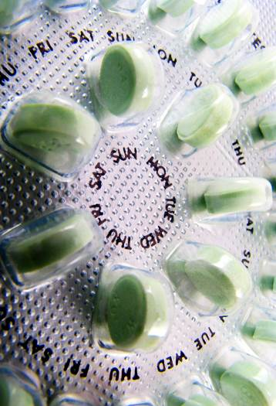
Combined Oral Contraceptive Pills
Contain estrogen & a progestin, in varying doses
Most include 21 days of active pills and 7 days of placebo pills to allow for withdrawal bleeding
Primary mechanism: Inhibits ovulation
Notes:
Counseling:
- Works by stopping your ovaries from releasing eggs so that you cannot get pregnant
- Between 91-93% effective with typical use (99.7% with perfect use)
HOW DO I START THE PILL?
There are 2 ways to start the pill:
Quick Start: Take your first pill as soon as you get the pack.
Next period: Take your first pill soon after your next period begins.
If you take your first pill up to 5 days after the start of your period, you are protected against pregnancy right away.
If you take your first pill more than 5 days after the start of your period, you should use condoms as back-up for the first 7 days.
HOW DO I USE THE PILL?
Once you start using the pill, take 1 pill each day. Take your pill at the same time each day.
Try to take your pill at the same time you do something else in your daily routine, like brushing your teeth. You can also set a reminder for yourself or use an app or service to remind you to take your pill.
After you finish a pack of pills, you should start a new pack the next day. You should have NO day without a pill.
WHAT IF I MISS PILLS?
I forgot ONE pill: Take your pill as soon as you can.
I forgot TWO pills or more: Take your pill as soon as you can. Take your next pill at the usual time. Use condoms for 7 days. Use emergency contraception (EC) if you have unprotected sex.
WHAT IF I STOPPED TAKING THE PILL AND HAD UNPROTECTED SEX?
Take Emergency Contraception (EC) right away. EC can prevent pregnancy up to 5 days after sex, and it works better the sooner you take it.
HOW DOES THE PILL HELP ME?
The pill is safe and effective birth control.
Your periods may be more regular, lighter, and shorter
You may have clearer skin if you have acne.
The pill lowers your risk of getting cancer of the uterus and ovaries
The pill may offer protection against iron deficiency anemia, ovarian cysts and pelvic inflammatory disease
The pill has no effect on your ability to get pregnant in the future, after you stop taking it.
WHAT ARE SIDE EFFECTS OF THE PILL?
Most users have no side effects
In the first 2-3 months you may have nausea, bleeding between periods, and/or breast pain. These problems often go away after 2-3 months.
DOES THE PILL HAVE RISKS?
The pill is very safe. Serious problems are rare. If you have any of the symptoms below, call
your health provider.
Leg pain, swelling, and redness
Weakness or numbness on 1 side of your body
Bad headaches
Vision problems
Chest pain
Sources:
Fact Sheet: The Pill. Reproductive Health Access Project, updated October 2019. Available from https://www.reproductiveaccess.org/wp-content/uploads/2014/12/factsheet_pill.pdf
Birth Control Methods: The Pill. Bedsider. Available from https://www.bedsider.org/methods/the_pill#details

Slide 33
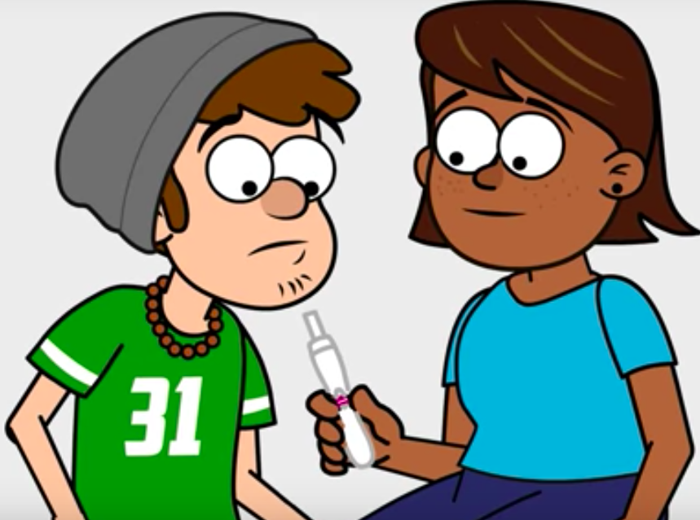
Failure Rate for Combined Oral Contraceptives
Perfect use: 0.3%
Failure rates for typical use by adolescents and adults vary widely across studies and by demographic characteristics such as age, race, marital status and poverty status
Typical adult use: 9% (range from 4.1-10.4%)*
Typical adolescent use: 8% (range 6.6-9.2%)*
*Estimates from the 2006-2010 National Survey of Family Growth
Notes:
When used correctly and consistently, the failure rate for combined oral contraceptive pills is <1%, but, because the pill requires daily maintenance, efficacy rates vary widely for both adolescent and adult users.
Failure rate = percentage of users experiencing unintended pregnancy within the first 12 months of typical use
In general, failure rate is lowest for women ages 30-44 at 4.1% and highest for women ages 25-29 at 10.4%
Sources:
1. Sundaram A, Vaughan B, Kost K, et al. Contraceptive Failure in the United States: Estimates from the 2006-2010 National Survey of Family Growth. Perspect Sex Reprod Health. 2017;49(1):7-16. doi:10.1363/psrh.12017
2. Trussell J. Contraceptive failure in the United States. Contraception. 2011;83(5):397-404. doi:10.1016/j.contraception.2011.01.021

Slide 34
Counseling for combined oral contraceptives
Remember to take a pill every day and to start a new pack the day after finishing a pack
If the user forgets 1 pill, they should take their pill as soon as they remember, and take the next pill on time
If the user forgets more than 1 pill, they should take a pill as soon as they remember, and continue taking them daily, and also use condoms as back-up protection for 7 days
Notes:
https://www.reproductiveaccess.org/wp-content/uploads/2014/12/factsheet_pill.pdf

Slide 35
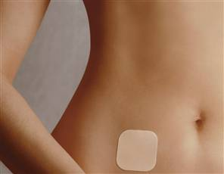
Transdermal Patch: XulaneTM
Estrogen and progestin
Beige-colored patch changed once per week
3 weeks on/1 week off
9 days of medication in each patch
Mechanism: Inhibits ovulation
99% effective with perfect use, less effective if used imperfectly
Notes:
HOW DOES THE PATCH WORK?
• The patch contains hormones like the ones your body makes. These hormones stop your ovaries
from releasing eggs. Without an egg, you can’t get pregnant.
• Between 91-93% effective with typical use (99.7% with perfect use)
HOW DO I START THE PATCH?
• There are 2 ways to start the patch:
- Quick Start: Put on your first patch as soon as you get the pack.
- Next period: Put on your first patch soon after your next period begins.
• If you put on your first patch up to 5 days after the start of your period, you are protected against
pregnancy right away.
• If you put on your first patch more than 5 days after the start of your period, you should use
condoms as back-up for the first 7 days.
HOW DO I USE THE PATCH?
• The patch is like a sticker you wear on your skin for a week. You can wear the patch anywhere on
your skin except your breasts, your genitals, palms of your hands or soles of your feet.
• Choose a spot on your body where you can see the patch if it falls off. Place the patch on a clean,
dry area and make sure the edges stick well.
• You will use a new patch every week for 3 weeks and no patch for the 4th week.
• Expect your period during the patch-free week. (You may have a light period or no period at all.)
• Start a new box of patches at the end of the 4th week.
WHAT IF THE PATCH COMES OFF?
• If the patch comes off, put it back on right away. If it does not stick, use a new patch.
• If the patch falls off for more than a day, put on a new patch and use condoms for the next 7 days.
• Put on your next patch a week from the date of this new patch.
WHAT IF I FORGET TO CHANGE THE PATCH AFTER 7 DAYS?
• The patch has enough hormones for 9 days. If you leave the patch on for 9 days or less, just put on
a new patch.
• If you leave the patch on for more than 9 days, put on a new patch and use condoms for the next 7 days.
WHAT IF I STOPPED USING THE PATCH AND HAD UNPROTECTED SEX?
• Take Emergency Contraception (EC) right away. EC can prevent pregnancy up to 5 days after sex,
and it works better the sooner you take it.
HOW DOES THE PATCH HELP ME?
The patch is safe and effective birth control.
Your periods may be more regular, lighter, and shorter
You may have clearer skin if you have acne.
The patch lowers your risk of getting cancer of the uterus and ovaries
The patch may offer protection against iron deficiency anemia, ovarian cysts and pelvic inflammatory disease
The patch has no effect on your ability to get pregnant in the future, after you stop taking it.
WHAT ARE SIDE EFFECTS OF THE PATCH?
Most users have no side effects
In the first 2-3 months you may have nausea, bleeding between periods, and/or breast pain. These problems often go away after 2-3 months.
You may have irritation where the patch sits on your skin
DOES THE PATCH HAVE RISKS?
The patch is very safe. Serious problems are rare. If you have any of the symptoms below, call
your health provider.
Leg pain, swelling, and redness
Weakness or numbness on 1 side of your body
Bad headaches
Vision problems
Chest pain
Sources:
Fact Sheet: The Patch. Reproductive Health Access Project, updated July 2015. https://www.reproductiveaccess.org/wp-content/uploads/2014/12/factsheet_patch.pdf
Birth Control Methods: The Patch. Bedsider. Available from https://www.bedsider.org/methods/the_patch#details

Slide 36
Counseling for the patch
Stick to clean, dry skin on arm, torso, buttocks or stomach – NOT on breast
Change patch weekly for 3 weeks, with no patch during week 4
Apply a new patch and use condoms for 7 days if:
  One patch is worn for more than 9 days (i.e. forgetting to change patch)
  Patch is off for more than 7 days during the patch-free week
  Patch falls off for more than 24 hours
Notes:
Extended cycling is also a safe and effective option with the patch.
Sources:
Edelman A, Gallo MF, Jensen JT, Nichols MD, Grimes DA. Continuous or extended cycle vs. cyclic use of combined hormonal contraceptives for contraception. Cochrane Database of Systematic Reviews 2005, Issue 3. Art. No.: CD004695. DOI: 10.1002/14651858.CD004695.pub2.
Nanda K. Contraceptive Patch and Vaginal Contraceptive Ring. In: Hatcher RA, Trussell J, Nelson A, Cates W, Stewart F, Kowal D. (editors) Contraceptive Technology, 19th revised edition. New York: Ardent Media, 2007

Slide 37

Contraceptive Vaginal Ring
Estrogen and progestin
Soft, flexible rubber ring placed in vagina
Stays in place for 3 weeks, then 1 week with no ring
NuvaRing®
  Each ring contains 4 weeks of medication
  Continuous use: change 1st day of each month
Annovera®
  3 weeks in, 1 week out
  Reuse for 1 year
Mechanism: inhibits ovulation
Notes:
HOW DOES THE RING WORK?
• The ring contains hormones like the ones your body makes. These hormones stop your ovaries
from releasing eggs. Without an egg, you cannot get pregnant.
• Between 91-93% effective with typical use (99.7% effective with perfect use)
HOW DO I START THE RING?
• There are 2 ways to start the ring:
- Quick Start: put in your first ring as soon as you get the pack.
- Next period: put in your first ring soon after your next period begins.
• If you put your first ring in up to 5 days after the start of your period, you are protected against
pregnancy right away.
• If you put your first ring in more than 5 days after the start of your period, you should use
condoms as back-up for the first 7 days.
HOW DO I USE THE RING?
• The ring is a small, bendable, plastic circle that you insert into your vagina.
The ring is easy to insert; there is no wrong way to insert it.
The ring can be placed anywhere in the vagina, but the deeper it’s placed, the less likely it will be felt.
• You leave the ring in your vagina for 3 weeks, and remove it for the 4th week.
• Remove the ring by hooking a finger under the rim and pulling it out.
• Most women get their period during the ring-free week.
• Insert a new ring (or the same ring if using Annovera) at the end of the 4th week.
• You can store the ring at room temperature up to four months. In the refrigerator, the ring lasts
much longer.
DO I HAVE TO GET A PERIOD?
• Because the ring has enough hormones to last 35 days, you can leave it in for more than 3
weeks. You can change the ring on the same day of each month (for instance, March 1st, April 1st,
May 1st, etc.). If you remove the old ring and insert the new ring on the same day, you may not
get a period. This is OK.
WHAT IF THE RING COMES OUT?
• The ring may slip out during sex or when you use the bathroom. The ring can stay out of your
body for up to 3 hours and still prevent pregnancy. If the ring is out of your body for more than 3
hours, you should put it back into your vagina and use condoms for the next 7 days.
WHAT IF I STOPPED USING THE RING AND HAD UNPROTECTED SEX?
• Take Emergency Contraception (EC) right away. EC can prevent pregnancy up to 5 days after sex,
and it works better the sooner you take it.
HOW DOES THE RING HELP ME?
• The ring is safe and effective birth control. Your periods may be more regular, lighter, and shorter.
You may have clearer skin if you have acne.
The ring lowers your risk of getting cancer of the uterus and ovaries.
The ring may offer protection against iron deficiency anemia, ovarian cysts and pelvic inflammatory disease
The ring has no effect on your ability to get pregnant in the future, after you stop using it.
WHAT ARE SIDE EFFECTS OF THE RING?
Most users have no side effects
In the first 2-3 months you may have nausea, bleeding between periods, and/or breast pain. These problems often go away after 2-3 months.
Sometimes the ring can cause increased vaginal discharge, irritation or infection
DOES THE RING HAVE RISKS?
• The ring is very safe. Serious problems are rare. If you have any of the symptoms below, call your
health provider:
- Leg pain, swelling, and redness
- Weakness or numbness on 1 side of your body
- Bad headache
- Vision problems
- Chest pain
Sources:
Fact Sheet: The Ring. Reproductive Health Access Project, updated July 2015. https://www.reproductiveaccess.org/wp-content/uploads/2015/03/factsheet_ring.pdf
Birth Control Methods: The Ring. Bedsider. Available from https://www.bedsider.org/methods/the_ring#details

Slide 38
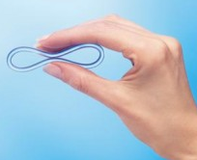
Counseling for the ring
Insert the ring by pinching two sides of the circle together and sliding it into the vagina
Remove by inserting a finger into the vagina, hooking the ring, and gently pulling it out

Slide 39
Counseling for the ring
If NuvaRing® falls out:
  During week 1 or 2, simply reinsert
  During week 3, may insert a new ring (to be left in for 3 weeks) or leave it out and have a withdrawal bleed, then insert new ring 7 days later
  Use condoms for 7 days as back-up protection
If Annovera® falls out for more than 2 hours, simply reinsert and use condoms for 7 days as back-up protection
Notes:
NuvaRing can safely be removed for up to three hours at a time. If it is out of the body for more than three hours, guidelines differ depending on timing within the cycle. During the first “ring in” weeks, she can reinsert an expelled ring. During week three, she can either insert a new ring right away or start the withdrawal bleed and insert a new ring seven days after the last one was removed/expelled. With any of these options, she should use another backup method of birth control for seven days.
Extended cycling is also a safe and effective option with NuvaRing.
”During the 21 days of continuous use, if ANNOVERA™ is out of the vagina for more than 2 continuous hours or more than 2 cumulative hours (multiple inadvertent removals or expulsions adding up to 2 hours), then back-up contraception, such as male condoms or spermicide, should be used until the vaginal system has been in the vagina for 7 consecutive days.”
Sources:
Nanda K. Contraceptive Patch and Vaginal Contraceptive Ring. In: Hatcher RA, Trussell J, Nelson A, Cates W, Stewart F, Kowal D. (editors) Contraceptive Technology, 19th revised edition. New York: Ardent Media, 2007
Edelman A, Gallo MF, Jensen JT, Nichols MD, Grimes DA. Continuous or extended cycle vs. cyclic use of combined
hormonal contraceptives for contraception. Cochrane Database of Systematic Reviews 2005, Issue 3. Art. No.: CD004695. DOI:
10.1002/14651858.CD004695.pub2.
FDA label for ANNOVERA™ (segesterone acetate and ethinyl estradiol vaginal system). https://www.accessdata.fda.gov/drugsatfda_docs/label/2018/209627s000lbl.pdf

Slide 40
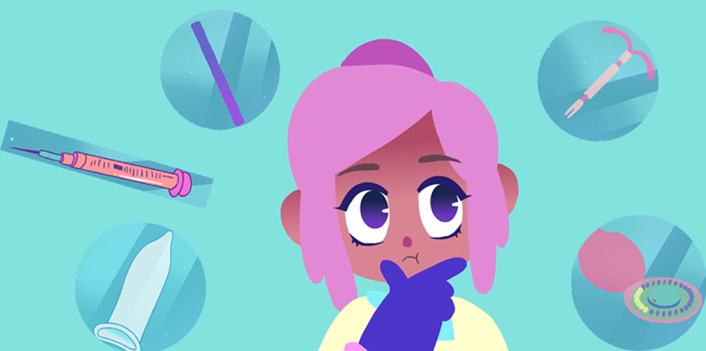
Short-Acting Reversible Contraception: Progestin-only Methods

Slide 41
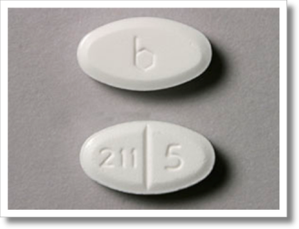
Progestin-Only Oral Contraceptive Pills
Sometimes called the “mini-pill”
Multiple formulations available
No placebo week
Mechanism: Multiple mechanisms, but primarily thickens cervical mucous
Generally best if taken at the same time every day
  New formulation, “Slynd” does not need to be taken at the same time each day
May cause irregular bleeding
Notes:
HOW DOES THE MINI-PILL WORK?
• The mini-pill contains a hormone like the ones your body makes. It works by making the
mucus in your cervix too thick for sperm to pass through. If sperm cannot reach the egg,
you cannot get pregnant.
• The mini-pill is 91% effective with typical use
HOW DO I START THE MINI-PILL?
• There are 2 ways to start the pill:
- Quick Start: Take your first pill as soon as you get the pack.
- Next period: Take your first pill soon after your next period begins.
• If you take your first pill up to 5 days after the start of your period, you are protected
against pregnancy right away.
• If you take your first pill more than 5 days after the start of your period, you should use
condoms as back-up for the first 7 days.
HOW DO I USE THE MINI-PILL?
• Once you start using the pill, take 1 pill each day. Take your pill at the same time each day.
• After you finish a pack of pills, you should start a new pack the next day. You should have NO day without a pill.
WHAT IF I MISS MINI-PILLS?
• I forgot ONE pill: Take your pill as soon as you can. If you take your pill more than 3 hours late, use condoms for the next 7 days.
• I forgot TWO pills or more: Take your pill as soon as you can. Take your next pill at the usual time. Use condoms for the next 7 days. Use emergency contraception (EC) if you have unprotected sex.
WHAT IF I STOPPED TAKING THE MINI-PILL AND HAD UNPROTECTED SEX?
• Take Emergency Contraception (EC) right away. EC can prevent pregnancy up to 5 days after sex, and it works better the sooner you take it.
HOW DOES THE MINI-PILL HELP ME?
• The mini-pill is safe and effective birth control.
The mini-pill is safe for you to use while breastfeeding, or if you are at high risk for blood clots, heart disease or strokes.
• The mini-pill has no effect on your ability to get pregnant in the future, after you stop taking it.
HOW WILL I FEEL ON THE MINI-PILL?
• You will feel about the same. Most people notice changes in their periods.
You may have spotting or no period at all. This is normal. You may have nausea, spotting, weight change, and/or breast pain. These problems often go away after 2-3 months.
DOES THE MINI-PILL HAVE RISKS?
• The mini-pill is very safe.
Sources:
Fact Sheet: Progesterone-Only/Mini-pill. Reproductive Health Access Project, updated August 2019. https://www.reproductiveaccess.org/wp-content/uploads/2015/03/factsheet_mini-pill.pdf

Slide 42
Counseling for the progestin-only pill
Try to take at the same time every day
If 1 pill is more than 3 hours late, take pill as soon as possible and use condoms as back-up protection for 7 days
If more than 1 pill is missed, take pill as soon as possible, take subsequent pills daily as usual, and use condoms as back-up protection for 7 days
Notes:
A new formulation, Slynd (drosperinone), allows users to be up to 24 hours late in taking a pill without compromising effectiveness

Slide 43
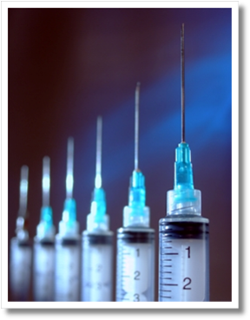
Injectable: Depo-Provera®
Progestin only
Intramuscular or subcutaneous injection every 3 months (14 weeks)
Mechanism: Inhibits ovulation
May temporarily decrease bone density, but density returns to normal after stopping injections
Can take up to 9 months for fertility to return
Notes:
HOW DOES DEPO WORK?
• Depo contains a hormone like the ones your body makes. This hormone stops
your ovaries from releasing eggs. Without an egg, you cannot get pregnant.
• Depo is 96% effective with typical use (99.8% with perfect use)
HOW DO I USE DEPO?
• You get a Depo injection in the arm or in the buttocks.
• Use condoms as back-up the first 7 days after your first shot of Depo.
• You should get a shot every 3 months (every 12 weeks).
WHAT IF I AM LATE FOR THE NEXT SHOT?
• Depo works best if you get a new shot every 12 weeks.
• If your shot is more than 4 weeks late, you should get a pregnancy test before
the next shot. You should use condoms for the next 7 days.
WHAT IF I AM LATE GETTING A SHOT AND HAD UNPROTECTED SEX?
• If your last shot was more than 16 weeks ago, take Emergency Contraception (EC) right after unprotected sex. EC can prevent pregnancy up to 5 days after sex, and it works better the sooner you take it.
HOW DOES DEPO HELP ME?
Depo is safe and effective.
It keeps you from getting pregnant for 3 months.
The shot lowers your risk of cancer of the uterus.
It is safe to use Depo while breastfeeding, or if you are at high risk for blood clots, heart disease or stroke.
The shot may give you shorter, lighter periods or no periods at all
Depo is very private, no one will know you use it unless you tell them
WHAT ARE SIDE EFFECTS OF DEPO?
• You will most likely have spotting between periods or irregular bleeding, especially for the first 6-12 months.
You may have weight gain, bloating, headaches and/or mood changes. Talk to your health care provider
about treating any side effects.
• After the first 2-3 shots, you may have no period at all. This is normal.
• Your bones may become slightly weaker while you take Depo. Bone strength returns to normal once you stop getting the shot.
• After you stop Depo, it takes a few months for your fertility to return to normal.
This means that it may take a while for you to get pregnant (even if you’re trying), but if you don’t want to get pregnant, you need to use a new form of birth control after you stop Depo.
DOES DEPO HAVE RISKS?
• The shot is very safe. Severe problems are rare. If you have any of the symptoms
below, call your doctor:
- Severe headaches
- Very heavy bleeding
Sources:
Fact Sheet: The Shot/Depo-Provera. Reproductive Health Access Project, updated July 2015. https://www.reproductiveaccess.org/wp-content/uploads/2016/07/factsheet_depo.pdf
Birth Control Methods: The Shot. Bedsider. Available from https://www.bedsider.org/methods/the_shot#details

Slide 44
Counseling for injectable contraception
Important to get repeat injections every 12-14 weeks
Likely to have unpredictable or prolonged spotting in first 3-6 months
Periods usually get shorter and lighter over time, and some patients stop having periods
If getting a shot late, get a pregnancy test first and use condoms as back-up protection for 7 days
Notes:
Primarily, women taking DMPA will experience menstrual irregularities.
In the first several months many women experience unpredictable and prolonged spotting. After one year of DMPA use, 40% to 50% of women experience amenorrhea and, after five years, up to 80% no longer menstruate. Research indicates that menstrual disturbances are the most frequent cause of dissatisfaction with this method, causing 20% to 25% of patients to discontinue use.
For teens, it is especially important to discuss potential issues with parents (i.e., no menses).
Providers must candidly discuss a patient’s comfort with initial spotting or irregular bleeding and the eventual lack of periods to ascertain whether DMPA is an acceptable contraceptive choice to her. If, after the first three months, a young woman has concerns about these menstrual irregularities, providers may offer her a short course of exogenous estrogen or a prostaglandin synthetase inhibitor (NSAID), if not contraindicated. These regimens have been shown to decrease bleeding in the short term but menstrual irregularities will most likely return upon discontinuation.
Sources:
Belsey EM. Vaginal bleeding patterns among women using one natural and eight hormonal methods of contraception. Contracetpion 1988;38:181–206.
Polaneczky M, Liblanc M. Long-term depot medroxyprogesterone acetate (Depo-Provider) use in inner-city adolescents. J Adolesc Health 1998;23:81–88.
Potter LS, Dalberth BT, Canamer R, Betz M. Depot medroxyprogesterone acetate. Patterns of use and reasons for discontinuation. Contraception 1997;56:209–214.
Said S, Sadek W, Rocca M, et al. Clinical evaluation of the therapeutic effectiveness of ethinyl oestradiol and oestrone sulphate on prolonged bleeding in women using depot medroxprogesterone acetate for contraception.
World Health Organization, Special Programme of Research, Development and Research Training in HIman Reproduction, Task Force on Long-acting Systemic Agents for Fertility Regulation. Human Reprod 1996;11 Suppl 2:2–13
Tantiwattanakul P, Tneepanichskul S. Effect of mefenamic acid on controlling irregular uterine bleeding in DMPA users. Contraception 2004;70:277–79

Slide 45

Common Myths about Contraception

Slide 46
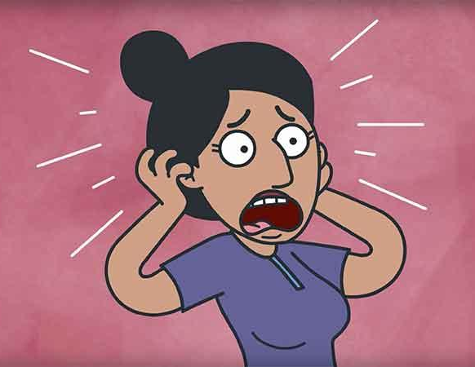
Dispelling Myths
When providers or patients hold misperceptions about the risks associated with contraception, teens’ choices are unnecessarily limited.
What myths have you heard about contraception?

Slide 47

Contraception and Weight Gain
Most contraceptive methods are not associated with weight gain
25% of users of injectable contraceptives will gain weight (average gain 15 lbs)
  Early weight gain at 6 months predicts ongoing weight gain
Notes:
Gallo MF, Lopez LM, Grimes DA, Carayon F, Schulz KF, Helmerhorst FM. Combination contraceptives: effects on weight. Cochrane Database Syst Rev. 2014 Jan 29;(1):CD003987. doi: 10.1002/14651858.CD003987.pub5. PMID: 24477630.

Slide 48
Contraception and Lesbians or Women who have sex with Women
It’s important to screen patients who identify as lesbian or bisexual or as women who have sex with women (WSW) for sexual activity with males, as young women with these identities may still need contraceptive care
Young women who have both male and female sexual partners have higher risk of unintended pregnancy than their peers who only have male partners
Notes:
Note that this study excluded youth who reported only same-gender sexual partners
Lisa L. Lindley and Katrina M. Walsemann, 2015:Sexual Orientation and Risk of Pregnancy Among New York City High-School Students
American Journal of Public Health 105, 1379_1386,https://doi.org/10.2105/AJPH.2015.302553

Slide 49
Contraceptive Efficacy and Weight
Does obesity decrease efficacy?
IUDs | No effect
Implants | No effect
Injectables | No effect
Patch | Data is weak, likely effect is minimal
Conbined Oral Contraceptives | Data is weak, likely effect is minimal
Progestin-only Oral Contraceptives | No effect
Ring | No effect
Emergency Contraception | Efficacy decreased for levonorgestrel (above 165 lb) and ella (above 195 lb)
Notes:
Sources:
1) Xu et al. Obstetrics and Gynecology 2012
SFP: Contraceptive Considerations in Obese Women, Contraception 2009
2) Lopez LM, Bernholc A, Chen M, Grey TW, Otterness C, Westhoff C, Edelman A, Helmerhorst FM. Hormonal contraceptives for contraception in overweight or obese women. Cochrane Database of Systematic Reviews 2016, Issue 8. Art. No.: CD008452. DOI: 10.1002/14651858.CD008452.pub4.
ARSHEP would like to acknowledge Dr. Rachael Phelps for creation of this slide.
EURAS-OC- 59,000 COC users2000-2005 no diferrence in efficacy
ｧ Levonorgestrel Regimens
o obese women (BMI ≥30 kg/m2) were at four-fold higher risk of pregnancy (OR 4.41; 95% CI 2.05–9.44)
o overweight women (BMI 25-29.9 kg/m2) were at two-fold higher risk of pregnancy (OR 2.09; 95% CI 0.86–4.87)
o for overweight and obese women, levonorgestrel use was not associated with a significant reduction in pregnancy rate compared with that expected with no medication.
ｧ Ulipristal acetate
o obese women were at two-fold higher risk of pregnancy (OR 2.62, 95% CI 0.89–7.00).
o Overweight women appeared to have no increase in risk (OR 0.97; 95% CI 0.27–2.83) compared to normal or underweight women using ulipristal acetate

Slide 50
Wrap Up:
Respect adolescent confidentiality, agency and autonomy
Take a full medical and sexual history
Explore patient’s knowledge, experience and preferences regarding contraceptive method choice
Discuss side effects candidly and validate concerns
Encourage dual condom/contraception use
Offer to write an advanced prescription for emergency contraception or instruct on over-the-counter access
✔️

Slide 51
Provider Resources
www.cdc.gov/reproductivehealth/unintendedpregnancy/usmec.htm United States Medical Eligibility Criteria (US MEC) for Contraceptive Use, 2016
store.managingcontraception.com/contraceptive-technology-20th-edition -Contraceptive Technology 20th Edition
www.choiceproject.wustl.edu -Contraceptive Choice Project
bedsider.org –Bedsider
https://powertodecide.org/ - Power to Decide, the campaign to prevent unplanned pregnancy
www.reproductiveaccess.org/key-areas/contraception -Reproductive Health Access Project

Slide 52
Adolescent Reproductive and Sexual Health Education Project (ARSHEP)
Essentials of Contraception and Adolescents
•Open your cell phone camera
•Aim the camera at the QR code
•The survey link will pop up – please click
•Fill out the survey ☺
Notes:
Updated 2020

