Slide 1

Adolescent Reproductive and Sexual Health Education Project (ARSHEP)
Adolescent-Friendly Health Services
Notes:
Updated 2020

Slide 2

Notes:
Advocates for Youth partners with youth leaders, adult allies, and youth-serving organizations to advocate for policies and champion programs that recognize young people’s rights to: honest sexual health information; accessible, confidential and affordable sexual health services; and the resources and opportunities necessary to create sexual health equity for all youth.
Our values are reflected in the 3Rs:
•Youth have the inalienable right to honest sexual health information.
•Youth deserve respect.
•Society has the responsibility to provide young people with tools need to safeguard their sexual health and lead the lives they desire.

Slide 3

This presentation was originally created by Physicians for Reproductive Health as part of the ARSHEP curriculum.

Slide 4
Adolescent Reproductive and Sexual Health Education Project (ARSHEP)
[Faculty Member information goes here}
Notes:
Updated 2020

Slide 5
Acknowledgment
This presentation was made possible by Cooperative Agreement PS18-1807 from the Centers for Disease Control and Prevention, Division of Adolescent and School Health (CDC-DASH). The contents do not necessarily represent the official views of the Centers for Disease Control and Prevention.

Slide 6
Objectives
Describe elements of adolescent-friendly health services
Identify key barriers to health care access faced by adolescents
Utilize the HEEADSSS model of patient interviewing

Slide 7
Rights. Respect. Responsibility.
RIGHTS. Young people have the right to accurate, unbiased information about their health and access to the full range of sexual and reproductive healthcare without discrimination or coercion.
ARSHEP and Advocates for Youth’s approach to adolescent health:
RESPECT. Young people deserve respect for their bodily autonomy, their ability to affirm their own goals and identities, and their agency to make informed decisions about their own lives and well-being.
RESPONSIBILITY. Medical providers and healthcare systems have the responsibility to provide confidential, accessible, respectful care to youth that is equitable and free from bias.
Notes:
Rights: Youth have the right to receive complete, accurate, and unbiased information about their sexual and reproductive health, and to access the full range of sexual and reproductive healthcare services in a way that is confidential and free of discrimination or coercion.
Respect: Young people deserve respect for their bodily autonomy, their ability to affirm their own goals and identities, and their agency to make informed decisions about their futures and their health and well-being.
Responsibility: Medical providers and healthcare systems have the responsibility to provide confidential, accessible, and respectful care to youth that centers young people’s agency and autonomy and is equitable and free from bias.

Slide 8

Adolescents
For the most part, adolescents are:
  Healthy
  Resilient
  Learning to be independent
Adolescents are not:
  Big children
  Little adults
Each adolescent is an individual

Slide 9
Why focus on adolescent health?
Reduce death and disease, now and for the rest of their lives
Fulfill the rights of adolescents to health care, especially reproductive health care
Support in developing into healthy adults

Slide 10

Why are adolescent-friendly services important?
Services that are not youth-friendly can lead young people to:
Not share important details about their health or behavior
Leave the clinic or nurse’s office without getting the care they need
Choose not to follow through with treatments
Refuse or forget follow-up care
Notes:
https://advocatesforyouth.org/resources/health-information/bp-youth-friendly-services/

Slide 11
Adolescent-Friendly Health Services
Adolescent-specific
Racially equitable and welcoming to LGBTQ+ youth
Accessible time and location
Free or low-cost
Confidential and respectful of young people’s autonomy
Multi- and interdisciplinary
Provides comprehensive care, including sexual and reproductive health care
Supports teen-parent communication
Supports youth transitioning into the adult medical care system
Notes:
Communication and flexibility are a vital part of adolescent care. Examination requirements and guidelines can be flexible, and providers should undertake the most appropriate steps to maximize the adolescent's health.
Is the clinic accessible? Financially affordable?
Are there adolescent focused materials on display such as magazines, posters, etc.?
Does the clinic offer flexible scheduling?
Has the staff been trained to be sensitive to adolescents’ needs?
Does the clinic offer comprehensive services?
Is a minor’s right to confidential health care respected, and has the staff been trained to ensure confidentiality?
Does the clinic have a method of helping youth transition into the adult medical care system?
Elements of adolescent-friendly health services derived from multiple sources, including the CDC, American Academy of Pediatrics, and the World Health Association

Slide 12

Case Discussion
Michelle is a healthy 15-year-old female
She has some questions about her health but is embarrassed to talk about it in front of her parents
What are Michelle’s options?
Notes:
Discussion:
Options would include school-based health centers, her primary care provider’s office or other clinic, a local health department, or a clinic specializing in reproductive health like Planned Parenthood

Slide 13
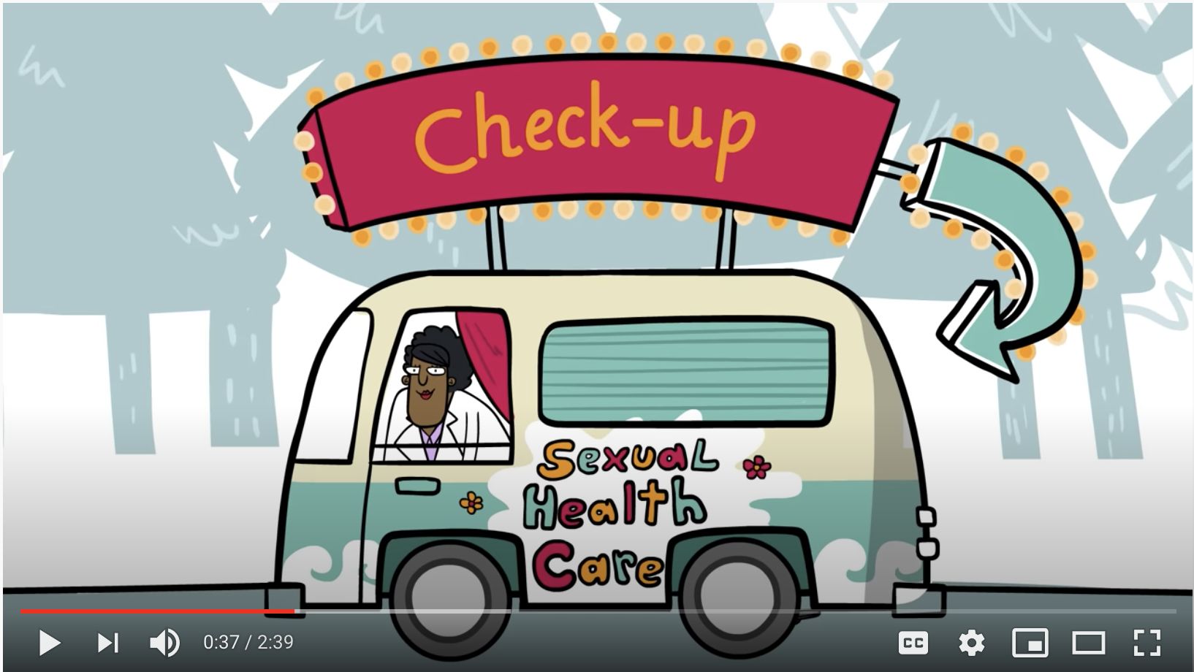
AMAZE: Accessing Sexual Health Care
Play video
Notes:
https://www.youtube.com/watch?v=VMhHx-9zwD8&feature=emb_logo

Slide 14
Barriers to Care
What are some barriers that might prevent a young person from getting the care that they need?
Notes:
Lack of knowledge of clinic locations and rights to access care
Legal or cultural restrictions
Physical or logistical restrictions
Inaccessible location
Inconvenient hours
Poor quality of clinical services
Lack of provider knowledge and skills
Limited services or supplies
Unwelcoming services
Perceived lack of confidentiality and restrictions (parental consent/notification)
Insensitive attitudes of care providers
Lack of health literacy – not knowing how to talk to health providers to express their health needs, or knowing when they need to access care
Source: Adolescent Friendly Health Services: An Agenda for Change. The World Health Organization, 2004. Available at: http://www.who.int/reproductivehealth/publications/cah_docs/cah_02_14.pdf

Slide 15
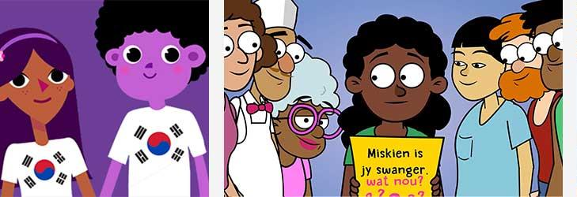
Adolescents in Context
Changes during adolescence are shaped by
  Race/Ethnicity
  Religion
  Socioeconomic Status
  Family
  Peers
What other internal and external factors affect a young person’s experience of adolescence?
Notes:
Question to audience: What other factors affect an adolescent’s experience of the changes that occur during adolescence?
A few possible answers:
Community
Urban/Rural environment
Immigration status
Females and males go through the same stages , although male stages are generally 1–2 years later

Slide 16
Adolescent Development
Biological/Physical
  Puberty and physical growth
Cognitive
  Brain development, ability to perform more complex cognitive tasks, regulation of impulse control
Emotional
  Developing capacity to understand feelings, learning healthy coping mechanisms. Many mental health problems present initially during adolescent years
Social
  Forming healthy relationships, understanding gender identity, sexual orientation and developing sexual identity
Adolescence is a critical period of development and change:
Notes:
Adolescence, defined as 11 through 21 years of age, is a critical period of development in a young person’s life, one filled with distinctive and pivotal biological, cognitive, emotional, and social changes.” – AAP Committee on Adolescence
Healthcare professionals can educate adolescents and their parents about the psychosocial and developmental aspects of adolescence.
The goal of youth during this stage is to gain independence and establish a secure identity of who they are. Recommendation to parents and guardians to continue to provide parental or supervisory monitoring and model positive health behaviors and conflict resolution is critical for ensuring that teens remain safe while gradually becoming more independent.
Note: WHO defines adolescents as young people ages 10-19 years of age
The World Health Organization, the Office of Adolescent Health of the US Department of Health and Human Services, the Health and Medicine Division of the National Academies of Sciences, Engineering, and Medicine (formerly the Institute of Medicine), the Lancet, with four international academic institutions, and the Society for Adolescent Health and Medicine have called for a closer examination of the unique health needs of adolescents.
Sources: Elizabeth M. Alderman, Cora C. Breuner and COMMITTEE ON ADOLESCENCE. Unique Needs of the Adolescent. Pediatrics originally published online November 18, 2019. https://pediatrics.aappublications.org/content/pediatrics/early/2019/11/14/peds.2019-3150.full.pdf
Growth and Development, Ages 13 to 17 – What Parents Need to Know. Advocates for Youth. 2002. https://www.advocatesforyouth.org/wp-content/uploads/storage//advfy/documents/13_17.pdf
Adolescent Friendly Health Services: An Agenda for Change. The World Health Organization, 2004. Available at: https://apps.who.int/iris/bitstream/handle/10665/67923/WHO_FCH_CAH_02.14.pdf?sequence=1&isAllowed=y
Sanders, RA. Adolescent Psychosocial, Social, and Cognitive Development. Pediatrics in Review. Aug 2013, 34 (8) 354-359; DOI: 10.1542/pir.34-8-354

Slide 17

Early Stages of Adolescence: 11-14
Physical
  Growth spurt
  Begin sexual maturation
  Increased interest in sexual anatomy
Cognitive
  Think concretely
  Begin to develop advanced reasoning skills, understand hypotheticals
Emotional
  Beginning to establish autonomy from parents/family
Social/Sexual
  Form same-gender peer groups
  Compare self to others and often try to fit in with peers
Notes:
The early adolescent is usually considered 11–14 years old.
It is important for physicians to understand the different phases of adolescence in order to connect with the adolescent patient in a meaningful way.
For example, counseling a younger teenager about cigarette cessation must be accomplished in a concrete fashion (e.g., focus on bad breath, teeth staining, or the cost of cigarettes) and not with the distant threat of future cancer. As the adolescent ages and they are capable of more abstract thoughts, counseling methods will change.
Sources:
1) Sanders, RA. Adolescent Psychosocial, Social, and Cognitive Development. Pediatrics in Review. Aug 2013, 34 (8) 354-359; DOI: 10.1542/pir.34-8-354
2) Adolescent Friendly Health Services: An Agenda for Change. The World Health Organization, 2004. Available at: http://www.who.int/reproductivehealth/publications/cah_docs/cah_02_14.pdf

Slide 18

Middle Stages of Adolescence: 15-17
Physical
  Completion of puberty
  Skeletal maturity for females (males continue to grow in height into early 20s)
Cognitive
  Develop abstract thought
  Learn to think reflectively
Emotional
  Developing a stronger sense of identity
  Risk-taking behaviors
  Often greatest parent/family conflict
Social/Sexual
  Peer groups often mixed-gender
  Increased awareness of and interest in sexuality
Notes:
Sexual development may include initiation of different sexual behaviors and testing ability to attract partners. Intense crushes and relationships are common at this stage
Risk-taking behavior: “Several studies have found that adolescents perceive more risk in certain areas than adults but that being aware of the risks fails to stop adolescents from participating in risk-taking behavior.”
Developing identity: [One] task of adolescence is for youth to develop a sense of identity. Identity relates to one’s sense of self. It can be divided into 2 areas: self-concept and self-esteem. Self-concept refers to an adolescent’s perception of self— one’s talents, goals, and life experiences. It can also relate to identity as part of ethnic, religious, and sexual identity groups. Self-esteem relates to how one evaluates self worth.
Sources:
1) Sanders, RA. Adolescent Psychosocial, Social, and Cognitive Development. Pediatrics in Review. Aug 2013, 34 (8) 354-359; DOI: 10.1542/pir.34-8-354
2) Adolescent Friendly Health Services: An Agenda for Change. The World Health Organization, 2004. Available at: http://www.who.int/reproductivehealth/publications/cah_docs/cah_02_14.pdf

Slide 19

Late Stages of Adolescence: 18+
Physical
  Adult body appearance
  Males reach adult height
Cognitive
  Plan for the future
  Develop meta-cognition (thinking about feelings and how others perceive them)
Emotional
  Identity is distinct from peers, parents and family
  Ideas and opinions become more settled
  Mature personal value system
Social/Sexual
  Focus on intimacy and formation of stable relationships
Notes:
Sexual development may include initiation of different sexual behaviors and testing ability to attract partners. Intense crushes and relationships are common at this stage
Risk-taking behavior: “Several studies have found that adolescents perceive more risk in certain areas than adults but that being aware of the risks fails to stop adolescents from participating in risk-taking behavior.”
Developing identity: [One] task of adolescence is for youth to develop a sense of identity. Identity relates to one’s sense of self. It can be divided into 2 areas: self-concept and self-esteem. Self-concept refers to an adolescent’s perception of self— one’s talents, goals, and life experiences. It can also relate to identity as part of ethnic, religious, and sexual identity groups. Self-esteem relates to how one evaluates self worth.
Sources:
1) Sanders, RA. Adolescent Psychosocial, Social, and Cognitive Development. Pediatrics in Review. Aug 2013, 34 (8) 354-359; DOI: 10.1542/pir.34-8-354
2) Adolescent Friendly Health Services: An Agenda for Change. The World Health Organization, 2004. Available at: http://www.who.int/reproductivehealth/publications/cah_docs/cah_02_14.pdf

Slide 20

Confidentiality and Consent

Slide 21
Case Discussion
Michelle goes with her dad to her annual check-up at her doctor’s office
In the waiting room, she notices a sign about confidentiality
She also sees brochures and posters with information on some of the topics she is interested in
It’s important that Michelle knows she can receive confidential care here!
Notes:
Confidentiality:
Teens receive clear information about their state’s laws governing the rights of adolescent patients to confidentiality and to consent to care or treatment. A teen’s health information cannot be shared with anyone—including parents or guardians—without the teen’s written permission, unless required by law or if the health care provider is concerned the teen might harm him or herself or someone else.
Health information disclosed or discussed during a visit is confidential, consistent with state laws and regulations.
Billing procedures maintain teen’s confidentiality. If this is not possible, the provider or billing staff advises the teen about the potential breach of confidentiality and provides options. For example, the patient might want to pay out of pocket, or sensitive lab services like pregnancy and STD tests may be indicated on the bill as “routine screening.” However, some health plans might not reimburse unless a service is fully itemized.
Source: Teen-Friendly Reproductive Health Visit. Centers for Disease Control and Prevention. Page last reviewed: December 6, 2018. https://www.cdc.gov/teenpregnancy/health-care-providers/teen-friendly-health-visit.htm

Slide 22
Confidentiality
Confidentiality in Adolescent Health Care
Clinically Essential | Developmentally Expected | Supported by Expert Consensus
Notes:
Clinically Essential-Several studies support the rationale for confidentiality in adolescent medicine and demonstrate that confidentiality is clinically essential in adolescents’ decisions to seek care, disclosure of behaviors, and if they will seek follow-up for care.
Developmentally Expected- Adolescents demonstrate an increasing need for autonomy. The stage of adolescent development is characterized as a transition from the dependence of childhood to the independence of adulthood. This process does not occur overnight. Additionally, adolescents have been shown to have increasing intellectual capacity to give informed consent. Many studies have demonstrated that by age 14 most adolescents possess adult decision-making capacity. Thus they want to have the opportunity to take responsibility for their own health.
Supported by Experts-Organizations such as The American College of Obstetricians and Gynecologists, the Society for Adolescent Health and Medicine, the American Medical Association, the American Public Health Association, and the American Academy of Pediatrics have reached consensus that adolescent health care should be confidential but encourage young people to discuss and include their parent’s when addressing their health.
Society for Adolescent Health and Medicine policy: https://www.jahonline.org/article/S1054-139X%2804%2900086-2/fulltext
Policy statement from American Academy of Pediatrics: https://pediatrics.aappublications.org/content/138/2/e20161347
Policy statement from American College of Obstetricians and Gynecologists: https://www.acog.org/-/media/project/acog/acogorg/clinical/files/committee-opinion/articles/2020/04/confidentiality-in-adolescent-health-care.pdf
Society for Adolescent Health and Medicine policy: https://www.jahonline.org/article/S1054-139X%2804%2900086-2/fulltext
Policy statement from American Academy of Pediatrics: https://pediatrics.aappublications.org/content/138/2/e20161347
Policy statement from American College of Obstetricians and Gynecologists: https://www.acog.org/-/media/project/acog/acogorg/clinical/files/committee-opinion/articles/2020/04/confidentiality-in-adolescent-health-care.pdf

Slide 23
Confidentiality: Sample Policy
Our Policy on Confidentiality
Our discussions with you are private. We hope that you feel free to talk openly with us about yourself and your health. Information is not shared with other people unless we are concerned that someone is in danger.
Notes:
Policy developed by the University of Rochester Medical Center Department of Pediatrics, Rochester, NY.

Slide 24

Discuss Confidentiality in Advance
Inform parents about the confidentiality policy up front before a visit.
  Send a letter home:
    Detail when parent will or will not be included in the clinical visit.
    Discuss billing issues (e.g., routine STI testing, etc.).
  Display materials discussing importance of doctor/patient confidentiality.
Notes:
Important to consider parent’s perspective, parents are experiencing their own adjustment to their child’s adolescence. Providers have an opportunity to educate parents about the need for confidentiality in the provider-patient encounter.

Slide 25

Minor Consent for Health Services
Providers must work within the bounds of state laws regarding the rights of adolescents to consent for sexual and reproductive health services, including contraception and testing and treatment for STIs
In addition, care may be limited by school district policy – for example, regarding the prescription of contraception or provision of condoms
Notes:
Consent:
Teens receive clear information about informed consent—their right to complete and understandable information about their care and medical procedures, and to give permission to receive medical care related to contraceptive and reproductive health.
Teens receive clear information that confidential contraceptive and reproductive health services are available without the need for parent or caregiver consent, consistent with state laws and regulations.
Sources:
Teen-Friendly Reproductive Health Visit. Centers for Disease Control and Prevention. Page last reviewed: December 6, 2018. https://www.cdc.gov/teenpregnancy/health-care-providers/teen-friendly-health-visit.htm
Fact Sheet: Adolescent Sexual and Reproductive Health in the United States. Guttmacher Institute, September 2019. https://www.guttmacher.org/fact-sheet/american-teens-sexual-and-reproductive-health

Slide 26
The Clinical Interview

Slide 27
Case Discussion
After talking with Michelle and her dad together about their questions and concerns, the doctor asks her dad to step out of the room and wait in a separate area
Her doctor tells her that this discussion will remain private unless they become concerned that she or someone else is in danger
Notes:
Privacy:
The provider has a counseling area to discuss sensitive topics with teens that provides visual and auditory privacy. For example, other health care staff or clients cannot hear the conversation or see who is participating
The health center has an examination room that provides visual and auditory privacy.
At every visit, each teen patient has time alone with a provider to discuss or ask questions about contraceptive and reproductive health concerns, regardless of whether the visit is urgent or preventive.
Staff members do not discuss teens’ information in common office spaces.
Medical records are kept secure and are accessible only to select health care staff, such as through the use of locked files, or password-protected electronic medical records.
“Clinicians can use the primary care visit to promote independence among adolescents. Starting during early adolescence, the parent and the adolescent should be seen together initially to assess the emotional and psychiatric health of adolescents and understand how family dynamics may contribute to symptoms experienced, identify not only sources of stress within families but predominant modes of coping with stress, and encourage parental involvement with the adolescent’s school, extracurricular activities, and knowledge about their child’s friends.”
Sources:
1)Teen-Friendly Reproductive Health Visit. Centers for Disease Control and Prevention. Page last reviewed: December 6, 2018. https://www.cdc.gov/teenpregnancy/health-care-providers/teen-friendly-health-visit.htm
2) Sanders, RA. Adolescent Psychosocial, Social, and Cognitive Development. Pediatrics in Review. Aug 2013, 34 (8) 354-359; DOI: 10.1542/pir.34-8-354

Slide 28
Taking a History: the HEEADSSS Model
H: Home
E: Education/Employment
E: Eating
A: Activities
D: Drugs and Alcohol
S: Sexuality and Gender Identity
S: Suicide/depression
S: Safety
*Additional questions:
  Strengths, Spirituality
Notes:
There are a number of standardized tools for taking an adolescent history - The HEEADDSSS model is one useful tool for taking a comprehensive psychosocial history for adolescent patients.
The HEEADDSSS Model was originally developed in 1972 by physicians. ARSHEP faculty, Melanie Gold, DO, DABMA, FAAP, FACOP developed the corresponding questions for this model.
The components of the model reflect the common causes of morbidity and mortality among adolescents, including unintended pregnancy and sexually transmitted diseases.
The health care provider who sees adolescents must be willing to take a developmentally appropriate psychosocial history, and may get more results by using non-traditional modes of physician-patient questioning.
The HEEADDSSS questions should be asked without a parent in the room unless the adolescent specifically gives permission or asks for a parent’s presence. If the questions are asked and answered with other people in the room, document this on chart and note that this was by patient request.
Some practitioners add yet another “S” to assess strengths, points of resiliency, or confidence in the patient.
Source: Klein DA, Goldenring JM & Adelman WP. HEEADSSS 3.0: The psychosocial interview for adolescents updated for a new century fueled by media. Contemporary Pediatrics. 2014. https://www.contemporarypediatrics.com/view/heeadsss-30-psychosocial-interview-adolescents-updated-new-century-fueled-media

Slide 29
Strengths-Based Approach
Sometimes questions about strengths precede the rest of the HEEADSSS assessment
Identify strengths early and reinforce them
Look for examples of past difficulties that your patient has successfully overcome
Use reflective listening and pause
Create a comfortable, trusting, nonjudgmental setting
Notes:
When talking to adolescents, emphasize the positives; approaches based on risk factors only may produce feelings of shame and deter patient engagement.
References:
Goldenring JM, Rosen DS. Getting into adolescent heads: an essential update. Contemp Pediatr. 2004;21(1):64-90.
Ginsburg KR. Viewing our adolescent patients through a positive lens. Contemp Pediatr. 2007;24(1):65-76.
Resnick MD, Bearman PS, Blum RW, et al. Protecting adolescents from harm. Findings from the National Longitudinal Study on Adolescent Health. JAMA. 1997;278(10):823-832

Slide 30
Home
Where do you live and who lives there with you?
What are relationships like at home?
Can you talk to anyone at home about stress? Who?
What are the rules like at home?
Is there a gun in your home?
Ever been homeless or in shelter care?
Ever been in foster care or group home?
Notes:
It is important to begin the assessment with questions regarding the adolescent’s home life.
The first question: Who lives in the home with you? Is in bold because the answer to this will dictate the rest of the interview. (no assumptions made)
Keep questions specific, allowing the patient to expound when needed.
Adapted from the presentation "Interviewing the Adolescent: Tricks of the Trade" by Dr. Melanie A. Gold.
1) Goldenring JM, Rosen DS. Getting into adolescent heads: an essential update. Contemp Pediatr. 2004;21(1):64-90.
2) Goldenring JM, Cohen E. Getting into adolescent heads. Contemp Pediatr. 1988;5(7):75-90.

Slide 31
Education and Employment
How are things going at school?
Do you feel connected to your school? Do you
feel as if you belong?
How many days have you missed in the past
year and what was the reason?
What are your grades right now? Is that different from how you’ve done in previous years?
Have there been any recent school changes?
What are your educational and life goals?
Notes:
Health care providers need to be aware of the risk factors associated with poor academic performance.
Poor attendance and grades have been shown to be a risk factor for early sexual initiation and teenage pregnancy.
Source:
Santelli JS, Kaiser J, Hirsch L, Radosh A, Simkin L, Middlestadt S. Initiation of sexual intercourse among middle school adolescents: the influence of psychosocial factors. J Adolesc Health. 2004;34(3):200–8.
Additionally, poor academic performance and truancy have been linked with alcohol abuse.
Source:
Ellickson SL, Tucker JS, Klein DJ, McGuigan KA. Prospective risk factors for alcohol misuse in late adolescence. J Stud Alcohol 2001;62(6):773–82

Slide 32
Education and Employment
Are you working? Where?
What type of work do you do?
How many hours a week?
Do you help to pay for things at home?
What are your future career interests?
Notes:
Adolescents are often employed part-time during the school year.
Frequently by their senior year, they are working more than 20 hours a week.
A review of the literature reveals that adolescent employment has both positive and negative effects.
Positive effects of adolescent employment include a stronger sense of personal efficacy and orientation to occupational achievement.
Working has also been associated with negative aspects of adolescents’ psychological, behavioral, and social well-being. For example, working adolescents, especially girls, have been found to be notably more depressed.
Working adolescents have also been noted to experience inferior relationships with their parents, which may be related to spending less time with their families.
In addition to less family time, they have less time to spend on homework, which may result in a lower grade point average.
It is important for the health care provider to assess the impact that employment is having on the adolescent’s development, including ability to handle stress, mood, and relationships.
Sources:
Bachman J, Schulenberg J. How part-time work intensity relates to drug use, problem behavior, time use and satisfaction among high school seniors: Are these consequences or merely correlates? Developmental Psychology 2003;29:220–235.
Mael , Morath R, McLellan J. Dimensions of adolescent employment. Career Development Quarterly 1997;45:351–368.
Sayfer A, Leahy B, Colan N. The impact of work on adolescent development. Journal of Contemporary Human Services 1995;1:38–45.
Steinberg L, Dornbusch S. Negative correlates of part-time employment during adolescence: Replication and elaboration. Developmental Psychology 1991;27:304–313.

Slide 33
Eating
How would you describe your diet?
How many fruits and vegetables do you eat in a typical day?
Have there been any recent changes in your weight?
Have you dieted in the past year? How? Have you done other things to control your weight?
Does your weight or body shape cause you stress or worry?
Notes:
1) Goldenring JM, Rosen DS. Getting into adolescent heads: an essential update. Contemp Pediatr. 2004;21(1):64-90.
2) Goldenring JM, Cohen E. Getting into adolescent heads. Contemp Pediatr. 1988;5(7):75-90.
3) Klein DA, Goldenring JM & Adelman WP. Contemporary Pediatrics. 2014.

Slide 34

A Note about Weight Stigma
Weight stigmatization or “fat-shaming” is pervasive, including in healthcare settings, and it is harmful to patients
  Physicians with weight bias spend less time examining and educating patients with higher BMI
  Patients with higher BMI are less likely to seek preventative care
Overall incidence of eating disorders is stable, but they are increasingly being diagnosed in children less than 12 years old, males, and minority youth
Notes:
A 2003 study found that severely obese children and adolescents have lower health-related quality of life than children and adolescents who are healthy and similar quality of life as those diagnosed as having cancer
Research shows that physicians associate obesity with noncompliance and decreased medication adherence, hostility, dishonesty, and poor hygiene. They often view patients with obesity as being lazy, lacking self-control, and being less intelligent. Furthermore, this prejudice negatively affects quality of care and can result in patients with obesity being less likely to seek preventive care and delaying or canceling appointments.
Most adolescents who develop an eating disorder were not previously overweight. However, it is not unusual for an eating disorder to begin with a teenager “trying to eat healthy.”
Adolescents who are overweight may adopt disordered eating behaviors while attempting to lose weight. In cross-sectional studies, adolescents who are overweight have been shown to engage in self-induced vomiting or laxative use more frequently than their normal-weight peers.
The lifetime prevalences of anorexia nervosa, bulimia nervosa, and binge eating disorder in adolescent females are 0.3%, 0.9%, and 1.6%, respectively
The reported female-to-male ratio is 9:1, but increasing numbers of males with eating disorders are being recognized, especially among younger age groups
Some steps providers can take to avoid weight stigma and help prevent both obesity and eating disorders include:
Recognize their own implicit biases about weight
Use patient-first language (for example, saying “a 15-year-old female with obesity” instead of “an obese 15-year-old female”)
Discourage dieting, skipping of meals, or the use of diet pills; instead, encourage and support the implementation of healthy eating and physical activity behaviors that can be maintained on an ongoing basis. The focus should be on healthy living and healthy habits rather than on weight.
Promote a positive body image among adolescents. Do not encourage body dissatisfaction or focus on body dissatisfaction as a reason for dieting.
Encourage more frequent family meals, which have been shown to be protective
Encourage families not to talk about weight but rather to talk about healthy eating and being active to stay healthy. Do more at home to facilitate healthy eating and physical activity.
Inquire about a history of mistreatment or bullying in overweight and obese teenagers and address this issue with patients and their families.
Carefully monitor weight loss in an adolescent who needs to lose weight to ensure the adolescent does not develop the medical complications of semistarvation.
Sources:
Pont SJ, Puhl R, Cook SR Slusser W. Stigma Experienced by Children and Adolescents With Obesity. Section on Obesity and the Obesity Society. Pediatrics December 2017, 140 (6) e20173034; DOI: https://doi.org/10.1542/peds.2017-3034
Hebl MR, Xu J. Weighing the care: physicians' reactions to the size of a patient. Int J Obes Relat Metab Disord. 2001 Aug;25(8):1246-52. doi: 10.1038/sj.ijo.0801681. PMID: 11477511.
Golden NH, Schneider M, Wood C. Preventing Obesity and Eating Disorders in Adolescents. Committee on Nutrition, Committee on Adolescence, Section on Obesity. Pediatrics Sep 2016, 138 (3) e20161649; DOI: 10.1542/peds.2016-1649

Slide 35
Case Discussion
Michelle’s doctor takes a thorough social history and finds:
S: Michelle feels her strengths are having a good relationship with her parents and being a loyal friend to others
H: Michelle’s parents are divorced, and she and her younger brother spend time at each of their houses
E: She is in 10th grade and enjoys most of her classes. She worked during the summer but is not currently working.
E: Michelle thinks she is a healthy weight and believes that she mostly eats healthy foods

Slide 36
Activities
What do you like to do for physical activity? Do you feel you’re getting enough physical activity to be healthy?
How do you like to spend your free time?
Hobbies, clubs, religious/spiritual activities?
Do you play any sports?
How many hours of television/computer per day?
Notes:
Adapted from the presentation "Interviewing the Adolescent: Tricks of the Trade" by Dr. Melanie A. Gold.

Slide 37
Physical Activity and Screen Time
Among US High School students:
  44.1% were physically active for at least 60 min/day on 5+days (35.3% of females, 52.8% of males)
  57.4% played at least one sport (54.6% of females and 60.2% of males)
  46.1% played video/computer games or used a computer for 3 or more hours per day (44.6% of females and 47.5% of males)
Source: CDC Youth Risk Behavior Survey 2019 Results
Notes:
counting time spent playing games, watching videos, texting, or using social media on their smartphone, computer, Xbox, PlayStation, iPad, or other tablet, for something that was not schoolwork, on an average school day
Source: High School Youth Risk Behavior Survey (YRBS): 2019 Results. Centers for Disease Control and Prevention. https://nccd.cdc.gov/youthonline/App/QuestionsOrLocations.aspx?CategoryId=C06
The YRBS, or Youth Risk Behavior Survey, is an anonymous survey administered by the CDC every two years in selected high schools throughout the United States. Thus, it is a survey of adolescents in grades 9–12 who are in school. The survey focuses on many different health concerns and behaviors including: mental health, exercise, nutrition, use of seatbelts, substance use behavior and sexual behavior.

Slide 38
Drugs and Alcohol
  Do any of your friends smoke, drink, or use drugs? How frequently and how much?
Do you use smoke cigarettes? If so, how often?
Do you use electronic cigarettes? How often?
Do you drink alcohol?
  What kind: beer, wine, hard liquor?
  Any blackouts? Ever pass out? Vomit?
Do you use any other drugs or substances to get high?
Notes:
In shifting from the non-sensitive, more general questions (home, activities, etc.) to questions regarding drugs, alcohol, and sex, it is important to acknowledge that a shift has taken place, explain to patients why you are asking about these behaviors, and once again secure confidentiality.
Most adolescents experiment with drugs at some point in their development, whether limited to alcohol, caffeine, and cigarettes or extended to marijuana, cocaine, and hard drugs. The United States has the highest rate of adolescent drug use of any industrialized nation. [i]
Adolescents who use drugs to manage stress are of particular concern as this can interfere with coping skills and responsible decision-making, and can lead to life long addiction. [ii]
Sources:
[i] Johnston L, O’Malley, P, and Bachman J. National survey results on drug use from the Monitoring the Future Study, Vol.1: Secondary school students. Ann Arbor: University of Michigan, Institute of Social Research, 1999.
[ii] Santrock, J. Child Development. University of Texas: Dallas, 2001.

Slide 39
CRAFFT Screening for Substance Use
During the past 12 months, on how many days did you:
Drink more than a few sips of beer, wine, or any drink containing alcohol?
Use any form of marijuana (by smoking, vaping, dabbing, or in edibles) or synthetic marijuana (K2, spice, etc)?
Use anything else to get high?
Notes:
The CRAFFT screening tool was developed by Boston Children’s Hospital. If the answer to any of the above questions was more than ‘none’, proceed to the following questions (next slide)

Slide 40
CRAFFT Screening for Substance Use
C | Have you ever ridden in a CAR driven by somebody (including yourself) who was ‘high’ or had been using alcohol or drugs?
R | Do you ever use alcohol or drugs to RELAX, feel better about yourself or fit in?
A | Do you ever use alcohol or drugs while you are by yourself, ALONE?
F | Do you ever FORGET things you did while using alcohol or drugs?
F | Do your family or FRIENDS ever tell you that you should cut down on your drinking or drug use?
T | Have you ever gotten into TROUBLE while you were using alcohol or drugs?
Notes:
Two or more “Yes” answers suggest high risk of a serious substance-use problem or a substance-use disorder.
This instrument was developed by John Knight, M.D., Children's Hospital Boston.
Knight JR, Sherritt L, Shrier LA, Harris SK, Chang G. Validity of the CRAFFT substance abuse screening test among adolescent clinic patients. Arch Pediatr Adolesc Med. 2002;156(6):607-614.

Slide 41

Drug and Alcohol Use
Among US High School students:
  29.2% said they currently drank alcohol (31.9% of females, 26.4% of males)
  21.7% said they currently used marijuana (20.8% of females, 22.5% of males)
Source: CDC Youth Risk Behavior Survey 2019 Results
Notes:
Percent who said they had ever used…
Prescription pain medicine without Rx: 14.3%
Hallucinogenic drugs: 7%
Inhalants: 6.4%
Cocaine: 3.9%
Ecstasy/MDMA: 3.6%
Methamphetamines: 2.1%
Heroin 1.8%
Current use is defined as using one or more times in the 30 days before the survey
Source: High School Youth Risk Behavior Survey (YRBS): 2019 Results. Centers for Disease Control and Prevention. https://nccd.cdc.gov/youthonline/App/QuestionsOrLocations.aspx?CategoryId=C03

Slide 42
Sexuality and Gender Identity
First, introduce the topic:
”I’m going to ask you some questions about your gender and sexual health now. I know these are private, but they are also a really important part of health and I ask these questions of all of my patients.”
Notes:
As children and adolescents develop, many will have questions regarding their bodies, sex, pregnancy, and STIs, and the majority will begin to experiment sexually.
Discussing sex with adolescent patients in a clinic or office setting provides opportunities for personalized information, for confidential screening of risk status, and for health promotion and counseling.
Prevention and counseling can be targeted to the needs of youth who are and who are not yet sexually active and to groups at high risk for early or unsafe sexual activity.
However, the majority of physicians are not offering this necessary care. Less than half of primary physicians routinely discuss sex, condoms, STIs, contraception, and sexual orientation with their adolescent patients.
Source:
American Academy of Pediatrics, Committee on Psychosocial Aspects of Child and Family Health and Committee on Adolescence. Sexuality Education for Children and Adolescents. Pediatrics 2001;108:498–502.

Slide 43
Sexuality and Gender Identity
Do you think of yourself as a boy, a girl, or another gender?
Are you attracted to boys, girls, or people of other genders?
Have you ever been in a romantic relationship?

Slide 44
Sexual Behavior
There are many ways of being sexual or intimate with another person: kissing, hugging, touching, having oral sex, vaginal sex, or anal sex.
  Have you ever had any of these experiences? Which ones? With boys, girls, both or other genders?
How often do you use protection against pregnancy or sexually transmitted infections?
  What kind of protection?
Notes:
There are several ways to ask this question, but this one defines sexual behaviors so the patients understand what we are asking about. Many teens may not consider oral sex sexual behavior, but 45% of females and 48% of males ages 15–19 have had oral sex.
Source: Copen CE, Chandra A, Martinez G. Prevalence and timing of oral sex with opposite-sex partners among females and males aged 15–24 years: United States, 2007–2010. National health statistics reports; no 56. Hyattsville, MD: National Center for Health Statistics. 2012.

Slide 45

Gender Identity and Sexual Orientation
Among US High School students:
  1.8% identify as transgender
  84.4% identify as heterosexual (77.6% of females, 91.2% of males)
  2.5% identify as gay or lesbian (2.9% of females, 2.1% of males)
  8.7% identify as bisexual (13.9% of females, 3.4% of males)
  4.5% were unsure of their sexual identity (5.6% of females, 3.2% of males)
Source: CDC Youth Risk Behavior Survey 2019 Results
Notes:
In terms of gender identity, 1.8 identified themselves as being transgender (94.4% said they were not transgender, 1.6% were unsure and 2.1% did not understand the question).
Source:
Johns MM, Lowry R, Andrzejewski J, et al. Transgender Identity and Experiences of Violence Victimization, Substance Use, Suicide Risk, and Sexual Risk Behaviors Among High School Students — 19 States and Large Urban School Districts, 2017. MMWR Morb Mortal Wkly Rep 2019;68:67–71.
Table 4: Number and percentage of students, by sexual identity. High School Youth Risk Behavior Survey (YRBS): 2019 Results. Centers for Disease Control and Prevention. https://www.cdc.gov/healthyyouth/data/yrbs/2019_tables/students_by_sexual_identity.htm

Slide 46
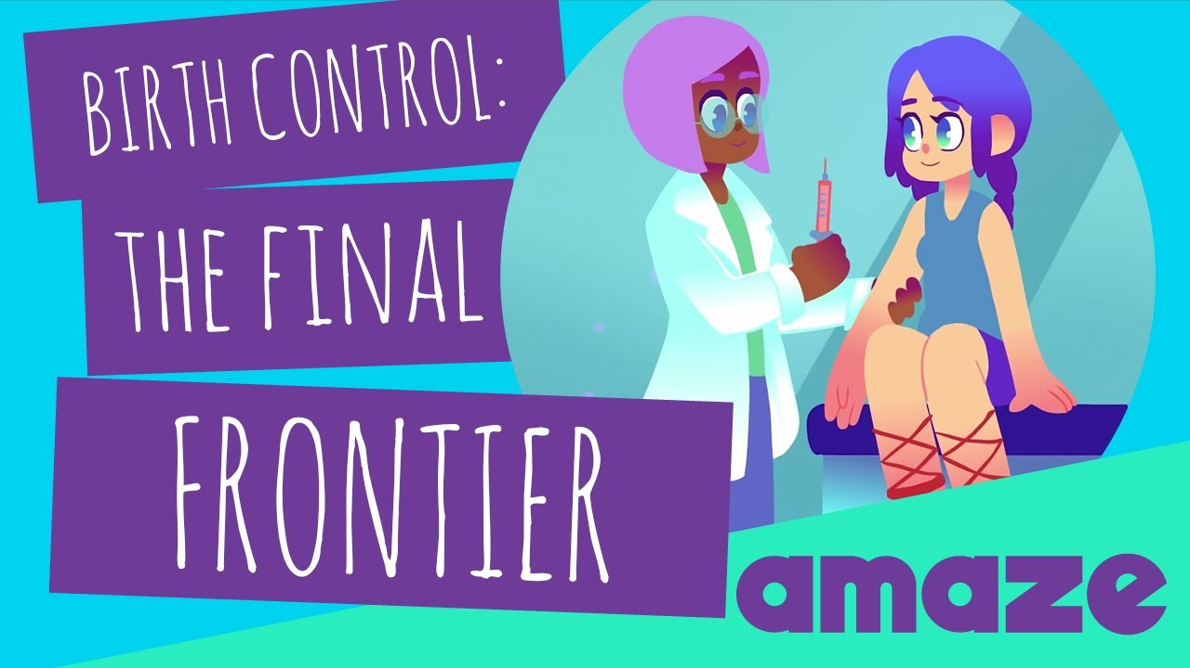
Sexual Behavior and Contraceptive Use
Among US High School students:
  38.4% said they had ever had sex
  27.4% were currently sexually active
  Contraceptive use at last sexual intercourse:
    Condoms: 54.3%
    Birth control pill: 33%
    IUD or implant: 4.8%
    Both a condom and another contraceptive method (dual use): 9.1%
    No method: 11.9%
Source: CDC Youth Risk Behavior Survey 2019 Results
Notes:
38.4% said they had ever had sex (37.6% of females, 39.2% of males)
27.4% were currently sexually active (28.4% of females, 26.3% of males)
Current sexual activity defined as sex with at least one person in the 3 months prior to the survey
Source: High School Youth Risk Behavior Survey (YRBS): 2019 Results. Centers for Disease Control and Prevention. https://nccd.cdc.gov/youthonline/App/QuestionsOrLocations.aspx?CategoryId=C04

Slide 47
Case Discussion
Michelle’s doctor continues the social history:
A: She plays volleyball and is in a few other extracurricular activities. She admits to spending a lot of time texting and using social media on her phone, especially in the evenings
D: Michelle has tried alcohol once and marijuana a few times, but hasn’t tried any other drugs
S: Michelle identifies as a girl. She has recently started a new relationship with a male partner. So far, they’ve only kissed but she is thinking about having sex and has some more questions.
Notes:
As adolescents’ relationships evolve, they may become interested in dating, intimacy, and sex-related experimentation. Health care professionals should create a climate that is sensitive to personal issues, including sexual identity development and sexual orientation, so that youth feel comfortable discussing different types of sexual activity, fantasies, and attractions. Adolescents will also need appropriate health information about avoiding risk-taking behavior, such as drug use and unsafe sexual behavior, skills that enhance their ability to negotiate difficult situations with peers, and career guidance.
Source: Sanders, RA. Adolescent Psychosocial, Social, and Cognitive Development. Pediatrics in Review. Aug 2013, 34 (8) 354-359; DOI: 10.1542/pir.34-8-354

Slide 48
Suicide and Depression
How often do you feel stressed or anxious? How often do you feel sad or down?
How do you handle those feelings? Who do you turn to for support?
Have you ever seen a counselor or therapist?
Are you having trouble getting to sleep?
Have you ever thought of hurting yourself or someone else?
Notes:
Adapted from the presentation "Interviewing the Adolescent: Tricks of the Trade" by Dr. Melanie A. Gold.
1) Goldenring JM, Rosen DS. Getting into adolescent heads: an essential update. Contemp Pediatr. 2004;21(1):64-90.
2) Goldenring JM, Cohen E. Getting into adolescent heads. Contemp Pediatr. 1988;5(7):75-90.
3) Klein DA, Goldenring JM & Adelman WP. Contemporary Pediatrics. 2014.
Many clinics use a validated screening tool to screen for depression, such as the PHQ-9, available at https://www.med.umich.edu/1info/FHP/practiceguides/depress/phq-9.pdf. This questionnaire asks:
Over the past 2 weeks, how often have you been bothered by any of the following problems?
Little interest or pleasure in doing things
Feeling down, depressed, or hopeless
Trouble falling or staying asleep, or sleeping too much
Feeling tired or having little energy
Poor appetite or overeating
Feeling bad about yourself or that you are a failure or have let yourself or your family down
Moving or speaking so slowly that other people could have noticed. Or the opposite; being so fidgety or restless that you have been moving around a lot more than usual
Thoughts that you would be better off dead or of hurting yourself in some way.

Slide 49

Depression and Suicide
Among US High School students:
  36.7% felt sad or hopeless almost every day for 2 or more weeks in a row during the past year (46.6% of females, 26.8% of males)
  18.8% seriously considered attempting suicide in the past year (24.1% of females, 13.3% of males)
  8.9% attempted suicide in the past year (11% of females, 6.6% of males)
Source: CDC Youth Risk Behavior Survey 2019 Results
Notes:
It is important to screen all adolescents for depression, and not just those who may look depressed. Depression is now the 2nd leading cause of death for 15-24 year olds.
Source: Heron, M. Deaths: Leading causes for 2017. National Vital Statistics Reports; Volume 68, Number 6. Hyattsville, MD: National Center for Health Statistics. 2019.

Slide 50

Mental Health and LGBTQ Youth
71% of LGBTQ youth reported feeling sad or hopeless for at least two weeks in the past year and 39% seriously considered suicide
  54% of transgender and non-binary youth have seriously considered suicide and 29% have attempted suicide
67% of LGBTQ youth reported someone attempted to convince them to change their sexual orientation or gender identity
Source: The Trevor Project 2019 National Survey on LGBTQ Mental Health
Notes:
Source: The Trevor Project. (2019). National Survey on LGBTQ Mental Health. New York, New York: The Trevor Project. https://www.thetrevorproject.org/wp-content/uploads/2019/06/The-Trevor-Project-National-Survey-Results-2019.pdf

Slide 51

AMAZE: Puberty; Feeling Depressed, Happy and Other Emotions
Play video
Notes:
https://www.youtube.com/watch?v=mAPLTaRM48Y

Slide 52
Safety
Do you always wear a seatbelt in the car?
Do you drive? How often do you send text messages while driving?
How often have you ridden with a driver who was drunk or high?
Is there a gun in your home? How is it stored? Who has access to it?
Have you ever been bullied on-line?
Notes:
Adapted from the presentation "Interviewing the Adolescent: Tricks of the Trade" by Dr. Melanie A. Gold.
1) Goldenring JM, Rosen DS. Getting into adolescent heads: an essential update. Contemp Pediatr. 2004;21(1):64-90.
2) Goldenring JM, Cohen E. Getting into adolescent heads. Contemp Pediatr. 1988;5(7):75-90.
3) Klein DA, Goldenring JM & Adelman WP. Contemporary Pediatrics. 2014.

Slide 53
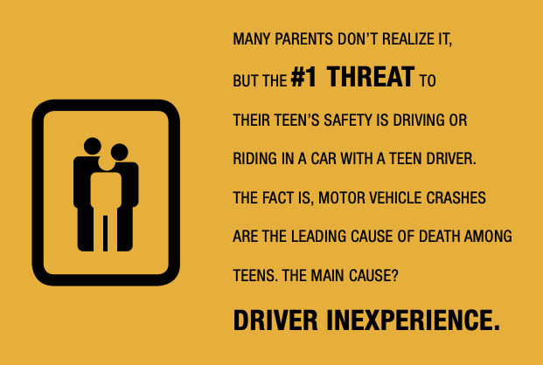
Car Safety
Teens aged 16-19 years are 3 times as likely to be in a fatal crash as drivers over 20
Source: CDC 2020. Teen Drivers: Get the Facts
Notes:
Sources:
Teen Drivers: Get the Facts. Centers for Disease Control and Prevention, National Center for Injury Prevention and Control. Last Reveiwed October 2020. https://www.cdc.gov/motorvehiclesafety/teen_drivers/teendrivers_factsheet.html
Parents Are The Key: Get it in writing. Centers for Disease Control and Prevention, National Center for Injury Prevention and Control. April 2017. https://www.cdc.gov/parentsarethekey/agreement/index.html

Slide 54
Car Safety
Among US High School students who drive:
  39% had texted or e-mailed while driving (38.4% of females, 39.6% of males)
  16.7% rode with a driver who had been drinking alcohol (17.5% of females, 15.6% of males)
  5.4% drove when they had been drinking alcohol (3.6% of females, 7% of males)
Source: CDC Youth Risk Behavior Survey 2019 Results
Notes:
*At least one time in the past 30 days before the survey among those who had driven in the past 30 days
Source: High School Youth Risk Behavior Survey (YRBS): 2019 Results. Centers for Disease Control and Prevention. https://nccd.cdc.gov/youthonline/App/QuestionsOrLocations.aspx?CategoryId=C01

Slide 55
Interpersonal Violence
Do you feel safe at home? At school? Does anyone in those places hurt you or threaten you?
Does anyone at school put you down or make you feel bad about yourself?
Does your romantic partner put you down or make you feel bad about yourself?
  Does he/she/they hurt you physically or threaten you?
  Does he/she/they try to control you or isolate you from friends and family?
Notes:
Adapted from the presentation "Interviewing the Adolescent: Tricks of the Trade" by Dr. Melanie A. Gold.
1) Goldenring JM, Rosen DS. Getting into adolescent heads: an essential update. Contemp Pediatr. 2004;21(1):64-90.
2) Goldenring JM, Cohen E. Getting into adolescent heads. Contemp Pediatr. 1988;5(7):75-90.
3) Klein DA, Goldenring JM & Adelman WP. Contemporary Pediatrics. 2014.
It’s important to support and validate what patients tell you. “Thank you for telling me that, and I’m so sorry that happened to you”. Assess for ongoing safety, available support, and the patient’s degree of distress (are they currently in crisis?).

Slide 56
Sexual Violence
Have you ever been forced to have sex or been touched sexually when you didn’t want to be touched?
  By whom and is this still going on?
  Who did you tell? Did they believe you and support you?
  How does it affect your day-to-day life?
  Have you ever talked about it with a counselor or therapist?
Notes:
Adapted from the presentation "Interviewing the Adolescent: Tricks of the Trade" by Dr. Melanie A. Gold.
1) Goldenring JM, Rosen DS. Getting into adolescent heads: an essential update. Contemp Pediatr. 2004;21(1):64-90.
2) Goldenring JM, Cohen E. Getting into adolescent heads. Contemp Pediatr. 1988;5(7):75-90.
3) Klein DA, Goldenring JM & Adelman WP. Contemporary Pediatrics. 2014.
It’s important to support and validate what patients tell you. “Thank you for telling me that, and I’m so sorry that happened to you”. Assess for ongoing safety, available support, and the patient’s degree of distress (are they currently in crisis?).

Slide 57

Bullying and Physical and Sexual Violence
Among US High School students:
  19.5% were bullied on school property
  8.2% experienced physical dating violence in the past year
  8.2% experienced sexual dating violence in the past year
  7.3% reported ever being forced to have sexual intercourse in their life
Source: CDC Youth Risk Behavior Survey 2019 Results
Notes:
Physical dating violence was defined as being physically hurt on purpose (counting such things as being hit, slammed into something, or injured with an object or weapon) by someone they were dating or going out with, one or more times during the 12 months before the survey, among students who dated or went out with someone during the 12 months before the survey
Sexual dating violence was defined as being forced to do sexual things (counting such things as kissing, touching, or being physically forced to have sexual intercourse) they did not want to do by someone they were dating or going out with, one or more times during the 12 months before the survey, among students who dated or went out with someone during the 12 months before the survey
Source:
1) High School Youth Risk Behavior Survey (YRBS): 2019 Results. Centers for Disease Control and Prevention. https://nccd.cdc.gov/youthonline/App/QuestionsOrLocations.aspx?CategoryId=C01

Slide 58
Violence and Transgender Youth
Among US High School students who identify as transgender:
  34.6% were bullied on school property
  26.4% experienced physical dating violence in the past year
  22.9% experienced sexual dating violence in the past year
  23.8% reported ever being forced to have sexual intercourse in their life
Sources: CDC Youth Risk Behavior Survey 2019 Results
Johns, Lowry, et.al. Transgender Identity and Experiences of Violence Victimization… MMWR 2017
Notes:
Physical dating violence was defined as being physically hurt on purpose (counting such things as being hit, slammed into something, or injured with an object or weapon) by someone they were dating or going out with, one or more times during the 12 months before the survey, among students who dated or went out with someone during the 12 months before the survey
Sexual dating violence was defined as being forced to do sexual things (counting such things as kissing, touching, or being physically forced to have sexual intercourse) they did not want to do by someone they were dating or going out with, one or more times during the 12 months before the survey, among students who dated or went out with someone during the 12 months before the survey
Data on transgender youth is from a convenience sample of 2017 Youth Risk Behavior Survey sites that piloted a measure of transgender identity. The authors write “The results of this study validate findings from smaller clinical and web-based studies that, at a population level, transgender students are at disproportionately higher risk than are cisgender students for violence victimization, substance use, and suicide risk (1–3). The prevalence of reported substance use (e.g., 27.1%, 26.1%, 24.9%, and 35.9% reporting lifetime use of cocaine, heroin, methamphetamines, and prescription opioid misuse, respectively) and suicide risk (e.g., 34.6% attempting suicide in the last 12 months) are concerning. Given that violence victimization is a documented risk factor for substance use and suicide risk (7), implementation of interventions focused on reducing the victimization of transgender adolescents might be a key strategy for improving overall health.”
Source:
1) High School Youth Risk Behavior Survey (YRBS): 2019 Results. Centers for Disease Control and Prevention. https://nccd.cdc.gov/youthonline/App/QuestionsOrLocations.aspx?CategoryId=C01
2) Johns MM, Lowry R, Andrzejewski J, et al. Transgender Identity and Experiences of Violence Victimization, Substance Use, Suicide Risk, and Sexual Risk Behaviors Among High School Students — 19 States and Large Urban School Districts, 2017. MMWR Morb

Slide 59
Case Discussion
Michelle’s doctor continues the social history:
S: Michelle says her parents’ divorce two years ago was stressful and she sometimes feels sad about it. She denies ever feeling suicidal and says she talks with her best friend or her aunt when she feels sad.
S: She always wears a seatbelt and has never ridden with a driver who was drunk or high. She says her best friend is 16 and sometimes texts her while driving. She wishes she wouldn’t do that because it isn’t safe.

Slide 60
Case Discussion
Michelle’s doctor continues the social history:
Michelle’s doctor answers her questions about her sexual health, contraception and preventing sexually transmitted infections
Her doctor also tells her that she has a right to and can consent for confidential sexual health care
They talk more about Michelle’s marijuana use and her doctor highlights some of the negative effects it can have on brain development, something Michelle didn’t know
Finally, the doctor offers to refer Michelle to the counselor at the clinic to talk about things in her life that are stressful or sad

Slide 61
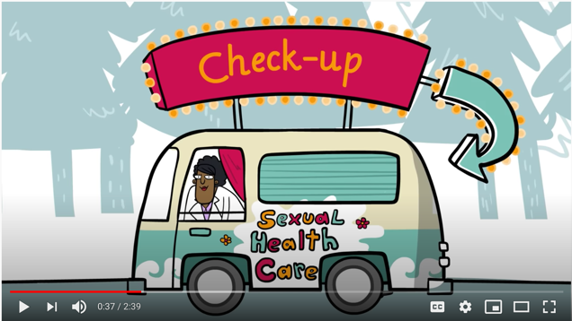
Questions? Discussion?
Notes:
Physical dating violence was defined as being physically hurt on purpose (counting such things as being hit, slammed into something, or injured with an object or weapon) by someone they were dating or going out with, one or more times during the 12 months before the survey, among students who dated or went out with someone during the 12 months before the survey
Sexual dating violence was defined as being forced to do sexual things (counting such things as kissing, touching, or being physically forced to have sexual intercourse) they did not want to do by someone they were dating or going out with, one or more times during the 12 months before the survey, among students who dated or went out with someone during the 12 months before the survey
Data on transgender youth is from a convenience sample of 2017 Youth Risk Behavior Survey sites that piloted a measure of transgender identity. The authors write “The results of this study validate findings from smaller clinical and web-based studies that, at a population level, transgender students are at disproportionately higher risk than are cisgender students for violence victimization, substance use, and suicide risk (1–3). The prevalence of reported substance use (e.g., 27.1%, 26.1%, 24.9%, and 35.9% reporting lifetime use of cocaine, heroin, methamphetamines, and prescription opioid misuse, respectively) and suicide risk (e.g., 34.6% attempting suicide in the last 12 months) are concerning. Given that violence victimization is a documented risk factor for substance use and suicide risk (7), implementation of interventions focused on reducing the victimization of transgender adolescents might be a key strategy for improving overall health.”
Source:
1) High School Youth Risk Behavior Survey (YRBS): 2019 Results. Centers for Disease Control and Prevention. https://nccd.cdc.gov/youthonline/App/QuestionsOrLocations.aspx?CategoryId=C01
2) Johns MM, Lowry R, Andrzejewski J, et al. Transgender Identity and Experiences of Violence Victimization, Substance Use, Suicide Risk, and Sexual Risk Behaviors Among High School Students — 19 States and Large Urban School Districts, 2017. MMWR Morb

Slide 62
Please complete the evaluation survey!
Adolescent Reproductive and Sexual Health Education Project (ARSHEP)
Adolescent-Friendly Health Services
insert QR code
•Open your cell phone camera
•Aim the camera at the QR code
•The survey link will pop up – please click
•Fill out the survey ☺

Slide 63
Adolescent Reproductive and Sexual Health Education Project (ARSHEP)
Adolescent-Friendly Health Services
Notes:
Updated 2020

