Slide 1
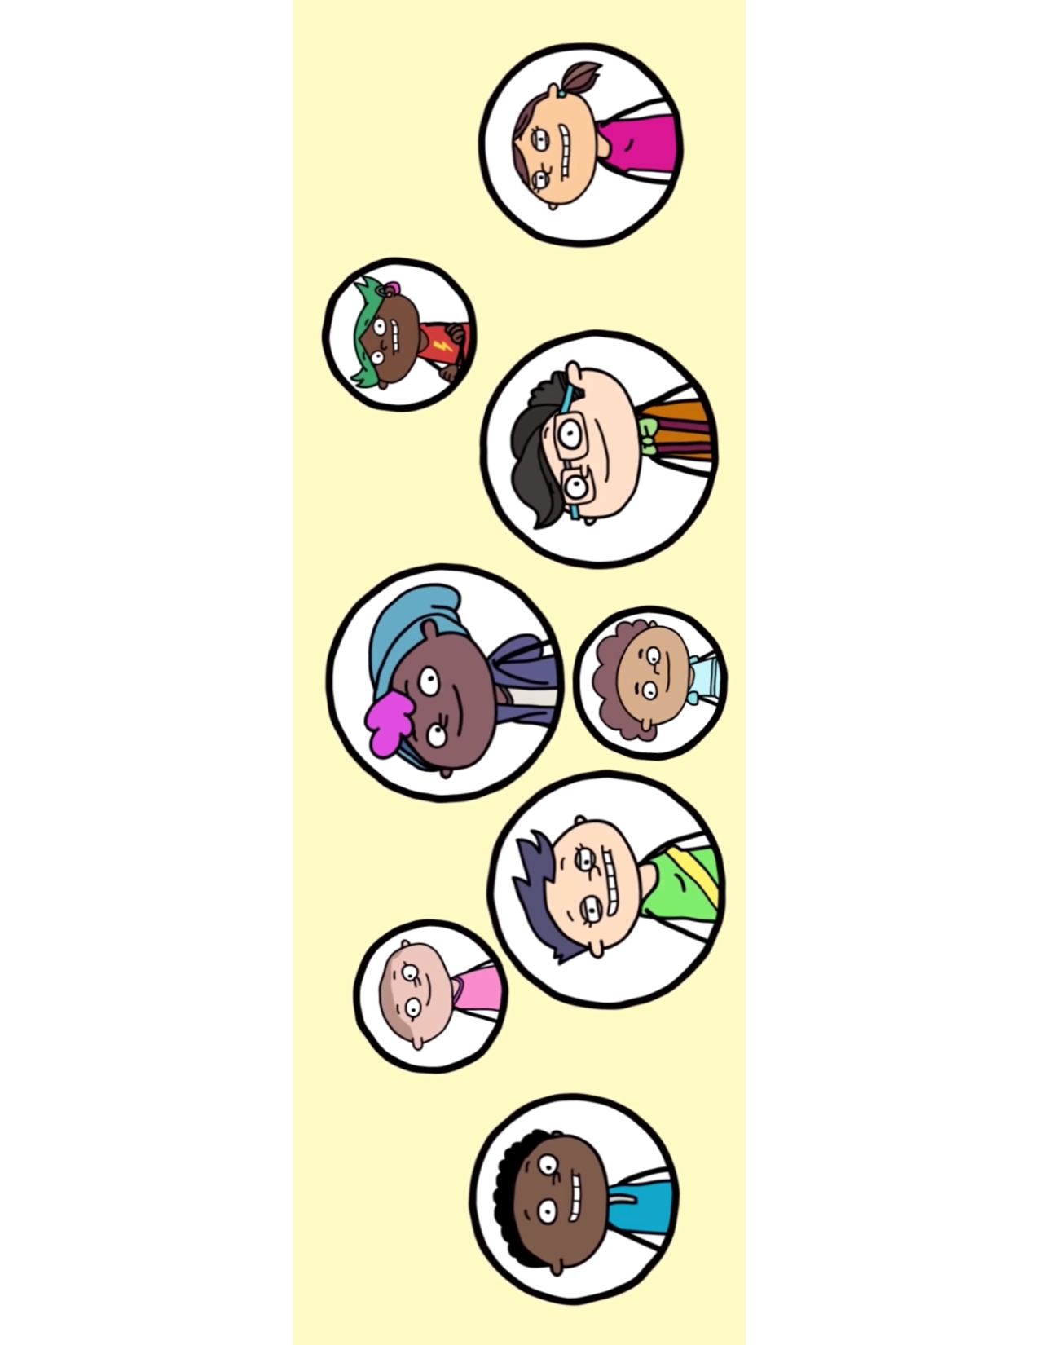
Adolescent Reproductive and Sexual Health Education Project (ARSHEP)
Cultural Responsiveness and Adolescent Health
Notes:
Updated 2021

Slide 2
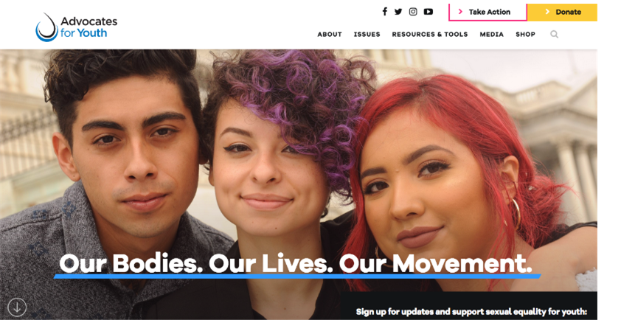
Notes:
Advocates for Youth partners with youth leaders, adult allies, and youth-serving organizations to advocate for policies and champion programs that recognize young people’s rights to: honest sexual health information; accessible, confidential and affordable sexual health services; and the resources and opportunities necessary to create sexual health equity for all youth.
Our values are reflected in the 3Rs:
•Youth have the inalienable right to honest sexual health information.
•Youth deserve respect.
•Society has the responsibility to provide young people with tools need to safeguard their sexual health and lead the lives they desire.

Slide 3

This presentation was originally created by Physicians for Reproductive Health as part of the ARSHEP curriculum.
Updates and modifications to this presentation were supported, in part, by Cooperative Agreement PS18-1807 from the Centers for Disease Control and Prevention, Division of Adolescent and School Health (CDC-DASH). The contents do not necessarily represent the official views of the Centers for Disease Control and Prevention.

Slide 4
Adolescent Reproductive and Sexual Health Education Project (ARSHEP)
[Faculty Member information goes here}
Notes:
Updated 2020

Slide 5
Acknowledgment
This presentation was made possible by Cooperative Agreement PS18-1807 from the Centers for Disease Control and Prevention, Division of Adolescent and School Health (CDC-DASH). The contents do not necessarily represent the official views of the Centers for Disease Control and Prevention.

Slide 6
Objectives
Discuss the relationship between culture and health in the context of adolescent-friendly services
Describe the intersection of patient-centered care and cultural competence
Utilize the framework of cultural humility to address implicit provider bias and optimize health outcomes

Slide 7
What is Cultural Competence?
Cultural and linguistic competence is:
  A set of congruent behaviors, attitudes, and policies that come together in a system, agency, or among professionals that enables effective work in cross-cultural situations
The Department of Health & Human Services defines culturally and linguistically appropriate services (CLAS) standards. The principal standard is to:
  Provide effective, equitable, understandable, and respectful quality care and services that are responsive to diverse cultural health beliefs and practices, preferred languages, health literacy, and other communication needs.
Notes:
'Culture' refers to integrated patterns of human behavior that include the language, thoughts, communications, actions, customs, beliefs, values, and institutions of racial, ethnic, religious, or social groups.
'Competence' implies having the capacity to function effectively as an individual and an organization within the context of the cultural beliefs, behaviors, and needs presented by consumers and their communities.
Sources:
Cross T, Bazron B, Dennis K, Isaacs M. (1989). Towards a Culturally Competent System of Care, Volume I. Washington, D.C.: Georgetown University Child Development Center, CASSP Technical Assistance Center.
National Culturally and Linguistically Appropriate Services Standards. Think Cultural Health. U.S. Department of Health and Human Services, Office of Minority Health. https://thinkculturalhealth.hhs.gov/clas/standards

Slide 8

Why is Cultural Competence Important?
Individual values, beliefs, and behaviors about health and well-being are shaped by various factors such as race, ethnicity, nationality, language, gender, socioeconomic status, physical and mental ability, sexual orientation, and occupation.
Notes:
Source:
Cultural Competence in Health Care: Is it important for people with chronic conditions? Georgetown University, McCourt School of Public Policy, February 2004. https://hpi.georgetown.edu/cultural/

Slide 9
Why is Cultural Competence Important?
The goal of culturally competent health care services is to provide the highest quality of care to every patient while being cognizant of these factors
Notes:
Source:
Cultural Competence in Health Care: Is it important for people with chronic conditions? Georgetown University, McCourt School of Public Policy, February 2004. https://hpi.georgetown.edu/cultural/

Slide 10
Adolescents Have Unique Health Needs Based On Development
Adolescence is a critical period of development and change including:
  Biological/Physical
    Puberty and physical growth
  Cognitive
    Brain development, ability to perform more complex cognitive tasks, regulation of impulse control
  Emotional
    Developing capacity to understand feelings, learning healthy coping mechanisms. Many mental health problems present initially during adolescent years
  Social
    Forming healthy relationships, understanding gender identity, sexual orientation and developing sexual identity
Notes:
“Adolescence, defined as 11 through 21 years of age, is a critical period of development in a young person’s life, one filled with distinctive and pivotal biological, cognitive, emotional, and social changes.” – AAP Committee on Adolescence
Healthcare professionals can educate adolescents and their parents about the psychosocial and developmental aspects of adolescence.
The goal of youth during this stage is to gain independence and establish a secure identity of who they are. Recommendation to parents and guardians to continue to provide parental or supervisory monitoring and model positive health behaviors and conflict resolution is critical for ensuring that teens remain safe while gradually becoming more independent.
Note: WHO defines adolescents as young people ages 10-19 years of age
The World Health Organization, the Office of Adolescent Health of the US Department of Health and Human Services, the Health and Medicine Division of the National Academies of Sciences, Engineering, and Medicine (formerly the Institute of Medicine), the Lancet, with four international academic institutions, and the Society for Adolescent Health and Medicine have called for a closer examination of the unique health needs of adolescents.
Sources: Elizabeth M. Alderman, Cora C. Breuner and COMMITTEE ON ADOLESCENCE. Unique Needs of the Adolescent. Pediatrics originally published online November 18, 2019. https://pediatrics.aappublications.org/content/pediatrics/early/2019/11/14/peds.2019-3150.full.pdf
Growth and Development, Ages 13 to 17 – What Parents Need to Know. Advocates for Youth. 2002. https://www.advocatesforyouth.org/wp-content/uploads/storage//advfy/documents/13_17.pdf
Adolescent Friendly Health Services: An Agenda for Change. The World Health Organization, 2004. Available at: https://apps.who.int/iris/bitstream/handle/10665/67923/WHO_FCH_CAH_02.14.pdf?sequence=1&isAllowed=y
Sanders, RA. Adolescent Psychosocial, Social, and Cognitive Development. Pediatrics in Review. Aug 2013, 34 (8) 354-359; DOI: 10.1542/pir.34-8-354

Slide 11
Adolescence in Context
An adolescent’s identity includes:
  Genetics
  Stage of development
  Gender identity
  Sexual orientation
  Ability
  Family structure
  Peers
  Geography
  Race and ethnicity
  Religion
  Socioeconomic Status
  Education
Notes:
Question to audience: What other internal and external factors contribute to an adolescent’s identity?

Slide 12
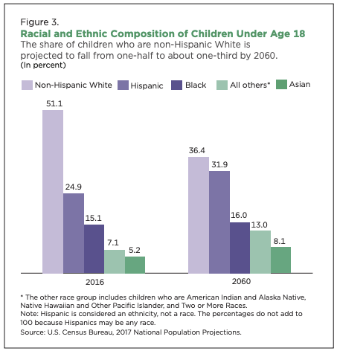
The Growing Diversity of the US Population
Notes:
Adolescent health providers need to be aware of the growing diversity of the adolescent population and understand the ways in which race, ethnicity, orientation, gender identity, culture, and socioeconomic status interact with heath behaviors and outcomes.
There is much debate as to whether to utilize the term “Hispanic” or “Latino” when referring to Spanish-speaking people in the U.S., or descendents of Spanish-speaking countries. However, because our data is taken directly from the United States Census Bureau, we are using the language used in their surveys. When treating patients, it is important to find out how he or she prefers to identify and not to assume that the adolescent is more comfortable with one label over the other.
Sources:
Demographic Turning Points for the United States: Population Projections for 2020 to 2060. Current Population Reports, Series P-25, No. 1144. U.S. Department of Commerce, Bureau of the Census, revised February 2020.
Davis BJ, Voegtle KH. Culturally Competent Health Care for Adolescents: A Guide for Primary Care Health Providers. Chicago, IL: American Medical Association; 1994
National Adolescent Health Information Center, 2000

Slide 13
Diversity in Gender Identity and Sexual Orientation
Among US High School students:
  1.8% identified themselves as transgender
  84.4% identified themselves as heterosexual (77.6% of females, 91.2% of males)
  2.5% identified themselves as gay or lesbian (2.9% of females, 2.1% of males)
  8.7% identified themselves as bisexual (13.9% of females, 3.4% of males)
  4.5% were unsure of their sexual identity (5.6% of females, 3.2% of males)
Source: CDC YRBS data 2017 and 2019
Notes:
The YRBS, or Youth Risk Behavior Survey, is an anonymous survey administered by the CDC every two years in selected high schools throughout the United States. Thus, it is a survey of adolescents in grades 9–12 who are in school. The survey focuses on many different health concerns and behaviors including: mental health, exercise, nutrition, use of seatbelts, substance use behavior and sexual behavior.
1.8% identified themselves as being transgender (94.4% said they were not transgender, 1.6% were unsure and 2.1% did not understand the question)
84.4% identified themselves as heterosexual (77.6% of females, 91.2% of males)
2.5% identified themselves as gay or lesbian (2.9% of females, 2.1% of males)
8.7% identified themselves as bisexual (13.9% of females, 3.4% of males)
4.5% were unsure of their sexual identity (5.6% of females, 3.2% of males)
Data on this slide regarding gender identity are from the 2017 YRBS (most recent available); data on sexual orientation are from the 2019 YRBS.
Sources:
Johns MM, Lowry R, Andrzejewski J, et al. Transgender Identity and Experiences of Violence Victimization, Substance Use, Suicide Risk, and Sexual Risk Behaviors Among High School Students — 19 States and Large Urban School Districts, 2017. MMWR Morb Mortal Wkly Rep 2019;68:67–71.
Table 4: Number and percentage of students, by sexual identity. High School Youth Risk Behavior Survey (YRBS): 2019 Results. Centers for Disease Control and Prevention. https://www.cdc.gov/healthyyouth/data/yrbs/2019_tables/students_by_sexual_identity.htm

Slide 14
Influences on Health
Direct
Socio-Economic Influences
Broad Socio-Economic Influences
Global Health Influences
Individual Patient Care
Access to Care
Notes:
There are a range of personal, social, economic & environmental factors that influence your patient's health status.
In the middle of this graph, you have your patient who is sitting in your exam room. The health of your patient that day is influenced by their ability to access care, their socioeconomic status and other socioeconomic influences, and environmental influences.
(Then you can either give examples—see below—or ask for examples from the audience.)
Due to these external influences, physicians and medical organizations are increasingly becoming more involved with policy change in order to have a larger impact on health.
Examples:
Access to care: insurance status, availability of clinics/providers
Direct socioeconomic influences: smoking, interpersonal violence, unsafe housing
Broad socioeconomic influences: race, income, employment status – voting rights, access to healthy food
Source:
Adapted from: Gruen RL, et al. JAMA 2004;291:94–98.

Slide 15
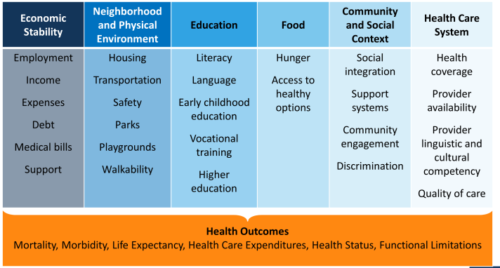
Social Determinants of Health
Notes:
Social determinants of health are “the conditions in which people are born, grow, work, live, and age, and the wider set of forces and systems shaping the conditions of daily life”. (WHO definition)
Sometimes we can feel overwhelmed with the magnitude of these problems, since they reach into nearly every facet of life.
There are large cultural and bias issues we are grappling with in medicine – these sometimes manifest as racial and ethnic disparities. How can we as doctors address these biases? – give examples
Image credit: http://kff.org/disparities-policy/issue-brief/beyond-health-care-the-role-of-social-determinants-in-promoting-health-and-health-equity/ Accessed 9/18/2016

Slide 16

“Minority” Status in One or More Aspects of an Adolescent’s Identity Can Affect:
How and where health care is sought
Ability to obtain and pay for quality care
Patient-health care provider interaction
Societal stereotyping and marginalizing

Slide 17
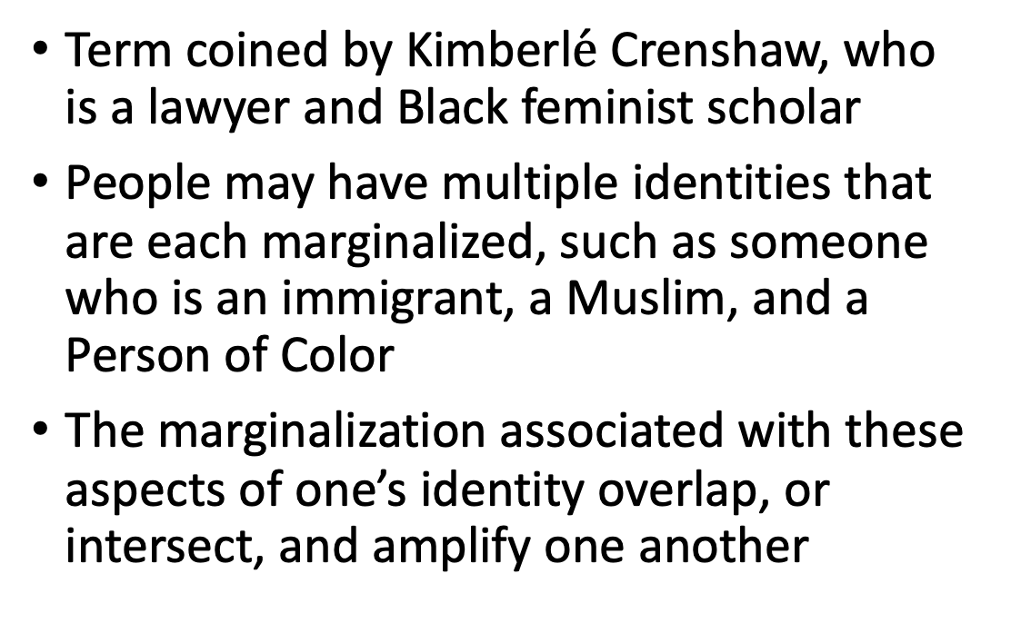

Intersectionality
Notes:
https://www.vox.com/the-highlight/2019/5/20/18542843/intersectionality-conservatism-law-race-gender-discrimination

Slide 18
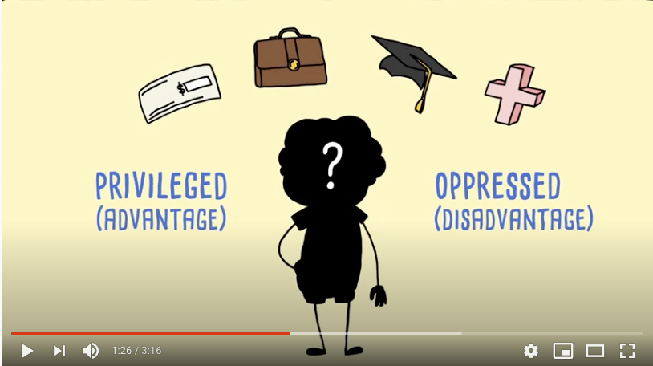
AMAZE: Intersectionality
Play Video
Notes:
https://www.youtube.com/watch?v=dV9vhtS_1rw&feature=emb_logo

Slide 19
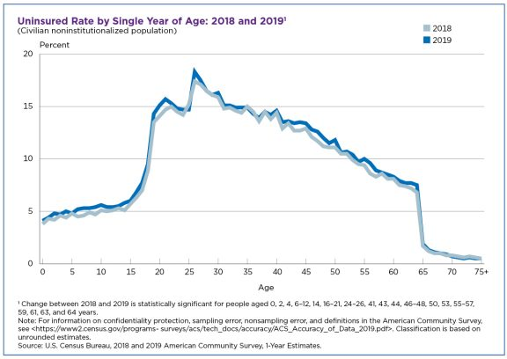
Lack of Insurance
Young adults ages 19-34
  15.6% uninsured (highest)
Teens and children under age 19:
  5.7% uninsured
41% of children under age 18 had public insurance
  Compared to 20% of adults 18-64
Source: Conway. US Census Bureau. Oct 2020.
Notes:
Lack of money and insurance is a significant external barrier to health care.
Uninsured rate increases at ages 19, when CHIP eligibility expires,
Increases again at 26, when eligibility for dependent coverage under a parent expires
26-year-olds have the highest uninsured rate among all ages (sharp peak in the graph)
The uninsured rates for people ages 19 to 34 was 10.5 percentage points higher in states that have not expanded Medicaid eligibility than in expansion states: 22.3% compared with 11.8%, respectively.
Source:
Conway D. Adults Age 26 Had Highest Uninsured Rate Among All Ages, Followed By 27-Year-Olds. United States Census Bureau. October 2020. https://www.census.gov/library/stories/2020/10/uninsured-rates-highest-for-young-adults-aged-19-to-34.html#:~:text=People%20in%20this%20age%20group,0.4%20percentage%20points%20to%2015.6%25.

Slide 20
Lack of Insurance = Lack of Care
Uninsured adolescents are:
  Less likely to receive medical care
  Less likely to have a usual source of care
  More likely to experience long wait times
  More likely to be low income and of color
Insured adolescents visit a physician’s office twice as often as uninsured teens.
Notes:
Sources:
Bullet 1-http://www.caiglobal.org/ Elizabeth Jones, MPA March 2013; In Their Own Words, The Kaiser Commission on Medicaid and the Uninsured, September 2000.
Bullet 2 – Source: Adolescent Health Care and Health Services Research. Role of Partnerships: Second Annual Meeting of Child Health Services Researchers. June 27, 2000. Agency for Healthcare Research and Quality, Rockville, MD. http://www.ahrq.gov/research/chsr2ado.htm
Source: Klein JD, Wilson K, McNulty M, Kaplan C, Collins K. Access to medical care for adolescents: results from the 1997 Commonwealth Fund survey of the health of adolescent girls. J Adol Health. 1999;25:120–130
Adolescents who were poor and uninsured were less likely to get a preventative care visit than those who had insurance.
Source:
Preventive Care for Adolescents: Few Get Visits and Fewer Get Services. Charles Irwin, Jr., Sally Adams, M. Jane Park and Paul Newacheck. Pediatrics 2009; 123; e565–e572. DOI: 10.1542/peds.2008–2601. Accessed November 3, 2010: http://pediatrics.aappublications.org/cgi/reprint/123/4/e565

Slide 21
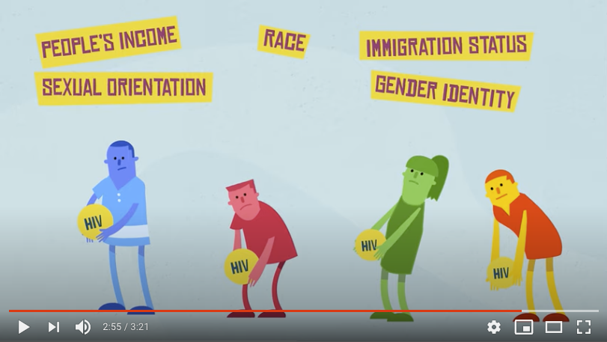
AMAZE: HIV and Health Disparities
Play Video
Notes:
https://www.youtube.com/watch?v=OAp7tJuZH7U&feature=emb_logo

Slide 22
Racial disparities
Sexual and Reproductive Health

Slide 23
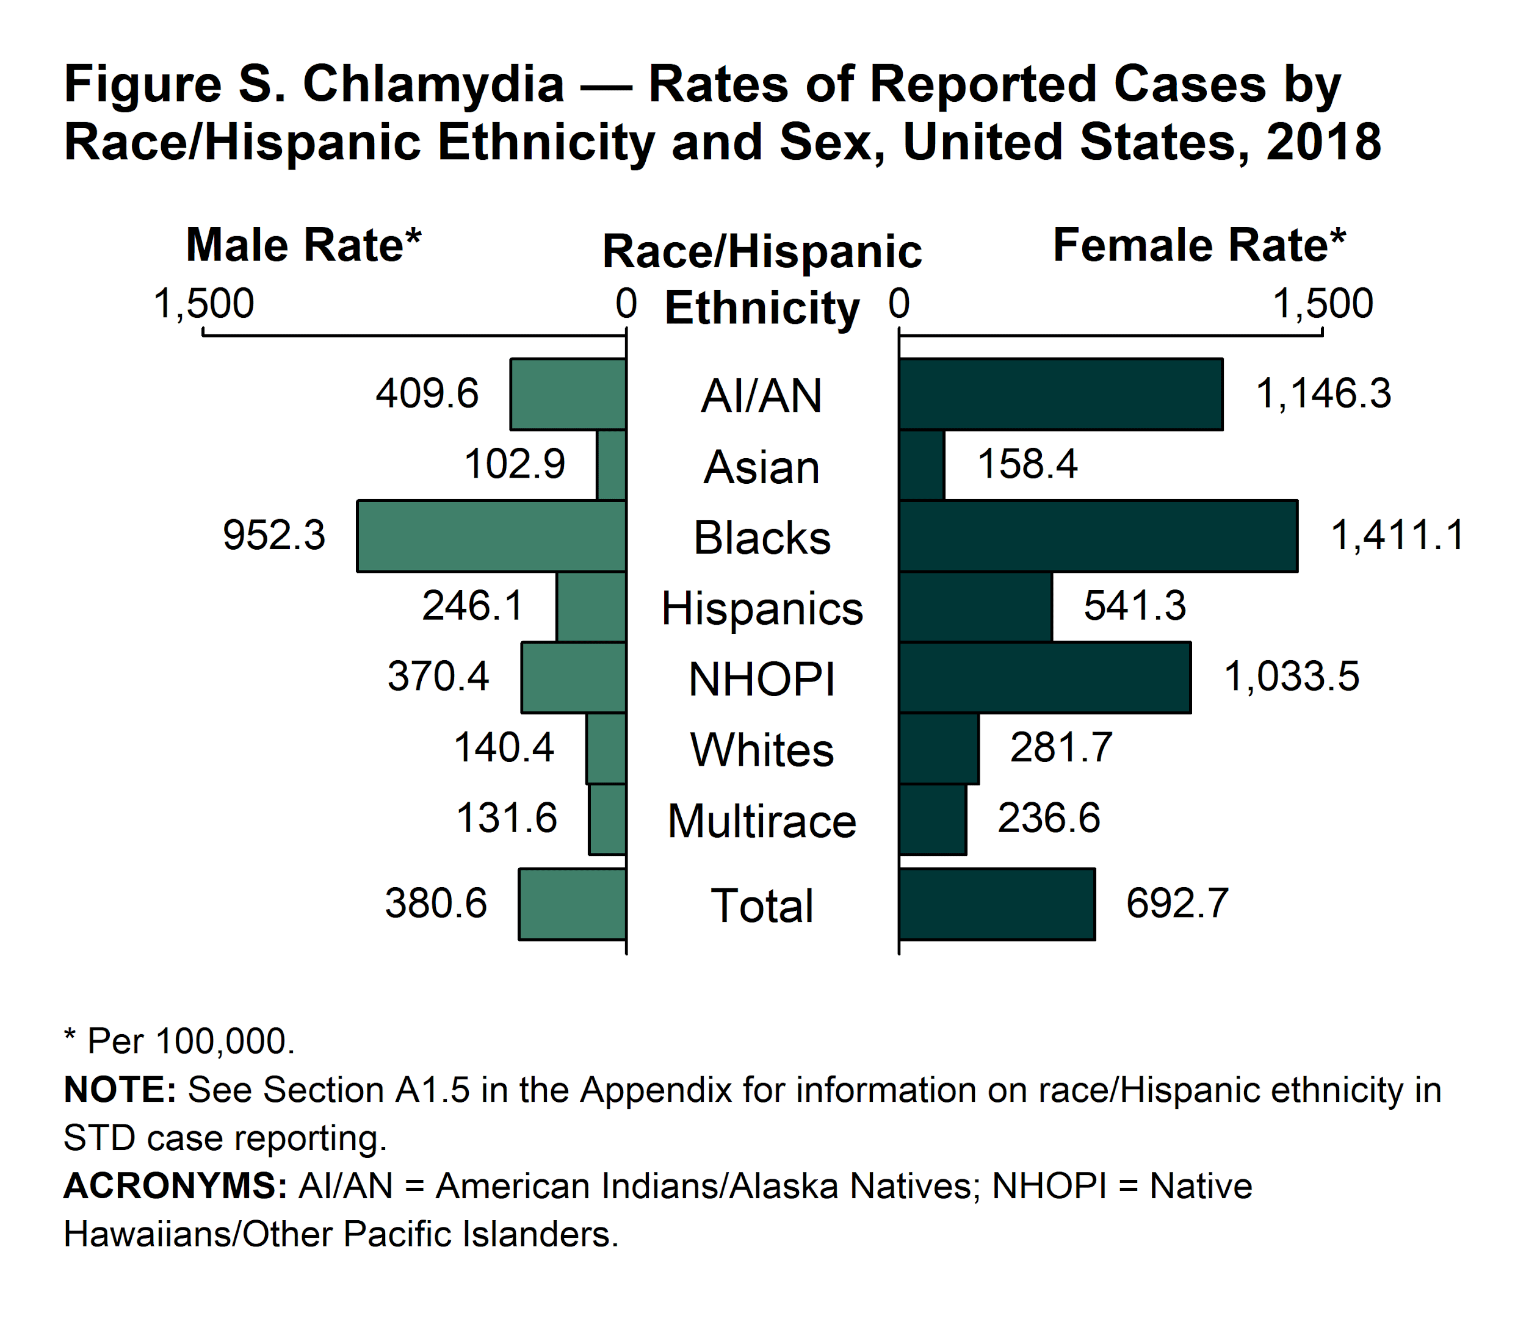
Racial Disparities in Sexually Transmitted Infections
Disparities among some racial minority or Hispanic groups persist in a variety of health outcomes, including STIs
  Chlamydia
  Gonorrhea
  Syphilis
  Trichomoniasis
  HIV
Source: CDC STD Surveillance 2018.
Notes:
Shown are the reported cases of chlamydia for 2018 by race/ethnicity and sex, but similar disparities exist in other STIs:
In 2018, the rate of reported gonorrhea cases was 7.7 times higher among Blacks, 4.6 times higher among American Indians/Alaska Natives, 2.6 times higher among Native Hawiaians/Other Pacific Islanders and 1.6 times higher among Hispanics than the rate among Whites. The rate among Asians was 0.5 times the rate among Whites.
Source:
STDs in Racial and Ethnic Minorities. Sexually Transmitted Disease Surveillance 2018. Centers for Disease Control and Prevention. https://www.cdc.gov/std/stats18/minorities.htm

Slide 24
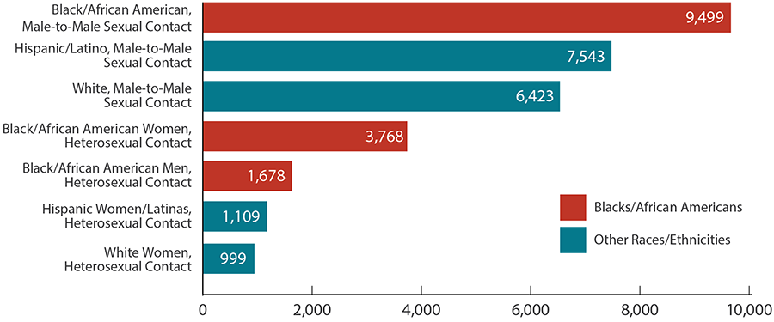
Disparities in new HIV diagnoses by race/ethnicity
Source: CDC HIV and African Americans. May 2020.
Notes:
In 2018, blacks/African Americans accounted for 13% of the US population but 42% of the 37,832 new HIV diagnoses in the United States and dependent areas.
Source:
HIV and African Americans. Centers for Disease Control and Prevention. Last reviewed May 2020. https://www.cdc.gov/hiv/group/racialethnic/africanamericans/index.html

Slide 25

Racial Disparities in Maternal Mortality
In 2019 the CDC released a report analyzing data on pregnancy-related mortality from 2007-2016
  Black women had a pregnancy-related mortality rate (PRMR) 3.2 times higher than of white women
  American Indian/Alaska Native women had a PRMR 2.3 times higher than of white women
  Even in states with the lowest PRMR, disparities persist
  Among women with at least a college degree, black women had a PRMR 5.2 times higher than that of white women
Source: CDC Brief. Racial and Ethnic Disparities in Pregnancy-Related Deaths. September 2019.
Notes:
CDC report determined that each pregnancy-related death was associated with several contributing factors, including
access to appropriate and high-quality care
missed or delayed diagnoses
lack of knowledge among patients and providers around warning signs.
Maternal Mortality Review Committee data suggest the majority of deaths – 60% or more – could have been prevented by addressing these factors at multiple levels.
Source:
Racial and Ethnic Disparities Continue in Pregnancy-Related Deaths: Black, American Indian/Alaska Native women most affected. Centers for Disease Control and Prevention. September 2019. https://www.cdc.gov/media/releases/2019/p0905-racial-ethnic-disparities-pregnancy-deaths.html

Slide 26
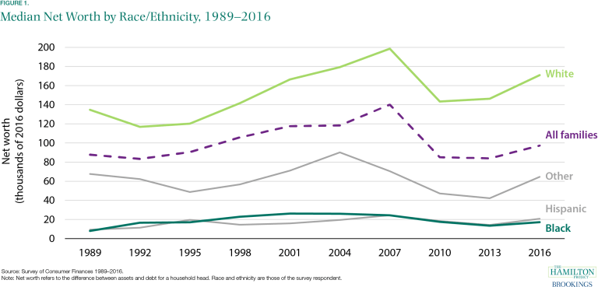
Disparate Rates of Poverty & Lack of Insurance
The net worth of a typical white family is nearly 10 times greater than that of a typical Black family
The poverty rate for Black (18.8%) and Hispanic (15.7%) people is more than twice that of whites (7.3%)
Uninsured rates among nonelderly people (ages 0 to 64) are highest in American Indian/Alaska Natives (22%) followed by Hispanic people of all races (19%)
Source: McIntosh, et.al. Brookings Institution, February 2020.
Notes:
Wealth and Poverty
In 2016, the median net worth of white families in America was $171,000 while the median net worth of black families was $17,150. (median is used to determine the wealth of typical families since mean or average values are skewed by a small number of very wealthy people)
In 2019, the overall poverty rate for the United States was 10.5%, the lowest since estimates were first released for 1959.
Poverty rates for all racial and Hispanic origin groups have declined, but Black and Hispanic individuals of all ages are still overrepresented among those in poverty relative to their share among the general population.
For example, Black people represented 13.2% of the U.S. population in 2019 but 23.8% of the population in poverty.
Uninsured rates
The Patient Protection and Affordable Care Act (ACA) reduced uninsured rates across the country. It had a larger impact in states that expanded Medicaid than in those that didn’t, and had a larger impact for Black, Asian, American Indian/Alaska Native and people of Hispanic origin than for non-Hispanic whites.
Despite these gains, disparities in uninsured rates remain among the total non-elderly population as noted above and among children and adolescents specifically
As of 2018, the uninsured rate for American Indian/Alaska Native children ages 0 to 18 was 14% compared to 8% for Hispanic children of all races, 4% for non-Hispanic Black children and 4% for non-Hispanic white children.
Sources:
McIntosh K, Moss E, Nunn R & Shambaugh J. Examining the Black-white wealth gap. Brookings Institute, February 2020. https://www.brookings.edu/blog/up-front/2020/02/27/examining-the-black-white-wealth-gap/
Creamer J. Inequalities Persist Despite Decline in Poverty for All Major Race and Hispanic Origin Groups. United States Census Bureau, September 2020. https://www.census.gov/library/stories/2020/09/poverty-rates-for-blacks-and-hispanics-reached-historic-lows-in-2019.html
Artiga S, Orgera K & Damico A. Changes in Health Coverage by Race and Ethnicity since the ACA, 2010-2018. Kaiser Family Foundation, March 2020. https://www.kff.org/racial-equity-and-health-policy/issue-brief/changes-in-health-coverage-by-race-and-ethnicity-since-the-aca-2010-2018/

Slide 27
Why Do These Disparities Exist?
Racism:
  Institutional racism (also called structural or systemic)
  Personally-mediated or interpersonal racism
  Internalized racism
Minority race and/or ethnicity is strongly correlated with other factors affecting health status, including:
  Poverty
  Low educational opportunity
  Few available jobs
  Higher rate of incarceration
  Lack of adequate insurance
  Reduced access to quality care
sewing machine pfaff
Notes:
Camara Jones’ 2000 article in the American Journal of Public health provides the theoretic framework for levels of racism referenced above:
Racism is a “system of structuring opportunity and assigning value based on the social interpretation of how one looks (which is what we call ‘race’) that unfairly disadvantages some individuals and communities, unfairly advantages other individuals and communities, and saps the strength of the whole society through the waste of human resources.”
Institutional racism is the accumulation of customs, laws, policies and practices that discriminate against specific racial groups and result in differential access to the goods, services and opportunities of society by race
Personally-mediated racism is prejudice and discrimination experienced between members of the dominant racial group and members of a stigmatized racial minority. It can be intentional and driven by explicit biases or unintentional and driven by implicit biases.
Internalized racism is acceptance by individual members of a stigmatized racial minority that the dominant racial group is superior
A 2015 meta-analysis found that experiencing racism was associated with poorer mental health, overall health and physical health. Age, sex, birthplace and education level did not moderate the effects of racism on health.
Sources:
Trent M, Dooley DG, Dougé J. AAP Section on Adolescent Health, AAP Council on Community Pediatrics, AAP Committee on Adolescence. The Impact of Racism on Child and Adolescent Health. Pediatrics. 2019;144(2):e20191765
Jones CP. Levels of racism: a theoretic framework and a gardener's tale. Am J Public Health. 2000;90(8):1212-1215. doi:10.2105/ajph.90.8.1212
Paradies Y, Ben J, Denson N, Elias A, Priest N, Pieterse A, et al. (2015) Racism as a Determinant of Health: A Systematic Review and Meta-Analysis. PLoS ONE 10(9): e0138511. https://doi.org/10.1371/journal.pone.0138511

Slide 28
Historical Racism in Medicine
Medicine and medical research has a long history of racism:
  1932-1972: Tuskegee Study of Untreated Syphilis in the Negro Male
  1907-1939: Eugenics movement in the United States
  1956: Initial trials of the first birth control pill were conducted in Puerto Rico without informed consent of the women participating
  Coerced sterilizations of minority women, incarcerated women, immigrants, and those with mental illness have continued throughout the 20th century and into the 21st
    California’s prison system sterilized more than 150 Mexican-American and Asian-American inmates between 2006-2010
Notes:
These and many other examples are the basis of deep mistrust among many in minority communities
Sources:
U.S. Public Health Service Syphilis Study at Tuskegee. Centers for Disease Control and Prevention. Last reviewed March 2020. https://www.cdc.gov/tuskegee/timeline.htm
Farber SA. U.S. scientists' role in the eugenics movement (1907-1939): a contemporary biologist's perspective. Zebrafish. 2008;5(4):243-245. doi:10.1089/zeb.2008.0576
“Unwanted Sterilization and Eugenics Programs in the United States.” PBS Independent Lens, Public Broadcasting Service, 29 Jan. 2016, www.pbs.org/independentlens/blog/unwanted- s terilization-and-eugenics programs-in-the-united-states/
“The Puerto Rico Pill Trials.” American Experience, Public Broadcasting Service. https://www.pbs.org/wgbh/americanexperience/features/pill-puerto-rico-pill-trials/

Slide 29
Trust in Health Care Providers
A 2020 survey found that Black adults were less likely than white adults to trust doctors to do what is right for them or their community (59 vs 78%)
  This disparity was even more pronounced for young black adults ages 18-29 with just 35% trusting the health care system overall and 54% trusting doctors specifically
1 in 5 Black and Hispanic origin adults report experiencing race-based discrimination while getting health care for themselves or a family member in the past year (compared to 1 in 20 white adults)
Source: Hamel, et.al. Kaiser Family Foundation. October 2020.
Notes:
Source:
Hamel L, Lopes L, Muñana C, Artiga S & Brodie M. KFF/The Undefeated Survey on Race and Health. Kaiser Family Foundation, October 2020. https://www.kff.org/report-section/kff-the-undefeated-survey-on-race-and-health-main-findings/

Slide 30
Socioeconomic Disparities
Sexual and Reproductive Health

Slide 31
Economic Disparities in Unintended Pregnancy
100-199% of poverty
≥ 200% of poverty
Source: Guttmacher Institute. March 2016.
Notes:
Source: U.S. Unintended Pregnancy Rate Falls to 30-Year Low; Declines Seen in Almost All Groups, but Disparities Remain. Guttmacher Institute. March 2016. https://www.guttmacher.org/news-release/2016/us-unintended-pregnancy-rate-falls-30-year-low-declines-seen-almost-all-groups

Slide 32
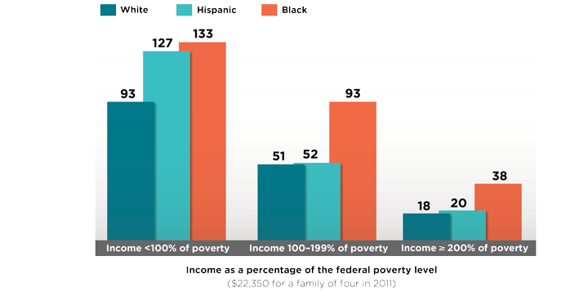
Even when controlling for income, racial disparities persist
Unintended pregnancy rate, 2011 (per 1000 women aged 15-44
Source: Guttmacher Institute. March 2016.
Notes:
This graph shows unintended pregnancy rate in 2011 per 1,000 women ages 15-44 by race/ethnicity. The horizontal black lines are the overall rate of unintended pregnancy in all women of reproductive age.
There continue to be disparities in unintended pregnancy rates based on race and ethnicity, even when controlling for income
This finding is reflective of the broader health disparities that people of color experience due to barriers in accessing health care services.
Previous research suggests that minority communities face barriers in accessing high quality contraceptive services and accessing their chosen method of birth control, leading to higher unintended pregnancy rates.
Some groups—including higher-income women, white women, college graduates and married women—are comparatively successful at timing and spacing their pregnancies. For example, higher-income white women experience unintended pregnancy at less than half the national rate (20 vs. 54 per 1,000).
Source: U.S. Unintended Pregnancy Rate Falls to 30-Year Low; Declines Seen in Almost All Groups, but Disparities Remain. Guttmacher Institute. March 2016. https://www.guttmacher.org/news-release/2016/us-unintended-pregnancy-rate-falls-30-year-low-declines-seen-almost-all-groups

Slide 33
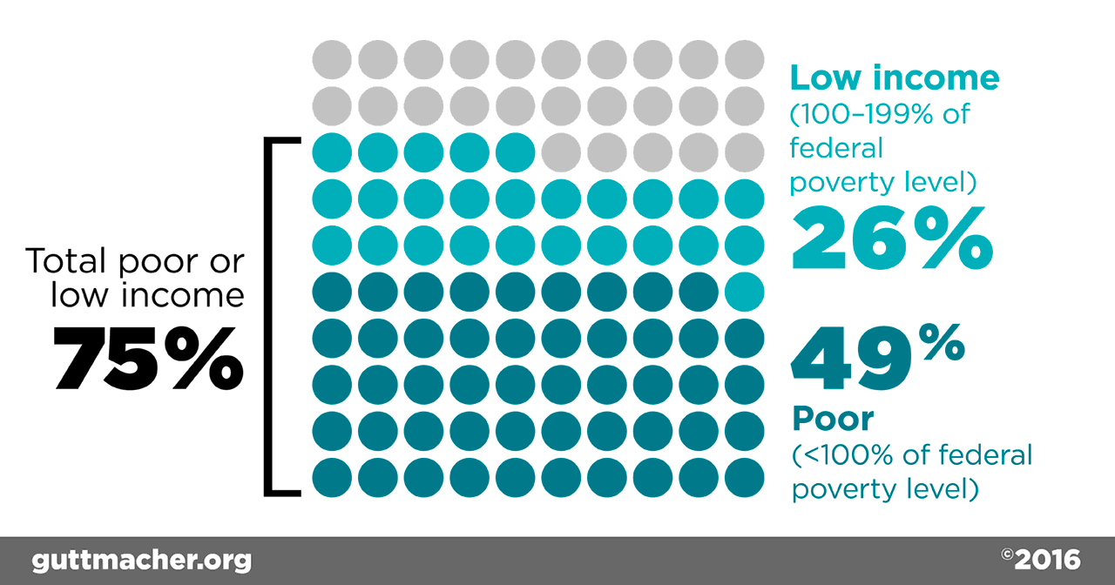
Abortion Patients are Disproportionately Poor and Low Income
Source: Guttmacher Institute. 2016.
Notes:
Nearly half of abortion patients in the United States are poor and another 26% are low income. These data come from a nationally representative survey of nonhospital abortion patients in the United States. Poor women continue to account for a disproportionate share of abortion patients, and this representation increased from 42% to 49% over the six-year period, mostly driven by an increase in the population of women of reproductive age who are poor.
Source. Jerman J, Jones RK and Onda T, Characteristics of U.S. Abortion Patients in 2014 and Changes Since 2008, New York: Guttmacher Institute, 2016.

Slide 34
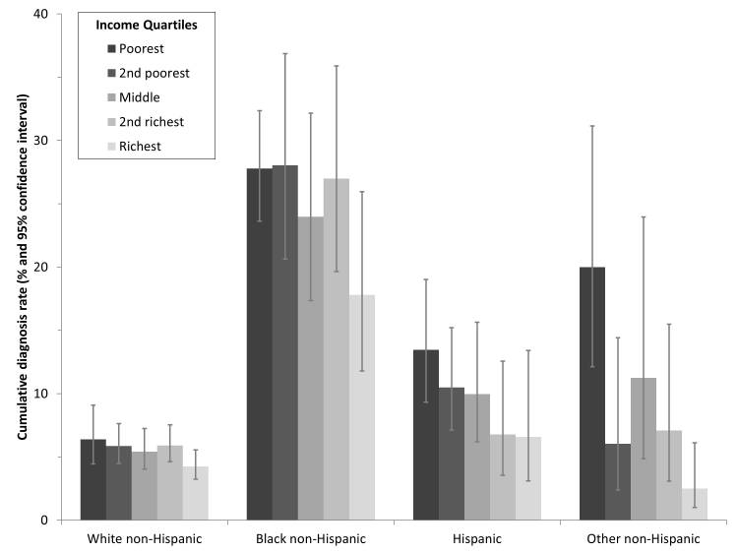
Lower income associated with higher STI rates across all racial/ethnic groups
Racial/ethnic differential still significantly larger factor than income
Source: Harling, et.al. Sex Trans Dis. 2013.
Notes:
“While racial/ethnic differentials are significantly larger than income differentials in STI rates nationwide, both factors are independent predictors of increased risk”
Source:
Harling G, Subramanian S, Bärnighausen T, Kawachi I. Socioeconomic disparities in sexually transmitted infections among young adults in the United States: examining the interaction between income and race/ethnicity. Sex Transm Dis. 2013;40(7):575-581. doi:10.1097/OLQ.0b013e31829529cf

Slide 35
Disparities for LGBTQ+ Youth
Physical, Mental & Emotional Health

Slide 36
Disparities in Homelessness
30-40% of homeless youths identify as LGBTQ
In one study, LGBTQ youth were 4 to 13 times more likely to be homeless than their heterosexual peers
Studies have reported that Sexual Minority Homeless Youth have:
  More lifetime sexual partners
  Higher rates of HIV and other STIs
  Younger Ages of Sexual Initiation
Notes:
Approximately 25% of lesbian/gay, 15% of bisexual, and 3% of exclusively heterosexual Massachusetts public high school students were homeless. Sexual-minority males and females had an odds of reporting current homelessness that was between 4 and 13 times that of their exclusively heterosexual peers. Sexual-minority youths’ greater likelihood of being homeless was driven by their increased risk of living separately from their parents or guardians.
Sexual risk behaviors also appear to disproportionately impact sexual-minority homeless adolescents. Studies have reported higher numbers of lifetime sexual partners, younger ages of sexual initiation, and higher rates of unprotected intercourse, survival sex, and HIV and other sexually transmitted infections among sexual minority
homeless adolescents.
LGBTQ youth had over twice the rate of early death among youth experiencing homelessness.
• LGBTQ youth are at more than double the risk of homelessness compared to non-LGBTQ peers.
• Youth who identified as both LGBTQ and black or multiracial had some of the highest rates of homelessness.
• Among youth experiencing homelessness, LGBTQ young people reported higher rates of trauma and adversity.
• Transgender youth often face unique and more severe types of discrimination and trauma
Sources:
Corliss et al., 2011H.L. Corliss, C.S. Goodenow, L. Nichols, S.B. AustinHigh burden of homelessness among sexual-minority adolescents: Findings from a representative Massachusetts high school sample. American Journal of Public Health, 101 (2011), pp. 1683–1689
Deborah L. McBride, MSN, RN, CPN, CPON, CCRN, Homelessness and Health Care Disparities Among Lesbian, Gay, Bisexual, and Transgender Youth. Journal of Pediatric Nursing, Volume 27, Issue 2, April 2012, Pages 177–179 http://dx.doi.org/10.1016/j.pedn.2011.11.007
Morton, M. H., Samuels, G. M., Dworsky, A., & Patel, S. (2018). Missed opportunities: LGBTQ youth homelessness in America. Chicago, IL: Chapin Hall at the University of Chicago. https://voicesofyouthcount.org/brief/lgbtq-youth-homelessness/

Slide 37
Disparate Rates of Substance Use Behavior among LGBTQ Youth
Source: Johns, et.al. MWMR. 2018.
Notes:
Lesbian/Gay youth were 6 times as likely to have used heroin (adjusted prevalence ratio 5.8 for females, 6.1 for males) as heterosexual peers
Bisexual females were 3 times as likely to have used heroin, bisexual males 5.2 times as likely as heterosexual peers
Lesbian/Gay and Bisexual youth and youth who were unsure of their sexual orientation were 2-3 times more likely to have used Cocaine, Ecstasy and Inhalants than heterosexual peers
Source:
Johns MM, Lowry R, Rasberry CN, et al. Violence Victimization, Substance Use, and Suicide Risk Among Sexual Minority High School Students — United States, 2015–2017. MMWR Morb Mortal Wkly Rep 2018;67:1211–1215. DOI: http://dx.doi.org/10.15585/mmwr.mm6743a4external icon

Slide 38
Disparities in Experience of Violence Victimization by Sexual Orientation
Source: Johns, et.al. MWMR. 2018.
Notes:
Males who identified as gay were 6.6 times as likely as heterosexual peers to have experienced forced sexual intercourse
Bisexual youth were about 3 times as likely to have experienced forced sexual intercourse (adjusted prevalence ratio 2.8 for females and 3.3 for males) as heterosexual peers
Lesbian females were about as likely as heterosexual females to have experienced sexual dating violence but were 50% more likely to have experienced physical dating violnece
Gay males were 5.5 times as likely to have experienced sexual dating violence and 3.2 times as likely to have experienced physical dating violence than heterosexual peers
Source:
Johns MM, Lowry R, Rasberry CN, et al. Violence Victimization, Substance Use, and Suicide Risk Among Sexual Minority High School Students — United States, 2015–2017. MMWR Morb Mortal Wkly Rep 2018;67:1211–1215. DOI: http://dx.doi.org/10.15585/mmwr.mm6743a4external icon.

Slide 39
Depression and Attempted Suicide is Higher Among LGBTQ Youth
71% of LGBTQ youth reported feeling sad or hopeless for at least two weeks in the past year (compared to 37% of all high school students) and 39% seriously considered suicide (compared to 19% overall)
  54% of transgender and non-binary youth have seriously considered suicide and 29% have attempted suicide
67% of LGBTQ youth reported someone attempted to convince them to change their sexual orientation or gender identity
Source: CDC. YRBS 2019 Results.
Notes:
Source: High School Youth Risk Behavior Survey (YRBS): 2019 Results. Centers for Disease Control and Prevention. https://nccd.cdc.gov/youthonline/App/QuestionsOrLocations.aspx?CategoryId=C01

Slide 40
Why Do These Disparities Exist?
Homophobia & Transphobia
  Acceptance of homosexuality in American society has grown in the past two decades from fewer than half of survey respondents to more than 70% in 2019
  At the same time, the U.S. still maintains one of the lowest rates of acceptance among the Western European and North and South American countries surveyed
40% of transgender and nonbinary youth reported being physically threatened or harmed due to their gender identity
30% of LGBTQ youth reported being physically threatened or harmed due to their sexual orientation
Source: The Trevor Project. 2020 Nat Survey on LGBTQ Youth Mental Health.
Notes:
Sources:
Pew Research Center (2013). The Global Divide on Homosexuality. Retrieved from http://www.pewglobal.org/files/2013/06/Pew-Global-Attitudes-Homosexuality-Report-FINAL-JUNE-4-2013.pdf
Pew Research Center (2020). The Global Divide on Homosexuality Persists. Retrieved from: https://www.pewresearch.org/global/2020/06/25/global-divide-on-homosexuality-persists/
The Trevor Project. (2020). 2020 National Survey on LGBTQ Youth Mental Health. New York, New York: The Trevor Project.
For additional information please contact: Research@TheTrevorProject.org

Slide 41
Effects of experiencing discrimination
A study of gay, lesbian and bisexual young adults found that those who experienced strong rejection from their families were:
  8 times more likely to have tried to commit suicide
  6 times more likely to report high levels of depression
  3 times more likely to use illegal drugs
  3 times more likely to have risky sex
LGBTQ students who experienced victimization at school:
  Had lower self esteem and higher levels of depression
  Were more likely to have missed school in the past month
  Had lower GPAs and were less likely to plan on pursuing post-secondary education (college or trade school)
Source: CDC. Gay and Bisexual Men’s Health. 2016.
Ryan, et.al. Pediatrics. 2009.
Notes:
Source:
Gay and Bisexual Men’s Health: Stigma and Discrimination. Centers for Disease Control and Prevention, last reviewed February 2016. https://www.cdc.gov/msmhealth/stigma-and-discrimination.htm
Ryan C, Huebner D, Diaz RM, Sanchez J. Family rejection as a predictor of negative health outcomes in white and Hispanic/Latino lesbian, gay, and bisexual young adults. Pediatrics 2009;

Slide 42
LGBTQ Patients Experience Discrimination when Accessing Health Care
In one 2010 survey:
  Almost 8% of LGB and 27% of transgender and gender nonconforming reported being denied care because of their identity/orientation
  11% reported that providers refused to touch them or used excessive precautions
  Transgender and gender nonconforming respondents reported facing discrimination and barriers to care 2-3 times more frequently than LGB respondents
In a 2017 survey, 8% of all LGBTQ people and 22% of transgender people reported avoiding or postponing needed medical care because of disrespect or discrimination from health staff
Source: Mirza, et.al. Center for American Progress. January 2018.
Notes:
Sources:
Lambda Legal (2010). When Health Care Isn’t Caring: Lambda Legal’s Survey of Discrimination Against LGBT People and People with HIV. Retrieved from www.lambdalegal.org/health-care-report
Mirza SA & Rooney C. Discrimination Prevents LGBTQ People From Accessing Health Care. Center for American Progress, January 2018. https://www.americanprogress.org/issues/lgbtq-rights/news/2018/01/18/445130/discrimination-prevents-lgbtq-people-accessing-health-care/

Slide 43
How Can Providers Improve These Health Outcomes?

Slide 44
Strategies for Providing Optimal Care
Cultural Competence/ Cultural Humility
Addressing Implicit Bias
Adolescent-Centered Care

Slide 45
Cultural Competence is a process for both individuals and organizations
Requires the capacity to:
Value diversity
Conduct self-assessment to identify implicit bias (individuals) and institutional bias (organizations)
Manage the dynamics of difference
Acquire and institutionalize cultural knowledge
Adapt to diversity and the cultural contexts of the communities they serve
Notes:
Source:
Cultural Competence in Health and Human Services. National Prevention Information Network, Centers for Disease Control and Prevention. Last updated October 2020. https://npin.cdc.gov/pages/cultural-competence#3

Slide 46
Cultural Competency in Practice
Listen to the patient's perception of the problem
Explain your perceptions of the problem and your strategy for treatment
Acknowledge and discuss the differences and similarities between these perceptions
Recommend treatment while remembering the patient's cultural parameters
Negotiate agreement. Understand the patient's explanatory model so medical treatment fits in cultural framework
Notes:
Source: Ladha T, Zubairi M, Hunter A, Audcent T, Johnstone J. Cross-cultural communication: Tools for working with families and children. Paediatr Child Health. 2018;23(1):66-69. doi:10.1093/pch/pxx126. https://www.ncbi.nlm.nih.gov/pmc/articles/PMC5815116/

Slide 47
Cultural Competence: Strengths
Brings culture into the discussion about manifestation of disease and notions of health
Encourages providers to learn about cultures of patients served
Supports respect for cultural differences and diversity

Slide 48
Cultural Competence: Potential Weaknesses
Not clearly defined
Denotes attainment of concrete level of knowledge
Risks cultural stereotyping
Focus on others instead of reflecting on individual and organizational biases and prejudices

Slide 49
Cultural Competency and Adolescent Health
What does is it mean to provide culturally competent care to adolescents?
How do stages of adolescent development interact with commonly held notions of culture?

Slide 50
Cultural Humility
Building On Cultural Competency

Slide 51

Cultural Humility
Cultural humility is a life-long commitment to self-evaluation and self-critique in an effort to address power imbalances and to advocate for others.
The practice of cultural humility helps mitigate implicit bias, promotes empathy, and aids the provider in acknowledging and respecting patients’ individuality
Notes:
Source:
Tervalon M, Murray-Garcia J. Cultural humility versus cultural competence: a critical distinction in defining physician training outcomes in multicultural education. J Health Care Poor Underserved. 1998 May;9(2):

Slide 52
Issues to Confront Before Seeing an Adolescent Patient
How comfortable are you talking to adolescents?
What are your feelings/beliefs about adolescent sexuality?
How are your feelings about adolescents shaped by the adolescents’ identities, including race, class, sexual orientation, and gender identity?

Slide 53
Implicit Bias in Healthcare
Implicit biases are subconscious beliefs about people of various racial, ethnic, sexual minority or other cultural backgrounds
  Can influence behavior without conscious volition
  Can be measured using the Implicit Associations Test (IAT) developed by Harvard researchers
Americans, including healthcare providers, have implicit racial bias with positive attitudes toward people with some attributes and negative attitudes towards people with other attributes
  This includes bias that favors white people and disadvantages people of other racial identities, but also is seen with other attributes, such as an implicit bias that favors people with thin bodies or people who are not transgender
Notes:
10
Sources:
Hall WJ, Chapman MV, Lee KM, et al. Implicit Racial/Ethnic Bias Among Health Care Professionals and Its Influence on Health Care Outcomes: A Systematic Review. Am J Public Health. 2015;105(12):e60-e76. doi:10.2105/AJPH.2015.302903
Implicit Association Test. Project Implicit. Copywrite 2011. https://implicit.harvard.edu/implicit/takeatest.html

Slide 54
Strategies to Counter Implicit Bias
Accept that you likely have implicit biases and that they may affect the care that you provide. Be willing to examine your own reactions to others with curiosity and open-mindedness rather than judgment. Commit to providing kind, respectful, high-quality care to every student that you see.
Notes:
10
Adapted from Strategies to Reduct Implicit Bias, at http://www.ihi.org/communities/blogs/how-to-reduce-implicit-bias

Slide 55
Strategies to Counter Implicit Bias
Learn as much as you can about the population groups your patients belong to, including racial and ethnic groups, LGBTQ communities, etc
  One way to do this is through media: books, movies, and social media created by people in these communities
Challenge yourself to see each patient as an individual, not as a stereotype
Notes:
10
Adapted from Strategies to Reduct Implicit Bias, at http://www.ihi.org/communities/blogs/how-to-reduce-implicit-bias

Slide 56
Strategies to Counter Implicit Bias
Examine your assumptions and responses to students – would you have provided the same care if the student you are seeing were white, or straight, or cisgender, or not an immigrant, or not Muslim, etc?
Think of your interactions with students as a partnership between equals, rather than as a person with more power and status talking to a person with less power and status
Notes:
10
Adapted from Strategies to Reduct Implicit Bias, at http://www.ihi.org/communities/blogs/how-to-reduce-implicit-bias

Slide 57



Self-Evaluation During a Clinical Encounter
How do you react when confronted with a patient situation that does not fit your expectations?
Does the situation provoke feelings of anxiety and discomfort?
Are you able to assess what is going on within yourself as well as within the patient?
Notes:
http://www.diversityrx.org/resources

Slide 58
Adolescent-Friendly Health Services
Adolescent-specific
Racially equitable and welcoming to LGBTQ+ youth
Accessible time and location
Free or low-cost
Confidential and respectful of young people’s autonomy
Multi- and interdisciplinary
Provides comprehensive care, including sexual and reproductive health care
Supports teen-parent communication
Supports youth transitioning into the adult medical care system
Notes:
Communication and flexibility are a vital part of adolescent care. Examination requirements and guidelines can be flexible, and providers should undertake the most appropriate steps to maximize the adolescent's health.
Is the clinic accessible? Financially affordable?
Are there adolescent focused materials on display such as magazines, posters, etc.?
Does the clinic offer flexible scheduling?
Has the staff been trained to be sensitive to adolescents’ needs?
Does the clinic offer comprehensive services?
Is a minor’s right to confidential health care respected, and has the staff been trained to ensure confidentiality?
Does the clinic have a method of helping youth transition into the adult medical care system?
Elements of adolescent-friendly health services derived from multiple sources, including the CDC, American Academy of Pediatrics, and the World Health Association

Slide 59
Adolescent-Centered Care
Assure confidentiality
Invite parents to wait in waiting room
Explain why you will be asking sensitive questions
Treat each patient as an individual, acknowledging all the interacting elements that make him/her unique

Slide 60
Taking a History: the HEEADSSS Model
H: Home
E: Education/Employment
E: Eating
A: Activities
D: Drugs and Alcohol
S: Sexuality and Gender Identity
S: Suicide/depression
S: Safety
*Additional questions:
  Strengths, Spirituality
Notes:
The HEEADDSSS model is a useful tool for taking a comprehensive psychosocial history for adolescent patients.
The HEEADDSSS Model was originally developed in 1972 by physicians. ARSHEP faculty, Melanie Gold, DO, DABMA, FAAP, FACOP developed the corresponding questions for this model.
The components of the model reflect the common causes of morbidity and mortality among adolescents, including unintended pregnancy and sexually transmitted diseases.
The health care provider who sees adolescents must be willing to take a developmentally appropriate psychosocial history, and may get more results by using non-traditional modes of physician-patient questioning.
The HEEADDSSS questions should be asked without a parent in the room unless the adolescent specifically gives permission or asks for a parent’s presence. If the questions are asked and answered with other people in the room, document this on chart and note that this was by patient request.
Some practitioners add yet another “S” to assess strengths, points of resiliency, or confidence in the patient.
Source: Klein DA, Goldenring JM & Adelman WP. HEEADSSS 3.0: The psychosocial interview for adolescents updated for a new century fueled by media. Contemporary Pediatrics. 2014. https://www.contemporarypediatrics.com/view/heeadsss-30-psychosocial-interview-adolescents-updated-new-century-fueled-media

Slide 61
Strengths-Based Approach
Sometimes questions about strengths precede the rest of the HEEADSSS assessment
Identify strengths early and reinforce them
Look for examples of past difficulties that your patient has successfully overcome
Use reflective listening and pause
Create a comfortable, trusting, nonjudgmental setting
Notes:
When talking to adolescents, emphasize the positives; approaches based on risk factors only may produce feelings of shame and deter patient engagement.
References:
Goldenring JM, Rosen DS. Getting into adolescent heads: an essential update. Contemp Pediatr. 2004;21(1):64-90.
Ginsburg KR. Viewing our adolescent patients through a positive lens. Contemp Pediatr. 2007;24(1):65-76.
Resnick MD, Bearman PS, Blum RW, et al. Protecting adolescents from harm. Findings from the National Longitudinal Study on Adolescent Health. JAMA. 1997;278(10):823-832

Slide 62
Wrap Up
Emphasize that your approach is nonjudgmental and that you welcome future visits
“I’m here for you, and I want you to feel comfortable confiding in me. If you have something personal to talk about, I will always give you accurate information.”
Notes:
1) Goldenring JM, Rosen DS. Getting into adolescent heads: an essential update. Contemp Pediatr. 2004;21(1):64-90.
2) Goldenring JM, Cohen E. Getting into adolescent heads. Contemp Pediatr. 1988;5(7):75-90.
3) Klein DA, Goldenring JM & Adelman WP. Contemporary Pediatrics. 2014.

Slide 63
Cultural Competence Resources
Think Cultural Health from the Office of Minority Health: https://thinkculturalhealth.hhs.gov/
School-Based Health Alliance: Social Determinants of Adolescent Health https://www.sbh4all.org/2017/04/social-determinants-adolescent-health-culturally-respectful-care-growing-beyond-competency/
National Association of School Nurses: Cultural Competency https://www.nasn.org/nasn/nasn-resources/practice-topics/cultural-competency
Implicit Associations Test: https://implicit.harvard.edu/implicit/takeatest.html
Achieving Health Equity, The Robert Wood Johnson Foundation: https://www.rwjf.org/en/library/features/achieving-health-equity.html

Slide 64
Anti-racism Resources
Society for Adolescent Health and Medicine’s Anti-Racism Toolkit: https://www.adolescenthealth.org/Resources/Anti-Racism-Toolkit.aspx
Racial Equity Tools: https://www.racialequitytools.org/plan/issues/health-and-healthcare
University of Washington Medicine Healthcare Equity and Anti-Racism Resources: https://huddle.uwmedicine.org/people/in-the-community/healthcare-equity-and-anti-racism-resources

Slide 65
Adolescent Reproductive and Sexual Health Education Project (ARSHEP)
Cultural Responsiveness and Adolescent Health
•Open your cell phone camera
•Aim the camera at the QR code
•The survey link will pop up – please click
•Fill out the survey ☺
Notes:
Updated 2020

