Slide 1

Adolescent Reproductive and Sexual Health Education Project (ARSHEP)
Sexually Transmitted Infections
Epidemiology, Testing and Treatment for Adolescents
Notes:
Updated 2020

Slide 2
Adolescent Reproductive and Sexual Health Education Project (ARSHEP)
[Faculty Member information goes here}
Notes:
Updated 2020

Slide 3

This presentation was originally created by Physicians for Reproductive Health as part of the ARSHEP curriculum.
Updates and modifications to this presentation were supported, in part, by Cooperative Agreement PS18-1807 from the Centers for Disease Control and Prevention, Division of Adolescent and School Health (CDC-DASH). The contents do not necessarily represent the official views of the Centers for Disease Control and Prevention.

Slide 4

Objectives
Describe the scope and risk factors for sexually transmitted infections (STIs) in adolescents
Describe the epidemiology, common symptoms and sequelae of STIs that most commonly affect adolescents.
Review current guidance to diagnose, treat, and prevent STIs in adolescent patients.

Slide 5
Rights. Respect. Responsibility.
RIGHTS. Young people have the right to accurate, unbiased information about their health and access to the full range of sexual and reproductive healthcare without discrimination or coercion.
ARSHEP and Advocates for Youth’s approach to adolescent health:
RESPECT. Young people deserve respect for their bodily autonomy, their ability to affirm their own goals and identities, and their agency to make informed decisions about their own lives and well-being.
RESPONSIBILITY. Medical providers and healthcare systems have the responsibility to provide confidential, accessible, respectful care to youth that is equitable and free from bias.
Notes:
Rights: Youth have the right to receive complete, accurate, and unbiased information about their sexual and reproductive health, and to access the full range of sexual and reproductive healthcare services in a way that is confidential and free of discrimination or coercion.
Respect: Young people deserve respect for their bodily autonomy, their ability to affirm their own goals and identities, and their agency to make informed decisions about their futures and their health and well-being.
Responsibility: Medical providers and healthcare systems have the responsibility to provide confidential, accessible, and respectful care to youth that centers young people’s agency and autonomy and is equitable and free from bias.

Slide 6
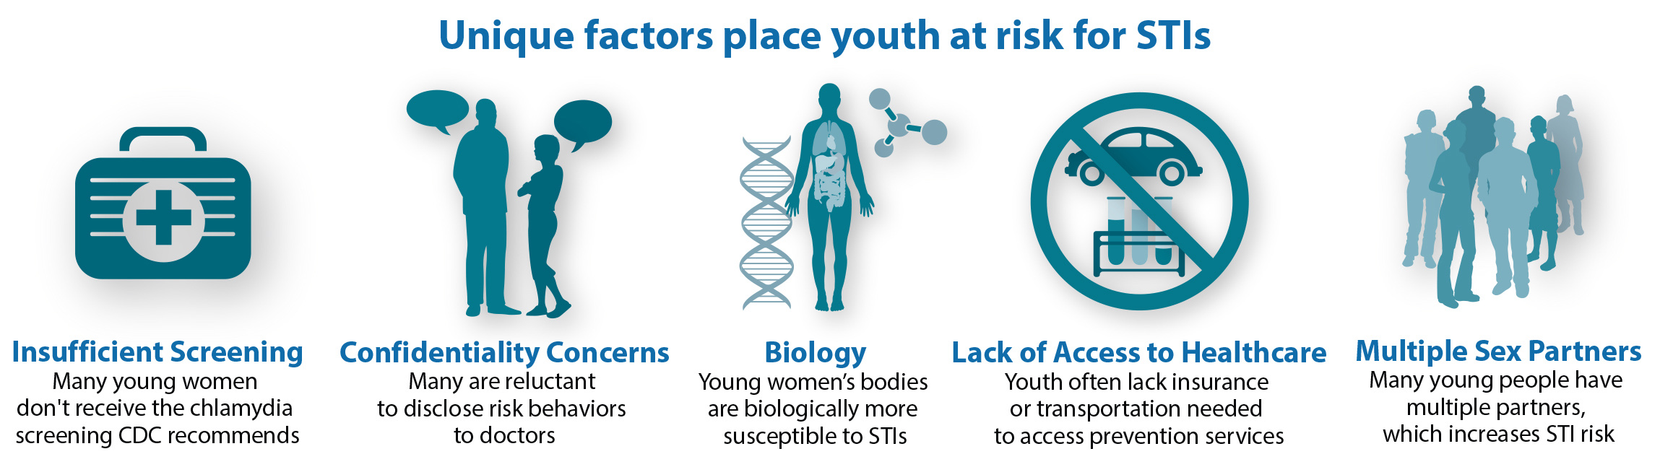
Why focus on STIs in young people?
Across states, fewer than half of high schools (43%) and less than one-fifth of middle schools (18%) teach key CDC topics for sexual health education.
Notes:
Adolescents are at increased risk due to individual characteristics, beliefs, and behaviors as well as external factors.
External factors:
Lack of access to medically accurate, developmentally appropriate and culturally relevant sexual health education
Insufficient screening
Confidentiality concerns
Lack of access to condoms, contraception, and sexual and reproductive healthcare
Individual factors:
Biological: Teenage women may be even more susceptible to a sexually transmitted infection than older women due to increased cervical ectopy (most STIs infect columnar cells in ectopy and not squamous cells covering surrounding cervix and vagina, but adolescent females are more likely to have columnar cells on the outer surface of the cervix). Adolescent women are also likely to have fewer protective antibodies to STIs, a biologically immature cervix, a smaller introitus, and a higher likelihood of dry, traumatic sex which increases likelihood of infection with an STI
Cognitive: Adolescents and young people are moving from concrete thinking into abstract thinking, which affects future planning and decision making
Behavioral: behaviors such as having multiple sex partners or substance use before sexual activity can increase STI risk for people of any age
Sources:
Sexually Transmitted Disease Surveillance 2018: STDs in Adolescents and Young Adults. Centers for Disease Control and Prevention. 2018. https://www.cdc.gov/std/stats18/adolescents.htm
What Works: Sexual Health Education. Centers for Disease Control and Prevention. Last reviewed February 2020. https://www.cdc.gov/healthyyouth/whatworks/what-works-sexual-health-education.htm

Slide 7
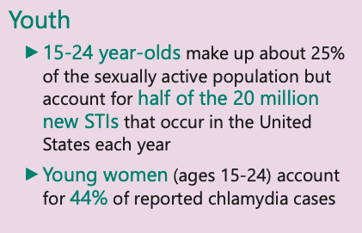
Young people account for half of all new STIs
Notes:
Though young people aged 15–24 make up 25% of sexually active individuals, they comprise half of the nearly 20,000,000 new STI infections each year
A CDC study released in March 2008 estimates that one in four young women ages 14 to 19 in the US are infected with at least one of the most common sexually transmitted infections (human papillomavirus, chlamydia, herpes simplex virus, and trichomoniasis). Data were based on an analysis of the 2003–2004 National Health and Nutrition Examination Survey.[ii]
The CDC estimates that STIs cost ~$16 billion/year in direct medical costs. A 2004 study investigating the annual cost of STIs in American young people found that the total estimated burden STIs occurred among 15–24-year-olds in 2000 was $6.5 billion (in year 2000 dollars).
In 2006, the incidence of HIV in young people ages 13–29 was 26.8 per 100 000, representing 34% of the total infections. More than half of the infections in this age group were in men who have sex with men (MSM). However, the 2006 CDC data includes reporting from 33 states and represents 14% of the persons diagnosed that year. Based on back reporting, researchers estimate that the percentage of total infections in young people may be as high as 50%.
While the consequences of untreated STIs are often worse for young women, the new analysis reveals that the annual
number of new infections is roughly equal among young women and young men (49 percent of incident STIs occurs among
young men, vs. 51 percent among young women).
**HIV incidence not calculated by age in the analysis
CDC estimates that HPV accounts for the majority of newly acquired STIs. While the vast majority (90 percent) of HPV
infections will go away on their own within two years and cause no harm, some of these infections will take hold and
potentially lead to serious disease, including cervical cancer
Source:
Incidence, Prevalence and Cost of Sexually Transmitted Infections in the United States. Centers for Disease Control and Prevention. February 2013. http://www.cdc.gov/std/stats/STI-Estimates-Fact-Sheet-Feb-2013.pdf
https://www.cdc.gov/std/dstdp/std-healthcare-infographic-december-2019.pdf

Slide 8

Condom use among high school students is declining
Notes:
Over the five-year time period, there was a gradual decline in condom use at last intercourse among high school students, from 59% in 2013 to 54% in 2017. Declines were reported by both male (66% to 61%) and female (53% to 47%) students.
When examined by both gender and race or ethnicity, the decline in condom use at last sex from 2013 to 2017 was most pronounced among black males, falling from 73% to 58%. Condom use also declined significantly among white females, from 56% in 2015 to 47% in 2017.
In 2017, some 9% of high school students used condoms and a prescription method at last intercourse. This represented a slight but significant decrease from 2015, when 12% reported such dual method use.
Source:
Witwer E, Jones RK, Lindberg LD. Sexual Behavior and Contraceptive and Condom Use Among U.S. High School Students, 2013‒2017. Guttmacher Institute, September 2018. https://www.guttmacher.org/report/sexual-behavior-contraceptive-condom-use-us-high-school-students-2013-2017

Slide 9

STI Protective Factors
Communities with high levels of trust and opportunities
Access to sexual health resources and healthcare
Access to high quality sex education
School connectedness, involvement and academic achievement
Supportive, responsive parenting and family connectedness
Healthy peer social norms and good communication with sexual partners
Individual knowledge, beliefs and attitudes
Notes:
Community or Neighborhood Factors
Protective Factors
Communities with high levels of trust, cohesiveness, and social capital help young people avoid risky sexual behaviors and pregnancy. Neighborhoods of this kind are also supportive of positive, attentive parenting styles.
Neighborhoods that offer youth many opportunities -- such as after-school programs, sports, and job training -- support positive sexual health, including decreased teen pregnancy.
Risk Factors
Neighborhoods with high rates of violence, hunger, and/or substance use tend to have poor sexual health outcomes among their youth.
School Factors
Protective Factors
School connectedness -- involvement in school activities, liking school and finding it important, bonding with teachers and peers, feeling safe and fairly treated -- protects against sexual risk taking.
Academic achievement and aspirations lead youth to make healthy decisions about sex.
Family Factors
Protective Factors
A supportive, responsive parenting style helps youth feel safe and enables them to plan positively for the future. In turn, this orientation toward the future makes it more likely that youth will avoid high-risk behaviors.
Parental monitoring -- so long as it does not become over controlling -- helps youth maintain health.
Family connectedness and good parent-child communication, including communication about sex, condoms, and contraception, help young people achieve positive sexual health outcomes.
Youth who live with both of their parents are less likely to engage in certain risky sexual behaviors.
When parents express disapproval of sex in adolescence, or support for contraception if a teen does have sex, youth are more likely to act on those values. Higher family income and higher levels of parents' education are protective factors.
Risk Factors
Substance use in the household has a negative influence.
An over-controlling parenting style backfires, leading youth to take more risks.
Peer Factors
Youth have a tendency to reflect peer social norms, which may be protective or may increase risk. For example, if they believe their peers disapprove of sex, they are less likely to become sexually active. If they believe their peers are having sex, they are more likely to become sexually active
Relationship Factors
Protective Factors
Good communication between sexual partners is associated with girls using contraception.
When girls feel connected to a sexual partner, they are more likely to use effective contraception.
Risk Factors
Having an older romantic partner increases the likelihood of pregnancy and STDs.
Frequent dating and having a close romantic relationship make sex more likely.
Individual Factors
Protective Factors
Having plans for a positive future and believing in the ability to control one's own life are protective factors.
Spirituality and religious affiliation help youth avoid risky sexual behavior.
Initiating sex at an older age is associated with better sexual health.
Beliefs and attitudes about sex, condoms, and contraception can be protective or can increase risk. For example, a positive attitude toward condoms is protective; a permissive attitude toward sex increases risk.
Having the skills and intention to use condoms and contraception, as well as belief in one's own ability to successfully use those skills, protects young people against early pregnancy and STDs/HIV.
Risk Factors
Being lesbian, gay, or bisexual is associated with an increase in risky behaviors.
Youth who use alcohol and other drugs are more likely to initiate sex at an early age and are also more likely to have multiple partners.
Gang involvement, fighting, and violence are associated with risky sexual behavior.
Source:
What Works: Sexual Health Education. Centers for Disease Control and Prevention. Last reviewed February 2020. https://www.cdc.gov/healthyyouth/whatworks/what-works-sexual-health-education.htm
Risk and Protective Factors for Adolescent Sexual Health. ACT for Youth Center for Community Action. 2020. http://actforyouth.net/sexual_health/behaviors/factors.cfm

Slide 10
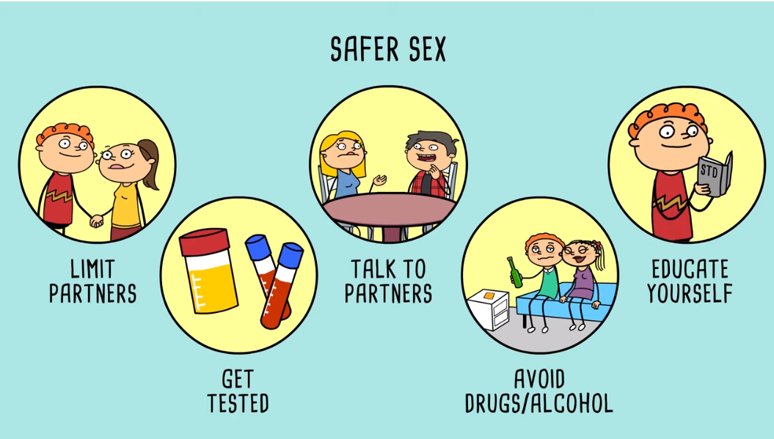
AMAZE: STI Prevention Beyond Condoms
Play Video
Notes:
https://www.youtube.com/watch?v=41cFmDTABJY&feature=emb_logo

Slide 11

Case Discussion: Maria
Maria is a 16-year-old female who comes into your clinic today for abnormal vaginal discharge
What might be the cause of her symptoms?

Slide 12

STIs associated with vaginitis:
Trichomoniasis
Bacterial Vaginosis
Vulvovaginal Candidiasis

Slide 13
Vaginitis
Common among women of reproductive age
Symptoms may include abnormal vaginal discharge, vulvar itching and irritation, or vaginal odor
Most common causes:
  Bacterial vaginosis (22-50%)
  Vulvovaginal candidiasis (17-39%)
  Trichomoniasis (4-35%)
  Other infectious causes including chlamydia, gonorrhea, or genital herpes
  Non-infectious causes including irritant dermatitis, allergic reactions, retained foreign bodies, or dermatologic conditions
Notes:
Normal vaginal discharge is clear to white, odorless and of high viscosity. It may change throughout the menstrual cycle.
Normal bacterial flora of the vagina is dominated by lactobacilli, but a variety of other bacteria and microbes may be present at lower levels. Lactobacilli produce lactic acid, which helps to maintain normal acidic vaginal pH of 3.8 to 4.5.
Vaginitis is a clinical diagnosis but should be supported by a complete history, physical examination and laboratory evaluation
History should include
Menstrual history
Sexual history including number and gender of sex partners and specific sexual practices
Vaginal hygiene practices including use of menstrual products and douching
Any other underlying medical conditions
Physical examination should include:
Visual inspection of the vaginal discharge, the external genitalia, vagina and cervix
Collection and evaluation of a discharge specimen under the microscope
Source:
Kinney RG & Spach DH. National STD Curriculum: Vaginitis. National STD Curriculum Version 2.13.0-std-AWS. Last updated September 2017. https://www.std.uw.edu/go/syndrome-based/vaginal-discharge/core-concept/all#references-unassigned

Slide 14
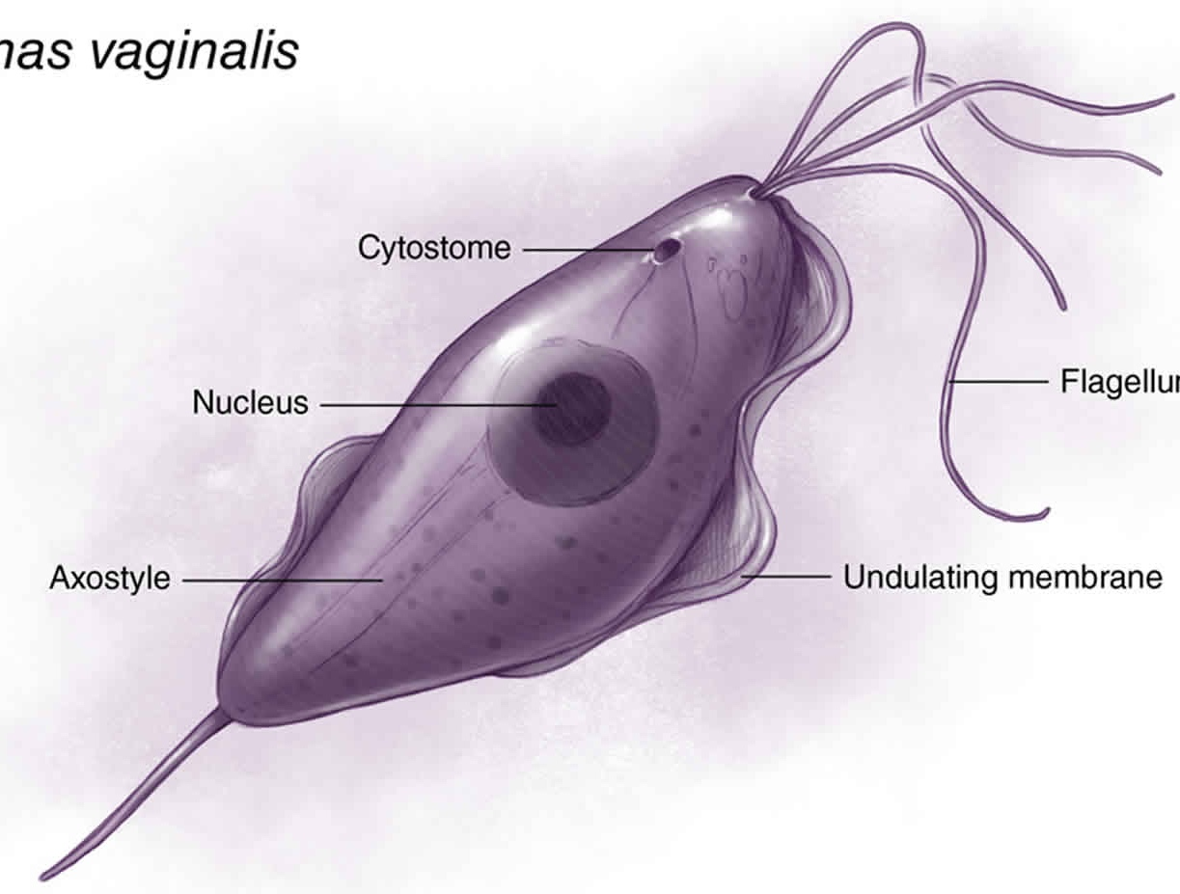
Trichomoniasis
Epidemiology
  Caused by infection with Trichomonas vaginalis, a protozoan parasite
  Estimated 3.7 million people in the US have trichomoniasis, 1.1 million new cases per year
Symptoms
  70-85% asymptomatic
  Abnormal vaginal discharge, vulvar irritation in women
  Urethritis, epididymitis or prostatitis in men
Sequelae
  2-3 times increased risk for HIV acquisition
  30% increased risk of preterm birth in pregnant women
Notes:
A 2007 study found 3.1% of asymptomatic women ages 14-49 from a nationally representative sample were positive for T. vaginalis
Symptoms in women may include abnormal vaginal discharge that is foul-smelling, frothy, and yellow-green in color. They may also describe vaginal itching, burning, redness, soreness, dysuria and/or dyspareunia
Symptoms in men may include itching or irritation inside the urethra, burning after urination or ejaculation and/or discharge from the penis.
Sources:
Illustration by Jared Travnicek, Cognition Studio
Kinney RG & Spach DH. National STD Curriculum: Vaginitis. National STD Curriculum Version 2.13.0-std-AWS. Last updated September 2017. https://www.std.uw.edu/go/syndrome-based/vaginal-discharge/core-concept/all#references-unassigned
Trichomonas – CDC Fact Sheet. Centers for Disease Control and Prevention. https://www.cdc.gov/std/trichomonas/stdfact-trichomoniasis.htm
Sutton M, Sternberg M, Koumans EH, McQuillan G, Berman S, Markowitz L. The prevalence of Trichomonas vaginalis infection among reproductive-age women in the United States, 2001-2004. Clin Infect Dis. 2007 Nov 15;45(10):1319–26.

Slide 15
Who should be screened for trichomoniasis?
People seeking care for vaginal discharge
Persons receiving care in high prevalence settings like STD clinics or correctional facilities
Asymptomatic persons at high risk of infection
  Multiple sex partners
  Persons who exchange sex for money or drugs
  All women with HIV
  Some experts recommend testing all women who receive testing for chlamydia and gonorrhea
Notes:
The 2015 STD Treatment Guidelines recommend diagnostic testing for trichomoniasis in the following three groups: (1) women seeking care for vaginal discharge; (2) persons receiving care in high prevalence settings (STD clinics, correctional facilities), and (3) asymptomatic persons at high risk of infection (i.e. persons with multiple sex partners, persons who exchange sex for money or drugs).
Some experts further recommend that all women who receive testing for C. trachomatis and N. gonorrhoeae should also receive testing for T. vaginalis. In addition, due to high rates of prevalent STDs among persons living with HIV infection, guidelines recommend screening all women with HIV for vaginal trichomoniasis. Because T. vaginalis does not infect the pharynx or rectum, screening at these sites is not recommended.
Source:
Trichomoniasis. Division of STD Prevention, National Center for HIV/AIDS, Viral Hepatitis, STD, and TB Prevention, Centers for Disease Control and Prevention. Last reviewed June 2015. https://www.cdc.gov/std/tg2015/trichomoniasis.htm

Slide 16
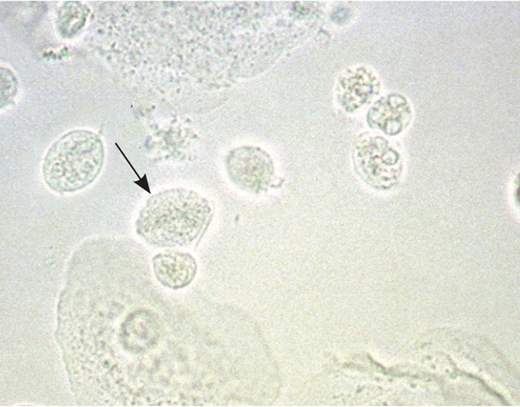
Trichomoniasis: Diagnosis
Wet mount with microscopy
  Most common, inexpensive method
  Sensitivity of ~60%
  Time dependent: motility of trichomonads decreases with time
Nucleic Acid Amplification Testing (NAAT)
  Highly sensitive and specific
  Can be performed on vaginal swab (self-collected or clinician-collected), urine, cervical swab or penile urethral swab
Culture
  Previous gold standard
  May be performed on penile urethral swab, urine sediment, semen or vaginal swab
Notes:
Diagnosis of vaginal trichomoniasis is usually performed by microscopy of vaginal secretions but this method has a sensitivity of only ~60%–70% and requires immediate evaluation of wet prep slide for optimal results.
Gold standard for identification is with Nucleic Acid Amplification Testing from a vaginal swab (self-collected or clinician-collected), urine, or liquid endocervical specimens in Thin Prep media.
Rapid, point of care testing is also available, though less commonly used
Sensitivity and specificity higher than wet mount but lower than culture
Source:
Kinney RG, Spach DH. Vaginitis: Trichomonas. National STD Curriculum. Last updated September 2017. https://www.std.uw.edu/go/syndrome-based/vaginal-discharge/core-concept/all#citations

Slide 17

Trichomoniasis: Treatment
Standard regimen:
  Metronidazole 2 grams orally in a single dose OR
  Tinidazole 2 grams orally in a single dose
Alternative regimen:
  Metronidazole 500 mg orally twice daily for 7 days
Partner treatment
  Current partners should be referred for presumptive treatment to avoid reinfection
  Can be treated with Expedited Partner Therapy (EPT) in states where it is legal
Notes:
Patients should be counseled that consuming alcohol while taking metronidazole (and for 24 hours after completion) or tinidazole (and for 72 hours after completion) could cause a disulfiram-like reaction (severe nausea and vomiting)
In randomized clinical trials, the recommended metronidazole regimens have resulted in cure rates of approximately 90%–95%, and the recommended tinidazole regimen has resulted in cure rates of approximately 86%–100%. The appropriate treatment of sex partners might increase these reported rates. Randomized controlled trials comparing single 2 g doses of metronidazole and tinidazole suggest that tinidazole is equivalent or superior to metronidazole in achieving parasitologic cure and resolution of symptoms. Treatment of patients and sex partners results in relief of symptoms, microbiologic cure, and reduction of transmission.
Metronidazole gel is considerably less efficacious for the treatment of trichomoniasis (<50%) than oral preparations of metronidazole and is not recommended for use.
For patients who have failed an initial single-dose therapy of metronidazole 2 grams orally, the recommended treatment is metronidazole 500 mg orally twice daily for 7 days. If this 7-day regimen fails, a subsequent 7-day course of higher dose therapy should be administered, with a 7-day oral course of either metronidazole 2 grams given once per day or tinidazole 2 grams once per day. Tinidazole retains activity against many metronidazole-refractory strains. If this third-line treatment fails, culture should be collected and sent to the CDC for susceptibility testing, in consultation with an expert.
Sources:
Centers for Disease Control and Prevention. Sexually Transmitted Diseases Treatment Guidelines, 2010. MMWR 2010;59(12):58–61.
Kinney RG, Spach DH. Vaginitis: Trichomonas. National STD Curriculum. Last updated September 2017. https://www.std.uw.edu/go/syndrome-based/vaginal-discharge/core-concept/all#citations

Slide 18
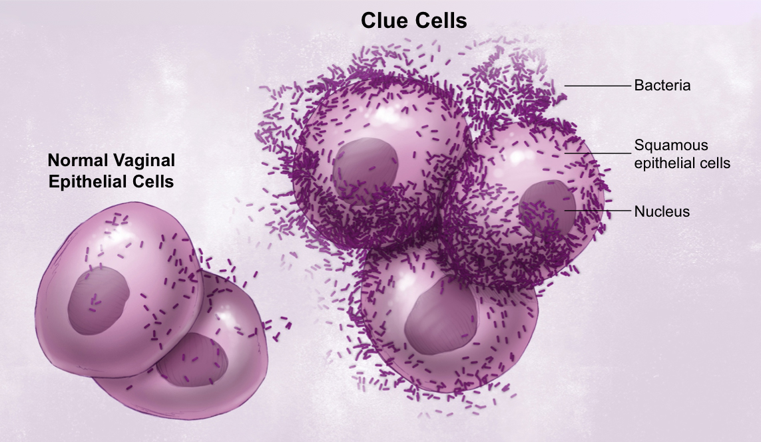
Bacterial Vaginosis (BV)
Epidemiology
  Caused by displacement of normal lactobacilli by anaerobic bacteria
  Prevalence from one study was 29% overall with only 16% of those reporting symptoms
Symptoms
  May be asymptomatic
  May cause “fishy” odor, white or gray vaginal discharge
Sequelae
  2 times risk of acquiring STIs including HIV, chlamydia, gonorrhea and HSV-2
  Higher risk of post-operation infections after gynecologic surgeries
  May increase risk of late miscarriage, premature delivery, low birthweight in pregnancy
Notes:
A 2007 study of the prevalence of BV in the US between 2001 and 2004 found that it is 29% overall but varies by population with higher rates among sexually active women. Racial and socioeconomic disparities exist. Information on the prevalence of BV is limited because it is not a reportable disease.
BV is not classically considered a sexually transmitted disease, but evidence suggests that it is correlated with frequency of sexual activity, younger age at firs sex, practicing anal and oral sex and using vaginal sex toys.
Symptoms of BV may be reported as more common after sexual intercourse and after completion of menses
Sources:
Kinney RG, Spach DH. Vaginitis: Bacterial Vaginosis. National STD Curriculum. Last updated September 2017. https://www.std.uw.edu/go/syndrome-based/vaginal-discharge/core-concept/all#citations
Koumans EH, Sternberg M, Bruce C, et al. The prevalence of bacterial vaginosis in the United States, 2001-2004; associations with symptoms, sexual behaviors, and reproductive health. Sex Transm Dis. 2007;34:864-9.

Slide 19
Who should be screened for BV?
People with symptoms suggestive vaginal discharge, odor, or irritation
Insufficient evidence to recommend screening and treatment of BV in asymptomatic pregnant people
  No consistent data proving that treatment can prevent adverse pregnancy outcomes
Screening and treatment prior to a surgical abortion or hysterectomy decreases rates of post-surgical infections
  Giving antibiotic treatment as standard surgical prophylaxis is more cost effective than screening and then treating if positive
Notes:
Source:
Bacterial Vaginosis. Division of STD Prevention, National Center for HIV/AIDS, Viral Hepatitis, STD, and TB Prevention, Centers for Disease Control and Prevention. Last reviewed June 2015. https://www.cdc.gov/std/tg2015/bv.htm
Kinney RG, Spach DH. Vaginitis: Bacterial Vaginosis. National STD Curriculum. Last updated September 2017. https://www.std.uw.edu/go/syndrome-based/vaginal-discharge/core-concept/all#citations

Slide 20
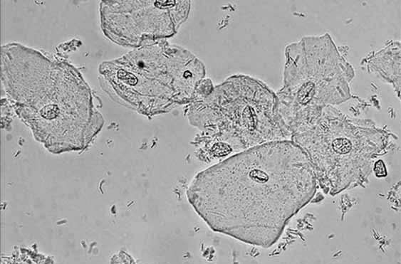
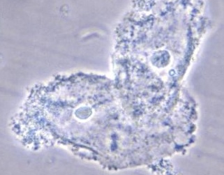
BV: Diagnosis
Amsel’s criteria (3 out of the 4 following):
  Vaginal pH >4.5 (most sensitive, least specific)
  Presence of “clue cells” constituting at least 20% of vaginal epithelial cells on wet mount examination
  Positive “whiff” test, a fishy odor detected with addition of 10% KOH
  Homogeneous, white/grey discharge adherent to the vaginal walls
Pictured: normal vaginal epithelial cells (top) and ”clue cells,” vaginal epithelial cells with adherent coccobacilli suggestive of BV (bottom)
Notes:
Detection of three out of four criteria has been correlated with results by gram stain with a sensitivity of 78.8% and specificity of 92.4%
The gold standard for diagnosis is Gram’s stain of a vaginal sample with Nugent scoring, though this is not usually performed due to time and expense. Diagnosis is based on the relative concentration of lactobacillus, Bacteroides, Gardnerella, and Mobiluncus species. A normal Gram's stain should show lactobacillus only, or lactobacillus with few Gardnerella morphotypes. Gram's stain showing a more mixed flora with relatively lower numbers of lactobacilli is consistent with bacterial vaginosis.
The FDA has approved at least one PCR assay to amplify DNA for lactobacillus species and several anaerobic bacteria commonly implicated in BV. The diagnosis is based on relative concentrations of these organisms.
Other less commonly used testing mechanisms include a point-of-care test using DNA hybridization probe to test for presence of trichomonas, Candida albicans (yeast) and Gardnerella vaginalis, the most common cause of BV. There are also indirect tests for enzymatic activity associated with the organisms that commonly cause BV.
Sources:
Images: Bacterial vaginosis. WikEM.org. Last updated 2019.
Kinney RG, Spach DH. Vaginitis: Bacterial Vaginosis. National STD Curriculum. Last updated September 2017. https://www.std.uw.edu/go/syndrome-based/vaginal-discharge/core-concept/all#citations

Slide 21
BV: Treatment
Standard regimens (including during pregnancy):
  Metronidazole 500 mg orally twice daily for 7 days
  Metronidazole gel 0.75%, 2 grams intravaginally once a day for 5 days
  Clindamycin cream 2%, 2 grams intravaginally at bedtime for 7 days
Partner treatment is not indicated
Notes:
Patients should be counseled that consuming alcohol while taking metronidazole (and for 24 hours after completion) or tinidazole (and for 72 hours after completion) could cause a disulfiram-like reaction (severe nausea and vomiting)
Alternative treatment regimens: oral tinidazole (not recommended during pregnancy), oral clindamycin, or intravaginal clindamycin ovules.
Secnidazole was FDA approved in 2017 as a single-dose therapy for BV in adult women
Recurrent BV occurs in up to 30% of women within three months following treatment and in up to 50% of patients after 6-12 months. Recurrence can be treated with the same regimen or a different regimen.
Women with multiple recurrences can be treated with either:
metronidazole intravaginal gel twice weekly for 4 to 6 months or
Oral metronidazole 500 mg twice daily (or tinidazole 500 mg twice daily) for 7 days
Followed by intravaginal boric acid 600 mg daily for 21 days
Followed by intravaginal metronidazole gel 0.75% twice weekly for 4 to 6 months.
Sources:
Centers for Disease Control and Prevention. Sexually Transmitted Diseases Treatment Guidelines, 2010. MMWR 2010;59(12):58–61.
Kinney RG, Spach DH. Vaginitis: Bacterial Vaginosis. National STD Curriculum. Last updated September 2017. https://www.std.uw.edu/go/syndrome-based/vaginal-discharge/core-concept/all#citations

Slide 22

Vulvovaginal Candidiasis (Yeast Infections)
Epidemiology
  Caused by overgrowth of Candida albicans, an opportunistic yeast organism
  An estimated 70-75% of women will experience at least one episode of vulvovaginal candidiasis
Symptoms
  Pruritis, thick, white and clumpy discharge, vaginal and vulvar soreness, dysuria and/or dyspareunia
Sequelae
  No direct consequences but recurrent or poorly responsive infections may indicate underlying conditions
Notes:
Candida species can be found in the lower genital tract in approximately 20% of asymptomatic women
Most patients with vulvovaginal candidiasis do not have specific risk factors
Frequent, complicated, and/or severe infections may be due to:
Uncontrolled or undiagnosed diabetes,
Immunocompromised state (HIV, genetic disease or medication-induced)
Use of corticosteroids
repeated courses of antibiotics
Pregnancy
hormone replacement therapy
behavioral factors (sexual practices, use of oral contraceptives, intrauterine devices, condoms, and spermicide)
genetic predisposition
Source:
Kinney RG, Spach DH. Vaginitis: Candidiasis. National STD Curriculum. Last updated September 2017. https://www.std.uw.edu/go/syndrome-based/vaginal-discharge/core-concept/all#citations
Image: Scanning Electron Microscope image of Candida albicans from Global Biodefense. https://globalbiodefense.com/tag/candida-albicans/

Slide 23
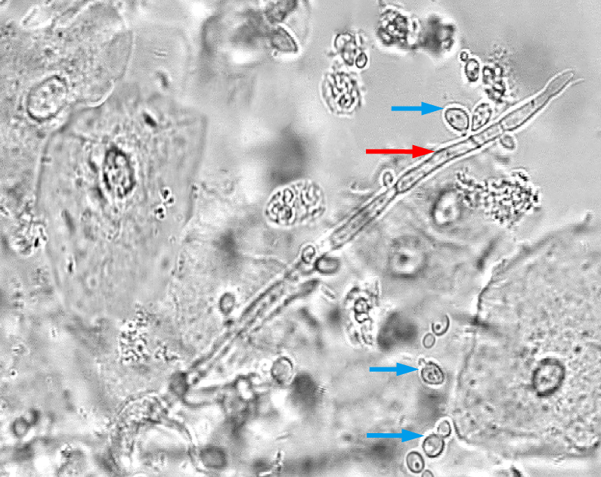
Candidiasis: Diagnosis
Vaginal pH is usually normal (3.8 to 4.5)
Potassium hydroxide (KOH) and saline wet mount microscopy
  Visualization of pseudohyphae and budding yeast forms
  10% KOH dissolves epithelial cells and improves sensitivity
Culture
  Not routinely recommended
  May help diagnose non-albicans species in recurrent disease
This photograph taken of a saline vaginal wet mount sample shows multiple yeast forms (blue arrows) and hyphae forms (red arrow on right). Magnification 40x.
Notes:
Clinical symptoms of vulvovaginal candidiasis overlap with other causes of vaginitis, so performing a microscopic examination of vaginal secretions is recommended to assist in diagnosis.
Abnormal vaginal pH (greater than 4.5) or abundant white blood cells visualized on microscopy suggests an alternative diagnosis such as BV or trichomoniasis, or a mixed infection.
Gram’s stain is not commonly performed to diagnose vulvovaginal candidiasis but if done, may show large strongly gram-positive staining yeasts and/or hyphae
Source:
Kinney RG, Spach DH. Vaginitis: Candidiasis. National STD Curriculum. Last updated September 2017. https://www.std.uw.edu/go/syndrome-based/vaginal-discharge/core-concept/all#citations
Image: From the National STD Curriculum, Public Health—Seattle & King County STD Clinic

Slide 24
Candidiasis: Treatment
Uncomplicated vulvovaginal candidiasis:
  Short-course intravaginal antifungal agents (multiple options)
    Several available over-the-counter
  Oral therapy: fluconazole 150 mg orally in a single dose
Recurrent infections (four or more episodes within a year):
  Culture of vaginal secretions to detect non-albicans species
  Longer 7-to-14-day initial course of therapy followed by 6-month maintenance regimen
Notes:
Over-the-counter intravaginal agents (patients should be advised that these oil-based formulations may weaken latex condoms and diaphragms):
Butoconazole 2% cream 5g PV x 3 days
Clotrimazole 1% cream 5g PV x 7–14 days
Clotrimazole 2% cream 5g PV x 3 days
Miconazole 2% 5g PV x 7days
Miconazole 4% cream 5g PV x 3 days
Miconazole 100mg vaginal suppository, one suppository daily for 7 days
Miconazole 200mg vaginal suppository, one suppository daily for 3 days
Miconazole 1200mg vaginal suppository, one suppository daily for 1 days
Tioconazole 6.5% ointment 5 g PV in a single application
Prescription intravaginal agents (patients should be advised that these oil-based formulations may weaken latex condoms and diaphragms):
Butoconazole 2% cream (single dose bioadhesive product), 5 g PV x 1 day
Nystatin 100,000-unit vaginal tablet, one tablet for 14 days
Terconazole 0.4% 5g PV daily x 7 days
Terconazole 0.8% cream 5g PV daily x 3 days
Terconazole 80 mg vaginal suppository, one suppository daily for 3 days
Treatment of recurrent disease can be given as:
Oral fluconazole given as 100 mg, 150 mg, or 200 mg dose every third day for 3 doses (day 1,4 and 7) to achieve mycologic remission
Preferred maintenance therapy consists of oral fluconazole (100, 150 or 200 mg) given weekly for 6 months
Non-albicans vulvovaginal candidiasis:
Optimal therapy is not known. CDC recommends that treatment may require longer courses of a non-fluconazole azole, either oral or topical. Intravaginal boric acid (600 mg in a type O gelatin capsule inserted nightly for 7 days or longer) has been suggested. If these measures fail, specialist consultation is advised.
Sources:
Vulvovaginal Candidiasis. Division of STD Prevention, National Center for HIV/AIDS, Viral Hepatitis, STD, and TB Prevention, Centers for Disease Control and Prevention. Last reviewed June 2015. https://www.cdc.gov/std/tg2015/candidiasis.htm
Kinney RG, Spach DH. Vaginitis: Candidiasis. National STD Curriculum. Last updated September 2017. https://www.std.uw.edu/go/syndrome-based/vaginal-discharge/core-concept/all#citations

Slide 25
Case Discussion: Maria
Maria tells you during the history that she has had vaginal and oral sex with one male partner
She is here today with vaginal discharge that is white and ”smells funny” as well as some vulvar itching
Your physical exam confirms the presence of thin white discharge with a fishy odor and is otherwise unremarkable
What type of diagnostic tests should you perform?

Slide 26
Case Discussion: Maria
Maria collects two vaginal swabs which you prepare with saline and 10% KOH for wet mount microscopy
  You see clue cells and many polymorphonuclear leukocytes. The pH of the fluid is 6. You diagnose BV and prescribe Metronidazole 500 mg orally twice daily for 7 days.
If you did not have access to a microscope, you might send a vaginal fluid sample for microscopy (to look for candidiasis or BV) in a lab and PCR for trichomoniasis
Does her partner need treatment?
What other testing should you offer Maria?
Notes:
Partner treatment is not indicated for BV
She should be counseled to avoid alcohol while taking metronidazole and for 24 hours afterward to avoid a disulfiram-like reaction
Maria should be screened for chlamydia, gonorrhea and HIV based on her history (these will be discussed in the next sections)
Further history should be taken to determine her fertility plans, contraceptive needs, and whether a pregnancy test and/or emergency contraception are indicated
Note: Trichomoniasis PCR testing can also be performed on a urine or endocervical sample

Slide 27
Bacterial Infections:
Chlamydia
Gonorrhea
Syphilis

Slide 28
Which STI is the most frequently reported infectious disease in the United States?
Notes:
Answer: Chlamydia

Slide 29
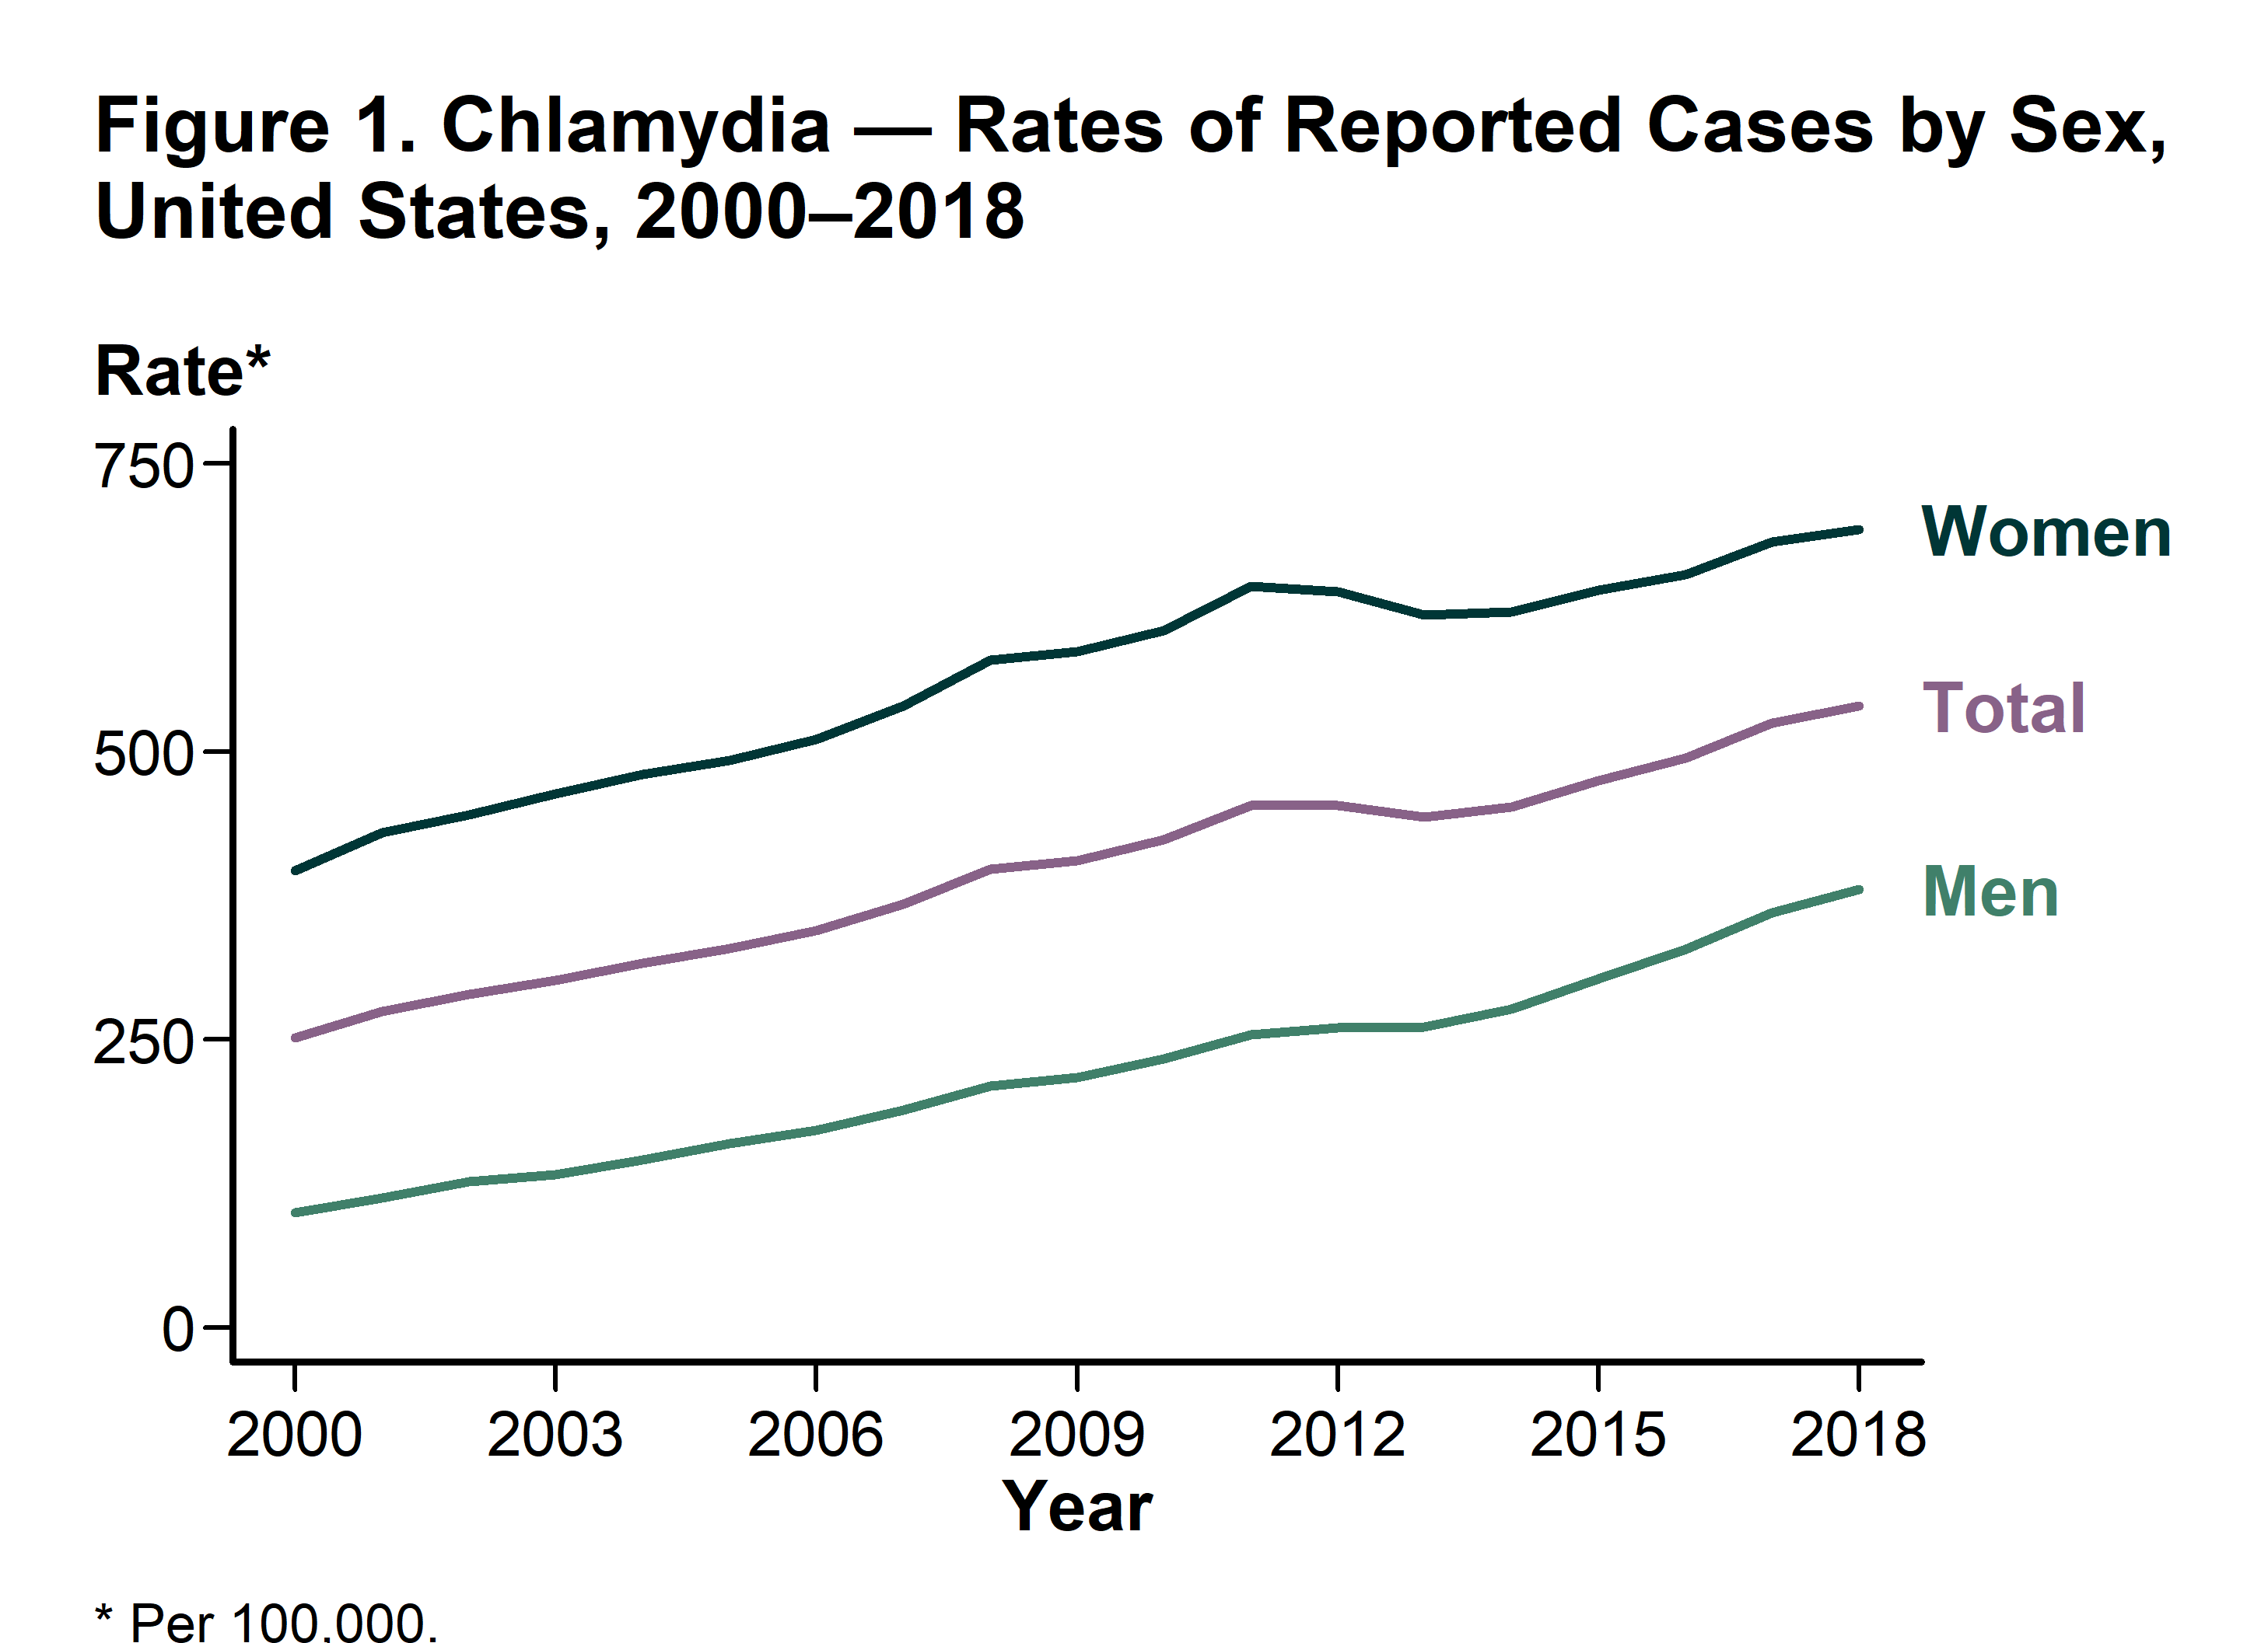
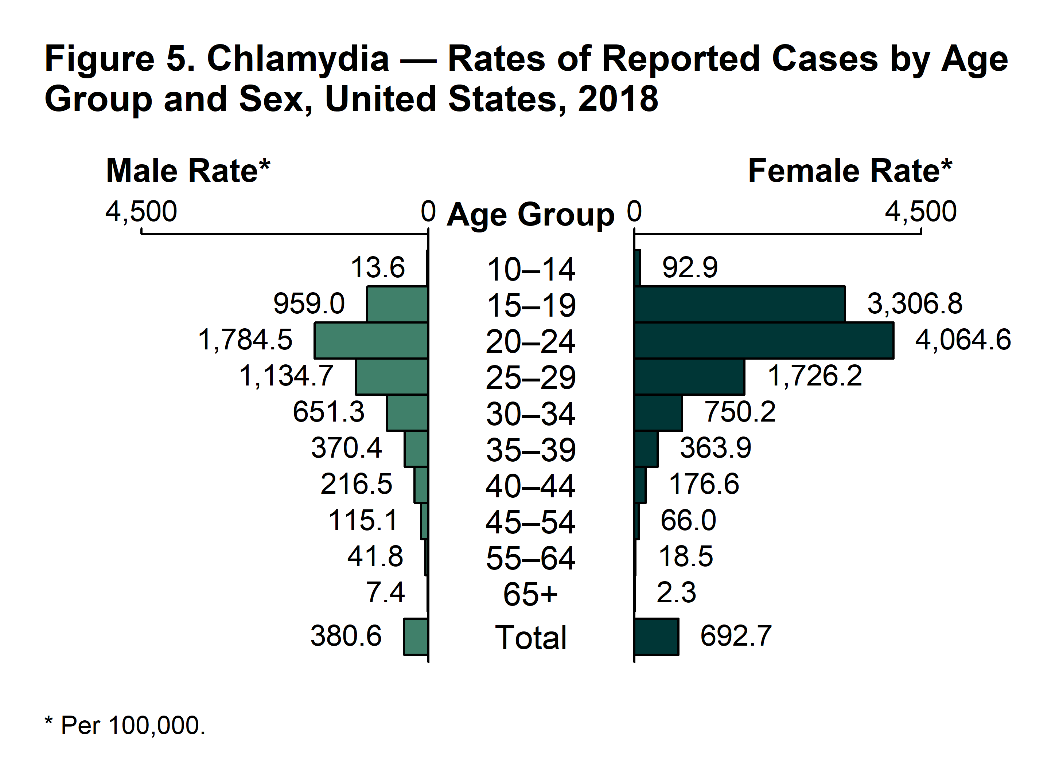
Chlamydia
Notes:
Nationally, rates of chlamydia are rising steadily since the year 2000. Infections are most common among 20-24 year olds, followed by 15-19 year olds.
Source:
Chlamydia Statistics. STD Surveillance 2018 – Chlamydia. Centers for Disease Control and Prevention. https://www.cdc.gov/std/chlamydia/stats.htm

Slide 30

Case Discussion: Nicole
Nicole is a 17-year-old female who comes in today for a routine physical
She is sexually active and has had vaginal sex with one male partner in the last 3 months. They used condoms most of the time.
What screening for STIs should you offer her?

Slide 31
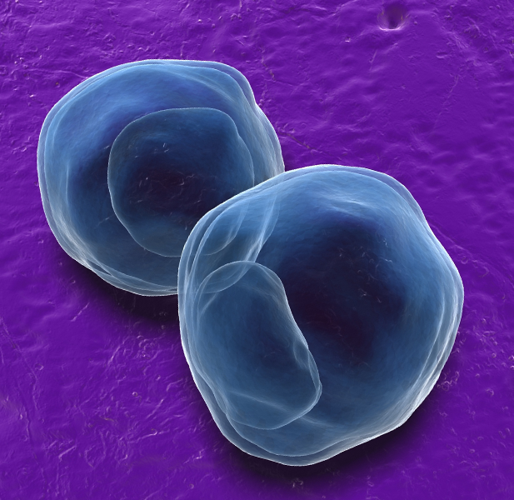
Chlamydia
Epidemiology
  Caused by the intracellular bacterium Chlamydia trachomatis
  More than 1.7 million cases reported in 2018, with highest rates among young people ages 15-24. Rate in females was 1.8 times higher than in males in 2018.
Symptoms
  Majority of cases are asymptomatic
  May cause urethritis, epididymitis, cervicitis
Sequelae
  PID can lead to scarring of the fallopian tubes. About 20% of women treated for PID become infertile and 30% develop chronic pelvic pain. PID also increases risk of ectopic pregnancy.
  Rectal chlamydia infection in men who have sex with men (MSM) significantly increases risk of HIV acquisition
Notes:
C. Trachomatis causes a variety of clinical syndromes depending on the location of infection and the specific serovar of the bacteria (determined by outer membrane protein A)
In men, genital chlamydia infection can cause:
Urethritis: most men with urethral chlamydial infection are asymptomatic, but some may experience dysuria and urethral discharge
Epididymitis: the most common local complication of C. trachomatis infection, symptoms include unilateral scrotal pain, epididymal swelling and tenderness
In women, genital chlamydia infection can cause:
Cervicitis: asymptomatic in most cases, may cause mucopurulent endocervical discharge and/or spontaneous or easily induced endocervical bleeding
Urethritis: usually asymptomatic, may cause dysuria, urinary frequency, and cloudy urine
Pelvic inflammatory disease (PID): subclinical to acute syndrome associated with ascending spread of microorganisms from the cervix to the endometrium, fallopian tubes, ovaries and contiguous structures. May present as abdominal pain along with cervical motion tenderness, with or without uterine or adnexal tenderness.
Perihepatitis (Fitz-Hugh-Curtis Syndrome): untreated pelvic infection in women can cause inflammation of the liver capsule. Characterized by right upper quadrant pain, nausea, vomiting, and fever which are usually accompanied by evidence of PID on physical examination
In men or women, chlamydia can cause:
Conjunctivitis
Oropharyngeal infection, which may be asymptomatic or cause acute pharyngitis or tonsillitis
Proctitis and proctocolitis, asymptomatic or causing rectal pain, mucoid or hemorrhagic discharge, fever and/or tenesmus
Lymphogranuloma venereum (LGV): uncommon in the United States though outbreaks have been reported among MSM. Symptoms include multiple enlarged, matted, tender inguinal lymph nodes that may be suppurative and are usually bilateral, along with fever, chills and/or myalgia. A self-limited genital ulcer may occur at the site of inoculation. Caused by specific serovars of the bacteria, serologic testing may be useful to diagnose LGV.
Reactive arthritis: post-inflammatory autoimmune disease 3 to 6 weeks after urogenital chlamydia infection that classically includes conjunctivitis, urethritis, oligoarthritis and skin lesions
Chlamydia infections can also affect infants and children, causing:
Conjunctivitis: perinatal transmission can cause inclusion conjunctivitis 5 to 14 days after delivery. Signs may be mild scant mucoid discharge or can be severe purulent discharge, chemosis, pseudomembrane formation, erythema, friablity and edema. Prophylactic ocular silver nitrate or antibiotic ointments for prevention of N. gonorrhea does not prevent chlamydial conjunctivitis
Trachoma: not sexually transmitted, uncommon in the United States. Transmission of certain serotypes of C. trachomatis (A, B, Ba and C) through person-to-person contact in the setting of poor sanitary conditions or fly transmission, trachoma is the leading cause of preventable blindness in the world. Begins as follicular conjunctivitis which, if untreated progresses to entropion and ulceration of the cornea by the lashes.
Pneumonia: perinatal transmission can cause nasopharyngeal inoculation and pneumonia that typically occurs 4 to 12 weeks after delivery
Urogenital infection: perinatally-acquired infections are usually asymptomatic and can persist for as long as 2-3 years. Sexual abuse is a major concern when chlamydia or any STI is detected in preadolescent children and should be evaluated.
Sources:
2015 STD Treatment Guidelines: Chlamydial Infections. Centers for Disease Control and Prevention. Last reviewed June 2015. https://www.cdc.gov/std/tg2015/chlamydia.htm
Hahn AW, Geisler WM. Chlamydia. National STD Curriculum. Last updated February 2020. https://www.std.uw.edu/go/pathogen-based/chlamydia/core-concept/all
Image: CDC - https://www.cdc.gov/std/chlamydia/default.htm

Slide 32
Who should be screened for Chlamydia?
Sexually active women aged <25 should be screened annually
Women 25 and older at increased risk for infection
  New sex partner
  More than one sex partner
  A sex partner with concurrent partners
  A sex partner who has a sexually transmitted infection
Insufficient evidence to recommend routine screening in sexually active young men
  Consider in clinical settings with a high prevalence of chlamydia (may include adolescent clinics, STD clinics, correctional facilities)
  Men who have sex with men (MSM) should be screened at least annually
Notes:
Pregnant women younger than 25 and those older than 25 with increased risk factors should be screened at the first prenatal visit and retested during the third trimester. Test-of-cure is indicated 3 to 4 weeks after treatment for pregnant women diagnosed with chlamydia.
Screening should include any sites of possible exposure based on reported types of sexual contact. For either men or women this may include the genitals and rectum Oropharyngeal screening is not recommended without symptoms.
Sources:
2015 STD Treatment Guidelines: Chlamydial Infections. Centers for Disease Control and Prevention. Last reviewed June 2015. https://www.cdc.gov/std/tg2015/chlamydia.htm
Hahn AW, Geisler WM. Chlamydia. National STD Curriculum. Last updated February 2020. https://www.std.uw.edu/go/pathogen-based/chlamydia/core-concept/all

Slide 33
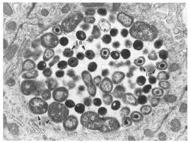
Chlamydia: Diagnosis
Nucleic Acid Amplification Tests (NAATs)
  FDA-cleared for use on urine specimens from men and women, urethral swabs in male-bodied people, endocervical swabs or vaginal swabs (only some tests) in female-bodied people
  Some also cleared for testing of extragenital sites (pharynx and rectum)
Culture
  Previously the gold standard but lower sensitivity than NAATs (50% vs 80%)
All states require reporting of chlamydia infections to the department of public health
Notes:
For NAATs:
In men, first-catch urine specimen is as sensitive as urethral swab and less painful
In women, vaginal swabs are preferred over urine samples. Vaginal swabs may be self-collected or clinician-collected
Self-collected rectal swabs for men or women may be used for testing
Other tests:
Molecular tests that do not use nucleic acid amplification include enzyme-immunoassays, direct fluorescence antibody tests (DFA) and nucleic acid hybridization tests. These all have lower sensitivity than NAATs and are not recommended by the CDC
Serologic testing including the chlamydia complement fixation test for a specific antibody and a micro-immunofluorescence test are available but not used to diagnose uncomplicated genital infections.
May be helpful in diagnosis of Lymphogranuloma venereum
Sources:
2015 STD Treatment Guidelines: Chlamydial Infections. Centers for Disease Control and Prevention. Last reviewed June 2015. https://www.cdc.gov/std/tg2015/chlamydia.htm
Hahn AW, Geisler WM. Chlamydia. National STD Curriculum. Last updated February 2020. https://www.std.uw.edu/go/pathogen-based/chlamydia/core-concept/all

Slide 34
Chlamydia: Treatment
Standard treatment regimens:
  Azithromycin 1 gram orally as a single dose OR
  Doxycycline 100 mg orally twice daily for 7 days
Treatment of sex partners
  All sex partners from the preceding 60 days or the most recent sex partner (if >60 days ago) should be referred for evaluation, testing and presumptive treatment
  If prompt referral and treatment is not possible or is impractical, partner(s) should be treated with Expedited Partner Therapy (EPT) in states where it is legal
    Regimen: Azithromycin 1 gram orally
Notes:
Alternative treatment regimens should be used only for patients with allergies or adverse reactions to first-line agents and include:
Erythromycin base 500 mg orally four times a day for 7 days
Erythromycin ethylsuccinate 800 mg orally four times a day for 7 days
Levofloxacin 500 mg orally daily for 7 days
Ofloxacin 300 mg orally twice a day for 7 days
Some experts do not recommend use of expedited partner therapy (EPT) in men who have sex with men due to high rates of concurrent infections such as syphillis and HIV, though it is legal in some states as a treatment option.
EPT should not be used to treat female partners with current signs or symptoms suggestive of PID as they require evaluation by a health care provider
EPT is not legal in all states, please refer to the CDC’s webpage with summarizing the legal status of EPT by state: https://www.cdc.gov/std/ept/legal/default.htm
Sources:
2015 STD Treatment Guidelines: Chlamydial Infections. Centers for Disease Control and Prevention. Last reviewed June 2015. https://www.cdc.gov/std/tg2015/chlamydia.htm
Hahn AW, Geisler WM. Chlamydia. National STD Curriculum. Last updated February 2020. https://www.std.uw.edu/go/pathogen-based/chlamydia/core-concept/all

Slide 35

Gonorrhea
Epidemiology
  Caused by the gram-negative diplococcus Neisseria gonorrhoeae
  More than half a million cases reported in 2018, rate has been steadily increasing since 2013
Symptoms
  Majority of cases are asymptomatic
  May cause urethritis, cervicitis, or epididymitis
Sequelae
  PID can lead to scarring of the fallopian tubes. About 20% of women treated for PID become infertile and 30% develop chronic pelvic pain. PID also increases risk of ectopic pregnancy.
Notes:
N. gonorrhoeae causes a variety of clinical syndromes in humans
In men, genital gonorrhea infection can cause:
Urethritis: most men develop overt, symptomatic urethritis with purulent or mucopurulent urethral discharge often accompanied by dysuria.
Epididymitis: an infrequent complication of gonococcal infection in men causing unilateral scrotal pain and swelling
Rare complications include inguinal lymphadenitis, penile edema, periurethral abscess or fistula, accessory gland infection, balanitis, urethral stricture and prostatitis
In women, genital gonorrhea infection can cause:
Cervicitis: asymptomatic in most cases, may cause mucopurulent endocervical discharge and/or spontaneous or easily induced endocervical bleeding
Urethritis: usually asymptomatic, may cause dysuria, urinary frequency, and cloudy urine
Pelvic inflammatory disease (PID): subclinical to acute syndrome associated with ascending spread of microorganisms from the cervix to the endometrium, fallopian tubes, ovaries and contiguous structures. May present as abdominal pain along with cervical motion tenderness, with or without uterine or adnexal tenderness.
Perihepatitis (Fitz-Hugh-Curtis Syndrome): untreated pelvic infection in women can cause inflammation of the liver capsule. Characterized by right upper quadrant pain, nausea, vomiting, and fever which are usually accompanied by evidence of PID on physical examination
In men or women, gonorrhea can cause:
Ocular infection: conjunctivitis, rarely ulcerative keratitis
Oropharyngeal infection, which may be asymptomatic or cause acute pharyngitis or tonsillitis with fever and cervical adenitis
Proctitis and proctocolitis, asymptomatic or causing rectal pain, mucoid or hemorrhagic discharge, fever and/or tenesmus
Disseminated Gonococcal Infection: systemic gonococcal infection occurs infrequently, more common in women than men, and in patients with complement deficiency. Signs and symptoms include skin lesions, arthralgia, tenosynovitis, arthritis, hepatitis, myocarditis, endocarditis and meningitis.
Reactive arthritis: post-inflammatory autoimmune disease 3 to 6 weeks after urogenital chlamydia infection that classically includes conjunctivitis, urethritis, oligoarthritis and skin lesions
Chlamydia infections can also affect infants and children, causing:
Conjunctivitis: perinatal transmission can cause ophthalmia neonatorum, though this is rare since prophylactic erythromycin is routinely applied to the eyes at birth
Urogenital infection in children should be considered possible evidence of sexual abuse and should be reported.
Source:
Hahn AW, Barbee LA. Gonorrhea. National STD Curriculum. Last updated March 2020. https://www.std.uw.edu/go/pathogen-based/gonorrhea/core-concept/all

Slide 36
Who should be screened for Gonorrhea?
Sexually active women aged <25 should be screened annually
Women 25 and older at increased risk for infection
  New sex partner
  More than one sex partner
  A sex partner with concurrent partners
  A sex partner who has a sexually transmitted infection
Insufficient evidence to recommend routine screening in sexually active young men
  Consider in clinical settings with a high prevalence of gonorrhea (may include adolescent clinics, STD clinics, correctional facilities)
  Men who have sex with men (MSM) should be screened at least annually
Notes:
Pregnant women younger than 25 and those older than 25 with increased risk factors should be screened at the first prenatal visit and retested during the third trimester.
Screening should include any sites of possible exposure based on reported types of sexual contact. For either men or women this may include the genitals, rectum, and/or pharynx.
Sources:
2015 STD Treatment Guidelines: Gonococcal Infections. Centers for Disease Control and Prevention. Last reviewed June 2015. https://www.cdc.gov/std/tg2015/gonorrhea.htm
Hahn AW, Barbee LA. Gonorrhea. National STD Curriculum. Last updated March 2020. https://www.std.uw.edu/go/pathogen-based/gonorrhea/core-concept/all

Slide 37
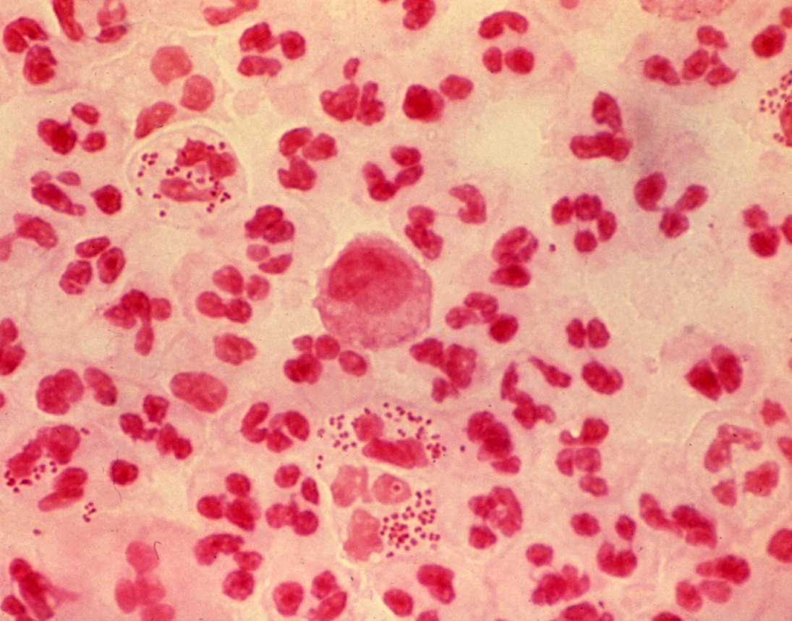
Gonorrhea: Diagnosis
Nucleic Acid Amplification Tests (NAATs)
  FDA-cleared for use on urine specimens from all genders, urethral swabs in male-bodied people, endocervical or vaginal swabs in female-bodied people
  Some also cleared for testing of extragenital sites (pharynx and rectum)
Culture
  Historic gold standard but lower sensitivity than NAATs
  Still useful to detect antimicrobial resistance in cases of treatment failure
Gram stain
  Can make a presumptive diagnosis of gonorrhea if polymorphonucleocytes (PMNs) with intracellular gram-negative diplococci are seen
Urethral swab Gram’s stain from a patient with Gonorrhea. Multiple PMN’s are seen, some with intracellular gram-negative diplococci
Notes:
Gonorrhea infections are also reportable in all states.
Sources:
2015 STD Treatment Guidelines: Gonococcal Infections. Centers for Disease Control and Prevention. Last reviewed June 2015. https://www.cdc.gov/std/tg2015/gonorrhea.htm
Hahn AW, Barbee LA. Gonorrhea. National STD Curriculum. Last updated March 2020. https://www.std.uw.edu/go/pathogen-based/gonorrhea/core-concept/all

Slide 38
Gonorrhea: Treatment
Standard treatment regimens:
  Ceftriaxone 500 mg IM in a single dose
  Treat for chlamydia (doxycycline 100 mg twice per day for 7 days) if infection has not been excluded
Treatment of sex partners
  All sex partners from the preceding 60 days or the most recent sex partner (if >60 days ago) should be referred for evaluation, testing and presumptive treatment
  If prompt referral and treatment is not possible or is impractical, partner(s) should be treated with Expedited Partner Therapy (EPT) in states where it is legal
    Cefixime 800 mg orally and doxycycline 100 mg twice daily for 7 days
Notes:
For patients with allergies or adverse reactions azithromycin, doxycycline 100 mg orally twice a day for 7 days may be used.
Some experts do not recommend use of expedited partner therapy (EPT) in men who have sex with men due to high rates of concurrent infections such as syphilis and HIV, and because an increased proportion of gonococcal isolates among MSM show reduced susceptibility to cefixime
EPT should not be used to treat female partners with current signs or symptoms suggestive of PID as they require evaluation by a health care provider
EPT is not legal in all states, please refer to the CDC’s webpage with summarizing the legal status of EPT by state: https://www.cdc.gov/std/ept/legal/default.htm
Disseminated Gonococcal infection can result in severe sequelae such as endocarditis or meningitis. Consultation with an infectious disease specialist is recommended.
Treatment failure:
The majority of cases of suspected treatment failure are reinfection rather than true treatment failure
Treatment failure should be considered in patients who report no sexual contact after initiating treatment but whose symptoms fail to resolve or who fail a test-of-cure
Because of increasing rates of antibiotic resistance in gonococcal bacteria, in case of suspected treatment failure a clinician should perform a culture and susceptibility testing of relevant clinical specimens and consult an expert. Specimens that grow N. gonorrhoeae should be saved and sent to the CDC through a state public health laboratory
Sources:
2015 STD Treatment Guidelines: Chlamydial Infections. Centers for Disease Control and Prevention. Last reviewed June 2015. https://www.cdc.gov/std/tg2015/chlamydia.htm
Hahn AW, Geisler WM. Chlamydia. National STD Curriculum. Last updated February 2020. https://www.std.uw.edu/go/pathogen-based/chlamydia/core-concept/all
St. Cyr S, Barbee L, Workowski KA, et al. Update to CDC’s Treatment Guidelines for Gonococcal Infection, 2020. MMWR Morb Mortal Wkly Rep 2020;69:1911–1916. DOI: http://dx.doi.org/10.15585/mmwr.mm6950a6external icon

Slide 39
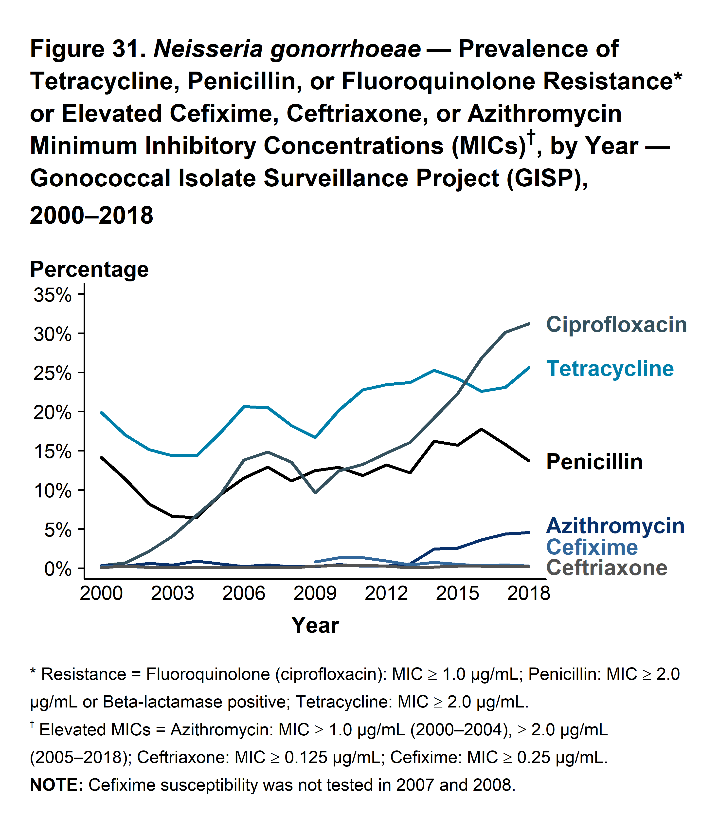
Gonorrhea:
Antimicrobial Resistance
The Gonococcal Isolate Surveillance Project (GISP), established in 1986, monitors trends of resistance among N. gonorrhoeae strains in the United States
  Resistance to azithromycin increased from 2.5 to 4.6% between 2014 and 2018
  Resistance to cefixime peaked in 2010 at 1.4% and has since declined to 0.3%
  Resistance to ceftriaxone has fluctuated since 2009 between 0.1 and 0.4%
Notes:
Resistance is also tracked for other antibiotic agents that have been previously used or are currently used for gonorrhea treatment.
As of 2018, resistance to various agents included:
31.2% to ciprofloxacin
25.6% to tetracycline
13.7% to penicillin
48.7% of isolates tested were susceptible to all antibiotics used, but 4.1% were resistant to any 3 agents and 0.3% were resistant to any 4 agents.
Source:
Sexually Transmitted Disease Surveillance 2018: Gonorrhea. Centers for Disease Control and Prevention. https://www.cdc.gov/std/stats18/gonorrhea.htm

Slide 40

Case Discussion: Nicole
Nicole has never been tested for any sexually transmitted infections but says she and her partner don’t have any symptoms
You explain that infections like chlamydia and gonorrhea don’t cause symptoms in most people but can still cause serious problems like infertility
Nicole agrees to be tested and you instruct her to collect a urine sample to send for NAAT testing for chlamydia and gonorrhea
What other testing should you offer Nicole?
Notes:
Nicole should also be offered an HIV test (covered in next section), also consider syphilis and trichomonas
Further history should be taken to determine her fertility plans, contraceptive needs, and whether a pregnancy test and/or emergency contraception are indicated
It is important to ensure a plan for following up (by phone, secure patient messaging or mail) with the results of testing to ensure treatment of positive cases
Urine samples for gonorrhea, chlamydia or trichomoniasis screening should be collected without first cleaning the external genitalia to increase sensitivity
When a urine sample is collected to test for presence of urinary tract infection (UTI), patients are directed to clean the external genitalia with cleansing wipes to reduce the chance of contamination from skin and genital sources
A patient for whom both STI and UTI testing is indicated can give two urine samples by
Urinating into first specimen cup without fully emptying the bladder. This is the “dirty” sample
Cleaning with provided cleansing wipes
Urinating into second cup. This is the “clean” sample.

Slide 41
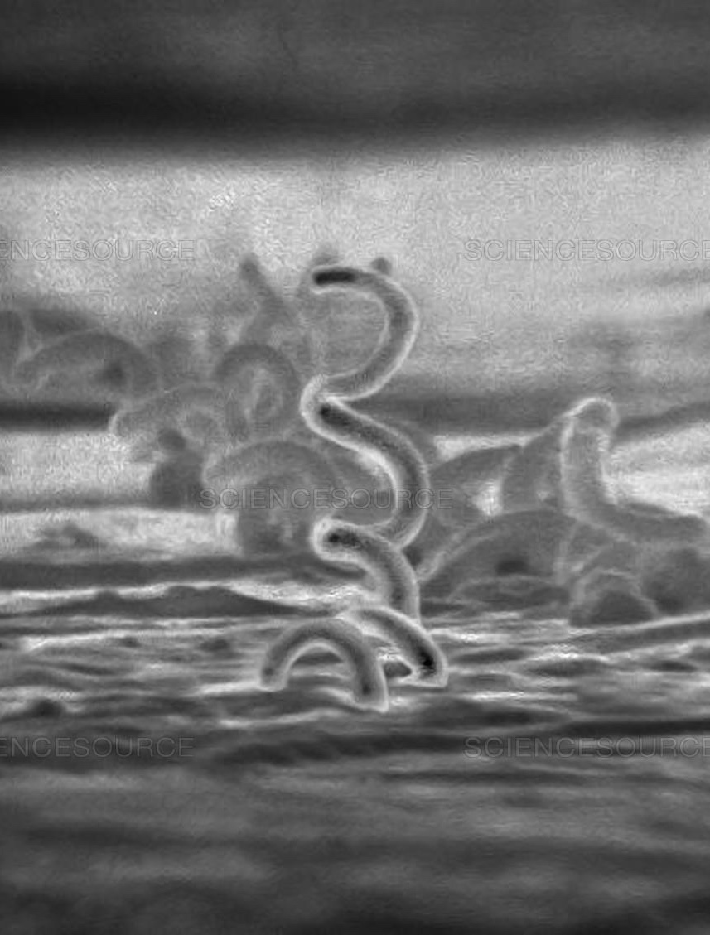
Syphilis
Epidemiology
  Caused by the spirochete bacterium Treponema pallidum
  Peaked in the 1930s and 1980s, steadily increasing number of cases since 2000
Symptoms
  Called “the great imitator” for its many presentations
  Progression of disease described in stages: primary, secondary and tertiary
  Latent syphilis is asymptomatic, may occur between any stages
Sequelae
  Left untreated, syphilis can infect the central nervous system and cause severe symptoms and/or death
  Can facilitate transmission and acquisition of HIV infection
  Congenital syphilis can cause miscarriage, neonatal death, or lead to severe abnormalities including disorders of the bone, skin and hair, deafness or neurologic impairment, and other disorders
Notes:
Sources:
Hahn AW, Barbee LA. Syphilis. National STD Curriculum. Last updated February 2020. https://www.std.uw.edu/go/pathogen-based/syphilis/core-concept/all
2015 STD Treatment Guidelines: Syphilis. Centers for Disease Control and Prevention. Last reviewed June 2015. https://www.cdc.gov/std/tg2015/syphilis.htm

Slide 42
Syphilis: Stages
Primary | Formation of a painless ulcer or “chancre” at the site of inoculation. May also cause regional non-tender lymphadenopathy
Secondary | After dissemination through the bloodstream (weeks to years), symptoms may include rash, which characteristically involves the trunk, palms and soles; lymphadenopathy; fever; and malaise among others
Tertiary | Left untreated for an average of 10-15 years, may cause “gummatous” destructive lesions in skeletal, spinal, mucosal areas, eyes, and/or visceral organs
Neurosyphilis | Can occur at any stage of syphilis Signs and symptoms may include meningitis, stroke, seizures Late neurosyphilis can progress to a general paresis or tabes dorsalis (demyelination of neurons in the dorsal root ganglia which can progress to paralysis, dementia and blindness)
Notes:
Latent syphilis, classified as early (if infection was acquired within the previous year), late (more than one year) or unknown duration, can occur between any stages of syphilis and may last weeks, months or many years.
Congenital syphilis is broken into:
Early congenital syphilis: manifestations in infants and children <2 years of age
Hepatosplenomegaly
Bone involvement in 60-80%
Skin and mucous membrane lesions
Alopecia
Lymphadenopathy
Meningitis
Osteitis or osteochondritis
Hematologic abnormalities such as thromboctopenia and anemia
Late congenital syphilis: manifestations in children older than 2 years of age
Bone lesions including frontal bossing, shortened maxilla, high palatal arch, may include perforation of the hard palate
Interstitial keratitis, corneal scarring due to chronic inflammation
Hutchinson’s triad: eighth cranial nerve deafness, interstitial keratitis and “Hutchinson teeth”
Result of scarring and chronic inflammatory changes form persistent infection and inflammation
Sources:
Hahn AW, Barbee LA. Syphilis. National STD Curriculum. Last updated February 2020. https://www.std.uw.edu/go/pathogen-based/syphilis/core-concept/all
2015 STD Treatment Guidelines: Syphilis. Centers for Disease Control and Prevention. Last reviewed June 2015. https://www.cdc.gov/std/tg2015/syphilis.htm

Slide 43
Who should be screened for Syphilis?
Men who have sex with men (MSM) at least annually
Persons with HIV infection at initial HIV evaluation and at least annually
At the first prenatal visit during pregnancy
Consider screening in individuals with increased risk of infection:
  History of incarceration
  History of exchanging sex for money
  Local area with high syphilis rate
  Persons taking pre-exposure prophylaxis for HIV prevention
Notes:
Of primary and secondary syphilis cases diagnosed in MSM, approximately one half of the men are coinfected with HIV, highlighting the importance of testing for both HIV and syphilis in this population.
Sources:
Hahn AW, Barbee LA. Syphilis. National STD Curriculum. Last updated February 2020. https://www.std.uw.edu/go/pathogen-based/syphilis/core-concept/all
2015 STD Treatment Guidelines: Syphilis. Centers for Disease Control and Prevention. Last reviewed June 2015. https://www.cdc.gov/std/tg2015/syphilis.htm

Slide 44
Syphilis: Diagnosis
Nontreponemal tests: Venereal Disease Research Laboratory (VDRL) and Rapid Plasma Reagin (RPR)
  Measure IgM and IgG antibodies and are not specific for T. pallidum, positive screening should be followed by a treponemal test to confirm
  Reported as a qualitative result and a quantitative titer, can be used to track disease in patients with syphilis
Treponemal tests: T. pallidum particle agglutination (TP-PA), fluorescent treponemal antibody absorption (FTA-ABS) and enzyme immunoassays (EIAs)
  Measure antibody directed against T. pallidum antigens
  Can remain reactive for life, even after treatment
  Some laboratories use a treponemal EIA for initial screening and confirm with a nontreponemal test if positive (called reverse screening)
Dark-Field microscopy: can detect early syphilis from a cutaneous specimen but rarely used due to specialized equipment, training and time-sensitivity
Notes:
Syphilis is difficult to diagnose for several reasons:
T. Pallidum cannot be cultivated on artificial growth media and cannot be seen by normal light microscopy
Must differentiate between active infection, latent infection, or prior infection
Several of the tests have poor specificity, with false positives more common in patients of older age, with autoimmune disorders, cardiovascular disease, pregnancy, malaria, leprosy, other spirochete infections and recent immunizations.
The “prozone effect” can cause a false negative reaction in patients with secondary syphilis have very high serum antibody levels that interfere with the mechanism of nontreponemal tests
Evaluation of CSF should be performed in patients with neurologic or ophthalmic symptoms, a diagnosis of tertiary syphilis, or in neonates with possible, probable or proven congenital syphilis)
Sources:
Hahn AW, Barbee LA. Syphilis. National STD Curriculum. Last updated February 2020. https://www.std.uw.edu/go/pathogen-based/syphilis/core-concept/all
2015 STD Treatment Guidelines: Syphilis. Centers for Disease Control and Prevention. Last reviewed June 2015. https://www.cdc.gov/std/tg2015/syphilis.htm

Slide 45
Syphilis: Treatment
Primary and secondary syphilis and early latent syphilis (acquired less than 1 year ago):
  Benzathine penicillin G, 2.4 million units IM in a single dose
  For infants and children, benzathine penicillin G, 50,000 units/kg IM up to max of 2.4 million units
Tertiary syphilis and late or unknown duration latent syphilis:
  Benzathine penicillin G, 2.4 million units IM x three doses at 1-week intervals
Neurosyphilis:
  Aqueous crystalline penicillin G, 3-4 million units IV every 4 hours or as a continuous infusion for 10-14 days
Notes:
Penicillin-allergic patients may be treated with doxycycline 100 mg orally twice daily for 14 days or tetracycline 500 mg four times daily for 14 days if not pregnant.
Pregnant patients and those with HIV should receive the same standard recommended therapy as other patients based on stage of disease
Patients found to have HIV infection should be started on antiretroviral therapy concurrently with syphilis treatment as this reduces serologic failure rates for syphilis treatment.
All persons who have sexual contact with a person diagnosed with syphilis of any stage should undergo evaluation and testing for syphilis
Persons who have had sexual contact within 90 days preceding that contact's diagnosis of primary, secondary, or early latent syphilis should receive presumptive treatment for early syphilis; if serologic testing is not immediately available, presumptive treatment should be started even if the sexual contact occurred more than 90 days prior.
The Jarisch-Herxheimer Reaction:
A self-limited reaction associated with initiation of anti-treponemal therapy, most common in early syphilis.
Characterized by fever, malaise, nausea, vomiting, chills, and occasionally rash
Clinicians should warn patients of the possibility of this reaction and clarify that it is not an allergic reaction to penicillin.
Sources:
Hahn AW, Barbee LA. Syphilis. National STD Curriculum. Last updated February 2020. https://www.std.uw.edu/go/pathogen-based/syphilis/core-concept/all
2015 STD Treatment Guidelines: Syphilis. Centers for Disease Control and Prevention. Last reviewed June 2015. https://www.cdc.gov/std/tg2015/syphilis.htm

Slide 46
Viral infections
Human Immunodeficiency Virus (HIV), Herpes Simplex Virus (HSV), Human Papilloma Virus (HPV), and Hepatits

Slide 47
Viral Infections:
Human Immunodeficiency Virus (HIV)
Herpes Simplex Virus (HSV)
Human Papilloma Virus (HPV)
Hepatitis

Slide 48

Case Discussion: Ben
Ben is a 16-year-old male patient of yours
He is sexually active and has had 3 male partners in the last 6 months
He is here today for STI testing and wants to talk about PrEP which he heard about from friends

Slide 49

Human Immunodeficiency Virus (HIV)
Epidemiology
  Caused by infection with the HIV virus, which progressively depletes CD4 T-lymphocytes critical for immune function
  As of 2018, an estimated 1.2 million people in the United States had HIV. There were nearly 38,000 new cases diagnosed in 2018
Symptoms
  Typically begins with a brief acute retroviral syndrome (flu-like symptoms)
  Can remain asymptomatic for many years before progressing to life-threatening acquired immunodeficiency syndrome (AIDS)
Sequelae
  Without treatment, virtually all persons with AIDS will die from AIDS-related causes
  Untreated HIV can be spread to others via sexual transmission, shared syringes, and perinatally from pregnant woman to neonate
Notes:
As of 2011, approximately 16% of persons with HIV infection in the US were unaware of their infection
Nearly 40% of new HIV infections are transmitted by people who don’t know they have the virus
New diagnoses are highest among people aged 25 to 34, followed by those aged 13 to 24
Men who have sex with men (MSM) are the population most affected by HIV, accounting for more than half of all current infections and more than two thirds of new diagnoses in 2018
Acute retroviral syndrome develops in 50-90% of persons within the first few weeks of infection and is characterized by nonspecific symptoms, including fever, malaise, lymphadenopathy, and skin rash
Persons with acute HIV infection are highly infectious and testing for antibodies (such as rapid tests) may be negative. Suspicion of acure retroviral syndrome should prompt testing with either antigen/antibody immunoassay or HIV RNA testing
Source:
HIV Infection: Detection, Counseling and Referral. 2015 STD Treatment Guidelines. Centers for Disease Control and Prevention. Last reviewed Jun 2015. https://www.cdc.gov/std/tg2015/hiv.htm

Slide 50
Who should be screened for HIV?
Everyone between the ages of 13 and 64 at least once
Persons likely to be at high risk at least annually:
  Men who have sex with men
  People who inject drugs
  Anyone with more than one sex partner since their last HIV test
All persons who seek care for sexually transmitted infections
Persons diagnosed with early syphilis, gonorrhea or chlamydia should be screened at the time of diagnosis
During pregnancy at the first prenatal visit
  Recommend second test during the third trimester in those at high risk or in care settings with high incidence of HIV
Notes:
Despite the CDC’s recommendation for universal screening, less than 40% of people in the U.S. have ever been tested for HIV according to a 2019 report
CDC recommends that persons should be notified that testing will be performed but retain the option to decline or defer testing (opt-out approach). A separate consent form for HIV testing is not recommended and providing prevention counseling should not be required to perform testing, though HIV testing is an opportunity to provide this counseling.
*Risk factors include:
Sexually active gay, bisexual and other men who have sex with men;
People who inject drugs;
Anyone who has had more than one sex partner since their last HIV test; and
People who have been diagnosed with another sexually transmitted infection, hepatitis, or tuberculosis
Sources:
CDC Press Release: Most Americans Have Never Had an HIV Test, New Data Show. Centers for Disease Control and Prevention. June 2019. https://www.cdc.gov/media/releases/2019/p0627-americans-hiv-test.html#:~:text=The%20CDC%20recommends%20that%20everyone,Mortality%20Weekly%20Report%20(MMWR).
HIV Infection: Detection, Counseling and Referral. 2015 STD Treatment Guidelines. Centers for Disease Control and Prevention. Last reviewed Jun 2015. https://www.cdc.gov/std/tg2015/hiv.htm

Slide 51
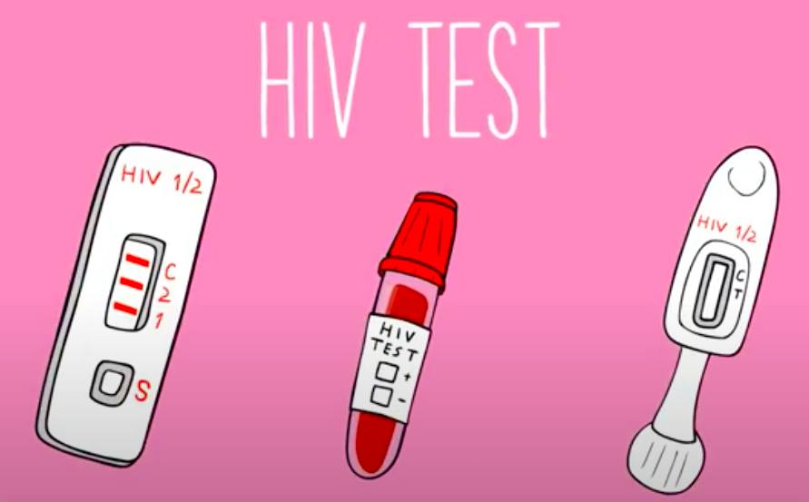
HIV: Diagnosis
Antigen/antibody tests: most common screening test
  Performed on a blood sample
  Immunoassay for both HIV antigen p24 and antibodies against HIV
  If either are positive, follow-up confirmatory testing is performed
Rapid antibody tests
  Performed on blood or saliva
  Include at least one FDA-approved self-test kit
  Can take longer to detect HIV infection after an
  exposure
Nucleic Acid Amplification tests
  Blood test for HIV RNA
  Most sensitive in acute HIV infection but not
  routinely used for screening
Notes:
Sources:
HIV Testing. HIV Public Health Partners. Centers for Disease Control and Prevention. Last reviewed June 2020. https://www.cdc.gov/hiv/testing/index.html
HIV Infection: Detection, Counseling and Referral. 2015 STD Treatment Guidelines. Centers for Disease Control and Prevention. Last reviewed Jun 2015. https://www.cdc.gov/std/tg2015/hiv.htm

Slide 52
HIV: Treatment
Antiretroviral medication is recommended for all people with HIV, regardless of CD4 count or other factors
  There are many regimens for HIV treatment which may be chosen based on ease of administration (single vs. multiple pills, liquid vs. pill formulation), cost, side effects, and resistance profiles
  All patients with HIV should be referred to a specialist for management
Treatment is prevention, since a person receiving effective treatment with an undetectable viral load cannot transmit HIV to others
Notes:
Sources:
HIV Infection: Detection, Counseling and Referral. 2015 STD Treatment Guidelines. Centers for Disease Control and Prevention. Last reviewed Jun 2015. https://www.cdc.gov/std/tg2015/hiv.htm

Slide 53

HIV: PrEP and PEP
Pre-exposure prophylaxis (PrEP) is antiretroviral medication taken to prevent acquisition of HIV infection
  Recommended for people at risk of being exposed to HIV through sexual contact or injection drug use
  At minimum, persons taking PrEP should have follow up every 3 months to test for HIV, measure serum creatinine and screen for bacterial STI’s and pregnancy as indicated
Post-exposure prophylaxis (PEP) is antiretroviral medication taken to prevent HIV infection after a specific high-risk exposure to HIV (within 72 hours)
Notes:
As of May 2020, two drugs have been approved for use as PrEP:
Emtricitabine (F) 200 mg in combination with tenofovir disoproxil fumarate (TDF) 300 mg (F/TDF – brand name Truvada®)
Emtricitabine (F) 200 mg in combination with tenofovir alafenamide (TAF) 25 mg (F/TAF – brand name Descovy®)
Management of persons taking PrEP should involve:
HIV testing every 3 months
Measurement of serum creatinine and bacterial STI screening at 3-month follow up and every 6 months thereafter
Pregnancy testing for women of reproductive age every 3 months
Bacterial STI screening every 3 months for MSM
For persons who inject drugs, assess access to sterile needles/syringes and to drug treatment services
PEP should be prescribed for 28 days and follow-up HIV testing is recommended at 30 at 90 days. It should be considered in people:
Whose vagina, rectum, eye, mouth or other mucus membrane, non-intact skin or perforated skin (eg. Needle stick) come into contact with potentially contaminated body fluids from an HIV-infected source within 72 hours prior to presentation
Exposure typically occurs through sex (including sexual assault) or sharing syringes with someone who has or might have HIV
Sources:
Pre-Exposure Prophylaxis (PrEP) and Post-Exposure Prophylaxis (PEP). Preventing New HIV Infections. Centers for Disease Control and Prevention. Last updated May 2020. https://www.cdc.gov/hiv/clinicians/prevention/prep.html

Slide 54
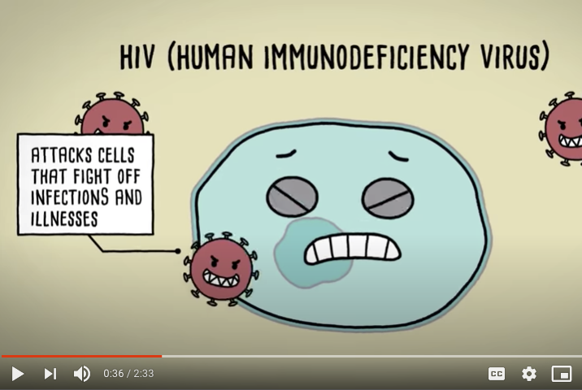
AMAZE
HIV: How to Protect Yourself and Others
Play Video
Notes:
https://www.youtube.com/watch?v=xK-VPgmn-18&feature=emb_logo

Slide 55
Case Discussion: Ben
What STIs should Ben be screened for today?
You explain how PrEP works and Ben wants to proceed with starting it, so you also order a serum creatinine and hepatitis B serology
Ben will need to return every 3 months for brief follow-up visits and routine testing
You encourage him to also use condoms since PrEP is not 100% effective at preventing HIV and does not protect against other STIs
Notes:
Ben should be screened for chlamydia, gonorrhea, HIV and syphilis. He may need oropharyngeal testing or rectal testing depending on the specifics of his sexual behaviors.
He must have a negative HIV test prior to starting PrEP. He should also be tested for hepatitis C.
Source:
Pre-Exposure Prophylaxis (PrEP) and Post-Exposure Prophylaxis (PEP). Preventing New HIV Infections. Centers for Disease Control and Prevention. Last updated May 2020. https://www.cdc.gov/hiv/clinicians/prevention/prep.html

Slide 56
Herpes Simplex Virus (HSV)
Epidemiology
  Genital ulcer disease caused is most commonly caused by herpes simplex virus type 2 (HSV-2) although HSV-1 can also cause genital infection
  Approximately 50 million people in the United States are estimated to be infected with genital herpes
Symptoms
  Primary infection typically causes symptoms which may include painful bilateral genital ulcers, itching, dysuria, and tender inguinal adenopathy
  Recurrent infections are typically shorter and milder
Sequelae
  Can cause aseptic meningitis most commonly at the time of primary infection
  HSV infection facilitates acquisition and transmission of HIV
  Maternal genital herpes infection can cause neonatal herpes
Notes:
Source:
Kinney RG, Johnston C. Herpes Simplex Virus – Genital. National STD Curriculum. Last updated September 2020. https://www.std.uw.edu/go/pathogen-based/hsv/core-concept/all

Slide 57
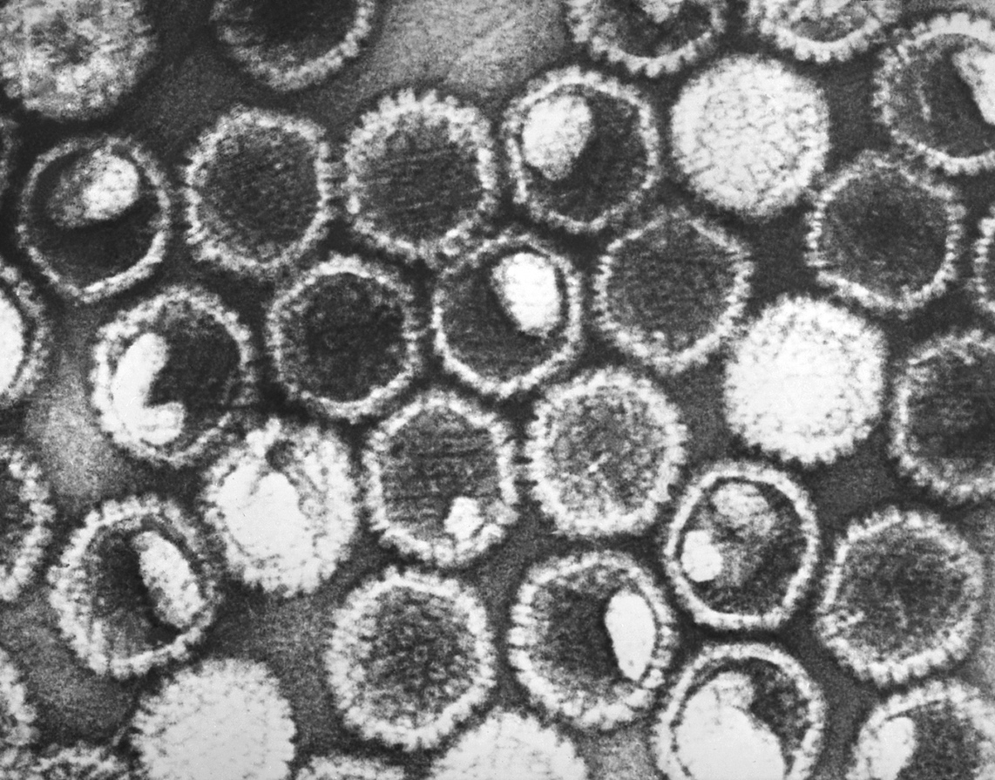
HSV: Diagnosis
Screening for HSV-1 or HSV-2 infections in asymptomatic persons is not recommended
Virologic tests:
  Polymerase chain reaction (PCR): four times higher sensitivity than culture, differentiates HSV-1 from HSV-2
  Viral culture: historic gold standard, less sensitive depending on when sample is taken
Serologic (antibody) tests:
  Rarely used to diagnose primary infections
  May be useful in patients with atypical symptoms, or history of clinical HSV diagnosis without laboratory confirmation
Notes:
Source:
Kinney RG, Johnston C. Herpes Simplex Virus – Genital. National STD Curriculum. Last updated September 2020. https://www.std.uw.edu/go/pathogen-based/hsv/core-concept/all

Slide 58
HSV: Treatment
Treatment for first clinical episode:
  7- to 10-day course of antiviral medication (acyclovir, valacyclovir or famciclovir)
Treatment for recurrent episodes:
  Episodic therapy for between 1 and 5 days depending on medication and dose
  Suppressive therapy can be given daily for patients with frequent recurrences
Pregnant women
  Women with known history of recurrent genital HSV should take suppressive therapy beginning at 36 weeks gestation
Notes:
Prevention of neonatal herpes infection:
Most likely to occur in women without aknown history of HSV, since during primary infection there may be a high viral load and few or no protective antibodies
Women with active genital herpes lesions or prodromal symptoms near or at delivery should have a cesarean section (recommendation of the American Academy of Obstetricians and Gynecologists)
Source:
Kinney RG, Johnston C. Herpes Simplex Virus – Genital. National STD Curriculum. Last updated September 2020. https://www.std.uw.edu/go/pathogen-based/hsv/core-concept/all

Slide 59
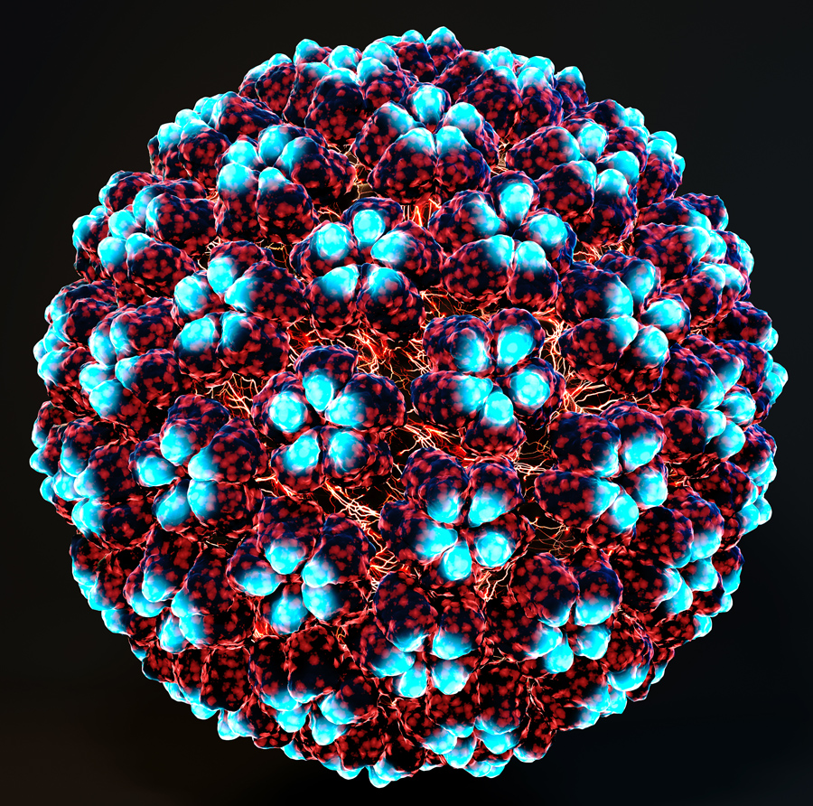
Human Papillomavirus (HPV)
Epidemiology
  More than 40 types of HPV can infect the genital tract in humans
  Most sexually active men and women will acquire a genital HPV infection at some point
Symptoms
  Most infections are asymptomatic and resolve spontaneously
  May cause anogenital warts
Sequelae
  High-risk infection with oncogenic HPV types leads to chronic inflammation, cellular abnormalities and can cause cervical and other cancers
  More than 90% of cervical and anal cancers are caused by HPV
Notes:
Sources:
Hahn AW, Spach DH. Human Papillomavirus Infection. National STD Curriculum. Last Updated November 2018. https://www.std.uw.edu/go/pathogen-based/hpv/core-concept/all

Slide 60
HPV: Screening and Diagnosis
HPV screening in patients 20 years and younger is not recommended
Persons with a cervix should be screened for cervical cancer starting at age 25
  Preferred testing is primary HPV testing every 5 years
  If primary HPV testing isn’t available, then co-testing with HPV testing and Pap smears every 5 years, or Pap smears alone every 3 years
    The Papanicolau test or Pap smear detects cervical cytologic abnormalities that can be classified by a pathologist
Notes:
Sources:
https://acsjournals.onlinelibrary.wiley.com/doi/full/10.3322/caac.21628

Slide 61
HPV: Treatment
& Prevention
Treatment of anogenital warts has a goal of removing visible warts
  Many warts regress spontaneously
  There are multiple options for patient- or provider-administered therapy
  Treatment does not prevent recurrence
Prevention: HPV vaccines target high-risk oncogenic HPV
  Current recommendation is for the 9-valent HPV vaccine for patients of all genders
    Routine 2-dose series: ages 11-12; as early as age 9 and up to age 15
    Catch-up 3-dose series: ages 15 and older, approved up to age 45
Notes:
HPV:
The 9 Valent HPV vaccine (incorporating 9 strains of HPV) may be used to continue or complete vaccination series started with a different HPV vaccine
For persons initiating vaccine before their 15th birthday, the recommended immunization schedule is 2 doses with the second dose 6-12 months after the first.
For persons initiating vaccination on or after their 15th birthday, the recommended immunization schedule is 3 doses of HPV vaccine with the second dose 1-2 months after the first and the third dose 6 months after the first.
Recommended for all MSM and immunocompromised persons
Permissive recommendation for adults up to age 45 y/o without risk factors
Sources:
Hahn AW, Spach DH. Human Papillomavirus Infection. National STD Curriculum. Last Updated November 2018. https://www.std.uw.edu/go/pathogen-based/hpv/core-concept/all
Meites E, Szilagyi PG, Chesson HW, Unger ER, Romero JR, Markowitz LE. Human Papillomavirus Vaccination for Adults: Updated Recommendations of the Advisory Committee on Immunization Practices. MMWR Morb Mortal Wkly Rep 2019;68:698–702. DOI: http://dx.doi.org/10.15585/mmwr.mm6832a3

Slide 62
Hepatitis A
Transmission: Hepatitis A virus (HAV) is transmitted by the fecal-oral route, can be transmitted to sexual contacts
Symptoms: self-limited nausea, vomiting, diarrhea and elevated liver enzymes
  Acute liver failure is rare
Diagnosis: Presence of IgM antibody to HAV is diagnostic of acute infection. Positive total anti-HAV antibody testing may indicate current or previous infection or vaccination.
Treatment: Usually supportive care only
Prevention: Hepatitis A vaccination (HAV)
  Routinely recommended for children age 12-23 months
  Catch-up recommended for persons up to 18 years or at-risk adults
Notes:
Hepatitis A transmission during sexual activity probably results from fecal-oral contact. Bloodborne transmission is uncommon.
While HAV does not cause chronic infection or chronic liver disease, up to 10% of patients experience a relapse of symptoms within 6 months after acute illness.
Adults are more likely to have symptoms compatible with acute hepatitis while children are often asymptomatic
Adults considered to be at risk for HAV include:
International travelers
Men who have sex with men
People who use injection or non-injection drugs
People who have occupational risk for infection
People who anticipate close contact with an international adoptee
People experiencing homelessness
People with HIV
People with chronic liver disease
Any person wishing to obtain immunity (protection)
In addition, a person who has not previously received hepatitis A vaccine and who has direct contact with someone with hepatitis A should get hepatitis A vaccine within 2 weeks after exposure.
Sources:
Viral Hepatitis. 2015 STD Treatment Guidelines. Centers for Disease Control and Prevention. Last updated June 2015. https://www.cdc.gov/std/tg2015/hepatitis.htm
Hepatitis A Vaccine Information Sheet. Centers for Disease Control and Prevention. Current edition 7/28/2020. https://www.cdc.gov/vaccines/hcp/vis/vis-statements/hep-a.html

Slide 63
Hepatitis B
Transmission: Hepatitis B virus (HBV) is transmitted via blood and body fluids, including sexual contact
Symptoms: may be self-limited or chronic
  In adults, approximately half of cases are symptomatic, 1% result in acute liver failure, and 2-6% become chronically infected
Diagnosis: Serologic testing for HBV antigen and antibodies to HBV surface and core antigens can distinguish acute or chronic infection or immunity
Treatment: Supportive care for acute illness, specialist referral is recommended for chronic disease
Prevention: Hepatitis B vaccination (HBV)
  Routinely recommended within 24 hours of birth followed by complete series
  Catch-up series recommended among persons through age 19 years and for all adults who are at risk or who request vaccination.
Notes:
Hepatitis B risk factors include:
People whose sex partners have hepatitis B
Sexually active persons who are not in a long-term monogamous relationship
Persons seeking evaluation or treatment for a sexually transmitted disease
Men who have sexual contact with other men
People who share needles, syringes, or other drug-injection equipment
People who have household contact with someone infected with the hepatitis B virus
Health care and public safety workers at risk for exposure to blood or body fluids
Residents and staff of facilities for developmentally disabled persons
Persons in correctional facilities
Victims of sexual assault or abuse
Travelers to regions with increased rates of hepatitis B
People with chronic liver disease, kidney disease, HIV infection, infection with hepatitis C, or diabetes
Anyone who wants to be protected from hepatitis B
Sources:
Viral Hepatitis. 2015 STD Treatment Guidelines. Centers for Disease Control and Prevention. Last updated June 2015. https://www.cdc.gov/std/tg2015/hepatitis.htm
Hepatitis B Questions and Answers for Health Professionals. Centers for Disease Control and Prevention. Last reviewed July 2020. https://www.cdc.gov/hepatitis/hbv/hbvfaq.htm#D4

Slide 64
Hepatitis C
Transmission: Hepatitis C virus (HCV) is primarily transmitted via blood and only rarely through sexual contact
Symptoms: can be asymptomatic or cause symptoms like nausea, vomiting, abdominal pain, fever and jaundice
  More than half of people infected develop chronic HCV
Who should be screened?
  All adults 18 and older at least once, all pregnant women, and those with risk factors
Diagnosis: Serologic testing for antibodies to HCV is used to screen for infection and HCV RNA testing is used for confirmation
Treatment: Over 90% of people infected with HCV can be cured with 8 to 12 weeks of oral therapy
  Pediatric patients, pregnant patients or those with cirrhosis should be referred to a specialist for treatment
Notes:
HCV is transmitted primarily through injection drug use and people who inject drugs are at highest risk
It can also be transmitted from mother to neonate at birth
Sex with an HCV-infected person is an inefficient means of transmission although HIV-infected men who have sex with men have increased risk
The CDC now recommends universal hepatitis C screening for all U.S. adults and all pregnant patients unless in a setting where prevalence of HCV is < 0.1%
Persons who should be tested include:
Pregnant women during each pregnancy
People who ever injected drugs and shared needles, syringes or other drug preparation equipment
People with HIV
People who have ever received maintenance hemodialysis, clotting factor concentrates from prior to 1987, a blood or blood component transfusion prior to July 1992
People who received an organ transplant before July 1992
People who were notified that they received blood from a donor who later tested positive for HCV infection
Children born to mothers with HCV infection
Healthcare and emergency workers after needle sticks, sharps or mucosal exposure to HCV positive blood
Any person who requests hepatitis C testing
Treatment guidelines:
To provide health-care professionals with timely guidance as new therapies are available and integrated into hepatitis C treatment regimens, the Infectious Diseases Society of America (IDSA) and American Association for the Study of Liver Diseases (AASLD), in collaboration with the International Antiviral Society–USA (IAS–USA), developed evidence-based, expert-developed recommendations for hepatitis C management. These recommendations are available at http://www.hcvguidelines.org
Sources:
Hepatitis C Questions and Answers for Health Professionals. Centers for Disease Control and Prevention. Last reviewed August 2020. https://www.cdc.gov/hepatitis/hcv/hcvfaq.htm#section2

Slide 65
Expedited Partner Therapy

Slide 66

Expedited Partner Therapy (EPT)
Definition: the clinical practice of treating the sex partners of patients diagnosed with an STI by providing prescriptions or medications to the patient to take to his/her partner without the health care provider first examining the partner
EPT is more effective at reducing rates of re-infection than the standard practice of referring sex partners for treatment
Notes:
The standard approach to partner treatment has consisted of partner notification by the index patient, healthcare provider or both with referral of the partner(s) to treatment. This practice is called “standard referral”
EPT has been found to reduce rates of re-infection in patients with chlamydia compared to standard referral
The CDC concluded that EPT is a “useful option” to further partner treatment, particularly for male partners of women with chlamydia or gonorrhea
EPT is a safe option, the risk of serious adverse intolerance, toxicity or allergic reactions is low for the regimens recommended for treatment of gonorrhea and chlamydial infections, and for drugs that might be contemplated for treatment of other STIs
Some experts do not recommend use of expedited partner therapy (EPT) in men who have sex with men due to high rates of concurrent infections such as syphilis and HIV, and because an increased proportion of gonococcal isolates among MSM show reduced susceptibility to cefixime
EPT should not be used to treat female partners with current signs or symptoms suggestive of PID as they require evaluation by a health care provider
Source:
Expedited partner therapy in the management of sexually transmitted diseases. Centers for Disease Control and Prevention. Atlanta, GA: US Department of Health and Human Services, 2006. https://www.cdc.gov/std/ept/default.htm

Slide 67

Expedited Partner Therapy (EPT): Legal Status
Officially recommended by the CDC since 2006 for treating partners of patients with chlamydia or gonorrhea
  Insufficient evidence for treatment of partners of patients with trichomoniasis
Legal status varies by state
Notes:
Legal status of EPT varies by state:
Historically, most states have had laws prohibiting physicians or healthcare providers from prescribing medications for a patient they have not physically examined, and many additionally have laws prohibiting the dispensing of medication by pharmacies if certain identifying information such as the patient’s name is missing from the prescription. Legalizing EPT requires reversing both these prohibitions, where they exist, and creating a specific exemption for cases of treating the partner of a patient with an STD.
California was the first state to legalize EPT in 2001. In 2006, the CDC recommended that health care providers utilize EPT to treat the partners of patients diagnosed with gonorrhea and chlamydia. Since then, 43 states and the District of Columbia have legalized EPT and the CDC recognizes an additional 5 states where EPT is “potentially allowable” based on current state law.
Mississippi and Pennsylvania have never had laws that would make EPT illegal, and therefore have not passed any new laws to legalize it.
EPT remains illegal in all cases only in South Carolina.
Some states have passed limited laws allowing EPT only in the case of chlamydia, but not gonorrhea. Other states have used broader language to allow EPT to treat any STI or have explicitly included trichomonas in addition to gonorrhea and chlamydia. The CDC recognized in their initial recommendation that EPT might be proven effective for trichomonas but as of 2006 there was not sufficient evidence to recommend it.
In several states, EPTs legality remains unclear because existing laws are contradictory.
Oklahoma, for example, passed a law in 2013 allowing “providers ordering appropriate medications for persons with laboratory-proven, sexually transmitted diseases” to provide medications to “persons who have been in contact with certain infectious diseases” without a face-to-face encounter. They did not, however, alter their existing laws prohibiting providers from “prescribing to a patient without sufficient examination or establishing physician/patient relationship,” and pharmacies “shall not dispense a prescription drug if the pharmacist knows or should have known that the prescription was issued without a valid preexisting patient-practitioner relationship.”
Similar contradictions exist in other states’ laws
Sources:
Centers for Disease Control and Prevention. Expedited partner therapy in the management of sexually transmitted diseases. Atlanta, GA: US Department of Health and Human Services, 2006.
Legal status of expedited partner therapy. (2019). US Department of Health and Human Services, Centers for Disease Control and Prevention. Retrieved from https://www.cdc.gov/std/ept/legal/default.htm
Okla. Admin. Code § 435:10-7-12
Okla. Stat. tit. 59 § 509(12)
Okla. Admin. Code § 535:15-3-13(d)

Slide 68
Screening Guidelines Summary

Slide 69
Screening Guidelines for:
Sexually active women under 25 (non-pregnant)
Sexually active young men who have sex only with women
Chlamydia and gonorrhea at least annually and for those with a new partner, multiple partners, or a partner with an STI
HIV at least once and for anyone seeking evaluation and treatment for STIs
Cervical cancer screening every 3 years starting at age 21
HIV at least once and if seeking evaluation and treatment for STIs
Chlamydia and gonorrhea screening in high prevalence clinical settings including adolescent clinics, STI clinics and correctional facilities
Notes:
Source:
Screening Recommendations and Considerations Referenced in Treament Guidelines and Original Sources. 2015 STD Treatment Guidelines. Centers for Disease Control and Prevention. Last reviewed June 2015. https://www.cdc.gov/std/tg2015/screening-recommendations.htm

Slide 70
Screening Guidelines for:
Pregnant women
Men who have sex with men
Chlamydia, gonorrhea, syphilis, HIV, and Hepatitis B at the first prenatal visit
History of genital herpes should be documented
Those at high risk for STIs should be retested for chlamydia gonorrhea, syphilis and HIV in the third trimester
Chlamydia, gonorrhea, syphilis and HIV at least annually
Hepatitis B at least once
Persons with HIV
Chlamydia, gonorrhea, syphilis and HCV at least annually
Trichomoniasis at least annually in women with HIV
Hepatitis B at least once
Notes:
Source:
Screening Recommendations and Considerations Referenced in Treament Guidelines and Original Sources. 2015 STD Treatment Guidelines. Centers for Disease Control and Prevention. Last reviewed June 2015. https://www.cdc.gov/std/tg2015/screening-recommendations.htm

Slide 71
Resources for visual diagnosis
CDC’S STD Clinical Slides: https://www.cdc.gov/std/training/clinicalslides/default.htm
CDC’s STD Picture Cards: https://www.cdc.gov/std/training/picturecards.htm
National STD Curriculum (images embedded in articles): https://www.std.uw.edu/

Slide 72
Additional Resources
CDC’s 2015 STD Treatment Guidelines: https://www.cdc.gov/std/tg2015/default.htm
The National STD Curriculum: https://www.std.uw.edu/
CDC’s Sexually Transmitted Disease Surveillance 2018 reports: https://www.cdc.gov/std/stats18/default.htm
CDC’s HIV Nexus Clinician Resources: https://www.cdc.gov/hiv/clinicians/index.html
AMAZE informational videos: https://amaze.org/

Slide 73

Adolescent Reproductive and Sexual Health Education Project (ARSHEP)
Sexually Transmitted Infections
Please complete the evaluation for this presentation by pointing your cell phone camera at the QR code and completing the survey.
Thank you!
Notes:
Updated 2020

