Slide 1

Adolescent Reproductive and Sexual Health Education Project (ARSHEP)
Caring for Pregnant and Parenting Adolescents
Notes:
Updated 2020

Slide 2
Adolescent Reproductive and Sexual Health Education Project (ARSHEP)
[Faculty Member information goes here}
Notes:
Updated 2020

Slide 3

This presentation was originally created by Physicians for Reproductive Health as part of the ARSHEP curriculum.
Updates and modifications to this presentation were supported, in part, by Cooperative Agreement PS18-1807 from the Centers for Disease Control and Prevention, Division of Adolescent and School Health (CDC-DASH). The contents do not necessarily represent the official views of the Centers for Disease Control and Prevention.

Slide 4
Objectives
Provide patients with accurate and nonjudgmental information about adolescent parenting
Counsel pregnant adolescents on their options
Describe guidelines for caring for pregnant and parenting adolescents
Describe models for providing primary care to parenting adolescents and their children

Slide 5
A Note on Gender Identity & Sexual Orientation of Pregnant People:
Pregnant people may identify as female, male or another gender and may have any sexual orientation
While this presentation may refer to “pregnant women,” “adolescent mothers” and “teen mothers,” the goal is to provide effective, equitable, and respectful quality care to all pregnant/expectant and parenting adolescents, regardless of gender identity and sexual orientation

Slide 6

Case Discussion: Kim
Kim, a 16-year-old female, saw a colleague in your office last week.
After disclosing unprotected sex in the past month, she was given a pregnancy test, which was positive.
How common is teen pregnancy?

Slide 7
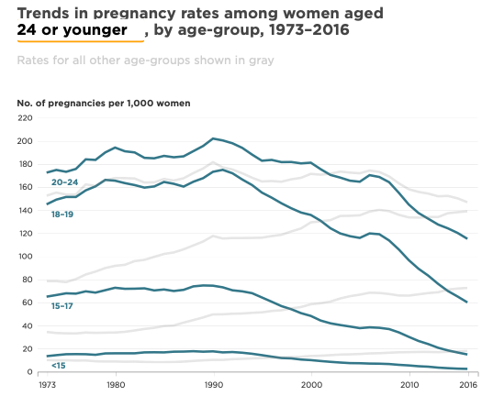
Teen Pregnancy Rates Are Declining
Notes:
A 2016 study that examined data from the National Survey of Family Growth estimated that the decline in adolescent pregnancy rates was almost entirely attributable to improved contraceptive use.
The study also found significant increases in teens using highly-effective methods like LARC, and in the use of more than one method (like condoms + pills, for example).
Sources:
Maddow-Zimet I, Kost K and Finn S, Pregnancies, Births and Abortions in the United States, 1973–2016: National and State Trends by Age, New York: Guttmacher Institute, 2020, https://www.guttmacher.org/report/pregnancies-births-abortions-in-united....
Hamilton BE et al., State Teen Birth Rates by Race and Hispanic Origin: United States, 2017–2018. National Vital Statistics Reports, 2020, Vol. 69, No. 6,
https://www.cdc.gov/nchs/data/nvsr/nvsr69/NVSR69-6-508.pdf

Slide 8
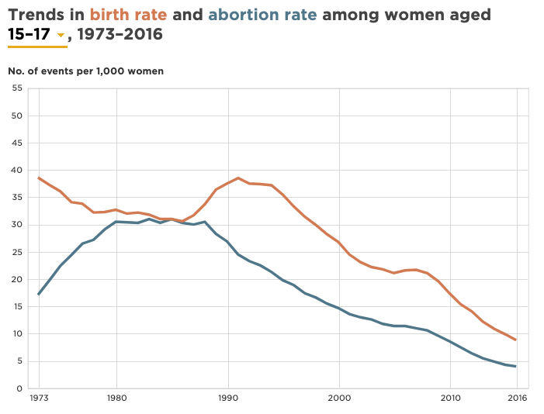
Both Birth and Abortion Rates are Declining
(Ages 15-17)
Notes:
Pregnancy rates reflect both birth and abortion rates, and these do not always move or change direction in tandem.
The decline in the pregnancy rate among adolescents and young adults over the past two-and-a-half decades was the result of declines in both birth and abortion rates.
Among women aged 30–34, 35–39, and 40 or older, the rate of abortions has stayed relatively stable since the late 1970s, during which time birth rates have consistently increased.
Source:
Maddow-Zimet I, Kost K and Finn S, Pregnancies, Births and Abortions in the United States, 1973–2016: National and State Trends by Age, New York: Guttmacher Institute, 2020, DOI: https://doi.org/10.1363/2020.31952. https://www.guttmacher.org/report/pregnancies-births-abortions-in-united-states-1973-2016

Slide 9
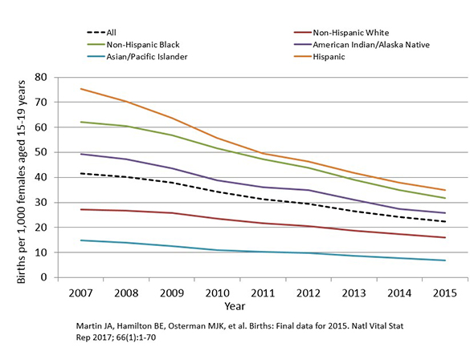
Birth Rates Have Declined Among All Race and Ethnicity groups
Notes:
Line chart of birth rates (live births) per 1,000 females aged 15–19 years for all races and Hispanic ethnicity in the United States, 2007–2015.
Source:
Birth Rates (Live Births) per 1,000 Females Aged 15-19 Years, by Race and Ethnicity, 2007-2015. Centers for Disease Control and Prevention, last reviewed May 2017. https://www.cdc.gov/teenpregnancy/about/alt-text/birth-rates-chart-2007-2015-text.htm

Slide 10
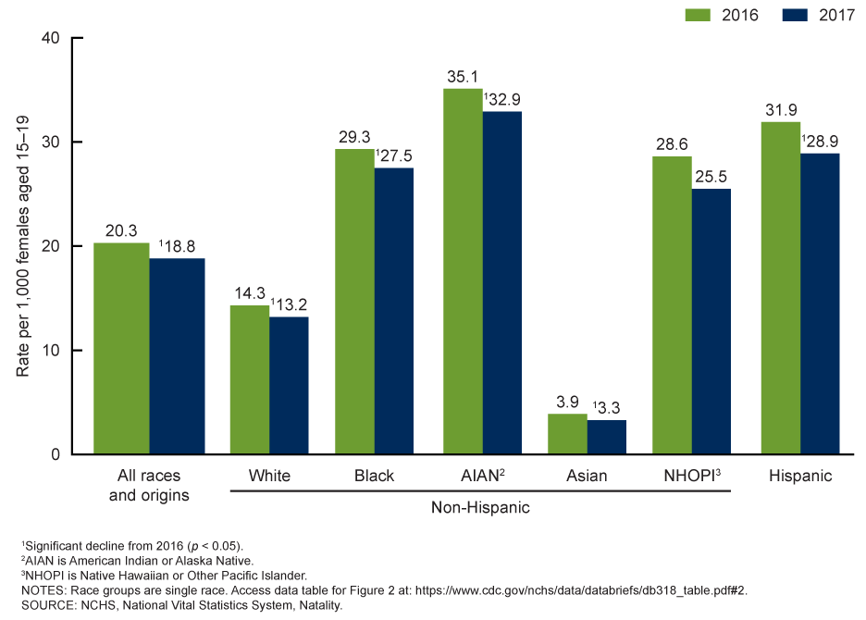
However, Disparities in Teen Birth Rates Persist
Notes:
In 2017, the birth rates of Hispanic teens (28.9) and non-Hispanic black teens (27.5) were more than two times higher than the rate for non-Hispanic white teens (13.2)
The birth rate of American Indian/Alaska Native teens (32.9) was highest among all race/ethnicities.
Geographic differences in teen birth rates persist, both within and across states. Among some states with low overall teen birth rates, some counties have high teen birth rates.
Source:
Social Determinants and Eliminating Disparities in Teen Pregnancy. Centers for Disease Control and Prevention, last reviewed October 2019. https://www.cdc.gov/teenpregnancy/about/social-determinants-disparities-teen-pregnancy.htm

Slide 11
Sexual Minority Youth have Higher Rates of Teen Pregnancy
Teen pregnancy rates are consistently higher among gay/lesbian and bisexual youth
  Use of condoms and hormonal contraception is lower among these groups
45% of the disparity is explained by higher rates of childhood maltreatment and bullying
Notes:
Sources:
Saewyc E.M. (2014) Adolescent Pregnancy Among Lesbian, Gay, and Bisexual Teens. In: Cherry A., Dillon M. (eds) International Handbook of Adolescent Pregnancy. Springer, Boston, MA. https://doi-org.laneproxy.stanford.edu/10.1007/978-1-4899-8026-7_8
Charlton BM et al. Sexual orientation differences in teen pregnancy and hormonal contraceptive use: an examination across 2 generations. American Journal of Obstetrics and Gynecology Volume 209, Issue 3 (2013): 204.e1-204.e8. https://doi.org/10.1016/j.ajog.2013.06.036
Charlton BM, Roberts AL, Rosario M, Katz-Wise SL, Calzo JP, Spiegelman D & Austin SB. Teen Pregnancy Risk Factors Among Young Women of Diverse Sexual Orientations. Pediatrics Apr 2018, 141 (4) e20172278; DOI: 10.1542/peds.2017-2278

Slide 12
Pregnancy in Transgender Men
Many transgender men retain their uterus and ovaries and retain the capacity to become pregnant
Among transgender men who take testosterone, the medication usually leads to anovulation and amenorrhea, but there is insufficient data on its effectiveness as a contraceptive
  Some transgender men have experienced unintended pregnancy while taking testosterone
No studies currently document the number of transgender men who have had a pregnancy
Notes:
Sources:
Obedin-Maliver J & Makadon HJ. Transgender men and pregnancy. Obstetric Medicine, October 2015. https://doi.org/10.1177/1753495X15612658

Slide 13
Pregnancy in transgender men: cross-sectional survey
A survey of 41 self-described transgender men who had been pregnant and delivered after transitioning from female-to-male gender
  61% had used testosterone
  32% were unplanned pregnancies
    half of the men who had never used testosterone reported their pregnancy was unplanned (compared to one quarter of those who had used testosterone)
  Among the 68% with a planned pregnancy, 58% conceived within 6 months of attempting to become pregnant
Notes:
Open ended questions were used to collect qualitative data about experiences:
Participants often used words such as “dad,” “carrier,” and “gestational parent” to affirm their male gender identity and describe their parenting role
Feelings of isolation were common among participants who cited “lack of support” and “lack of resources available to pregnant transgender men”
Participants reported varied experiences with health care providers ranging from positive gender-affirming care to one extreme experience in which Child Protected Services was alerted due to their gender identity
The proportion of men who had used never used testosterone who reported pregnancy being unplanned correlates with overall unplanned pregnancy rates in the population
Authors suggest a potential unmet need for contraceptive services among transgender men
Source:
Light AD, Obedin-Maliver J, Sevelius JM, Kerns JL. Transgender men who experienced pregnancy after female-to-male gender transitioning. Obstet Gynecol. 2014 Dec;124(6):1120-7. doi: 10.1097/AOG.0000000000000540. PMID: 25415163.
Finer LB, Kost K. Unintended pregnancy rates at the state level.Perspect Sex Reprod Health 2011;43:78–87.

Slide 14

Prevention Messages
Use of shame and stigma has traditionally been used to discourage sexual activity and teen parenthood
  No evidence to support efficacy of this approach
  Diminishes young parents’ perception of their ability to thrive
  Weakens advocacy efforts to support young parents and their children
Notes:
Image taken from http://www.reproductivejusticeblog.org/2014/04/noteenshame-schools-candies-foundation.html
Teen pregnancy happens—that much is clear. How effective are our public health messages and campaigns, and how do they affect how others see teen parents and how they see themselves?
Unfortunately, shame and fear are often used in pregnancy prevention campaigns and programs, despite the lack of evidence that such tools work. Analysts of these strategies in abstinence-only-until-marriage programs concluded such programs did not delay sexual initiation, or decrease unintended pregnancy or sexually transmitted infections among youth. Yet many teen pregnancy prevention programs continue to stigmatize young parents in an attempt to discourage adolescent sexual behavior.
Additionally, stigmatizing teen parents ignores a complex picture of why some adolescents may not postpone childbearing or at least not make delayed childbearing a priority. Research shows young people’s perceptions of opportunities and their own ability to achieve can play a role in their actions regarding early parenthood. Teens who believe that a lack of opportunity at the individual, family, or community level prevents them from investing in future goals like education have less incentive to delay early childbearing, and by extension to avoid behaviors that put them at risk for parenthood.
Finally, enabling the stigma around teen parenting does nothing to create support for programs or campaigns that might help young parents and their children.
Sources:
Impacts of Four Title V, Section 510 Abstinence Education Programs. Princeton, NJ: Mathematica Policy Research; 2007. 59–61.
Driscoll AK, Sugland BW, Manlove J, Papillo AR. Community opportunity, perceptions of opportunity, and the odds of an adolescent birth. Youth & Society. 2005;37(1):33–61.

Slide 15
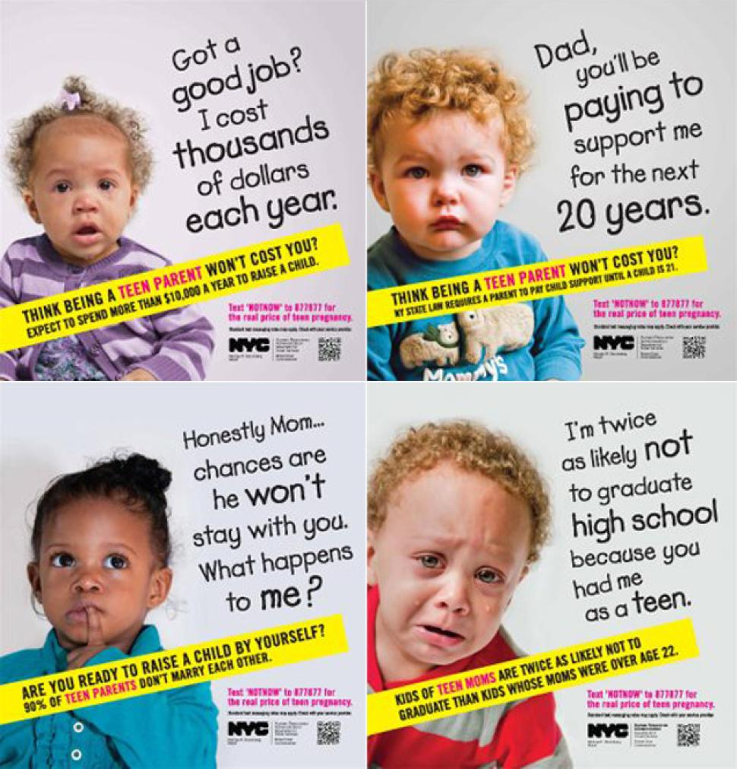
NYC Teen Pregnancy Prevention Campaign: Effective or Stigmatizing?
Notes:
Talking Point: Under the Bloomberg administration, the NYC HRA campaign launched a teen pregnancy prevention campaign in March 2013, which consisted of 6 print advertisements (4 shown above). The original campaign website is now gone.
What’s harmful or shaming about this language and rhetoric? Does this campaign empower teen parents?
What would a successful campaign about pregnancy prevention look like? Perhaps increased access to information on family planning services and confidentiality for adolescents?

Slide 16
Addressing Root Causes
What kinds of prevention strategies do not marginalize teen parents?
  Increased access to reproductive health care and sexual and reproductive health information
  Increased access to higher education and employment
Notes:
Polices that increase access to reproductive health care and health information:
Comprehensive sexuality education
Public funding for reproductive health care
Title X
Medicaid
Increased access to contraceptives
Policies that increase access to higher education and employment:
Loan forgiveness
Affirmative action
Fair wages
Child care for students
Source:
Fuentes L, Bayetti Flores V, Gonzles-Rojas J; National Latina Institute for Reproductive Health. Removing Stigma: Towards a Complete Understanding of Young Latinas’ Sexual Health. New York: National Latina Institute for Reproductive Health; 2010.

Slide 17
Case Discussion: Options Counseling
You ask Kim how she feels about the pregnancy. Does she have an idea of what she wants to do next?
  You reaffirm confidentiality
  You provide options counseling
  You explore support and safety
Notes:
In terms of support and safety, is there anyone who she is worried will react negatively to the pregnancy? Anyone she is concerned may threaten or hurt her physically? Does she worry about being kicked out of her home? How will her partner react?

Slide 18

Pregnancy Options Counseling
A pregnant person has 3 main options:
  Parenting: giving birth and raising the child
  Abortion: taking medication or having a medical procedure to end the pregnancy
  Adoption: giving birth and placing the child with another person or family permanently
Notes:
Source:
Pregnancy Options. Planned Parenthood. https://www.plannedparenthood.org/learn/pregnancy/pregnancy-options

Slide 19
Pregnancy Options Counseling
It is the professional and ethical responsibility of healthcare providers to:
  Offer unbiased counseling regarding any of the possible options for an adolescent’s pregnancy
  If you cannot provide comprehensive, medically accurate counseling, you must refer the patient to someone who can
Notes:
Some adolescents will desire to continue an unintended pregnancy, and some adolescent pregnancy is intended and planned. While this may not always seem in the best interest of the patient, it is essential for providers to put personal feelings aside, provide unbiased counseling, and ultimately support the patient whatever decision they make.

Slide 20

AMAZE: So, You Think you’re Pregnant
Play Video
Notes:
https://www.youtube.com/watch?v=qs4do1DwMrI&feature=emb_logo

Slide 21
Case Discussion: Kim
Kim has decided to continue the pregnancy and wants to discuss her options.
How many teens choose to continue their pregnancies?
Notes:
In 2006, there were 742,990 pregnancies among women 15–19 in the U.S. 435,436 of these pregnancies ended in births; 200,420 ended in abortion; 107,130 is the estimated number of miscarriages.
Source:
Kost K, Henshaw S, Carlin L; Guttmacher Institute. U.S. Teenage Pregnancies, Births, and Abortions: National and State Trends and Trends by Race and Ethnicity, 2010. http://www.guttmacher.org/pubs/USTPtrends.pdf. Accessed September 21, 2010.

Slide 22

What Do Teens Decide?
As of 2013, fewer than 5% of teens aged 15-19 become pregnant.
Of this group, outcomes are:
Births (61%)
Abortion (24%)
Miscarriage (15%)
Notes:
Talking point: The majority of teen pregnancies end in birth.
When we say “teen” we are referring to 15–19 year olds unless otherwise specified.
<5% of teenagers aged 15–19 become pregnant. Of this group, the above percentages have been computed.
When faced with a pregnancy, an adolescent has three options:
(1) Carrying her pregnancy to delivery and raising the baby.
(2) Carrying her pregnancy to delivery and planning an adoption.
(3) Terminating her pregnancy.
Source:
Livingston G & Thomas D. Why is the teen birth rate falling? Pew Research Center, August 2019. https://www.pewresearch.org/fact-tank/2019/08/02/why-is-the-teen-birth-rate-falling/#:~:text=Of%20the%20roughly%20450%2C000%20pregnancies,15%25%20in%20miscarriages%20or%20stillbirths.
Kost K, Maddow-Zimet I and Arpaia A, Pregnancies, Births and Abortions Among Adolescents and Young Women in the United States, 2013: National and State Trends by Age, Race and Ethnicity, New York: Guttmacher Institute, 2017, https://www.guttmacher.org/report/us-adolescent-pregnancy-trends-2013.

Slide 23
Provider Values Clarification
What are your feelings about teen parenthood?
Can you respect a teenager’s autonomy in deciding whether to parent?
Can you identify biases in yourself that may affect your ability to counsel Kim? (and refer to another provider if you cannot counsel her in a nonjudgmental manner?)
Notes:
Take a moment to consider your own values, beliefs, understanding of teen parenthood, and how your experiences might shape your ability to counsel patients about this option.

Slide 24
Case: Supporting Adolescents Who Choose To Parent
Kim tells you she wants to become a parent.
She is unsure of what to do next.
What do you advise for her?

Slide 25
Factors That May Improve Outcomes
Twenty-year study of teen mothers showed improved outcomes when:
  Participating in program for pregnant teens
  Remaining in school
  No subsequent pregnancies 26 months postpartum
  Not isolated
  Have sense of control
  Have only 1 or 2 subsequent children
Notes:
Outcomes measured were
Finishing high school
Employment or support by spouse at time of follow up
Source:
Horowitz SM, Klerman LV, Kuo HS, Jekel JF. School-age mothers: predictors of long-term educational and economic outcomes. Pediatrics. 1991;87:862–868.

Slide 26
Risks of Teen Pregnancy and Parenting
Unintended pregnancies can prove challenging regardless of age
Research has historically indicated poor outcomes for teen parents and their children
  Health of teen mothers and infants
  Educational & employment outcomes for teen parents
Some outcomes may, in fact, more strongly reflect socioeconomic status or access to education and healthcare
Notes:
Teen pregnancy remains a concern for several reasons. Unintended pregnancy is a cause for concern, regardless of age. Unintended pregnancies create crises for women and their families. The challenges created by an unintended pregnancy are exacerbated for teens who have the least financial and social support to overcome them. When looking at the outcomes for teens and their children, it is essential to examine the context of these adolescents’ lives. How do poverty, barriers to education, and barriers to health care exacerbate the effects of unintended pregnancy for teens and their children?
Looking closely at the data, some poor outcomes seem to remain linked with early childbearing. Others seem to be more strongly influenced by socioeconomic status or access to health care or education.
One study from 1994 demonstrated that children of teen mothers appear to score no worse on measures of development than their first cousins whose mothers had first births after their teen years. These findings suggest that differences in family background of mothers (factors that precede their childbearing years) may account for the low scores observed among young children of teen mothers.
Source:
Arline T. Geronimus, Sanders Korenman and Marianne M. Hillemeier, “Does Young Maternal Age Adversely Affect Child Development? Evidence from Cousin Comparisons in the United States,” Population and Development Review 20 (1994): 585-609;

Slide 27
Medical and Psychosocial Risks for Pregnant Adolescents
Pregnant adolescents are at higher risk (compared to older pregnant people) of:
  Poor maternal weight gain
  Anemia
  Pregnancy-induced hypertension
  Postpartum depression
  Intimate partner violence
Notes:
Compared to women in their twenties, younger mothers are at increased risk for medical complications of pregnancy, including postpartum depression and intimate partner violence. One study found that 50% of adolescent mothers experience moderate-to-severe depression during the first year postpartum. While these outcomes exist for all young mothers, they are greatest in women whose first birth was at or before age 15.
Factors like poverty, lack of access to education and prenatal care, can contribute to these poor outcomes.
The psychosocial problems of adolescent pregnancy include school interruption, persistent poverty, limited vocational opportunities, separation from the child's father, divorce, and repeat pregnancy.
Having repeat births before 18 years of age has a negative effect on high school completion.
Sources:
American Academy of Pediatrics Trends
Klein JD; American Academy of Pediatrics Committee on Adolescence. Adolescent pregnancy: current trends and issues. Pediatrics. 2005;116:281–286

Slide 28
Educational Achievement and Poverty
Unintended pregnancy can disrupt education
Poverty may be a stronger factor in educational disparities than early pregnancy
Low-income women have poorer educational outcomes
  Low-income teen mothers no different than counterparts who delay parenting until >20
Notes:
Emerging research highlights the role of poverty in young mothers’ educational achievement. While childbearing can disrupt education for any young women, it is women in the lowest income groups who are least likely to graduate high school. Additionally, barriers to higher education exist for all low income women, and some research indicates that when controlling for socioeconomic status and comparing teen mothers with those delaying parenthood until 20 or later, educational outcomes are similar.
A 2005 analysis of the National Educational Longitudinal Study examined the likelihood of early childbearing among young women of varying socioeconomic status. In their findings, authors point out that all women in the lowest socioeconomic quartiles have poor educational outcomes, regardless of the age of childbearing. While childbearing certainly creates challenges to completing education, it seems that poverty may play a stronger role.
Additionally, young people’s perceptions of opportunities and their own ability to achieve can play a role in their actions regarding early parenthood. Doing well in school and believing that one will be able to continue on to college are protective factors against early childbearing. In contrast, teens who believe that a lack of opportunity at the individual, family, or community level prevents them from investing in education have less incentive to delay early childbearing, and by extension to avoid behaviors that put them at risk for parenthood.
Sources:
Driscoll AK, Sugland BW, Manlove J, Papillo AR. Community opportunity, perceptions of opportunity, and the odds of an adolescent birth. Youth & Society. 2005;37(1):33–61.
Klein JD; American Academy of Pediatrics Committee on Adolescence. Adolescent pregnancy: current trends and issues. Pediatrics 2005;116:281–286.
Fuentes L, Bayetti Flores V, Gonzalez-Rojas J; National Latina Institute for Reproductive Health. Removing Stigma: Towards a Complete Understanding of Young Latinas’ Sexual Health. New York: National Latina Institute for Reproductive Health; 2010.

Slide 29
Violence Affects Adolescent Mothers
Birth control sabotage/inability to negotiate contraceptive use with dating partner
Difficulty refusing sexual activity
Increased chance of repeat pregnancy within 2 years when physically abused within 3 months of delivery
Prenatal violence is a risk factor for preterm birth
Notes:
Futures Without Violence, February 2010
Source:
http://www.futureswithoutviolence.org/userfiles/file/HealthCare/Adolescent%20Pregnancy%20Reproductive%20Risk%20FINAL%202-10.pdf
A 2005 study of 474 teen mothers on public assistance found that of the teens (55 percent of the total sample) experiencing intimate partner violence in the past year, two in three teen mothers also experience birth control sabotage at the hands of their dating partner.
• In a qualitative study of 53 sexually active young women age 15 to 20 with a history of intimate partner violence, one in four (26 percent) young women reported that their abusive male partners were actively trying to get them pregnant.
• Adolescent mothers who are in violent relationships may find it difficult to refuse sexual activity or to negotiate contraceptive use with an agitated partner. A study of more than 500 adolescent mothers from Texas found that those who experienced physical abuse within three months after delivery were nearly twice as likely to have a repeat pregnancy within 24 months.
• Pregnant teens who experience abuse are more likely to miscarry than their non abused peers.
• A 2000 study on the consequences of prenatal violence among adolescent and adult participants in a North Carolina county health department prenatal care coordination program of Medicaid-eligible program participants found that prenatal violence is a significant risk factor for preterm birth, especially among teens.
Sources:
Raphael J. 2005. Teens Having Babies: The Unexplored Role of Domestic Violence. The Prevention Researcher,
12(1):15–17.
Miller E, Decker MR, Reed E, Raj A, Hathaway JE, Silverman JG. 2007. Male Partner Pregnancy-Promoting
Behaviors and Adolescent Partner Violence: Findings from a Qualitative Study with Adolescent Females.
Ambulatory Pediatrics, 7(5):360–366.
Raneri LG, Wiemann CM. 2007. Social Ecological Predictors of Repeat Adolescent Pregnancy. Perspectives on
Sexual and Reproductive Health, 39(1):39–47.
Jacoby M, Gorenflo D, Black E, Wunderlich C, Eyler AE. 1999. Rapid Repeat Pregnancy and Experiences of
Interpersonal Violence Among Low-Income Adolescents. American Journal of Preventive Medicine, 16(4):318–
321.
Covington DL, Justason BJ, Wright LN. 2001. Severity, Manifestations, and Consequences of Violence Among
Pregnant Adolescents. Journal of Adolescent Health, 28:55–61.

Slide 30
Medical Risks for Infants born to Adolescent Mothers
Infants born to adolescent mothers have higher risk of:
  Low birth weight
  Prematurity
  Developmental disabilities
  Poorer developmental outcomes than infants born to older mothers
Notes:
Maternal age alone has not been shown to be a risk factor in sudden infant death syndrome, injuries, child abuse, or infections
Source:
Care of Adolescent Parents and Their Children. Committee on Adolescence and Committee on Early Childhood and Adoption, and Dependent Care. Pediatrics February 2001, 107 (2) 429-434; DOI: https://doi.org/10.1542/peds.107.2.429

Slide 31
Birth Outcomes for Infants
Born to Youngest Teens
Women <15 years old have infants at greater risk for poor health
  Age group accounts for ~1% of teen births
  Receives less prenatal care than older teens or adults
Infants born to 16- to 19-year-olds have outcomes similar to births in women >20
Notes:
Much attention has been brought to the risk for poor health outcomes among infants born to teen mothers: low birth weight, risk for infant death, very preterm (less than 32 weeks’ gestation) birth. However, when we look at teen mothers by age, the picture becomes more complex. Of nearly 450,000 teen births in the U.S. in 2006, just 6,400 were to women under 15. Most (296,000) were to older teens—18 or 19 years old. These women have outcomes similar to their older counterparts. It is only the smallest group of young women, those 15 and under, whose infants consistently have poor health outcomes. This youngest group is also much less likely to receive adequate prenatal care, which if improved, could contribute to better infant outcomes.
Sources:
Fuentes L, Bayetti Flores V, Gonzalez-Rojas J; National Latina Institute for Reproductive Health. Removing Stigma: Towards a Complete Understanding of Young Latinas’ Sexual Health. New York: National Latina Institute for Reproductive Health; 2010.
Fraser AM, Brocker JE, Ward RH. Association of young maternal age with adverse reproductive outcomes. N Eng J Med. 1995;332:1113–1117.
Kost K, Henshaw S, Carlin L; Guttmacher Institute. U.S. Teenage Pregnancies, Births, and Abortions: National and State Trends and Trends by Race and Ethnicity, 2010. http://www.guttmacher.org/pubs/USTPtrends.pdf. Accessed September 21, 2010.
Phipps MG, Sowers M. Defining early adolescent childbearing. Am J Public Health. 2002;92:125–128.

Slide 32
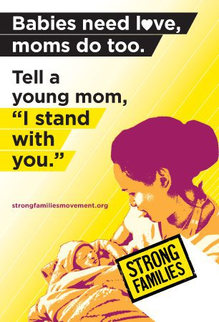
Teen Parents are both Resilient and Vulnerable
Unplanned pregnancy and young parenthood are not universally negative experiences
Notes:
Slide adapted from presentation by teen mom and doctor, Rebecca Trotzky-Sirr, M.D. Family Medicine

Slide 33
Case: Prenatal Care and Support
Kim tells you she is excited but also scared about what comes next.
How can you facilitate her referral to prenatal care?
What are the characteristics of successful teen parenting programs?

Slide 34
Clinician’s Role During and After Pregnancy
Respect adolescent’s decision to parent
Provide or refer for
  Prenatal care
  Postpartum care
  Peer support for young parents
  Educational support
  Employment assistance
  Housing assistance

Slide 35
Research on Supporting Young Mothers
Research is limited on most effective ways to support pregnant/parenting teens
  Many programs and models exist, but most have not been evaluated rigorously
Data support multidisciplinary approach, school-based programs and engagement of teen fathers
Nurse-family partnership with a home-visiting model may improve infant and maternal health and well-being
  Focus on family planning for the mother can decrease rapid-succession second pregnancy which improves maternal health
Notes:
While the research is limited, the data that does exist on effective programs to improve the outcomes for teen parents support multidisciplinary approaches where primary care, reproductive health care, nutrition, mental health care, educational support, housing support, and assistance accessing public benefits are provided by a team in one location or institution.
Such programs have shown improved outcomes in
Reducing rapid repeat pregnancy
Improved prenatal care
Improved delivery weights
Improved substance use
Decreased stress/depression
Decreased child abuse/neglect
Increased contraceptive compliance
Continued parental education
Improved teen and infant health over the course of 6–18 months
Sources:
Akinbami LJ, Cheng T, Kornfeld D. A review of teen-tot programs: comprehensive clinical care for young parents and their children. Adolescence. 2001 Summer;36(142):381–393.
Cox JE, Buman M, Valenzuela J, Natalie JP, Mitchell A, Woods ER. Depression, parenting attributes, and social support among adolescent mothers attending a teen tot program. J Pediatr Adolesc Gynecol. 2008;21:275–281.
Klerman LV. Another Chance: Preventing Additional Births to Teen Mothers. Washington, DC: National Campaign to Prevent Teen Pregnancy and National Organization on Adolescent Pregnancy, Parenting, and Prevention; 2004.
Omar H, Fowler A, D’Angelo S. Improved continuation rate of depo-provera in teen mothers. J Adolesc Health. 2001;14(3):147.
Jorge L. Pinzon, Veronnie F. Jones. Care of Adolescent Parents and Their Children. COMMITTEE ON ADOLESCENCE and COMMITTEE ON EARLY CHILDHOOD. Pediatrics December 2012, 130 (6) e1743-e1756; DOI: https://doi.org/10.1542/peds.2012-2879

Slide 36
Clinician’s Role
When teens are pregnant and considering parenting, assess
  Diet, pre-pregnancy BMI, lifestyle (smoking, substance use)
  Sexually transmitted infections
  Family and partner support
  Intimate partner violence
  Financial support, eligibility for public benefits
Notes:
While family support can be essential to young mothers, in most states adolescents do not need parental consent to receive prenatal care. All minors can receive confidential services at sites funded by federal title X.
http://www.guttmacher.org/statecenter/spibs/spib_MAPC.pdf

Slide 37

Nutritional Recommendations
Supplementation of iron, calcium, B6, C, folate (usually combined into one prenatal vitamin)
Weight gain
  Recommend the same gain as older women
  Higher end of the range is appropriate for teens
  Gain early in pregnancy
  Specific weight limits not established
Notes:
Also note that poverty may complicate nutritional issues for pregnant teens. This is another reason to refer pregnant teens to programs like the Special Supplemental Nutrition Program for Women, Infants, and Children, better known as the WIC Program. WIC provides food assistance for mothers and children. It safeguards the health of low-income women, infants, and children up to age 5 who are at nutritional risk by providing nutritious foods to supplement diets, information on healthy eating, and referrals to health care.
Source:
American Dietetic Association. Position of the American Dietetic Association: nutrition care for pregnant adolescents. J Am Diet Assn. 1994;94(4):449.
U.S. Department of Agriculture, Food and Nutrition Service. About WIC. http://www.commodityfood.usda.gov/wic/aboutwic/. Accessed July 30, 2010.

Slide 38
Family Support Is Key
Family support critical to positive long-term outcomes for young mothers
  Providing childcare
  Supporting efforts to finish education
  Family support of partner/relationship should be assessed
Notes:
Source:
Cooley ML, Unger DG. The role of family support in determining developmental outcomes in children of teen mothers. Child Psychiatry Hum Dev. 1991;21:217–234.

Slide 39
Recommended Screening for Sexually Transmitted Infections
All pregnant people under 25 years should be screened at the first prenatal visit for:
  Chlamydia
  Gonorrhea
  Syphilis
  HIV
  Hepatitis B
Repeat screening in the third trimester for those at high risk for:
  Chlamydia
  Gonorrhea
  Syphilis
  HIV
Notes:
High risk for chlamydia and gonorrhea includes those with:
New sex partner
More than one sex partner
A sex partner with concurrent partners
A sex partner who has a sexually transmitted infection
High risk for syphilis includes:
History of incarceration
History of exchanging sex for money
Local area with high syphilis rate
Persons taking pre-exposure prophylaxis for HIV prevention
High risk for HIV includes:
Sexually active gay, bisexual and other men who have sex with men;
People who inject drugs;
Anyone who has had more than one sex partner since their last HIV test; and
People who have been diagnosed with another sexually transmitted infection, hepatitis, or tuberculosis
History of genital herpes should be documented in all pregnant people
Hepatitis C screening is indicated for those at high risk
Source:
Screening Recommendations and Considerations Referenced in Treament Guidelines and Original Sources. 2015 STD Treatment Guidelines. Centers for Disease Control and Prevention. Last reviewed June 2015. https://www.cdc.gov/std/tg2015/screening-recommendations.htm

Slide 40
Case: Providing Care for Both Adolescent Parents and Their Children
Kim asks if she can bring the baby to the clinic for care in the future.
Are there any models for caring for parenting teens and their children?

Slide 41

Practice Models for Teen Parent Support
Several practice models exist to care for pregnant and parenting teens
  Group prenatal care
  Teen-tot clinic
  Fatherhood outreach programs
Which models are part of your practice?
What are the professional standards for care?

Slide 42

Recommended Practices
The American Academy of Pediatrics recommends that healthcare providers:
  Provide a medical home for teenage parents and their children
  Address the development of both infant and the adolescent parent
  Routinely assess the risk of domestic violence
  Support the adolescent in continuing their education
  Provide positive reinforcements to successes
Notes:
The complete list of recommended practices:
Provide a medical home for teenage parents and their children, and help them gain access to needed services
Address the development of both infant and the adolescent parent, particularly with anticipatory guidance, early childhood education, teaching of basic caregiving and breast-feeding skills, and contraceptive counseling
Encourage continuation of healthful behaviors; adolescent mothers often improve their nutrition and decrease substance abuse during pregnancy, only to return to their pre-pregnancy habits within six months of delivery
Routinely assess the risk of domestic violence—pregnant adolescents are at greater risk
Emphasize to the parent the importance of completing high school
When possible, include both parents in patient education that is appropriate for their development
Stress the importance of the adolescent parent caring for the child, even if other caregivers are involved
Utilize community resources such as the Special Supplementation Nutrition Program for Women, Infants, and Children (WIC)
Provide positive reinforcements to successes such as achieving educational goals, initiation or continuation of breast-feeding, and avoiding substance abuse
Source:
American Academy of Pediatrics Committee on Adolescence, Committee on Early Childhood, Adoption, and Dependent Care. Care of adolescent parents and their children. Pediatrics. 2001;107:429.

Slide 43
Group Prenatal Care
Compared to those in one-on-one care, young women in group prenatal care had:
  Decreased preterm birth
  Increased prenatal knowledge
  Felt “more ready” for labor and delivery
  Greater satisfaction with care
No differences in birth weight
No differences in cost of care
Notes:
Sources:
Ickovics JR, Kershaw TS, Westdahl C, Magriples U, Massey Z, Reynolds H, Rising SS. Group prenatal care and perinatal outcomes: a randomized controlled trial. Obstet Gynecol. 2007 Aug;110(2, pt 1):330–339.
Grady MA, Bloom KC. Pregnancy outcomes of adolescents enrolled in a centering pregnancy program. J Midwifery Womens Health. 2004;49:412–420.

Slide 44
Teen-Tot Model: Medical Services
Teen-tot clinics provide a range of health services, including but not limited to:
Adolescent services
  Depression screening/ treatment
  Contraceptive counseling
  STI screening/treatment
  Nutrition counseling
Child services
  Well-baby care
  Comprehensive pediatric care
  Immunizations
  Developmental assessments
Notes:
Often services are available for young people up to age 21.
A meta-analysis from 2001 showed that programs had some success in
preventing repeat pregnancies
helping teen mothers continue their education
and improving teen and infant health over 6 to 18 months
evaluations were limited
Source:
Akinbami LJ, Cheng TL, Kornfeld D. A review of teen-tot programs: comprehensive clinical care for young parents and their children. Adolescence. 2001 Summer;36(142):381-93. PMID: 11572313.

Slide 45
Teen-Tot Model: Psychosocial Support
Hotline for parenting questions
Partnership with schools to help meet educational goals
Parenting classes
Job training
Support groups
Home visits by nurse or social worker
Overall parenting support
Fathers support groups/program
Notes:
While teen-tot clinics differ from site to site, they offer a range of supportive services to teen parents including, but not limited to, those listed here.
Provider models vary between clinics but include:
Single provider sees parent and child
Pediatric provider partners with adolescent specialist or OB/GYN
May be located in a freestanding clinic or integrated within:
Pediatric practice
School-based health center
Adolescent clinic
Family planning clinic

Slide 46
Making Support for Adolescent Parents Accessible
Make the schedule/program accessible
  Allow for after-school/weekend appointments
  Set consistent hours
  Setting a weekly time can allow a peer group to meet and support one another
Reach out to gather referrals
  Schools, youth centers, religious institutions
  Maternity homes/schools
  Local maternity wards
  Programs for young mothers (e.g., WIC, Nurse Family Partnership)
Notes:
Whether offering group prenatal care, a teen-tot clinic, fatherhood programs, or other services to support teen parents, make sure those services are accessible and adolescent-friendly in their timing and structure.

Slide 47
Case: Support for Young Fathers
Kim tells you her partner is supportive and wants to be involved in the pregnancy and the child’s life.
What services are available for young fathers?

Slide 48

How Do Adolescent Fathers Fare?
Poorer academic performance
Higher school dropout rates
Limited financial resources
Decreased income capacity
Difficulties staying involved in children’s lives
Research on supporting adolescent fathers is limited
  Understudied and underserved population
  Fewer programs for young fathers
Notes:
In the past, programs trying to involve teen fathers often started with a focus on collection of child support. Not only did this discourage young men from participating in programs, it also had the effect of limiting the pool of young fathers willing to participate in research.
Sources:
Healthy Teen Network. Fast facts: Unique needs of teen fathers. http://www.healthyteennetwork.org/vertical/Sites/%7BB4D0CC76-CF78-4784-BA7C-5D0436F6040C%7D/uploads/%7B831934FA-3A1B-42BB-8ED4-425528E23D5E%7D.PDF. Accessed May 20, 2010.
Marsiglio W. Adolescent fathers in the United States: their initial living arrangements, marital experience, and educational outcomes. Fam Plann Perspect. 1987;19:240-251.
Hardy JB, Duggan AK. Teenage fathers and the fathers of infants of urban, teenage mothers. Am J Public Health. 1988;78:919–922.

Slide 49
Supporting Young Fathers
Ensure medically accurate information
Assist young men in effectively communicating about their reproductive health
Help young men examine and break down negative stereotypes surrounding their reproductive health, sexual behaviors, and values
  Research has demonstrated that teen fathers are/want to be involved in child’s life, more than just financially
  Young father’s parental role helps form healthy, enduring parent-child bond
Notes:
Healthy Teen Network
References:
Gavin, L., et al. (2002). Young, disadvantaged fathers’ involvement with their infants: An ecological perspective. Journal of Adolescent Health, 31, 266–276.
6 Allen, W. & Doherty, W. (1996). The responsibilities of fatherhood as perceived by African American Teenage Fathers. Families in Society
Sanchez-Flores, H. Young male involvement in pregnancy prevention and parenting. NOAPPP Network, 23, 3 (2003)

Slide 50
Train Staff to Work with Young Fathers
Respect differences in communication styles
Recognize/respect different parenting styles
Realize the importance of young father involvement in the early years
Address barriers to young father involvement
Develop recruitment and retention strategies for working with young fathers
Notes:
Healthy Teen Network
Reference: Tift, N. Inviting young dads in. NOAPPP Network, 23, 3 (2003).

Slide 51
Young Fathers’ Programs
Resources for young fathers vary:
  Support groups
  One-on-one mentoring programs
  Teen-tot clinics open to male and female patients
  Community-based organizations
Research suggests that promising practices include
  Partnering with community organizations
  Hiring qualified staff with connections to the community
  Providing culturally and age-appropriate care
Notes:
To date, few teen fatherhood programs have been evaluated and even fewer have undergone rigorous (i.e., experimental) evaluations. Fortunately, much can be learned from examining program practices across those existing teen fatherhood programs that have adhered to specific rigorous evaluation research criteria.
ChildTrends/HHS evaluated 18 teen fatherhood programs that they deemed rigorous in evaluation and found common features in effective programs. They identified the 10 “promising strategies” above by looking for commonalities in teen fatherhood programs they designated as “model” or “promising.”
Promising practices included:
Partner with community organizations
Develop one-on-one relationships
Offer services beyond parenting information
Use logic model
Deliver services in engaging ways
Conduct needs assessments
Hire quality staff with connections to community
Appropriate for fathers’ ages and cultures
Incentives (child care)
Mentorship
Source:
Bronte-Tinkew J, Burhauser M, Metz, A; U.S. Department of Health and Human Services. Promising teen fatherhood programs: initial evidence-based lessons from evidence-based research. http://dcfs.co.la.ca.us/katieA/docs/PTFP.pdf. Published September 2008. Accessed June 25, 2010.

Slide 52
Case: Consent and Confidentiality
While there is no teen-tot clinic at your institution, you do refer Kim to group prenatal care.
Can Kim consent to prenatal care without a parent’s involvement?
As a minor, will she be able
to consent for her child’s health care in the future?

Slide 53
Minors’ Rights to Consent for Prenatal Care & Medical Care of Their Children
State laws vary widely regarding minors’ rights to consent for health care services
  Providers should be aware of laws regarding minor consent in their state
37 states and the District of Columbia allow minors to consent for prenatal care in at least some cases
  29 states and the District of Columbia allow all minors to consent for prenatal cares
  15 states allow physicians to inform parents of minors seeking prenatal care (not required)
30 states and DC allow minors to consent for their children’s medical care (the other 20 states have no explicit policy)
Notes:
29 states and DC allow all minors to consent to prenatal care
4 states require the minor to be a specific age before she can consent to prenatal care.
4 states allow a minor who is considered mature enough to understand the nature and consequences of the treatment to consent to prenatal care.
1 state requires parental consent during all but one prenatal visit during the second and third trimesters; the minor may consent to prenatal care during the first trimester and for the first visit after the first trimester.
14 of the 37 states above allow, but do not require, physicians to inform parents that their minor daughter is seeking or receiving prenatal care when they deem it in the best interests of the minor.
13 states have no explicit policy on minors’ authority to consent to prenatal care.
Source:
Guttmacher Institute. State policies in brief: minors’ access to prenatal care. http://www.guttmacher.org/statecenter/spibs/spib_MAPC.pdf.
Guttmacher Institute. State policies in brief: minors’ rights as parents. http://www.guttmacher.org/statecenter/spibs/spib_MRP.pdf. Last updated December 2020

Slide 54

Consent for Abortion
A majority of states (37) require parental involvement in a minor’s decision to have an abortion
  In 36 of these states there is a judicial bypass procedure, which allows a minor to obtain approval from a court
  Most states make exceptions under certain circumstances like
    In a medical emergency (34 states)
    In cases of abuse, assault, incest or neglect (15 states)
Notes:
21 states require only parental consent; 3 of these require both parents’ consent.
6 states require both parental notification and consent.
10 states require only parental notification; 1 of these requires that both parents be notified.
7 states permit a minor to obtain an abortion if a grandparent or other adult relative is involved in the decision.
11 states require identification for parental consent.
4 states require proof of parenthood for parental consent.
2 states require a minor’s identification to have an abortion.
Source:
Guttmacher Institute. Parental Involvement in Minors’ Abortions. Last updated December 2020. https://www.guttmacher.org/state-policy/explore/parental-involvement-minors-abortions

Slide 55
Consent for Adoption
40 states and the District of Columbia allow minors to place their child for adoption
10 states require involvement of an adult, either a parent or legal counsel
Notes:
Source:
Guttmacher Institute. State policies in brief: minors’ rights as parents. http://www.guttmacher.org/statecenter/spibs/spib_MRP.pdf. Last updated December 2020

Slide 56
Case: Public Support
Kim has the support of her mother and will live at home after the birth
What if Kim did not have family/partner support?
What public benefits are available?

Slide 57

Programs and Benefits
Women, Infants, and Children (WIC) programs
  Nutrition and breastfeeding support
Medicaid & Children’s Health Insurance Program (CHIP)
Community-based organizations
  Parenting education
  Support groups
  Housing assistance/shelter
  Counseling
Notes:
This is just a very brief list of the kinds of support available to pregnant and parenting adolescents. Know what local resources exist for adolescent parents in your area in order to make referrals for health care, nutrition, and housing, as well as for educational support, counseling, parenting education, etc.

Slide 58
Summary
Provide unbiased counseling
Support adolescents’ decisions
Consider practice models to support pregnant and parenting teens and their children
Know local resources for pregnant and parenting adolescents

Slide 59
Changing the Narrative
Some advocates now recommend moving away from a “Teen Pregnancy Prevention” paradigm
  Stigmatizes and shames young parents
  Majority of “teen” parents are 18-19 years old
  Many young parents choose parenthood as a rational decision in conditions where pursuing higher education and/or a lucrative career seem nearly impossible
Instead, we can provide high-quality reproductive health information and access to services for all people
Continue work to address the root causes of inequity that impact quality of life and outcomes for all people
Notes:
Source:
Cadena, Micaela, Raquel Z. Rivera, Tannia Esparza and Denicia Cadena. Dismantling Teen Pregnancy Prevention. Albuquerque, New Mexico: Young Women United, 2016.

Slide 60
Teen Parenting Resources
Adolescent Pregnancy and Parenting Resources
  Bold Futures (Previously Young Women United): https://boldfuturesnm.org/tag/research/
  Healthy Teen Network (formerly National Organization on Adolescent Pregnancy, Parenting, and Prevention-NOAPP) www.healthyteennetwork.org
  The Adolescent Parenting Program (North Carolina): https://www.childrenandfamily.org/programs/adolescent-parenting-program/
  US Department of Health and Human Services, Administration of Children and Families: www.acf.hhs.gov
  Strong Families Network: strongfamiliesmovement.org/young-parents

Slide 61

Adolescent Reproductive and Sexual Health Education Project (ARSHEP)
Caring for Pregnant and Parenting Adolescents
Please complete the evaluation for this presentation by pointing your cell phone camera at the QR code and completing the survey.
Thank you!
Notes:
Updated 2020

